Slide 1
The Usage of State-of-the-Art Simulators in the Formation of Future Navy Officers
Lt.commander(N) Ovidiu Cristea
Col. Catalin Popa
Lt. (N) Silviu-Nicolae Popa

Slide 2
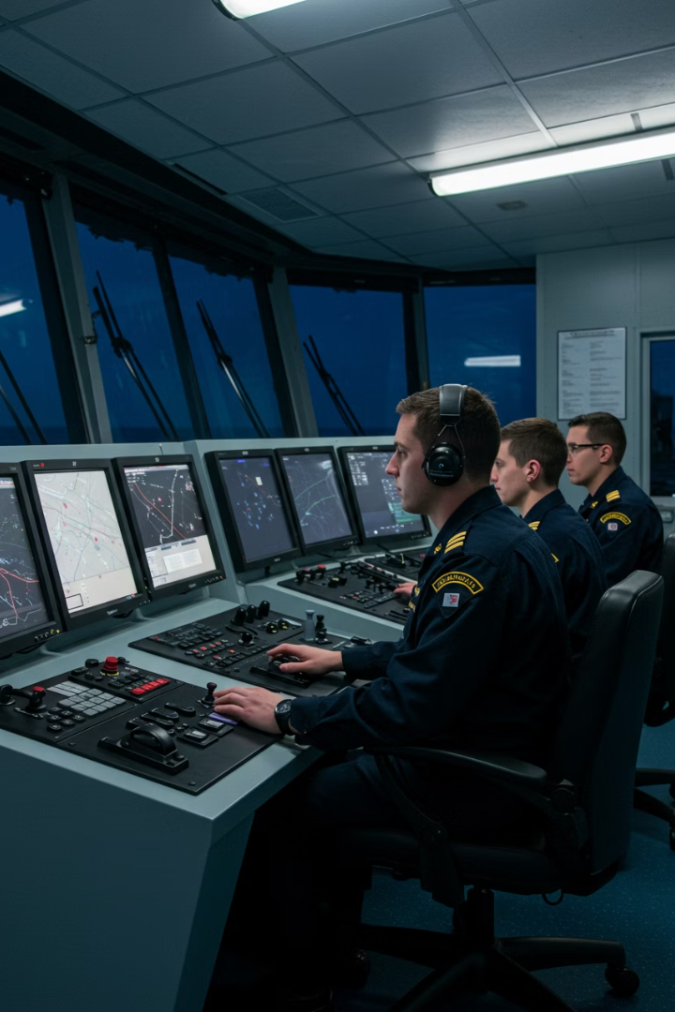
Introduction
Motivation
Background
Russia
How to train?
Bachelor degree
OC

Slide 3
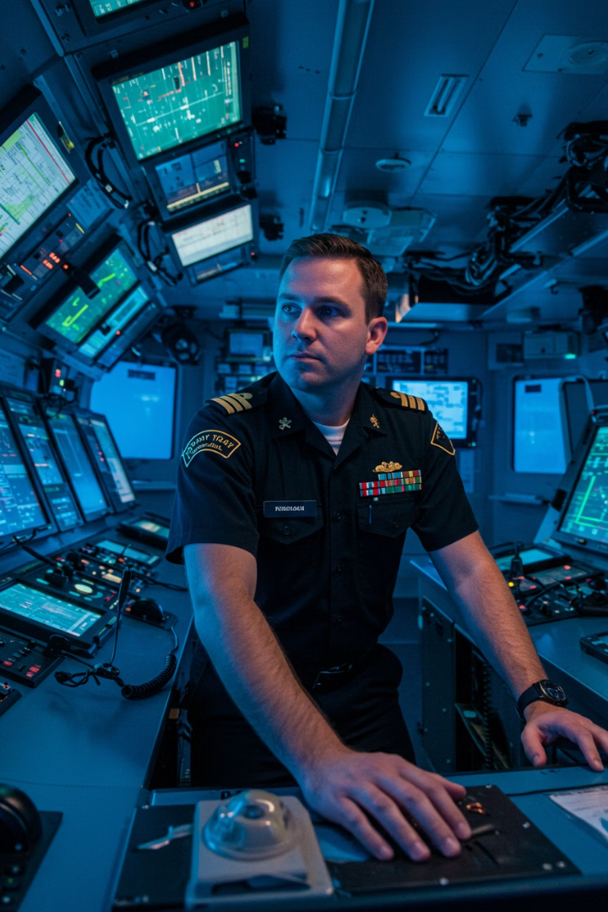
The Modern Training Imperative
Information Overload
Vast modern knowledge makes comprehensive learning difficult
Knowledge Selection
Effective teaching requires careful content curation
Rapid Global Change
Necessitates faster, predictive training improvements
Virtual Practice
Simulators enable use of pre-release technologies

Slide 4
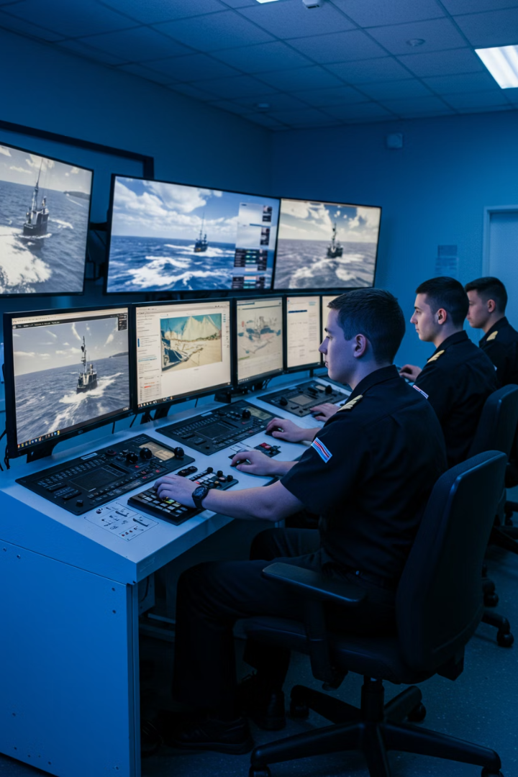
Simulation: Elevating Naval Officer Training
Modern vs Traditional
Key Skill Development
Contrasts classroom theory with hands-on simulator practice
Tactical decision-making, navigation, communications, weapons
Virtual Reality Experience
Immersive training environments for realistic skill acquisition

Slide 5
Global Standards in Naval Education
Maritime Skills
Academic Foundations
Navigation, Seamanship, Watchkeeping
Math, Science, Oceanography
Technical & Engineering
Naval Eng., Damage Control, Weapons, Cyber
Physical Training
Military fitness and discipline
Tactics & Strategy
Operations planning and execution
Professional Knowledge
Leadership & Ethics
History, Geopolitics
Management principles and moral conduct

Slide 6
RNA's Framework for Simulator-Based Training
EU ESCO Alignment
Common terminology for skills and occupations
Dual Training Categories
STCW (Seafarers) and Military Training
150+ Years Experience
Building on tradition while embracing innovation

Slide 7
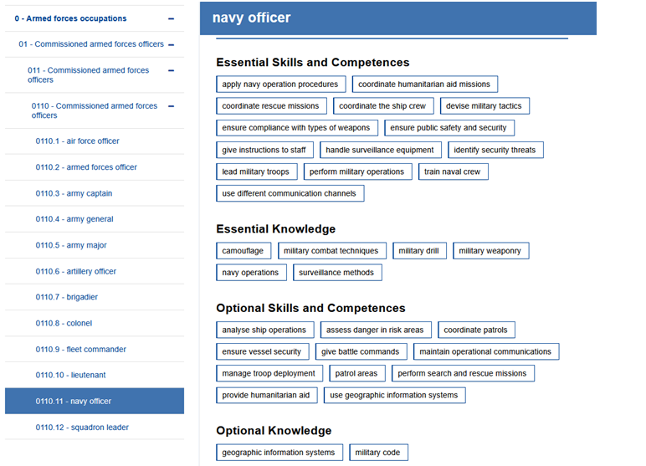
European Skills, Competences, Qualifications and Occupations (ESCO)
http://data.europa.eu/esco/occupation/262f21a3-ae78-46f4-a5f9-5a1f502caa90

Slide 8
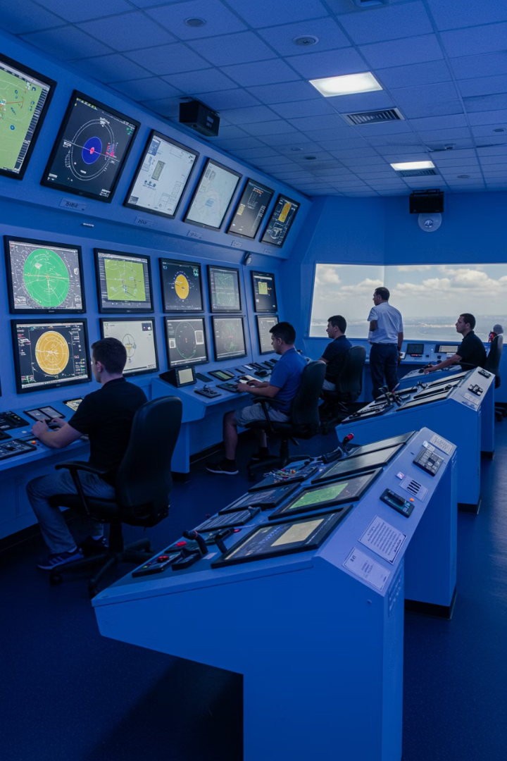
Integrated Ship Steering Simulator (ISSS) - Navigation
IMO STCW 78/95 Compliant
11 SOLAS-Equipped Bridges
Regular Upgrades
Trains watch officers, masters, pilots to international standards
Periodic hardware and software improvements
Complete navigation decks with briefing room

Slide 9
Lessons Learned & Future Needs (ISSS Navigation)
Joint Experience
Realistic Watch Training
Combine active crews with student training
Tactical Integration
Modern Threat Scenarios
Connect with combat information center simulators
Implement 4-hour shifts for endurance practice
Mines, drones, jamming simulations needed

Slide 10
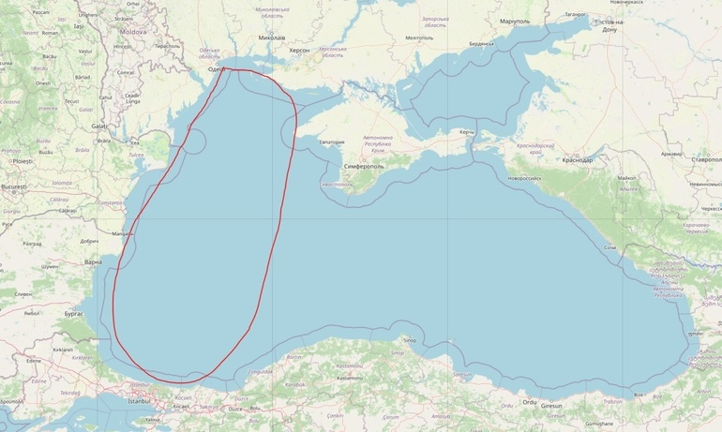
Drifting mines in the Black Sea
https://i0.1616.ro/media/2/2621/33238/20647952/1/1647686069-352.jpg?width=770

Slide 11
Engine Room Simulator (ERS TechSim 9)
Familiarization
Basic systems and controls introduction
Standard Operations
Routine procedures and maintenance tasks
Advanced Operations
Complex scenarios and emergency response
Watchkeeping
Sustained monitoring and troubleshooting

Slide 12
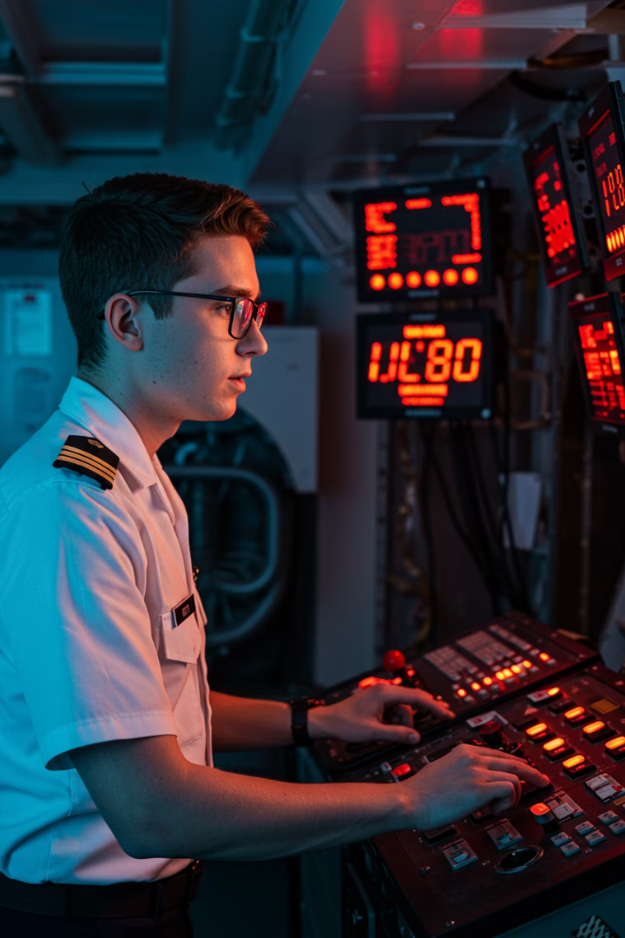
Lessons Learned & Future Needs (ERS)
Modern Threat Scenarios
Cyber-attacks and advanced damage control simulations
Extended Watch Training
4-hour realistic shifts to build endurance
Joint Training
Active crews working alongside students
Remote Access
Training capabilities for cadets at sea

Slide 13
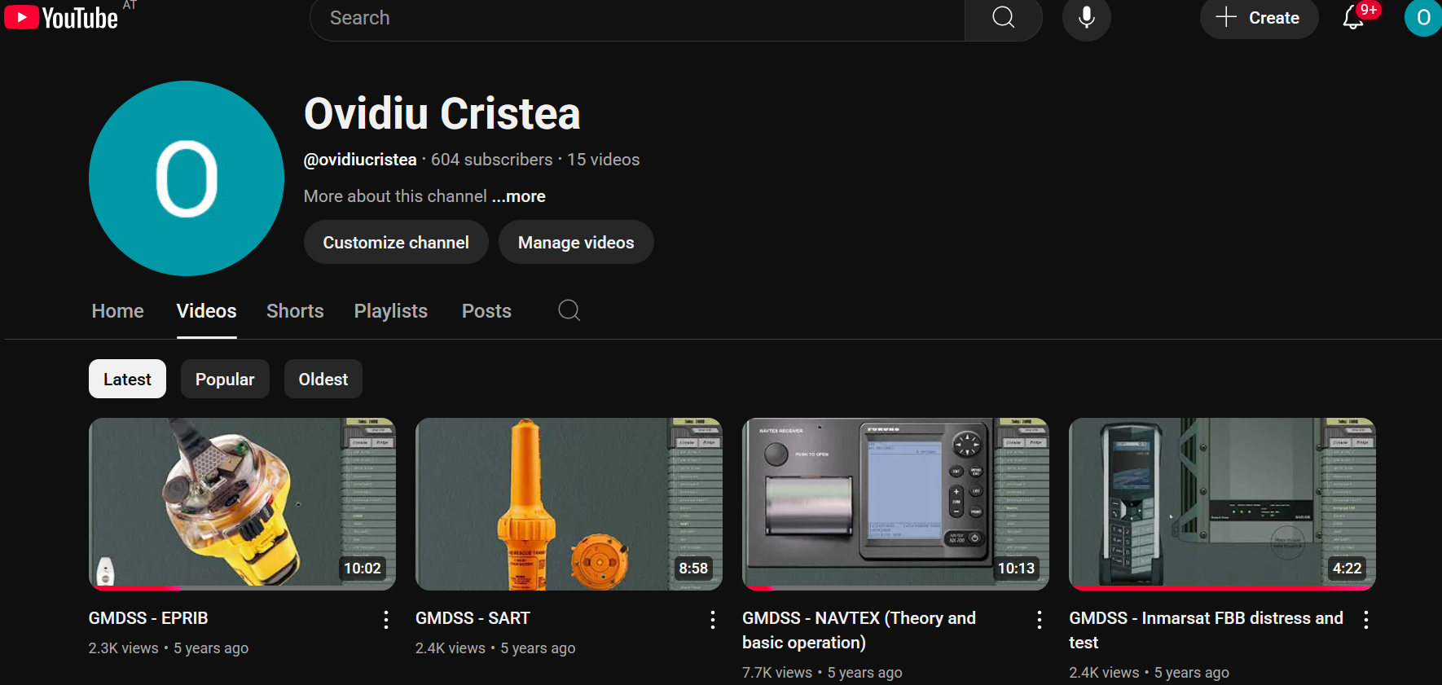
GMDSS Communications Simulator
Integrated System
Training Focus Areas
Incorporated into ISSS bridges for comprehensive training
Comprehensive communication competency development
SAILOR 4000/5000/6000 variants
Equipment operation protocols
Standard maritime radio equipment
Standard communication procedures
Satellite communication systems
Search and rescue coordination
Emergency message handling

Slide 14
Inland Navigation Simulator
8
1
100%
Virtual Decks
Main Deck
ES-QIN Compliance
Training stations for multiple simultaneous exercises
Primary training station with full controls
Meets European Standards for Qualification in Inland Navigation

Slide 15
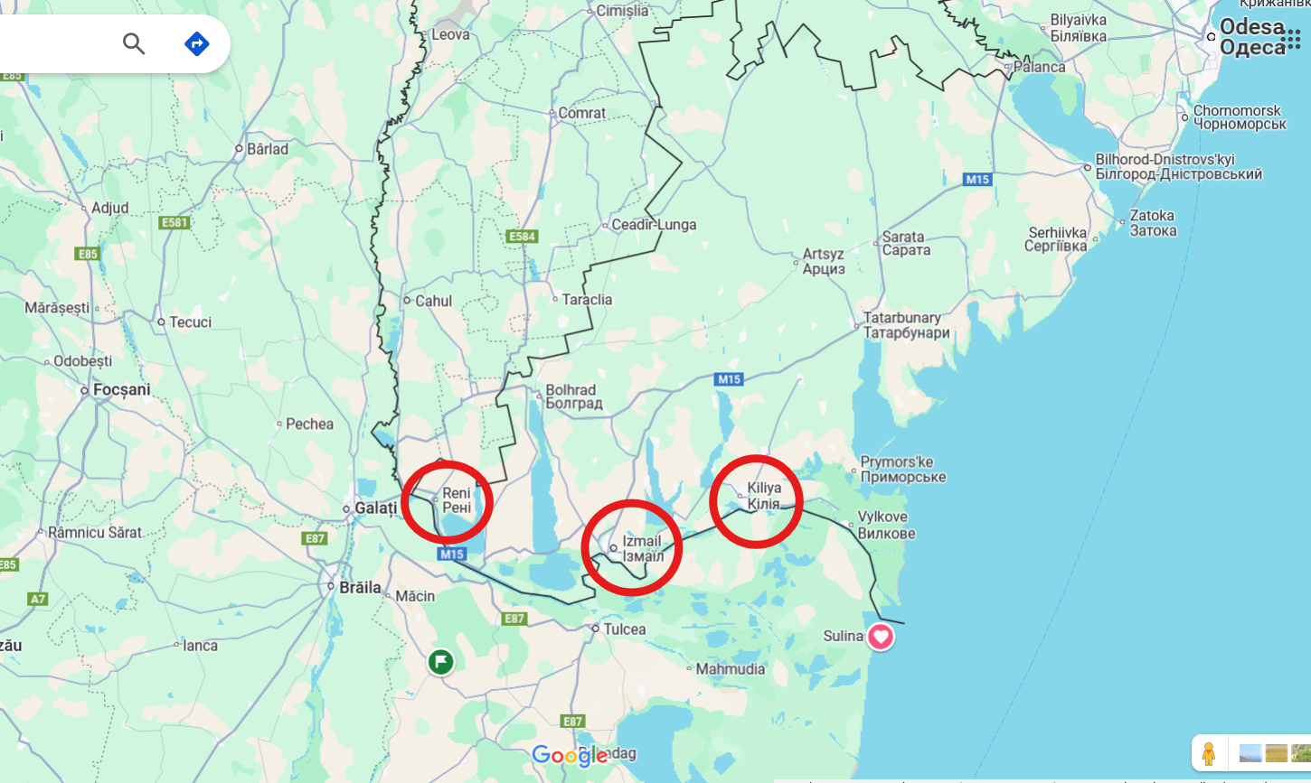

Slide 16
Lessons Learned & Future Needs (Inland Navigation)
System Integration
Modern Threats
Implement WAIS and ATIS technologies
Add mines, drones, and jamming scenarios
Realistic Shifts
Tactical Connection
4-hour watch simulation for endurance
Link with military combat simulators

Slide 17
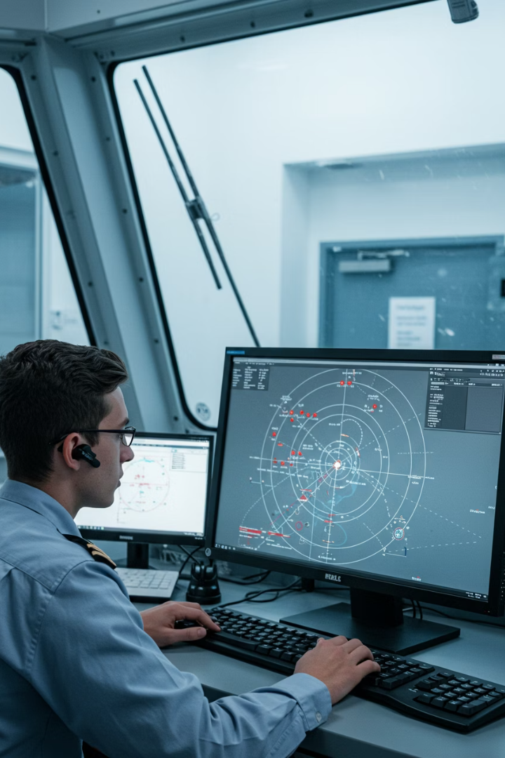
Focused Training: Radar/ARPA & ECDIS Simulators
System
Current Capabilities
Improvement Needs
Radar/ARPA
Navigation and collision avoidance
Threat scenarios, EW countermeasures
ECDIS
Type-specific certification training
WECDIS development, real case studies
Integrations
Basic data exchange
LINK22 and tactical data sharing

Slide 18
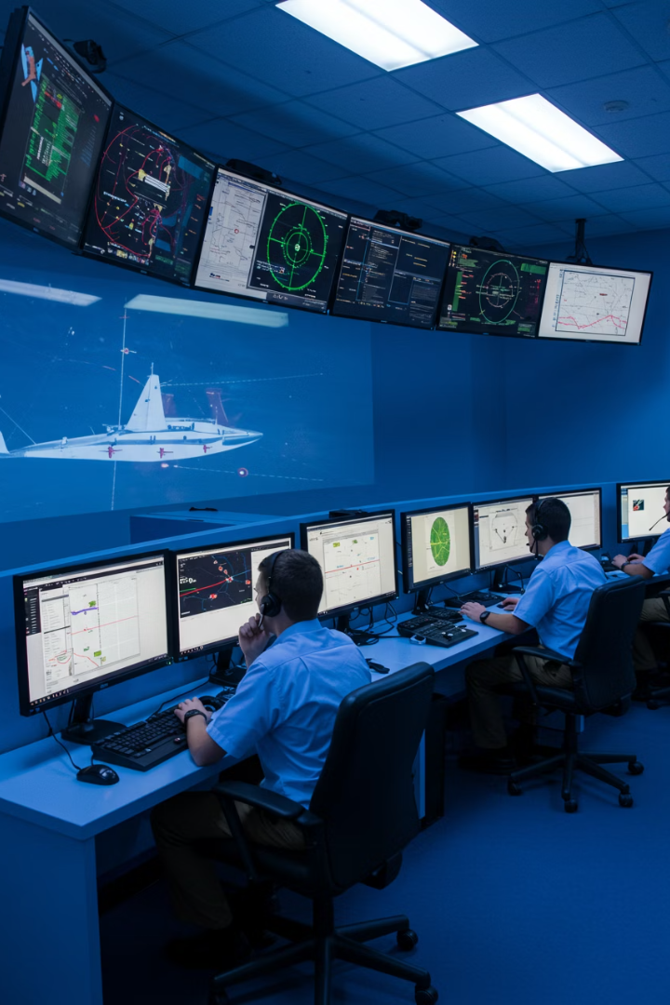
Action Speed Tactical Trainer (ASTT) PROTEUS
NATO Standard Training
Tactics, Operations & Strategy per alliance requirements
Collective CIC Training
Supports up to 6 ships for coordinated exercises
Comprehensive Simulation
Platforms, sensors, weapons using unclassified procedures
x
Tactical Skill Development
Sensor operation, weapons handling, command decisions

Slide 19
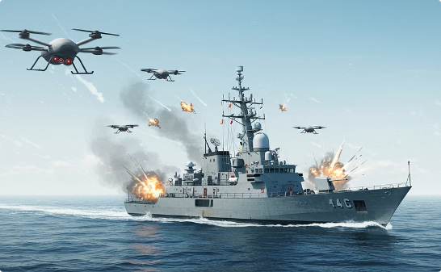
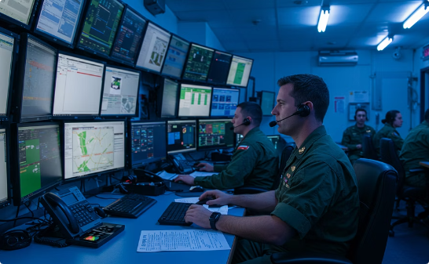
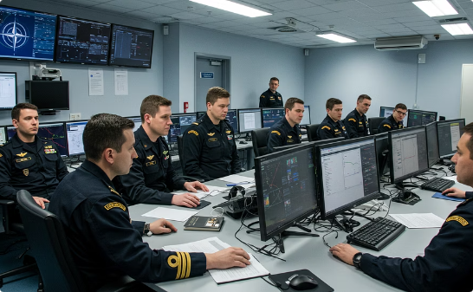
Lessons Learned & Future Needs (ASTT Proteus)
Modern Threats Modeling
Shift Training Implementation
Joint NATO Training
Drones, mines, electronic warfare scenarios needed
4-hour watch simulations for endurance and realism
Combined crews and cadets from alliance nations

Slide 20
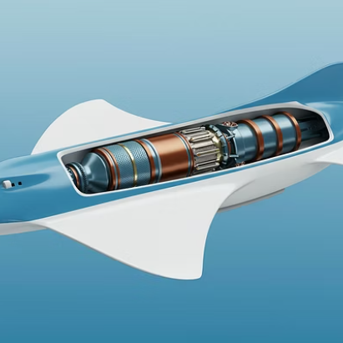
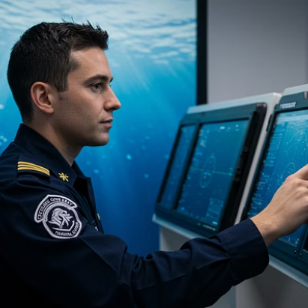
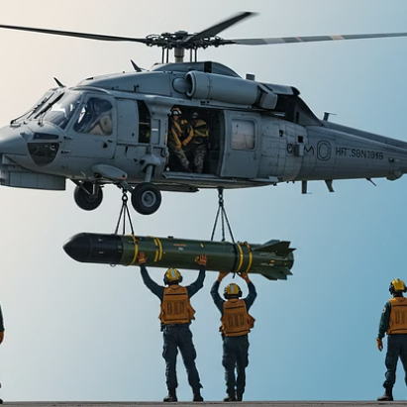
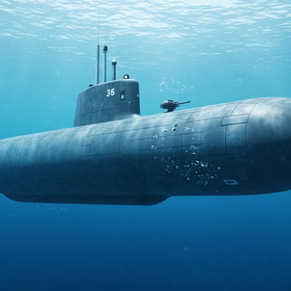
Anti-Submarine Warfare: STING RAY Torpedo Simulator

Slide 21
Lessons Learned & Future Needs (Sting Ray)
Current Configuration
Improvement Needs
BAE Systems simulator for torpedo launch operators
Extending capabilities and integration
Configurable parameters
Helicopter ASW personnel training
Various target simulations
Joint training exercises
Environmental condition settings
Real torpedo launch data integration
Operational Launch Simulator program
Sonar/propagation simulator connection
Includes sectioned torpedo model

Slide 22
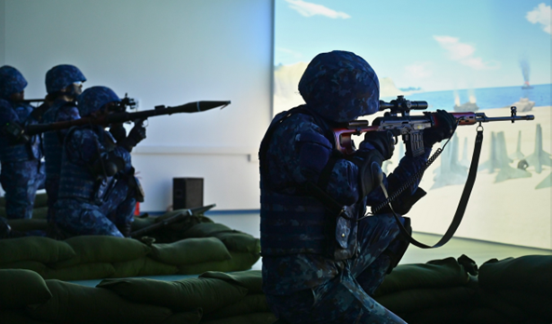
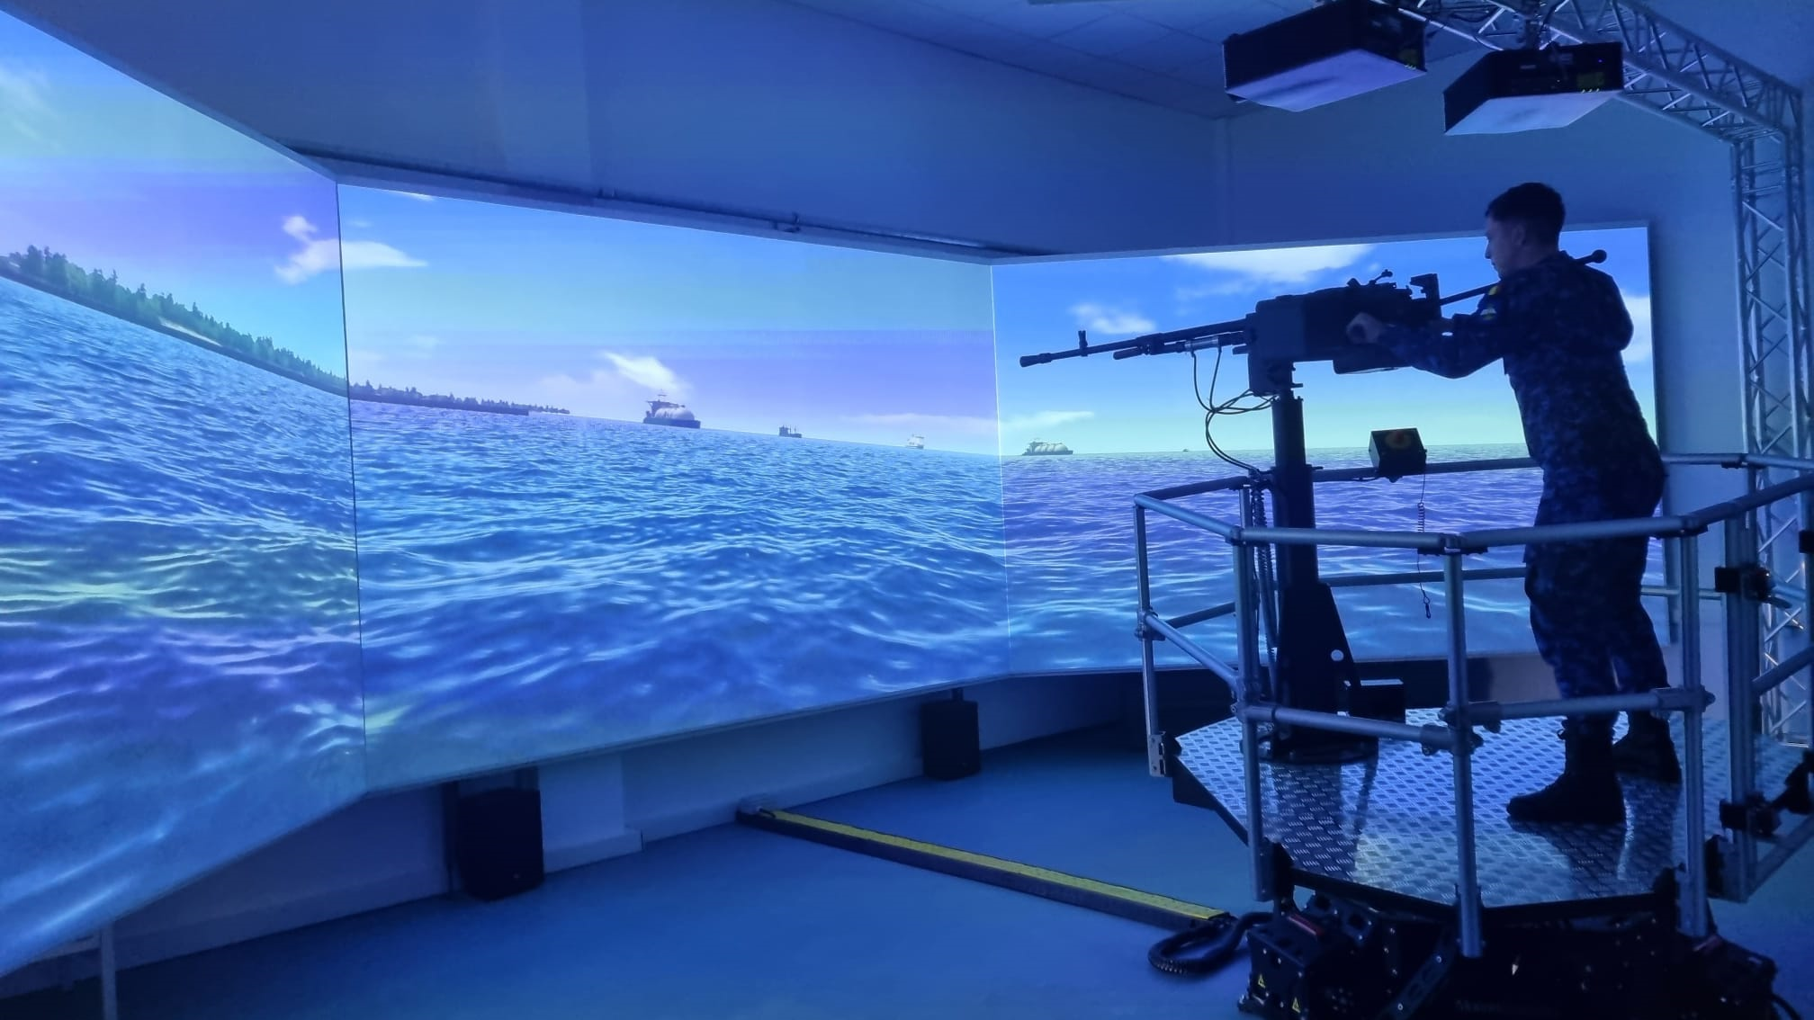
Complex of Shooting Simulators
(Infantry & Artillery)
Infantry Simulator
1
Pistols, rifles, sniper rifles, grenade launchers
Artillery Simulator
2
Large-caliber machine gun on motion platform
Realistic Physics
3
Ballistics, recoil, environmental factors

Slide 23
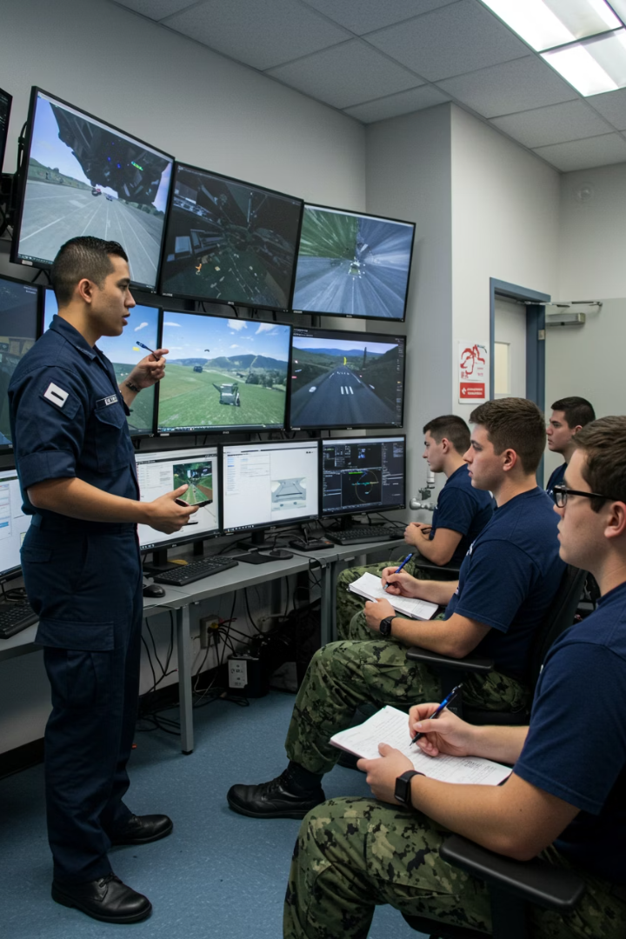
Case Study: Measuring ASTT Proteus Effectiveness
20
Student Participants
After completing 3 simulator sessions
30%
Situational Awareness
Average improvement in tactical awareness
35%
Decision Speed
Faster tactical decisions under pressure
100%
Weakness Identification
All previously unaware students discovered gaps

Slide 24
Conclusions
New Threats
Integration
Drones, mines, cyber-attacks,
Fake-narative/news
Connect different simulator types
Joint Training
EU Network
Crews and students together
Shared simulator database

Slide 25
Thank You For Your Attention
Questions and feedback are welcome as we continue advancing officer training capabilities.
Demonstrations
Schedule a visit to observe our simulation training facilities in action.
Contact
Reach our training department with inquiries about our simulator programmes.
Partnerships
Explore collaboration opportunities to enhance naval training capabilities.

