Slide 1
Moral Warfare Through Lethal Autonomous Weapons Systems?
© Alex Schuppich
Ethical Challenges.
Lisa Tragbar, Preet Ghuman – TMAF Wiener Neustadt, 7. Mai 2025

Slide 2
What are LAWS?
Overview
LAWS and
moral warfare

Slide 3
What are LAWS?
LAWS and
moral warfare
Overview
Ethical Challenges

Slide 4
LAWS and
moral warfare
Ethical Challenges
Overview

Slide 5
Definition of LAWS
Without prejudging any other options for measures, a lethal autonomous weapon system can be characterized as a weapon system that, after activation, can select and engage a target without further intervention by a human operator. The above description also applies to those weapon systems that require only nominal human input after activation, thus operating without context-appropriate human involvement and judgement. It does not apply to autonomous systems that are not weapon systems, manually guided /remote controlled munitions, mines or unexploded explosive ordnance.” UN GGE on LAWS (26 July 2024)

Slide 7
What makes LAWS (morally) problematic?
“third revolution in warfare, after gunpowder and nuclear weapons” (Scharrer 2015) – contributes to global inequalities
Moral distance (Nagel 2016)
Accountability gap (Schmitt & Thurnher 2013)
AI can’t act morally (Coeckelbergh 2021)
Not neutral technology (Winner 1980)

Slide 8
LAWS and moral warfare – promising arguments?
Nonstop Performance in contrast to humans (Arkin 2009)
Follow IHL (Haque 2016)
Ethically programmed weapon systems (Scholz 2011)
Army of None (Scharre 2019)

Slide 9
Challenge I
The Autonomy Argument
Immanuel Kant, Groundwork for the Metaphysics of Morals | "Functional" Autonomy of AWS (Stanhope 2021)
Autonomy = the capacity to create moral laws for oneself rooted in moral self-governance, dignity, and responsibility | rule-based or machine learning algorithms cannot choose to disobey immoral commands functional autonomy is no substitute for moral autonomy (Gunkel 2012)

Slide 10
Challenge II
The Responsibility Gap Argument
Immanuel Kant, Groundwork for the Metaphysics of Morals | Accountability of LAWS (Sparrow, 2007)
Responsibility = reserved for rational agents capable of moral reasoning and duty requires awareness of obligations—not just causation | LAWS lack this capacity Algorithmic systems cannot reflect ethically or act from duty Hence, cannot bear moral responsibility
Moral Vacuum

Slide 11
Moral Detachment – Thomas Nagel
Nagel on Drone Warfare - “Really Good at Killing” (2016)
AWS create emotional and moral distance in warfare
Killing becomes procedural, sanitized, and depersonalized
Removes the moral confrontation that war traditionally demands
Thought Experiment
A battlefield with only AWS
How can we ensure accountability without a human decision-maker?

Slide 12
Challenge III
Less moral costs?
LAWS reduce moral costs by precise targeting and strict adgerence to IHL (Haque 2017)
Thought experiment of Clean Warfare (based on Scharre 2019)
A: LAWS Exclusively engage legitimate targets = noncombatants aren‘t dying
B: LAWS keep humans completely out of the loop = nobody is dying
Moellendorf wars must be ended when the anticipated moral costs ex bello disproportionately outweigh the war aims ad bellum (Moellendorf 2018).
Challenged by Thought experiment: no moral costs = never ending wars?
Reconceptualization of harm: cumulative and invisible moral damage

Slide 13
Challenge IV
Moralization by Design?
There is no neutral technology (Winner 1980)
Unequal usability
operations require specializes training, data analysis, cybersecurity, high costs of aquisition, … = only operable by technologically advanced states or well-funded non-state actors
Moralization by design (Scholz 2021)
AI cannot act autonomously or have moral agency
moral actions require human-machine interaction (Coeckelbergh 2021)
Shifts the focus from weapon design to the normative application of weapons

Slide 14
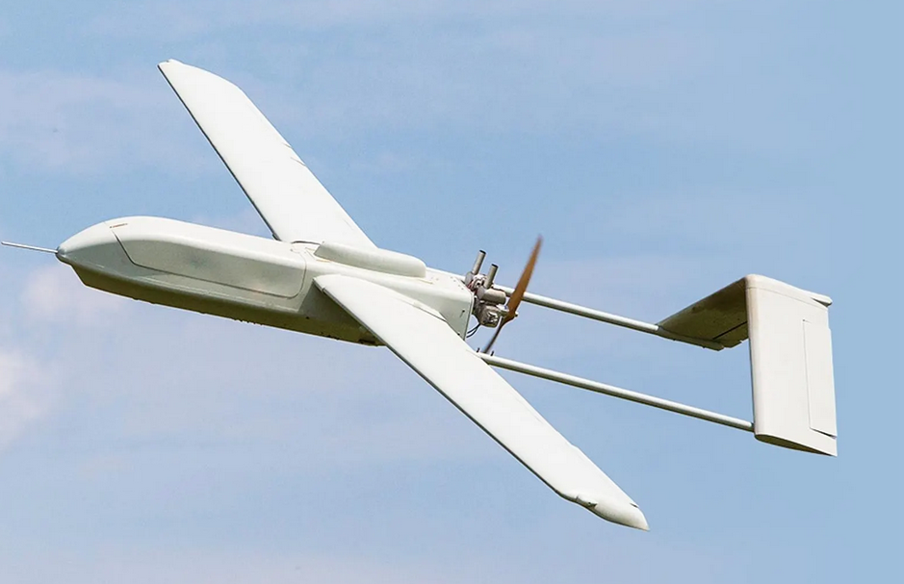
Dominator Phoenix Ghost Drone
Is technology neutral?
A political artefact?
(based on Winner 1980)

Slide 15
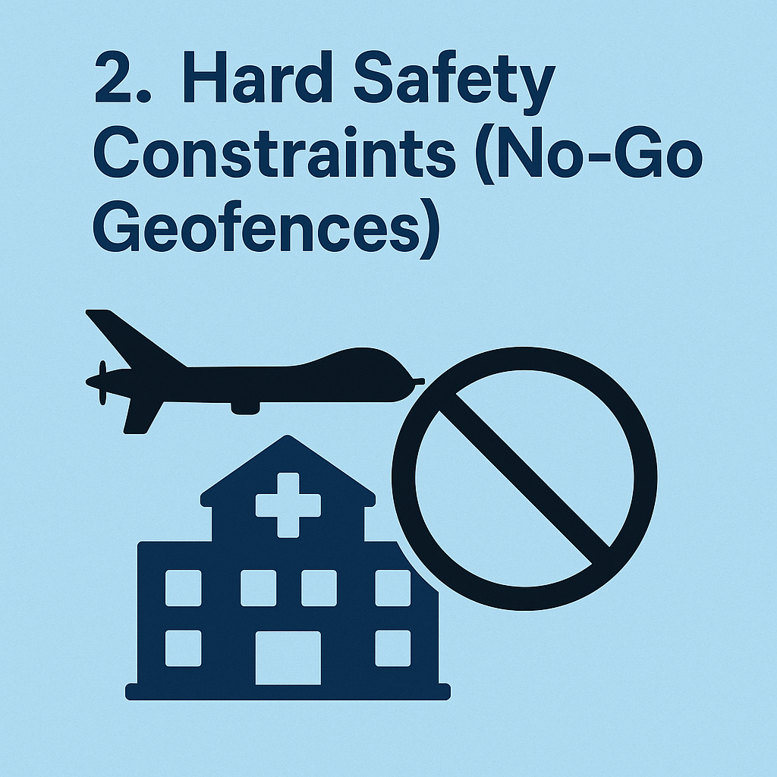
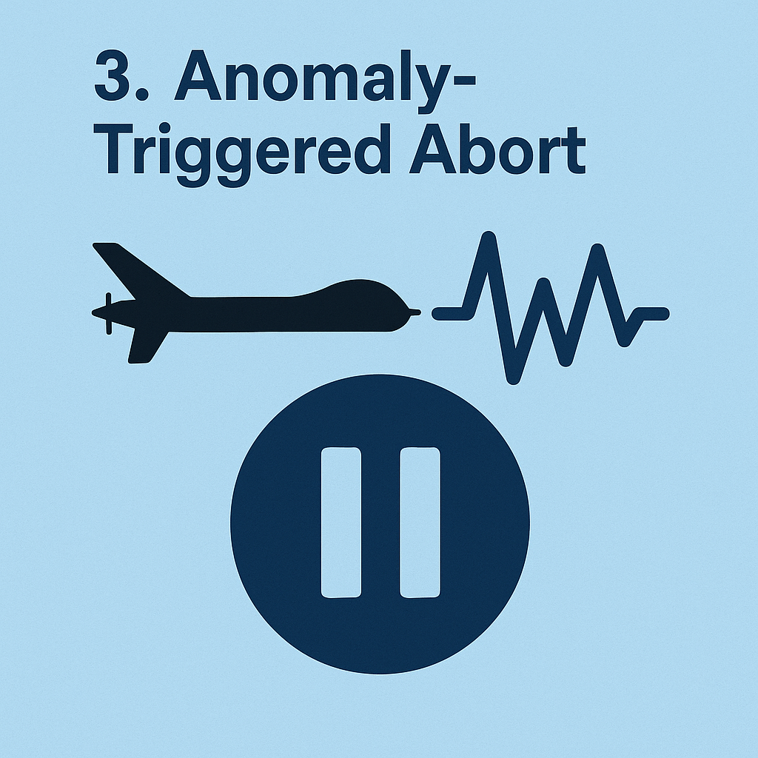
Moralization by Design?

Slide 16
Autonomy
Responsibility
Summary
Ex Bello
Autonomy
Responsibility
Ex bello
Design
Design
Ex bello

Slide 17
Thank you for listening!

