Slide 1



From An Engineering Perspective:
Small Drones Affecting the Course of Warfare
CPT Kevin TEBBE (M.Sc.)
Funded by

Slide 2
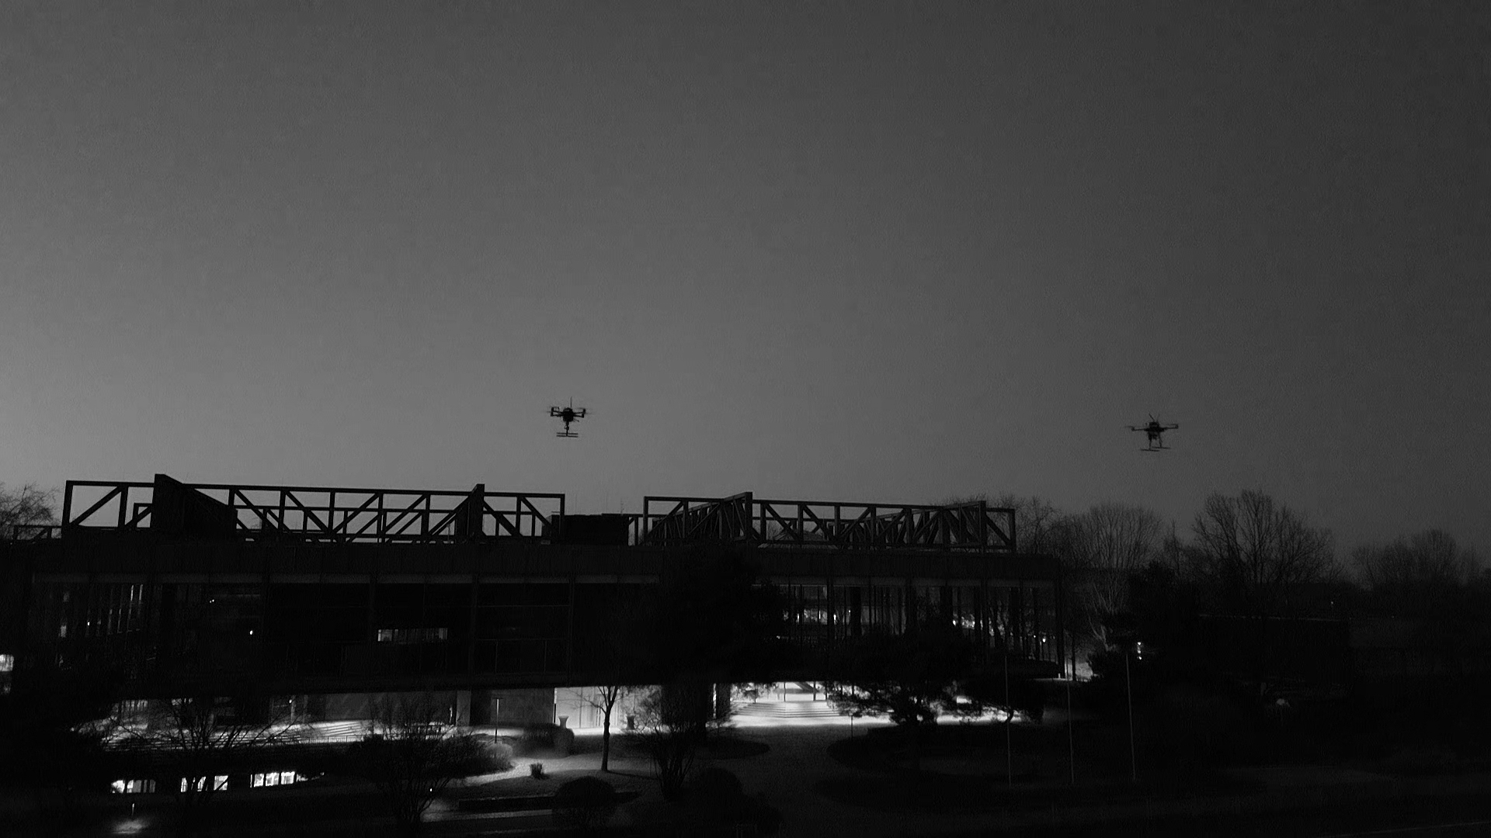
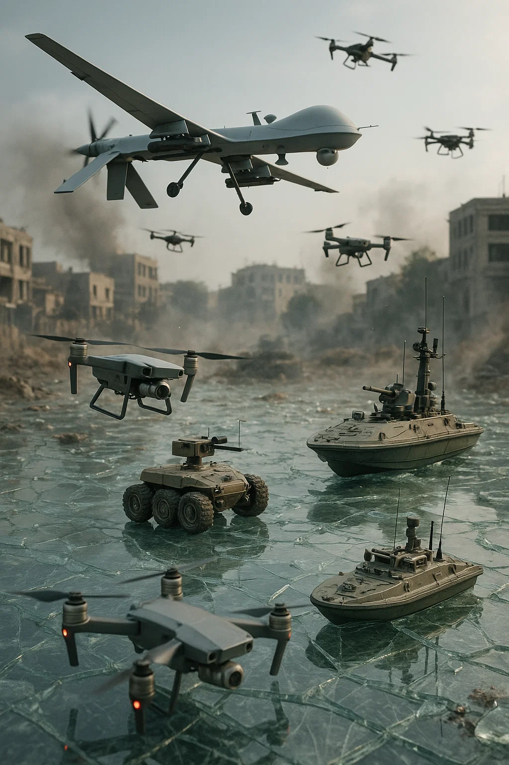
What are Drones?
Unmanned Aerial Vehicle (UAV)
Unmanned Ground Vehicle (UGV)
Unmanned Surface Vehicle (USV)
Source: ChatGPT

Slide 3
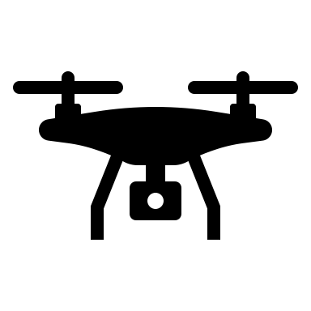
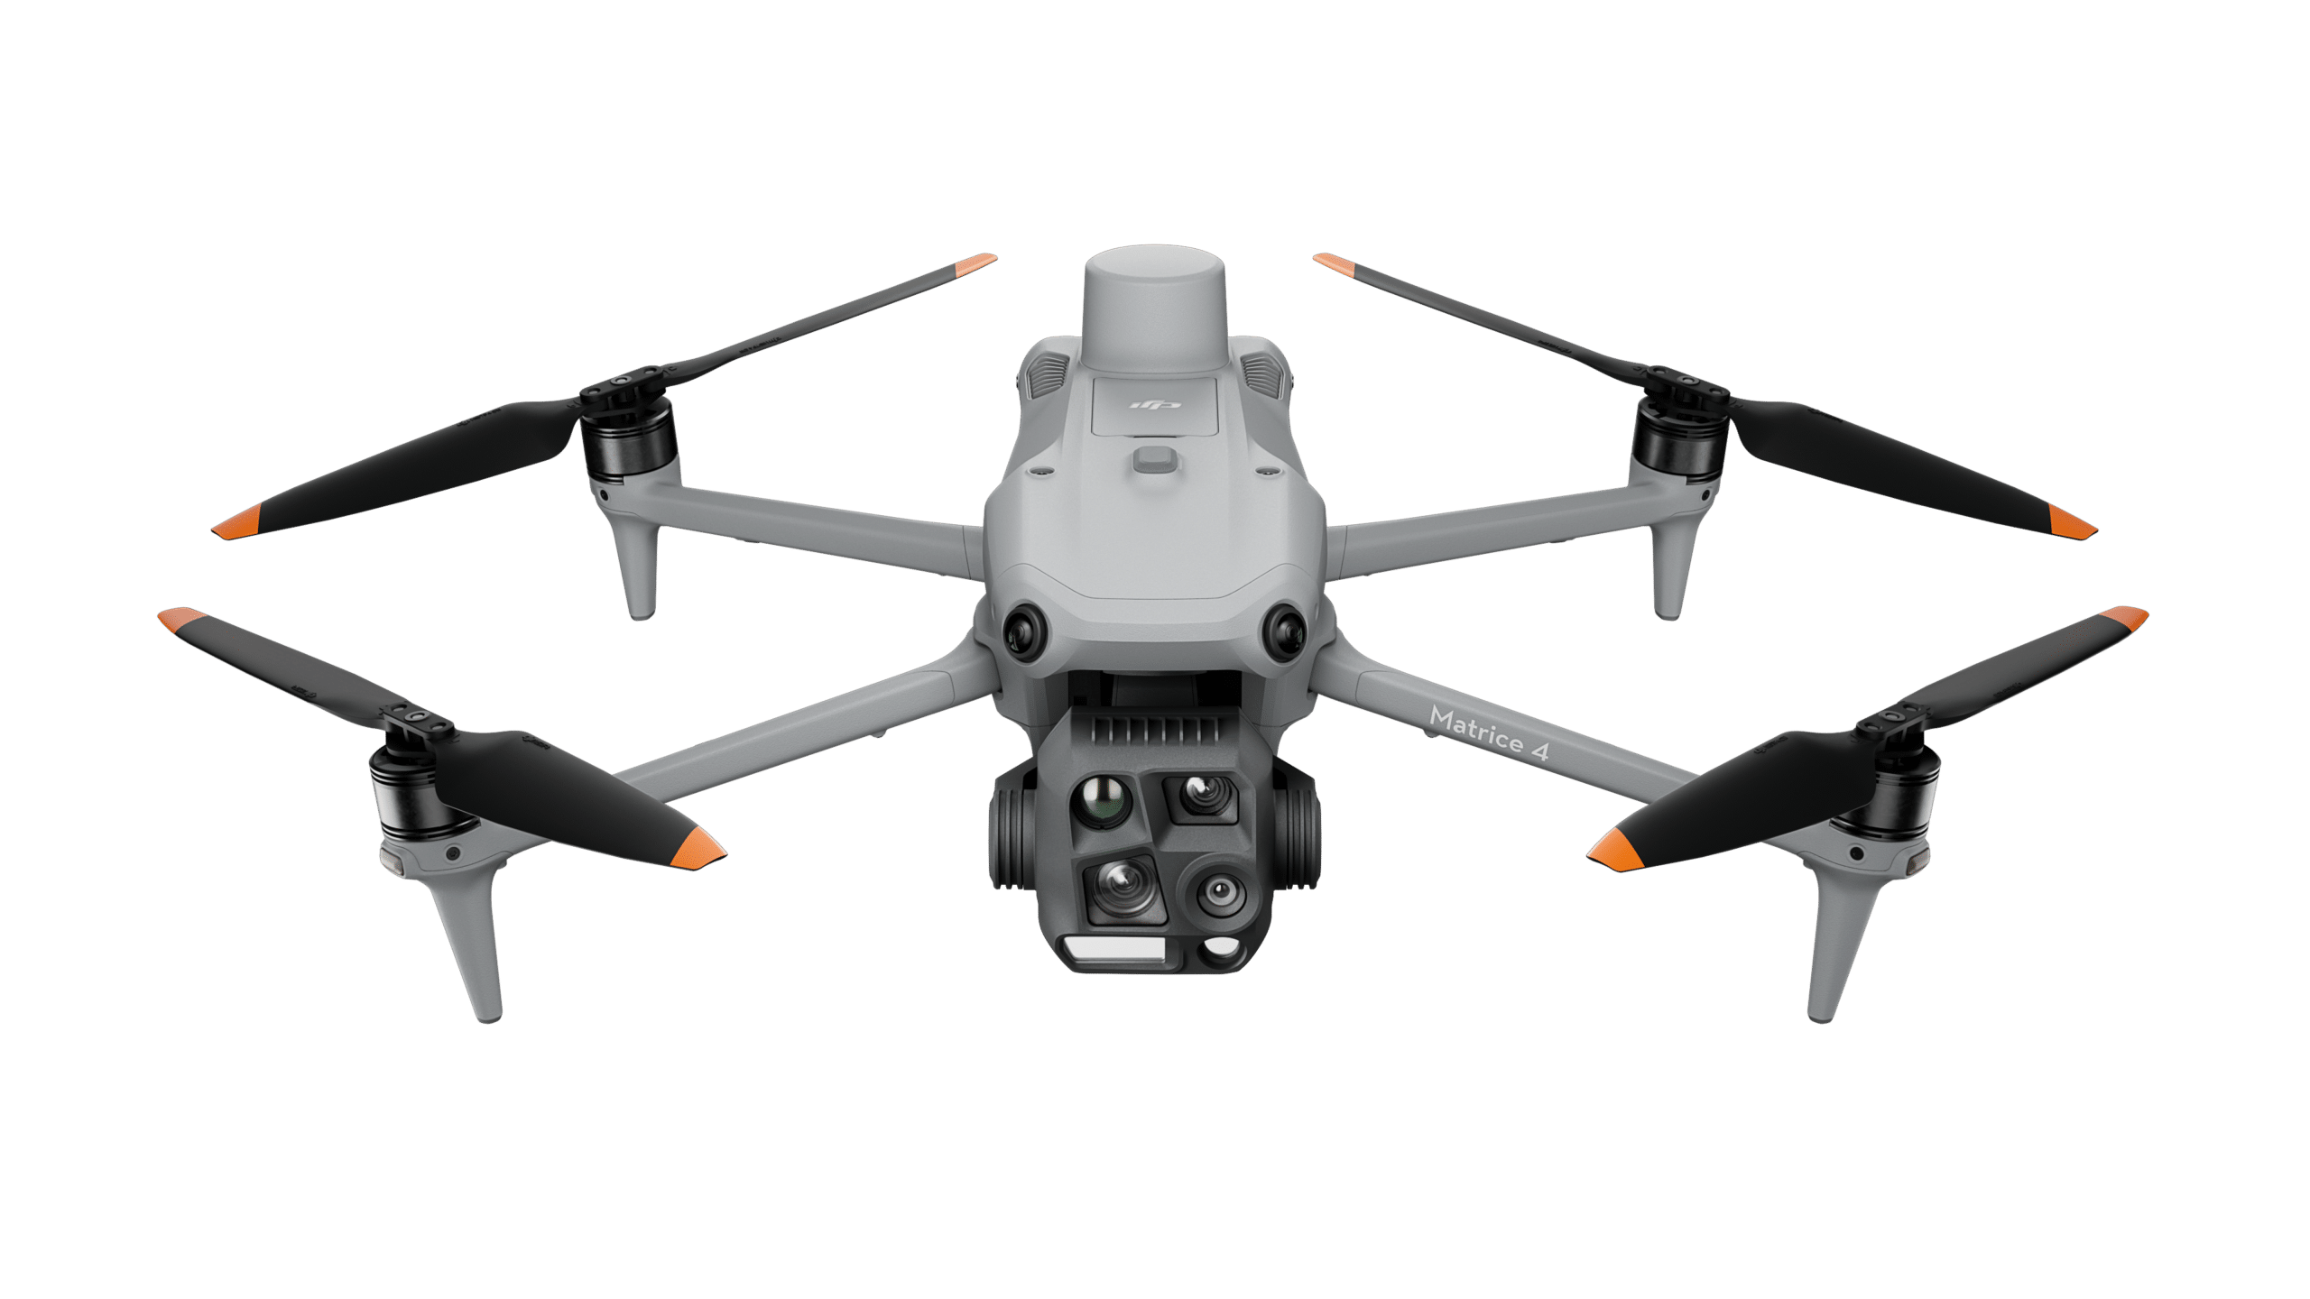
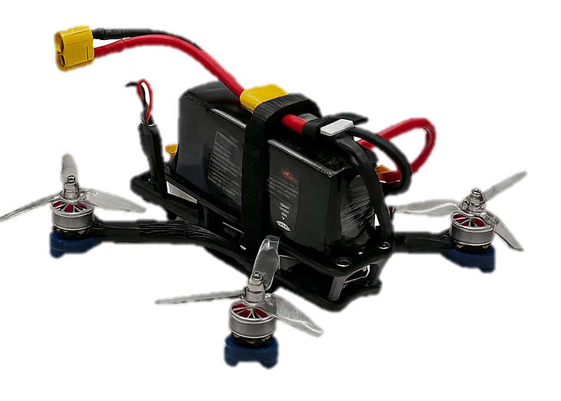
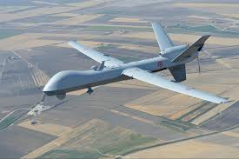
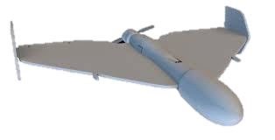
Small or Large UAV ?
Small or Big UAV ?
SMALL
MTOM: 250 g – 25 kg
LARGE
DJI Matrice 4T
5-Inch Custom Built
MTOM: > 25 kg (55 LBS)
MP-9 Reaper
Shahed 136
Source: DJI
Source: General Atomics Aeronautical
Source: Sketchfab

Slide 4
Small or Big UAV ?
LARGE
SMALL
MTOM: > 25 kg (55 LBS)
MTOM: 250 g – 25 kg
MP-9 Reaper
Shahed 136
DJI Matrice 4T
5-Inch Custom Built
Source: General Atomics Aeronautical
Source: Sketchfab
Source: DJI
Notes:
Federal Aviation Agency (US)
Euopean Union Aviation Safety Agency (EASA)

Slide 5
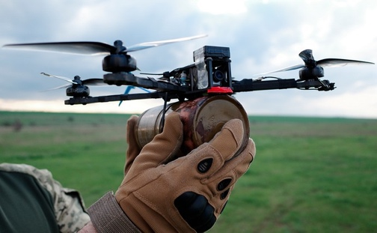
Small Drones Affecting the Course of Warfare
Advanced Reconnaissance
Precision Strikes
Low Cost, High Impact
Asymmetrical Tactics
Disruption of Traditional Defense
Source: Militarnyi
No Universal Defense Solution Available
Notes:
Surveillance / Reconnaissance
Logistics and Supply
Electronic Warfare (e.g. Jamming)
Combat Missions

Slide 6
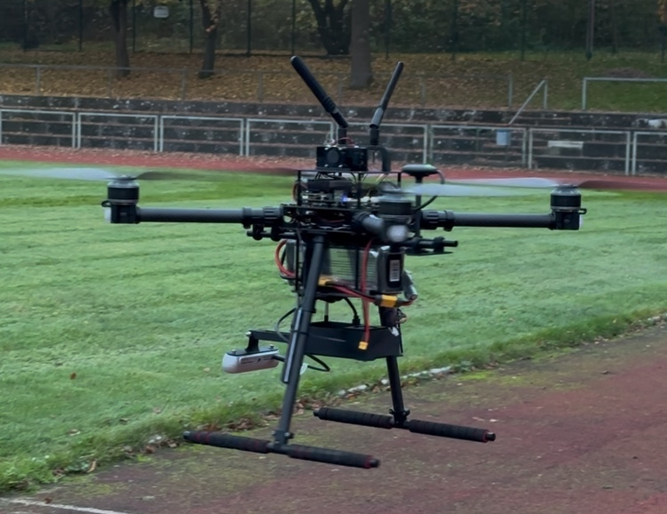


Problems in Countering UAVs on the Battlefield
Remote Controlled?
Communication type?
Mission based or autonomous flight ?
Size, Weight, Velocity ?
Friend-Enemy Recognition?
Further unknown parameters:
Radio Frequency, Analog or Digital Video Transmission,
GNSS-based Positioning, Fiber optic guided, Additional sensors,
IR-Camera, Cellular Network Controlled, Supervised AI-based Operation, Intended use
CUSTOM BUILT
Unknown communication
Customizable with minimal effort
Less intuitive than COTS systems to fly (flight mode dependent)
Open Source possible
Flight speed (≤ 480 $\frac{km}{h}$ / Peregreen2)
COTS
Known communication (Type & Frequencies)
Modification challenging / restricted
Effortless to fly
Closed Source
Slower flight speed ( ≤ 100 $\frac{km}{h}$ / DJI AVATA 2)
Capable of penetrating defended airspace easily
Less capable of penetrating defended airspace

Slide 7

Problems in Countering Quadcopter sUAS on the Battlefield
Remote Controlled?
Communication type?
Mission based or autonomous flight ?
Size, Weight, Velocity ?
COTS
CUSTOM BUILT
Known communication (Type & Frequencies)
Modification challenging / restricted
Effortless to fly
Closed Source
Slower flight speed ( ≤ 100 $\frac{km}{h}$ / DJI AVATA 2)
Unknown communication
Customizable with minimal effort
Less intuitive than COTS systems to fly (flight mode dependent)
Open Source possible
Flight speed (≤ 480 $\frac{km}{h}$ / Peregreen2)
Radiotransmissionfrequency? Analog or Digital? GNSS-based
Positioning? Fiber optic guided? Additional sensors? IR-Camera?
Cellular Network Controlled?
Less capable of penetrating defended airspace
Capable of penetrating defended airspace easily

Slide 8

Limitations of C-RAM Systems in Countering UAV Threats
Altitude
High Trajectory Predictability
Low Trajectory Predictability
Distance
Target

Slide 9
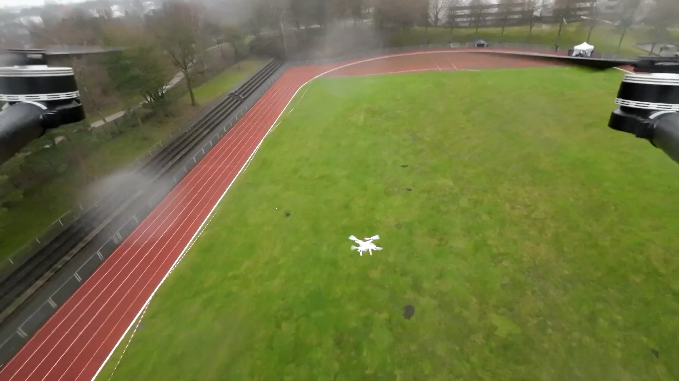
Defense Systems against Threats from Drones (C-UAS)
Soft-Kill (Non-destructive)
  Net launcher
  Jamming (RF & GNSS)
  Spoofing
  Protocol Takeover

Slide 10

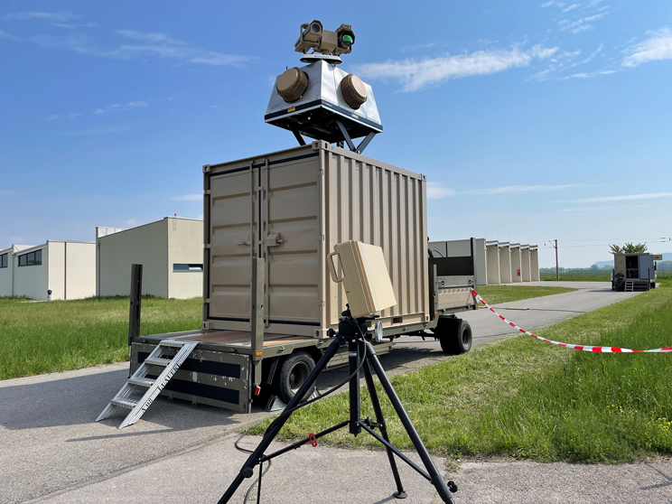
Defense Systems against Threats from Drones (C-UAS)
Soft-Kill (Non-destructive)
  Net launcher
  Jamming (RF & GNSS)
  Spoofing
  Protocol Takeover
Hard-Kill (physical destruction)
  Nets
  Lasers
  Microwave
  Guns / Missiles
  Drones vs Drones
Source: Argus Interception
Source: Hardthöhenkurier

Slide 11

Source: Youtube / Palantir – The Future of Warfare 12/2024

Slide 12
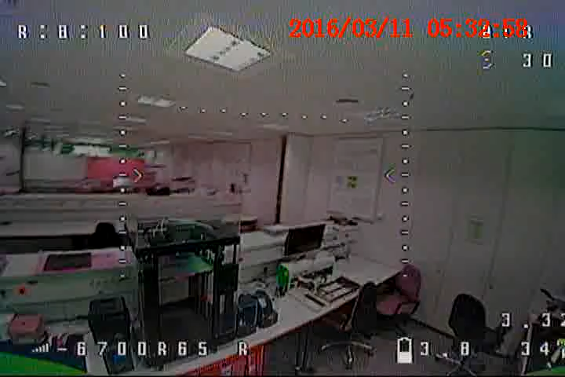
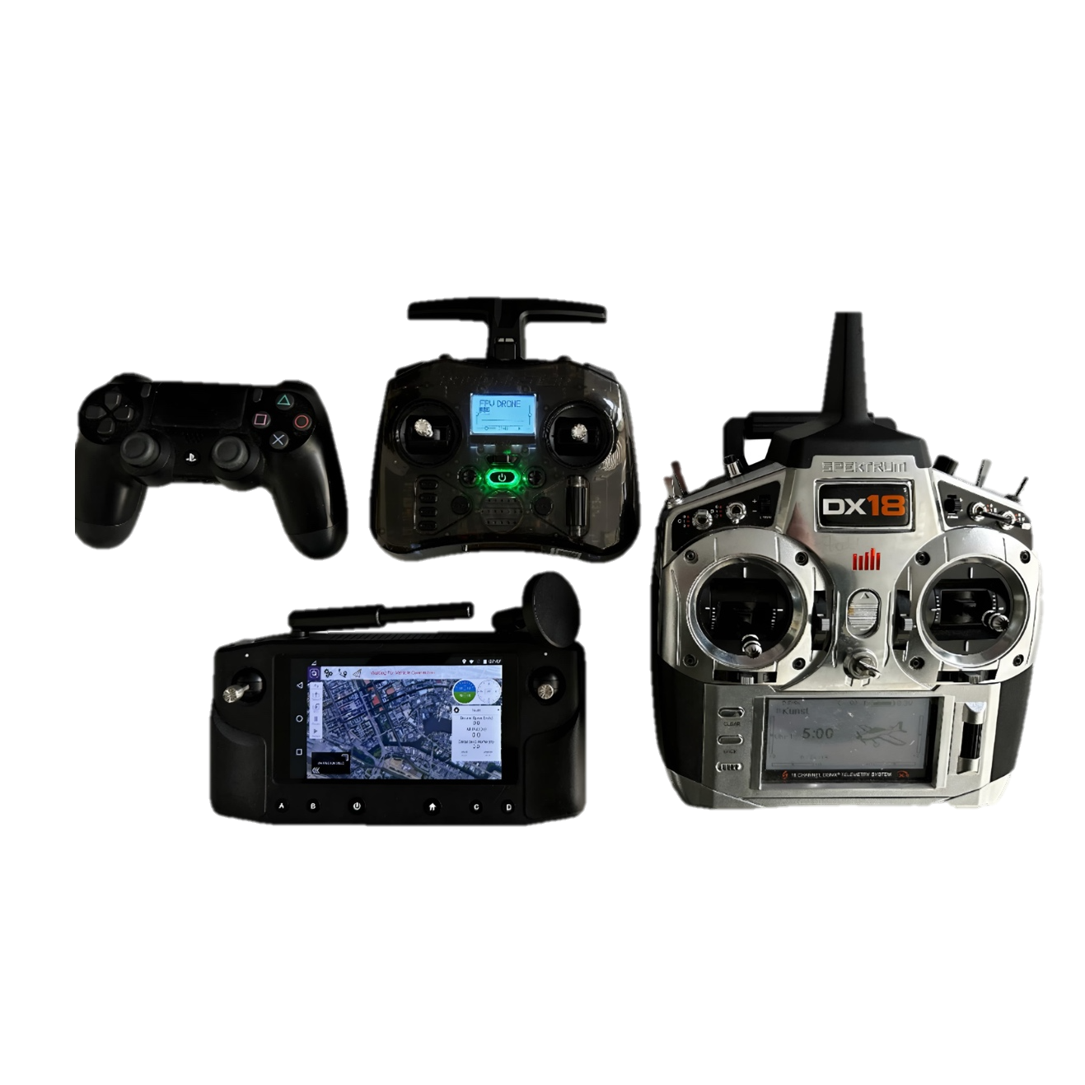
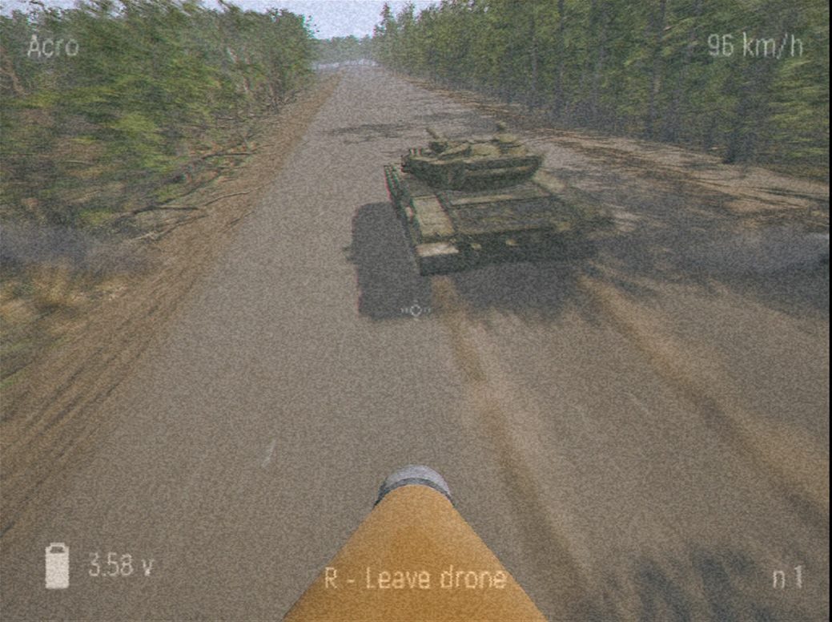
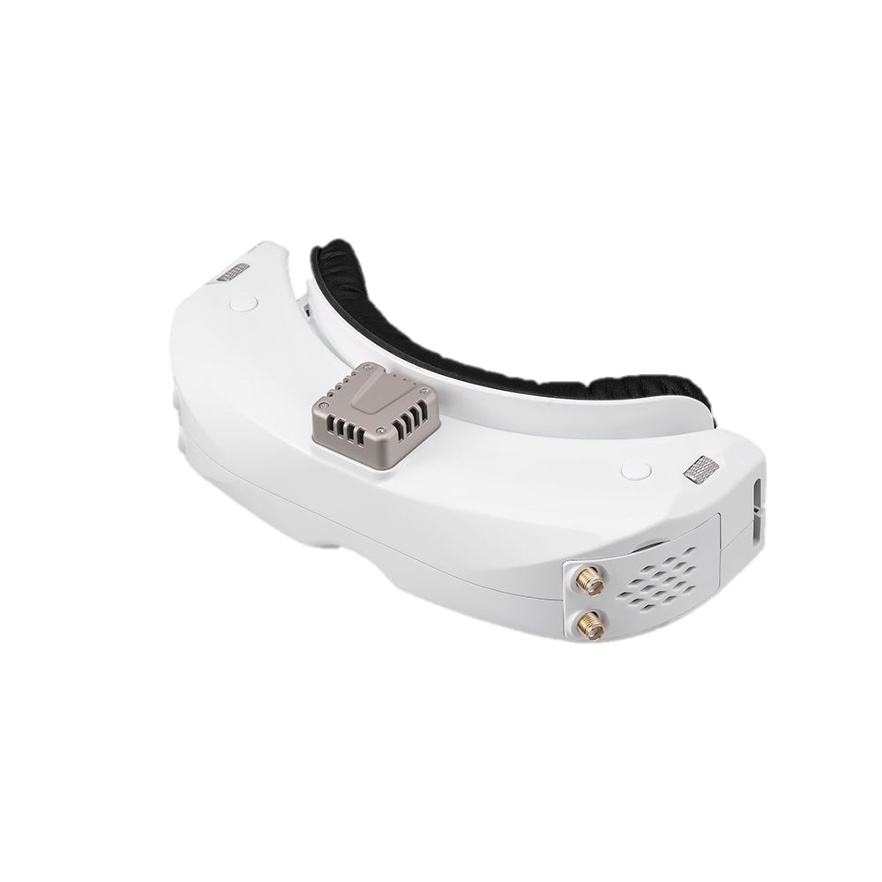
Excursus: How to become a (military) FPV UAV Pilot?
1
2
3
4
REMOTE CONTROLLER
SIMULATOR
HARDWARE SETUP
Real-world flight
The Remote Controller is used to control the UAV in the simulator and in real flight.
Practicing in a simulator will avoid expensive hardware costs and no need for training areas
Buy or build a complete FPV UAV Setup
Since simulators cannot fully replicate the complexities of real-world flight conditions, extensive practical experience with physical drone flights is essential
Source: Steam

Slide 13
Excursus: How to become a (military) FPV UAV Pilot?
1
2
3
4
REMOTE CONTROLLER
SIMULATOR
HARDWARE SETUP
Real-world flight
The Remote Controller is used to control the UAV in the simulator and in real flight.
Practicing in a simulator will avoid expensive hardware costs and no need for training areas
Buy or build a complete FPV UAV Setup
Since simulators cannot fully replicate the complexities of real-world flight conditions, extensive practical experience with physical drone flights is essential
Source: Steam

Slide 14
Excursus: How to become a (military) FPV UAV Pilot?
1
2
3
4
REMOTE CONTROLLER
SIMULATOR
HARDWARE SETUP
Real-world flight
The Remote Controller is used to control the UAV in the simulator and in real flight.
Practicing in a simulator will avoid expensive hardware costs and no need for training areas
Buy or build a complete FPV UAV Setup
Since simulators cannot fully replicate the complexities of real-world flight conditions, extensive practical experience with physical drone flights is essential
Source: Steam

Slide 15
Excursus: How to become a (military) FPV UAV Pilot?
1
2
3
4
REMOTE CONTROLLER
SIMULATOR
HARDWARE SETUP
Real-world flight
The Remote Controller is used to control the UAV in the simulator and in real flight.
Practicing in a simulator will avoid expensive hardware costs and no need for training areas
Buy or build a complete FPV UAV Setup
Since simulators cannot fully replicate the complexities of real-world flight conditions, extensive practical experience with physical drone flights is essential
Source: Steam

Slide 16
Excursus: How to become a (military) FPV UAV Pilot?
1
2
3
4
REMOTE CONTROLLER
SIMULATOR
HARDWARE SETUP
Real-world flight
The Remote Controller is used to control the UAV in the simulator and in real flight.
Practicing in a simulator will avoid expensive hardware costs and no need for training areas
Buy or build a complete FPV UAV Setup
Since simulators cannot fully replicate the complexities of real-world flight conditions, extensive practical experience with physical drone flights is essential
Source: Steam

Slide 17
Costs?
Source: SkyzoneFPV
>= 60$
< 30$
> 100$
> 100$
Simulator | Price (USD) (One-Time Payment) (04/25)
The Drone Racing League Simulator | 8.56
Velocidrone | 21.41
Liftoff | 20.97
FPV Kamikaze Drone | 4.18
FPV.SkyDive | Free
TRYP FPV | 17.30

Slide 18
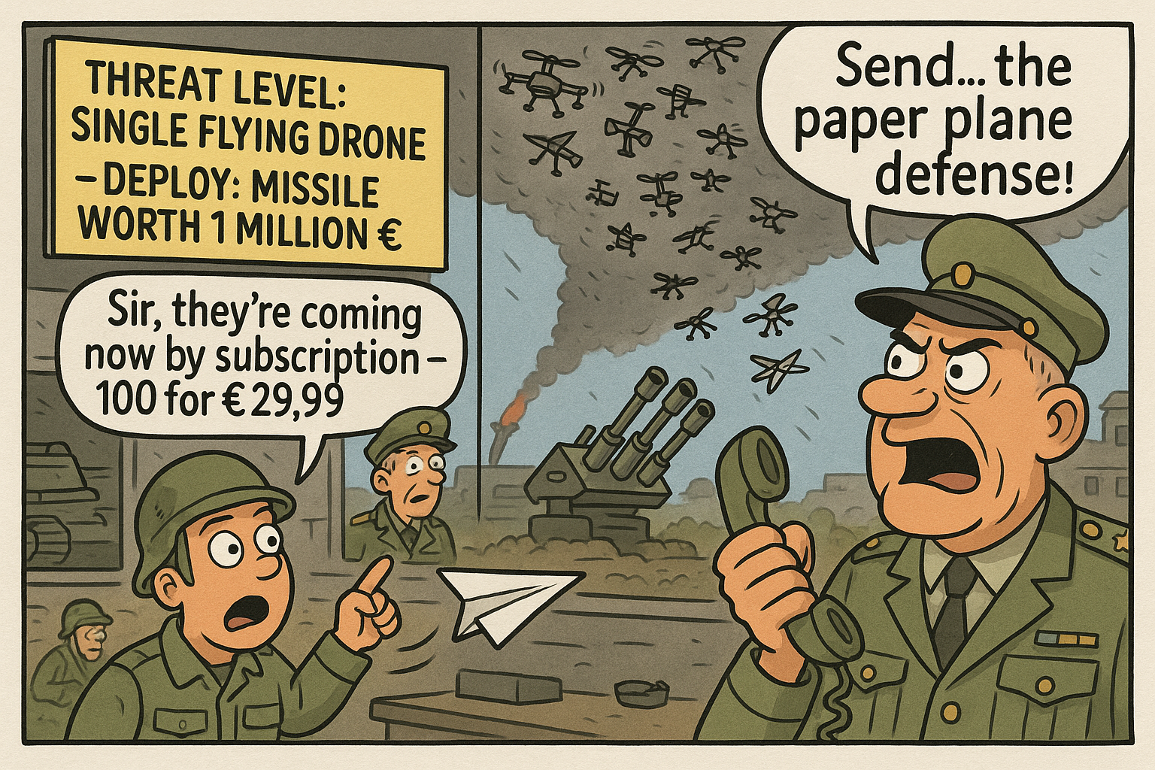
Source: ChatGPT

