Slide 1
Countering High-Altitude Platforms: Defending Against a New Generation of Aerial Threats
Assist. Prof. Miha Šlebir, PhD, University of Ljubljana
Prof. Janja Vuga Beršnak, PhD, University of Ljubljana

Slide 2
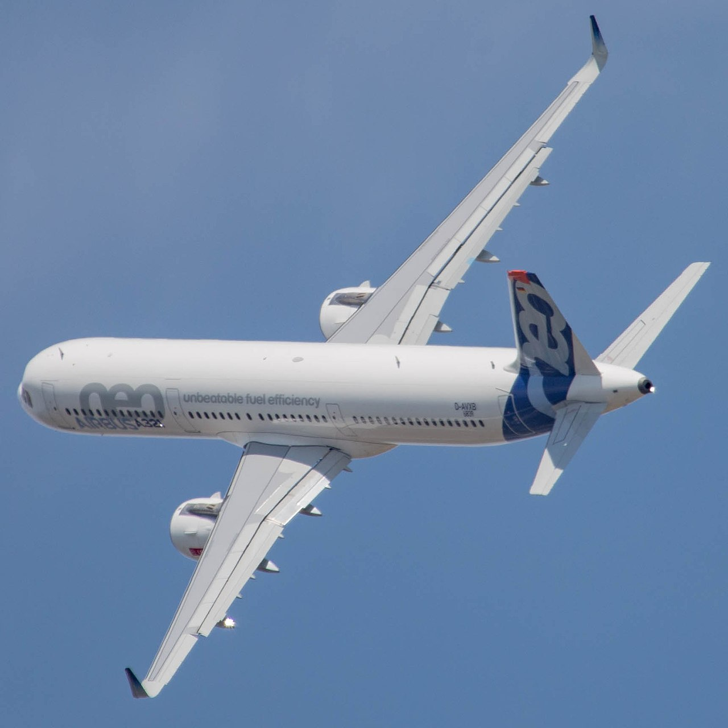
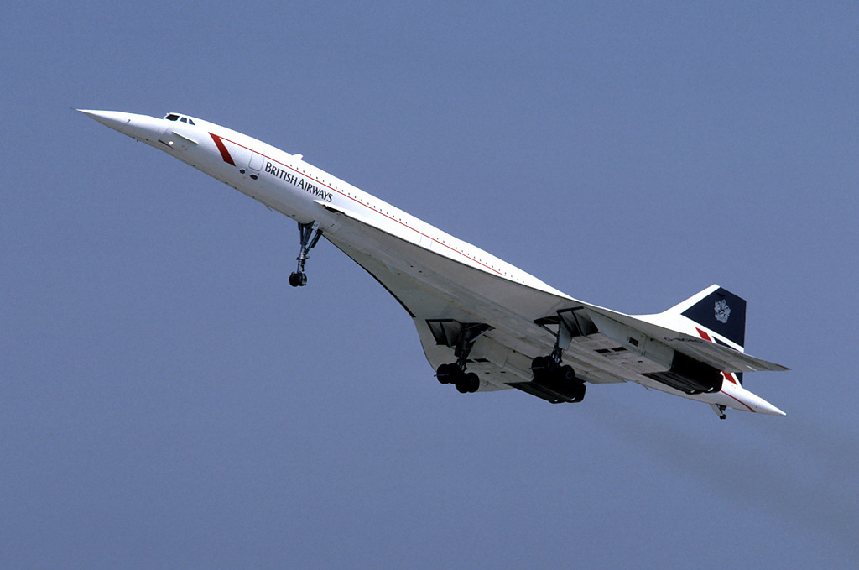
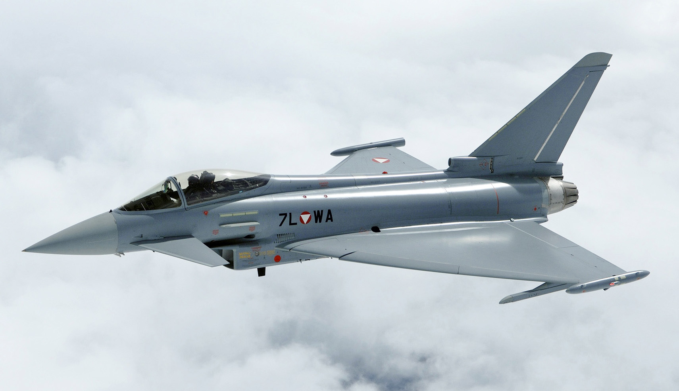
How high do we fly?
Typical passenger jet:
up to 12 km
Specialized passenger jet:
up to 18 km
Typical military jet:
up to 18 km
Photos: courtesy of Clemens Vasters (left), Eduard Marmet (middle) and Markus Zinner (right)

Slide 3
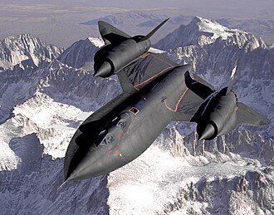
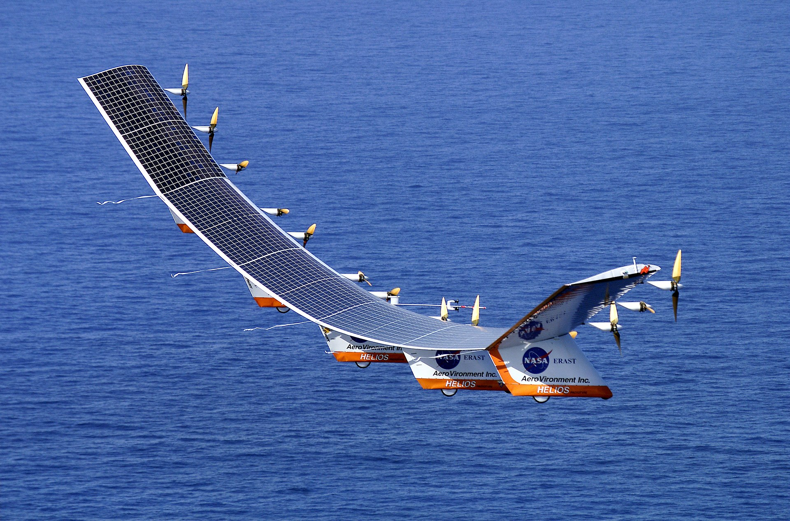
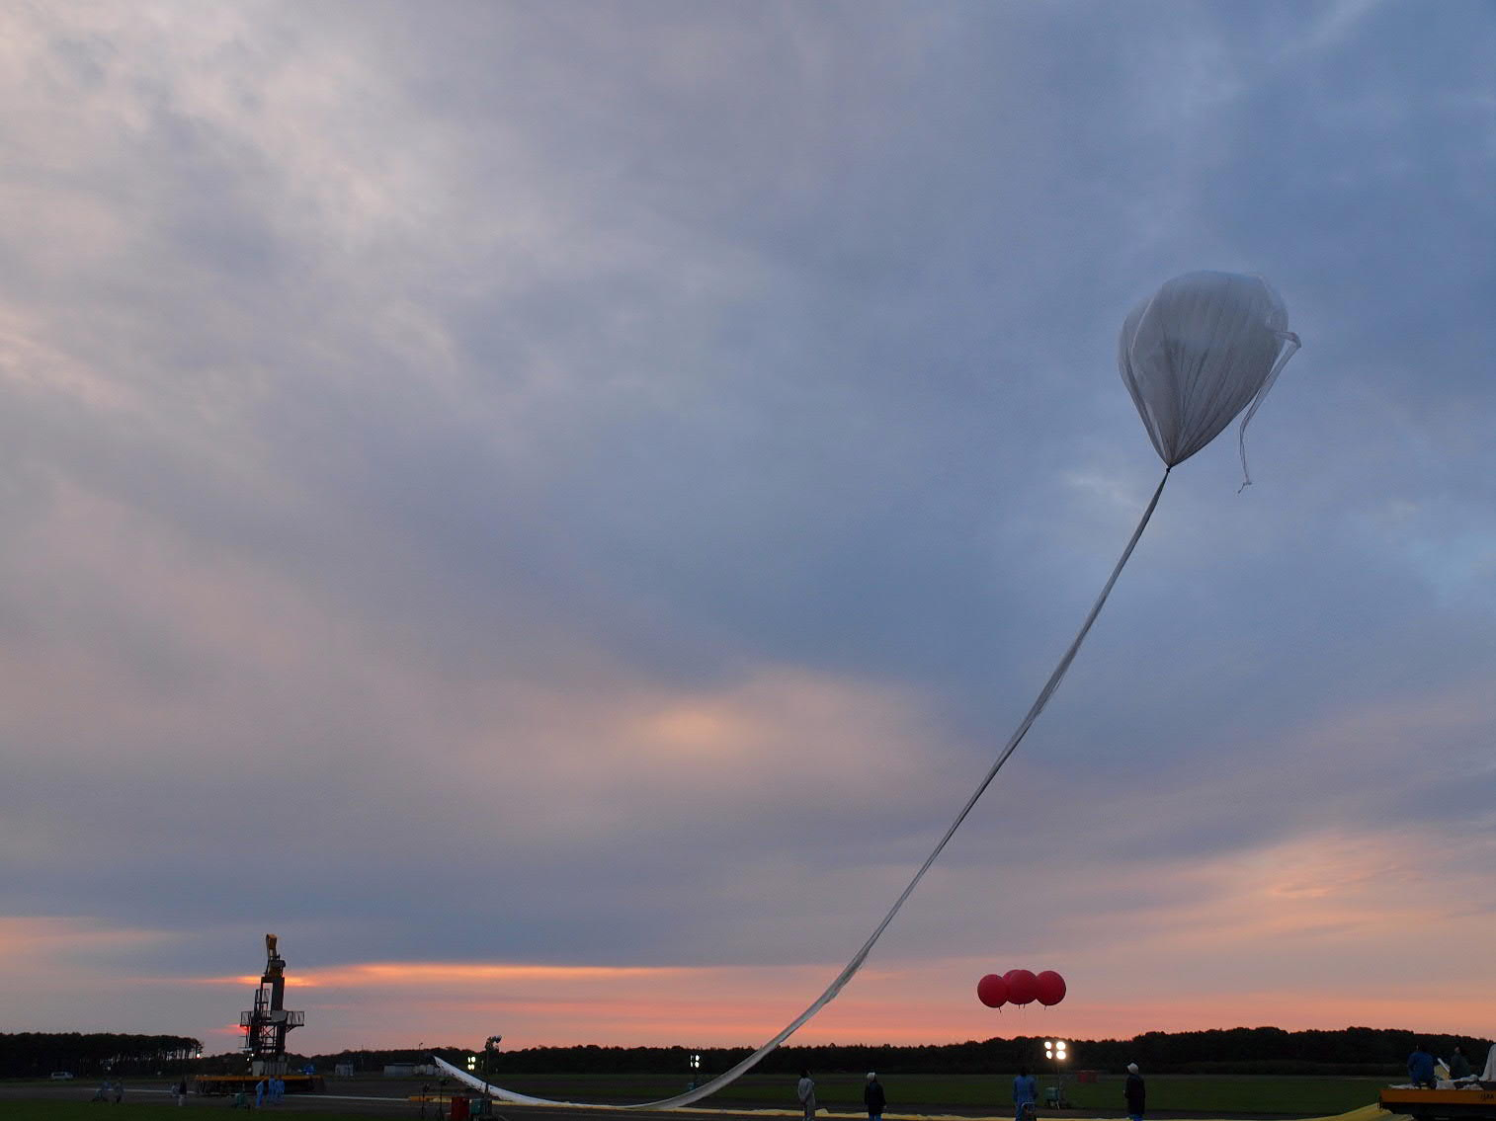
The record holders
SR-71 – altitude record for horizontal flight of manned heavier-than-air aircraft (25.93 km)
Helios Prototype – altitude record for horizontal flight of unmanned heavier-than-air aircraft (29.52 km)
BS 13-08 – absolute aircraft altitude record (53.64 km)
Photos: courtesy of Judson Brohmer (USAF) (left), NASA (middle) and unknown author (right)

Slide 4
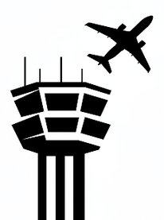
Altitude
50 km
40 km
30 km
20 km
10 km
High altitude airspace – a vast volume of largely unoccupied airspace with:
Low air density
High cosmic radiation
Low adverse weather phenomena
Low air traffic density
Low regulation
altitude ceiling of ATC services (controlled airspace)
High density of air traffic due to jet cruise levels
Medium density of air traffic due to turboprop cruise levels
High density of air traffic due to departures/arrivals, leisure flying, UAVs

Slide 5
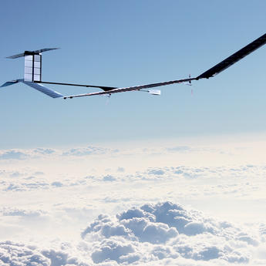
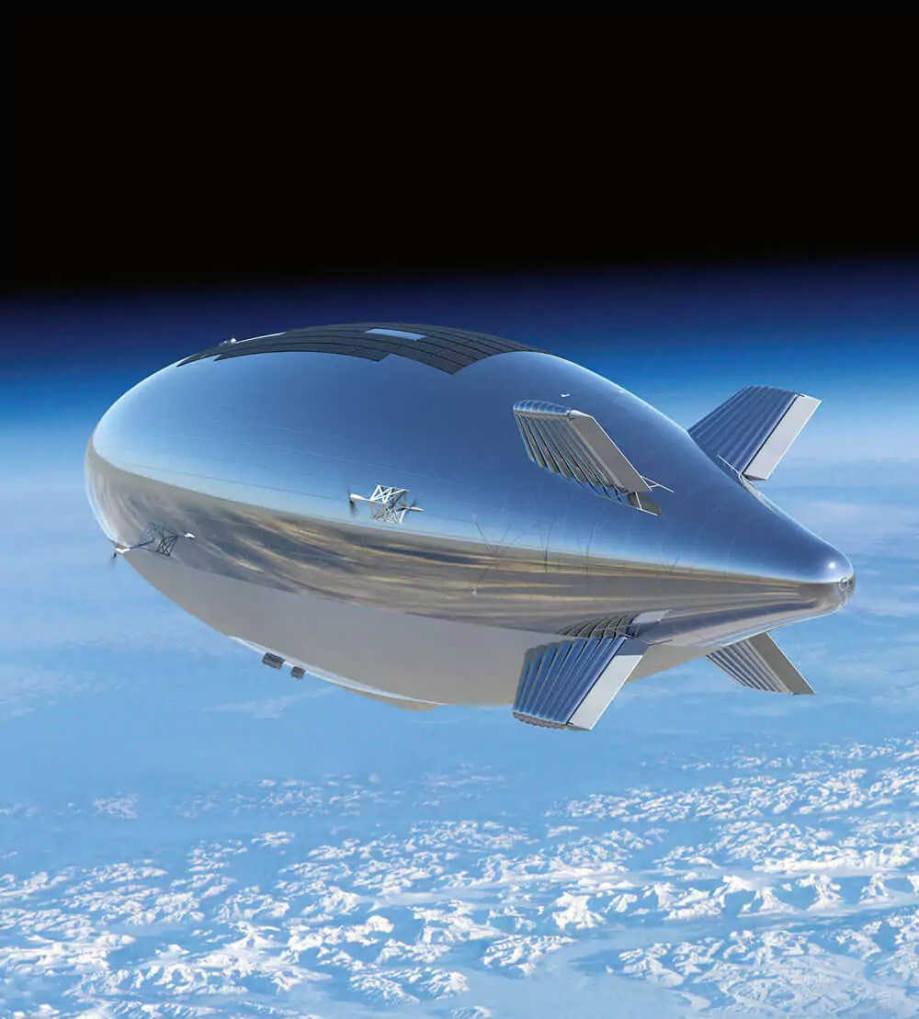
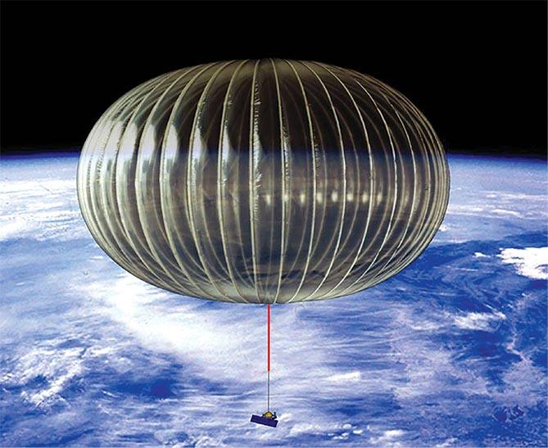
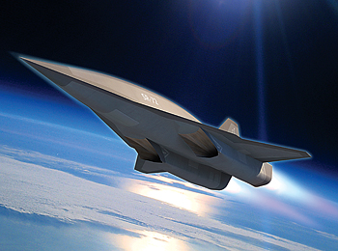
What is about to change?
The physical properties of the atmosphere have made flying above 20 kilometres of altitude difficult and uncommon.
This is about to change – with advances in aviation technology, the proliferation of aircraft designed to operate in high altitude airspace seems imminent.
Over the next decades, the lower part of high-altitude space is likely to be populated by four different base designs:
Unmanned, solar- powered, battery-backed aeroplanes
Unmanned, solar- powered, battery- backed airships
Unmanned
balloons
Unmanned, airbreathing engine- powered aeroplanes
Photos: courtesy of Airbus (left), Lockheed Martin (middle left and right) and NASA (middle right)

Slide 6
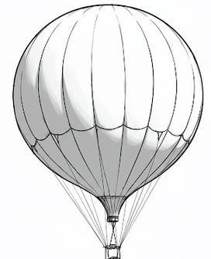
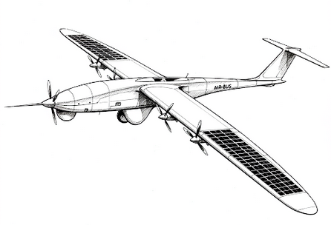
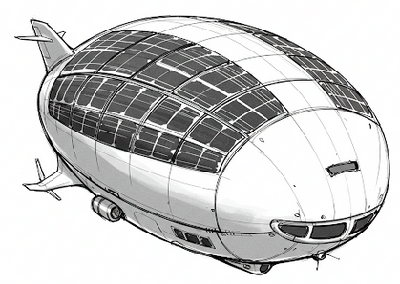
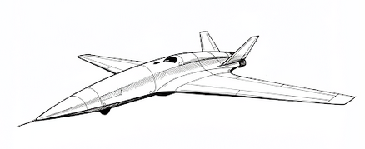
Expected general characteristics
 | Unmanned, solar-powered, battery-backed aeroplanes | Unmanned, solar-powered, battery- backed airships | Unmanned balloons | Unmanned, airbreathing engine powered aeroplanes
Speed | low | very low | wind-dependent | up to hypersonic
Ceiling | 20–30 km | 18–20 km | 30 km+ | 30 km+
Payload | tens of kilograms | hundreds of kilograms | hundreds of kilograms | hundreds of kilograms
Endurance | months | months | weeks | hours
Flight pattern | long route or quasi-geostationary | quasi-geostationary | wind-dependent long route | long route
Stealth | low speed, low noise, low IR, potentially low RCS | low speed, low noise, low IR, potentially low RCS | low speed, no noise, low IR, potentially low RCS | high IR and high noise, but potentially low RCS

Slide 7
Why does it matter?
High-Altitude Platforms will be of great military utility as:
Communication nodes
Intelligence, surveillance and reconnaissance platforms
Electronic warfare stations
Kinetic weapon stations
Decoys
For other usage
There is no internationally agreed boundary between airspace and outer space!

Slide 8
What does it mean for air defence?
DETECTION
IDENTIFICATION
WEAPON ALLOCATION
ENGAGEMENT
Especially solar-powered, battery backed High-Altitude Platforms may be difficult to detect due to:
Low speed
Low noise
Low temperature
No condensation trails
Potentially low radar reflection

Slide 9
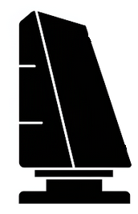
Altitude
50 km
40 km
30 km
20 km
10 km
typical instrumented ceiling of air defence radars
Elevation coverage of some air defence radars – only 20 degrees

Slide 10
What does it mean for air defence
DETECTION
IDENTIFICATION
WEAPON ALLOCATION
ENGAGEMENT
Difficult to identify by interception by fighter aircraft due to:
Operational ceiling difference
Speed difference
Potential abundance of high-endurance targets
Legal ambiguities (at what altitude does the national jurisdiction end?)

Slide 11
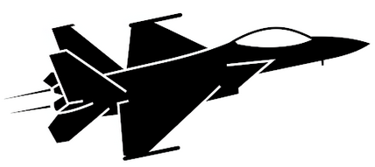
Altitude
50 km
40 km
30 km
20 km
10 km
typical operational ceiling of fighter aircraft

Slide 12
What does it mean for air defence
DETECTION
IDENTIFICATION
WEAPON ALLOCATION
ENGAGEMENT
Should the decision be made to engage:
Is there a suitable weapon in the arsenal?
Is there a suitable munition that one is willing to spend? (cost vs. benefit)
Is there a suitable munition capability that one is willing to reveal?
How to effectively engage a large number of high altitude targets?

Slide 13
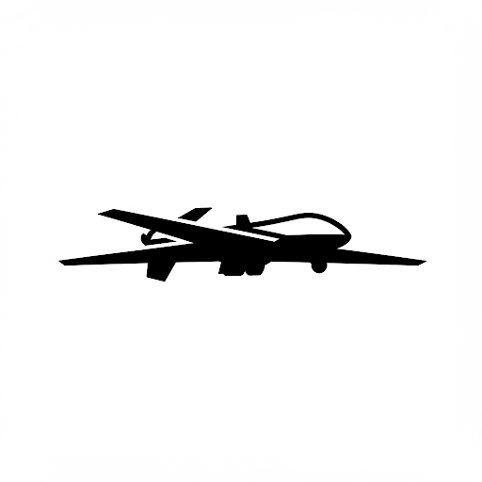
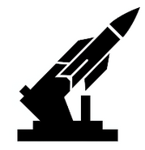
Altitude
50 km
40 km
30 km
20 km
10 km

Slide 14
Conclusion
A dual use technology and a force multiplier.
Complex problem for aerospace defence.
Converging air and space domains.
Potential shift in concepts such as sovereignty, airspace control and deterrence.
If you have expertise in the fields of military aviation or military theory and would be open to sharing your thoughts, please contact me either in person or at miha.slebir@fdv.uni-lj.si. I am writing a paper on the subject and would be very happy to hear your insights. THANK YOU!

Slide 15
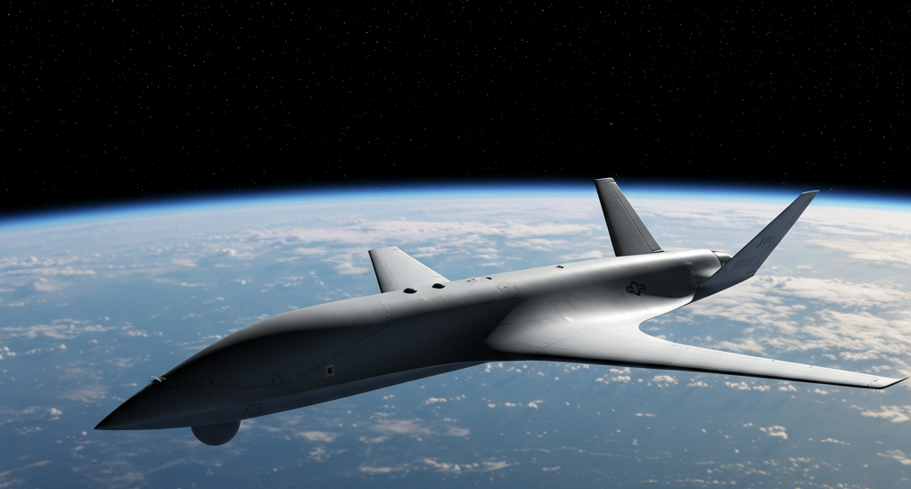
THANK YOU FOR YOUR ATTENTION!

