Slide 1
1+1 ≠ 2: Digital Friction, Uncertainty, And The Limits Of Technological Determinism
Schaebler Alexander
- The views expressed in this presentation are the author’s alone and do not represent the views of the German Armed Forces -
Notes:
Unfounded confidence in military technology crumbles when confronted with unanticipated battlefield conditions, ultimately reducing warfare to its archaic elements.
As Storr asserts: “Fundamentally, three things occur on the battlefield: men think, move, and commit violence. All other activities support these functions.”[2]

Slide 2
- The views expressed in this presentation are the author’s alone and do not represent the views of the German Armed Forces -
Notes:
Unfounded confidence in military technology crumbles when confronted with unanticipated battlefield conditions, ultimately reducing warfare to its archaic elements.
As Storr asserts: “Fundamentally, three things occur on the battlefield: men think, move, and commit violence. All other activities support these functions.”[2]

Slide 3
Shock without awe The “Cult of the Offensive” attacks reality
Notes:
Mikael Weissmann and Peter Ahlström, “Mirror, Mirror on the Wall, Who Is the Most Offensive of Them All? – Explaining the Offensive Bias in Military Tactical Thinking,” Defence Studies 19, no. 2 (2019): 183–185, https://doi.org/10.1080/14702436.2019.1599287.
Historical and Theoretical Bias: Military history and theory often emphasize successful offensive operations, reinforcing a pro-offensive narrative.
Doctrinal and Educational Emphasis: Doctrine, TTPs, training exercises, and military education systems are structured around offensive action.
Cultural, Psychological, and Practical Factors: Military culture rewards offensive thinking; psychological associations link offense with valor and leadership; modern technology, geographic realities, and tactical objectives often favor offensive approaches. Opening Anecdote: "Would You Like To Know More?"
Slide Theme: Starship Troopers VHS-style intro, lighthearted and brutal.
In the late '90s, I watched Paul Verhoeven’s "Starship Troopers". It had it all: propaganda, bugs, orbital drops... and utter chaos.
Troopers stormed in with digital bravado and broadcasted confidence. But what saved them? → Not tech, but brute improvisation in the mud.
That dissonance stuck with me. Today, we still bank on the same illusion: that digital tools alone can win an analogue war.

Slide 4
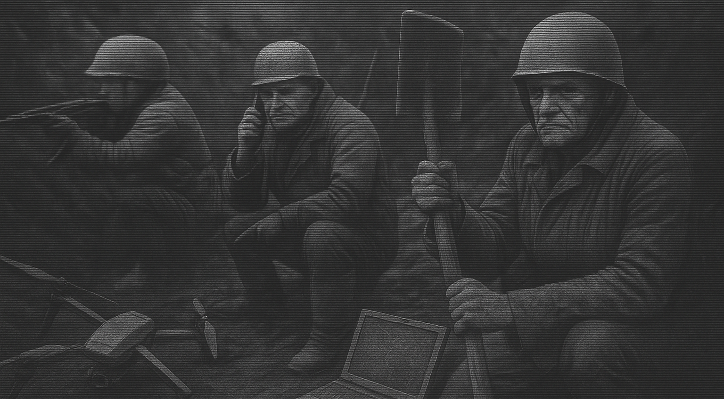
The Situation in Ukraine
Military rule or exception?
Notes:
Unfounded confidence in military technology crumbles when confronted with unanticipated battlefield conditions, ultimately reducing warfare to its archaic elements. As Storr asserts: “Fundamentally, three things occur on the battlefield: men think, move, and commit violence. All other activities support these functions.”[2]
In the ongoing war in Ukraine, both sides have increasingly relocated non-combat operations underground, seeking refuge in bunkers, trenches, and urban subterranean infrastructure to mitigate exposure to persistent aerial threats.
Evolving in various shapes and sizes, drones controlled via radio signals, fibre-optic cables, or autonomous AI-driven systems have become a defining feature of today’s wars. Bullets:
Ukrainian units rely on solar panels, paper maps, local radios.
The frontlines are filled with downed drones and burnt comms gear.
Starlink may win battles—but shovels win wars.
NATO’s new Minimum Capability Requirements (MCR) will demand a significant increase in personnel and spending to counter the eventuality of attritive and prolonged conflicts, according to media reports.

Slide 5
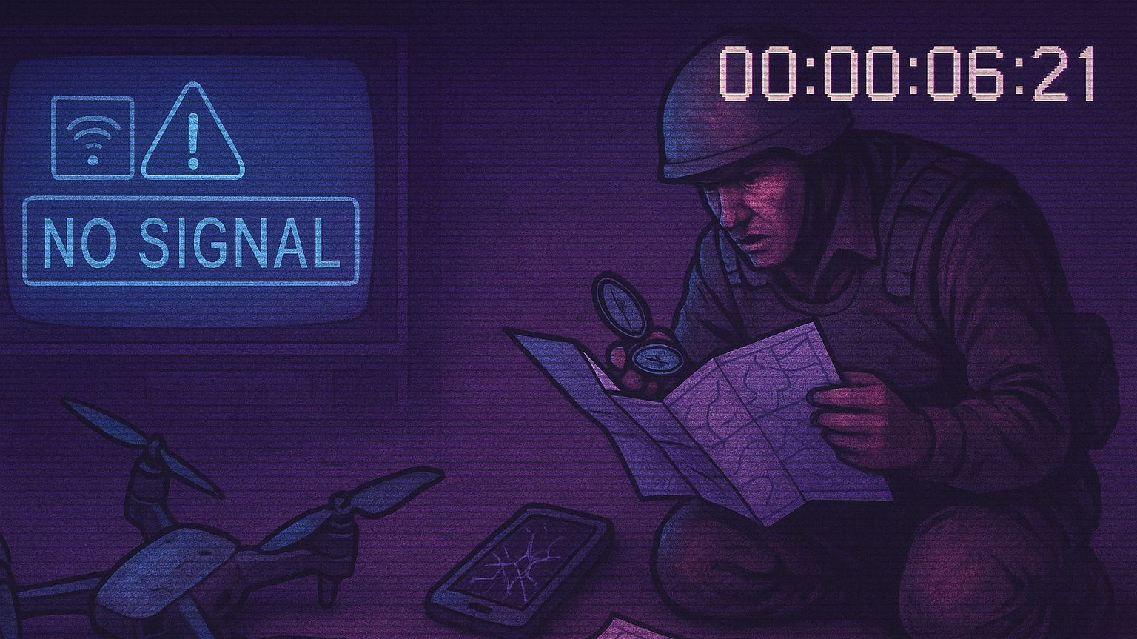
Splitting the Fog of War Digital Friction strikes
Notes:
Jaqueline Schneider 2024, Digital Cult of the Offensive
“Everything in war is very simple, but the simplest thing is difficult. The difficulties accumulate and produce a kind of friction… This tremendous friction is everywhere in contact with chance, and brings about effects that cannot be measured, just because they are largely due to chance.”
“Friction is the only concept that more or less corresponds to the factors that distinguish real war from war on paper.”
Electronic Warfare (EW), attacks on the power grid, cyberattacks, and logistical breakdowns lay bare the bloodstained chasm between digitalised war planning and the unforgiving, ultimately analogue, realities of combat

Slide 6
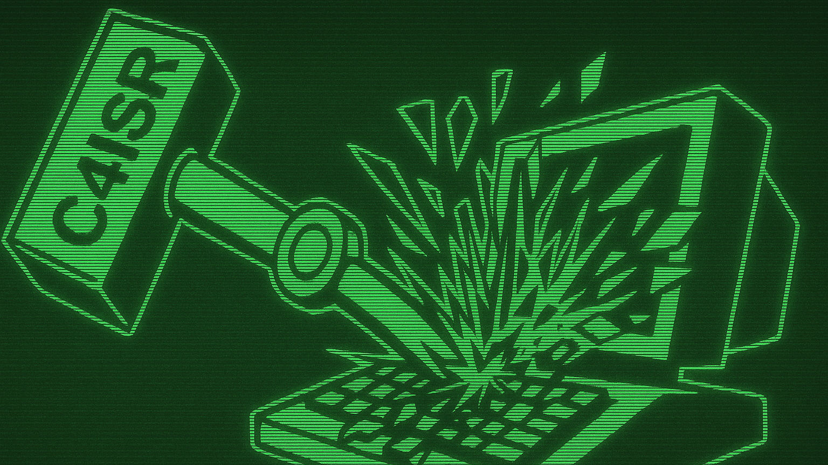
The Law of the Instrument When all you have is a computer –
everything becomes code
Notes:
Maslow
To achieve this, Western militaries must ensure both analogue and digital resilience to meet the demands of LSCO. The prevailing Zeitgeist may resist a more conservative approach, misinterpreting it as institutional inertia rather than strategic prudence.
Even when AI is used merely to augment crewed platforms, the interdependence of network-reliant weapon systems introduces potential flashpoints for friction and operational vulnerabilities

Slide 7
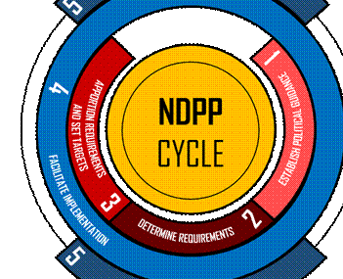
“The F-35 has left the group…”
The Capability-Vulnerability Paradox
Source: NATO ACT + Stanley Kubrick, 2001 A Space Odysee
Notes:
Even when AI is used merely to augment crewed platforms, the interdependence of network-reliant weapon systems introduces potential flashpoints for friction and operational vulnerabilities
The aim of the NATO Defence Planning Process (NDPP) is to provide a framework within which national and Alliance defence planning activities can be harmonised to enable Allies to provide the required forces and capabilities in the most effective way.
Key Message: High-tech systems attract high-risk failure points.
Bullets:
EMPs, EW, and sabotage can cascade through digital logistics.
F-35: A billion-dollar system dependent on WiFi.
Complexity breeds fragility in LSCO.

Slide 8
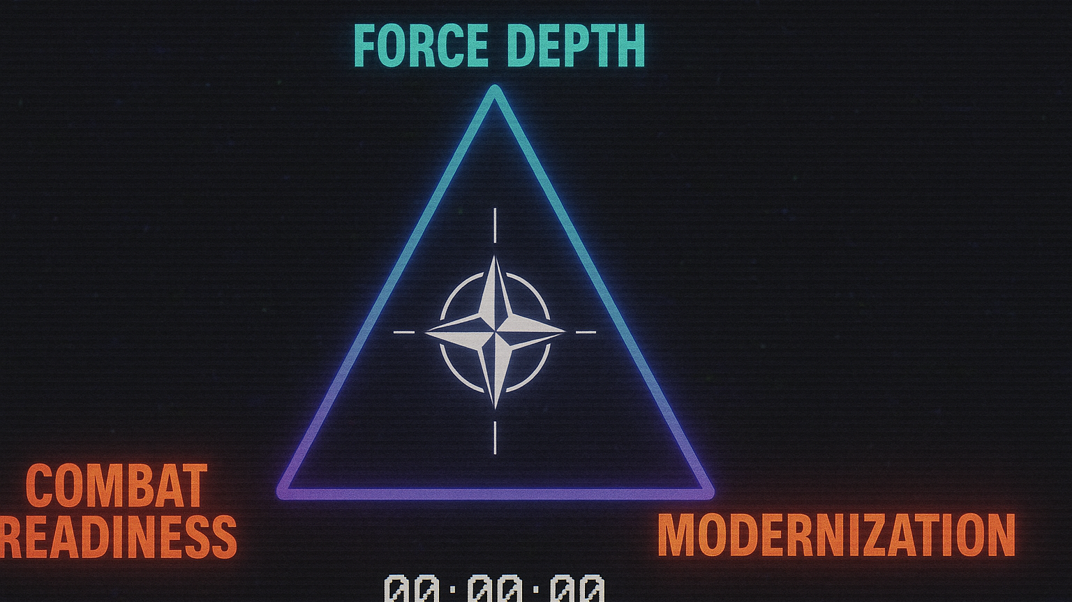
Source:
Kathleen H. Hicks
„Iron Triangle Of Painful Trade-offs“
Notes:
NATO’s Structural Drag: Interoperability vs. Inoperability
The NDPP process is too slow for battlefield innovation cycles.
New gear from South Korea, old radios from the Cold War.
Interoperability must mean more than compatible cables.

Slide 9
The Rise of the WarTech Nexus From procurement bureaucracies to
Plug-and-Play combat?
Notes:
Key Message: EDTs evolve faster than doctrine.
Bullets:
FPV drones + AI = revolution from below.
Commercial actors (Helsing, Musk, DJI) drive innovation.
Starshield as Wartech Archetype
there is growing momentum for more flexible procurement models, including PPP, Project, Programme, and Portfolio Offices (P3O), and broader outsourcing of force multipliers within the expanding WarTech Nexus.
Evolving in various shapes and sizes, drones controlled via radio signals, fibre-optic cables, or autonomous AI-driven systems have become a defining feature of today’s wars. “70 per cent of all Russian and Ukrainian casualties” are caused by drones, the New York Times quotes a senior Ukrainian defence official in 2025. “It is, they say, a feeling of a thousand snipers in the sky,” the report further paraphrases.[60]
Starshield is not just a satellite constellation—it is a strategic instrument of neo-industrial warfighting in which:
Commercial launch capacity becomes a sovereign asset,
Communication resilience is distributed across private platforms,
Innovation cycles outpace bureaucratic acquisition models,
And space dominance is increasingly predicated on commercial-military interoperability.
It is a canonical case of the wartech nexus: a system that reflects, amplifies, and accelerates the convergence of private technology leadership and state strategic requirements.

Slide 10
Lessons from the Past
Clausewitz rebooted
Notes:
„Look, there’s two things a military officer does. Coordinates information, releases energy.“
https://singjupost.com/transcript-of-erik-d-prince-on-ai-and-the-future-battlefield/?singlepage=1&utm_source=chatgpt.com
the hypernormalised notion of how warfare must be conducted increasingly marginalises the why in a broader, more political and strategic sense due to availability, political reasoning and the legal straitjacket of decade-long procurement contracts.
Clausewitz: War is not just destruction; it is political.
Manoeuvre vs. Attrition: Interpretation based on perspective, context, not dogma.
Schwerpunkt cannot be digitally engineered.

Slide 11
Breaking the Digital Straitjacket
Accepting failure & Anticipating defeat
Notes:
Key Message: Training must simulate chaos, not success.
Bullets:
Reintroduce unscripted LSCO field exercises.
Embrace analogue tools: maps, compasses, spades.
Old soldiers bridge the digital divide—young ones must learn.
In 1962, Operation Starfish Prime unintentionally showcased the devastating effects of a high-altitude nuclear detonation, generating an Electromagnetic Pulse (EMP) capable of disrupting or destroying satellites within line of sight.[90] Such a blast could irradiate orbital space, rendering unshielded satellites inoperable and producing satellite debris that may trigger a cascading Kessler Syndrome effect, severely degrading space-based capabilities.[91] In short, the consequences of yielding nuclear weaponry in space are so severe and unpredictable that no further attempt has been made in over 60 years.

Slide 12
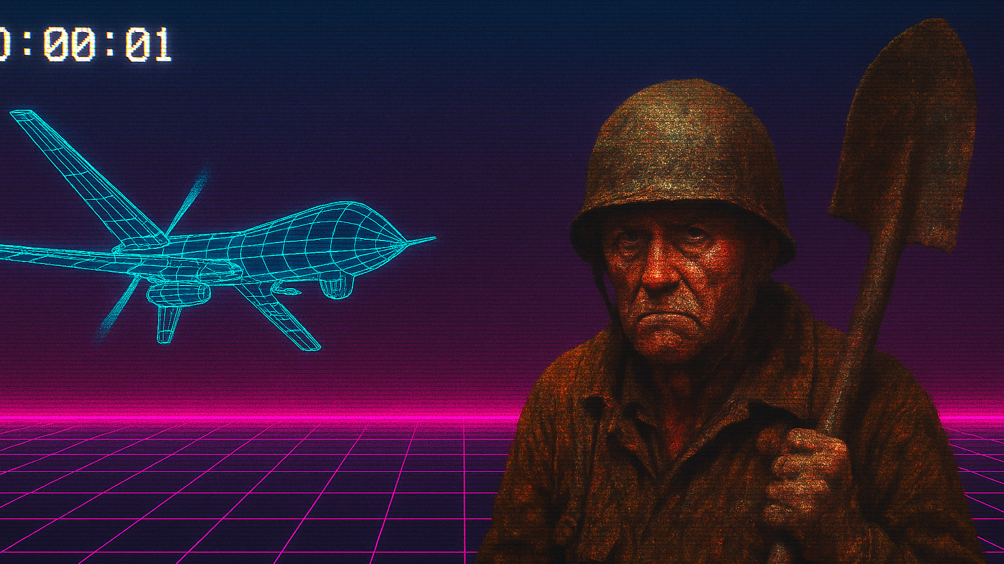
Thank you for your attention Take care and stay prepared!
Alexander Schaebler, Alex.Schaebler@gmail.com
- The views expressed in this presentation are the author’s alone and do not represent the views of the German Armed Forces -
Notes:
In the ongoing war in Ukraine, both sides have increasingly relocated non-combat operations underground, seeking refuge in bunkers, trenches, and urban subterranean infrastructure to mitigate exposure to persistent aerial threats.
In a 2024 address to defence industry leaders, Vandier warned: “Just like the dinosaurs—you see the smoke of volcanoes and simply say you are in changing times. Most Europeans are herbivores; they think there is sufficient grass to feed on. This is not the case.”
Historically, unscheduled, large-scale exercises have been crucial for identifying vulnerabilities, forcing doctrinal evolution, and enhancing force agility.
Final Note: Digging Into The Future
After writing my last paper in 2024, I was finally issued a shovel.
It may not plug into a NATO mainframe, but it digs trenches.
And in 2025, that might just be the one tool left standing.

Slide 13
- The views expressed in this presentation are the author’s alone and do not represent the views of the German Armed Forces -
Notes:
Unfounded confidence in military technology crumbles when confronted with unanticipated battlefield conditions, ultimately reducing warfare to its archaic elements. As Storr asserts: “Fundamentally, three things occur on the battlefield: men think, move, and commit violence. All other activities support these functions.”[2]

