Slide 1
Resilience and agility:
supply chain requirements
in military operations
Major Superior Instructor Ana-Maria Merlusca, PhD Candidate
Military Student Matei-Alexandru Ropotan
„Carol I” National Defence University, Bucharest

Slide 2
Provide a point of view on:
the importance of a supply chain resilience and agility
the benefits of innovative solutions over supply chains efficiency
Aim

Slide 3
01
Supply Chain Management
02
Military Supply Chains
Theoretical concepts
Shortfalls
Causes
Possible effects
03
Resilience &
Agility of
Military Supply Chains
04
2024 Supply Chain Innovation Award
Agenda

Slide 4
Supply Chain Management

Slide 5
Logistics
Logistics
Suppliers
Costumers

Slide 6
PROCUREMENT
SCM
Development
Customer satisfaction
Information access
Logistics
Suppliers
Costumers
Distribution
Manufacturing
Competition for resources
Plan
Management
Notes:
information access, competition for resources, or customer satisfaction.

Slide 7
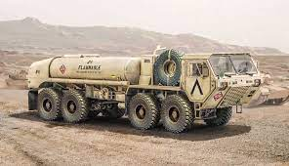
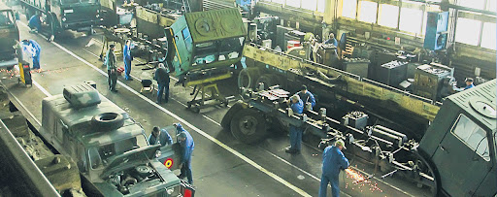
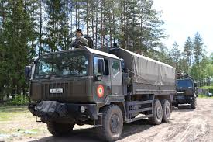
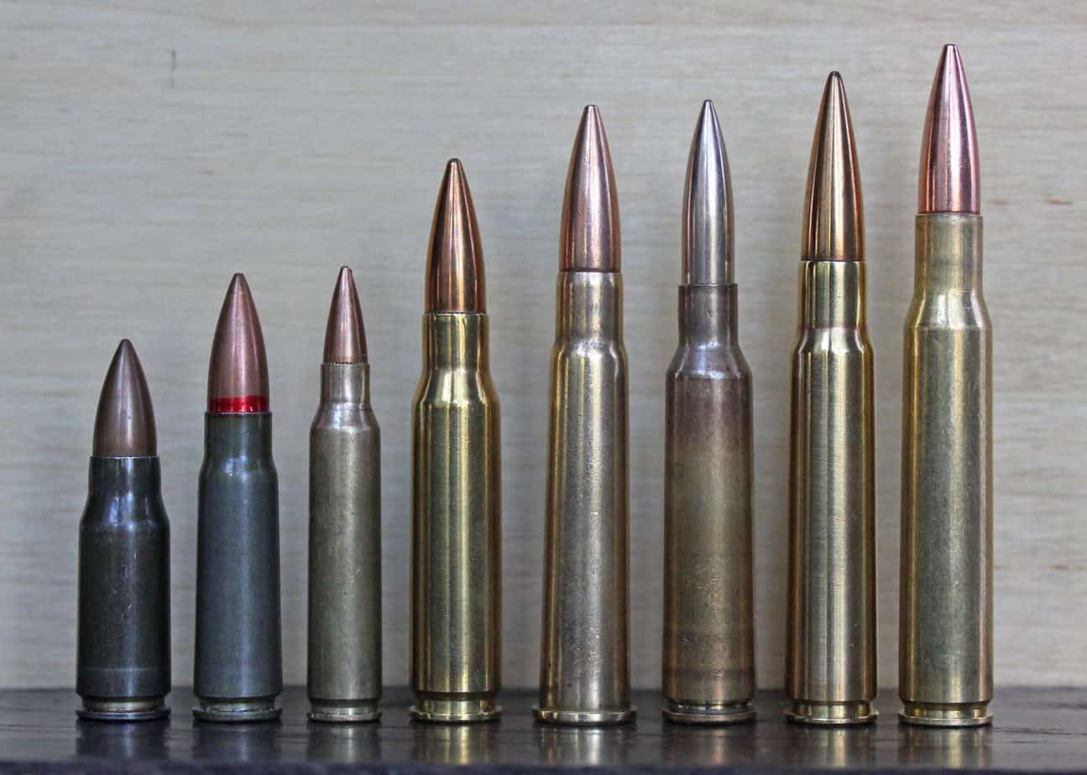
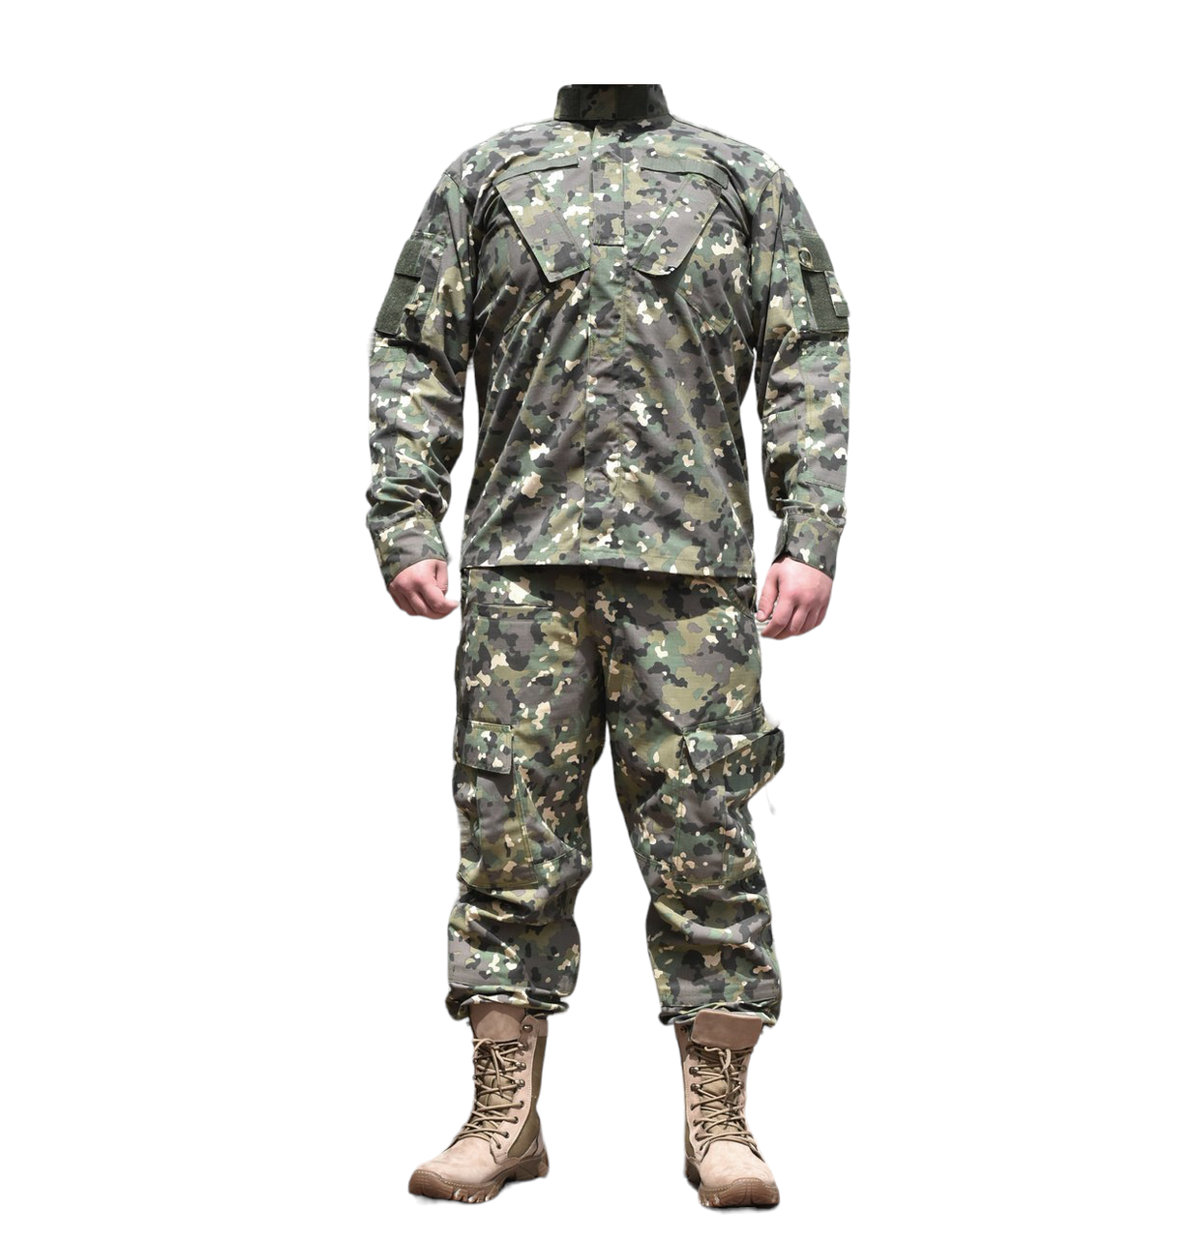
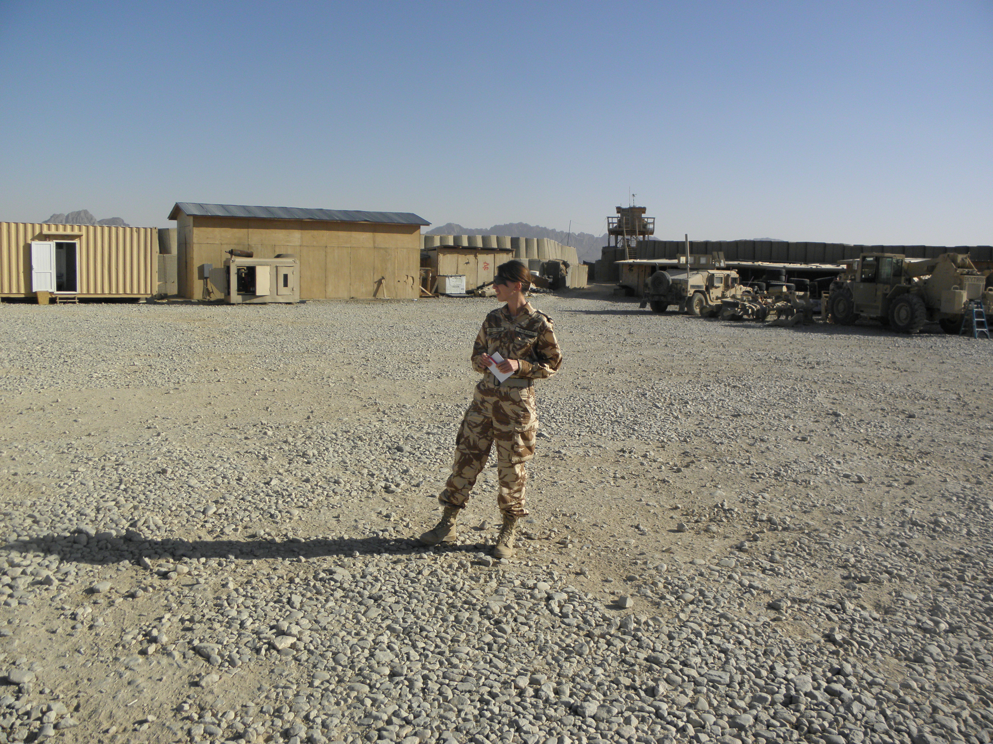
Military Supply Chains

Slide 8
Causes
Shortfalls
Possible effects
Logistical challenges
Shortages of critical materials
Affected readiness
Disruptions
Changing battlefield conditions
Demand variability
Logistical inefficiencies
Transportation & distribution coordination
Delayed information
Personnel training
Wasted resources
Increased costs
Limited visibility & transparency
Resource Constraints
Route obstructions

Slide 9
Resilience &
Agility of
Military Supply Chains

Slide 10
Resilience in a military supply chain refers to the ability to anticipate, respond to, and recover from disruptions while maintaining operational continuity.
Visibility
Flexibility
Collaboration
RESILIENCE
„Carol I” National Defence University

Slide 11
The military supply chain's ability to respond swiftly to changes and demands in operational circumstances proves agility.
Real-time data analysis
Effective communication
Interoperability
AGILITY
„Carol I” National Defence University

Slide 12
Technologies in military supply chains
AI
predictive analytics
decision-making
forecast demand
Internet of Things
supplies tracking
live data on inventory levels
predictive maintenance
Blockchain
transparency
security
integrity
Robotic systems
enhance efficiency
reduce labour costs
safety of personnel
Notes:
AI, the Internet of Things (IoT), blockchain, or robotics

Slide 14
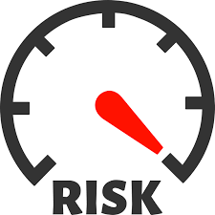
CYBER RISKS
Delivery of false or counterfeit
IT solutions
Insertion of false or counterfeit software and hardware components
Unauthorized production
Cyber espionage
Fraudulent manipulation of
software and hardware products
Unintentional compromises of computer systems and networks
Notes:
Delivery of false or counterfeit IT solutions;
b) Unauthorized production;
c) Fraudulent manipulation of software and hardware products, as well as computer systems and networks;
d) Insertion of false or counterfeit software and hardware components;
e) Software and hardware services that are dangerous for operation;
f) Cyber espionage;
g) Unintentional compromises of computer systems and networks;
h) Deficient manufacturing practices and development of software and hardware products.

Slide 15
2024 Supply Chain Innovation Award

Slide 16
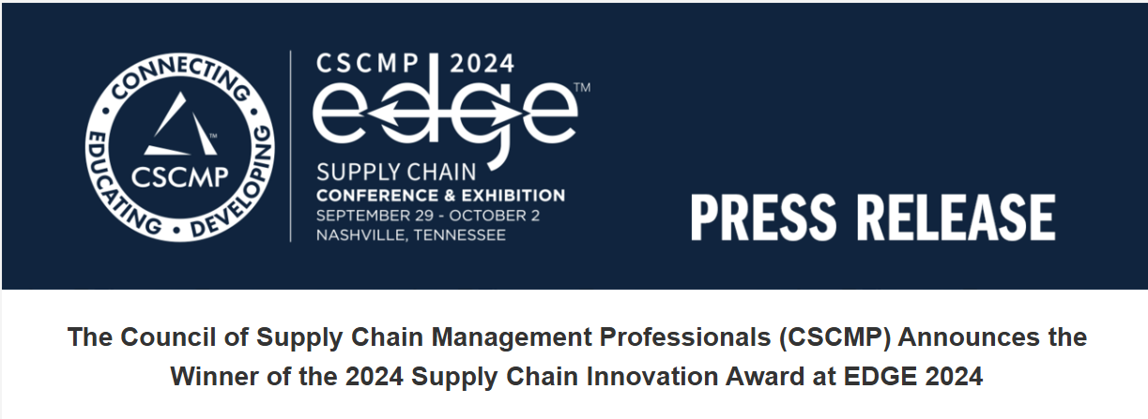

Slide 17
Benefits for military SCM
Fast tracking of military shipments
Predict congestion
AI
Enhances demand forecasting and inventory management
Enabling the seamless flow of operations
IoT and blockchain
Facilitate real-time tracking, transparency, and sustainability
Improve stakeholder collaboration

Slide 18
THANK YOU !

