Slide 1
Additive Manufacturing
A Key Enabler Of Low-Cost Modern Warfare (?)
Wolfgang Mueller/
German Institute for Defense and Strategic Studies
Sergej Sumlenny/
Managing Director United Unmanned Systems

Slide 2


Challenge
At least 2 million drones are being produced per year just by Ukraine alone
→mass production
You can‘t produce
them for the shelf:
Technology and roles
are changing too fast
→ high adaptability

Slide 3
Question
What insights can we get from the experience in the Ukraine for the production of drones in peace time?
What are the opportunities and restrictions using modern production methods like Additive Manufacturing in this process?

Slide 4
Experiences
Steady increase in the number of drones with no end in sight
usage rate of one-time- compared to multiple-time-use-drones is increasing
perception of a drone as a carrier/ shifts to – low cost – ammunition
cost of drones is degressive, but will most likely cap in the near → cost per unit still an issue
shift from off-the-shelf to tailor made for specific needs drones (regarding landscape, EW environment, weather)
increasing variability both with regards to their roles and the technical modifications
majority of drones can be produced at ordinary workshops with parts from the global market

Slide 5
Experiences
production has shifted from industry level to grass-roots level (garage solutions)
production happens on a trial-and-error basis with regular and timely feedback loops established between producing industry and the military
use of AI is still at a very early stage, but constantly new features (fibre optic, optical recognition, fake AI)
cost-benefit ratio/ cost-per-kill ratio extremely good/ “hit or fall”/ every target is worth killing
Specific drone units are now found often at company-, at least at bataillion-level → decentralized large scale adaptation must be possible (last mile)
30-50% of drones on average will be lost

Slide 6
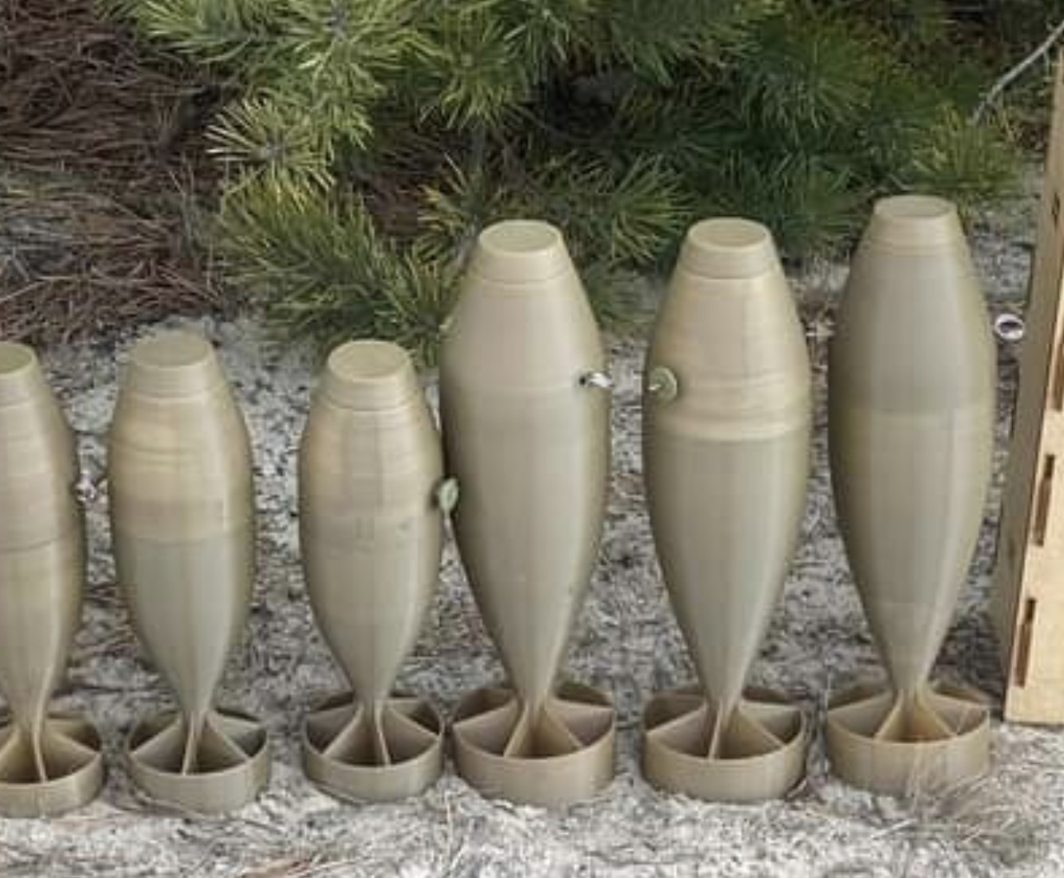
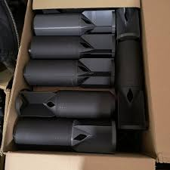
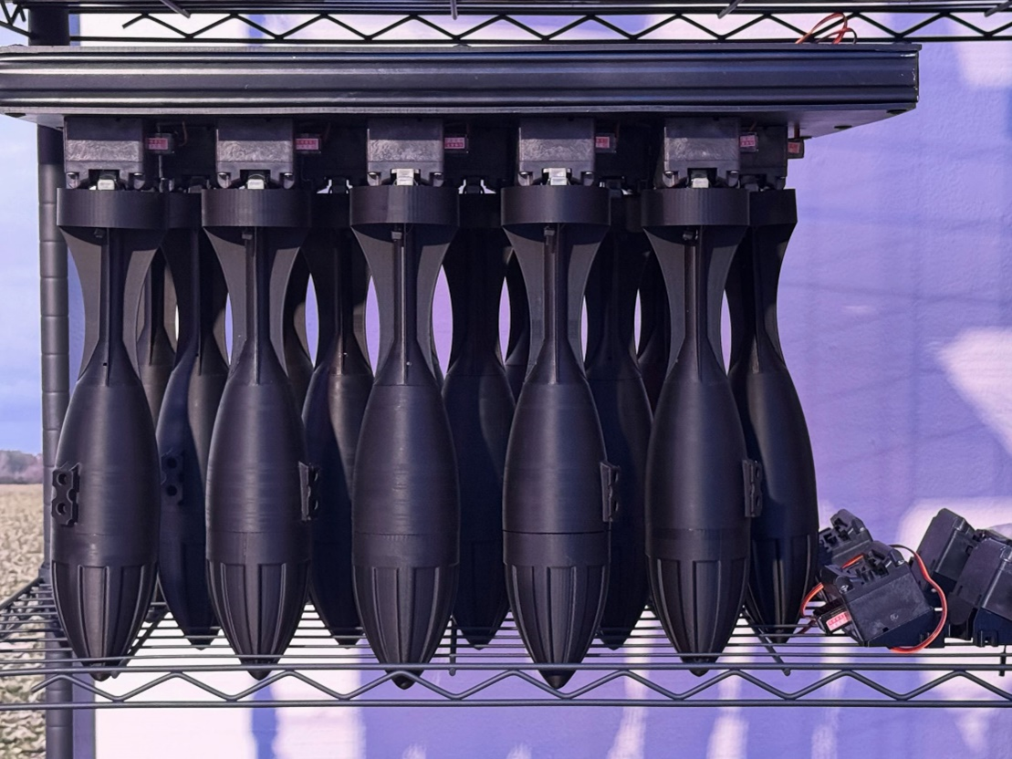
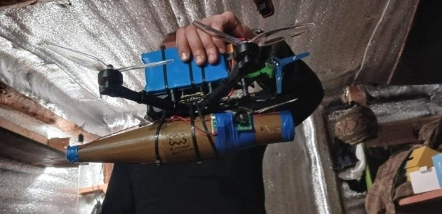
Last Mile
- Army made IEDs -

Slide 7
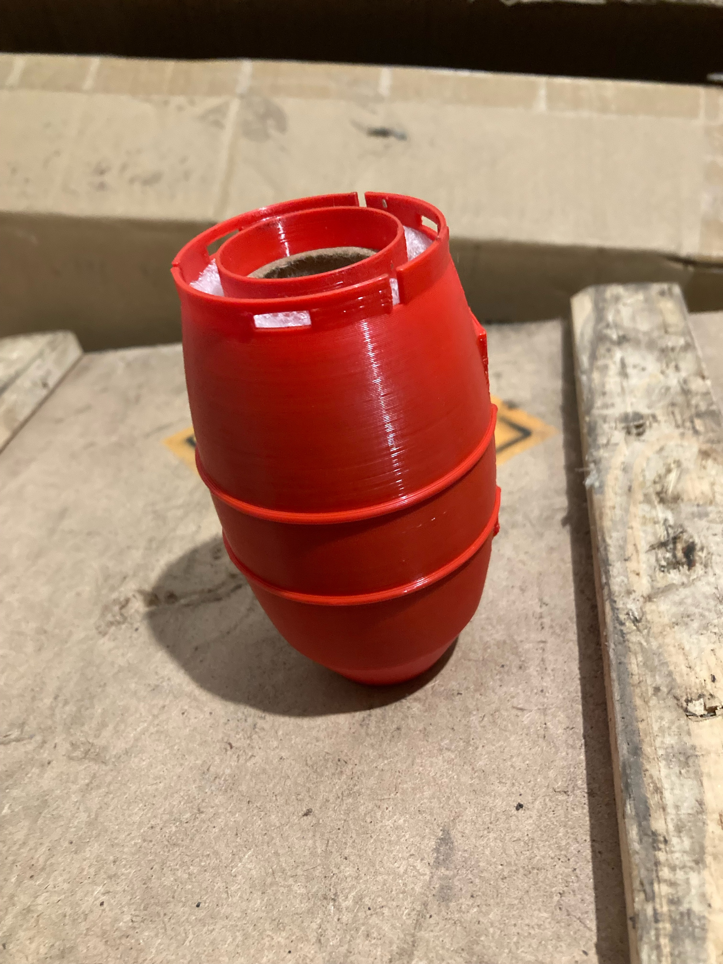
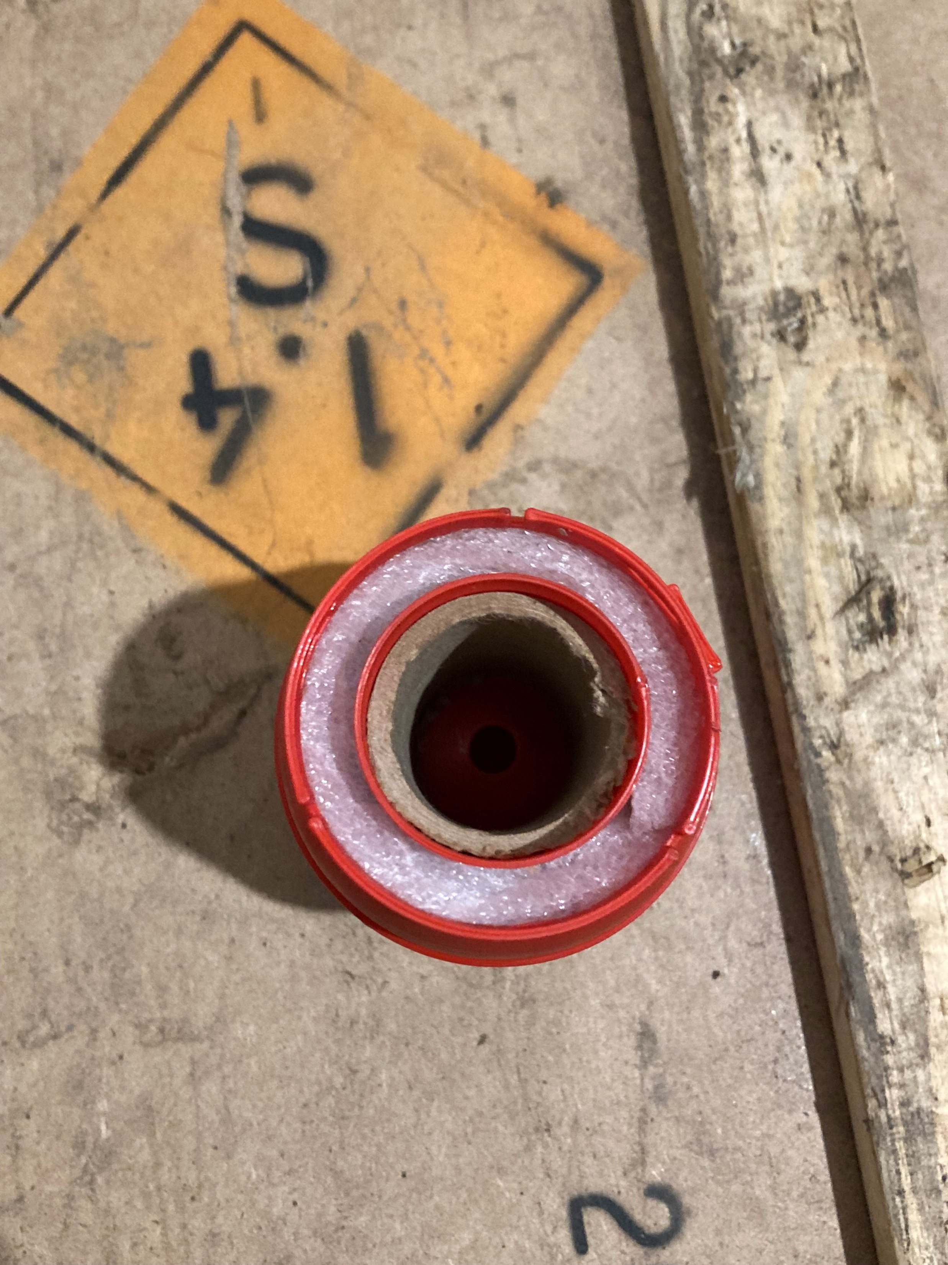
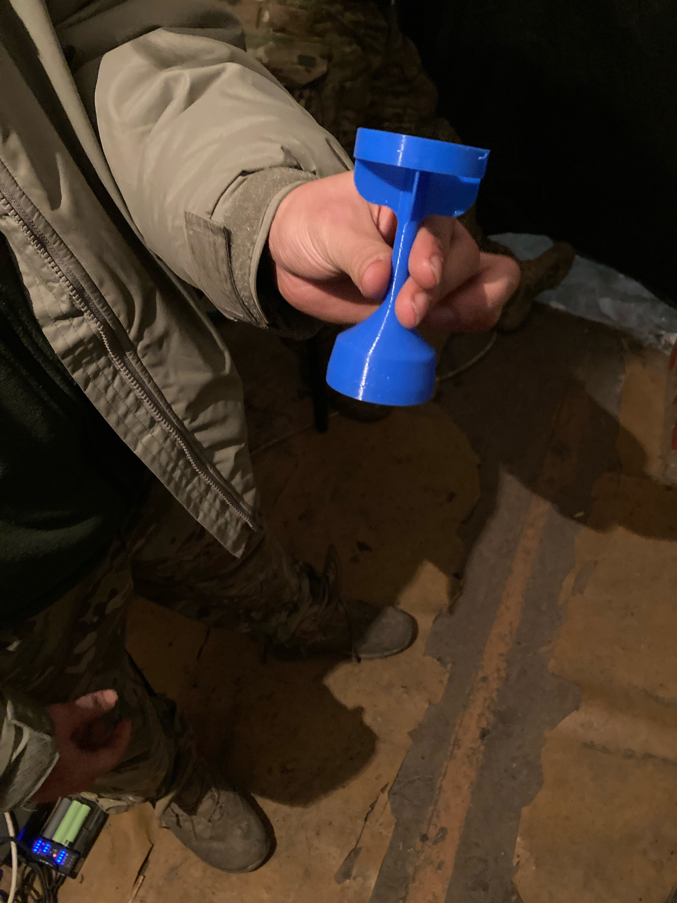
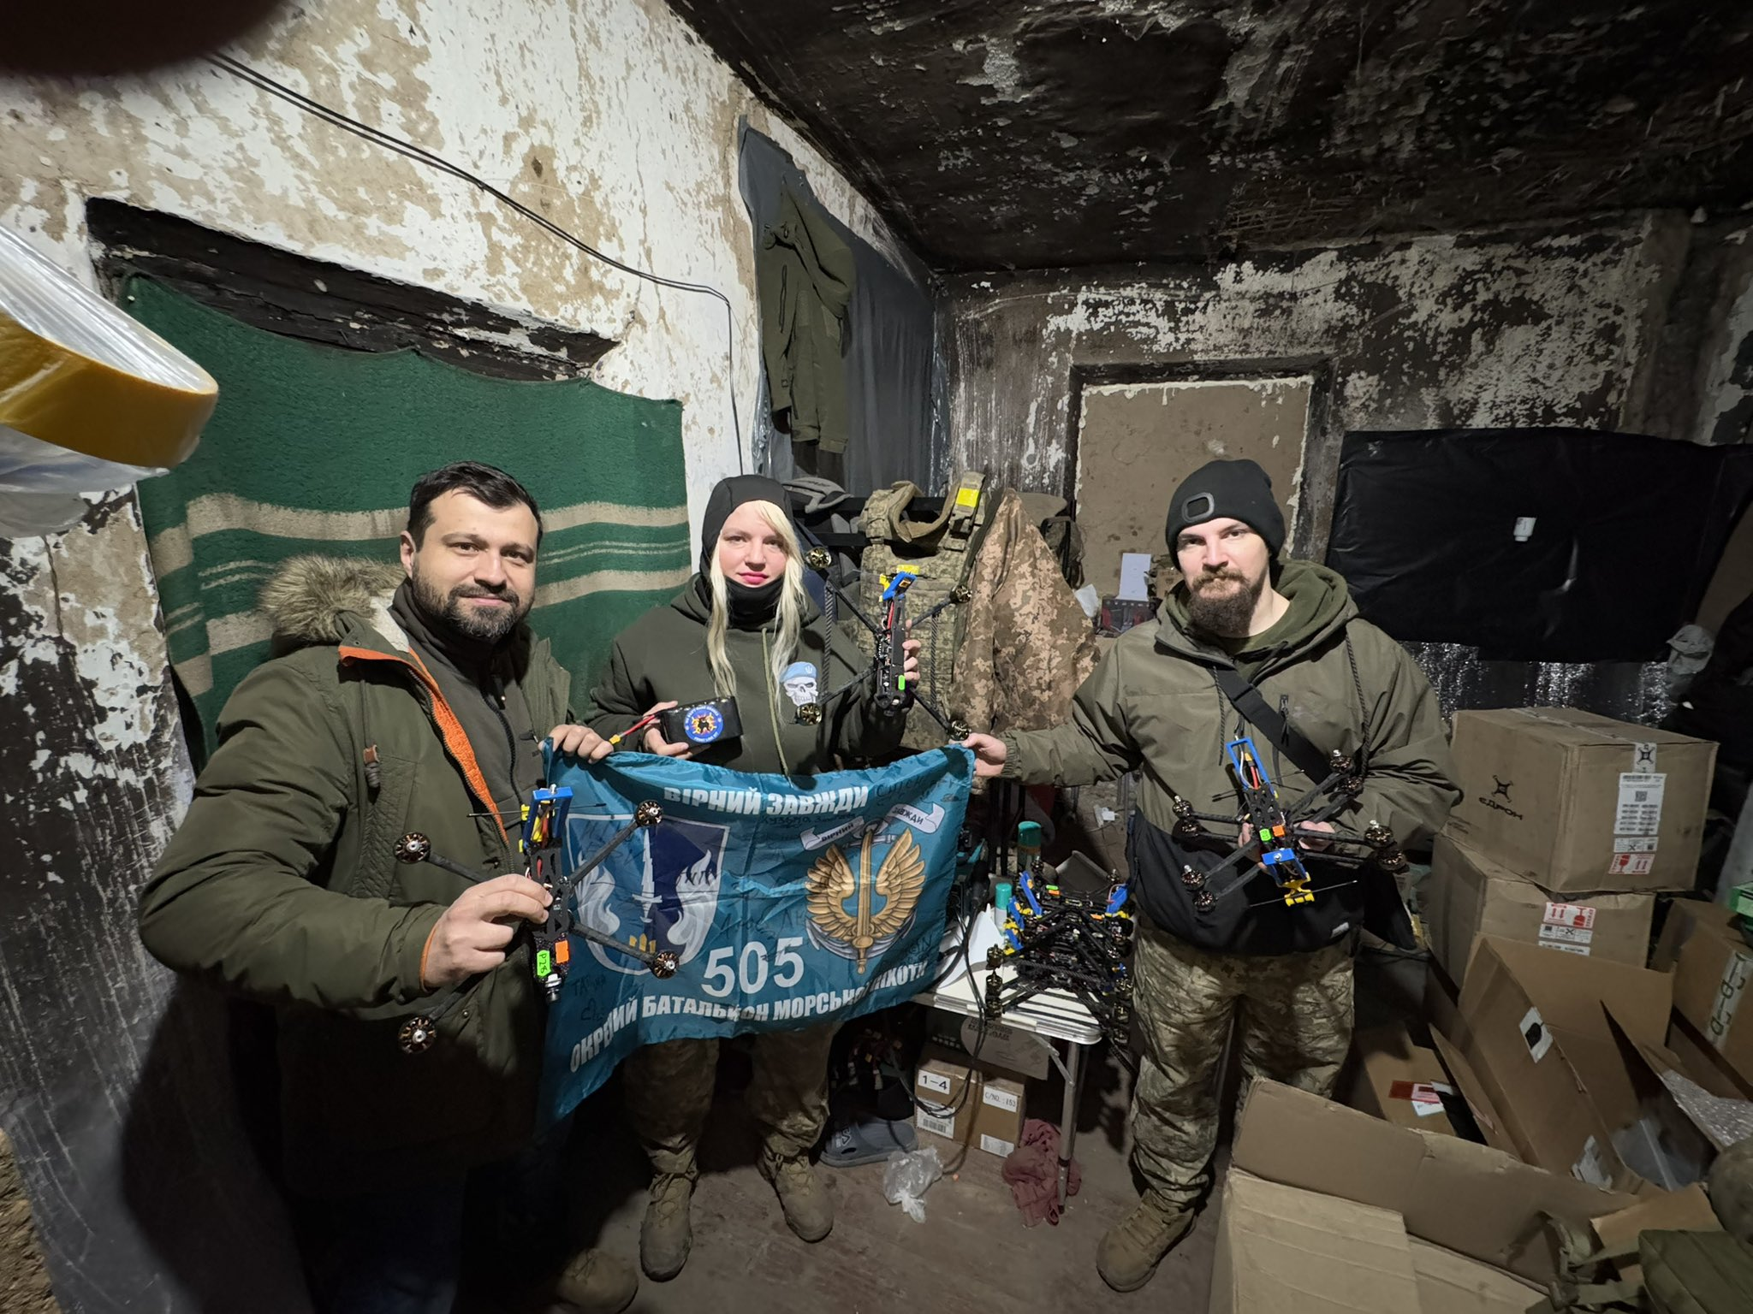
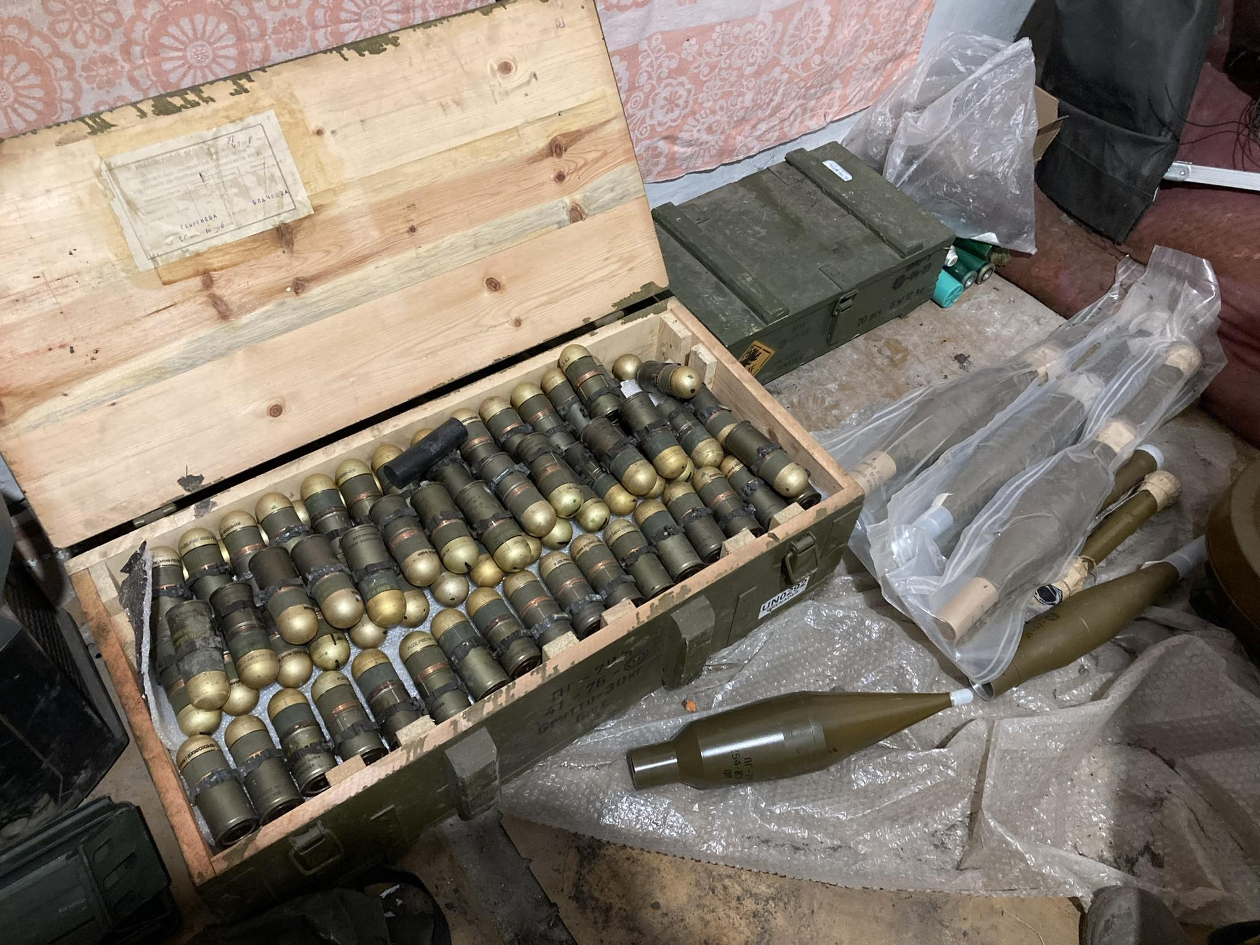
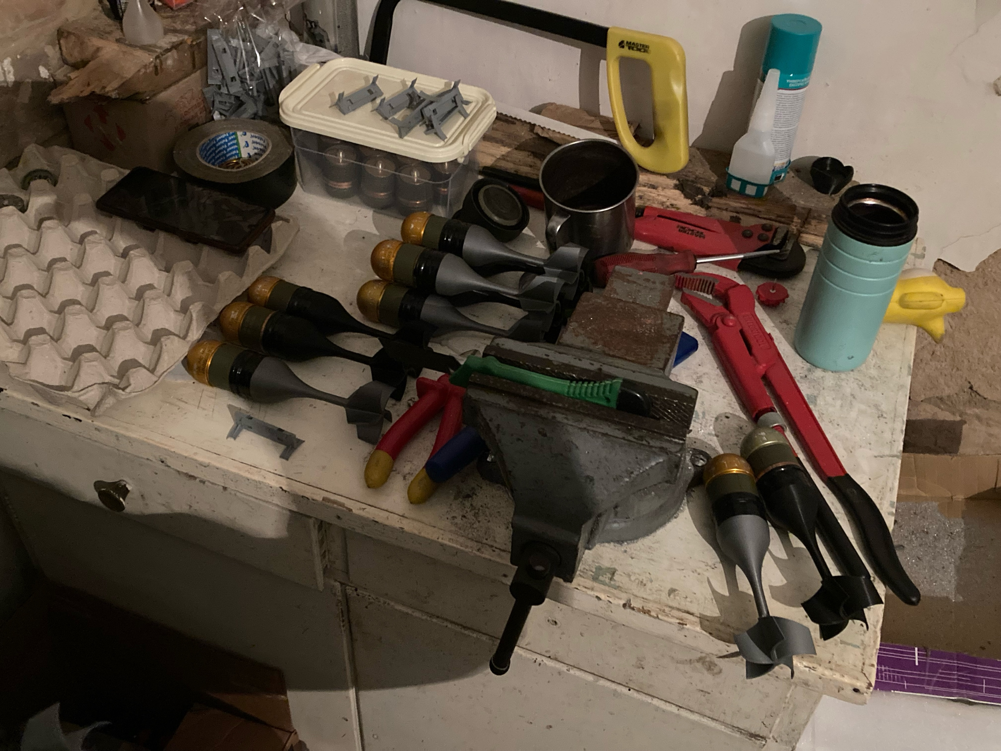
Last Mile
- Army made IEDs -

Slide 8
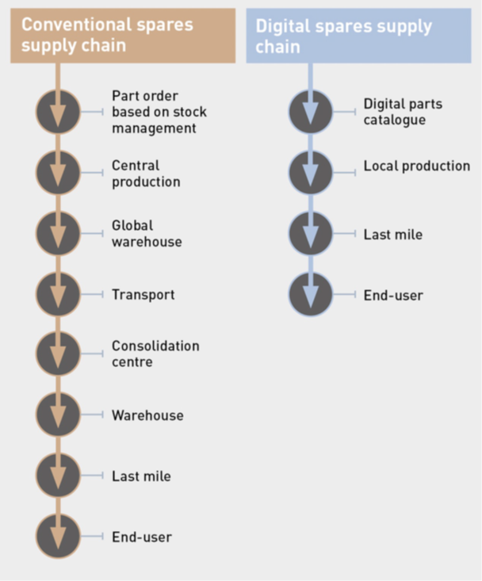
Advantages
customized production
reduction in resources (time, material)
potential for a lights-out production line
multiple parts of different size can be produced in one production cycle
ready to be used in difficult conditions

Slide 9
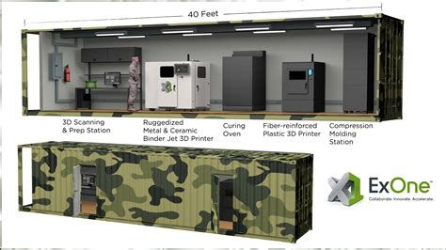
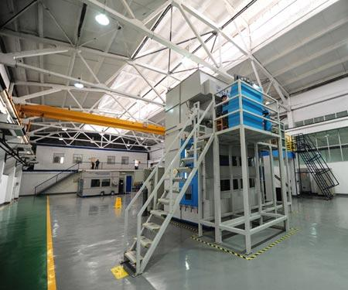
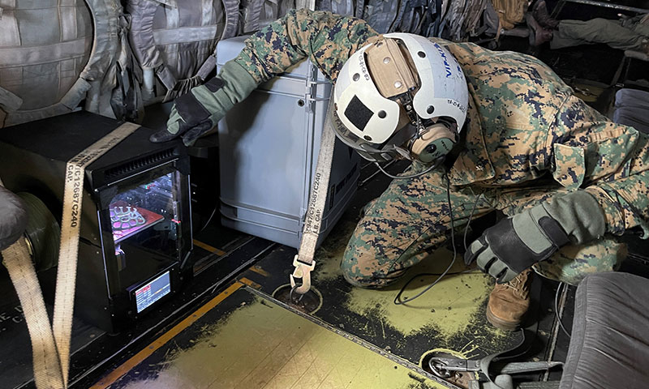

Slide 10
Conclusions
vital parts of drones (flight controller, batteries, cameras, motors) cannot be produced cost-efficiently through AM
on the other side, only AM is able to realize quality optimization through decentralized adaptation
strategic stock taking of vital parts necessary (treated as ammunition)
in mid term, production of vital parts should be introduced and located domestically
until then, production capacities in the Ukraine can be used

