Slide 1
Enhancing Battlefield Observation
With Imitation Learning And Digital Twin-Based Model Training
Kefalakis Michail, PhD Candidate
Earth Observation Technical Assistant, Planetek Hellas
Dr. Nikolaos V. Karadimas, Department of Mathematics and Engineering Sciences
Associate Professor, Hellenic Army Academy
Notes:
Greetings everyone, my name is Michalis Kefalakis. I am a PhD candidate in Digital Twins, Wargames and Earth Observation Strategies in the Hellenic Army Academy. I am also an Earth Observation Technical Assistant for Planetek Hellas.
First of all I would like to thank the TMAF academy for the organization, the invitation and personally Colonel Moser for his availability for assistance.
This presentation “ Enhancing Battlefield Observation With Imitation Learning And Digital Twin-Based Model Training was coauthored with, Dr. Nikolaos Karadimas, Associate Professor of the department of Military Sciences in the Hellenic Army Academy. So lets begin.

Slide 2
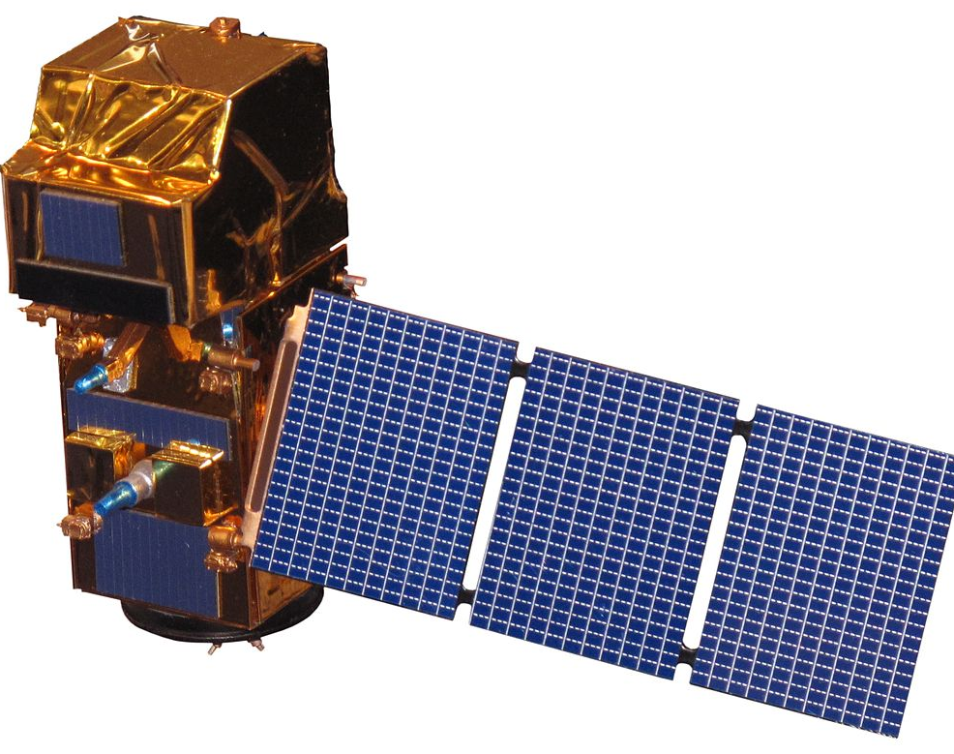
BATTLEFIELD OBSERVATION
Notes:
Is battlefield observation a new concept? Actually, no. Battlefield observation has been a critical aspect of military strategy since ancient times, providing vital information for decision-making in military endeavours.
One of the most common approaches was to gather intelligence by observing the battlefield from elevated positions, such as cliffs or other high vantage points, allowing for a comprehensive view of the area of interest.
Fast forward to the present day, and battlefield observation remains just as crucial for gaining insights. Still, the methods and tools have evolved to provide quicker responses and enhanced predictive capabilities.
In recent conflicts, Satellite Remote Sensing,(observing the Earth from space) methods have become integral for surveillance and reconnaissance, transforming terrain data into actionable insights for military decision-making.

Slide 3
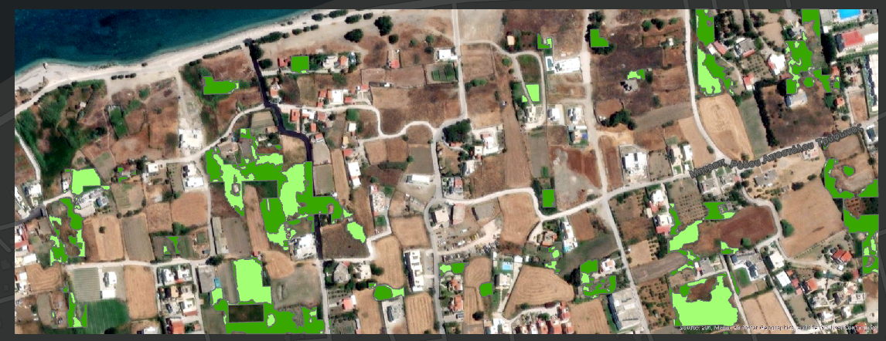
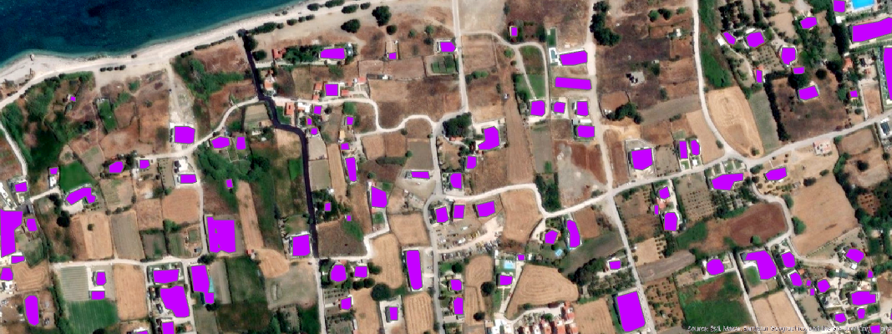
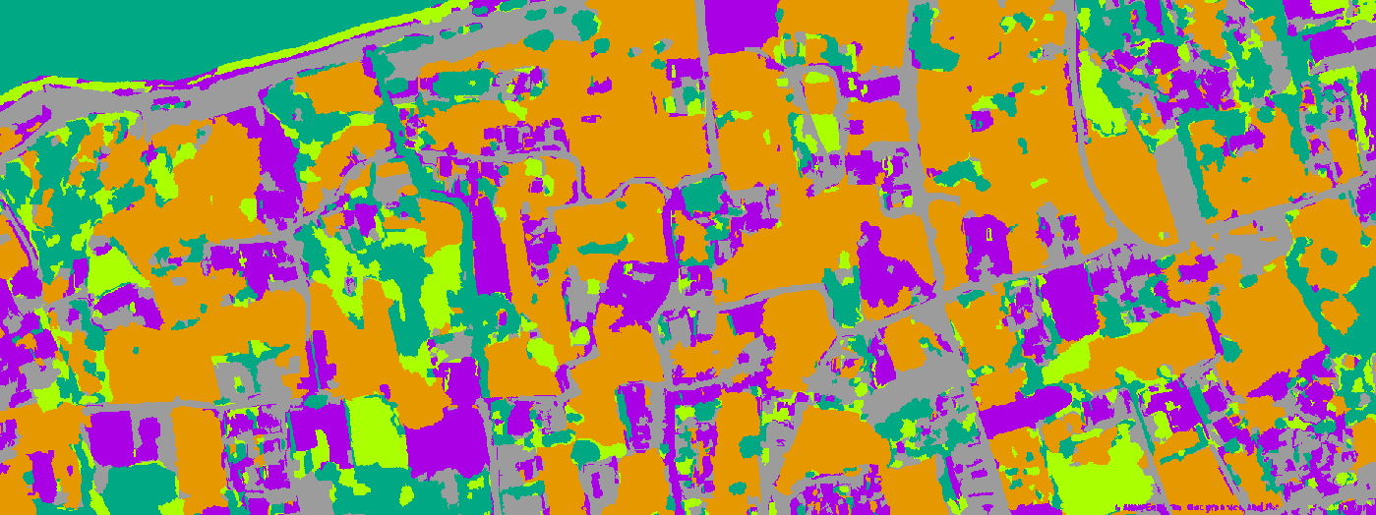
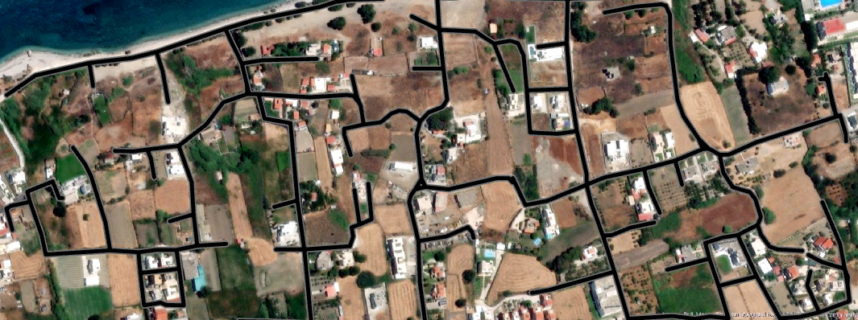
CONCEPTUALIZING A BATTLEFIELD DIGITAL TWIN
Notes:
The military is known for gathering intel from topographic maps.
Right now, battlespace maps are usually shown on paper topographic maps or digital maps in command-and-control systems. It can take several years just to fully update one set of maps, like those at a 1:50,000 scale.
Satellite images are sometimes used, but they usually only show small areas and aren’t updated often.
Satellite images from private companies also come in slowly and at irregular times.
But the battlespace is constantly changing—because of people, changes in land and vegetation, or shifting soil and ground conditions. These changes need to be captured and shown within days, especially during a real conflict.
This gap shows a serious problem: the way we currently see and understand the battlespace is outdated. It doesn't keep up with the fast-changing reality on the ground, even though modern technology could help us do much better.

Slide 4
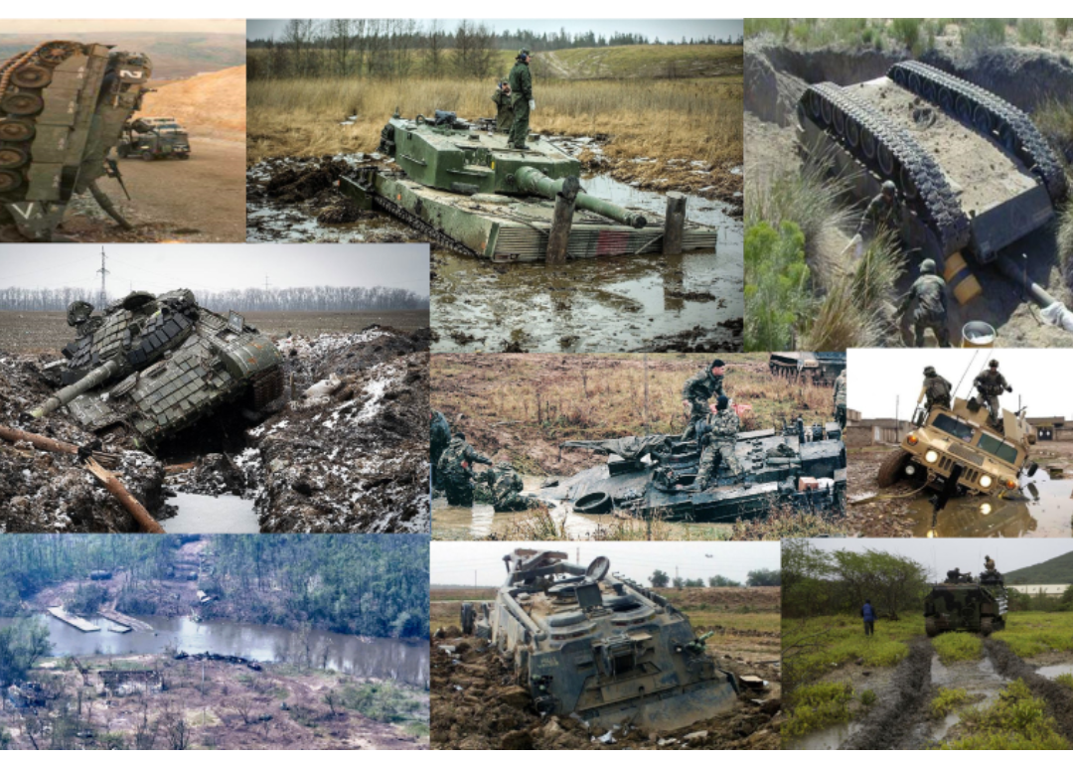
NECESSITY OF A BATTLEFIELD DIGITAL TWIN
Notes:
Is a battlefield digital twin though a necessity? Unfortunately, the images speak for themselves.
Geospatial information is the foundation for all systems that use mission data and supports many decisions in the field.
If this information isn’t consistent, those decisions can be at risk.
That’s why it’s crucial to keep track of the changing situation in the battlespace all year round. This helps spot trends and assess military scenarios and plans.

Slide 5
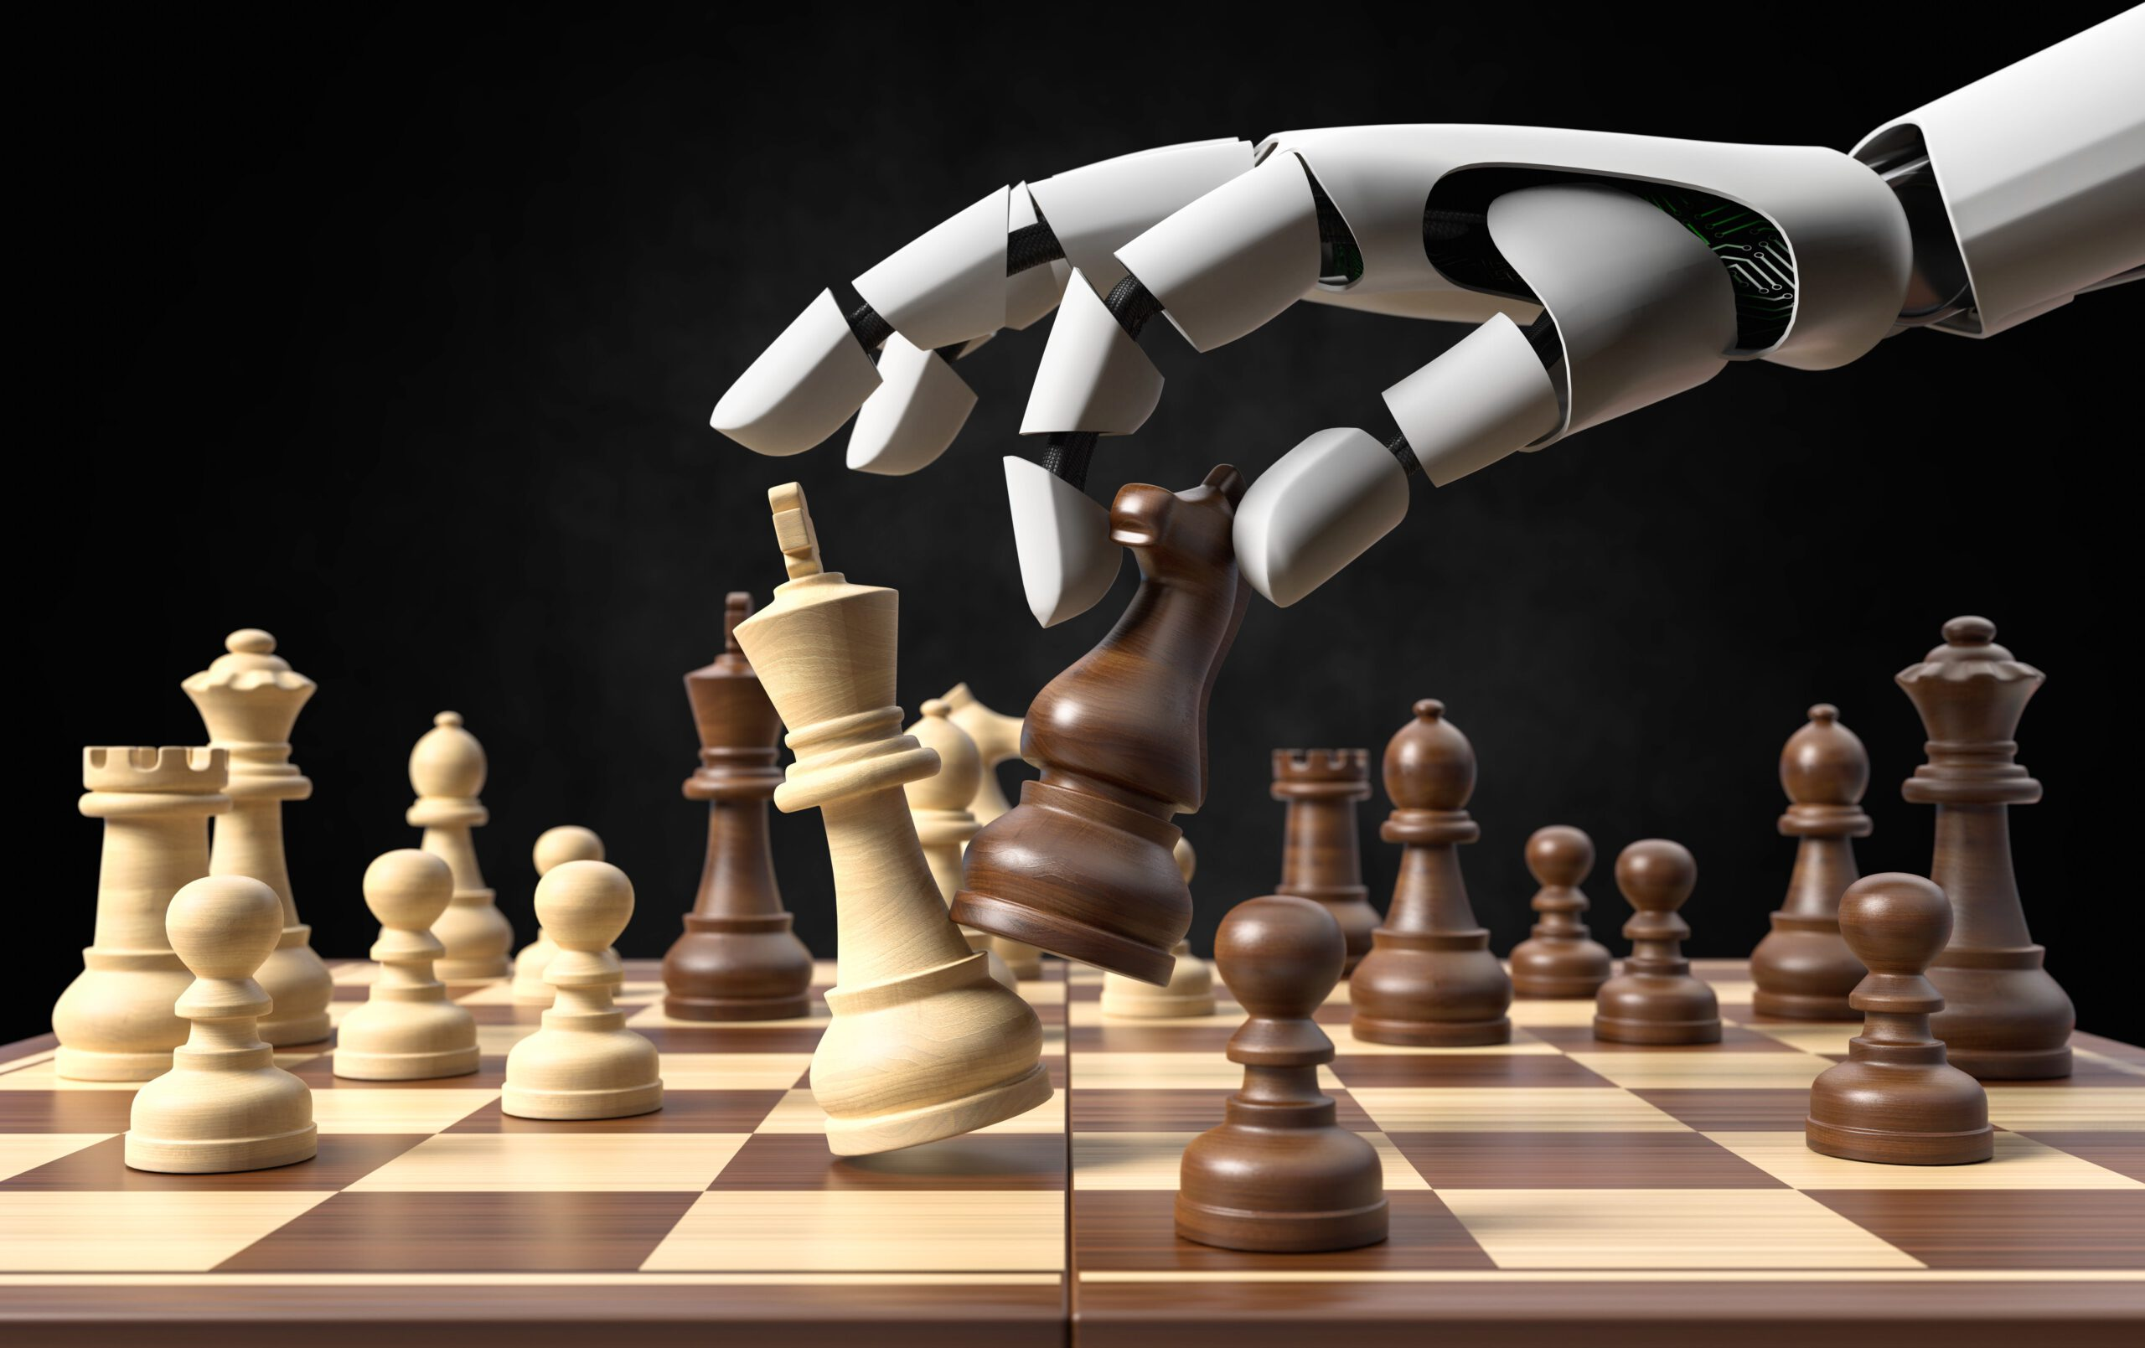
IMITATION LEARNING
Notes:
On the other hand, imitation learning represents a distinct field within artificial intelligence, primarily focused on mimicking human behaviour.
Initially popularised in the realm of entertainment games, such as chess, to create AI opponents, imitation learning has been largely overlooked in other scientific disciplines.
However, as mentioned before the battlefield is inherently dynamic, with strategies often shaped by human-level decision-making.
So what intrigues as about the merging of those two fields is that by capturing various human strategies in different battlefield conditions, imitation learning can be leveraged to create tailored synthetic data through battlefield simulations

Slide 6
PURPOSE
Data driven simulations
Personel training
Machine learning model development
Notes:
Combining these technologies could create dynamic, real-world, data-driven simulations for military applications.
This would provide a powerful tool for generating synthetic data that can be utilised across various applications, including training, machine learning model development, and decision-making.

Slide 7
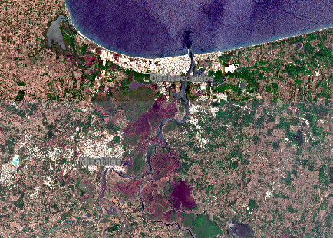
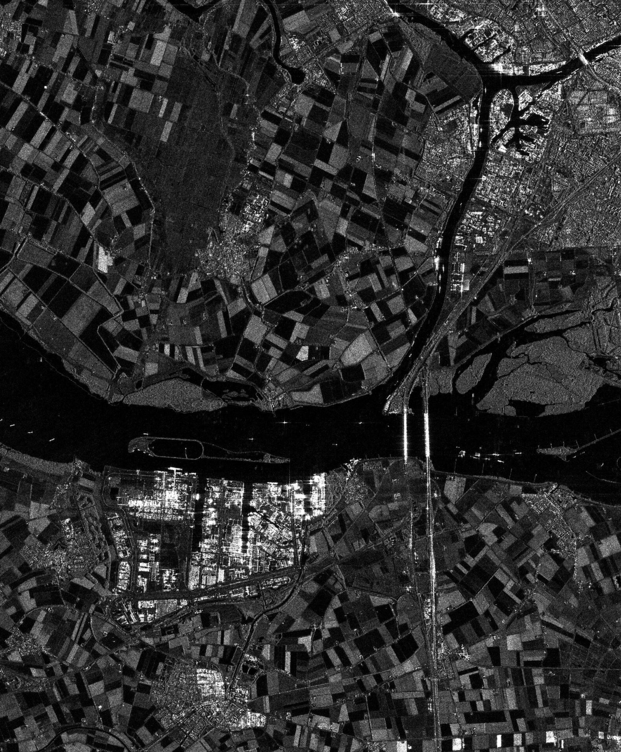
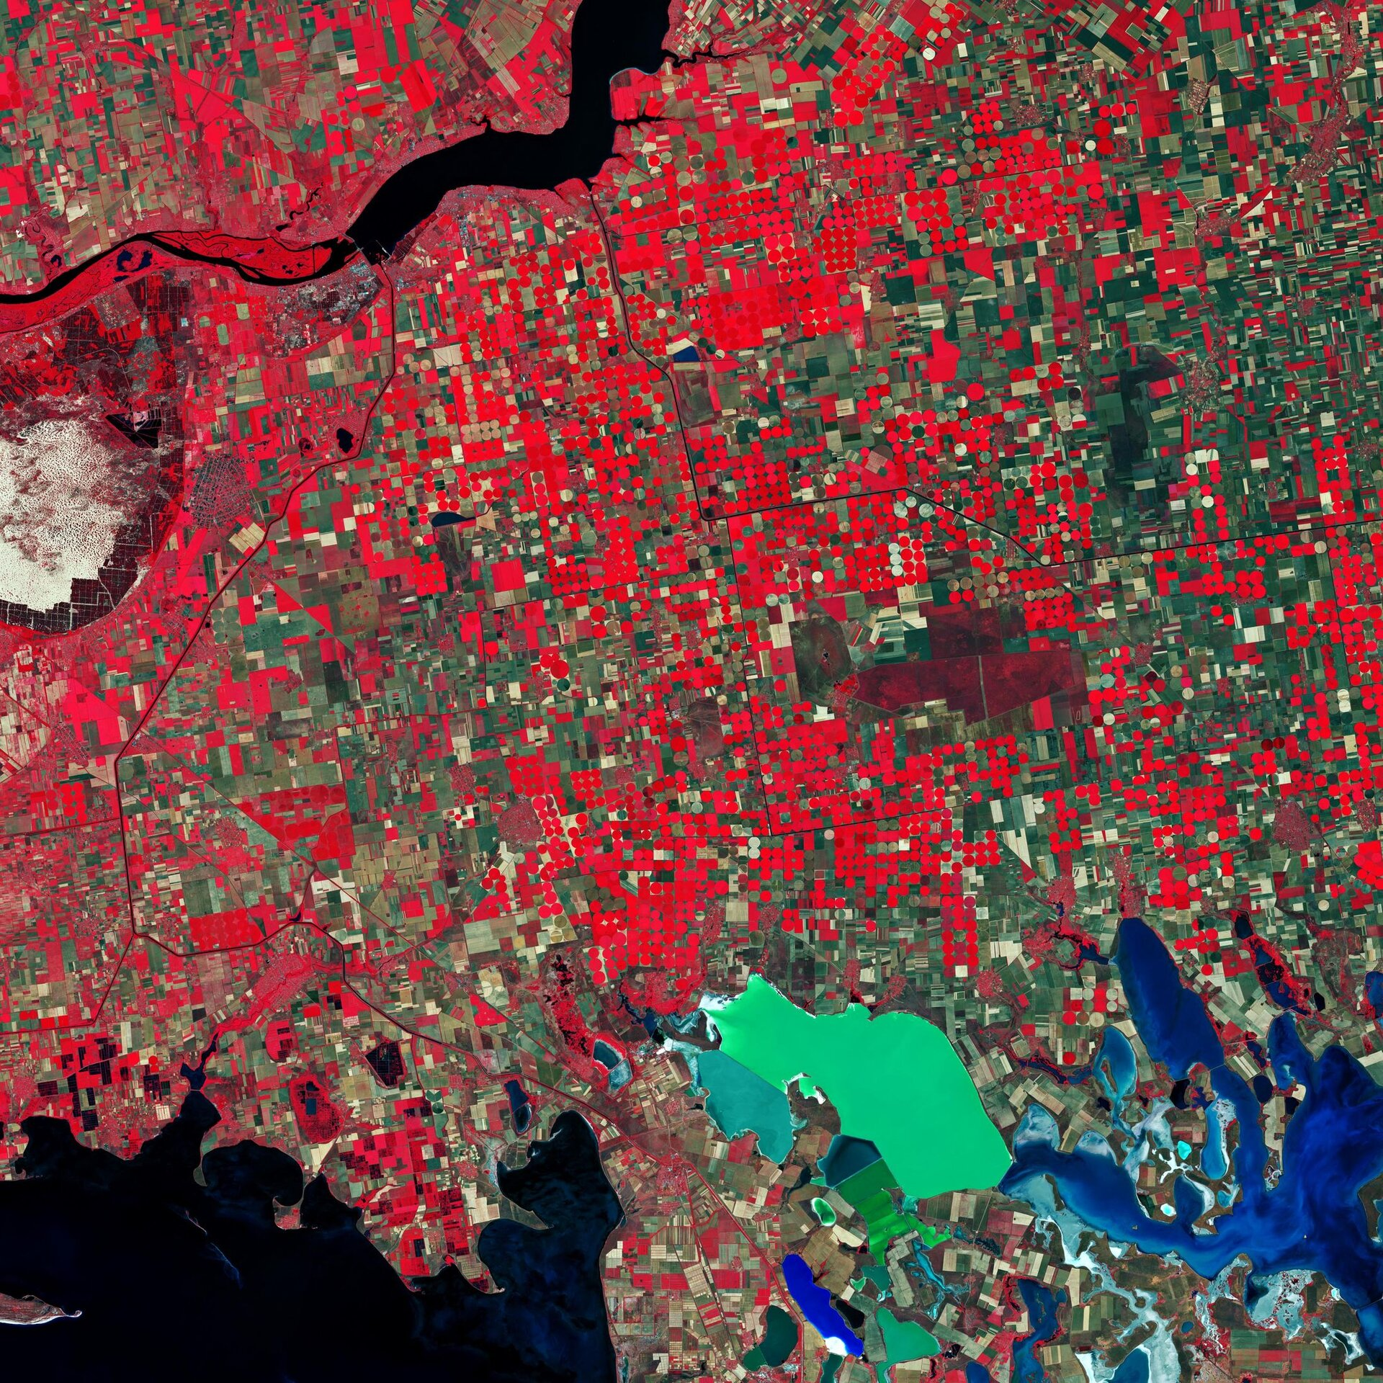
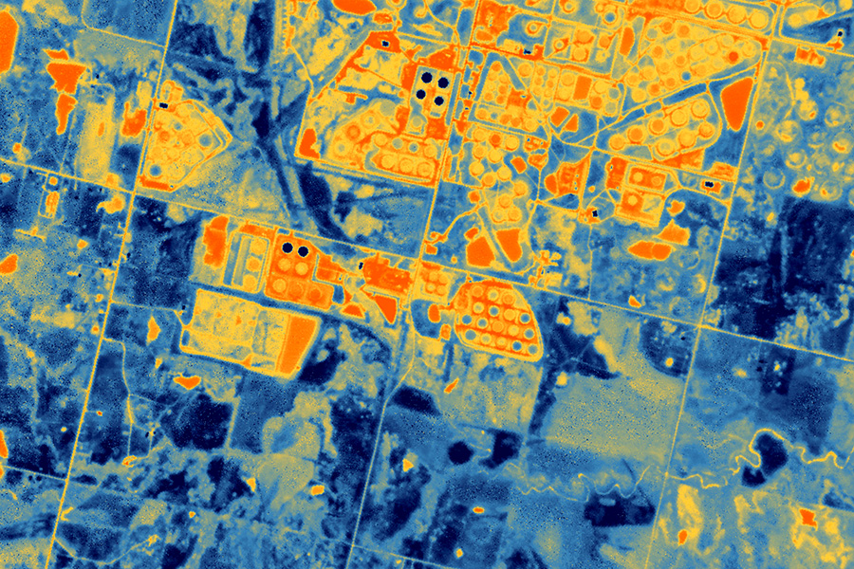
SATELLITE IMAGERY DATA
Notes:
Satellite Data can come in a variety of forms depending on the type of sensor and their resolution.
Each sensor has its strength and weaknesses in certain applications, and combining them can provide infused insights.
Sentinel-2 data is crucial in land cover estimation, particularly in gathering remote sensing indices related to vegetation.
Vegetation cover is an essential factor in military decision-making, as it directly impacts the movement of units, ground permeability, and the ability to conceal movements or assets.
In the context of Synthetic Aperture Radar (SAR) imagery, Sentinel-1 can effectively monitor and assess soil moisture levels, which are crucial for understanding terrain conditions that impact military operations. Soil moisture plays a significant role in military activities, as it can hinder the movement of personnel and vehicles and contribute to the failure of various types of equipment. However, directly assessing soil moisture using remote sensing techniques can be challenging due to the complex interactions between radar signals and soil properties.
Monitoring population displacement and urban expansion is critical as urban areas significantly impact military operations. Additionally, the timely detection of insurgent base construction is essential for strategic planning. Sentinel-1 data were obtained from the Copernicus Open Access Hub to support this. The Sentinel-1 product used for this analysis featured dual polarisation, specifically HV and VV polarisations. The VV polarisation is particularly effective in urban footprint estimation, as it efficiently captures backscatter from flat surfaces, making it suitable for identifying urban areas.

Slide 8
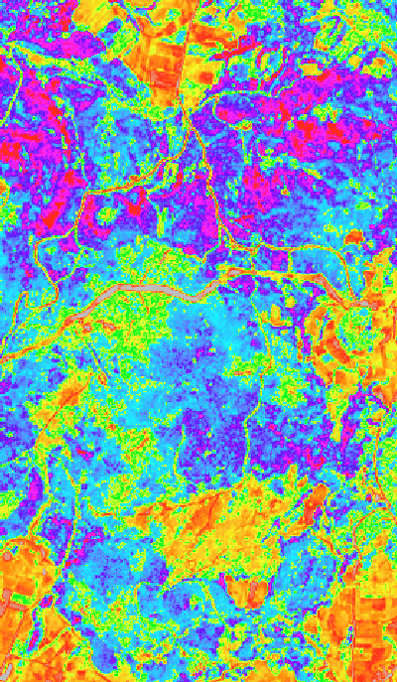
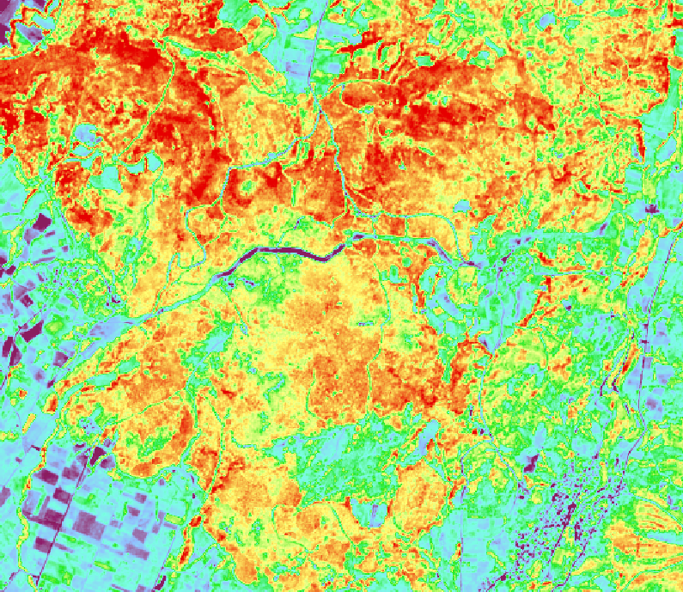
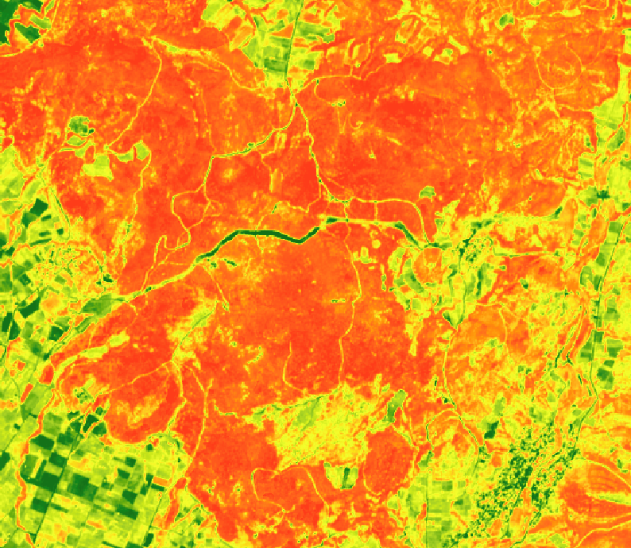
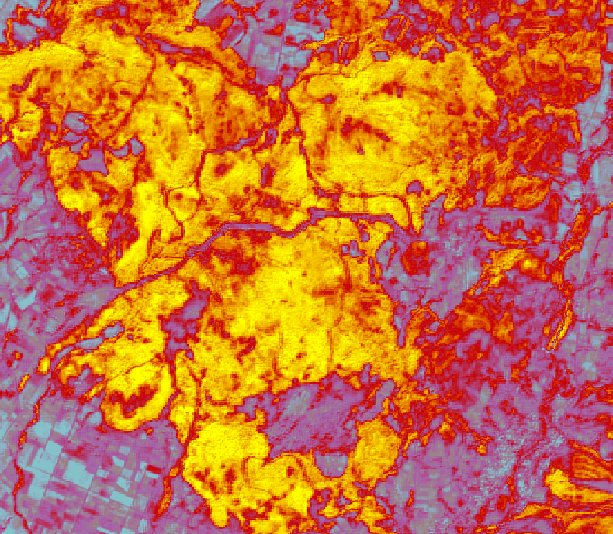
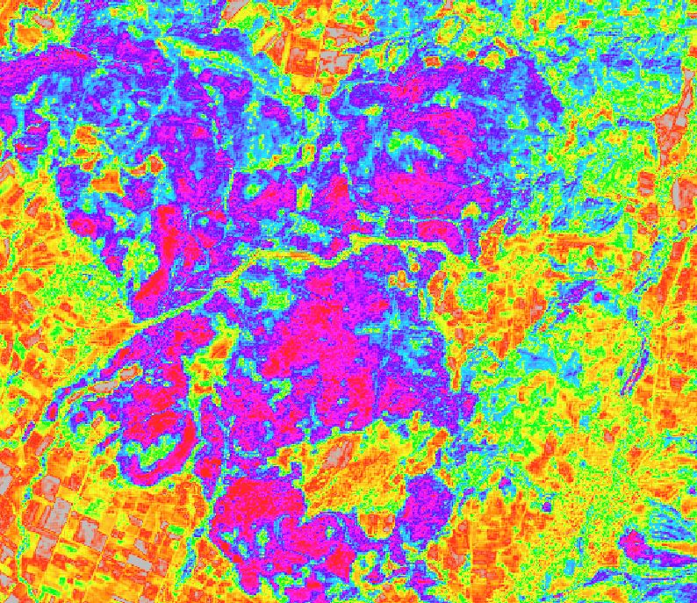
Notes:
A problem that we faced with satellite data, was the inexistence of datasets that represent the ground truth for our landcover.
How can we be able to correlate pixel information with land cover when there is no ground truth to verify.
To address the issue the Coppernicus High Resolution Layers were used to correlate with remote sensing indices,
ensuring that the Digital Twin remains continuously updated with current information
However, these products are not provided at frequent intervals; instead, they are typically released on a yearly basis or at longer intervals, which limits their applicability for monitoring changes over shorter periods.
A model was developed to address this limitation using the Copernicus Access Hub's High-Resolution Layers as ground truth and Vegetation Indices as input data. As mentioned, vegetation and other entities have different spectral identities at various times, so collecting input data from different time points is crucial.
The OpenEO API was utilised to gather mean values for the pixels within the Area of Interest over a two-year interval. This approach enables more representative spectral identities over time, accurately reflecting vegetation cover changes.

Slide 9
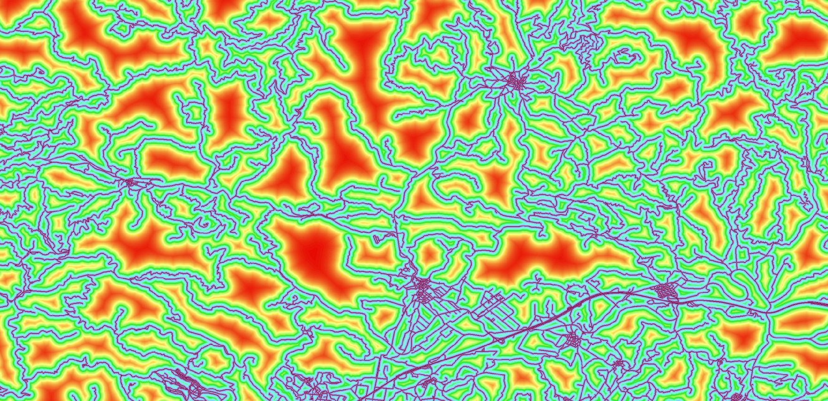
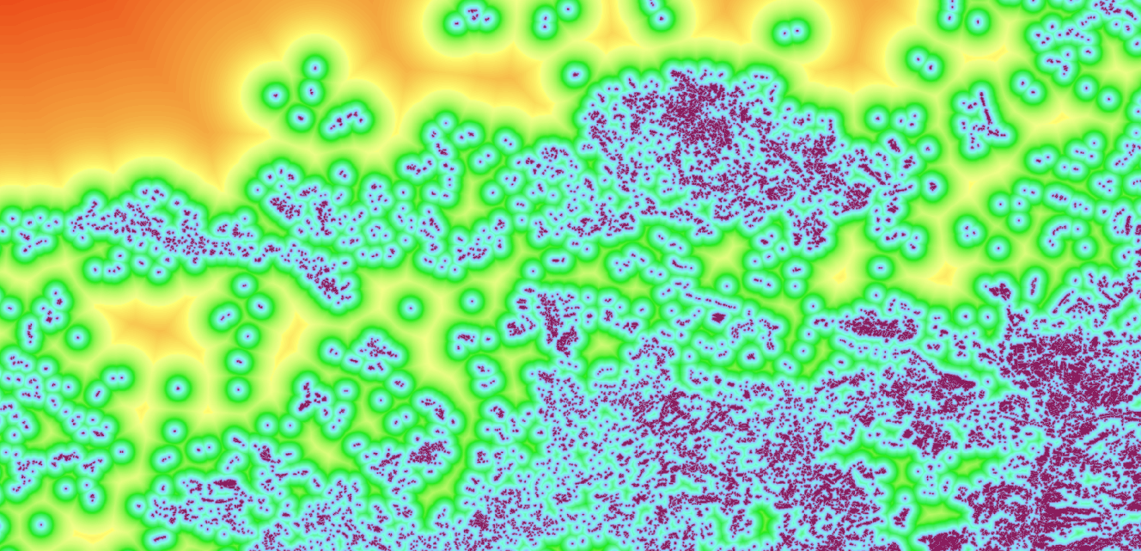
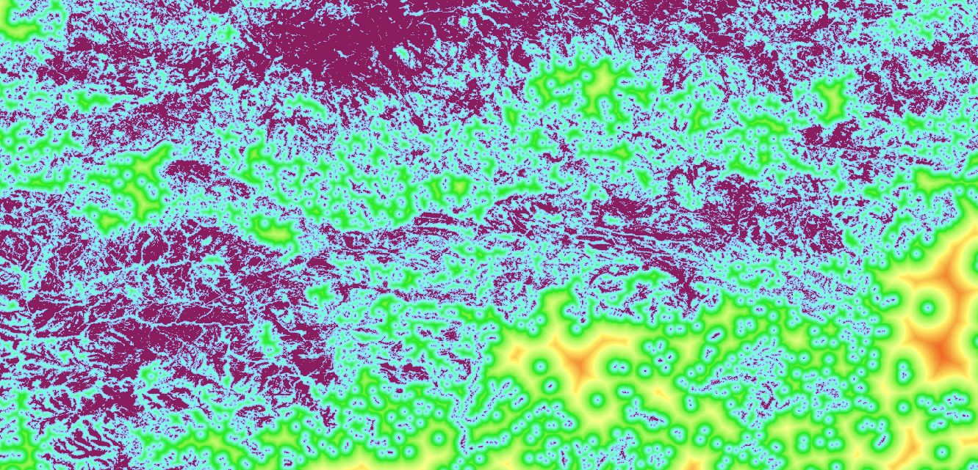
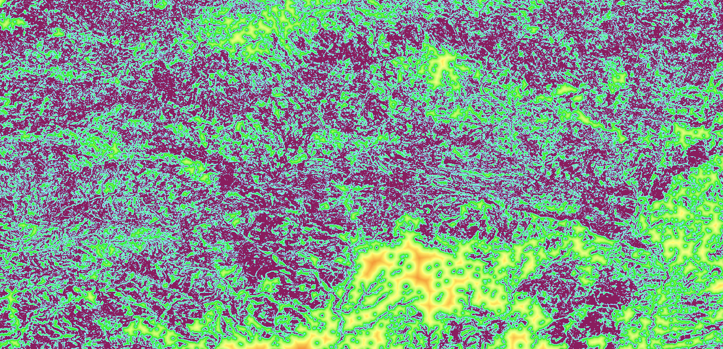
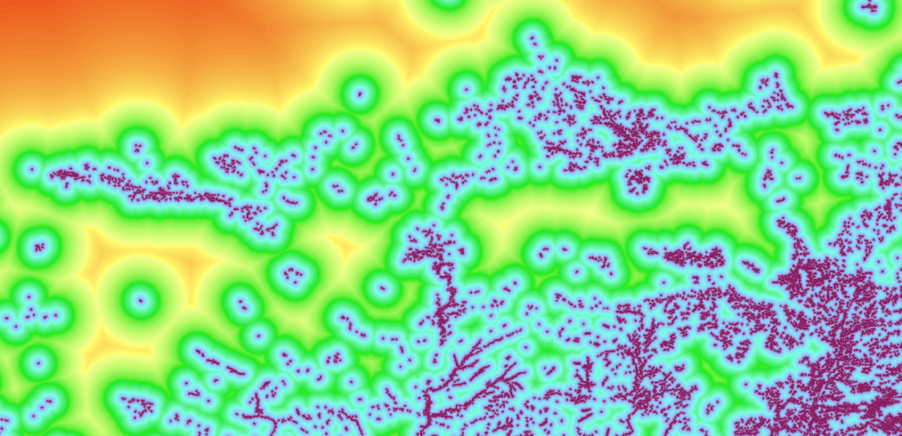
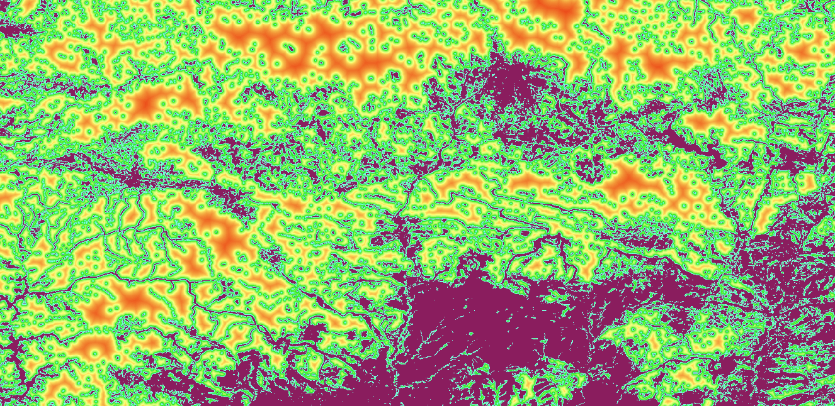
Layers of Information
Notes:
The layers of information we are interested for visualizing the digital twin
are the Tree Density High-Resolution Layer,
Small Woody Features High-Resolution Layer,
and Grassland High-Resolution Layer, roads and urban footprint as these are widely used for military planning to create suitability products.

Slide 10
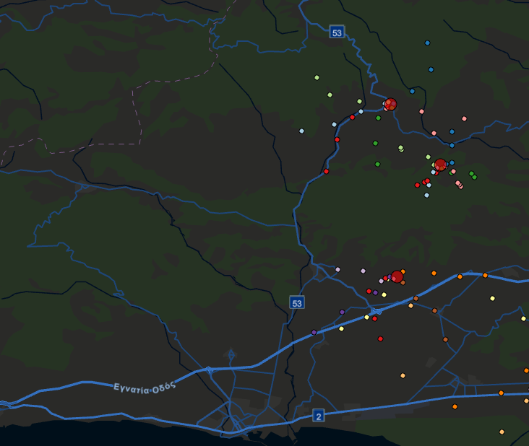
Notes:
The suitability products that were calculated from the previously aforementioned layers of information,
Is movement permeability and cover suitability.
Due to the restrictions on military surveillance data and the licenses required for simulation software, simplified rules were applied to the units in the simulation.
2 strategies were followed.
The first team of units prioritised approaching the target location by seeking concealment areas, while the second team focused on permeability capability.
The Intersect tool in ArcGIS Pro was employed to determine the grid code for each unit's position relative to the concealment and permeability layers, as well as to calculate the distance from the target at each step.
The extracted data was then exported to Excel, where one-hot encoding was applied to the categorical variables.
The continuous variable, distance, was normalised, and the encoded values were scaled to match the same range as the continuous variable for consistency.
A random forest model was then used to mimic the player’s strategy to unseen data.

Slide 11
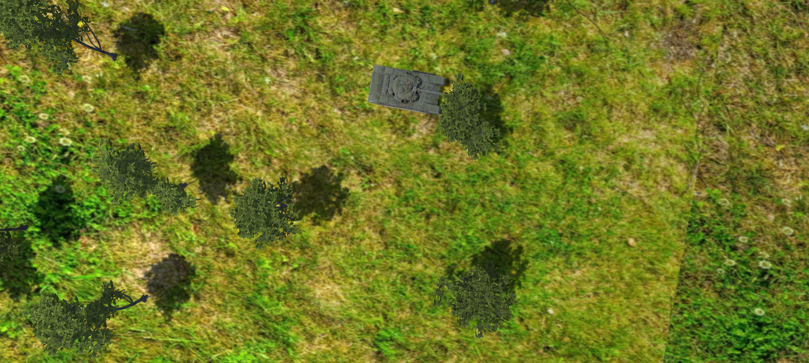
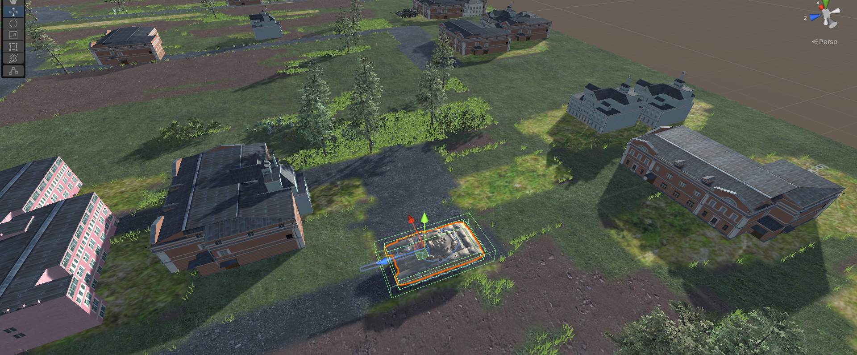
SIMULATION SOFTWARE
Notes:
The Unity Engine was used to simulate the landscape and create a synthetic environment incorporating GIS data.
A Unity simulation program, adapted from previous work, was employed to facilitate this process.
The software reads landscape class data in raster format and, based on the class values, imports corresponding 3D graphics.
These 3D graphics are derived from photogrammetric imagery, ensuring that the environment closely represents reality while also considering the hardware capabilities available for rendering the simulation.
11

Slide 12
RESULTS
Merging of Digital Twins, Imitation Learning and Simulation.
Captured human strategic behavior.
Cost Free approach for updating the digital twin.
Notes:
We managed to integrate three distinct areas that were otherwise separated from each other in an interdisciplinary architecture.
The digital twin can be continuously updated, while enhanced applications through imitation learning can be implemented as models can capture the behavior of the human controller given ofcourse the right parameters. Ofcourse such behaviors are much more complicated and a vast amount of parameters must be discussed with military personel in order to capture this complexity.
What is also promising is that the data retrieved are all from open sources, meaning the creation of the digital twin and its updating is cost-free.

Slide 13
FUTURE WORK
Battlefield behaviour data
Experimentation on Battlefield Simulation Software
Personel Training Assessment
Machine Learning Training
Notes:
The results provide a good sneakpeak to the benefits of the merging of these technologies. So preparation for future work must be done.
Real battlefield behaviour data must be gathered or synthetically created based on real-world engagement rules.
Simulation software will serve as a valuable addition to the development of this research.
More environmental data like weather conditions must be integrated in the digital twin
And data of strategic importance like bridges, must ofcourse be imported. Case studies should be conducted to assess whether training done through simulations from a Digital Twin is more effective,
as well as to evaluate data generation for machine learning training and determine how closely the simulation reflects the real world.

Slide 14
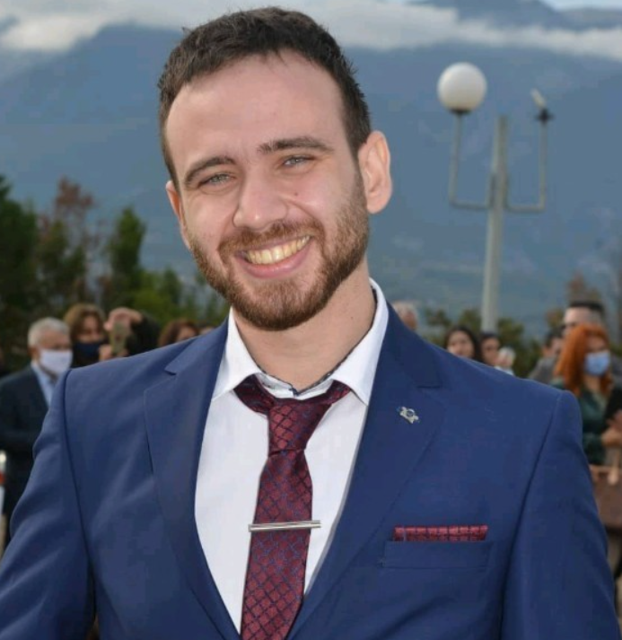
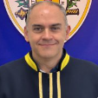
THANK YOU FOR YOUR ATTENTION!
Notes:
So, at this point, we reached the end of our presentation. I would like thank you for your attention. I know this presentation provided an interdisciplinary approach combining different fields, so in case of any questions, I will be glad to hear them and answer them at the best of my ability. Thank you very much!

