Slide 1
Beyond the Horizon:
Training Minds And Systems For Tomorrow's Conflicts
SCHMID Markus, OF-3
GINTHÖR Johannes, OF-2

Slide 2
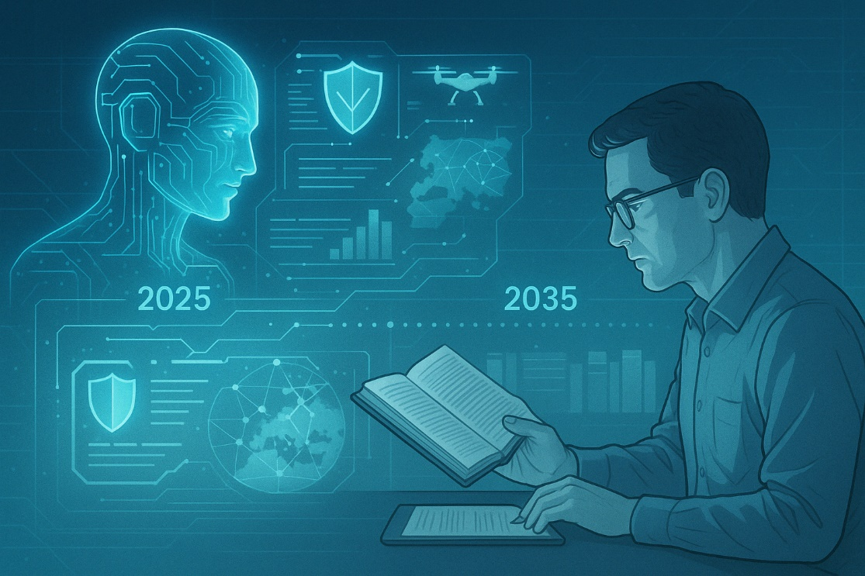

Agenda
(Personal) Introduction
Methodology Used
Scenarios I – III
Reflection & Conclusion

Slide 3
(Personal) Introduction

Slide 4
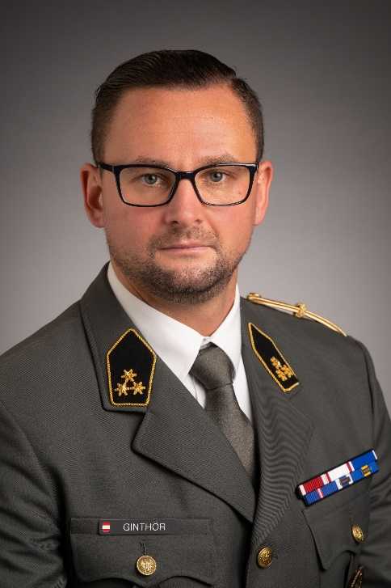
Personal Introduction
OF-2 GINTHÖR Johannes, M.A.
Born 1991, married and one daughter,
Graduated from the Theresan Military Academy in 2014,
PLTLDR, 2IC, COYCDR/Mechanized Infantry Battalion 35,
Graduated from the 23. General Staff Course at the National Defence Academy in VIENNA in 2024,
Currently instructor at the Theresan Military Academy.

Slide 5
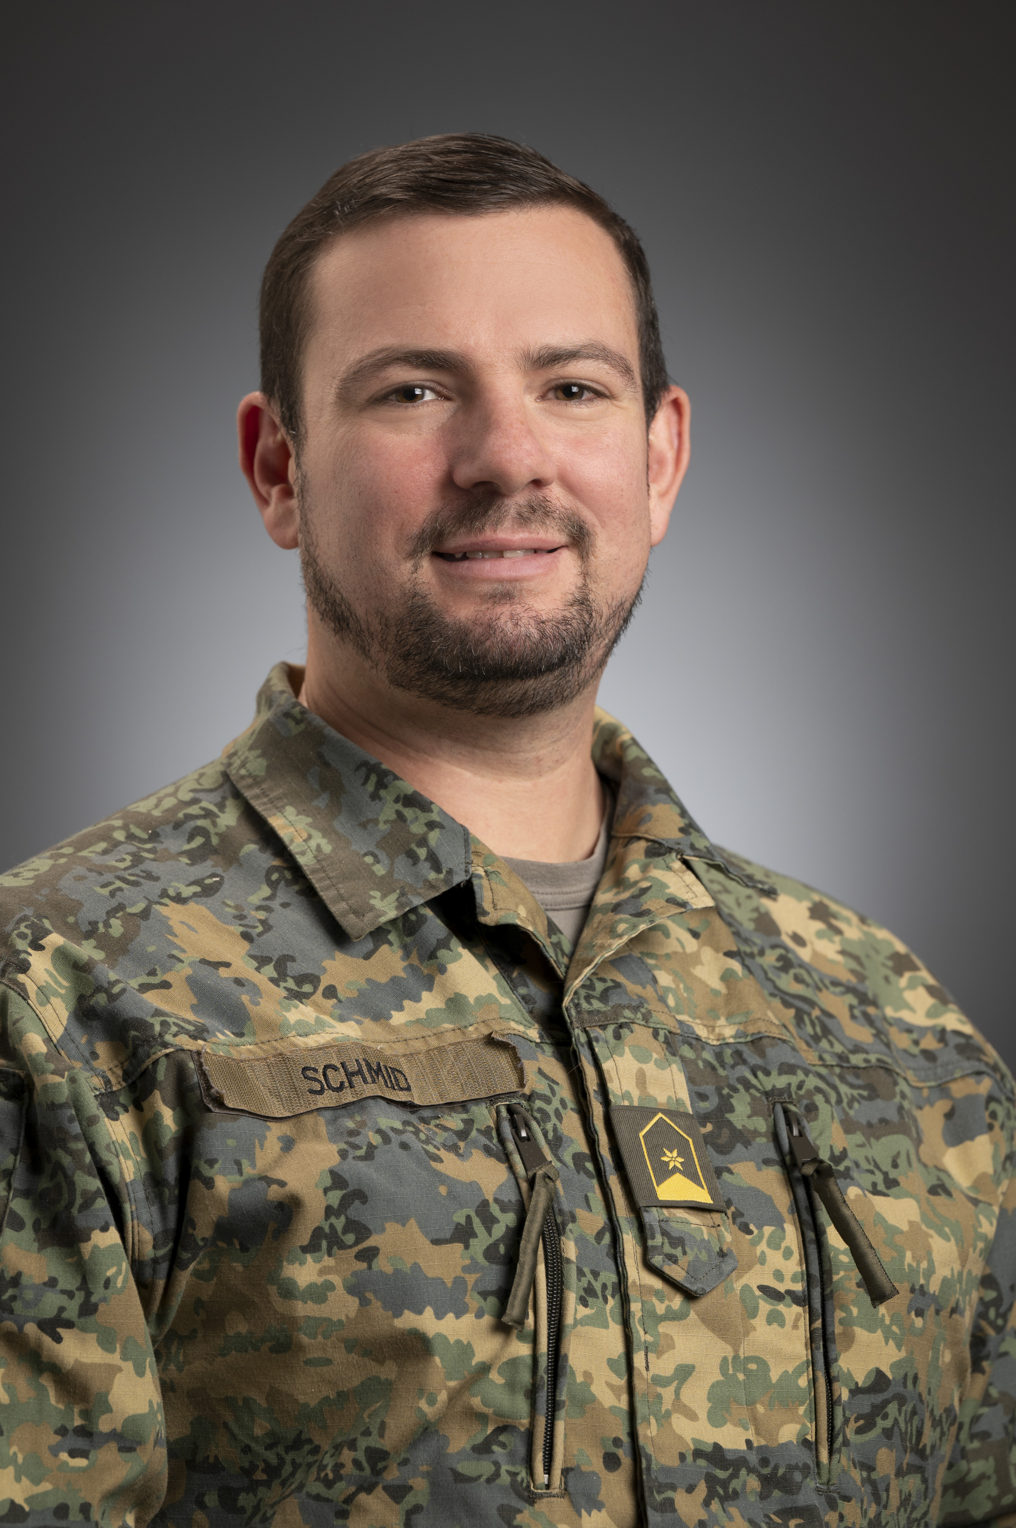
Personal Introduction
OF-3 SCHMID Markus J., B.Sc M.Sc M.A.
Born 1988, married.
Graduated from the Theresan Military Academy in 2013,
PLTLDR, 2IC, S6/Mechanized Infantry Battalion 35,
Graduated from the 23. General Staff Course at the National Defence Academy in VIENNA in 2024,
Dep Head of CIS-Management Dion6 &
Leading ICT-Architect AAF

Slide 6
Introduction – Intent
Aim of the presentation:
  How will future military scenarios require a changed behavior from military leaders?
  We will focus on CIS and tactical considerations!
The Purpose:
  …is to understand the applicability of leadership tools by first mastering the fundamentals and second, fostering the ability to think beyond conventional frameworks.
Notes:
How can emerging technologies alter the requirements for the command-and-control system with focus on information and communication and tactical planning and what has to be done to ensure effective decision-making and combat readiness through training and education?

Slide 7
Methodology Used

Slide 8

AI-Assisted Scenario Development
Overview
  AI application (ChatGPT 4o) used to generate future scenarios.
  Prompts and excerpts documented for transparency, reproducibility, and verifiability.
  Adherence to scholarly diligence ensures scientific standards.

Slide 9

AI-Assisted Scenario Development
Methodology
  Blend of creative, exploratory (qualitative) approaches with quantitative grounding.
  Synthesis of technical and military domains (e.g., electronic & cyber warfare attack vectors).
  Consideration of Technology Readiness Levels (2025) to model 2035 scenarios.

Slide 10

AI-Assisted Scenario Development
Scenario Creation & Validation Strategy
  Fictional scenarios to depict plausible operational settings.
  Critical examination and theoretical grounding to minimize bias.
  Comparison of AI-generated scenarios with peer-reviewed military literature.
  Ensures trends, risks, and principles are realistic and scientifically robust.

Slide 11
Scenarios I – III
Somewhere way down the road…

Slide 12
Technical Considerations
Physical Realm
Virtual Realm
Cognitive Realm

Slide 13
Fundamentals of Combat Power
Combat
Power
Capability
(physical)
Will
(moral)
Comprehension
(intellectual)

Slide 14
Fundamentals of Combat Power
Combat
Power
Capability
(physical)
Will
(moral)
Comprehension
(intellectual)

Slide 15
Scenario I
Capability
(physical)
Plains of Eldoria, ca. 2035

Slide 16
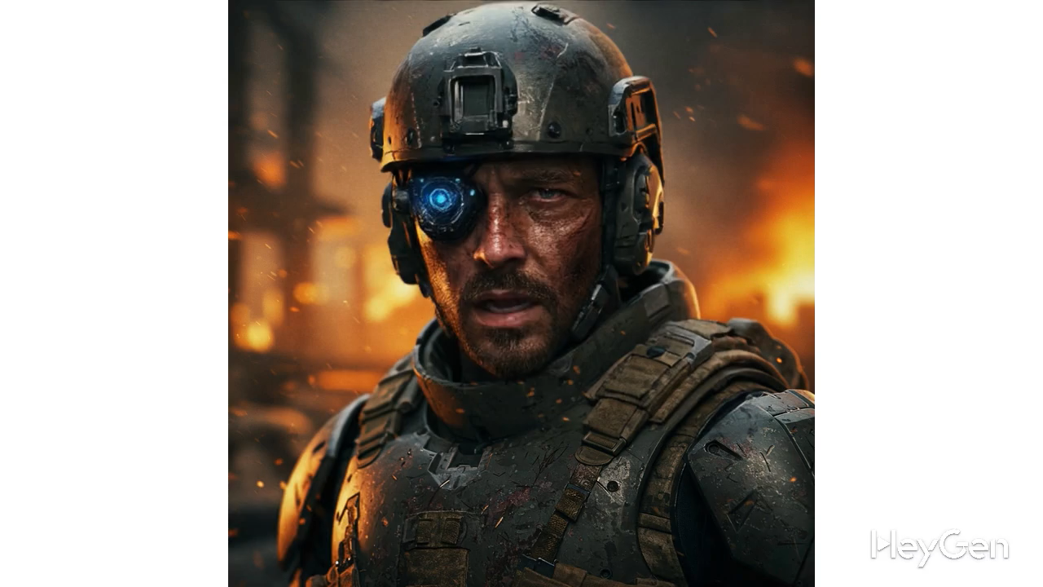

Slide 17
Technical Considerations
Bolster Supply Chain Vigilance
  Microchip-level infiltration can cripple forces.
  Full oversight and patch management are non-negotiable.

Slide 18
Technical Considerations
Bolster Supply Chain Vigilance
  Microchip-level infiltration can cripple forces.
  Full oversight and patch management are non-negotiable.
Reinforce C2 Structures with Human Oversight
  Adaptive networks + human anomaly detection = resilience.
  Signals officers must counter electronic disruptions swiftly.

Slide 19
Technical Considerations
Bolster Supply Chain Vigilance
  Microchip-level infiltration can cripple forces.
  Full oversight and patch management are non-negotiable.
Reinforce C2 Structures with Human Oversight
  Adaptive networks + human anomaly detection = resilience.
  Signals officers must counter electronic disruptions swiftly.
Cultivate Cyber-Conscious Leadership
  Every soldier as an active sensor.
  Tech-savvy leadership prevents manipulation and preserves agility.

Slide 20
Tactical Considerations
Know. Think. Act!
Decentralised Decision-Making
  Empower leaders to act independently under degraded conditions.
  Foster adaptive thinking beyond procedural execution.

Slide 21
Tactical Considerations
Know. Think. Act!
Decentralised Decision-Making
  Empower leaders to act independently under degraded conditions.
  Foster adaptive thinking beyond procedural execution.
Controlled Initiative
  Avoid overconfidence in technology through preemptive reconnaissance.
  Base tactical decisions on verified battlefield awareness.
Look sharp, stay sharp, strike hard.

Slide 22
Tactical Considerations
Know. Think. Act!
Decentralised Decision-Making
  Empower leaders to act independently under degraded conditions.
  Foster adaptive thinking beyond procedural execution.
Controlled Initiative
  Avoid overconfidence in technology through preemptive reconnaissance.
  Base tactical decisions on verified battlefield awareness.
Redundant Combat Power
  Synchronise effects from multiple systems per target.
  Avoid critical failures through layered fire planning.
Look sharp, stay sharp, strike hard.
Double Tap.

Slide 23
Fundamentals of Combat Power
Combat
Power
Capability
(physical)
Will
(moral)
Comprehension
(intellectual)

Slide 24
Scenario II
Comprehension
(intellectual)
Command Post 12th Armored Brigade

Slide 25
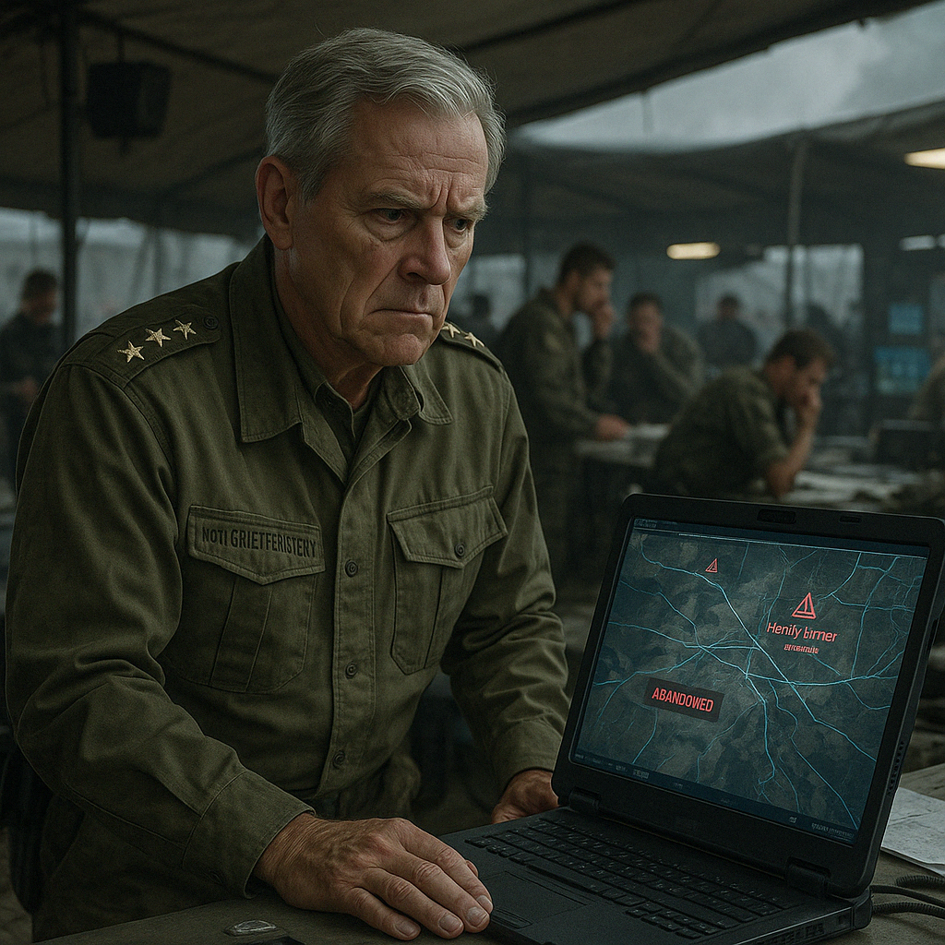
Notes:
Bitte erstelle aus folgender Geschichte ein einziges realistisches, hochauflösendes Foto. Achte auf lebensechte Details, natürliche Lichtverhältnisse und realistische Texturen (z. B. Haut, Haare, Stoffe, Natur, Gebäude). Die Szene soll so aussehen, als wäre sie von einer Profi-Kamera aufgenommen worden. Wähle eine passende Perspektive (z. B. Nahaufnahme, Weitwinkel, Vogelperspektive), die die Stimmung der Geschichte perfekt einfängt. Stil: Ultra-Realismus, keine Comic-, KI- oder Malerei-Ästhetik. Fokus auf Authentizität und emotionaler Tiefe. Bildgröße mindestens 2048x2048 Pixel.
Hier ist die Geschichte: It was a grey morning, and the command post of the 12th Armored Brigade buzzed with activity. Brigadier General Lothar von Greiffenstein was moments away from transmitting the attack order when he noticed something odd on the digital situational map: the enemy’s positions had changed dramatically within minutes. What had been a lightly defended ridge now appeared to be abandoned while heavy armor advanced toward his flank. His staff was confused—no new drone data had been received, no scouts had reported back. The map had updated itself. It soon became clear that they were victims of a sophisticated deception. The enemy had exploited vulnerabilities in satellite networks, injecting false data into their systems through forged transmissions that mimicked legitimate reconnaissance feeds. This was paired with a malware update that visually manipulated the brigade’s tactical display. The entire battlefield picture was false. In truth, the enemy had reinforced their lines and prepared artillery for a devastating counterattack. Communications were overloaded, and field reports were delayed or missing. Von Greiffenstein realised he was planning an assault based on a fabricated reality. A hasty attack meant walking into a trap; retreating risked other unknown dangers. He ordered system integrity checks, re-flights of drones, and encrypted reports from forward observers. In the end, he delayed the attack, avoiding disaster—but the damage was done. The brigade was paralysed by confusion. Later analysis confirmed: lax cybersecurity and digital overdependence had crippled their understanding. “Next time,” the general thought grimly, “we verify the truth—before we act on it.

Slide 26
Technical Considerations
Multi-Layer Validation of Incoming Intelligence
  Cross-check data from multiple sources
  Routine system integrity checks to expose manipulated inputs.

Slide 27
Technical Considerations
Multi-Layer Validation of Incoming Intelligence
  Cross-check data from multiple sources
  Routine system integrity checks to expose manipulated inputs.
Human Interaction & Training as the Cornerstone of Awareness
  Train all personnel to detect anomalies and suspicious data.
  Regular cyber drills turn soldiers into active sensors.

Slide 28
Technical Considerations
Multi-Layer Validation of Incoming Intelligence
  Cross-check data from multiple sources
  Routine system integrity checks to expose manipulated inputs.
Human Interaction & Training as the Cornerstone of Awareness
  Train all personnel to detect anomalies and suspicious data.
  Regular cyber drills turn soldiers into active sensors.
Robust Command Processes and Flexible C2 Structures
  Embed fallback protocols and redundant communications.
  Crisis simulations prepare leaders to pivot under digital stress.

Slide 29
Tactical Considerations
Two is one, one is none.
Redundancy in Systems
  Establish multiple, independent communication and reconnaissance paths.
  Avoid single points of failure in planning and execution.

Slide 30
Tactical Considerations
Two is one, one is none.
Redundancy in Systems
  Establish multiple, independent communication and reconnaissance paths.
  Avoid single points of failure in planning and execution.
Operate Within Constraints
  Focus on remaining capabilities under uncertainty.
  Train for mission continuity without full situational clarity.
No limits—just possibilities.

Slide 31
Tactical Considerations
Two is one, one is none.
Redundancy in Systems
  Establish multiple, independent communication and reconnaissance paths.
  Avoid single points of failure in planning and execution.
Operate Within Constraints
  Focus on remaining capabilities under uncertainty.
  Train for mission continuity without full situational clarity.
Train for Uncertainty
  Integrate adversarial stress-testing into command routines.
  Apply real-time wargaming with live personnel for decision validation.
No limits—just possibilities.
Practice chaos, master control.

Slide 32
Fundamentals of Combat Power
Combat
Power
Capability
(physical)
Will
(moral)
Comprehension
(intellectual)

Slide 33
Scenario III
Will
(moral)
Corporal L. H. and the invisible front…

Slide 34
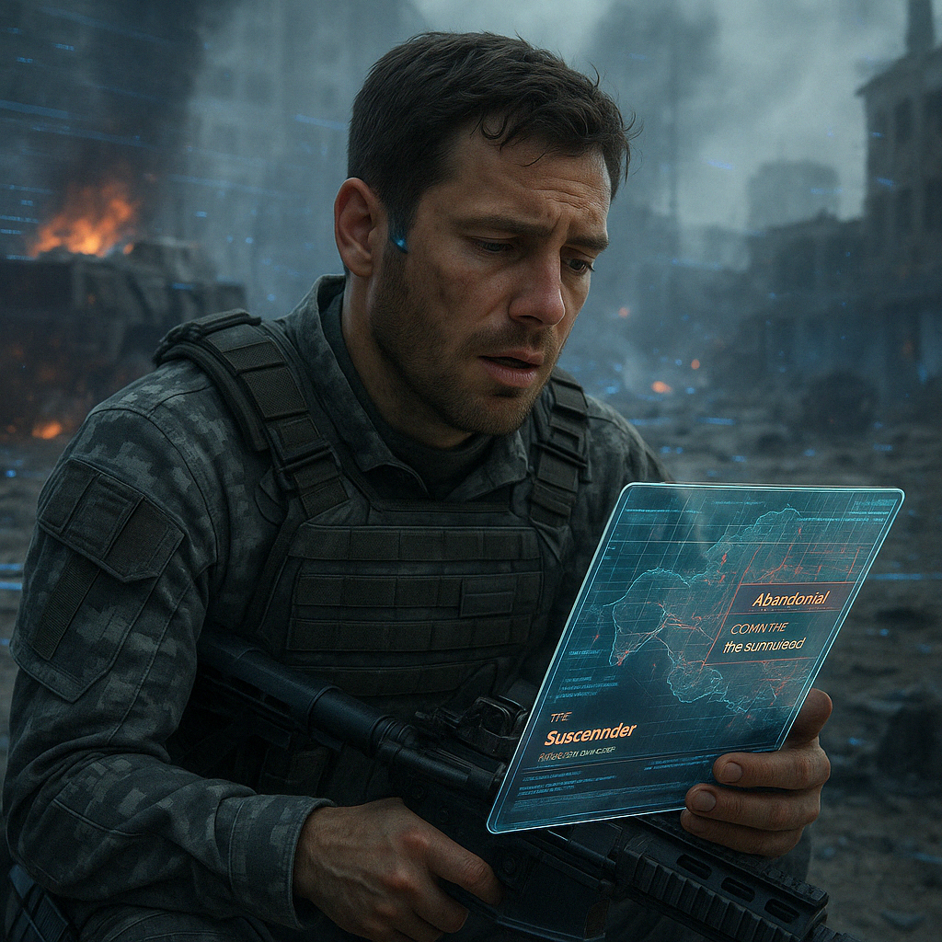
Notes:
Bitte erstelle aus folgender Geschichte ein einziges realistisches, hochauflösendes Foto. Achte auf lebensechte Details, natürliche Lichtverhältnisse und realistische Texturen (z. B. Haut, Haare, Stoffe, Natur, Gebäude). Die Szene soll so aussehen, als wäre sie von einer Profi-Kamera aufgenommen worden. Wähle eine passende Perspektive (z. B. Nahaufnahme, Weitwinkel, Vogelperspektive), die die Stimmung der Geschichte perfekt einfängt. Stil: Ultra-Realismus, keine Comic-, KI- oder Malerei-Ästhetik. Fokus auf Authentizität und emotionaler Tiefe. Bildgröße mindestens 2048x2048 Pixel.
Hier ist die Geschichte: The battle had become a nightmare. Corporal Lukas Hoffmann crouched behind a burned-out vehicle, his rifle limp in his hands. Gunfire and explosions echoed around him, but the real damage wasn’t physical—it was psychological. His digital map flickered uselessly, distorted and confusing. Morale in the unit had collapsed, not from enemy fire, but from an invisible assault on their minds. It started with digital manipulation: false data, shifting enemy positions, erratic system behavior. Soon, targeting systems failed, and comms were compromised. Every decision became uncertain. Then the propaganda began—flyers dropped by drones, chain messages on personal devices, fake social media posts: “Your commander has betrayed you,” “You’ve been abandoned.” They weren’t true, but they planted doubt. Then came the deepfake—video of their commander apparently surrendering to the enemy. It spread through their secure network like wildfire. Everyone knew it was fake, but trust shattered anyway. Soldiers began to suspect one another. Paranoia grew. And then the most personal attack of all: a message to Hoffmann’s sister, claiming he would soon be dead. It cut deeper than any wound. That was when he realised—this war wasn’t about bullets or tanks. It was about belief. About will. As morale crumbled, his platoon leader’s voice pierced the fog: “The enemy can only defeat us if we let them. If we lose our heads, we lose the war.” Somehow, they held together. Scarred, shaken—but not broken. Hoffmann understood then: the true battlefield was the mind. And surviving meant fighting to stay human.

Slide 35
Technical Considerations
Guarding the Digital Front
  Encrypt, authenticate, and audit networks to resist infiltration.
  Maintain rapid threat detection and secure backup channels.

Slide 36
Technical Considerations
Guarding the Digital Front
  Encrypt, authenticate, and audit networks to resist infiltration.
  Maintain rapid threat detection and secure backup channels.
Securing the Ground
  Defend command posts and rigorously vet on-site hardware.
  Strengthen perimeter security to prevent physical breaches.

Slide 37
Technical Considerations
Guarding the Digital Front
  Encrypt, authenticate, and audit networks to resist infiltration.
  Maintain rapid threat detection and secure backup channels.
Securing the Ground
  Defend command posts and rigorously vet on-site hardware.
  Strengthen perimeter security to prevent physical breaches.
Forging Unbreakable Will
  Train cognitive resilience against psychological manipulation.
  Promote open communication to sustain trust and unity.

Slide 38
Tactical Considerations
Structured Reflection
  Include psychological effects in after-action reviews.
  Institutionalise lessons learned across units and echelons.
Fool me once—never twice.

Slide 39
Tactical Considerations
Structured Reflection
  Include psychological effects in after-action reviews.
  Institutionalise lessons learned across units and echelons.
Understand external influence
  Identify how enemy actions shape mission execution and mindset.
  Include psychological threats in planning and risk assessment.
Fool me once—never twice.
The ground fights with you…

Slide 40
Tactical Considerations
Structured Reflection
  Include psychological effects in after-action reviews.
  Institutionalise lessons learned across units and echelons.
Understand external influence
  Identify how enemy actions shape mission execution and mindset.
  Include psychological threats in planning and risk assessment.
Resilience Through Leadership
  Build trust through transparency, consistency, and shared understanding.
  Strengthen cohesion by aligning leadership intent with action.
Fool me once—never twice.
The ground fights with you…
Trust wins battles.

Slide 41
Reflection & Conclusion
Mastering what comes„beyond the horizon“

Slide 42
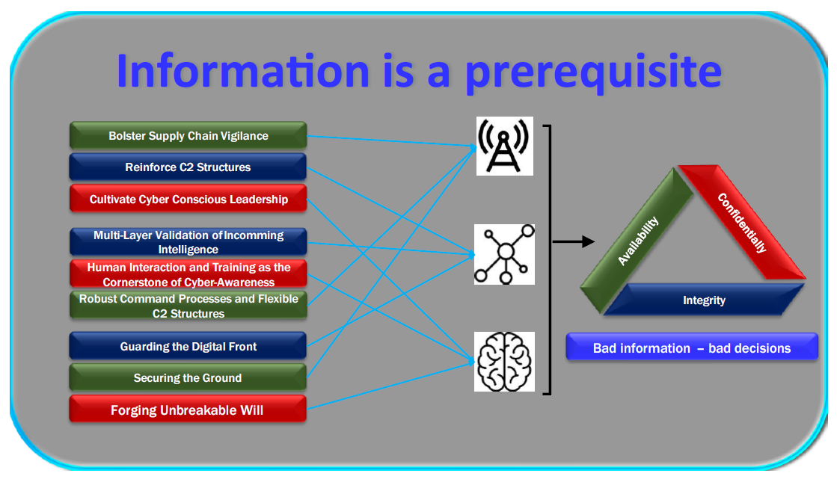
Scenario I
Scenario II
Scenario III
Notes:
Before addressing the final considerations from an IT technician and signals officer’s perspective, it is essential to weave together the key strands of technology, leadership, and human resilience. Although these principles resonate across operational and strategic spheres, the immediate focus is preventing tactical collapse. The conclusion condenses these insights, demonstrating how synergy across virtual, physical, and cognitive domains preserves battlefield momentum and morale.
In a battlespace where hidden code can disable key hardware, where deepfake propaganda seeds mistrust, and where a single compromised data feed can unravel entire operations, defence demands more than technical fixes. Information is a prerequisite, and bad information usually leads to bad decisions, as illustrated in the following graphic. It requires an airtight supply chain, adaptable command and control, and a cyber-conscious force unafraid to question every signal. A modern military safeguards its momentum and morale by layering authentication and verification across all digital inputs, securing physical infrastructure against on-site tampering, and training every soldier to see and stop manipulation before it spreads. This synergy across the virtual, physical, and cognitive domains also aligns with the CIA principles: confidentiality is associated with the cognitive domain, integrity upholds the virtual realm, and availability secures the physical environment. Ultimately, neither code, nor chaos, nor psychological strike can deny victory to those who remain vigilant.

Slide 43
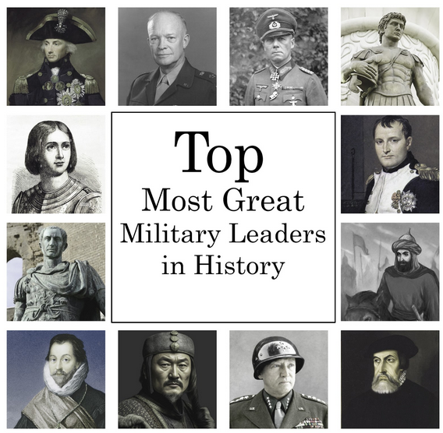
Tactical Reflection
Know. Think. Act!
Scenario I
Look sharp, stay sharp, strike hard.
Double Tap.
Two is one, one is none.
Scenario II
No limits—just possibilities.
Practice chaos, master control.
Loose smart, so you can win again.
Fool me once—never twice.
Scenario III
The ground fights with you…
Trust wins battles.
Sources:
https://bestdiplomats.org/wp-content/uploads/2023/10/Top-14-Most-Great-Military-Leaders-in-History-Upd.jpg
Notes:
Analysis – Synthesis -

Slide 44
Tactical Reflection
Know. Think. Act!
Scenario I
Look sharp, stay sharp, strike hard.
Double Tap.
Two is one, one is none.
Scenario II
No limits—just possibilities.
Practice chaos, master control.
Loose smart, so you can win again.
Fool me once—never twice.
Scenario III
The ground fights with you…
Trust wins battles.
Sources:
https://bestdiplomats.org/wp-content/uploads/2023/10/Top-14-Most-Great-Military-Leaders-in-History-Upd.jpg
Notes:
Analysis – Synthesis -

Slide 45

Tactical Reflection
Know. Think. Act!
Scenario I
Look sharp, stay sharp, strike hard.
Double Tap.
Two is one, one is none.
ENY
Scenario II
No limits—just possibilities.
Practice chaos, master control.
Loose smart, so you can win again.
TER
Fool me once—never twice.
Scenario III
The ground fights with you…
II
Trust wins battles.
Sources:
https://bestdiplomats.org/wp-content/uploads/2023/10/Top-14-Most-Great-Military-Leaders-in-History-Upd.jpg
Notes:
Analysis – Synthesis -

Slide 46
Tactical Reflection
Know. Think. Act!
Scenario I
Look sharp, stay sharp, strike hard.
Double Tap.
Two is one, one is none.
ENY
Scenario II
No limits—just possibilities.
Practice chaos, master control.
Loose smart, so you can win again.
TER
Fool me once—never twice.
Scenario III
The ground fights with you…
II
Trust wins battles.
Sources:
https://bestdiplomats.org/wp-content/uploads/2023/10/Top-14-Most-Great-Military-Leaders-in-History-Upd.jpg
Notes:
Analysis – Synthesis -

Slide 47
Tactical Reflection
Know. Think. Act!
Scenario I
Look sharp, stay sharp, strike hard.
Double Tap.
Two is one, one is none.
ENY
Scenario II
Employment of Combat Power!
No limits—just possibilities.
Practice chaos, master control.
Loose smart, so you can win again.
TER
Fool me once—never twice.
Scenario III
M E T T – E
The ground fights with you…
II
Trust wins battles.
Sources:
https://bestdiplomats.org/wp-content/uploads/2023/10/Top-14-Most-Great-Military-Leaders-in-History-Upd.jpg
Notes:
Analysis – Synthesis -

Slide 48
Information-Information-Information-Information-Information-Information-Information-
Information-Information-Information-Information-
Know. Think. Act!
Scenario I
Look sharp, stay sharp, strike hard.
Double Tap.
Two is one, one is none.
ENY
Scenario II
No limits—just possibilities.
Practice chaos, master control.
Loose smart, so you can win again.
TER
Fool me once—never twice.
Scenario III
M E T T – E
The ground fights with you…
II
Trust wins battles.
Information-Information-Information-Information-
Information-Information-Information-Information-Information-Information-Information-
Notes:
Analysis – Synthesis -

Slide 49
M E T T – E
Know. Think. Act!
Look sharp, stay sharp, strike hard.
Double Tap.
Two is one, one is none.
ENY
No limits—just possibilities.
Practice chaos, master control.
TER
Fool me once—never twice.
The ground fights with you…
Loose smart, so you can win again.
II
Trust wins battles.
Notes:
Analysis – Synthesis -

Slide 50
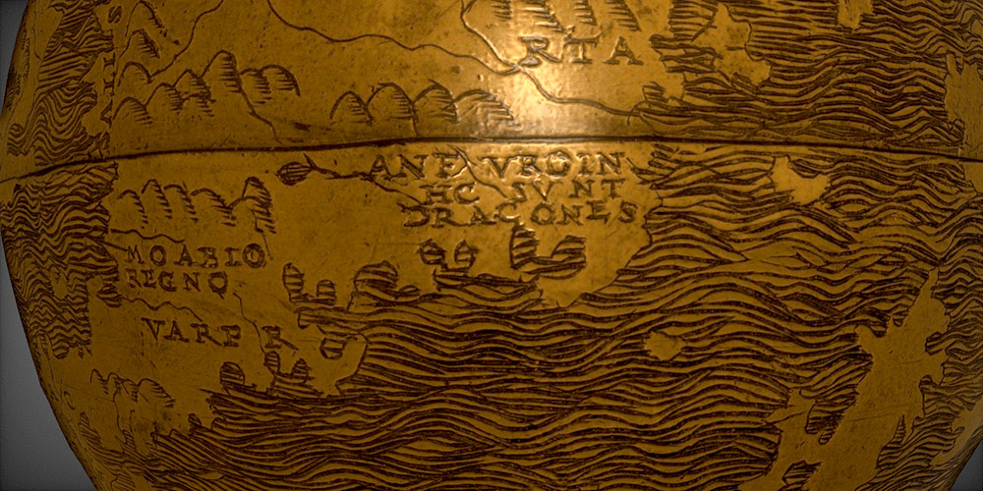
Conclusion
Hic sunt dracones.
Source:
https://www.rochester.edu/newscenter/worlds-oldest-globe-hunt-lenox-lazarus-project-417532/

Slide 51
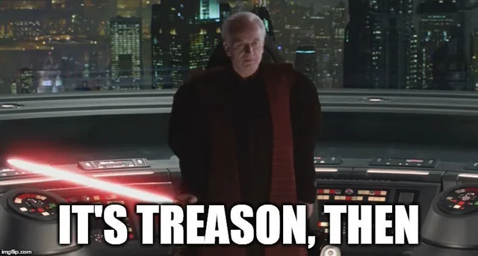
Conclusion
Hic sunt dracones.
Inductive
Deductive
e/o??
Source:
https://www.rochester.edu/newscenter/worlds-oldest-globe-hunt-lenox-lazarus-project-417532/

Slide 52
Conclusion
Hic sunt dracones.
Inductive
Deductive
Training Minds AND Systems for tomorrow´s conflicts!!
Source:
https://www.rochester.edu/newscenter/worlds-oldest-globe-hunt-lenox-lazarus-project-417532/

Slide 53
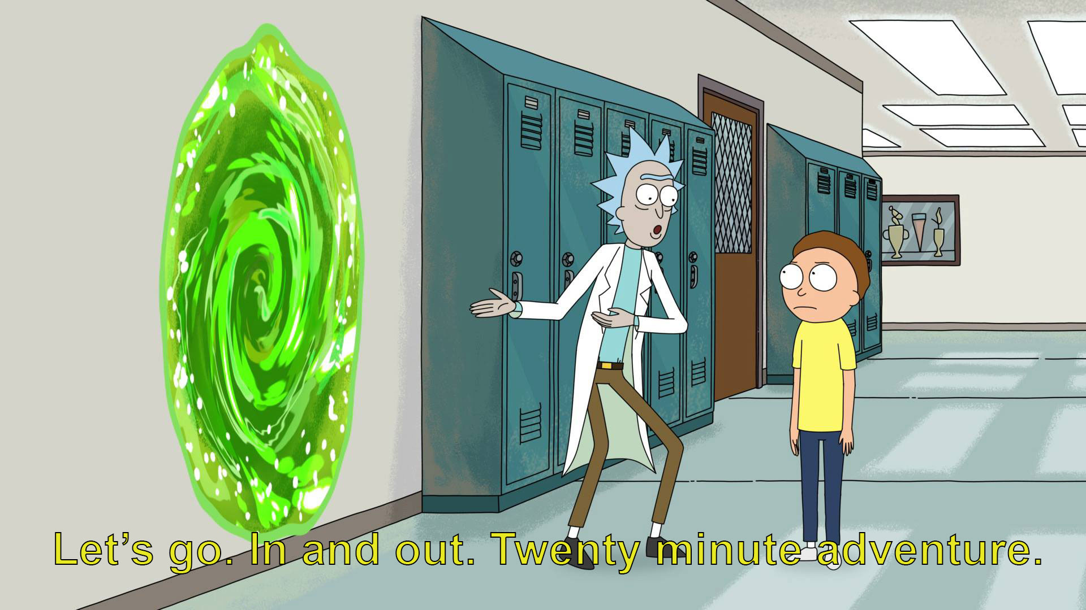
Thank you for your attention – please feel free to challenge us!

