Slide 1
Autonomy, Innovation and Leadership:
The Future Of Maritime Interations in the Age of AI
CDT Marco Francavilla,CDT James F. Armstrong

Slide 2
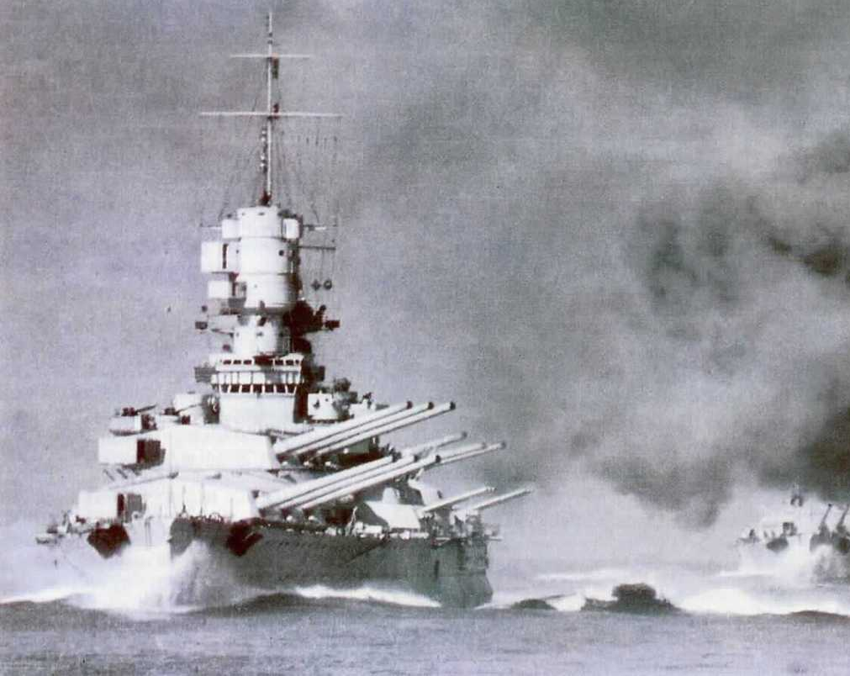
From “Kinetic” to AI-Driven Technologies
The adoption of AI in the military field arose from the need to overcome the limitations of weapon systems based solely on ‘kinetic’ technologies.
Machine learning and sensor fusion enable real-time battlefield awareness by combining data from radars, LIDAR, high-res cameras, and communications.

Slide 3
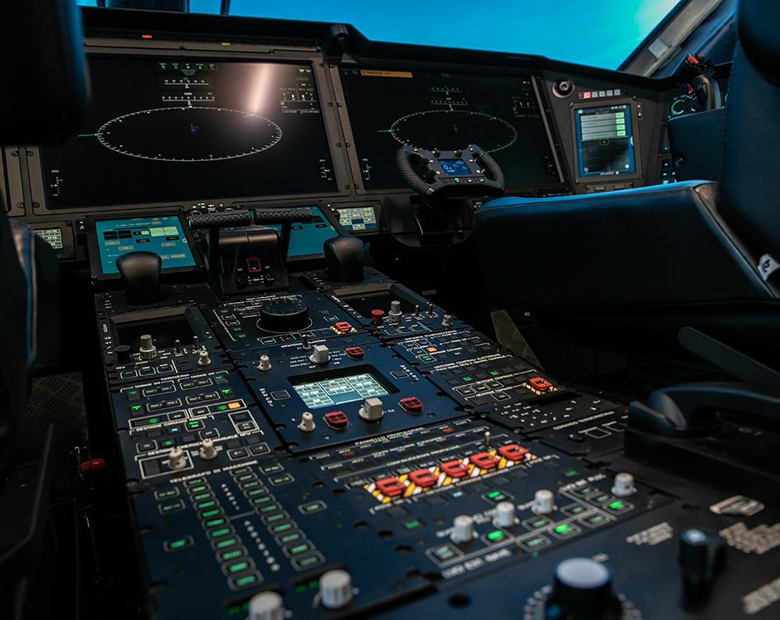
How they work: Hardware and Architecture
Modern operational units employ high-performance processors (such as GPUs) and convolutional neural networks (CNNs) to process sensor data in real time.
This architecture supports integrated naval platforms and rapid decision-making optimizing the OODA loop.

Slide 4
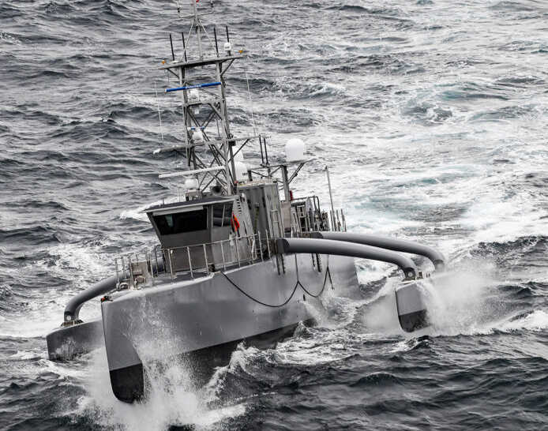
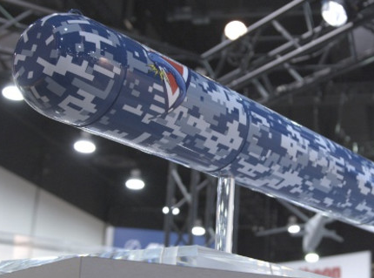
Examples of Decision Models
The use of a “human-in-the-loop” (HITL) is a crucial aspect: AI offers scenarios, humans decide.
HITL: Full human control;
HOTL: Supervised autonomy;
HOOTL: Fully autonomous.
Aegis Combat System (USN)
Sea Hunter (USN)
Knifefish (USN)

Slide 5
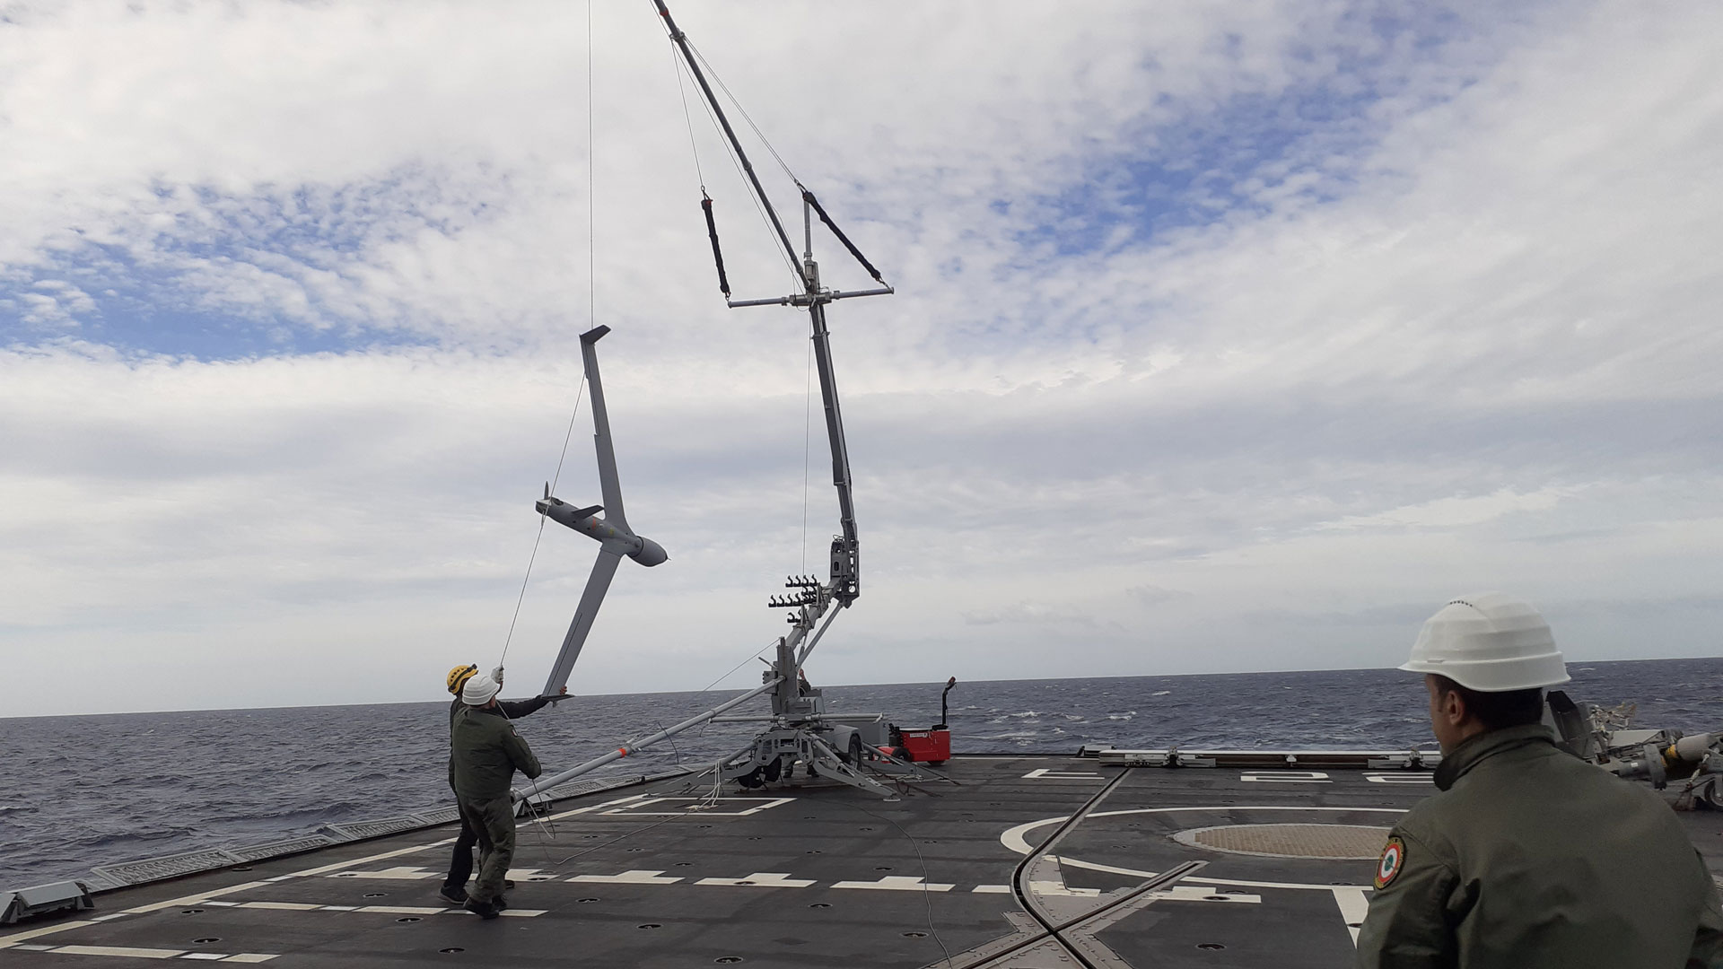
Case Study: AI Drones and Electronic Warfare
Intelligent drones have proven resilient in high electronic interference environments (e.g., Ukraine).
AI enables semi/fully autonomous operations even when GPS or communications are jammed.

Slide 6
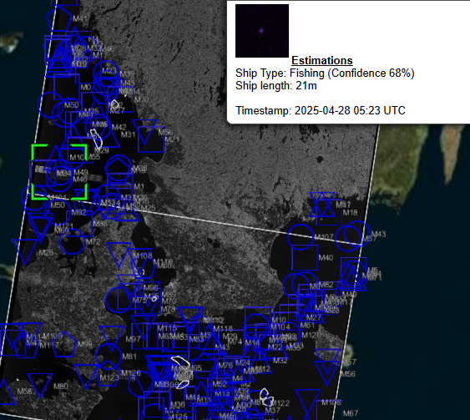
SatShipAI
What is SatShipAI?
Developed by Nodalpoint Systems (Greece)
Advanced satellite surveillance system
Uses AI and Sentinel-1 satellite imagery to detect and track maritime vessels
Why is AI Important?
Enables image recognition and behavioral analysis
Predicts suspicious vessel patterns in near real-time

Slide 7
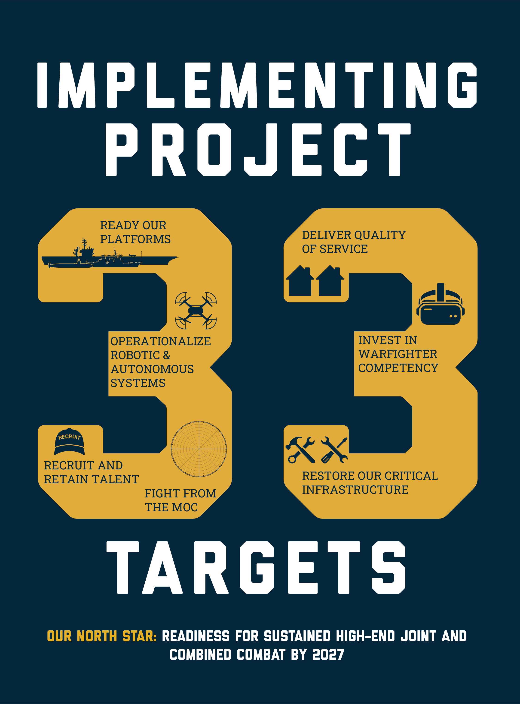
Operationalise Robotic & Autonomous Systems
Core focus: integrate unmanned and autonomous systems for multi-domain operations.
AI-driven automation supports:
• Sea denial & sea control
• Real-time decision-making
• Enhanced C2 (Command & Control) efficiency
Applications include:
• Intelligence gathering
• Acoustic surveys & bottom mapping
• Missions in dangerous or inaccessible environments

Slide 8
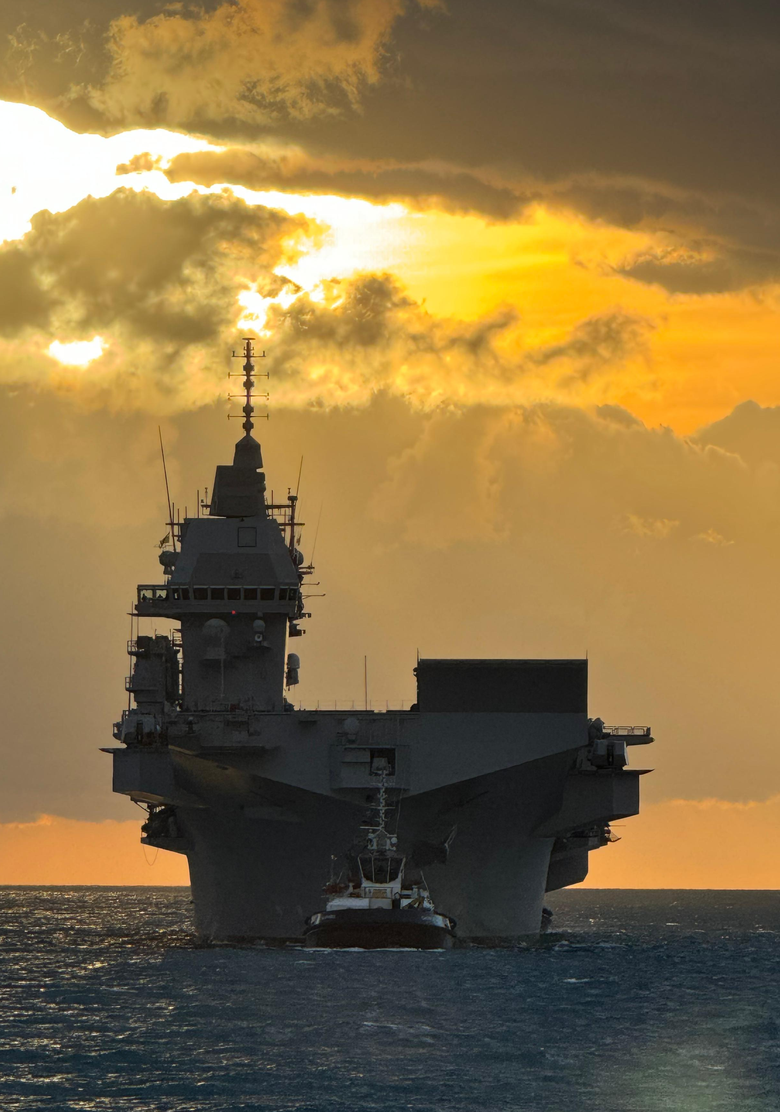
FINCANTIERI NextTech
Fincantieri NexTech is a leading Italian company providing high-tech solutions in naval automation and systems integration.
LHD Trieste is the newest amphibious assault ship of the Italian Navy, delivered in December 2024.
On board Fincantieri has implemented:
SEASNavy
Ship Management System (SMS)
Marine Portal Evolution SCADA

Slide 9
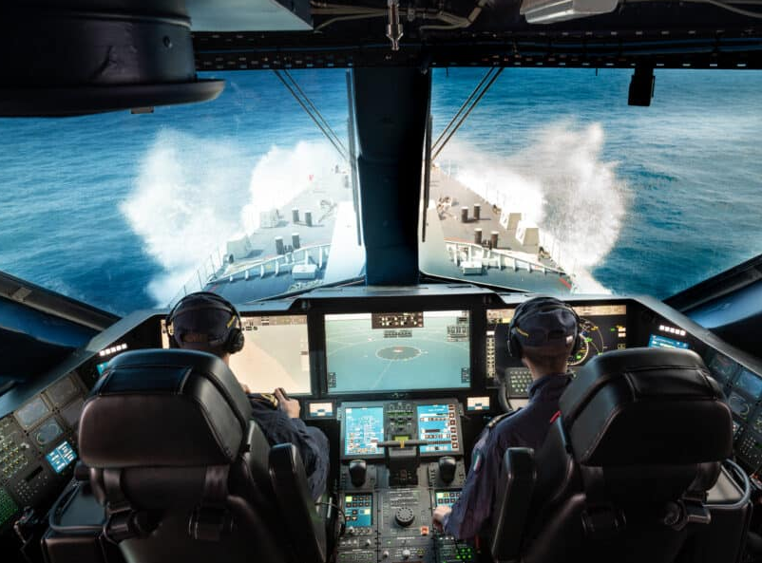
Naval Cockpit
Is an advanced control station developed by Fincantieri NexTech for PPA-class patrol vessels
• Combines ship navigation and combat system control • Two operators (Pilot and Co-Pilot) autonomously manage core ship functions
Enhancing: • Naval readiness • Operational responsiveness • Situational awareness

Slide 10
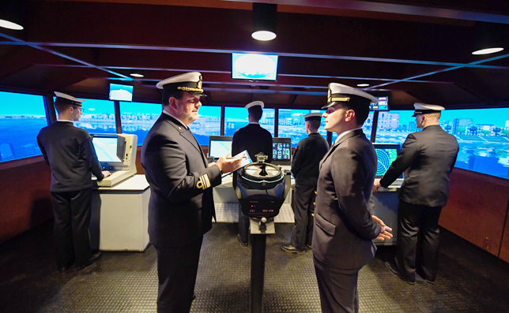
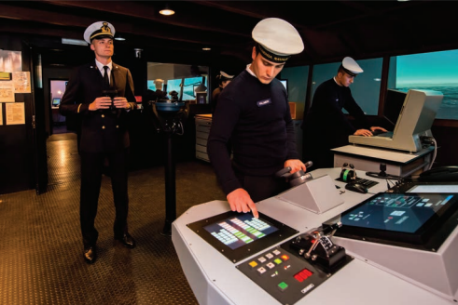
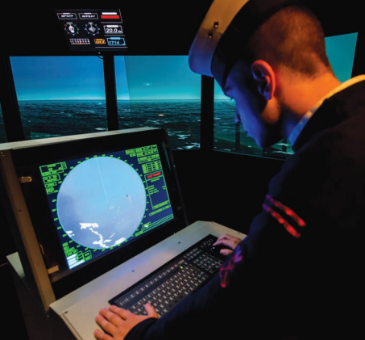
SIMAP
What it is:
A professional naval simulator used at the Italian Naval Academy to train future naval officers in ship handling, decision-making, and crisis response through realistic and immersive maritime scenarios
Key Capabilities:
Realistic Scenario Simulation
AI-driven training
Immersive learning

Slide 11
“As future Naval Leaders it is our responsibility to embrace technology, ensuring readiness to protect stability, security and freedom at sea.”

Slide 12
Thank you for your attention.

