Slide 1
Innovative Tehnologies in the
Development
of Explosives and Pyrotechnics
for Modern Warfare
Officer Cadet Doris Dasović

Slide 2
Agenda
Introduction and Motivation
Historical Overview of Explosives
Nanotechnology in Explosives
3D Printing and Explosives
AI in Additive Manufacturing
AI in Explosive Threat Detection
AI in EOD Operations
Ethical Considerations in Military AI
Geopolitical Divergence
Global Governance Challenges
International Regulation and Ethics
Future Directions
Conclusion and Recommendations
Notes:
Outline of the key topics to be discussed in this presentation.

Slide 3
Introduction and Motivation
Rapid advances in AI, nanotech, and 3D printing
Military applications evolving rapidly
Need to balance innovation with responsibility
Notes:
Introduce the context and importance of studying these technologies.

Slide 4
Historical Overview of Explosives
From black powder to TNT, RDX, PETN
Advancements in explosive stability and power
Progress toward smart explosives
Notes:
Summarize the evolution of explosive technology over time.

Slide 5
Nanotechnology in Explosives
Nano-aluminum enhances efficiency and control
Enables smart and self-repairing explosives
Reduces accidental detonations
Notes:
Explain how nanotech enhances explosive reliability and effectiveness.

Slide 6
3D Printing and Explosives
Rapid prototyping of weapons
Customization and on-site manufacturing
Reduced logistical burdens
Notes:
Present the strategic implications of 3D printing in the military.

Slide 7
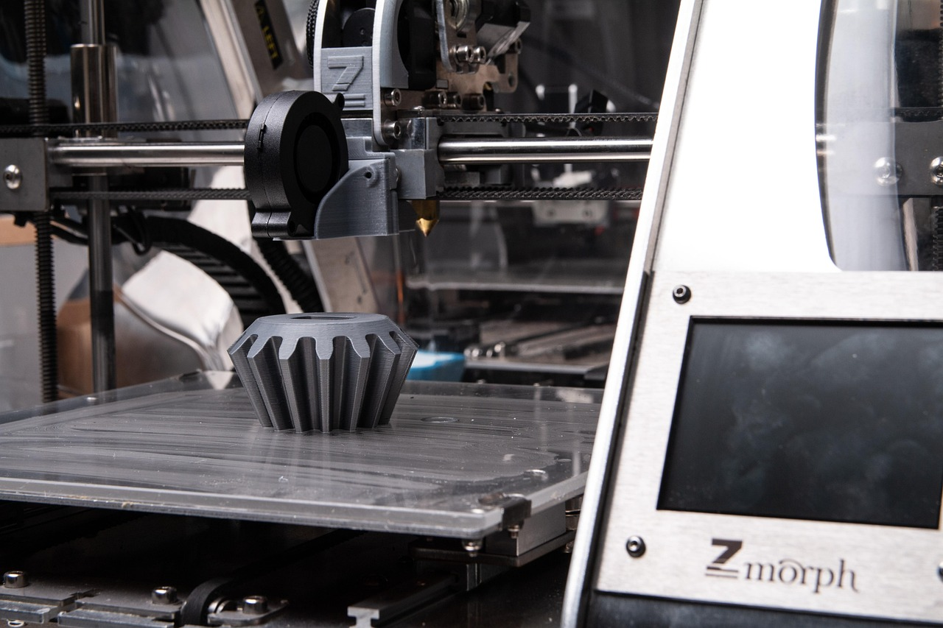
3D Printing and Explosives
Portable fabrication units
Precision-made components
Greater adaptability in combat
Notes:
Emphasize efficiency and operational benefits of additive manufacturing.

Slide 8
3D Printing and Explosives
Potential misuse by non-state actors
Harder to regulate production
Sensitive designs may be leaked
Notes:
Address the key risks and proliferation challenges.

Slide 9
AI in Additive Manufacturing
Predicts structural performance
Automates quality control
Reduces human error
Notes:
AI ensures higher quality and safety in production.

Slide 10
AI in Explosive Threat Detection
AI processes satellite and sensor data
Real-time detection of threats
Improves precision and reduces false alarms
Notes:
Explore AI applications in identifying and responding to explosive threats.

Slide 11
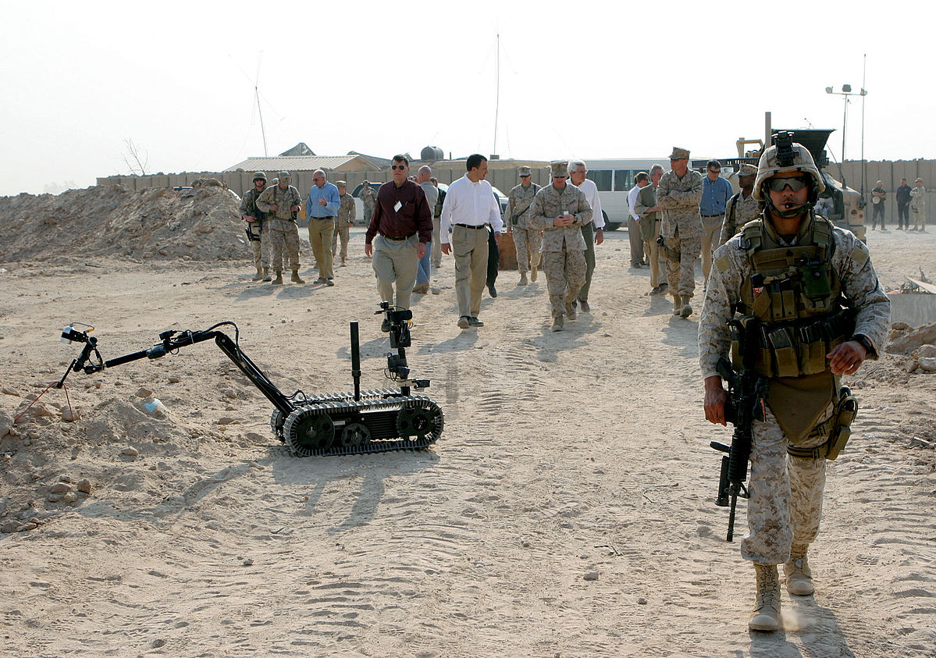
AI in EOD Operations
Autonomous drones and robots
Handle dangerous explosives
Reduces risk to human bomb squads
Notes:
Discuss how AI transforms explosive ordnance disposal.

Slide 12
Ethical Considerations in Military AI
Who is responsible for AI actions?
Need for legal accountability
Rules of engagement must evolve
Notes:
Highlight the ethical dilemmas and regulatory needs.

Slide 13
Geopolitical Divergence
Western vs. authoritarian approaches
Europe prioritizes ethics
Others focus on strategic dominance
Notes:
Show differing global perspectives on military tech regulation.

Slide 14
Global Governance Challenges
Tech outpaces policy
Dual-use nature complicates regulation
Enforcement across nations is difficult
Notes:
Examine barriers to effective international regulation.

Slide 15
International Regulation and Ethics
Call for global treaties
Export control and blueprint monitoring
Shared ethical standards
Notes:
Propose ways to regulate sensitive tech use worldwide.

Slide 16
Future Directions
AI-guided swarms
Adaptive ordnance
Integrated battlefield ecosystems
Notes:
Forecast future innovation trends and scenarios.

Slide 17
Conclusion and Recommendations
Innovations must be managed responsibly
Regulations should keep pace with tech
Ethical use ensures long-term security
Notes:
Summarize key points and present action steps.

