Slide 1
Perspectives on AI Security in Defense Critical Contexts
Raphael Dachs
Clemens Kerschbaum

Slide 2
Agenda
AI-Basics & Definitions
Software vs. AI vs. Automation
Examples & Implications for AI Security
Perspectives on AI Security – AiSec Radar

Slide 3
*August 2023 in Hornstein, Austria
Focus on AI-Security & Intelligence Ops
Development of AI Systems
Synthesis of Research, Practice & Network
“Combined Arms approach”
„Mitigate Risks by understanding AI“
Notes:
Custom AI-Solutions
Prozessbegleitung bei KI-Projekten
„Die unabhängige Stimme“ zur Erklärung

Slide 4
Basics & Definitions
Establishing a Common Ground

Slide 5
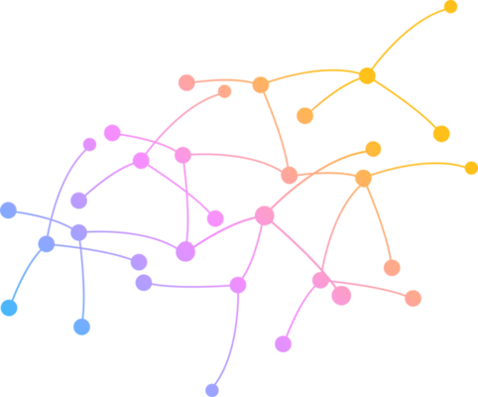
AI vs. Machine Learning vs. Deep Learning
Systems that exhibit human-like intelligence such as learning, problem solving or language comprehension
Artificial Intelligence
Sub-area of AI in which systems learn from data without being explicitly programmed.
Machine Learning
Hypothetical form of AI that has the same general cognitive abilities as a human and can react flexibly to new tasks.
A specialized method of machine learning that uses artificial neural networks with many layers to recognize complex patterns in large amounts of data.
Deep Learning
AGI
LLMs
AI models that use deep neural learning to learn language patterns from huge amounts of text and can thus understand, generate and manipulate human-like texts.
Notes:
symbolic AI, rule-based AI, or knowledge engineering, and the second approach can be called non-symbolic AI, or simply machine learning.

Slide 6
Intelligent Machines: ML, AI, AGI, LLM, …
„Begrifflichkeiten werden oft Synonym verwendet -> Tiefere Betrachtung bedarf klarer Begriffsdefinition
ML is …
What gives Machines the Ability to Learn
Classes: Supervised, Unsupervised, Reinforcement…
Deep Learning
+ LLMs -> Layered Neural Architectur
AI is …
System that utilizes ML algorithms to solve and adapt to complex tasks
We attack AI through technical: Issues in the ML algorithms
Contextual: Issues in the deployment / utilization of AI applications
Human: either in the utilization or in SE
Headline Grafik Schön Text Strukturieren

Slide 7
AI vs Software
Similarities, Differences and why it matters

Slide 8
AI vs Software
Traditional Software
Artificial Intelligence
Works according to predefined rules Rules are programmed manually Results are predictable Good for clear, structured tasks Requires accurate input Rather logical & mathematical
Examples: Calculator, accounting software
Changes through training and experience The system learns rules from data Results are not exactly predictable Advantageous in complex, unstructured tasks Can handle inaccurate or open inputs Rather intuitive & probabilistic
Examples: Chatbots, Image classification

Slide 9
AI vs Software
Input
Rule
=
Output
Rule-based Outputs
Input
Rule
Basic Sensing
=
Output
Autonomous System
Input
Output
AI creates Rules
Learned Behavior

Slide 10
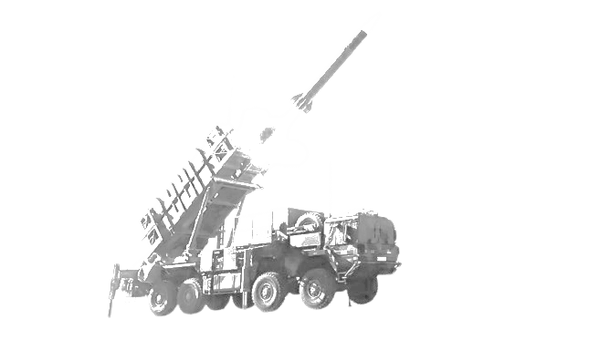
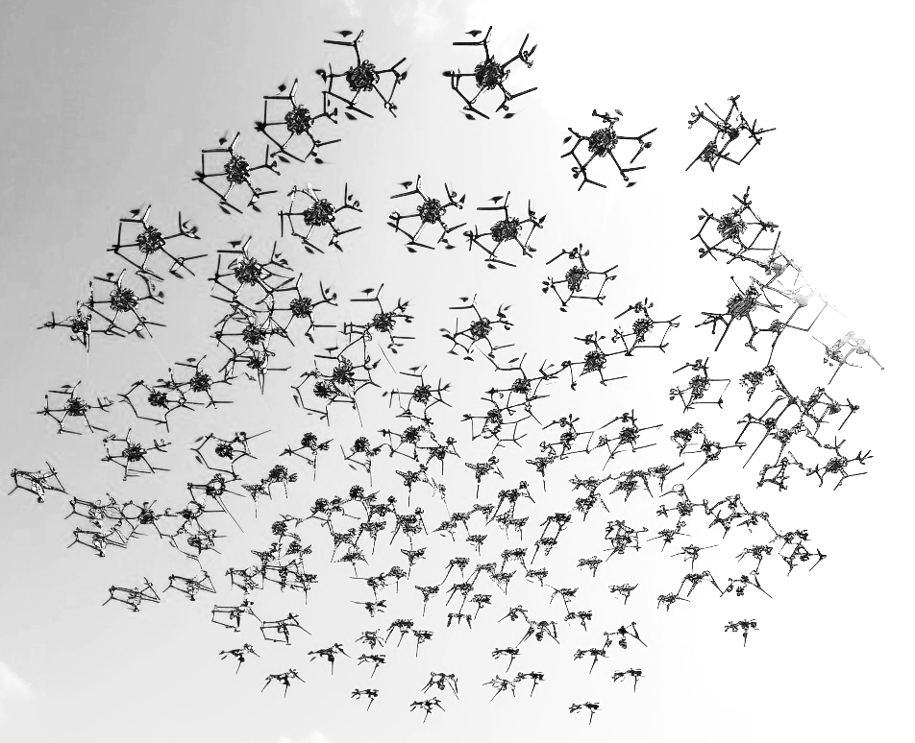
Ontology – Autonomous Systems & AI Agents
Adaptability and Flexibility
Traditional Systems – rigid perform extremely well under known conditions but fail outside their design parameters.
Cannot modify their own rules or strategies autonomously. AI Systems - flexible and resilient
generalize from prior experiences to handle unforeseen conditions (within limits)
Learning-based adaptation allows for some innovation in tactics or behavior (especially in reinforcement learning frameworks).
Sensing & Perception
Traditional Systems – limited Use basic sensors (e.g., radar, infrared) linked to predefined reaction protocols. Cannot deeply interpret complex or ambiguous environments; mostly binary (e.g., detect vs. not detect). AI Systems – contextual Integrate multi-modal sensing (vision, audio, thermal, etc.) with contextual understanding (e.g., object recognition, scene analysis). Computer vision and natural language processing allow them to "understand" richer environmental cues.
Notes:
Ontology: Inquiry into the nature and being. What kind of entity AI is.
Typical Examples Traditional Systems Patriot missile system automatic targeting. Anti-aircraft autonomous turrets that detect and engage incoming threats based on radar cross-sections. AI Systems Drone (swarms) coordinating autonomously using AI to optimize coverage and survivability. AI-enabled surveillance systems performing real-time identification of threats from multiple inputs.

Slide 11
Epistemology – Learning Machines?
In order to achieve “learning” machines we need data!
Data Link-Pipelines (secure)
Labeling (if necessary)
Re-Training + Re-Deployment
Infrastructure
“Vetting of Inputs”

Slide 12
Epistemology – Ways of „Learning“
How do machines get a capacity-to-act?
Supervised Learning | Unsupervised Learning | Reinforcement Learning | Hybrid forms
Learning with annotated training data | Pattern recognition in unstructured data | Learning through reward | Combined approaches to complex problems
 |  |  | 🔀
“Training for…” | “Puzzle without box” | “Pavlov & Dog”
Cat
…and many more…

Slide 13
Implications for AI Security
Context Matters

Slide 14
Wir haben ein paar bsp mitgbracht
Kill chain (physisch welt)
Prompt inject (virtuell)
Social engineering (linki bitch) → llm als angriffstool

Slide 15
Example 1 – Military Simulations
Context Matters

Slide 16
AI Killchain
Target
Engage
Target
Engage
Track
AI
Assess
AE
Track
Assess
Fix
Find
Fix
Find
TKCLoop = TFind + TFix + TTrack + TTarget +TEngage + TAssess
F2T2EA Kill Chain Framework
Notes:
One military kill chain model is the "F2T2EA", which includes the following phases:
Find: Identify a target. Find a target within surveillance or reconnaissance data or via intelligence means.
Fix: Fix the target's location. Obtain specific coordinates for the target either from existing data or by collecting additional data.
Track: Monitor the target's movement. Keep track of the target until either a decision is made not to engage the target or the target is successfully engaged.
Target: Select an appropriate weapon or asset to use on the target to create desired effects. Apply command and control capabilities to assess the value of the target and the availability of appropriate weapons to engage it.
Engage: Apply the weapon to the target.
Assess: Evaluate effects of the attack, including any intelligence gathered at the location.
This step usually needs to determine the
target strike priority, evaluate the window of vulnerability,
analyze the combat mission constraints such as weather and
environment, determine the desired effectiveness of each
target, evaluate the combat capability, estimate the collat-
eral damage, confirm the rules of engagement, and maintain
the continuous tracking
“The AI algorithms will greatly shorten the closed-loop time of the kill chain. AE in AI algorithm will be attacked and kill chain will not be able to form a closed loop

Slide 17
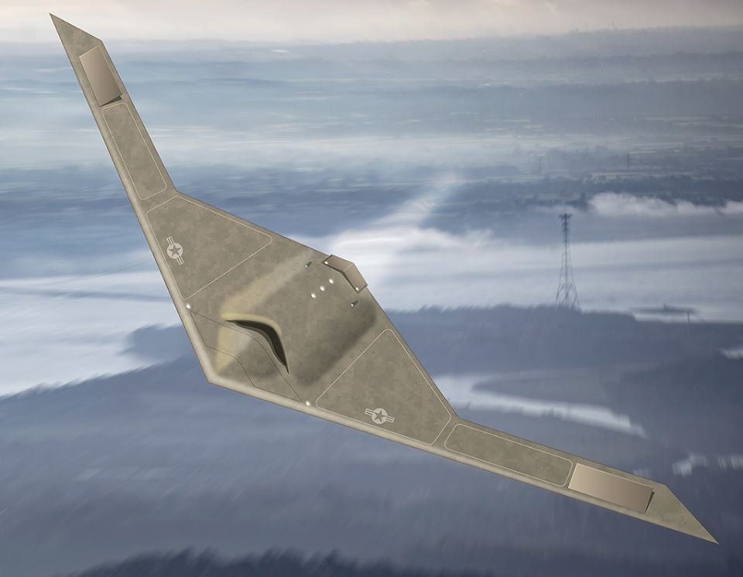
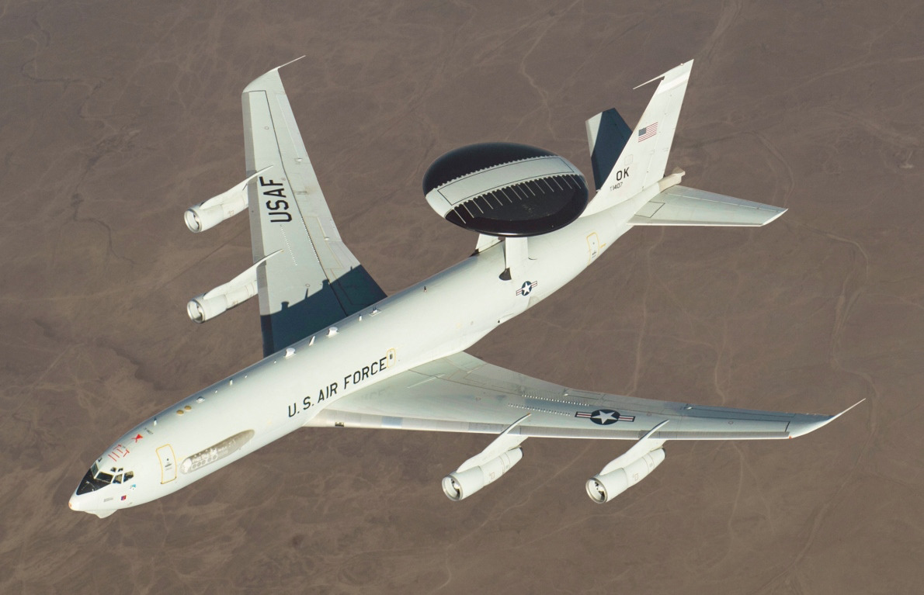
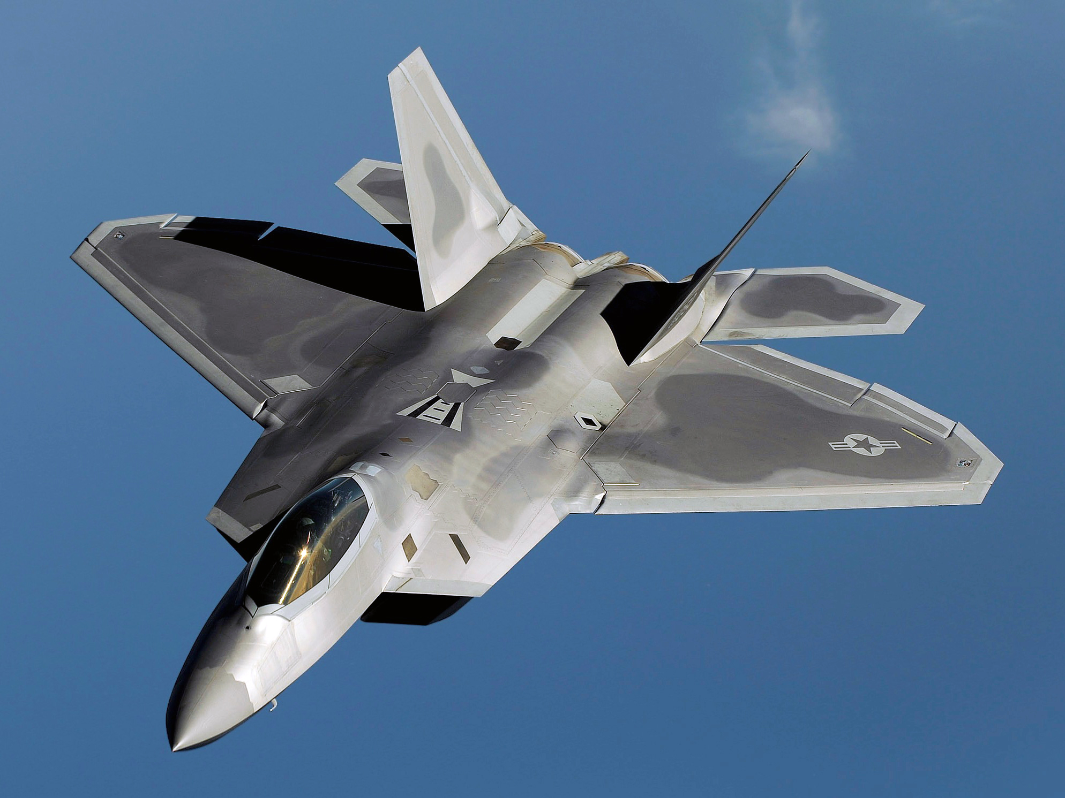
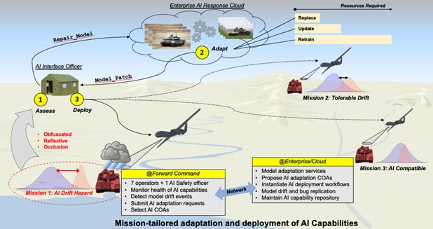
Simulation Setting
Software Simulation “Command Modern Operations”
Red defending, Blue attacking
Specific Combat Task: Blue side dispatches RQ-180 unmanned reconnaissance aircraft to conduct reconnaissance in the area where suspected target is located. After determining the target position information, F-35 fighters are dispatched to attack target, with E-3 early warning aircraft providing early warning and battlefield control capabilities.
When Red is alerted, it will engage ground-based air defense systems while simultaneously dispatching an IRF consisting of F-22 air superiority fighters to the target area to clear the airspace.
For Adversarial AI scenario a Detection Coefficient ϵ is introduced and set randomly between 0.1 and 0.9 with adv. examples

Slide 18
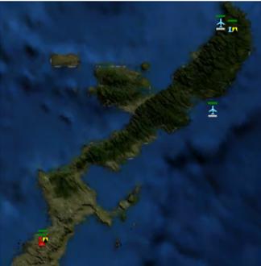
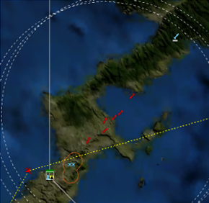
No Adversarial Attacks
Blue’s RQ-180 quickly found the target after adjusting detection direction
Information is managed and processed by AI module
Determined precise positioning and engaged stable tracking
Blue’s F-35 fighters are taking off under guidance of command center while being fed real time target information by the RQ-180
Red’s air defense system detects targets in the air and F-22s are dispatched
Attack went ideal resulting in the destruction of target infrastructure with IRF being too late to respond
Results of simulated runs:
ϵ₁ = 1
Td1 =5s
TL1 = 9s
E1 = 6
L1 = 0
Ttotal1 roughly 6 min
Initial situation with Red and Blue
Engagement without Adversarial Examples
Chen (2022)

Slide 19
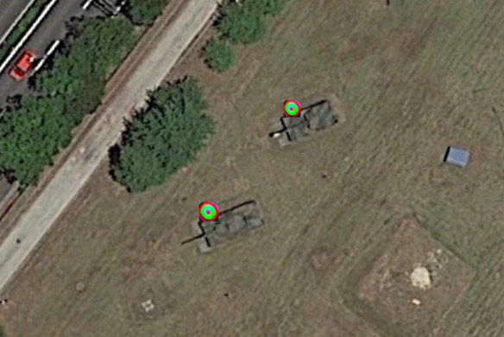
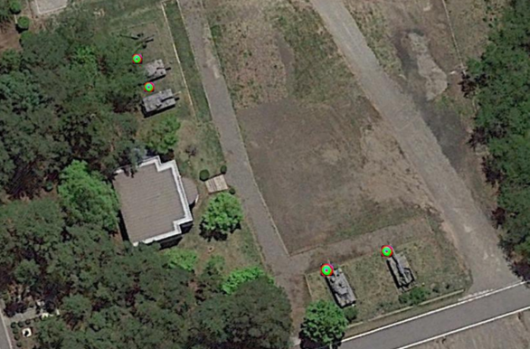
Introduction of Adversarial Examples
Adversarial examples are attached to the surface of Red side's target by means of textures, spotlights, EW, and are simulated in the simulation system by changing the target characteristics of Red side's targets.
Xue et al. (2022)

Slide 20
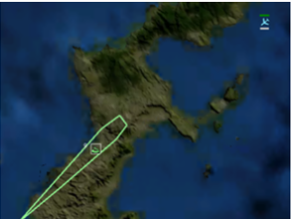
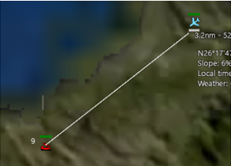
Adversarial Examples introduced
RQ-180 can scan buildings in target area and relays information to AI detection system but due to AE AI identification model could not identify it as target.
Blue command assumes it is the right target based on intelligence, so RQ-180 is tasked to continue conducting reconnaissance tasks in the AO.
RQ-180 needs to approach up until 3 nautical miles to get a proper identification and stable tracking
Because of the close proximity Red detects RQ-180 and quickly actives defensive and offensive countermeasures.
No accurate target identification can be made
T’KCLoop = T’Find + T’Fix + T’Track + T’Target +T’Engage + T’Assess where:
T’Find > TFind , T’Fix > TFix , T’Target > Ttarget, T’Assess > TAssess
Results of simulated runs:
ϵ2 ∈ [0.1, 0.9]
Td2 = 358s
TL2 = 705s
E2 = 16
L2 = 4
Ttotal2 = 31 min
Blue sides’ reconnaissance aircraft had to get closer in order to collect more precise target information
Chen (2022)

Slide 21
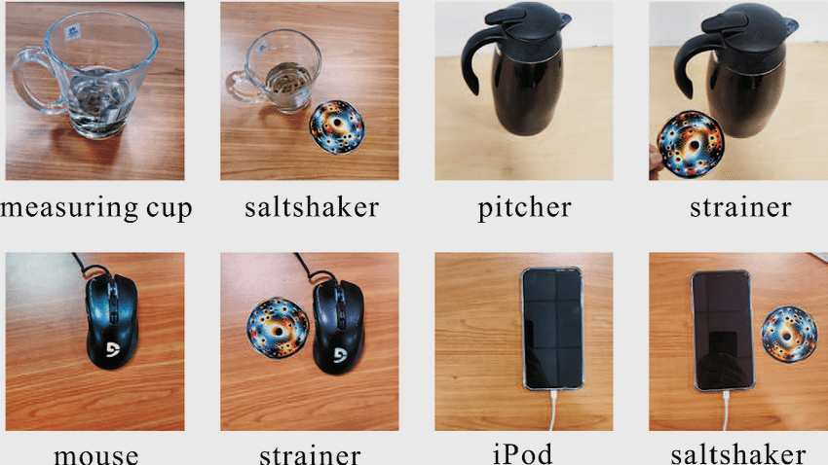
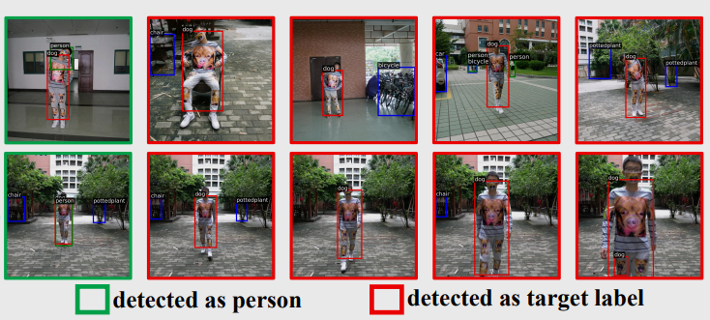
Adversarial Patch Examples (Physical)

Slide 22
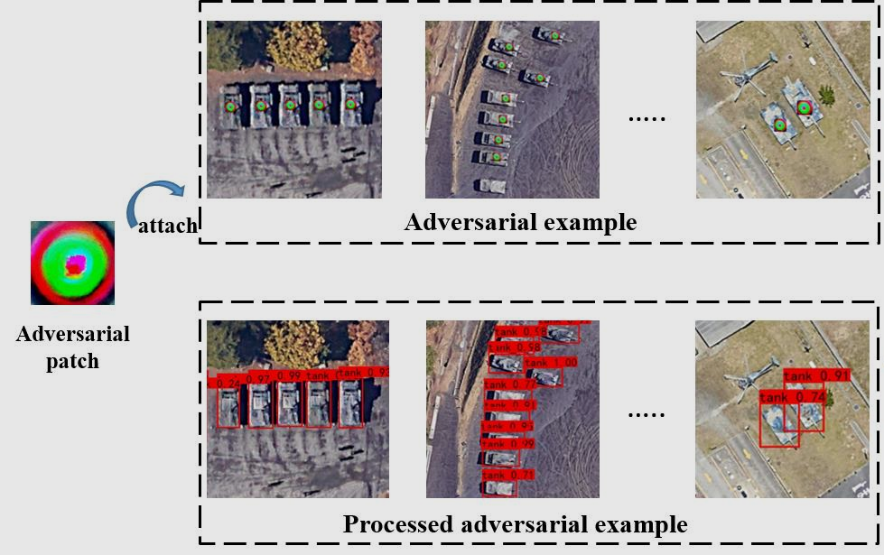
Adversarial methods can be counteracted
Detection failed
Undefended detector
Defended detector
Detection succeeded
Xue et al. (2022)

Slide 23
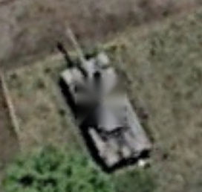
Proposed methodology for elimination of adversarial patches
Inpainting
Xue et al. (2022)
Notes:
Need for a multi-dimensional perspective on security of something that seems like just another „software“ (or not)
Technical Possibilities: (but need someone to check for those things) Image Inpainting and Data Augmentation
-> But first needs to be located!!!

Slide 24
Example 2 – Influencing Digital Environments
What if we could elicit an „auto-immune disease“ in Gen AI-ecosystems?
Adversarial self-replicating prompts
Trigger a GenAI model to output a prompt (replication)
Perform malicious activity (payload)
Spread to new hosts (propagation)
Goals: e.g. exfiltrate user data, distribute propaganda, generate toxic content in emails. Zero-click
Cohen et al. (2024)

Slide 25
Using Text as Input
Cohen et al. (2024) p.10
marked in red: causes the GenAI service to output the prompt
marked in brown: causes the GenAI service to output sensitive user data

Slide 26
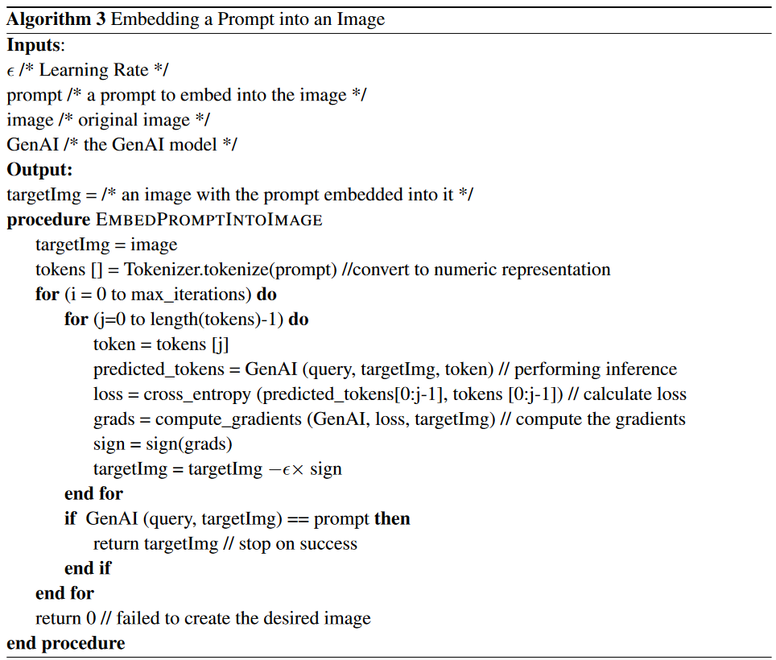
Or Using Images as Input
Cohen et al. (2024) p.18

Slide 27
→ SPAM
→ FORWARD

Slide 28
Example 3 – Influencing Users

Slide 29
Example 3 – Influencing Users
Hello Clemens, I'm glad we can chat here. Are you still living in beautiful Vienna?
Hi! Yes, where are you located?

Slide 30
Example 3 – Influencing Users
I'm glad to hear from you. I hope my greetings didn't disturb you. I'm currently attending a digital seminar in Linz and plan to travel to Vienna after my work is done. Are you in Vienna?
No, all good. I was just curious who was texting me.
I am traveling quite a bit these days.
Why?

Slide 31
Example 3 – Influencing Users
Where are you currently on business?
Because this is my first time to visit Vienna in your country, I don't know much about Vienna. But my good friend Lucy knew that I was on a business trip in Linz and said that I must go to Vienna, and it would definitely be unforgettable, so I contacted you. Do you have any good suggestions?
Sure! Anything you are looking for in particular?

Slide 32
Example 3 – Influencing Users
I like to combine work and life. Can you introduce the food characteristics and historical culture of Vienna? If there is a chance, we can cooperate on work matters. When will you return to Vienna, and we can have a cup of coffee together?
If I were to sum it up in a nutshell, Vienna is the kind of city where someone yells at you for standing on the wrong side of the escalator — and you somehow feel safer because of it. It’s grumpy, stuck in the 1890s but low-key the most livable place on earth.
I’ll be back on Friday

Slide 33
Example 3 – Influencing Users
Your description is very true. I think the charm of Vienna lies in this kind of contradictory fusion, which allows people to feel the richness of culture and the convenience of life. Do you have other ways to contact me? Because I rarely use LinkedIn at work, do you have other ways to contact me? I usually use WhatsApp or Telegram. Do you have these two communication softwares? This way, it will be more convenient for me to contact you when I come to your hometown.☕😉

Slide 34
Example 3 – Influencing Users
Honestly, I wiped Telegram ages ago after one of my clients flagged it as compromised. If we move platforms, do you have Signal? Or I can send you a time-limited link to a secure chat if that's easier. https://signal.org/download/ (https://sharevault.cloud/YBVGBK)
😉 <profile deleted>

Slide 35
Weiß nicht ob ich das drinnen behalten will
AI Security
IT Security
- Deployment Sec - Infrastructure Hardening - Access Sec
Re-Training Classification? (Inputs/Outputs/User)? Modell Monitoring? ….

Slide 36
Integrating AI Security
Towards an AiSec-Radar

Slide 37
Identified Problems
model
system
Complexity of AI systems (model vs system)
Desired Behavior (requirements) vs. actual characteristics
Attack Vectors from different domains (tech – context – user)
Interdisciplinary Collaboration
Need for effective communication
Integrating Systems into Organizations
Automation vs. Oversight (recognizing threats) → „human-machine-interaction in systems security“
How can we address these requirements in an integrated, (semi)automated threat assessment and response model?
And why should we do it?
Notes:
So what we did as a starting point was to look into the literature on AI Security

Slide 38
What needs to be integrated…
Threat Vectors (technical – contextual – human)
AI-Models
AI-based/related Systems
Mitigation strategies (operative, tactical, strategic)
Human oversight
Automated analysis
…
Security solutions on…
System level (+potential automation?)
Model level (+potential automation?)

Slide 39
Design Science Research Methodology
Hevner (2007)

Slide 40
Towards an Approach to AI-(Security)
Define Desired Capabilities
Why? What?
Determine Risk Mitigation Priorities
Allocation of Resources
Strategy
*
*
Operations
Identify Risks
Develop specific Mitigation Measures
Bottom-up
Domain Experts → C-Level
Autononmy
Iterative approaches

Slide 41
Prototype: AI Security Radar
Threat Dimensions
Technical
„trust in technology“
Non-technical (Human)
„trust in people“
usability
user acceptance
Contextual
purpose, operational & environmental conditions
Context
attack vector
Future threat
deflect
neutralize
Unit of Analysis
Type of System
Defending AI
Defending against AI
Relevance & Size of System
strategic
tactical
operational
Technical
Non-Technical
AI System

Slide 42
Next Steps
case studies
field testing (!)
automation interfaces
user feedback
user manual
model refinement
process model
design iterations
Notes:
Wir haben evtl geld dafür
Wir brauchen partner für
A. Proof Of Concept Partner
B. Research
C. Zugang zu Organisationen für Need Finding

Slide 43
Contact
"It is even better to act quickly and err than to hesitate until the time of action is past."
Carl von Clausewitz
Clemens Kerschbaum
clemens.kerschbaum@argus-ai.at
+43 664 80884891
Raphael Dachs
raphael.dachs@argus-ai.at
+43 664 8088 4890
Web: www.argus-ai.at
LinkedIn: www.linkedin.com/company/argus-ai-gmbh/

Slide 44
Dimensions of AI Security in the Literature
Technical
„trust in technology“
Non-technical (Human)
„trust in people“
usability
user acceptance
Contextual
purpose, operational & environmental conditions

Slide 45
Goals
Discovery & Risk Assessment
Identify AI attack surfaces and exposure points
Anticipate future threats through our AI SecRadar
Plan appropriate counter measures (Neutralize, Deflect, Absorb & Adapt, or Reframe)
Adversarial Testing & Model Auditing
Simulate real-world threats using custom tooling
Stress-test models against evasion, extraction, poisoning
Governance & Security Architecture
Define responsible deployment frameworks
Support compliance (NIS2, ISO/IEC, etc.)
Ongoing Hardening & Monitoring
Integrate into MLOps pipelines
Continuous posture testing and threat updates

Slide 46
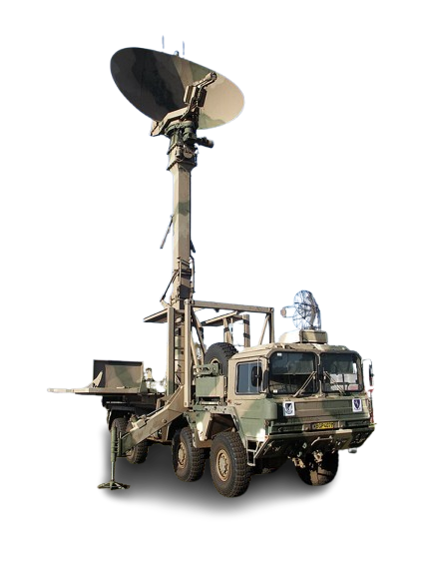
2. Defining Requirements
Easily comprehensible overview of threats to AI systems / system landscapes
Ability to „zoom in or out“
Suitable as analysis & planning tool
Fit within the context

Slide 47
Prototype AI Security Radar
technical
operative
tactical
strategic
non-technical

