Slide 1
«Autonomous Weapons and Soldier Morale»
André Korsmo Berntsen, University of Bergen
Olt Cyrill Kischel, ETH Zurich
Olt Nick Husmann, ETH Zurich
Militärakademie an der ETH Zurich
Notes:
Imagine facing the enemy — but never seeing them. You’re not even sure if it’s a human behind the trigger. This is not science fiction. It’s the reality of modern warfare — and today, we ask: What does it do to morale?
"Good morning/afternoon. My name is André Berntsen, and along with my co-authors, Cyrill Kischel and Nick Husmann, I will be discussing a critical intersection of technology and the human element in warfare: Autonomous Weapons and Soldier Morale."
"This presentation draws from our research exploring how the rise of autonomous weapons systems, or AWS, impacts morale, within soldiers in the field, within the military organization, and within society itself."
"We will examine historical parallels, draw lessons from the ongoing drone warfare in Ukraine, and discuss the crucial implications for military leaders and policymakers.

Slide 2
«Autonomous Weapons and Soldier Morale»
KLASSIFIZIERUNG: INTERN
André Korsmo Berntsen, Cyrill Kischel, Nick Husmann
ETH Zurich, University of Bergen

Slide 3
Introduction
Rapid Technological Shifts: Warfare is being transformed by AI and autonomy.
The Human Element: How do these systems affect the soldier's psyche and will to fight?
Focus: Psychological impact of Autonomous Weapons Systems (AWS) on soldier morale.
Central Case Study: Lessons from extensive drone use in the Ukraine conflict.
Research Question: How are AWS and the narratives surrounding them expected to affect soldiers' combat morale, service morale, and societal morale to defend?
VBS/DDPS - Urheber (André Scheidegger)
Notes:
(Point 1): "We are witnessing a fundamental transformation in warfare, driven by the rapid advancement of artificial intelligence and autonomous capabilities. The very nature of conflict is shifting."
(Point 2): "But amidst this technological revolution, a crucial question remains: What about the human core? How do these sophisticated systems affect the psychology, the resilience, and ultimately the will to fight of the individual soldier?"
(Point 3): "Our research zeroes in on this human dimension, specifically examining the psychological impact of Autonomous Weapons Systems – AWS – on the multifaceted concept of soldier morale."
(Point 4): "The ongoing conflict in Ukraine, with its unprecedented integration of drones and emerging autonomous functions, provides a vital, real-world laboratory for understanding these dynamics."
(Point 5): "This leads us to our central research question: How are AWS, and just as importantly, the narratives surrounding them, expected to influence the different dimensions of morale – the soldier's readiness for battle (combat morale), their commitment to daily military life (service morale), and the essential societal backing for defense efforts (morale to defend)?"

Slide 4
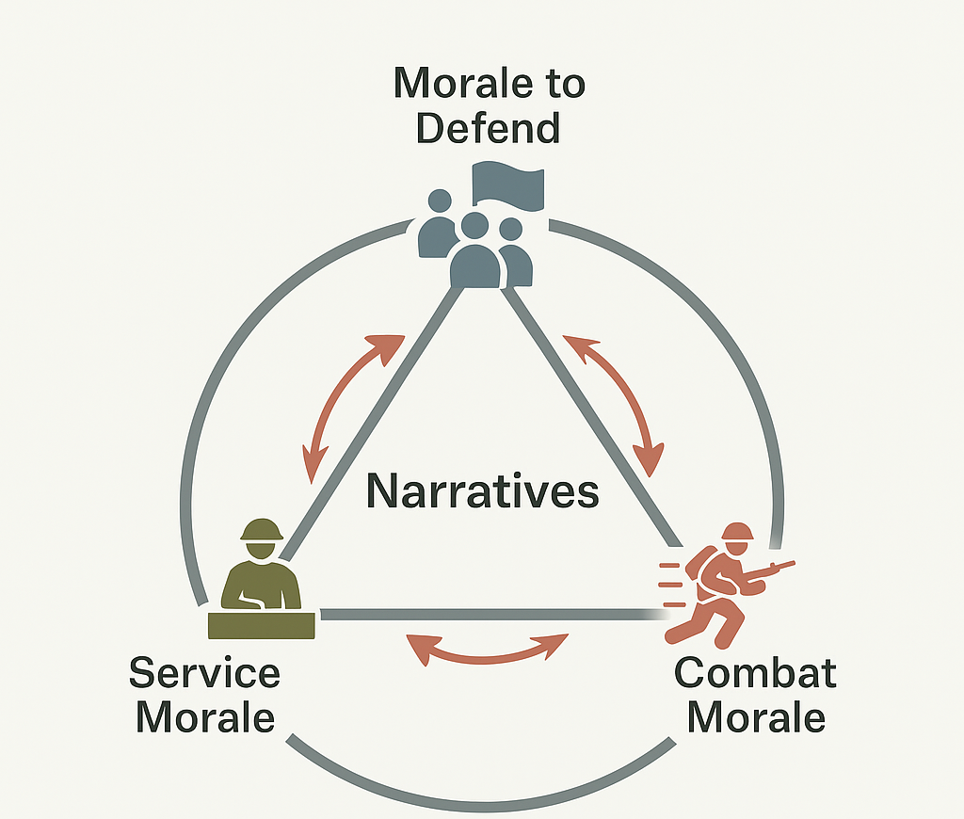
Conceptual Framework
Annen’s tripartite model:
Morale to Defend (societal-level support)
Service Morale (routine military life)
Combat Morale (willingness to fight)
The power of Narratives, shaping perceptions and justifying actions
Ethical imperative of meaningful human control
Own illustration
Notes:
(Point 1): "To dissect this complex issue, we employ Annen's well-established tripartite model of morale. It helps us understand that morale isn't monolithic.
First, there's the Morale to Defend – this resides at the societal level. It’s the public's belief in the necessity and legitimacy of the military and its actions, crucial especially in democracies and conscription-based systems.
Second, Service Morale. This is about the individual soldier's long-term commitment, their motivation, and well-being within the military organization. Think factors like leadership, meaningful work, and career outlook.
Third, Combat Morale. This is the sharp end – the soldier's willingness to face extreme danger and perform under fire. It’s heavily influenced by unit cohesion, trust in leaders, and mental resilience."
(Point 2): "Crucially, these levels are interconnected and profoundly shaped by narratives. Stories – whether official doctrines, media portrayals, or soldier Canteen talk – frame our understanding, justify actions, and ultimately bolster or undermine morale. As the article notes, narratives offer 'meanings and assumptions' acting as 'a guidance tool for personal justified actions'."
(Point 3): "And anchoring this entire framework, particularly when discussing AWS, is the ethical imperative of maintaining Meaningful Human Control over lethal systems. This isn't just a technical detail; it's fundamental to legitimacy and trust."

Slide 5
An Army which preserves its usual formations under the heaviest fire... disputes the ground inch by inch... never loses its sense of obedience, its respect for and confidence in its leaders, even under the depressing effects of defeat; an Army with all its physical powers, inured to privations and fatigue... looks upon all its toils as the means to victory... Such an Army is imbued with the true military spirit. Carl von Clausewitz, J.J Graham(Translator), On War, 2006, bk. 3 Chapter 5,

Slide 6
Methodology
Narrative analysis of historical and contemporary sources
Qualitative synthesis of:
Historical cases of technological innovation
Ukraine drone warfare data and secondary literature
Limitations: Exploratory; no direct morale quantification.
VBS/DDPS - Urheber (Unbekannt)
Notes:
(Point 1): "Our methodological approach is a Narrative Analysis. We examine and interpret historical accounts of technological shifts in warfare alongside contemporary reports and analyses."
(Point 2): "Our key sources include deep dives into historical precedents – like the introduction of tanks, submarines, and the impact of televised war in Vietnam – combined with analysis of the extensive data and secondary literature emerging from the drone-heavy conflict in Ukraine."
(Point 3): "Through qualitative synthesis, we aim to construct a coherent narrative that illuminates the complex, often subtle relationships between new military technologies, the stories told about them, and observable shifts in morale."
(Point 4): "It's important to frame our findings correctly: this is an exploratory study. We are identifying trends and patterns, not providing precise, empirical measurements of morale, and acknowledge limitations in accessing direct testimony, particularly from Ukraine."

Slide 7
Historical Technology Cases – Combat Morale
Case: WWI Tanks - Early psychological impact.
Boosted morale (Percieved power)
Technically unreliable
Decreased morale of enemy troops
Perceived control vs. vulnerability drastically affects combat morale.
Technology shifts the perception of battlefield control
Photograph Q 2486 Collections of the Imperial War Museums (collection no. 1900-09)
Notes:
Point 1 & 2): "History provides powerful illustrations. Consider the debut of tanks in World War I. Despite their initial technical flaws, their psychological impact was enormous. For Allied infantry, these machines offered a perceived shield against machine guns, a tangible sense of increased power that significantly boosted their combat morale and willingness to attack. Soldiers described them as 'a decisive factor for their courage'."
(Point 3): "Conversely, for German soldiers encountering this novel threat, the effect was shock and panic, demonstrating the potent demoralizing effect of intimidating new technology."
(Point 4): "This case vividly shows how dramatically technology can alter the perception of control versus vulnerability on the battlefield, directly impacting the will to fight. It speaks to the enduring importance of the 'true military spirit' Clausewitz described – that ability to withstand fire and stress. An army possessing this spirit, he wrote, '...preserves its usual formations under the heaviest fire... disputes the ground inch by inch... never loses its sense of obedience, its respect for and confidence in its leaders... Such an Army is imbued with the true military spirit.' New technology can fundamentally challenge or reinforce this spirit by reshaping the soldier's psychological experience of combat."

Slide 8
Historical Technology Cases – Service Morale
Case: WWI U-boats an unseen threat
The fear of the unknown wreaks havoc on sailors service morale
Chronic stress, and feelings of lost autonomy
Countered through: Training, understanding, stricter protocols
Persistent, invisible threats require active and visible organizational countermeasures.
IWMCollections IWM Photo No.: Q 20220
Notes:
(Point 1 & 2): "Another WWI example involves the British Navy facing German U-boats. Here, the threat was different – it was invisible and constant. This pervasive, unpredictable danger created chronic stress and feelings of helplessness among sailors, significantly degrading their service morale – their capacity to endure the daily grind of naval duty under threat."
(Point 3): "Recognizing this, the naval leadership responded proactively. They increased technical training to help sailors understand the threat and implemented stricter routines and discipline to enhance the feeling of safety and control aboard ships."
(Point 4): "The lesson here is crucial, especially in light of modern surveillance: when technology creates persistent, invisible threats, organizations must actively counteract the negative effects on service morale through training, structure, and by fostering narratives of competence and mastery."

Slide 9
Historical Technology Cases – Morale to Defend
Medias power to shape public opinion
Case: Vietnam war – Uncensored tv images.
"Credibility gap"; negative effect on recruitment & morale.
Morale collapses when legitimacy is questioned
Public narrative is critical; loss of legitimacy undermines all morale levels.
US Military Picture, U.S. National Agricultural Library. (From en wiki, uploaded by w:user:Achille)
Notes:
(Point 1): "The narrative presented to the public has immense power over the Morale to Defend – society's willingness to support a war effort."
(Point 2 & 3): "The Vietnam War remains a watershed example. Uncensored television coverage brought the brutal realities of combat into homes nightly, starkly contrasting with optimistic official reports. This created a profound 'credibility gap,' leading vast segments of the public to question the war's legitimacy."
(Point 4): "This collapse in public trust and support had direct, devastating consequences for the military. Recruitment became increasingly difficult. More importantly, soldiers in the field felt isolated, unsupported, and began questioning the purpose of their sacrifice, leading to plummeting service and combat morale."
(Point 5): "The insight is stark: public narrative and perceived legitimacy are not peripheral issues. A breakdown in societal support can poison morale across all levels, from recruitment to the front lines."

Slide 10
When Machines Take Aim: Defining Autonomy in Warfare
Drones: Remotely piloted or pre-programmed; tactical to strategic.
AWS: Capable of independent target selection & engagement post-activation.
Key Distinction: Potential shift from human 'in/on' loop to 'out of the loop'.
Concerns: Accountability, bias, escalation, Meaningful Human Control (MHC).
VBS/DDPS - Urheber (André Scheidegger)
Notes:
(Point 1): "Before focusing on Ukraine, let's clarify terms. Drones,, range widely from small tactical platforms to large strategic ones, typically remotely operated or following set paths."
(Point 2): "Autonomous Weapons Systems, or AWS, go further. They are designed with the capability to independently select and engage targets based on pre-programmed parameters, once activated by a human."
(Point 3): "The critical distinction lies in potentially removing the human from direct control over the final lethal action – moving from 'human in or on the loop' to potentially 'human out of the loop' for engagement."
(Point 4): "This capability, driven by AI, raises significant concerns regarding accountability if things go wrong, potential algorithmic bias, risks of unintended escalation, and the ethical necessity of maintaining Meaningful Human Control."

Slide 11
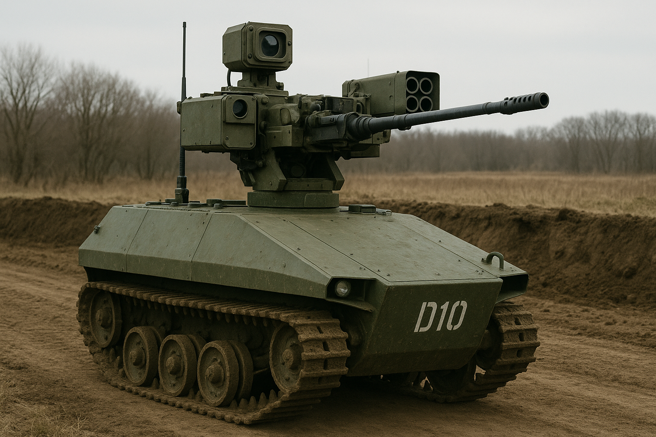
Autonomous Weapon Systems (AWS)
A weapon system that, once activated, can select and engage targets without further intervention by an operator. This includes, but is not limited to, operator-supervised autonomous weapon systems that are designed to allow operators to override operation of the weapon system, but can select and engage targets without further operator input after activation. U.S. D.O.D. Directive 3000:09
AWS defined: target selection and attack without human input
Ethical and psychological risks:
Accountability gap
Potential morale impacts
Erosion of perceived human agency
Ai-Generated image
Notes:
(Point 1): "Focusing specifically on AWS, the definition provided by the U.S. Department of Defense is instructive. It defines them as weapon systems that, 'once activated, can select and engage targets without further intervention by an operator'. This explicitly includes systems where humans can override, but which can operate lethally without further input."
(Point 2): "This capability crystallizes the key risks we've touched upon. The Accountability Gap becomes acute – if an autonomous system causes unintended harm, who bears responsibility? Furthermore, there's a deep concern about the erosion of human agency – removing human judgment and potentially empathy from the critical moment of lethal decision-making, as critics argue."
(Point 3): "From a morale perspective, the implications are significant. Entrusting lethal decisions to machines can fundamentally undermine soldiers' trust in their equipment and potentially their leaders. The perceived loss of human control can be deeply unsettling, impacting both willingness to fight and commitment to serve."

Slide 12
Ukraine: A Case Study in Robot-First Warfare
Ukraine: Drone warfare reshaping tactics ('robot first').
Dominance of small, tactical drones (ISR, strike).
Psychological Pressure: Constant
surveillance ("thousand snipers in the sky").
Dynamic: Rapid innovation/counter-innovation cycle.
«on the Western Front, each side gradually learned from its mistakes, but often applied that learning only to find that its adversary had learned a little more» Michael Howard
VBS/DDPS - Urheber (Unbekannt)
Notes:
(Point 1): "Turning now to the Ukraine conflict, we see these concepts playing out in real-time. Drone warfare isn't just present; it's often dominant, fundamentally reshaping tactics on the ground. We're seeing the rise of 'robot first' concepts and drones reportedly responsible for a huge percentage of casualties."
(Point 2): "This creates an intense psychological pressure cooker for soldiers. The feeling of being under constant surveillance from adversaries' drones has been starkly described as living under 'a thousand snipers in the sky'. This creates a qualitatively different kind of stress from intermittent artillery fire – it's persistent and pervasive."
(Point 3): "The conflict also exemplifies a rapid, high-stakes innovation cycle. Both sides constantly develop new drone tactics, technologies, and countermeasures, creating a dynamic arms race. As Michael Howard observed in the context of World War I, but highly applicable here: '...on the Western Front, each side gradually learned from its mistakes, but often applied that learning only to find that its adversary had learned a little more.' This continuous adaptation creates periods of intense vulnerability and uncertainty for soldiers when the adversary gains a temporary technological edge, directly impacting morale."

Slide 13
Ukraine – Combat and Service Morale
Combat Morale: Pressured by surveillance, BUT potentially boosted by friendly drones.
Service Morale (Operators): High stress, isolation, potential lack of recognition.
Resilience Factors: Need for tailored support, cohesion-building, role validation.
https://war.ukraine.ua - Urheber (Wjatscheslaw Ratynskyj)
Notes:
(Point 1): "Looking specifically at morale impacts in Ukraine: Combat morale is under pressure from constant enemy surveillance, inducing a feeling of lost control. However, it's not entirely negative. Access to friendly drones for reconnaissance or protection can boost morale by restoring situational awareness and a sense of agency."
(Point 2): "Challenges to Service Morale are particularly acute for drone operators themselves. They face immense stress, potential 'psychological whiplash', and often work in physical and social isolation, detached from traditional unit structures and the vital camaraderie that builds resilience. As one source notes, 'one of the most significant drivers of morale [lies in] the fellow soldier'. Furthermore, there's a risk they may lack recognition, being seen more as technicians than warriors, which can undermine long-term commitment."
(Point 3): "This highlights the critical need for developing tailored resilience factors: specific psychological support programs, intentional efforts to build cohesion and peer support networks for technical personnel, and clear organizational validation of their essential contributions."

Slide 14
Ukraine – Morale to Defend
Mediatized War: Unprecedented public access via digital platforms.
Double-Edged Sword: Mobilizes support BUT risks fatigue/disillusionment.
Narrative Battleground: Framing of events is crucial for societal support.
Strategic Imperative: Managing narratives vital for long-term public will.
https://war.ukraine.ua - Urheber (Kostiantyn Liberow & Wlada Liberowa)
Notes:
Point 1): "The Ukraine war also vividly demonstrates the impact of conflict in the digital age on the Morale to Defend. Social media and instant news provide unprecedented public access to the front lines."
(Point 2): "This is a distinct double-edged sword. It can galvanize immense public support – fundraising, volunteering, reinforcing narratives of heroic defense. But the relentless exposure to graphic content also risks 'compassion fatigue,' desensitization, and disillusionment over time."
(Point 3): "The information space truly becomes a narrative battleground, where how events are framed – as justified actions or unbearable atrocities – directly shapes societal willingness to continue supporting the conflict."
(Point 4): "Therefore, managing these narratives and countering misinformation becomes a strategic imperative for maintaining the long-term public will required to sustain the defense effort."

Slide 15
Implications for Military Leaders
Proactive Narrative Management: Frame AWS within ethics & control.
Bolster Combat Morale: Ensure soldier agency & mastery.
Cultivate Service Morale: Integrate & support "tech soldiers"; avoid divides.
Secure Morale to Defend: Build public trust via transparency & Human control
VBS/DDPS - Urheber (Joshua Kropf)
Notes:
"So, what are the essential implications for military leaders? Our analysis points to four key imperatives:"
Point 1): "First, Proactive Narrative Management is essential. Leaders must actively shape how AWS are understood, embedding them within existing military ethos and consistently communicating the primacy of ethical guidelines and human control. Don't let the technology's narrative run unchecked."
(Point 2): "Second, take deliberate steps to Bolster Combat Morale. This means adapting training and doctrine to ensure soldiers feel competent and retain a sense of meaningful agency and control on the battlefield, even when interacting with autonomous systems."
(Point 3): "Third, actively Cultivate Service Morale for all personnel. Create recognized career paths for technical specialists, invest in tailored support systems, and foster an inclusive culture that values both traditional combat skills and technical expertise, explicitly working to avoid organizational divides."
(Point 4): "And fourth, Secure the Morale to Defend. This requires earning and maintaining public trust through transparency about AWS capabilities and limitations, and establishing clear, verifiable policies that guarantee meaningful human control and legal accountability. Without this societal backing, the legitimacy of using these systems evaporates."

Slide 16
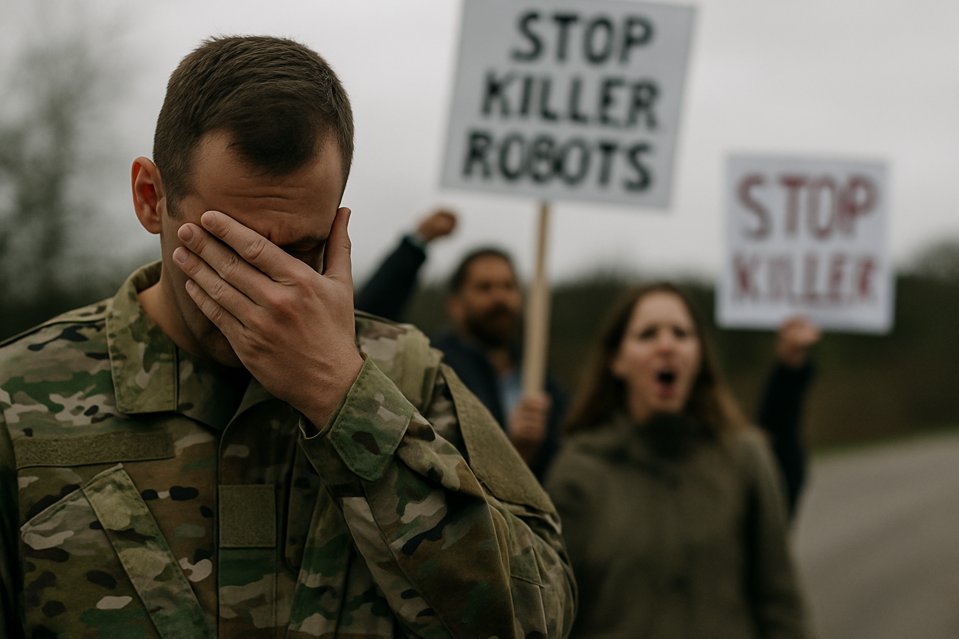
What Happens If We Get It Wrong?
Loss of soldier trust
Fragmented force: tech vs. tradition
Recruitment crisis
Public outrage after AWS mistakes
Weakening of democratic legitimacy
Ai-Generated image
Notes:
(Opening): “Before we close, we need to consider the consequences if we fail to integrate autonomous weapons systems thoughtfully and ethically.”
(Notes for Bullet 1): “First, we risk a breakdown in trust within the force. Soldiers may feel alienated or unsupported by machines they neither control nor understand.”
(Notes for Bullet 2): “Second, we face the danger of internal division. A fragmented force where traditional soldiers and technical personnel don’t trust each other weakens cohesion — and effectiveness.”
(Notes for Bullet 3): “Third, a crisis in recruitment. If the public perceives military service as morally ambiguous or dominated by machines, motivation to enlist — especially among young people — will suffer.”
(Notes for Bullet 4): “Fourth, the public’s response to even a single AWS error could be catastrophic. Without clear accountability, outrage spreads fast. Trust in the armed forces can evaporate overnight.”
(Notes for Bullet 5): “And finally, these issues undermine democratic legitimacy itself. If civilians lose faith in military leadership or see AWS as unethical, the will to defend erodes at the national level.”
(Closing): “So the stakes are high. But this slide isn’t meant to instill fear — it’s to make the risks visible. If we act early, transparently, and with strong leadership, we can avoid these outcomes. But we must act deliberately.”

Slide 17
Narratives Win Wars: The Leadership Imperative
Technological effects on morale are narrative-dependent
Historical and current wars show morale is malleable, shaped by integration and management.
AWS can strengthen or undermine morale depends on framing, not tech alone
Leadership must manage the cultural integration of AWS deliberately
VBS/DDPS - Urheber (André Scheidegger)
Notes:
(Point 1): "In conclusion, our research strongly indicates that technology itself does not determine its effect on morale. Its impact is critically narrative-dependent and shaped by the human and organizational context surrounding its use."
(Point 2): "Morale, across all its levels, is malleable. History and the current conflict show it can be strengthened or severely weakened by technological shifts, depending entirely on how those shifts are integrated and managed through leadership."
(Point 3): "Autonomous Weapons Systems represent both significant potential and considerable peril. Whether they become a source of strength or a weakness hinges less on the technology itself, and more on how they are framed, controlled, and integrated into our ethical structures."
(Point 4): "Therefore, the imperative for leadership is clear: the cultural, ethical, and practical integration of AWS must be managed deliberately, proactively, and holistically."
(Point 5 & Closing): "As we argue in our paper, 'morale is the soul of war, and even autonomous machines will operate in the shadow of existing human narratives'. The fundamental challenge is uniting technological innovation with the psychological and ethical grounding that motivates soldiers and legitimizes military action in the eyes of society. Successfully navigating this requires us to, as we phrase it, 'maintain humanity as the moral compass in the midst of war’s autonomous storm'. How we meet this challenge will define the future effectiveness and character of our armed forces."
"Thank you."

Slide 18
Literature:
Manning, Frederick J., ed. Military Psychiatry: Preparing in Peace for War. Washington, D.C.: Office of the Surgeon General, U.S. Department of the Army, 1994.
McEwen, Andrew. “‘A Useful Accessory to the Infantry, but Nothing More’: Tanks at the Battle of Flers-Courcelette, September 1916.” Canadian Military History 20, no. 4 (April 30, 2012). https://scholars.wlu.ca/cmh/vol20/iss4/2.
Molendijk, Tine. Moral Injury and Soldiers in Conflict: Political Practices and Public Perceptions. 1st ed. London: Routledge, 2021. https://doi.org/10.4324/9781003089957.
Newman, Christopher. “‘Moralization’ of Technologies – Military Drones: A Case Study.” E-International Relations (blog), May 2, 2012. https://www.e-ir.info/2012/05/02/moralization-of-technologies-military-drones-a-case-study/.
U.S. Department of Defense. DoD Directive 3000.09: Autonomy in Weapon Systems. Washington, D.C.: Office of the Under Secretary of Defense for Policy, January 25, 2023. https://www.esd.whs.mil/portals/54/documents/dd/issuances/dodd/300009p.pdf.
Watson, Alexander. Enduring the Great War: Combat, Morale and Collapse in the German and British Armies, 1914–1918. Cambridge Military Histories. Cambridge, UK: Cambridge University Press, 2008.
Zasiekin, Serhii, Victor Kuperman, Iryna Hlova, and Larysa Zasiekina. “War Stories in Social Media: Personal Experience of Russia-Ukraine War.” East European Journal of Psycholinguistics 9, no. 2 (December 26, 2022): 160–70. https://doi.org/10.29038/eejpl.2022.9.2.zas.
VBS/DDPS - Urheber (Nicola Pitaro)

Slide 19
Discussion
VBS/DDPS - Urheber (Philipp Schmidli)

Slide 20
Thank you!
MPhil. André Korsmo Berntsen
Research Associate Military Academy at ETH Zurich
Department of Leadership and Communication
Military Academy at ETH Zurich
Kaserne, CH-8903 Birmensdorf, Switzerland
Tel +41 58 464 80 31
Andre.Berntsen@vtg.admin.ch

Slide 21
MPhil. André Korsmo Berntsen
Research Associate Military Academy at ETH Zurich
Department of Leadership and Communication
Military Academy at ETH Zurich
Kaserne, CH-8903 Birmensdorf, Switzerland
Tel +41 58 464 80 31
Andre.Berntsen@vtg.admin.ch

Slide 22
Vorname Name Organisation Adresse +00 000 00 00 00 +00 000 00 00 00 E-Mail
US Military Picture, U.S. National Agricultural Library. From en wiki, uploaded by w:user:Achille

