Slide 1
The WarTech Nexus –
Are Military Structures Fit Enough?
SCHULYOK Bernhard, MA
Ministry of Defence, Military Strategy Division
Dr. GRANGL Lukas
Member of the Austrian Armed Reserve Forces, Military Expert
Dr. GRUBER Markus
Member of the Austrian Armed Reserve Forces, Military Expert

Slide 2
The WarTech Nexus Are Military Structures Fit Enough?
“Intelligence is The Ability to Adapt to Change.“ (Stephan Hawking)

Slide 3
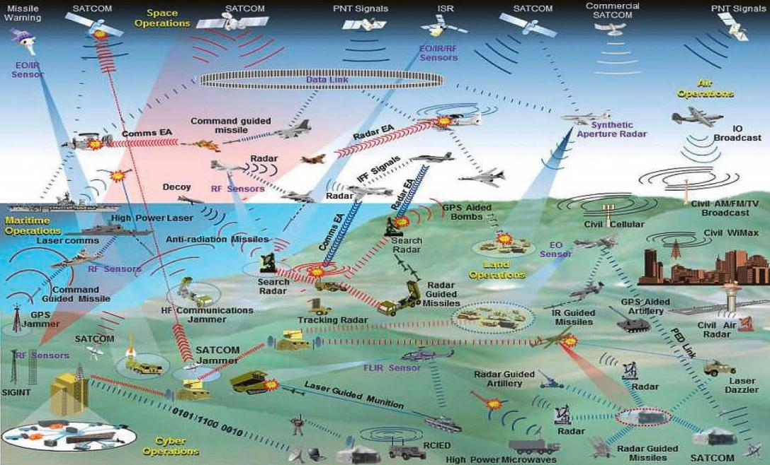
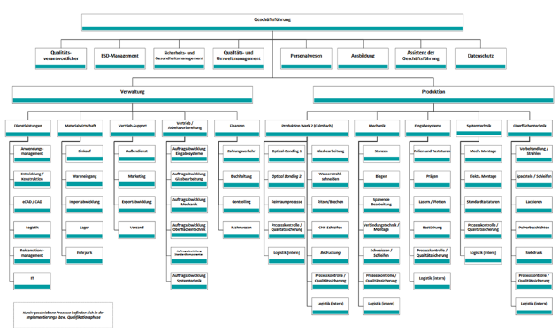
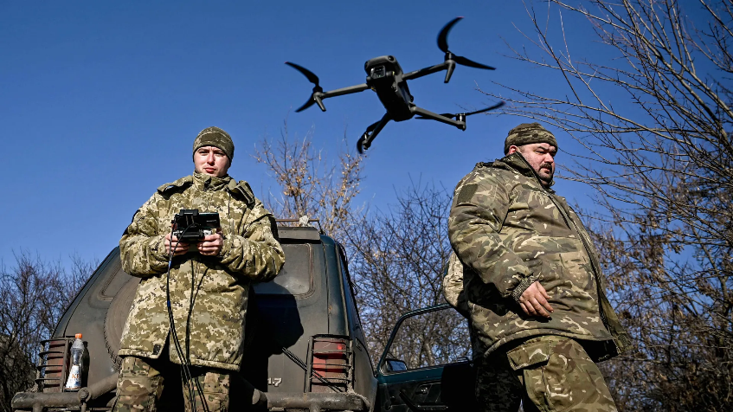
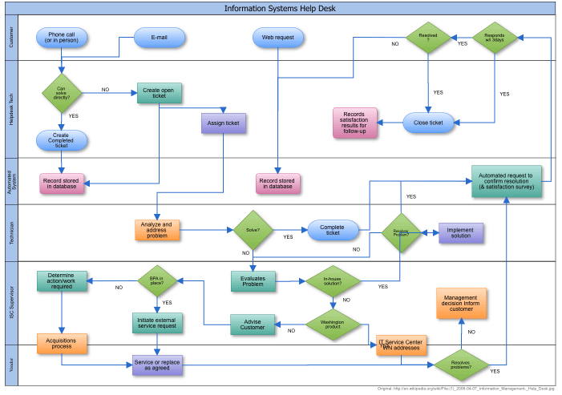
What´s the Problem?
Hierarchy
?
Processes
Time from Innovation to Implementation:
rather years than months
Time from Innovation to Implementation:
rather months, sometimes only weeks

Slide 4
Agenda / Intro
Part 1: The Innovation Readiness Gap & Organizational Fitness
Part 2: Transformation to an Innovative Military Organization
Part 3: Technology as a Catalyst

Slide 5
Part I The Innovation Readiness Gap & Organizational Fitness

Slide 6
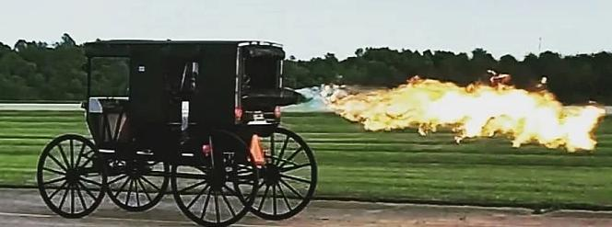
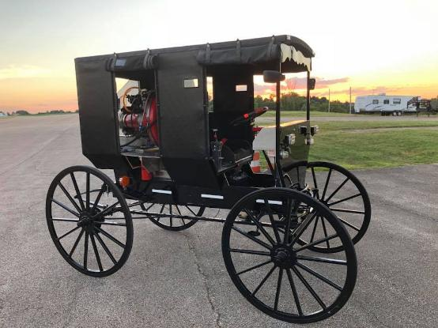
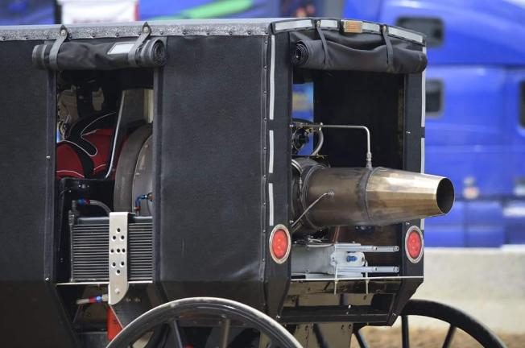
…putting a jet engine on a horse cart- power without integration is useless.

Slide 7
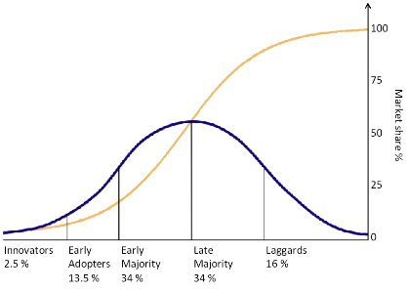
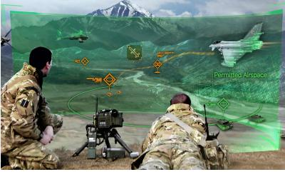
The Innovation Readiness Gap – The True Battlefield
The real challenge: Overcoming structural, cultural, and strategic barriers to integrate new technologies.
Military tech adoption lags behind civilian innovation:
Civilian – 3 years
Military – 15 years.
3 main barriers to military innovation
Structural,
cultural, and
strategic barriers block implementation.
Copyright MOD/Close Air Solutions.

Slide 8
Innovation without absorption is like pouring water on a stone—it doesn’t sink in

Slide 9
The Three Barriers to Innovation Diffusion
Bureaucratic inertia, misallocation of resources, and cultural resistance block the adoption of new technologies.
Bureaucratic inertia: Resistance to change within established hierarchies.
Misallocated resources: Financial and intellectual resources stuck in legacy systems.
Cultural resistance: A culture that discourages risk-taking and experimentation.
“Culture eats strategy for breakfast.”
Peter Drucker

Slide 10
Innovate or Be Outpaced. Or: How Slow Innovation Kills
Innovation delays do not only reduce efficiency but result in strategic and operational failure.
Inaction is not neutral—it’s deadly. Outdated systems have slow response times
Rigid doctrines fail in dynamic environments (Russia vs. Ukraine’s digital warfare)
Disrupt yourself before the enemy does.

Slide 11
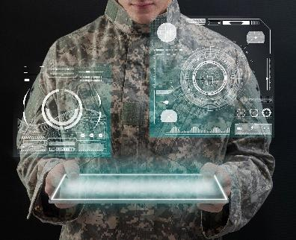
The Different Types of Military Innovation
Military innovation occurs on three levels: product, process, and strategy. Each demands distinct organizational responses.
Product Innovation: New technologies like AI, drones, and autonomous systems.
Process Innovation: Evolving logistics, decision-making, and training.
Strategic Innovation: Shifting doctrines, network-centric operations, hybrid warfare.
Product
Military Innovation
Process
Strategy

Slide 13
Three Levels of Organizational Fitness
Military organizations must be reactive, adaptive, and proactive to stay competitive.
Reactive Fitness
Adaptive Fitness
Proactive Fitness
Can we respond effectively to ermerging threats?
Can we adjust to evolving environments?
Are we setting the terms for future warfare?

Slide 14
Introducing innovation into a rigid system is like planting a seed in concrete—it won’t grow.

Slide 15
Part II Building Blocks of Innovation in an Organisation

Slide 16
Organisational Models
Effective applicability as an enhancer of Innovation depends on the situation, the organization and its essential conditions
Alternatives to the bureaucratic model of organizational control
Four building blocks to enhance innovation in large organisations (not exhaustive!):
Organizational Agility – a network of agile, interconnected Teams
Phased adoption of innovations – systematic exploration, piloting and integration
Cultural Transformation Programs – learning to think and act differently
Strengthened and structural civil-military cooperation (Public Private Partnerships)

Slide 17
Networks
Introduction of goal-oriented, agile-dynamic teams that network and exchange ideas with each other
Advantages:
Communication more flexible than in strict hierarchical systems
Solving problems closer to their source
Disadvantages:
Difficulties in managing large organizations
High demands on those involved, not possible to extend to a military as a whole
Opportunity: Introduction for selected parts and subunits, whose adaptability and innovation capability rises.

Slide 18
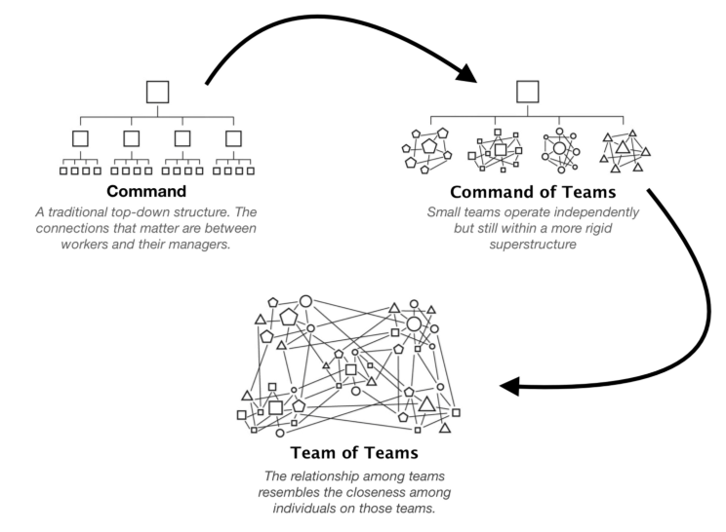
Example Gen. Arthur McChrystals
“Team of Teams” Model

Slide 19
Phased Adoption Framework Step by Step – Open for Innovations
Exploration
What?
Pilot Programs
Testing and Learning
Scaling
Thoughtful integration
Full integration
Introduction as part of an implemented process:
Persistent, but open to learning.
Iterative setting enables in-depth learning effects.

Slide 20
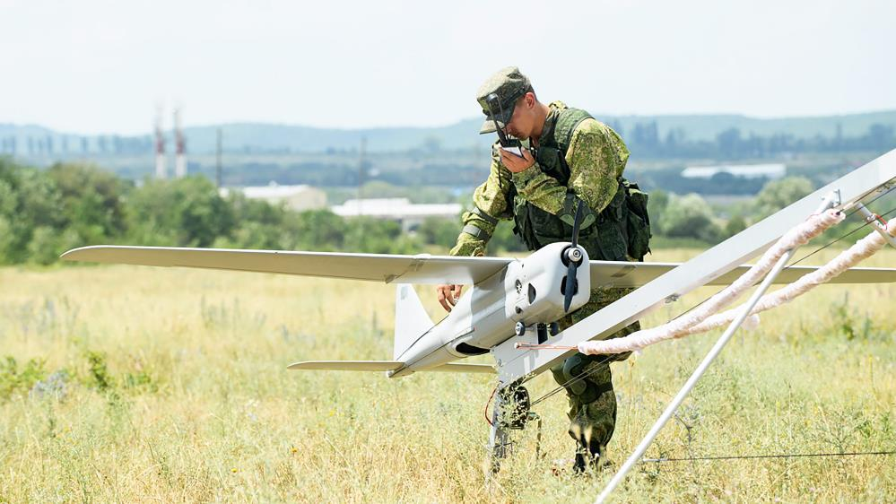
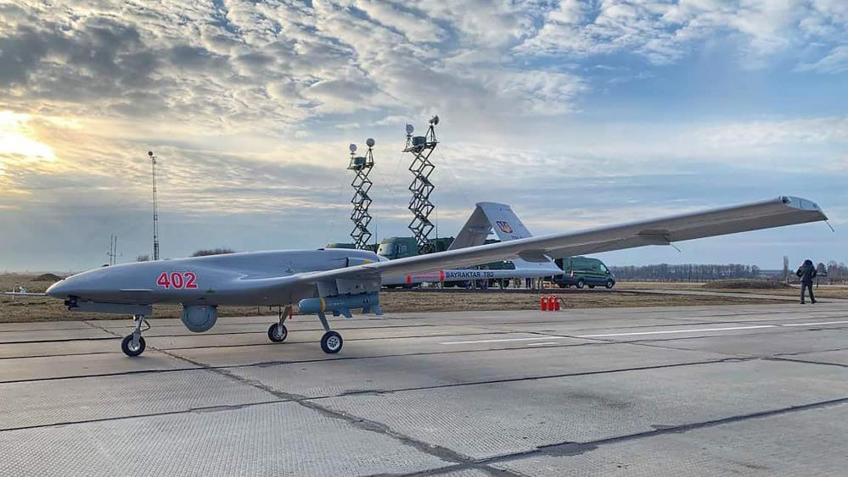
Example: Introduction of drones - learning effects from
external observation,
own considerations,
trials with troop units,
integration into the command and control system, etc.
Innovative dynamics are the result of an intensive search for measures and countermeasures, especially if there is a corresponding openness to new ideas
Reconnaissance drone, „Orlan-10“ (RAF)
Combat and reconnaissance drone „Bayraktar TB2“ (UAF)

Slide 21
Cultural Transformation Programs See and think differently.
How we think, perceive and do things is the central driver of innovation or persistence
Aligning anchored cultural norms with the imperatives of innovation
Personnel selection, role models, training, error culture, etc.
Advantages:
Long term changes possible, takes time
Disadvantages:
Counterintuitive in a bureaucratic culture (Errors & responsibilities)
Resource-intensive

Slide 22
Public Private Partnerships Working together with others
Close cooperation with private companies - utilizing their opportunities and flexibility
Advantages:
Extended (long-term) funding capacity (capital markets) / shared financial burden and risk
unlocking expertise in advanced technologies and solutions
Mutual civil-military progress (e.g. internet, GPS)
Disadvantages:
Conflicts about intellectual property
Different priorities (defence / business)
Examples: DARPA (internet, GPS)

Slide 23
Part III Technology as a Catalyst

Slide 24
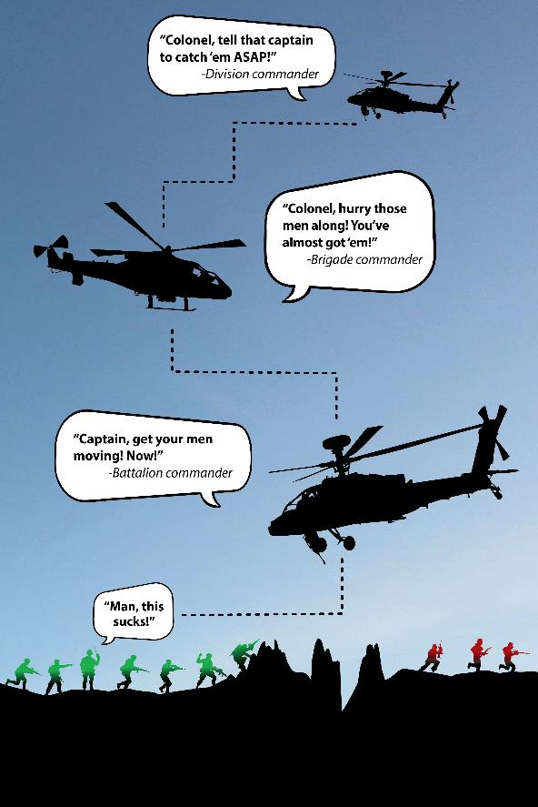
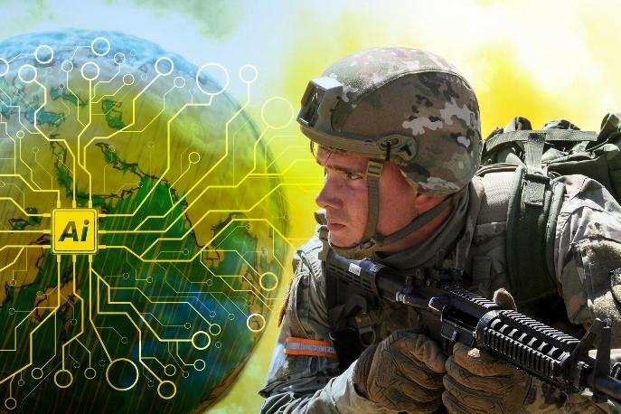
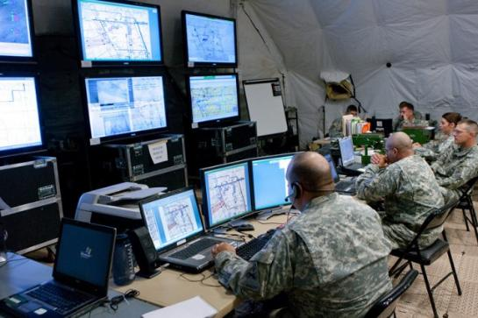
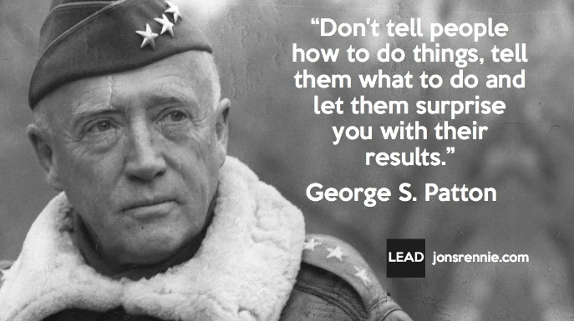
AI in Military Leadership – Beyond the Battlefield
Observe
Act
Orient
Decide

Slide 25
Conclusion

Slide 27
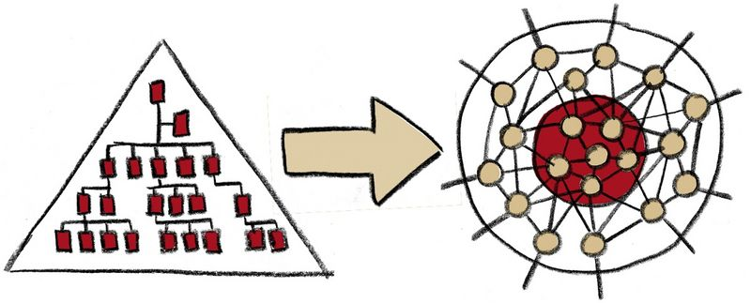
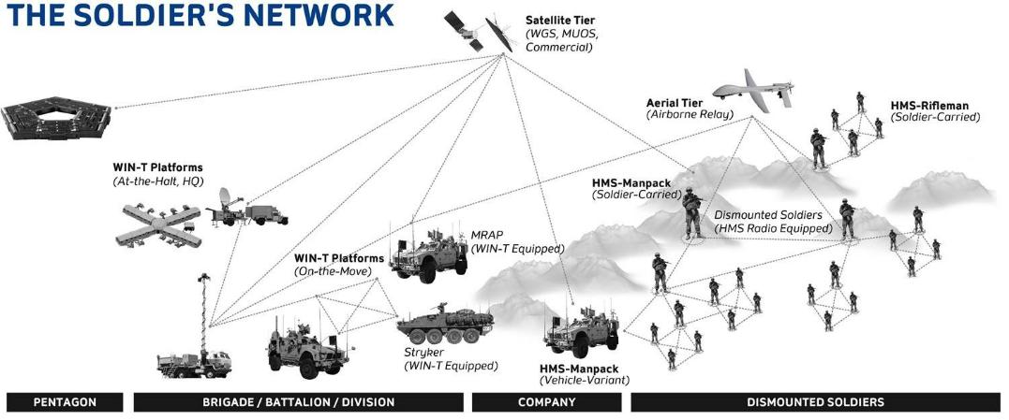
The Future of Military Organizational Structures – From Hierarchies to Networks

Slide 28
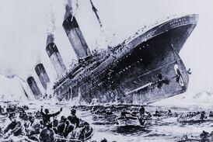
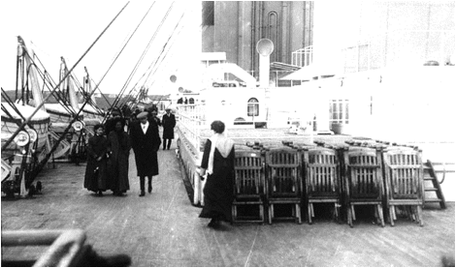
Changing tactics without changing strategy is like rearranging deckchairs on a sinking ship.
The best forces don’t just upgrade - they rewire their systems. That’s what transformation looks like.
Notes:
Narrativ
The U.S. investment in stealth bombers was revolutionary in product, but only transformative after process changes in targeting and strategy shifts in air dominance doctrine.
https://www.wolverton-mountain.com/articles/rearranging-deck-chairs-on-the-titanic.html
https://www.psychologytoday.com/us/blog/psychoanalysis-unplugged/202110/are-you-rearranging-deck-chairs-on-your-very-own-titanic
In the face of a crisis, "rearranging deck chairs" is a futile act of denial.
Source: The Everett Collection via Canva

Slide 29
Innovation is the cornerstone of future success.
On the modern battlefield, innovation isn't just an advantage—it’s a lifeline.
Organizational fitness secures the power to innovate.

Slide 30
Innovate,
or die!

Slide 31
Quellenverzeichnis
Team of Teams: https://beaugordon.medium.com/key-takeaways-from-team-of-teams-by-general-stanley-mcchrystal-eac0b37520b9 [10.04.2025]
Bayraktar TB2 und Orlan-10: https://www.truppendienst.com/themen/beitraege/artikel/der-einsatz-von-drohnen-im-ukraine-krieg [11.04.2025]
Conclusion / Soldat: https://eda.europa.eu/news-and-events/news/2023/10/23/beyond-2040---eda-analysis-warns-on-future-warfare-trends-and-technology-imperatives-for-european-defence [11.04.2025]

