Slide 1
A Study on the Relationship between
Automation Levels and Combat Effectiveness
Kim Insoo, Sung Kieun, Hwang Yeeun
(Korea Military Academy)

Slide 2
Outline
1. Background & Research Question
2. Why Automation and Simulation?
3. Research Design
4. Simulation Results
5. Conclusion

Slide 3
Background & Research Question
The demographic cliff of South Korea
- Low birth rate and super - aging occur simultaneously
- Total fertility rate 0.63 in 2024
The necessity for restructuring the military structure
- Assessing the Balance of Military Manpower on the Korean Peninsula = 1 : 2.5
- Challenge to the mobilization of military personnel
Research Question: Can UCS Replace Human Combatants?
South Korea | North Korea
500,000 | 1,280,000

Slide 4
Why Automation and Simulation?
Advantages and limitation of UCS:
- Reduced risk to human life, Higher lethality and mobility
- High maintenance demand, Vulnerable to system failure
War simulation rather than a single battle simulation
- Missed long-term conflict dynamics by battle simulation
- War = ∑ battles
- Agent Based Model(ABM) developed by ecological dynamics

Slide 5
Research Design
ABM for analysis
- Predator-Prey population model
- The concept of symbiosis
Three distinct types of agents
- Machine(M)
- Human Combatant(Hb)
- Human Maintenance(Hm)
Simulation Assumptions
- Isolated battlefield (no reinforcements)
- Fixed initial force capacity
- Continuous sequential engagements
- War ends with total annihilation of a group
Ma
Mb
Hba
Hbb
Hma
Hmb

Slide 6




Research Design
Definitions and Assigned Values of War Simulation Parameters
Parameter | Definition | Assigned Value
α | Rate of attrition for M in engagements with opposing M | 0.01
β | Redeployment rate of M | 0.03
γ | Lethality rate of M against Hb | 0.05
ε | Attrition rate of Hb in engagements with opposing Hb | 0.01
ζ | Redeployment rate of Hb | 0.05
η | Lethality rate of M against Hm | 0.03
θ | Lethality rate of Hb against Hm | 0.01
ι | Redeployment rate of Hm | 0.03
K1 | Carrying capacity of Hm | initial value of Hm
K2 | Carrying capacity of Hb | initial value of Hb

Slide 7
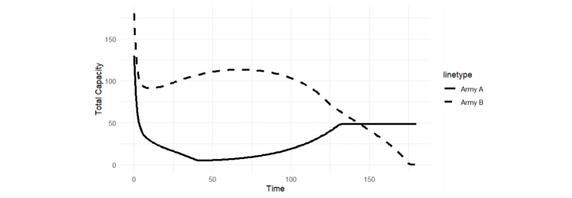
Simulation Results 1 : Current State
S.K.(Army A) : Ma = 50, Hba = 50, Hma = 30 vs. N.K. (Army B) : Mb = 50, Hbb = 100, Hmb = 30
Army A (S.K.): sharp decline in total capacity → increase to equilibrium
Army B (N.K.): decline rapidly → reaches zero in 175th engagement
Hb’s negative effect (More human soldiers ≠ guaranteed victory)

Slide 8
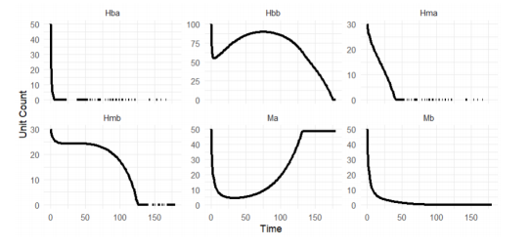
Simulation Results 1 : Current State
Army A(S.K.): Rapid decrease of Hb, Hm and initial decrease → subsequent increase of M
Army B(N.K.): Gradual decrease of Hb, Hm and rapid decrease of M
High Hb → Increased cost → Defeat under limited carrying capacity
Army A(S.K.) victory but prolonged duration of war

Slide 9
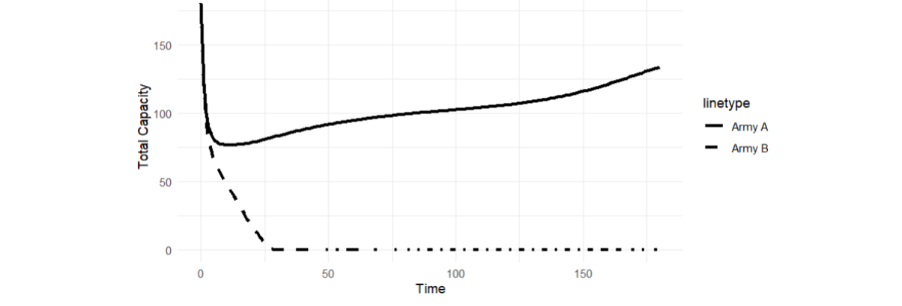
Simulation Results 2 : Strengthening UCS by S.K.(Army A)
S.K.(Army A) : Ma = 100, Hba = 50, Hma = 30 vs. N.K. (Army B) : Mb = 50, Hbb = 100, Hmb = 30
Army A(S.K.): sharp initial decline → recover gradually
Army B(N.K.): decline steadily → converging zero after 25th engagement
Army A(S.K.) quick and decisive victory
→ Strategic advantage of M-dominat force structure

Slide 10
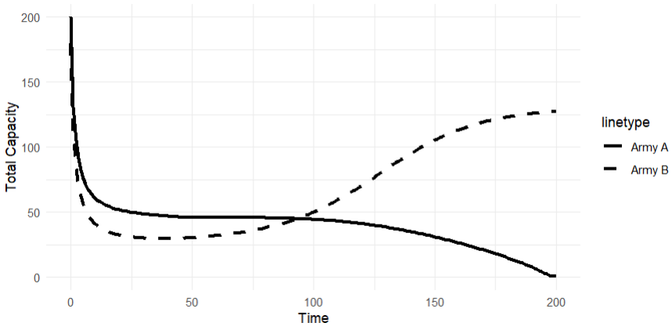
Simulation Results 3 : Strengthening Hb and Hm by S.K.(Army A)
S.K.(Army A) : Ma = 50, Hba = 100, Hma = 50 vs. N.K. (Army B) : Mb = 50, Hbb = 100, Hmb = 30
Army A (S.K.): sharp decline → converges to zero by the 200th battle
Army B (N.K.): rapid decrease → recovers and surpasses Army A
Army A's defeat due to human-intensive strategy without UCS reinforcement

Slide 11
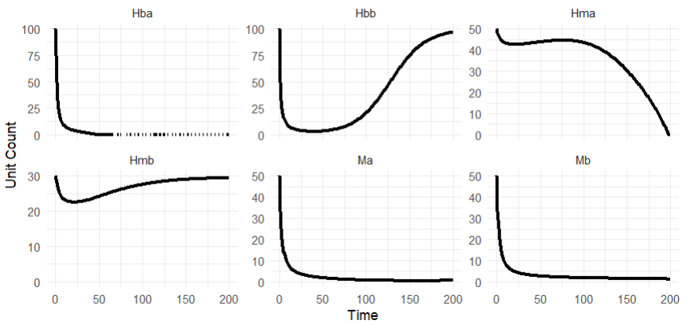
Simulation Results 3 : Strengthening Hb and Hm by S.K.(Army A)
Army A(S.K.): Rapid decline in Hb and M, gradual decline in Hm
M shortage → wasted Hm capacity → Defeat under limited carrying capacity
Army B(N.K.): Rapid initial decline → Gradual recovery of Hb and M, sharp decline in Hm
Army B (N.K.) Victory despite lower initial capacity

Slide 12
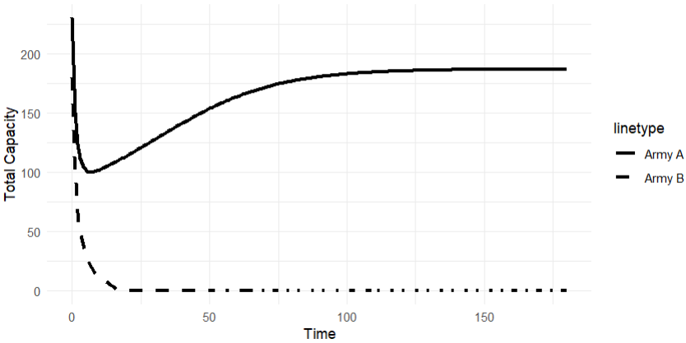
Simulation Results 4 : Strengthening UCS and Hb by S.K.(Army A)
S.K.(Army A) : Ma = 100, Hba = 100, Hma = 30 vs. N.K. (Army B) : Mb = 50, Hbb = 100, Hmb = 30
Army A (S.K.): high initial M units → swift victory
Army B (N.K.): fewer M units → capacity collapses by 15th battle
Positive effect of UCS reinforcement with balanced human forces

Slide 13
Conclusion
Simulation results
Strategic Implications from Simulation Results
- Human forces alone ≠ Victory, Scenarios 1 & 3: More human units → Still defeated
- Personnel burden matters, expanding Hb/Hm must consider carrying capacity limits
Optimal Force Structure for ROK
- Integrating UCS + human combatants → shorter wars(Scenario 4 vs. 2), faster & decisive victory
- Best outcome from combined deployment of humans & UCS
 |  | Scenario 1 | Scenario 2 | Scenario 3 | Scenario 4
Capacity | Army A | M: 50 Hb: 50 Hm: 30 | M: 100 Hb: 50 Hm: 30 | M: 50 Hb: 100 Hm: 50 | M: 100 Hb: 100 Hm: 30
 | Army B | M: 50 Hb: 100 Hm: 30 | M: 50 Hb: 100 Hm: 30 | M: 50 Hb: 100 Hm: 30 | M: 50 Hb: 100 Hm: 30
War Outcome |  | Victory of A | Victory of A | Victory of B | Victory of A
War Duration |  | 175 battles | 25 battle | 200 battles | 13 battles

