Slide 1
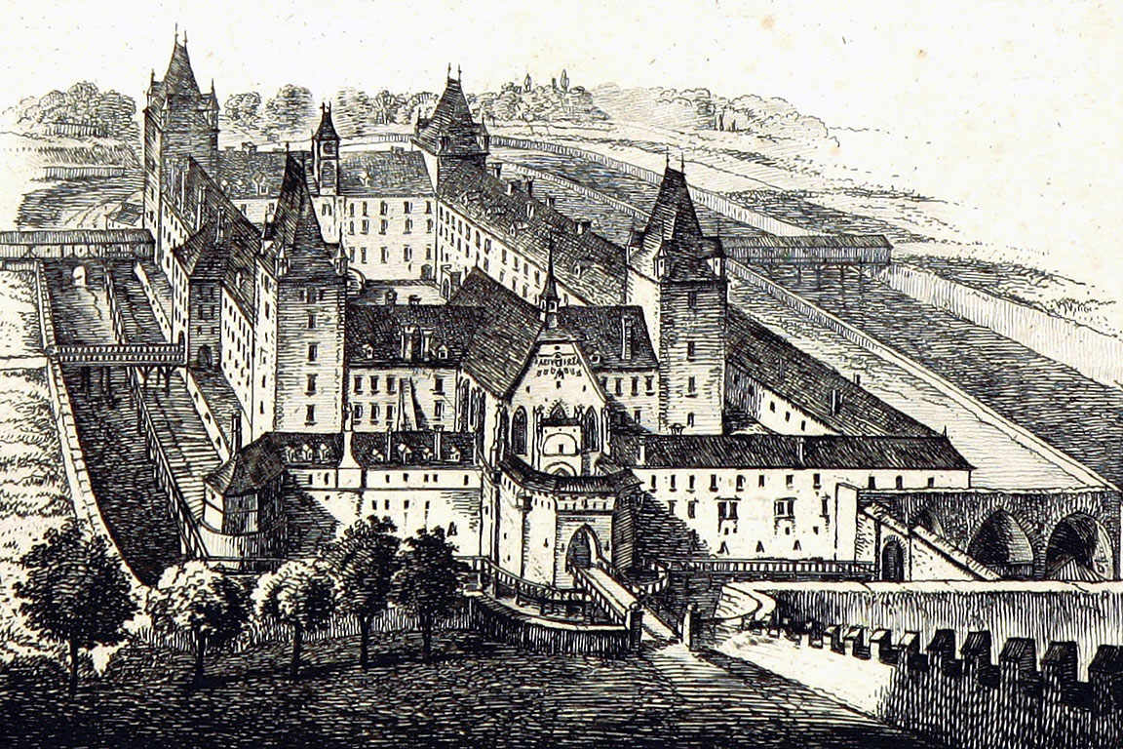
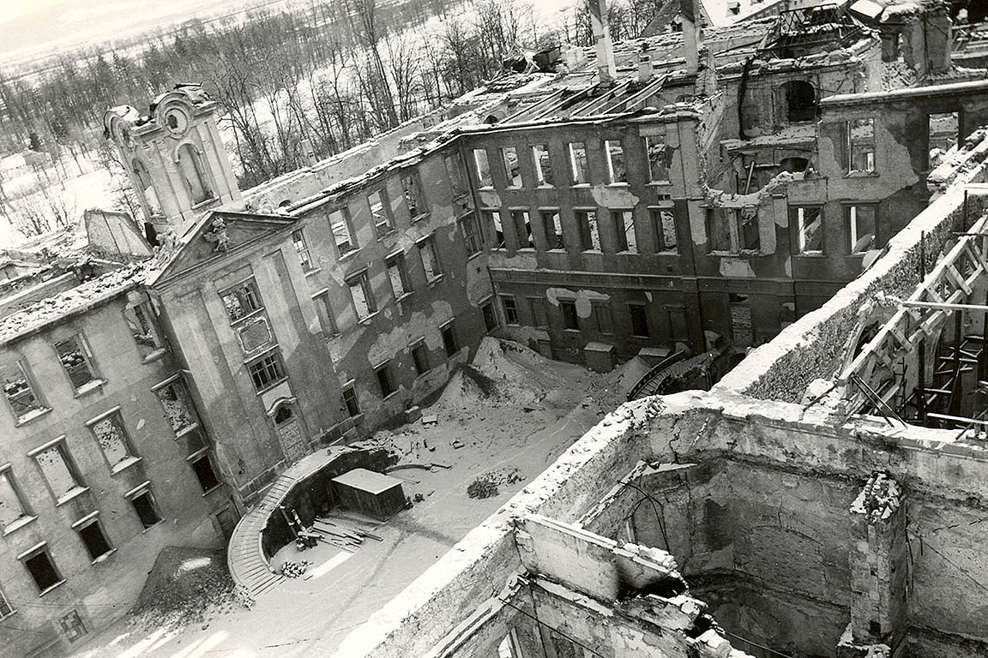
1.1 History
The castle of Wiener Neustadt, along with the city itself, due to its strategically important location has a eventful and varying history.
The function of the castle was varying as well: from its initial intention as a bulwark, via its role as imperial residence, to a top-notch officer training institution, the Military Academy.
The military Academy was founded in 1751 by Empress Maria Theresa, and can be considered the world's oldest military academy.
The Castle of Wiener Neustadt before 1768
Bulwark
Imperial residence
Prison
Military Academy
The Castle of Wiener Neustadt in April 1945

Slide 2
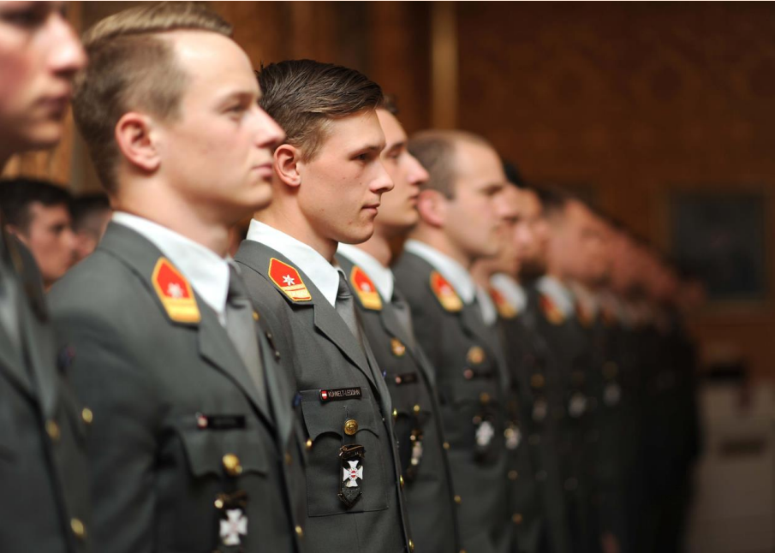
1.2 Mission
Historically, the Academy has had a dual mission, stated by Maria Theresia in 1751: to make fine officers and righteous men.
This mission still holds true today as the Academy makes fine officers of the Austrian Armed Forces and righteous persons in society.

Slide 3
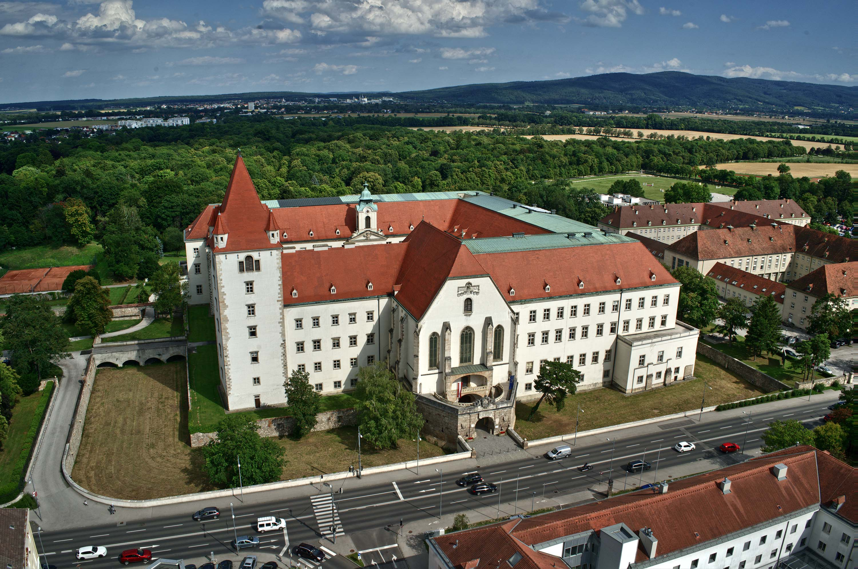
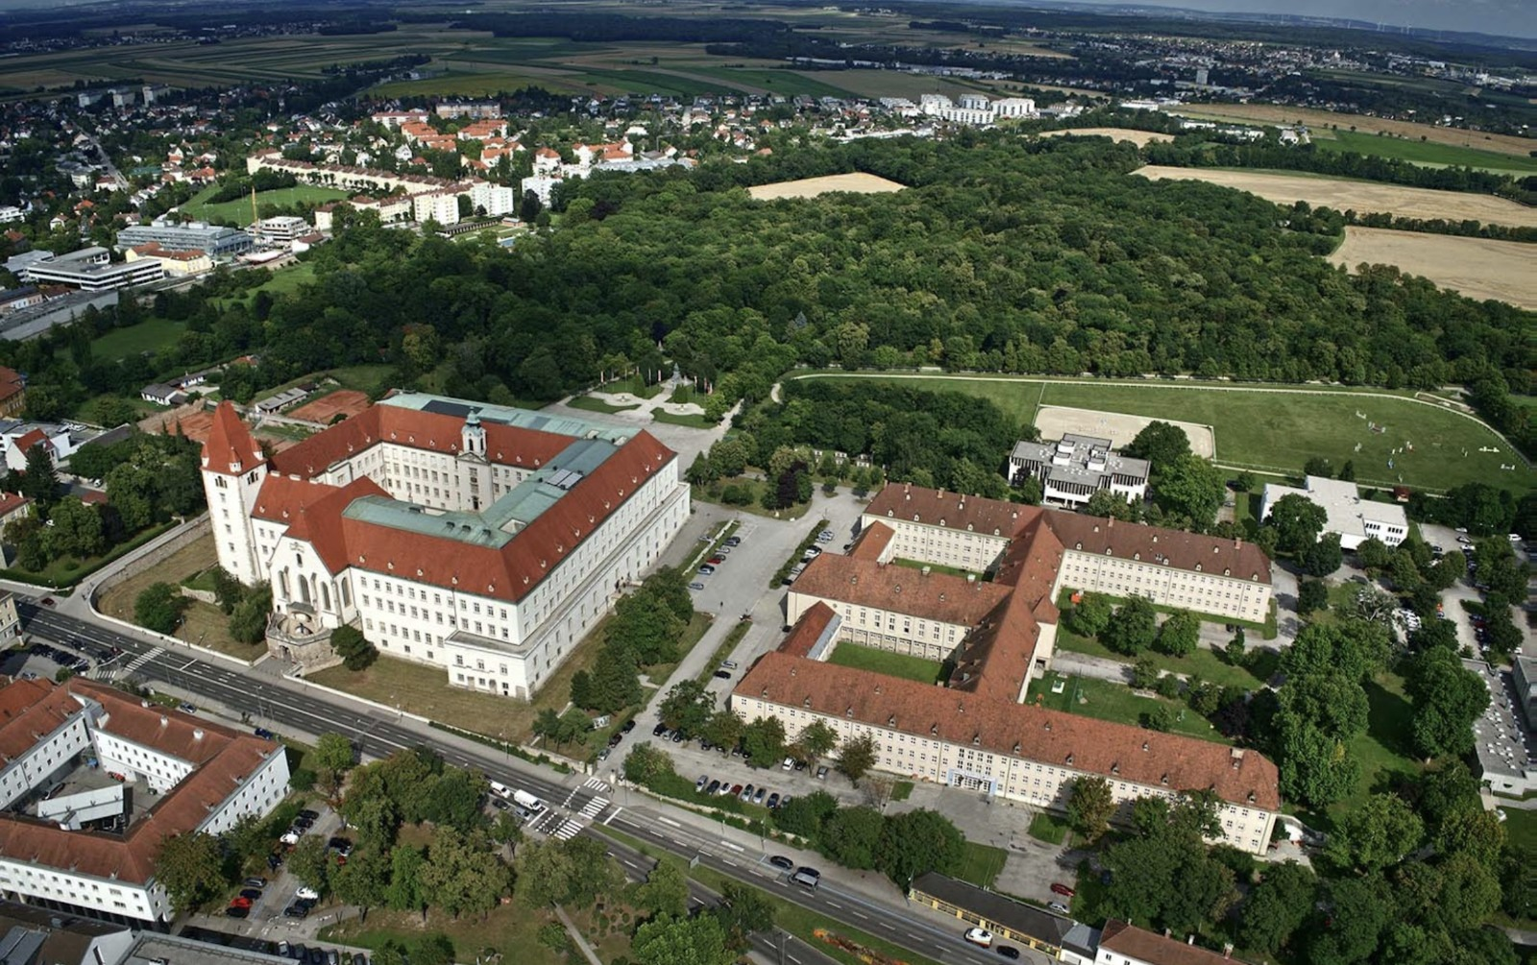
1.3 Location &
general information
The Academy complex, along with its famous castle, is located at the centre of Wiener Neustadt, approximately 40km south of Wien.

Slide 4
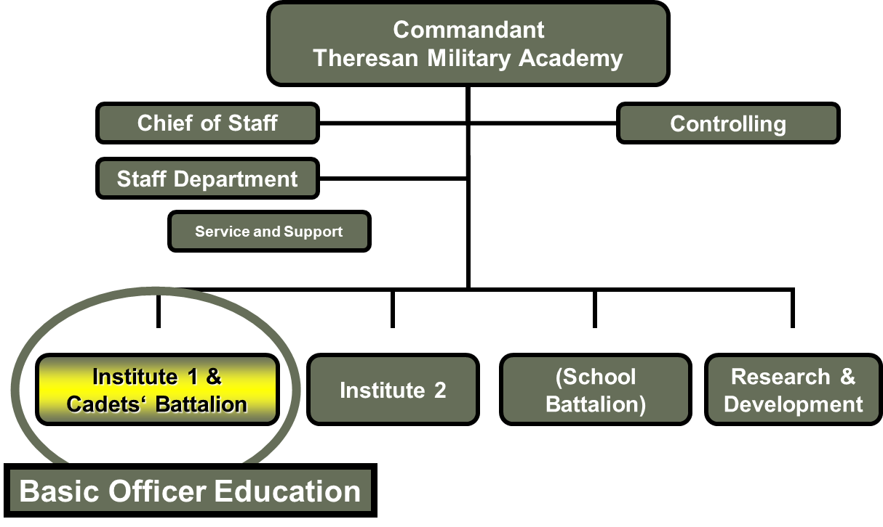
1.3.1 Academy’s structure

Slide 5
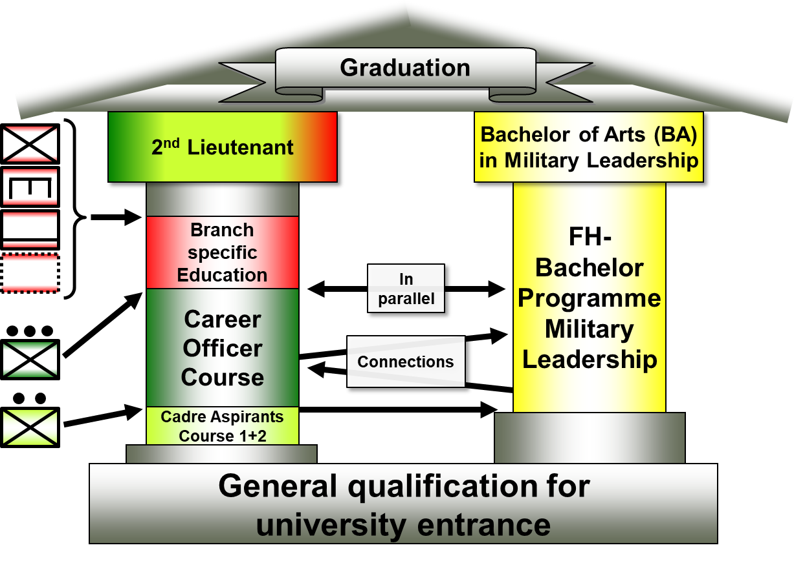
1.3.2 Basic Officer’s Education
Education and formation of cadets are the main goals of the Academy’s Institute 1 & Cadets Bataillon.
On average, 90 officer cadets are accounted each year at the Academy. About 70 of them graduate after three years of training.
The two parallel and complementary main pillars of education at the TMA are: military education and academic education.
Both of those pillars are a precondition for the cadet’s graduation as officers of the Austrian Armed Forces.

Slide 6
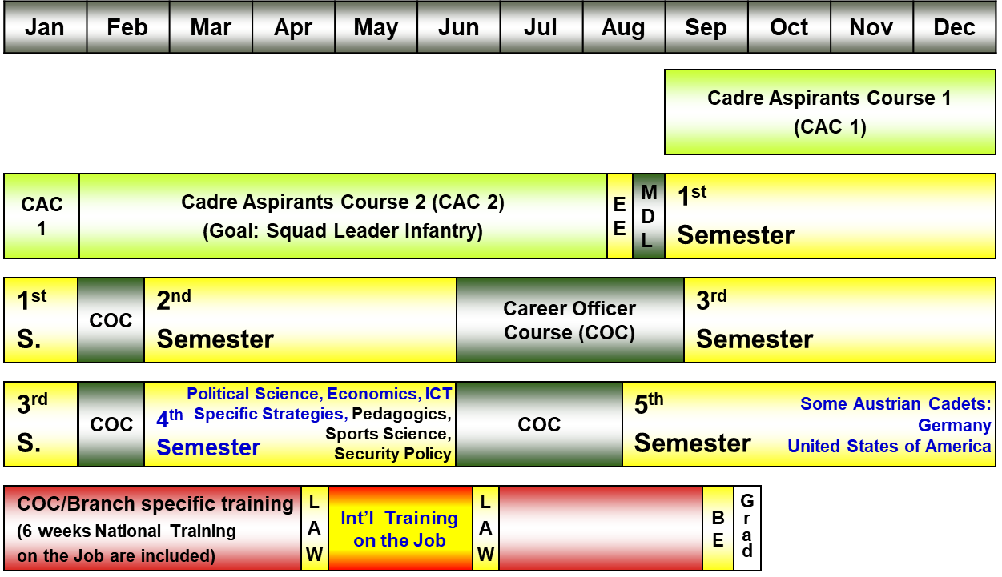
1.3.3 International semesters
International mobility - both outgoing and incoming - happens in specific periods during the cadets' formation at the TMA.
For outgoing cadets there are two distinct mobility periods:
4th or 5th semester: international semester abroad
6th semester: international training on the job
For incoming cadets and civilians there are also two main mobility possibilities:
3rd semester (winter): international semester in English
4th semester (spring): thesis writing and internships

Slide 7
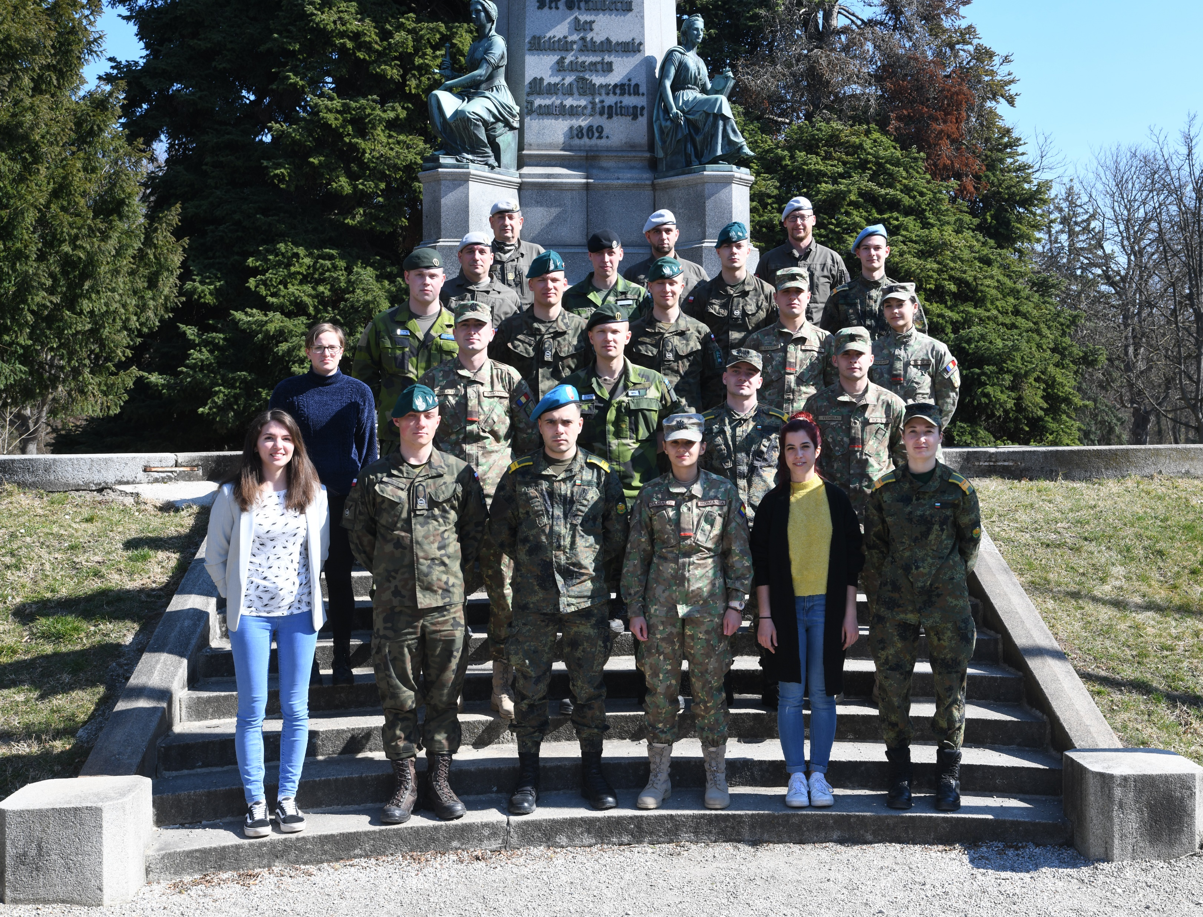
1.4 The international office
Outgoing possibilities
International semesters
Traineeships on the job
Incoming possibilities
International semesters
Thesis preparation
Traineeships on the job
One week modules
The international office of the TMA is responsible for the international mobility of the incoming and outgoing students, both civilians and soldiers.
International summer semester 2022

Slide 8
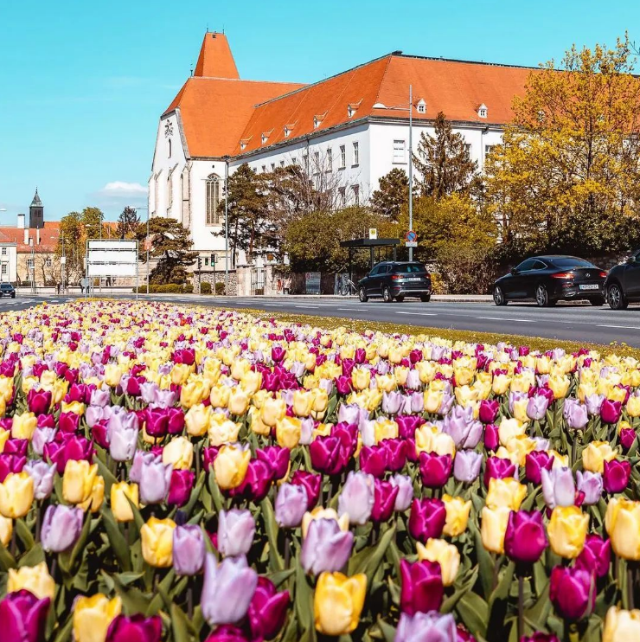
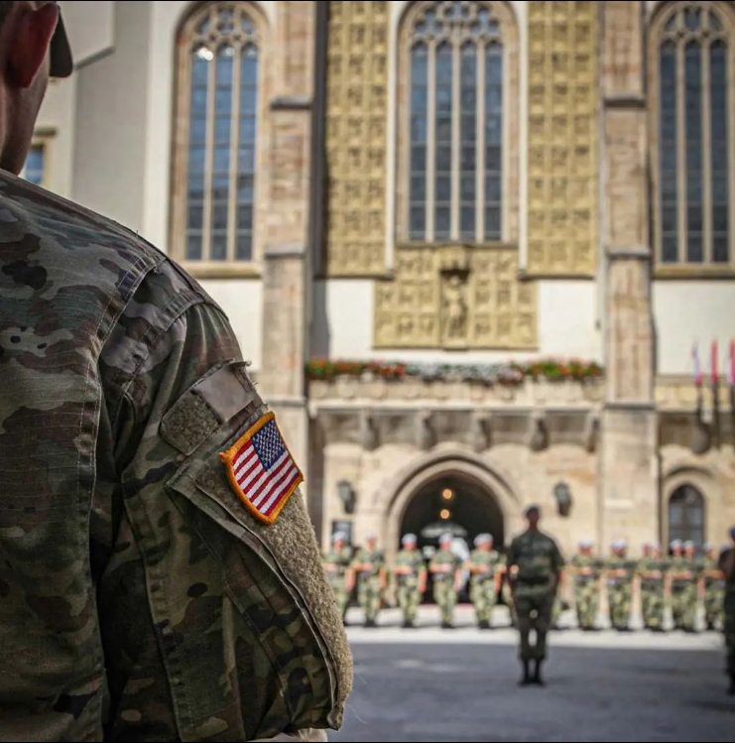
2.1 Arrival at the Academy
To support incoming cadets, it is offered a pick up service to reach the Academy.
Once arrived, the "internationals" receive useful information about their stay and how the TMA works, along with a guided tour of the Academy.
Arrival
Pick up service
Entrance in the Academy
Guided tour
Useful details
Welcome to the TMA!

Slide 9
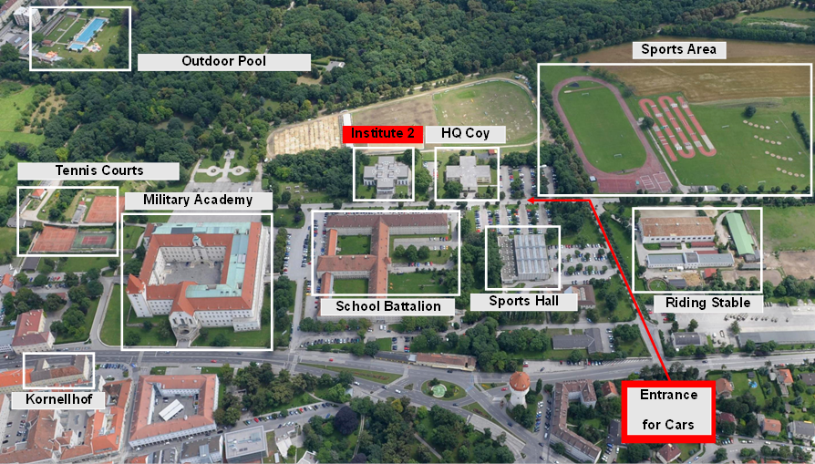
2.2 Academy’s infrastructures
The Academy complex is composed by multiple buildings and infrastructures, that can be divided into three main categories:
Housing infrastructures: Kornellhof, School Battalion, Military Academy
Sports infrastructures: Tennis courts, outdoor pool, sports areas, sports hall, riding stable
Military education infrastructures: Military Academy, Institute 2, HQ Coy, School for Security and Leadership

Slide 10
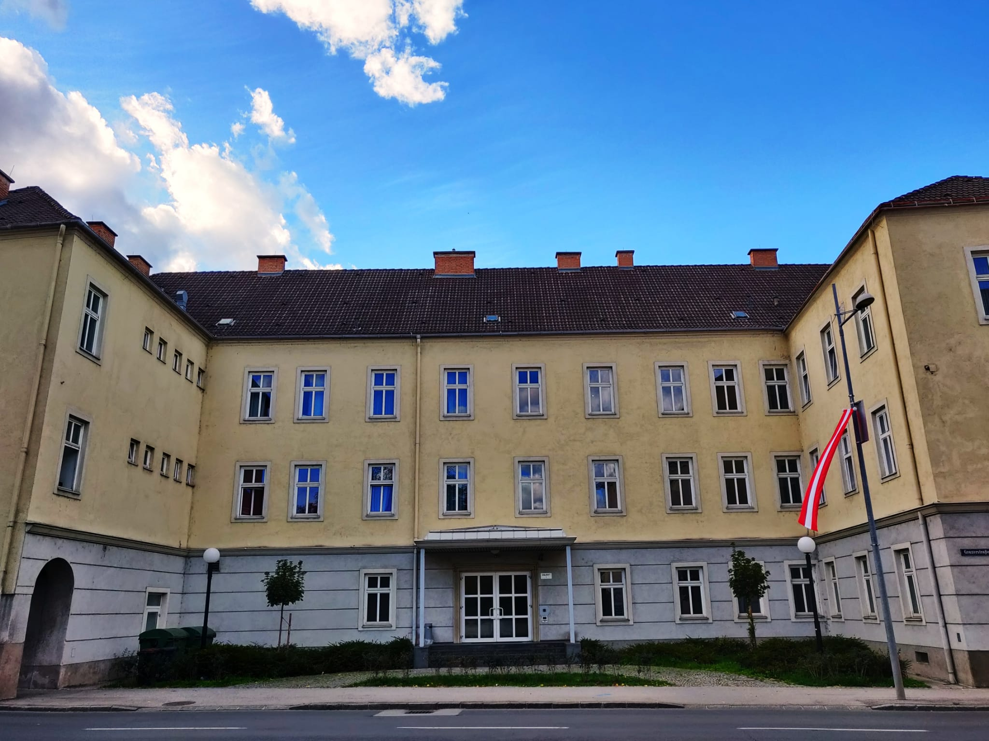
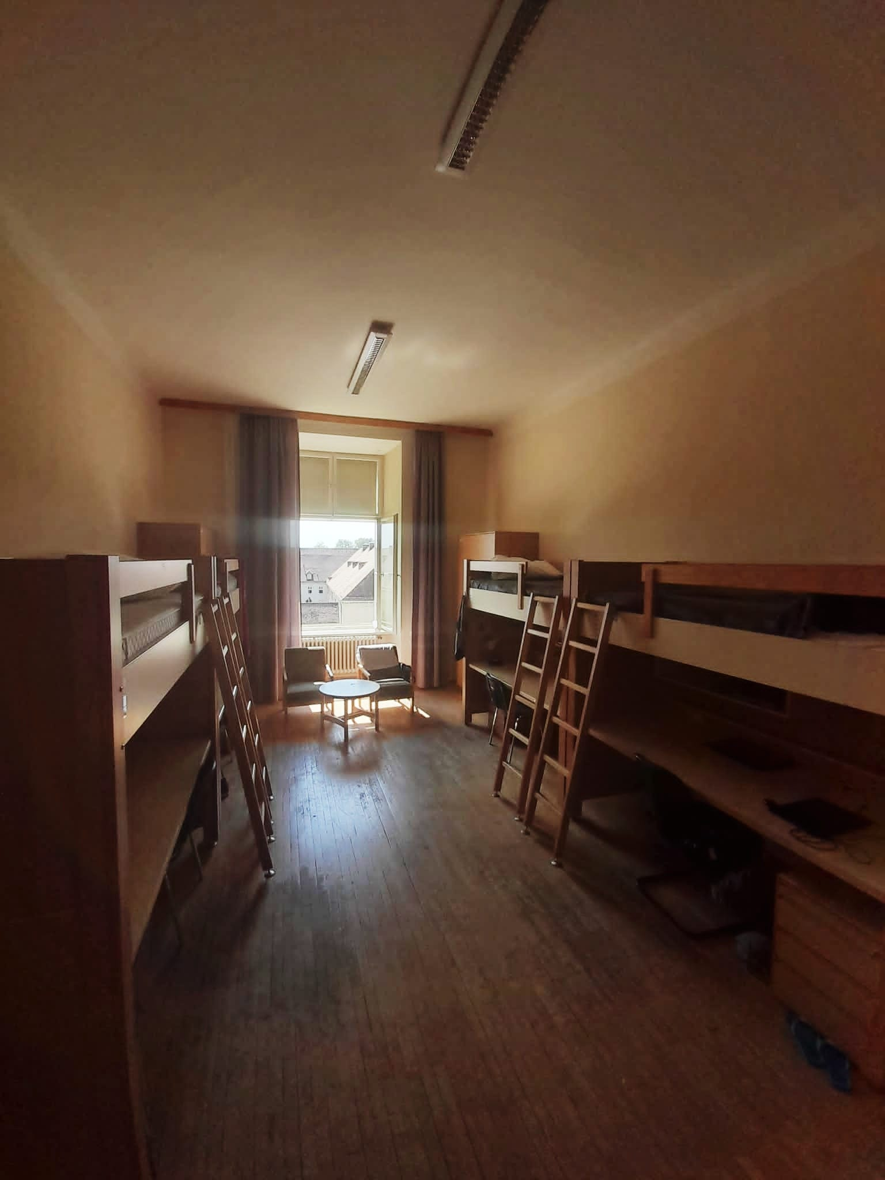
2.3 Accommodation
International cadets and civilians can be hosted in one of the Academy’s housing structures – depending on their availability – for the duration of their stay at the TMA.
On the left: Kornellhof dormitory; on the right: one of the Academy’s rooms

Slide 11
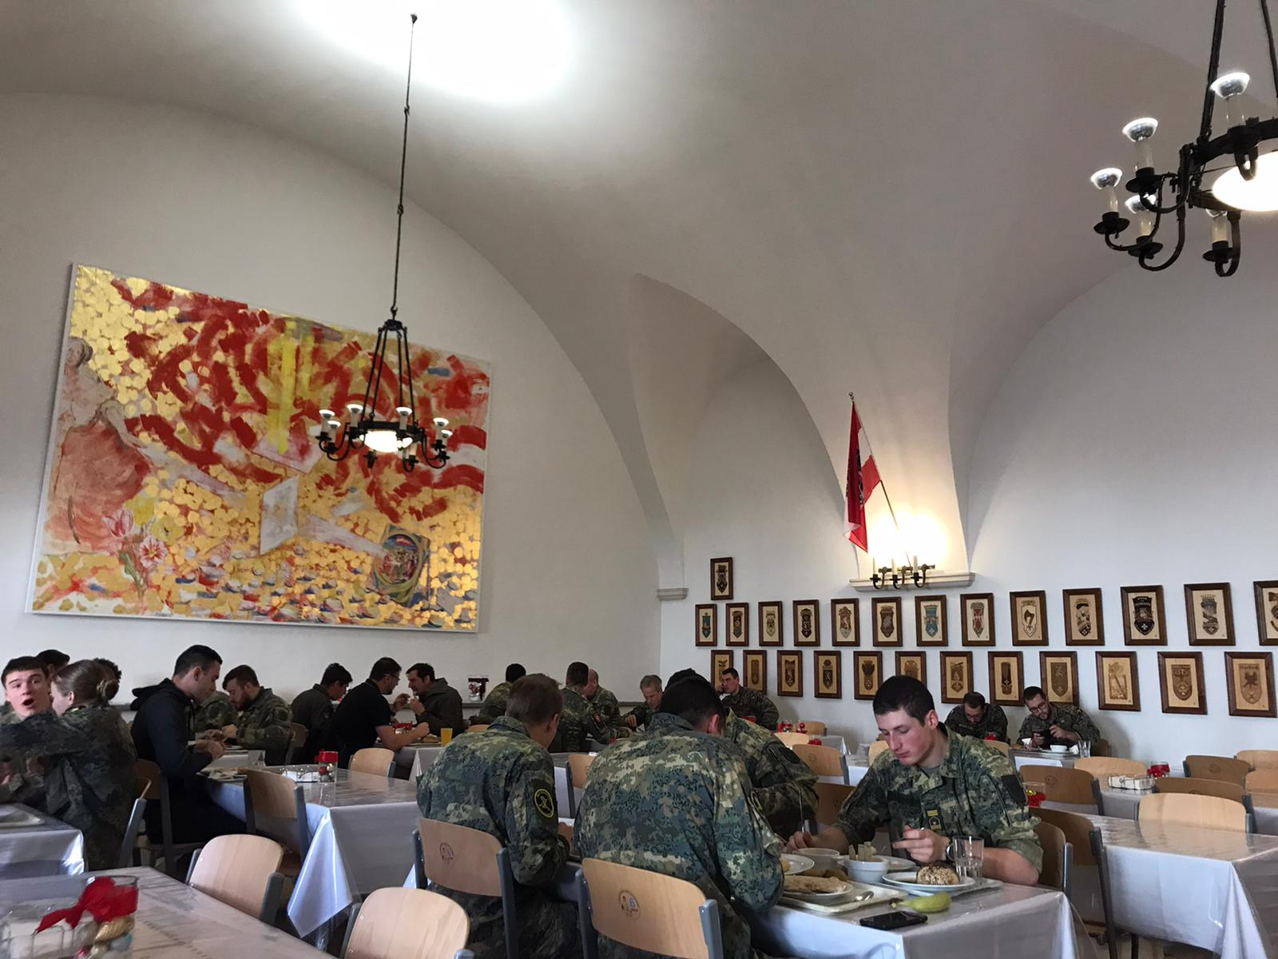
2.4 Canteen & cafeteria service
Besides the accommodation, the TMA also provides fresh meals (breakfast, lunch and dinner) for its students every day in its dining hall.
The cafeteria service offers refreshment for convenient prices for anyone in need during working days.

Slide 12
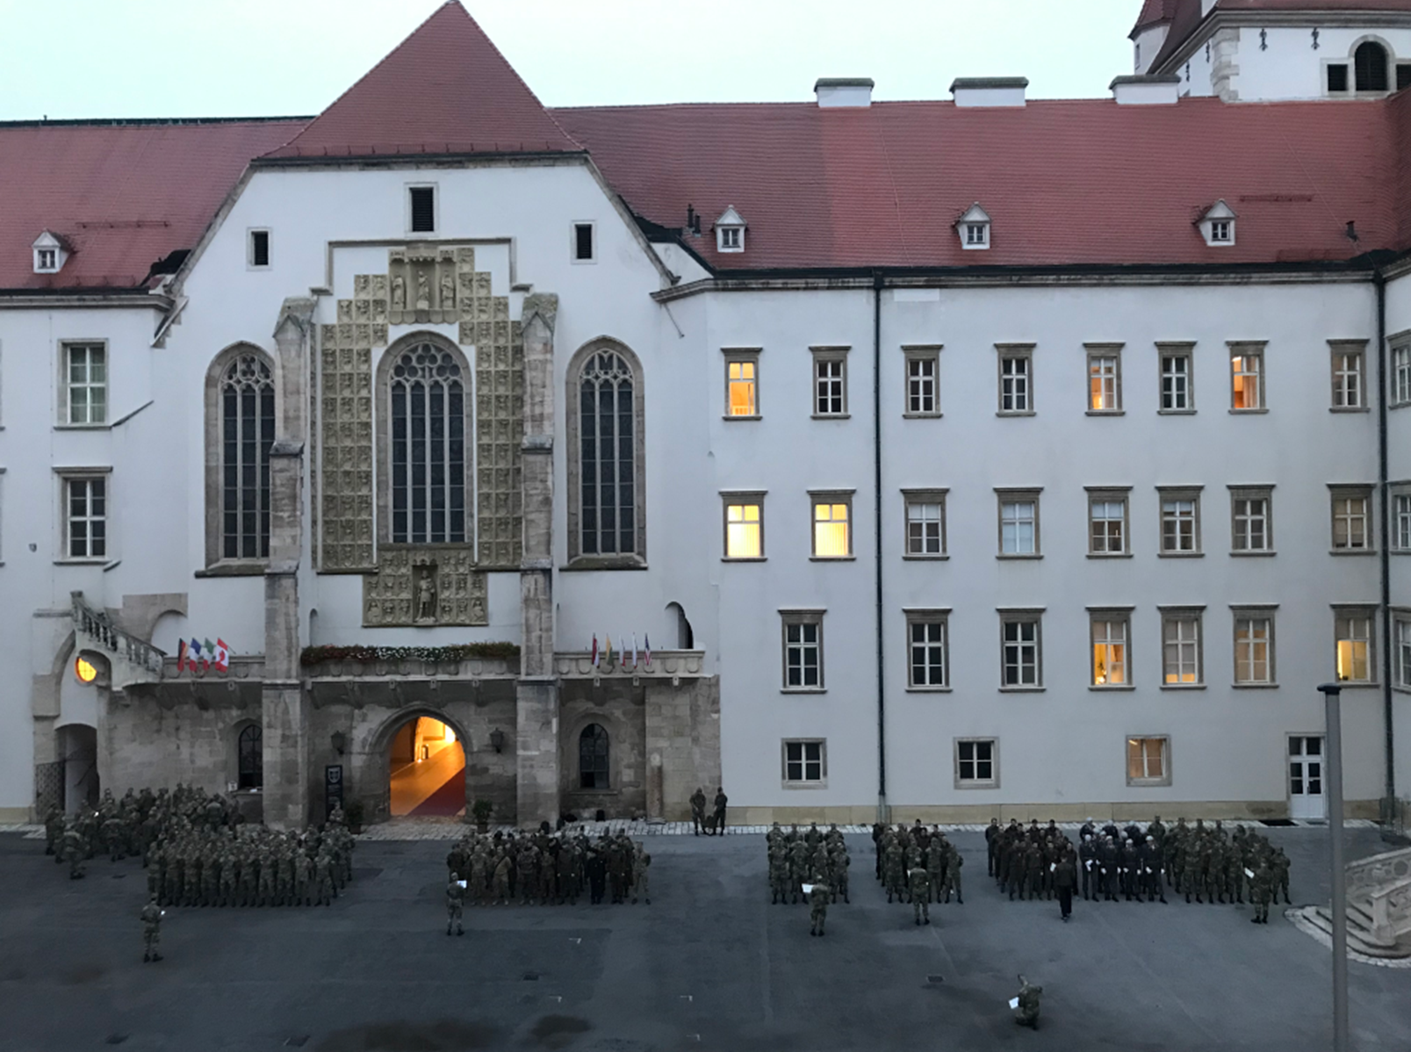
3.1 Education and formation
The first step in the daily routine of the cadets – both soldiers and civilians of the Academy, as well as the internationals, is the roll call (on the right) which is mandatory for everyone.
It’s set at 7:25 a.m., and it signs the beginning of the working day.
Until 7:25 a.m.
Breakfast
7:25 a.m. to 7:45 a.m. ca.
Roll Call
From 7:45 ca.
Lectures & Courses

Slide 13
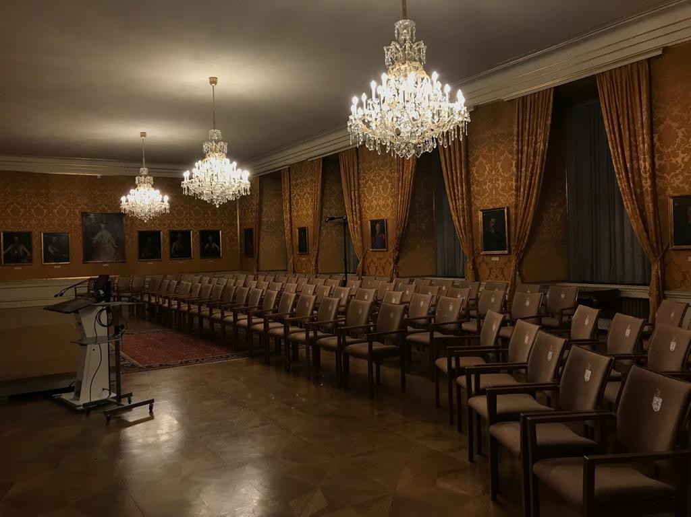
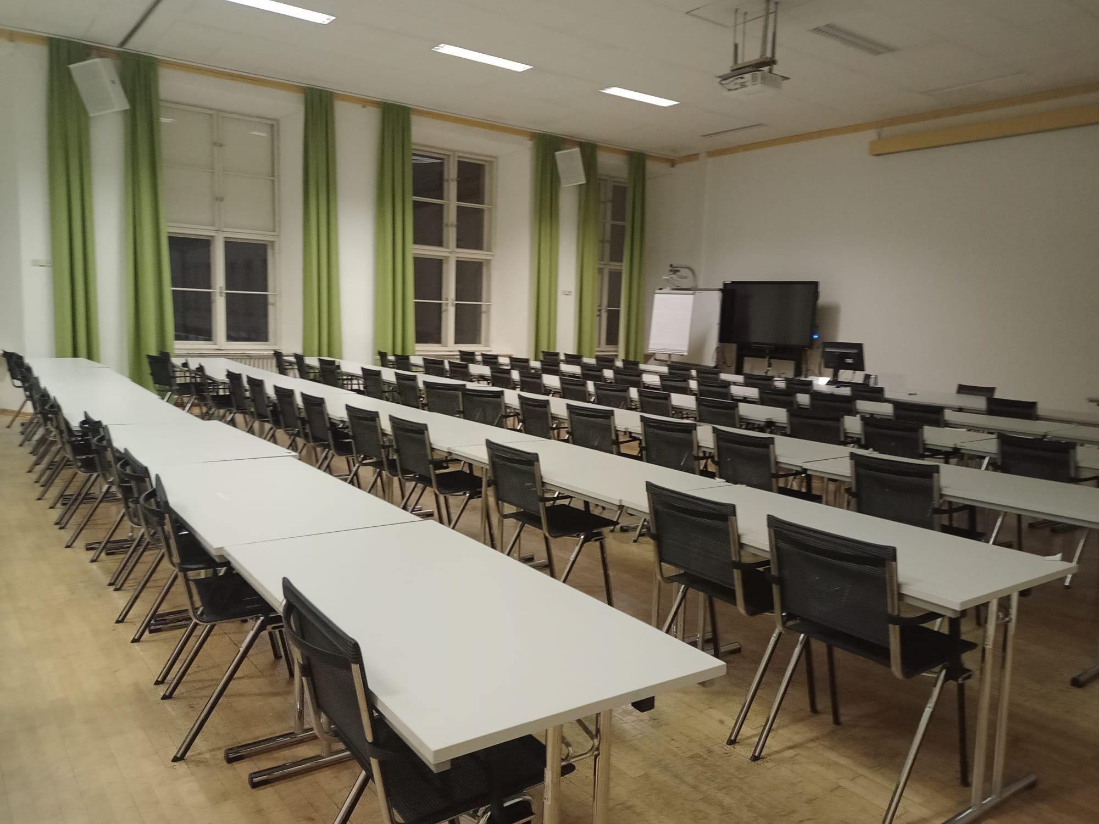
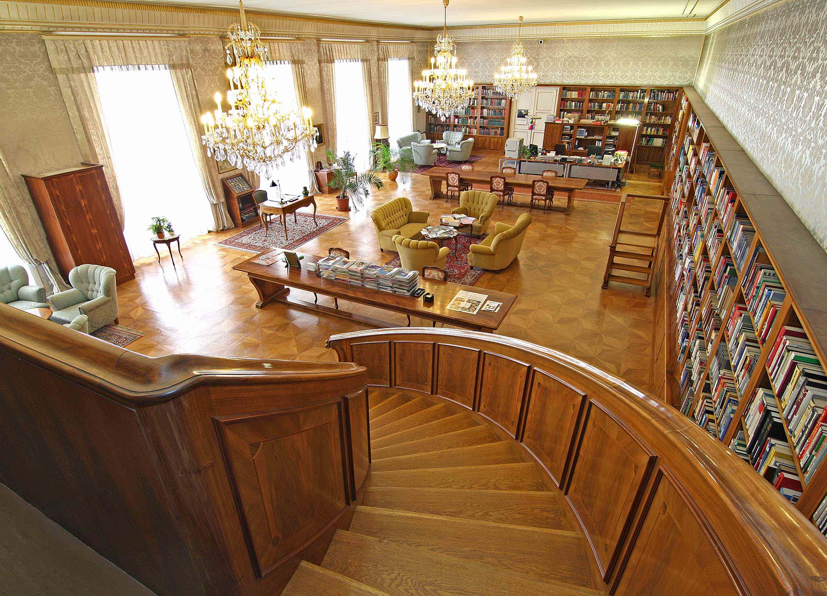
3.1.1 Lectures and courses
A big part of the cadets’ academic formation is centered on lectures, structured in the form of modules that can be either of one week or longer.
The Academy has many different lecture rooms situated inside the main Castle, along with a great hall, a library and many computer rooms.
On the top: the Knights Hall
On the bottom left: a lecture room
On the bottom right: the library

Slide 14
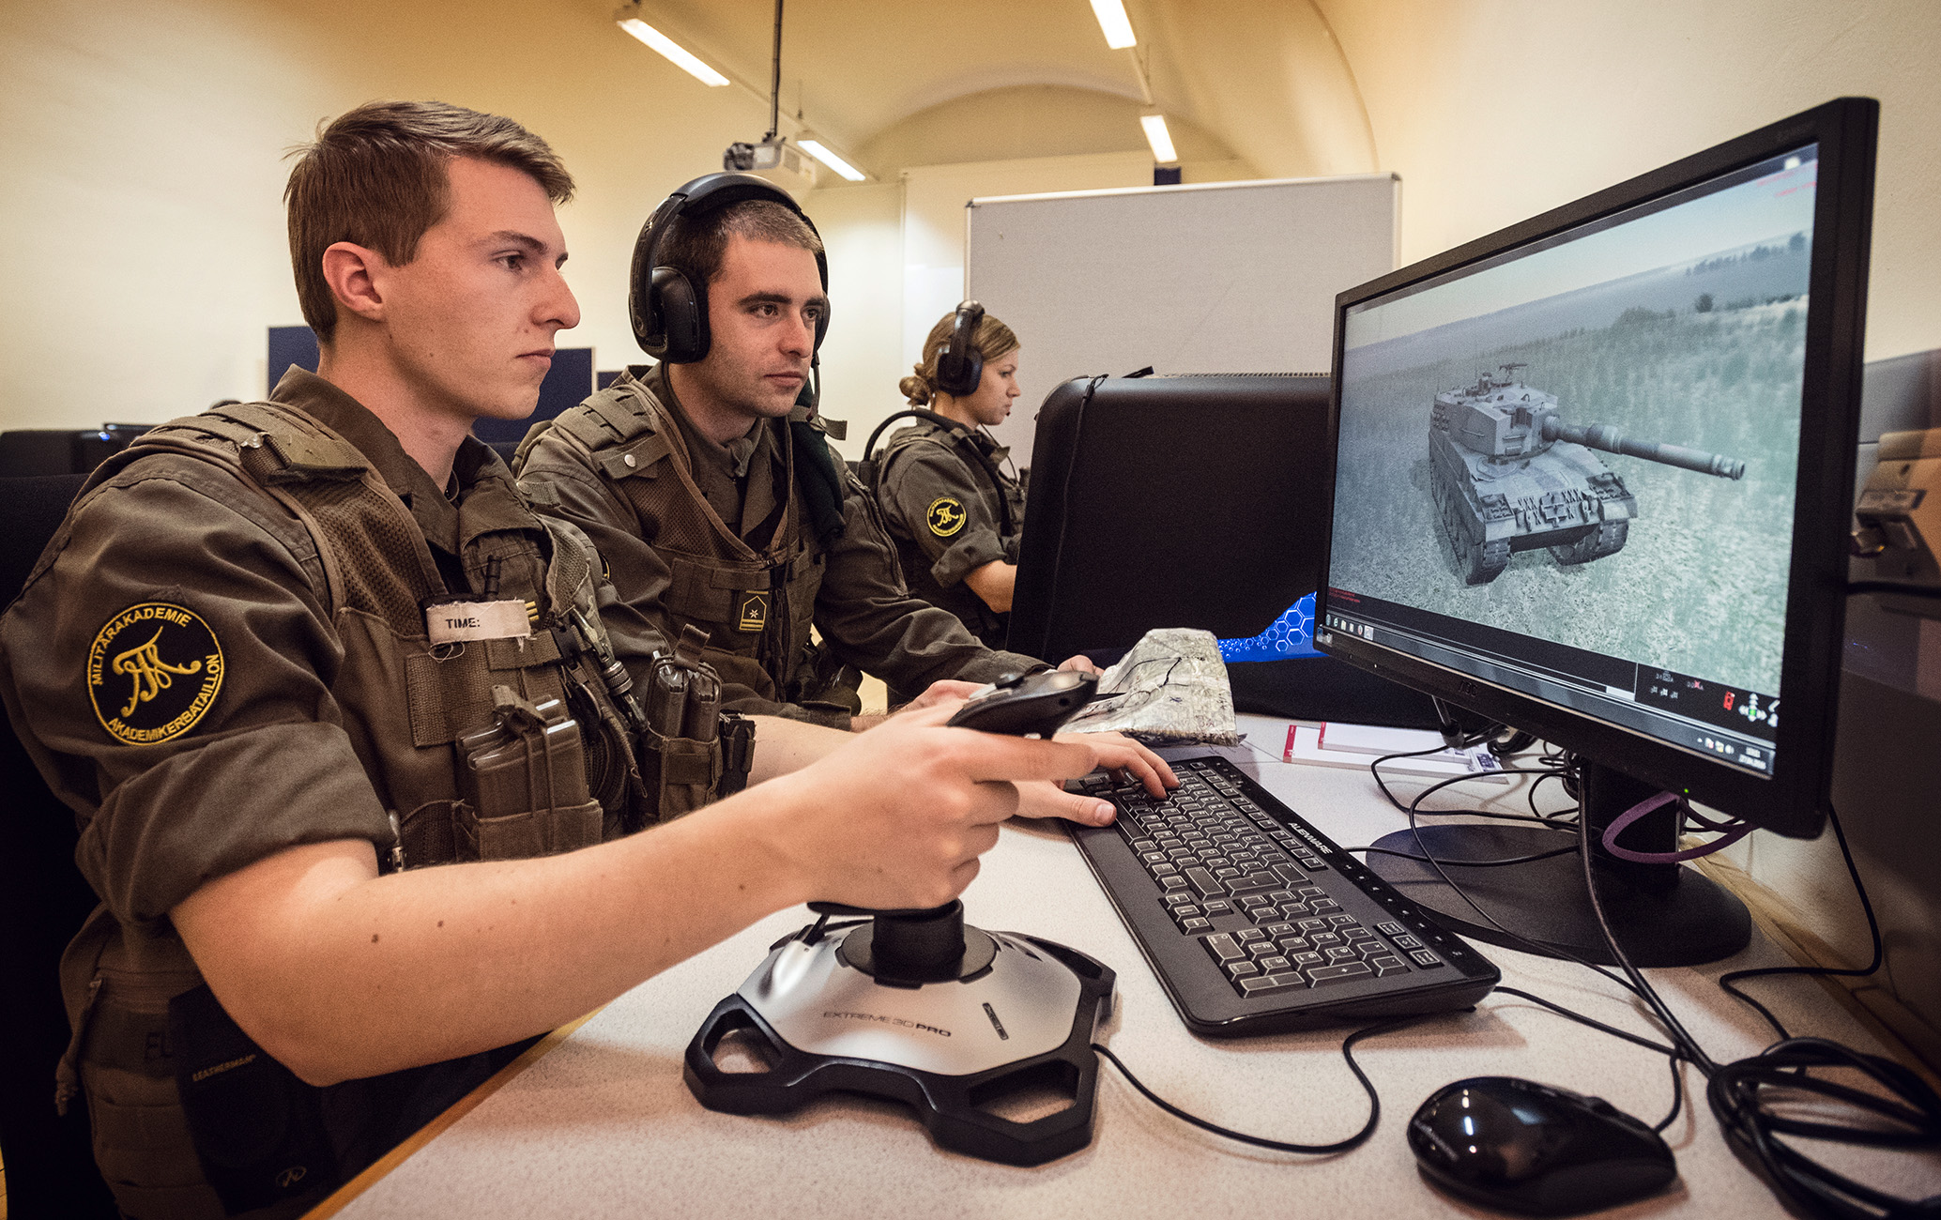
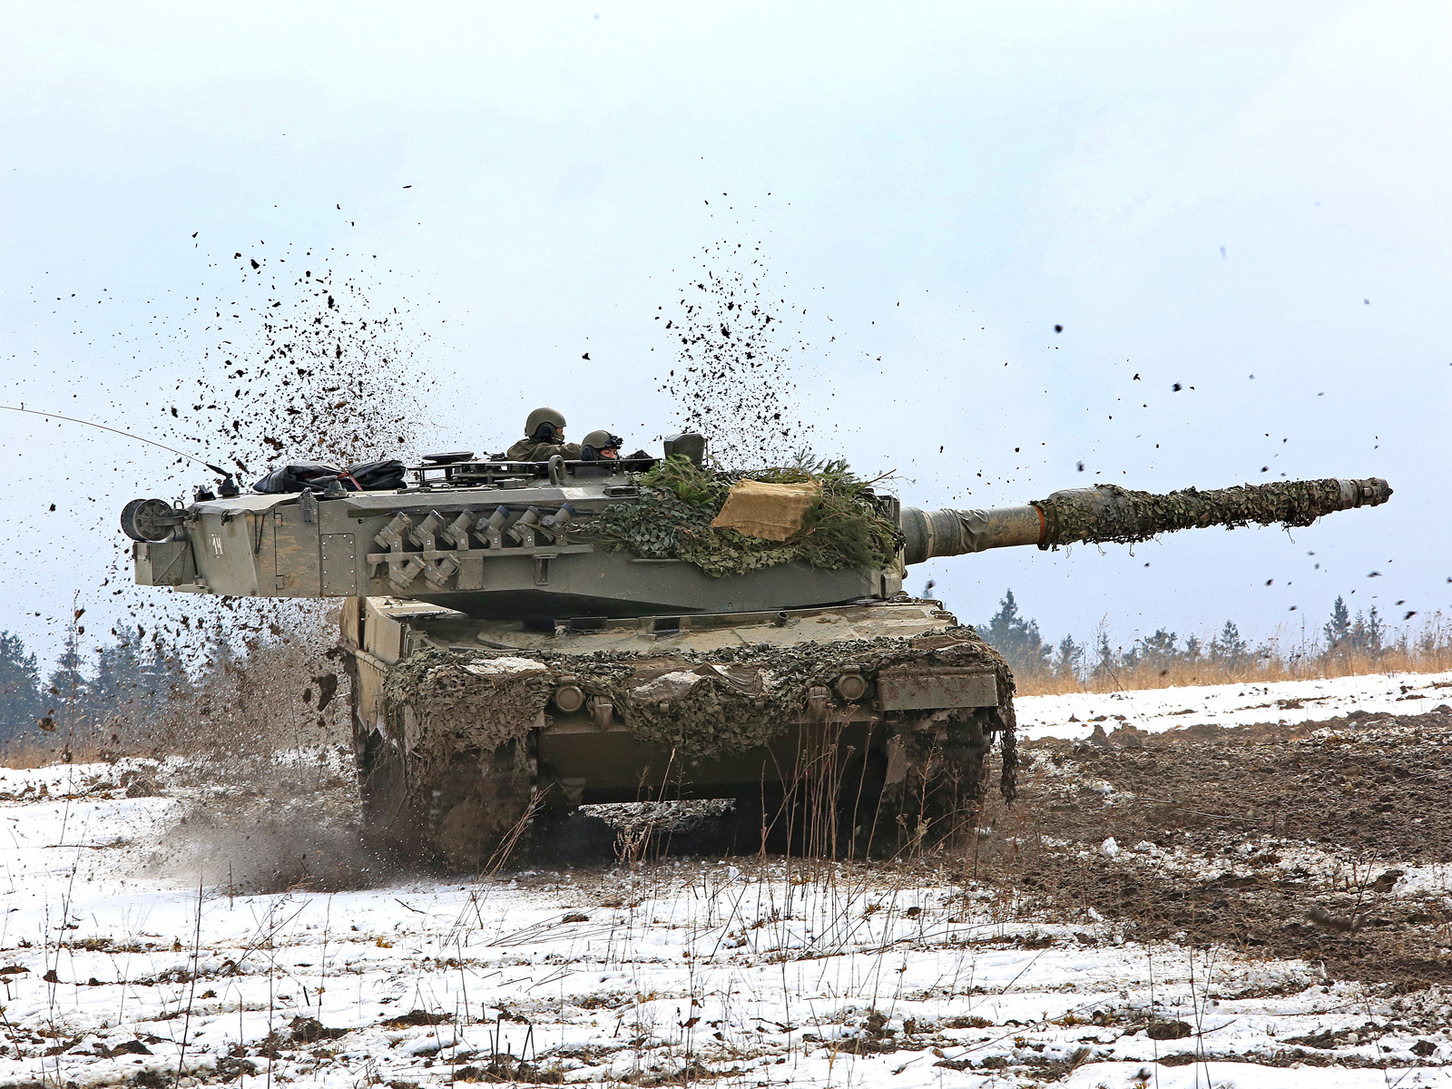
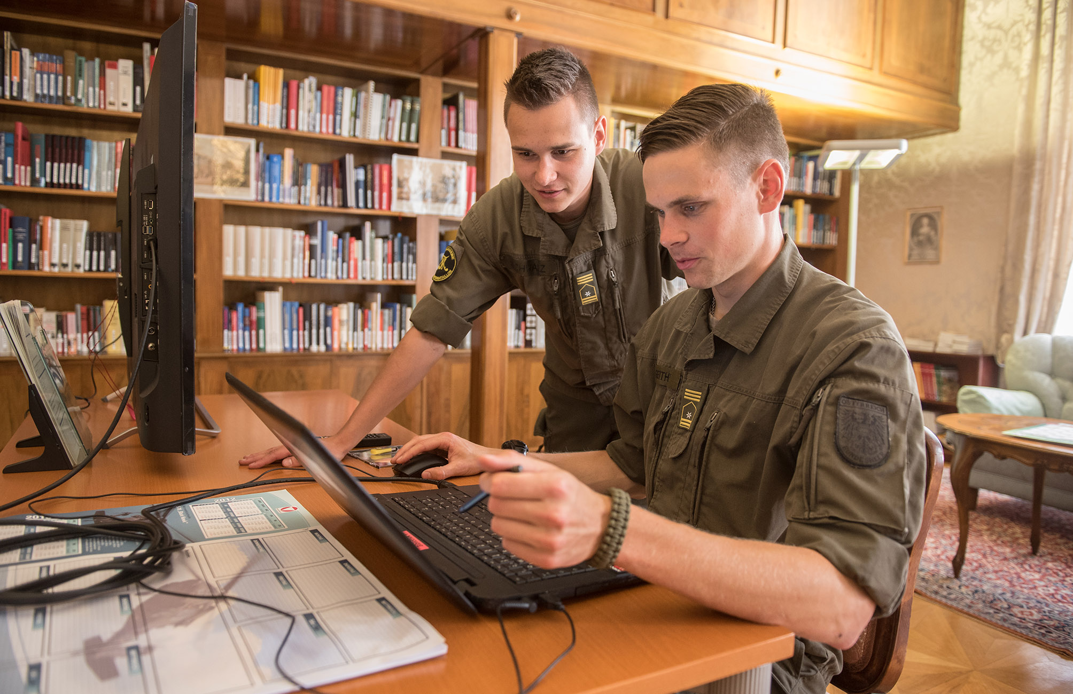
3.1.2 Application and dedication
Application and dedication are fundamental for the success of the cadets in their studies, and since many of their academic teachings have direct links to their military training, it is imperative for the cadets to succeed.
Application and dedication
Academic formation
Military formation

Slide 15
3.2 Military training & activities
On the field and tactical exercises constitute a fundamental formative step for all the officers who enter the TMA.
As already stated, this part of the cadets’ education grows parallelly to the their Academic studies:

Slide 16
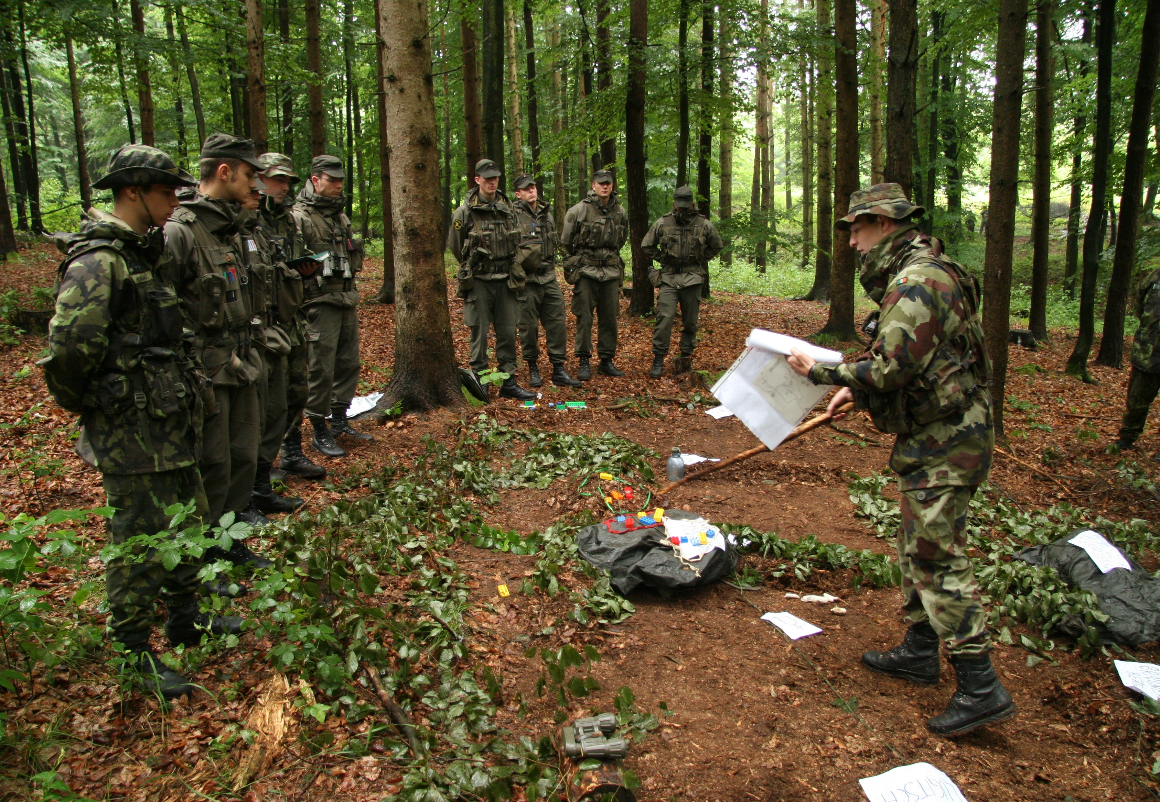
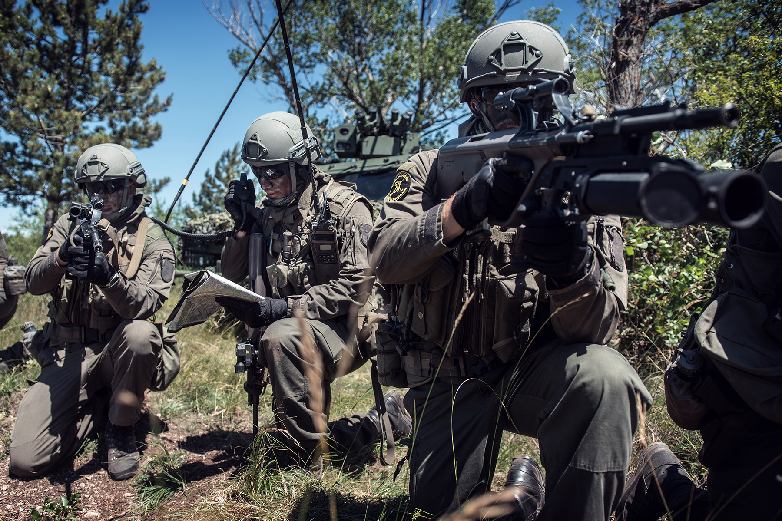
3.2.1 Tactical and leadership training
Tactical and leadership training are strictly bound together and they proceed as follows:
Education in tactical symbols and how to use maps;
Application on the field of the theoretical training;
Computer exercise training in the Academy’s simulation centers;
Tactical training spread along the entire semester, to try in practice what previously learned.

Slide 17
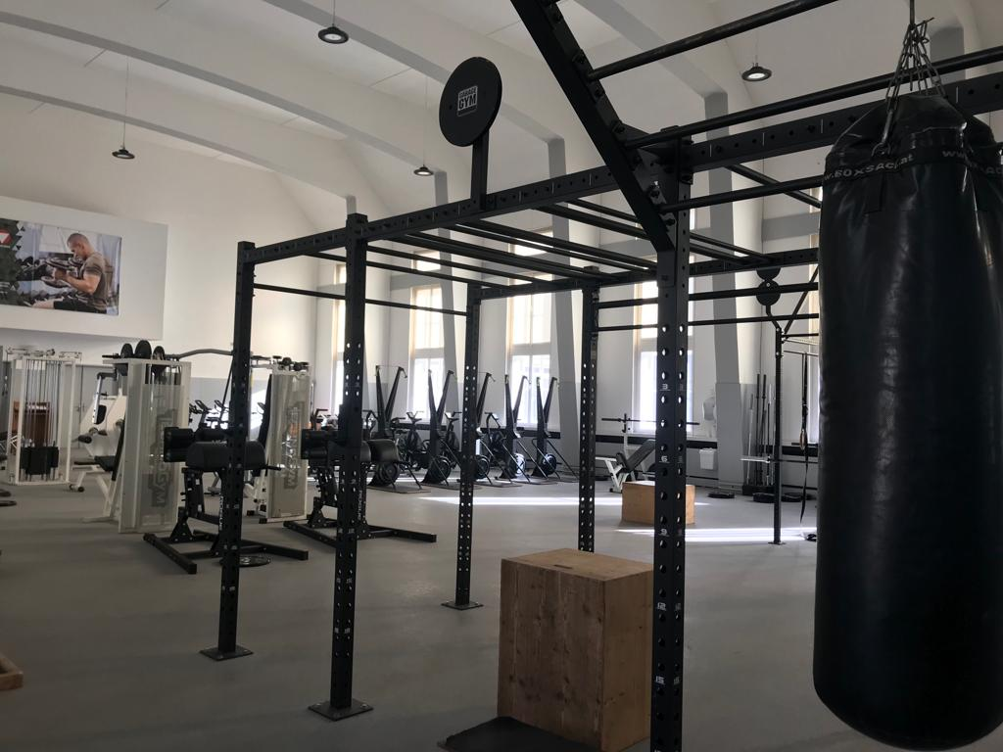
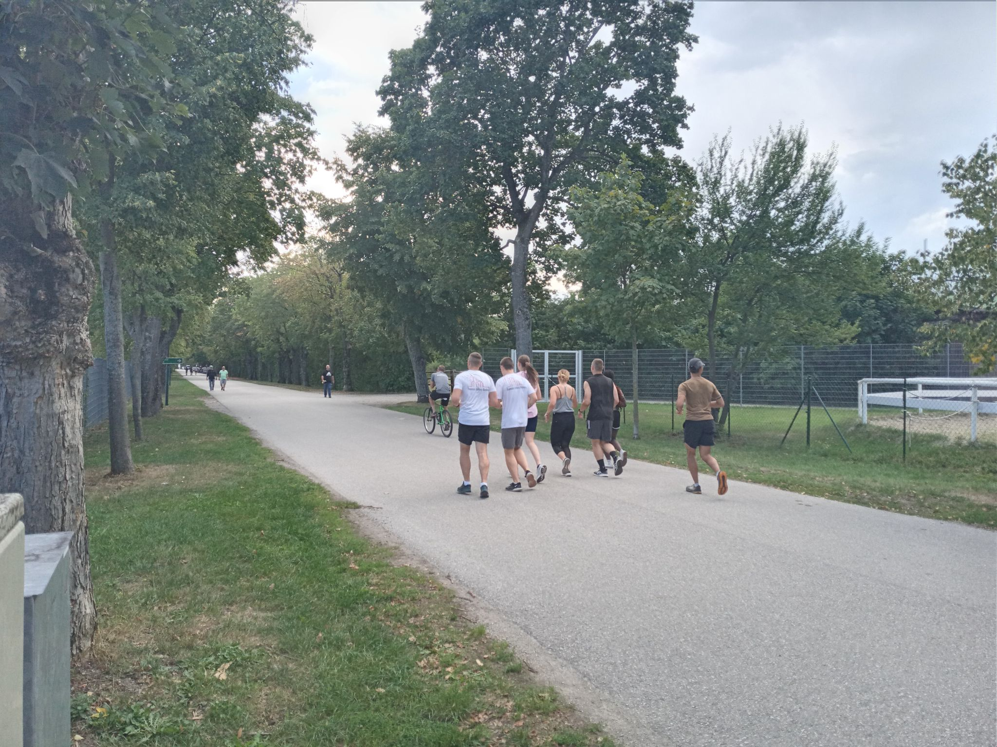
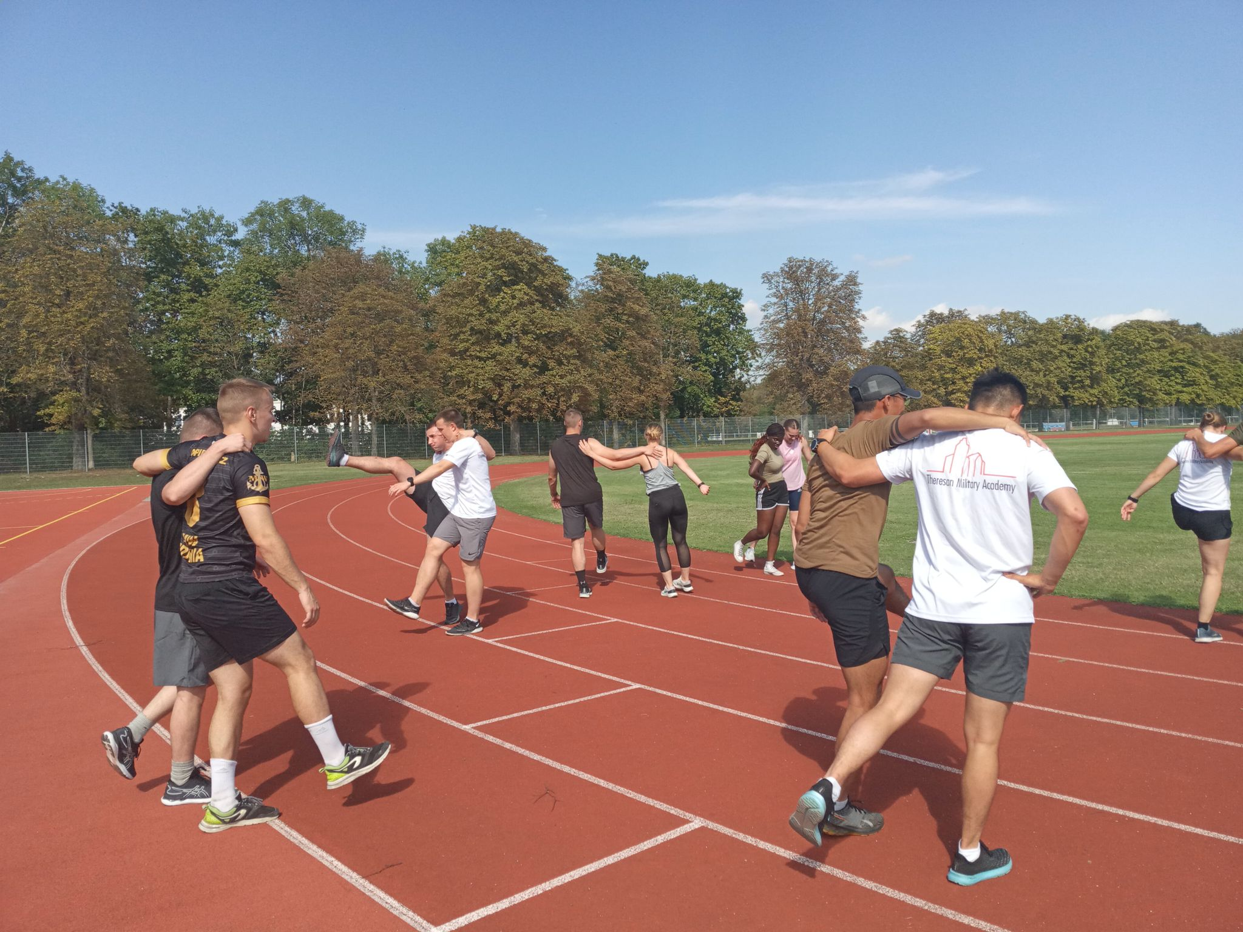
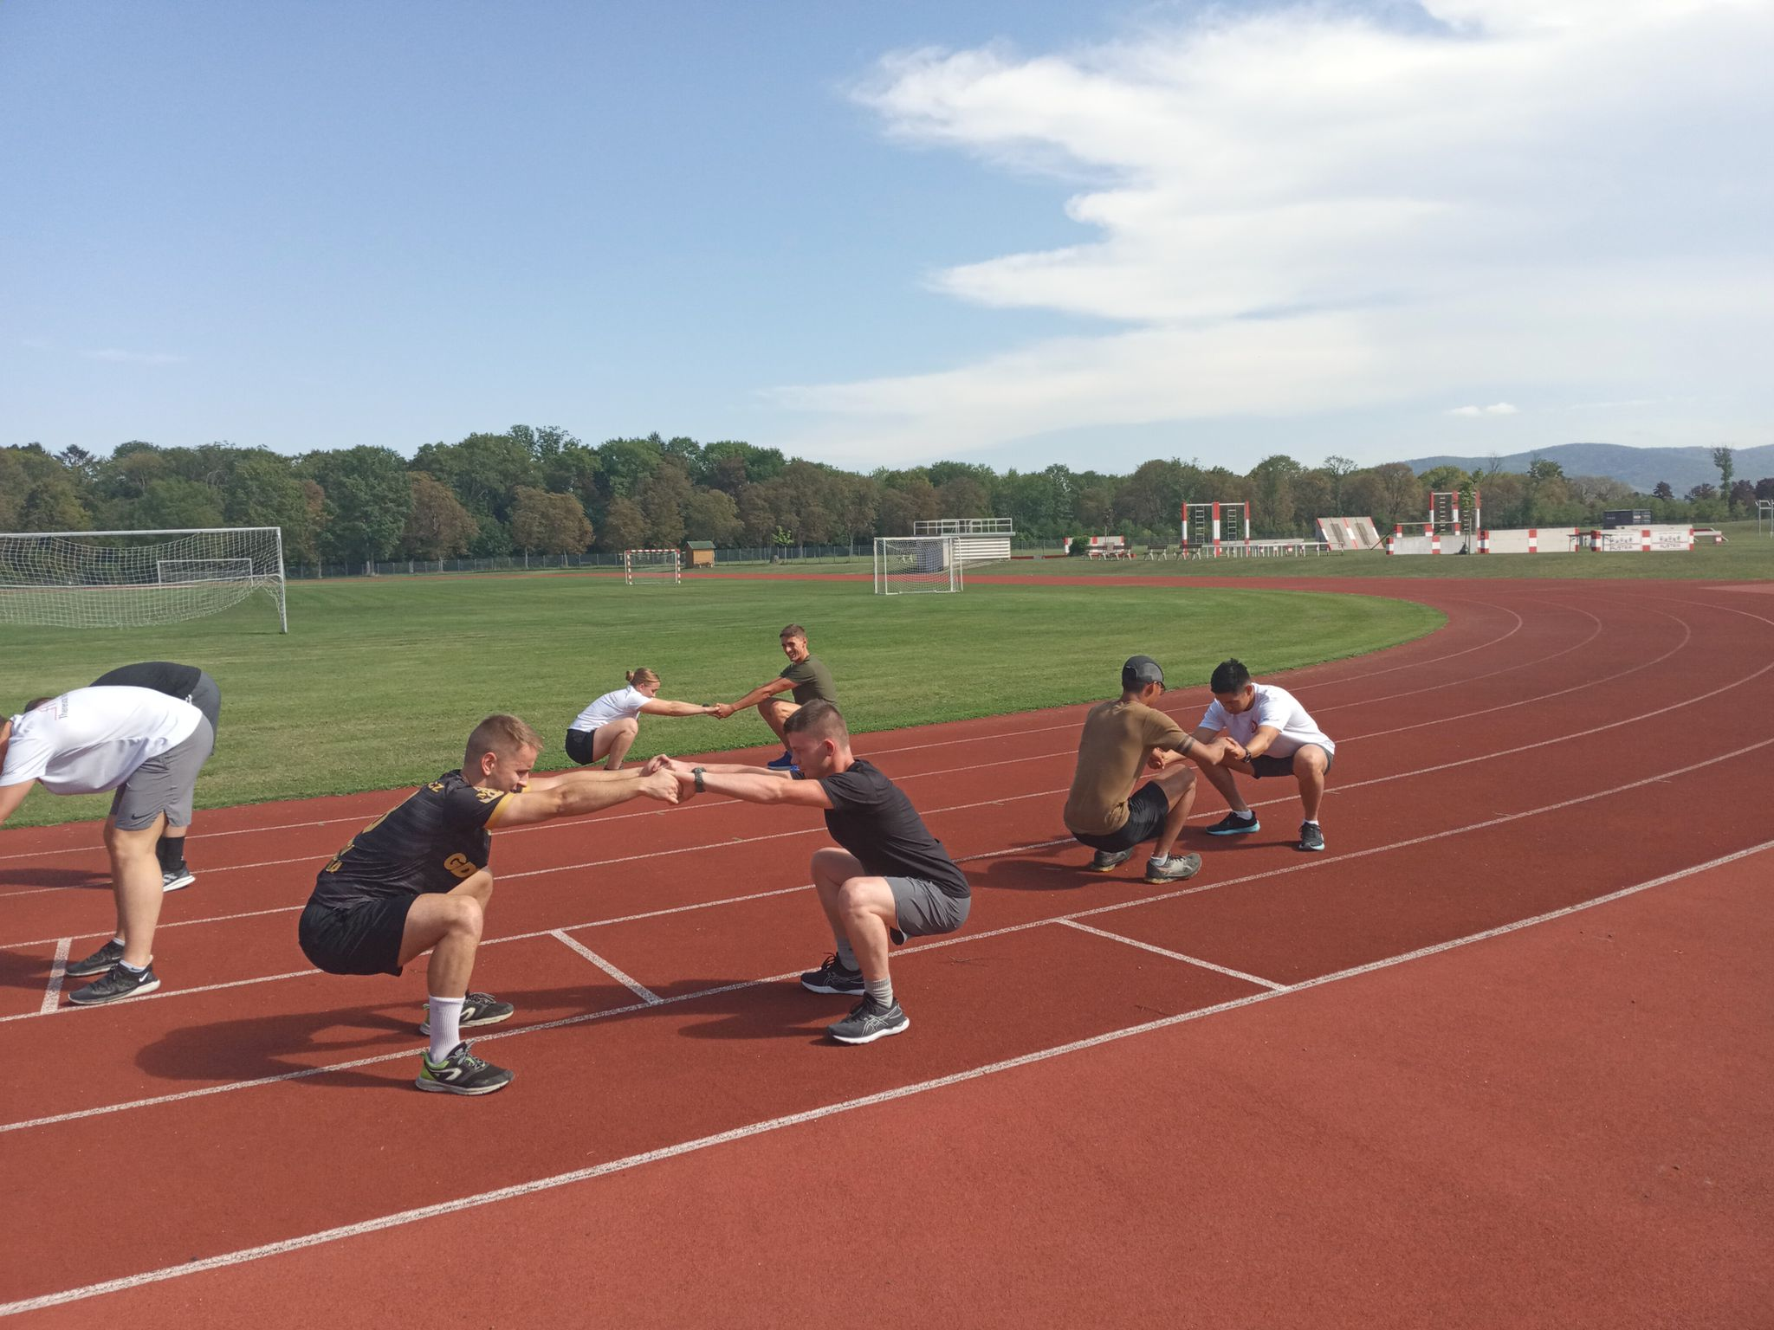
T
3.2.2 Sport activities
Sport activities constitute a pivotal part of the cadets’ daily life. As a matter of fact, they have the possibility to train either during duty or free time.
To that end, cadets and students have at their disposal not only the Academy’s gym along with the Sports field, but also the entirety of the Academy’s park.
On the top left: the Academy’s gym;
On the top right: cadets running in the Academy’s park;
On the bottom left and right: Cadets working out in the Academy’s Sports field.

Slide 18
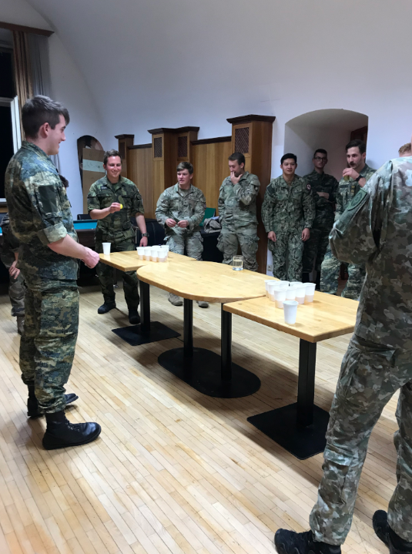
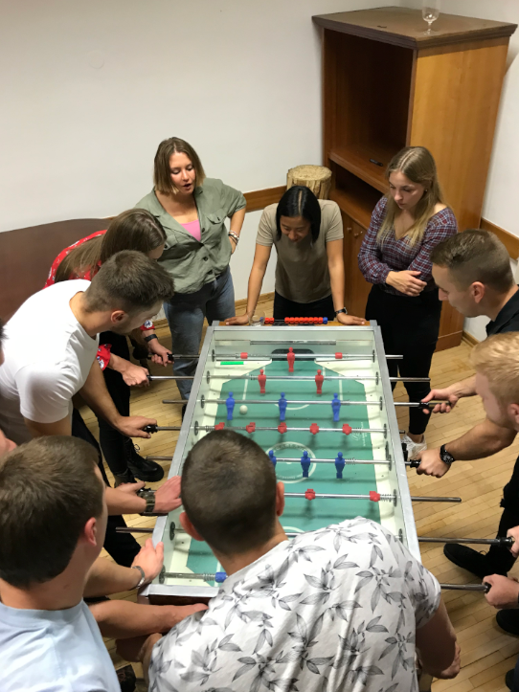
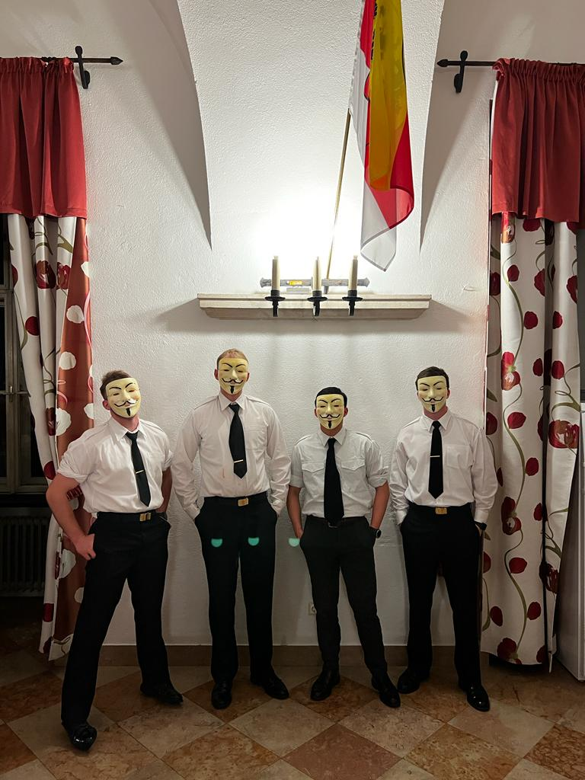
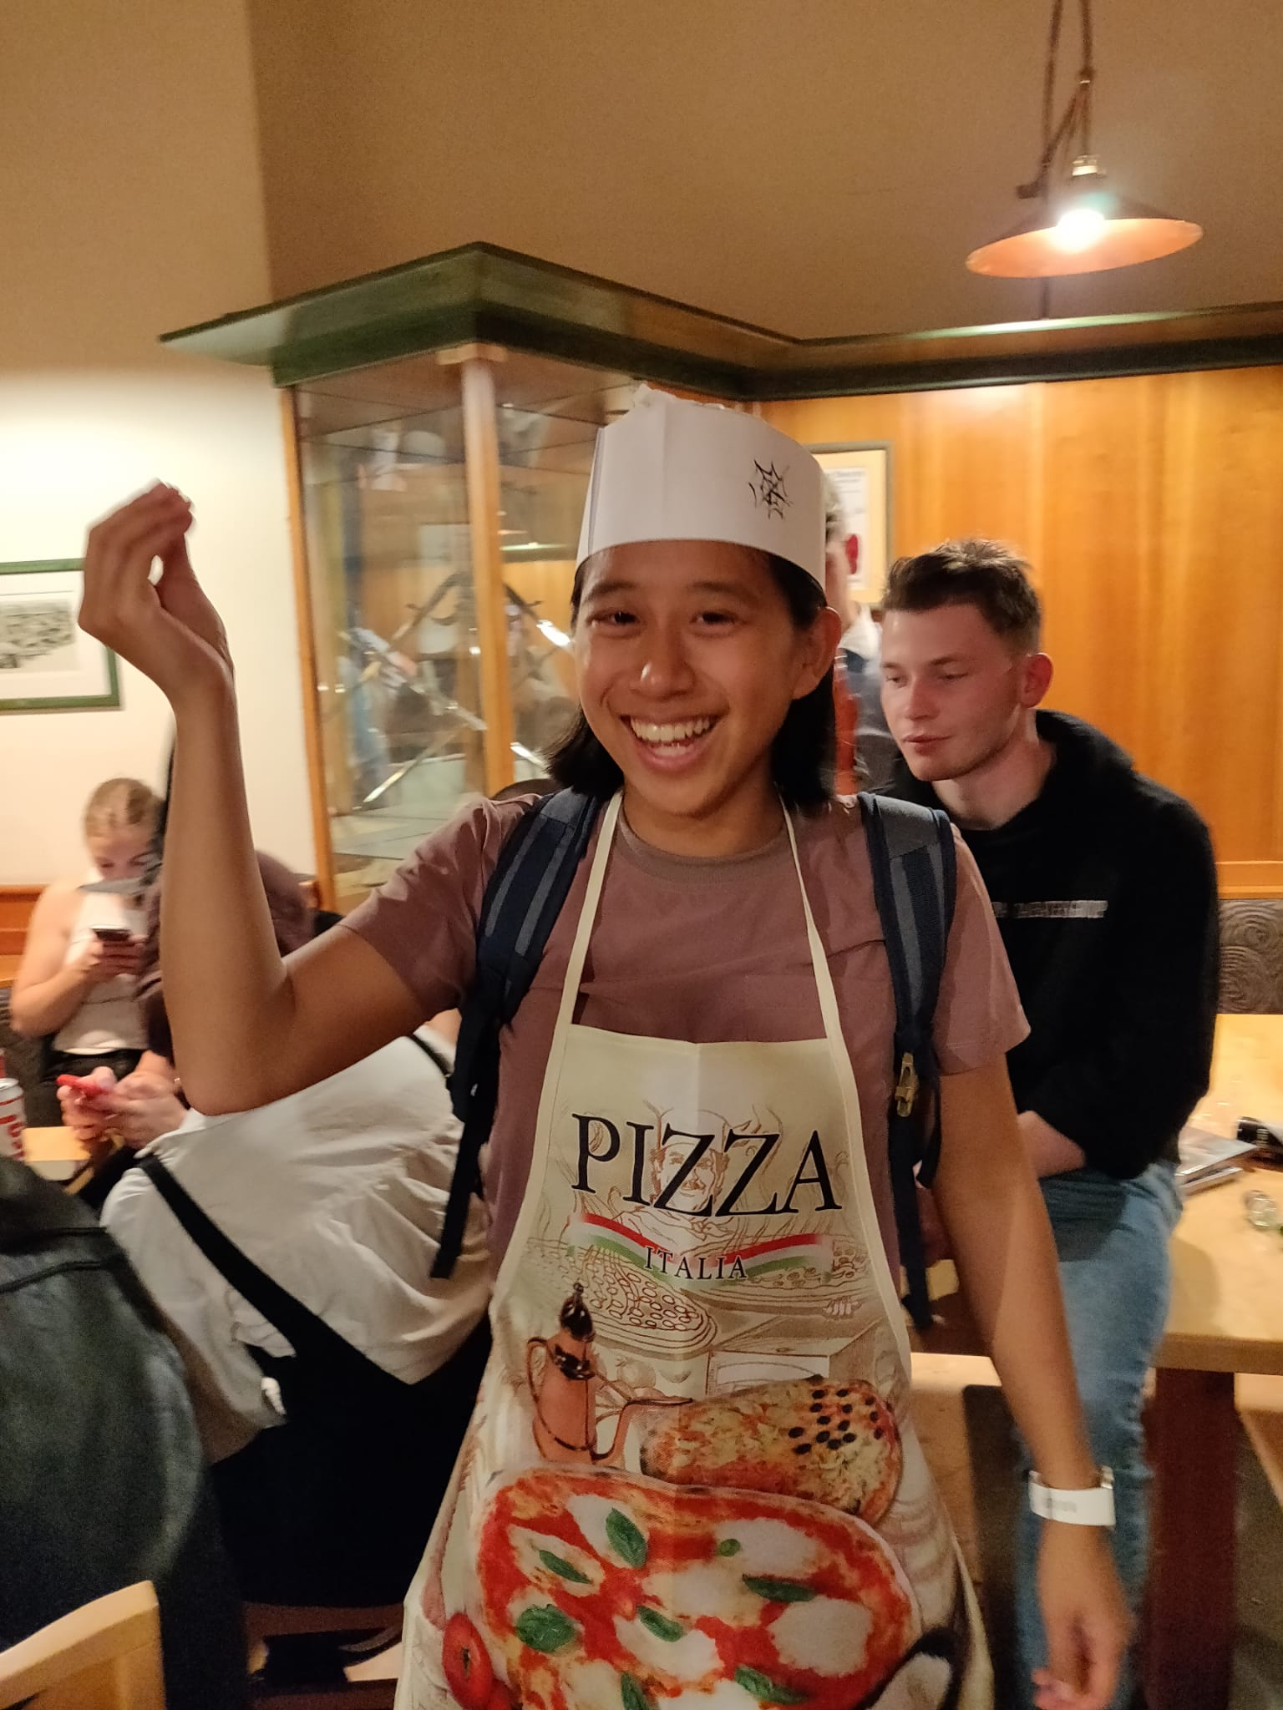
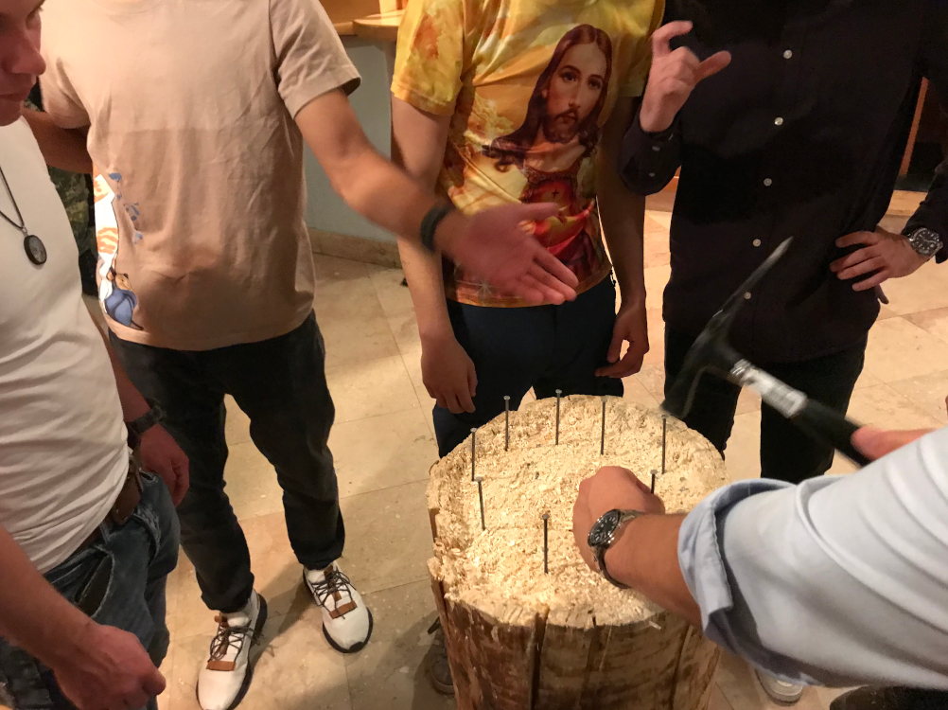
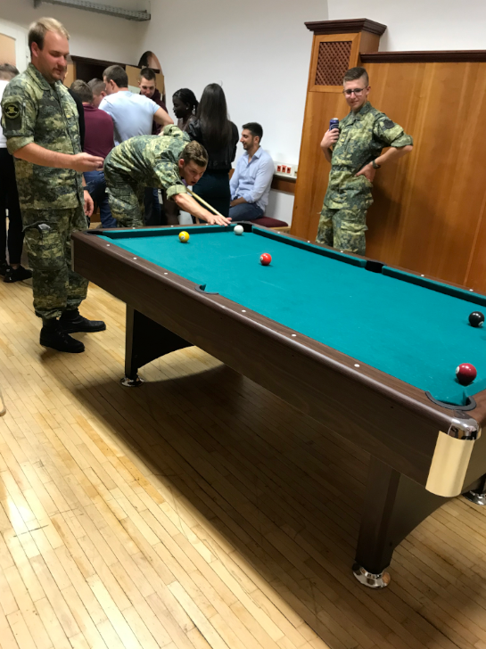
3.3 Life inside the Academy
6
5
International students can enjoy their free time at the Academy doing sports in the various infrastructures of the TMA, or having fun and socializing at the MAK Kasino (cadets’ club).
From the left to the right: Halloween party (1, 2) and cadets having fun at the MAK Kasino (3, 4, 5 , 6)
1
2
3
4

Slide 19
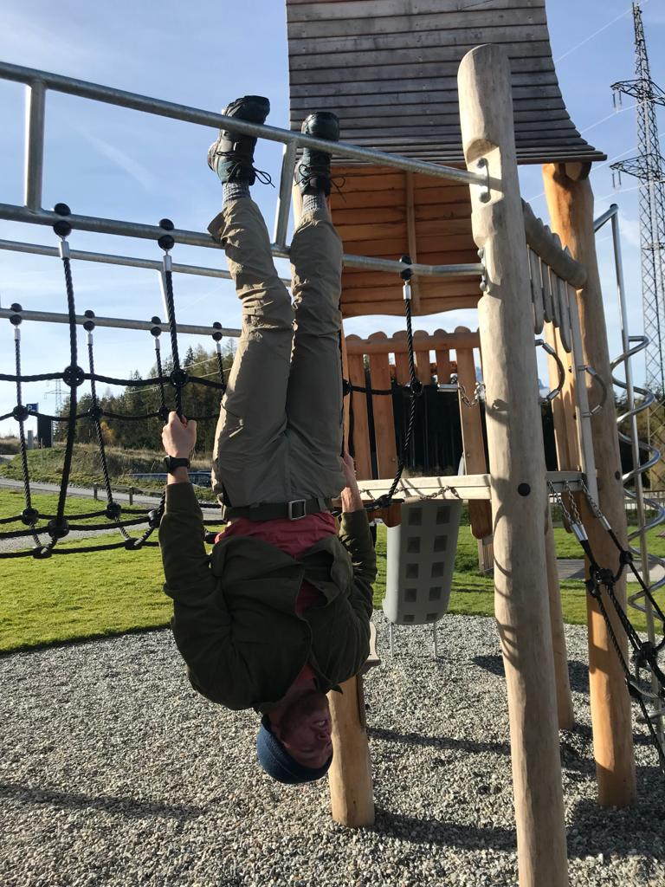
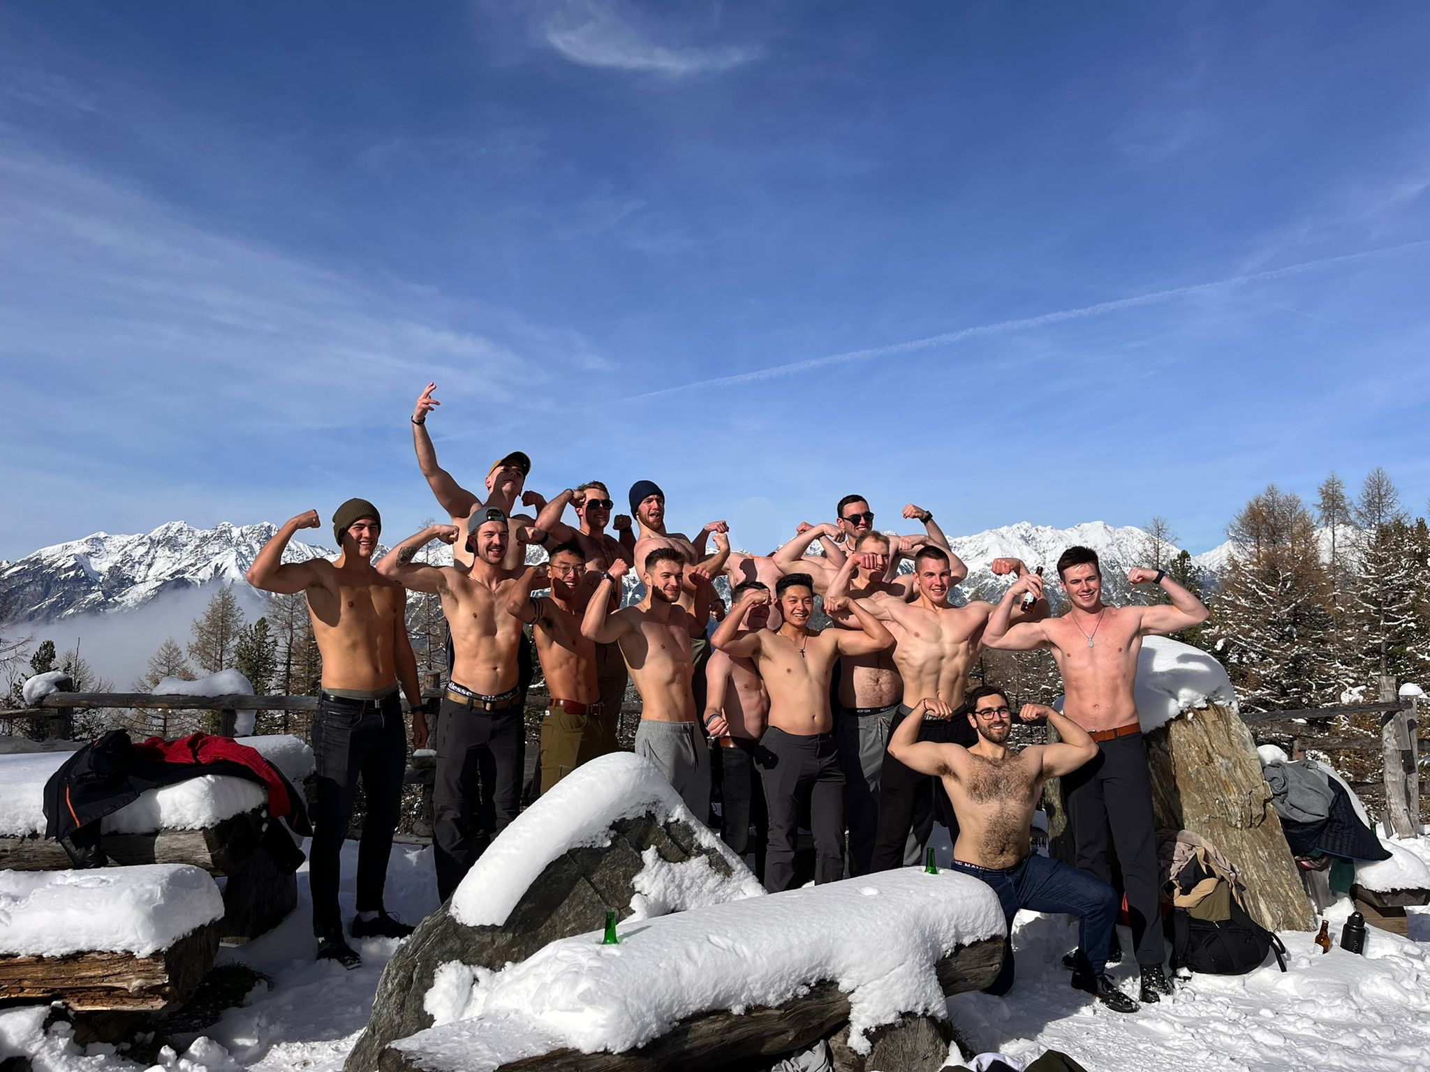
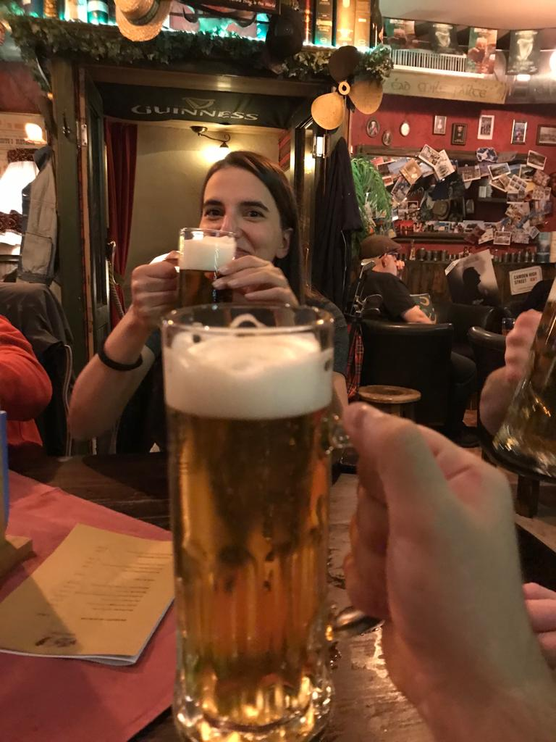
3.4 Life outside the Academy
Is there anything else to say?

Slide 20
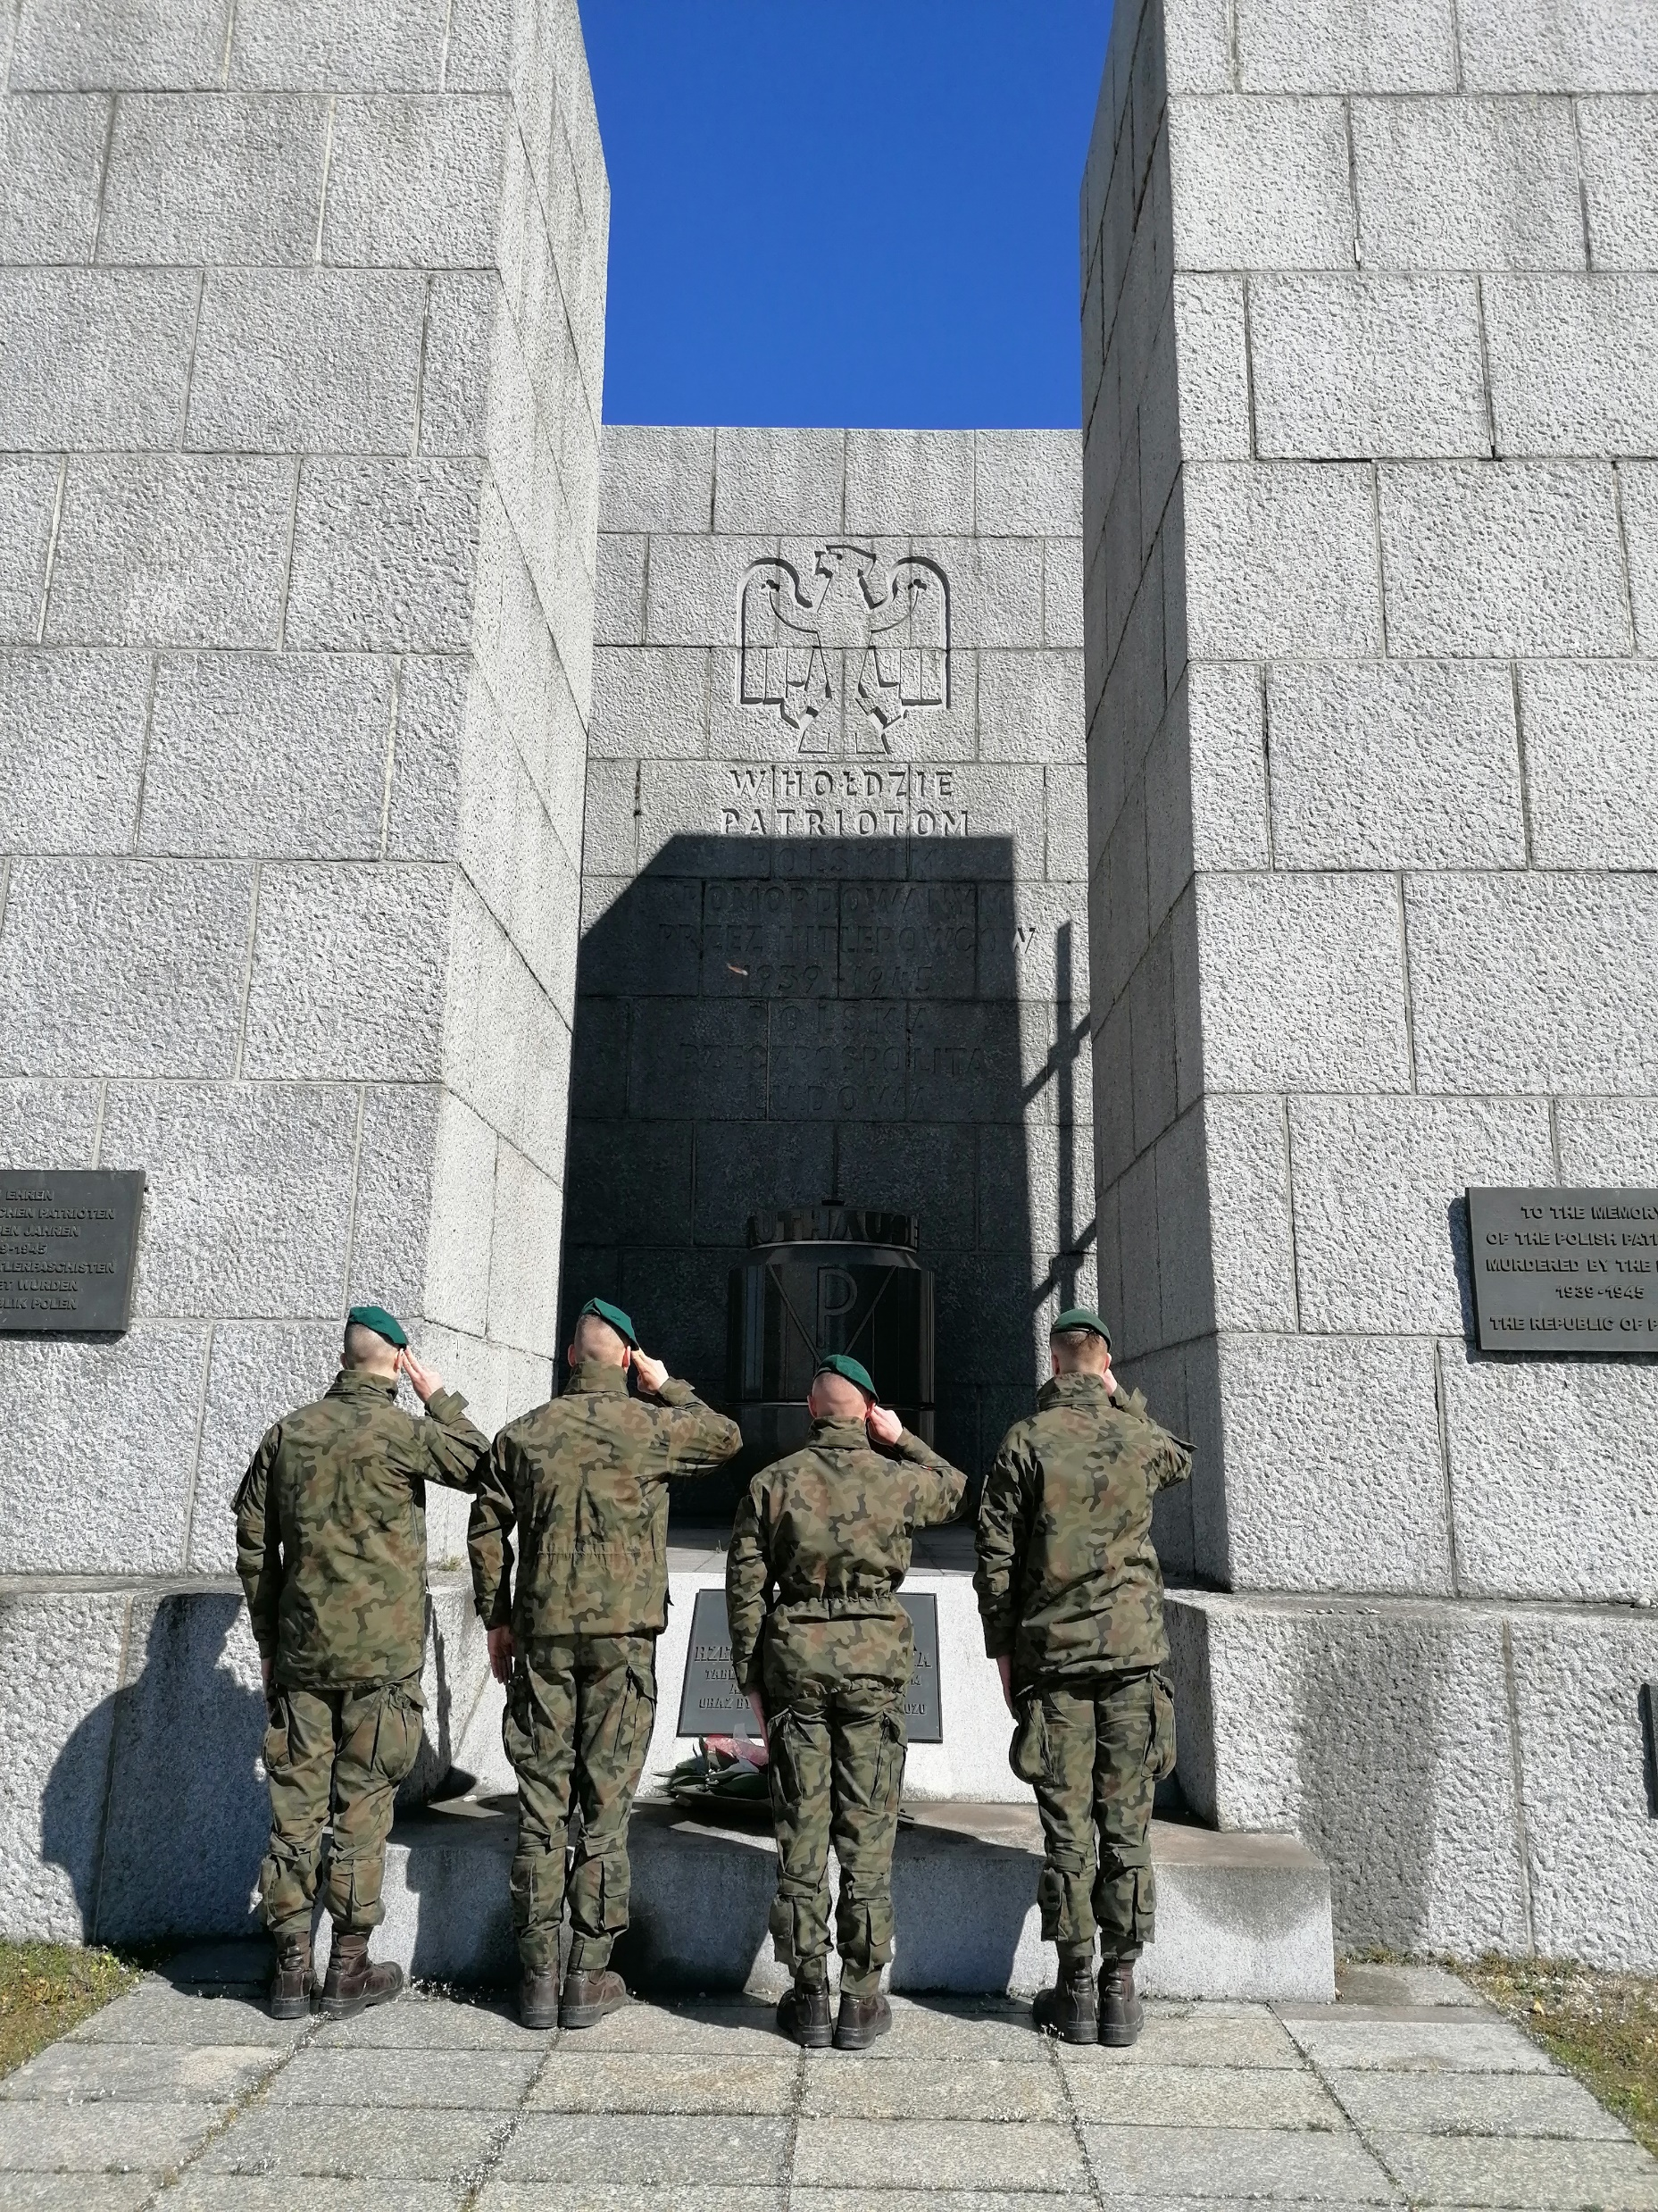
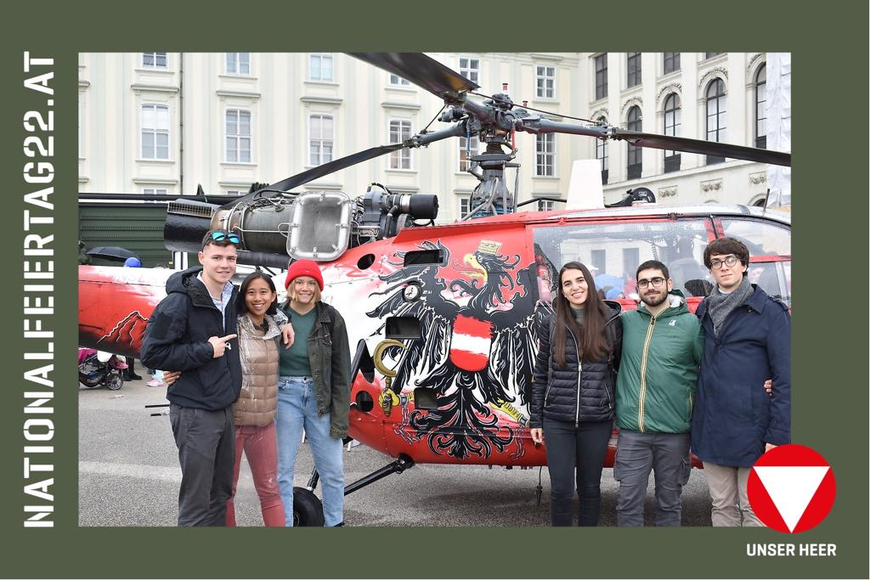
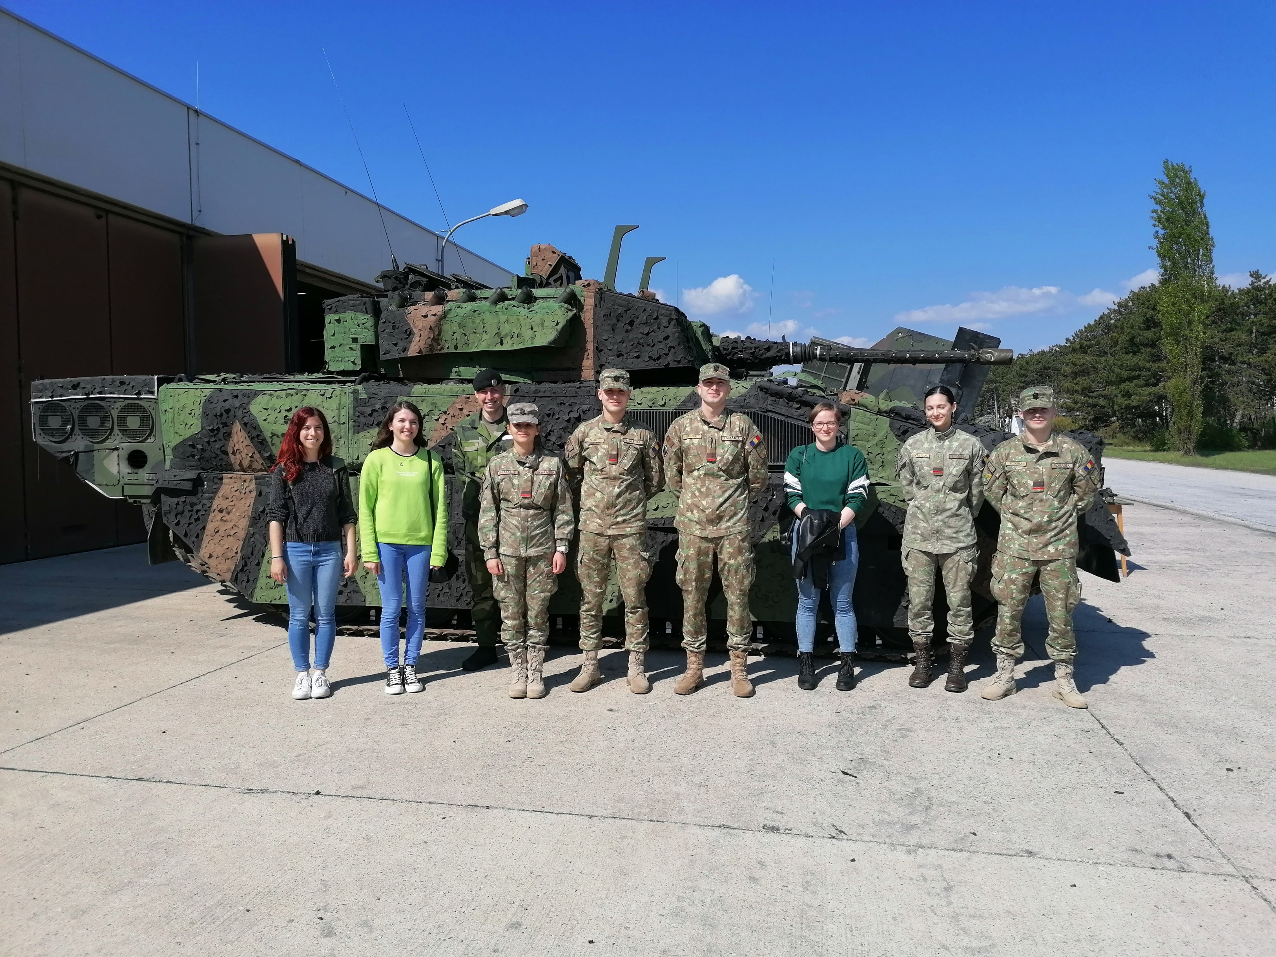
3.5 Events, occasions & cultural experiences
The Academy regularly organises or takes part in many different kinds of events and cultural activities, to keep the cadets’ formation at the highest levels.
4
From the left to the right: internationals at the Nationalfeiertag22 in Wien (1); cadets and staff visiting an armoured company (2); cadets paying homage at Mauthausen concentration camp (3); cadets pulling and pushing trucks at a sports event (4).
3
1
2

Slide 21
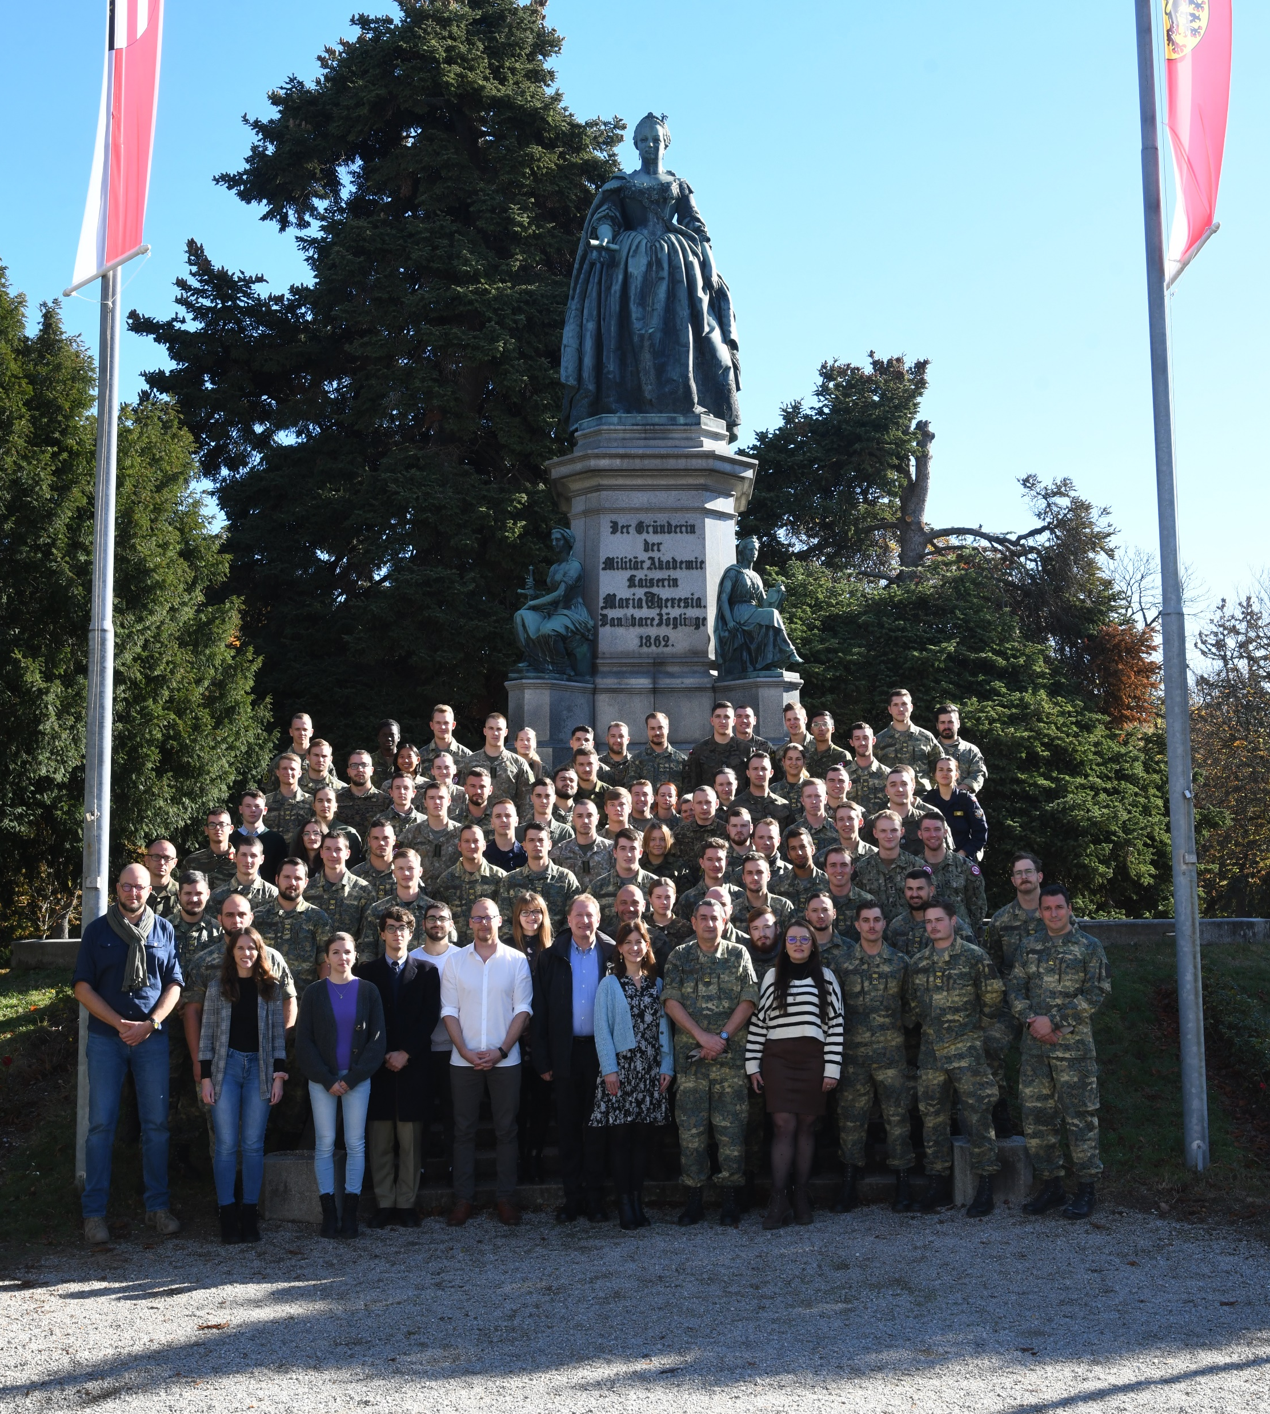
4.1 Outcome of the experience
Interviews with cadets and students of the International Semester of winter 2022, who answered the question:
“Could you describe us your experience at the TMA in one sentence?”
1) “That was amazing! For sure one of the best experiences of my life until now”
2) “I loved meeting new people from many different countries, I think it was the greatest strength of the project”
3) “I learned many things about myself, about who I want to be in my life and why I wish to become an officer. It was very formative”
The international semester, along with austrian cadets, one week participants and members of the International Office in occasion of the CSDP common module 2022

Slide 22
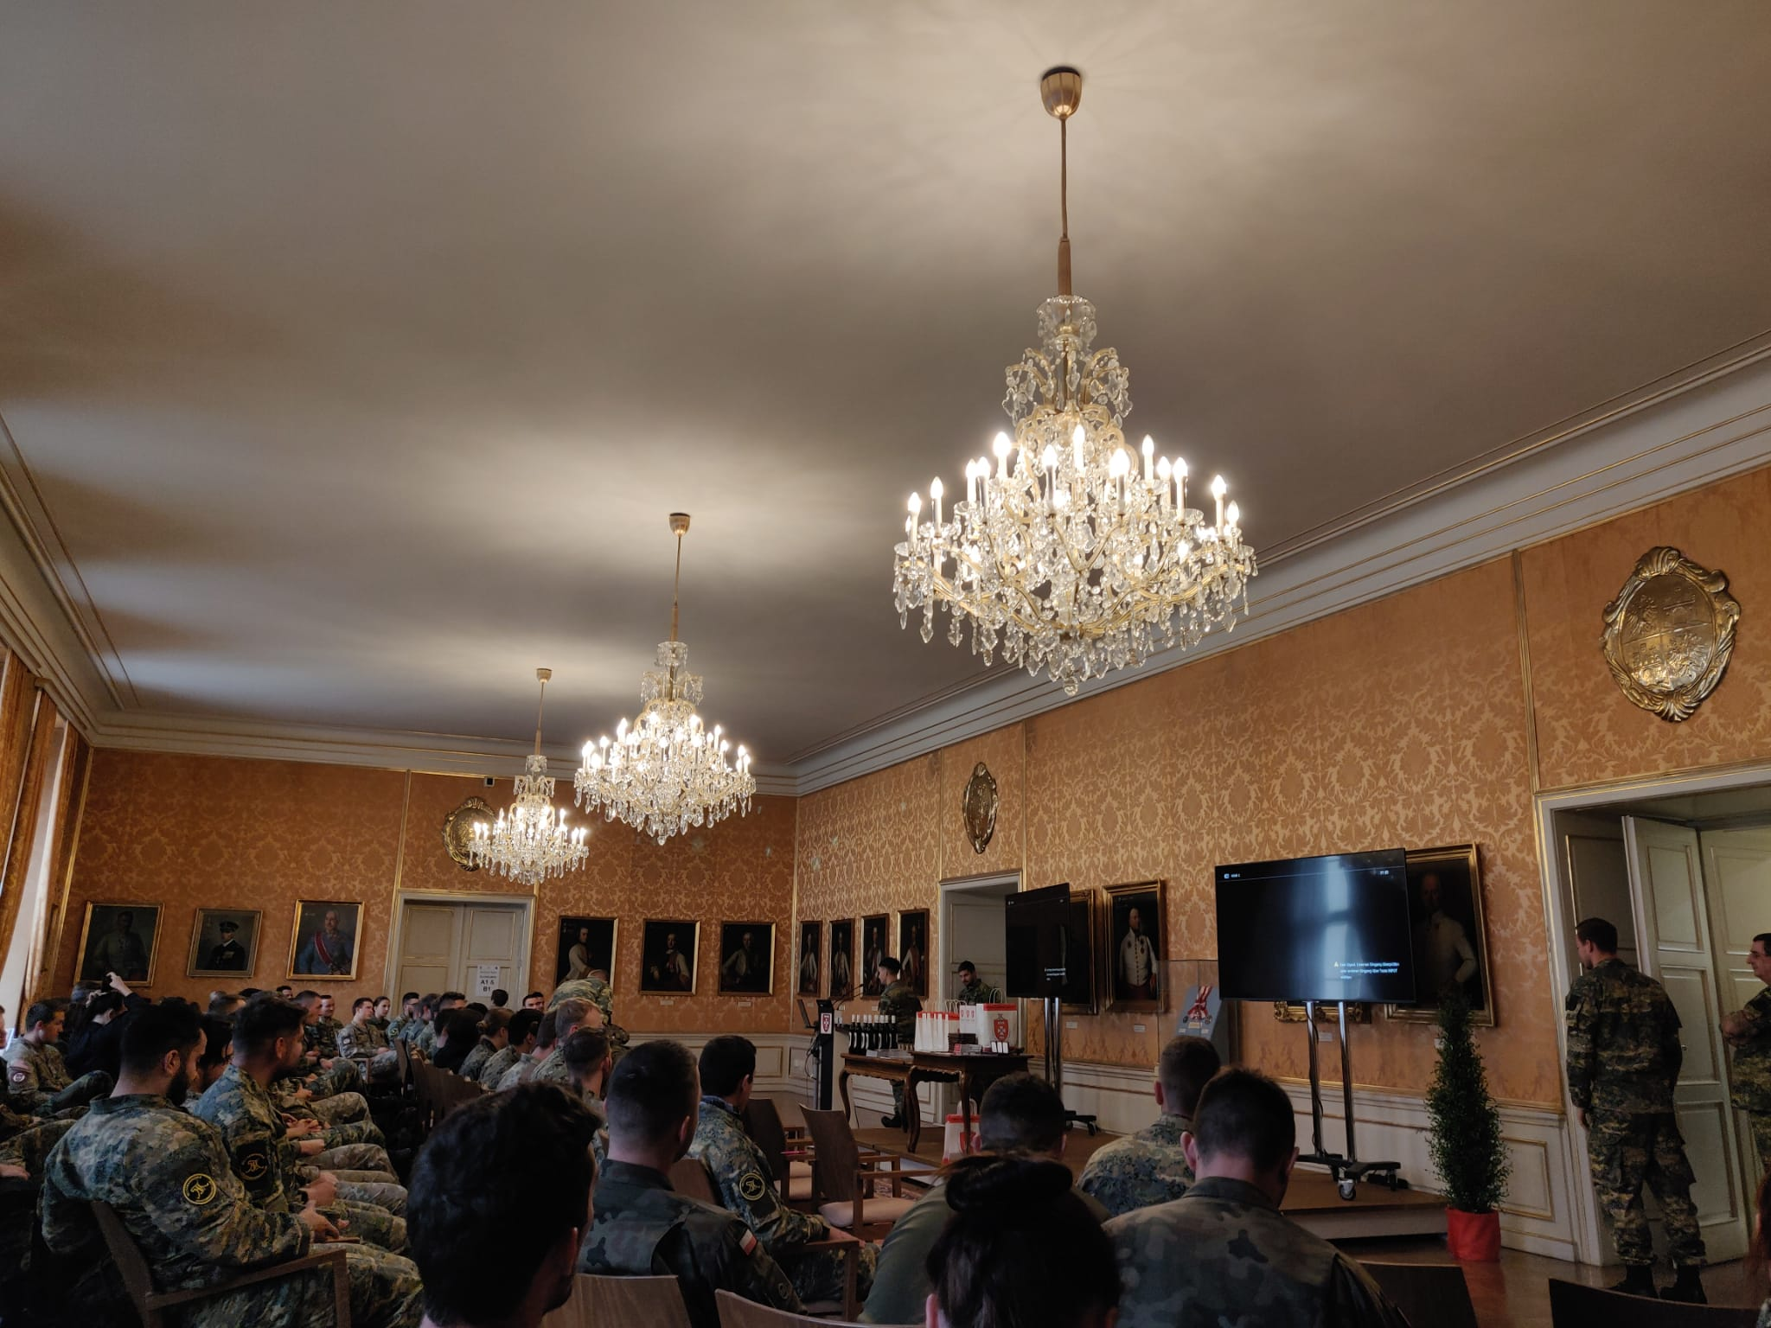
4.2 Departure from the Academy
At the end of the mobility period at the TMA, international cadets and students receive a certificate of attendance or the necessary Erasmus papers.
When it’s time to leave the Academy, a pick up service from there to either the railway station or the local airport or other transport infrastructures, is offered, to help and support them.
Goodbye ceremony at the Knights Hall

Slide 23
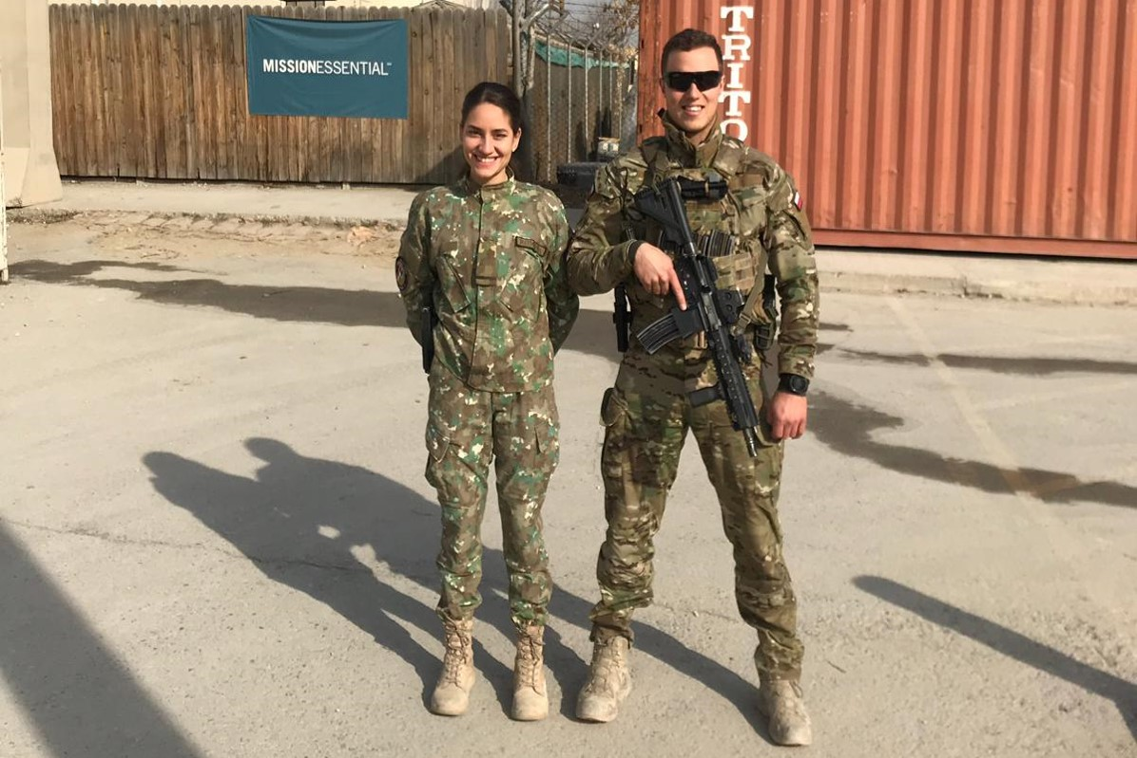
5.1 Keeping contacts
& meeting again
Dear Sir Colonel Gell,
after making many friendships during my participation in the Erasmus programmes, you can imagine how surprised I was after meeting a friend in Bagram base in Afghanistan, who like me was studying at the Theresan Military Academy and also at MALF in Wrocław. [….]
Kind regards,
2nd Lt Raluca VASILE
2nd Lt Tadeusz MANGOLD
BAF, Afghanistan,
02 January 2020

Slide 24
5.2 New competences
Social skills
Personal development
Technical skills
EU and extra EU integration
Civilian-military cooperation
Academic knowledge
Human relations
Foreign language improvement
Understanding of local culture
Digital skills
Management and time management
New competences
Development of self esteem
CSDP Common module
LOAC Common module
Media & relations common module
…

