Slide 1
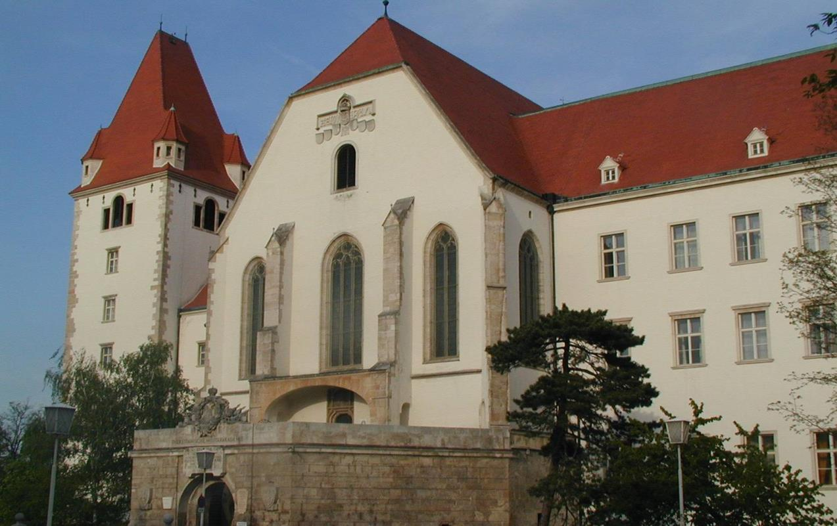

Basic Officer Education
&
Internationalisation
at the Theresan Military Academy
Briefing
by
Colonel Assoc. Prof. Harald GELL, PhD, MSc, MSD, MBA

Slide 2
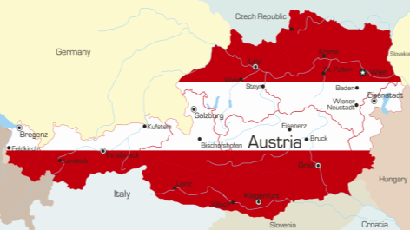
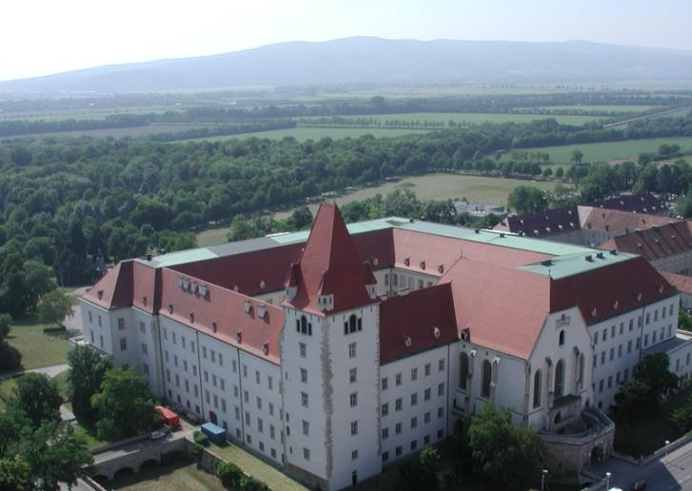
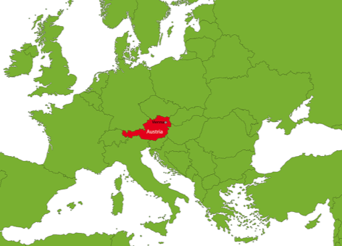
Location
Castle building process – year 1194
Source: https://www.google.at/search?q=Austria&rlz=1C1MDNF_deAT498AT498&source=lnms&tbm=isch&sa=X&ved=0ahUKEwidldqC7bbQAhVBtBoKHWRVBAYQ_AUICCgB&biw=1396&bih=790#tbm=isch&q=Austria+map&imgrc=8H8RCeJmp7OloM%3A

Slide 3
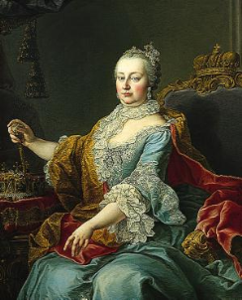
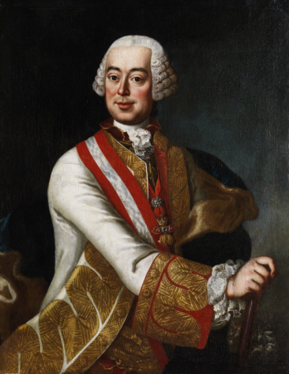
History
Order
on
14th Dec. 1751:
“Make them
fine officers
and
righteous men”
Empress
Maria
Theresa
Field Marshal Leopold Count Daun

Slide 4
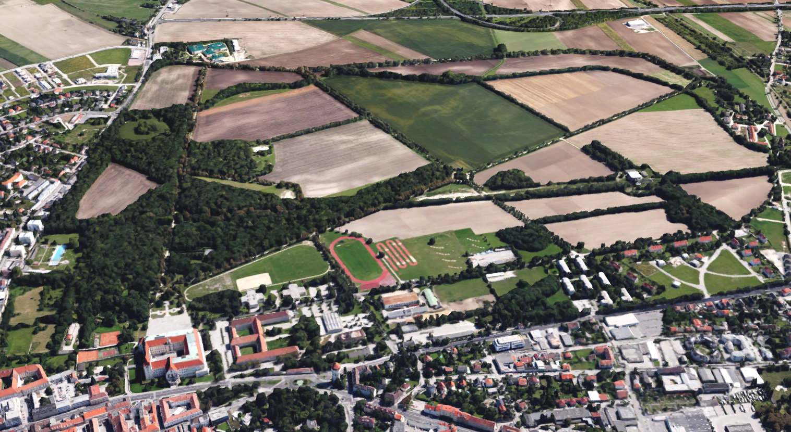
Campus
1,400 metres
1,700 metres
Source: Google Maps; re-shaped by Col Gell

Slide 5
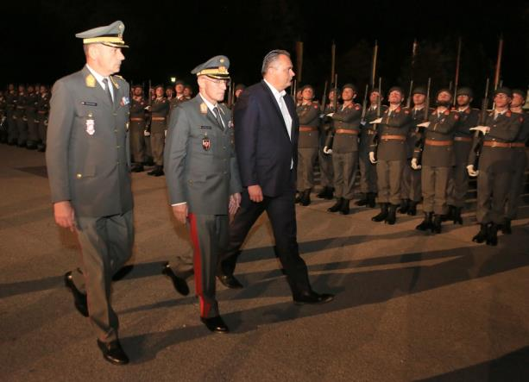
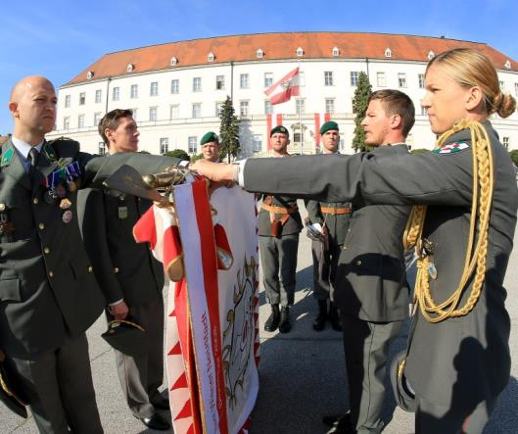
Mission
pre-
education?
basic
education
advanced
training
for Officers of the Austrian Armed Forces

Slide 6
Organisation
TMA
Commandant
Theresan Military Academy
Chief of Staff
Controlling
Staff Department
Service and Support
Institute 1 &
Cadets‘ Battalion
Institute 2
(School
Battalion)
Research &
Development
Basic Officer Education

Slide 7
Organisation
Institute 1
Institute 1
Directorate
(Ad-
ministration
(Library, IT, …)
International
Office
Military
Leadership
(Tactics+TTP
& Languages)
Pedagogics &
Psychology &
Sports
History &
Political
Science &
Law &
Economics
Cadets’
Battalion
= academic
= vocational
A
Company
B
Company
C
Company

Slide 8
Education System
Schematically
Graduation
2nd Lieutenant
Bachelor of Arts (BA) in Military Leadership
FH-
Bachelor Programme Military Leadership
Branch
specific Education
In
parallel
Career
Officer
Course
Connections
Cadre Aspirants Course 1+2
General qualification for
university entrance

Slide 9
Education System
Timing
Jan | Feb | Mar | Apr | May | Jun | Jul | Aug | Sep | Oct | Nov | Dec
Cadre Aspirants Course 1
(CAC 1)
CAC 1
Cadre Aspirants Course 2 (CAC 2)
(Goal: Squad Leader Infantry)
EE
MDL
1st
Semester
1st
S.
COC
2nd
Semester
Career Officer Course (COC)
3rd
Semester
3rd
S.
COC
4th
Semester
COC
5th
Semester
Political Science, Economics, ICT
Specific Strategies, Pedagogics,
Sports Science,
Security Policy
Some Austrian Cadets:
Germany
United States of America
COC/Branch specific training
(6 weeks National Training
on the Job are included)
L
A
W
Int’l Training on the Job
L
A
W
BE
G
r
a
d
Abbreviations:
EE = Entrance Exam
MDL = Military Driving License
ICT = Information and
Communication Technology
BE = Bachelor Exam
Grad = Graduation
6th Semester

Slide 10
Education System
Academic Semesters
Jan | Feb | Mar | Apr | May | Jun | Jul | Aug | Sep | Oct | Nov | Dec
Cadre Aspirants Course 1
(CAC 1)
CAC 1
Cadre Aspirants Course 2 (CAC 2)
(Goal: Squad Leader Infantry)
EE
MDL
1st
Semester
1st
S.
COC
2nd
Semester
Career Officer Course (COC)
3rd
Semester
3rd
S.
COC
4th
Semester
COC
5th
Semester
Political Science, Economics, ICT
Specific Strategies, Pedagogics,
Sports Science,
Security Policy
Some Austrian Cadets:
Germany
United States of America
COC/Branch specific training
(6 weeks National Training
on the Job are included)
L
A
W
Int’l Training on the Job
L
A
W
BE
G
r
a
d
Abbreviations:
EE = Entrance Exam
MDL = Military Driving License
ICT = Information and
Communication Technology
BE = Bachelor Exam
Grad = Graduation
6th Semester

Slide 11
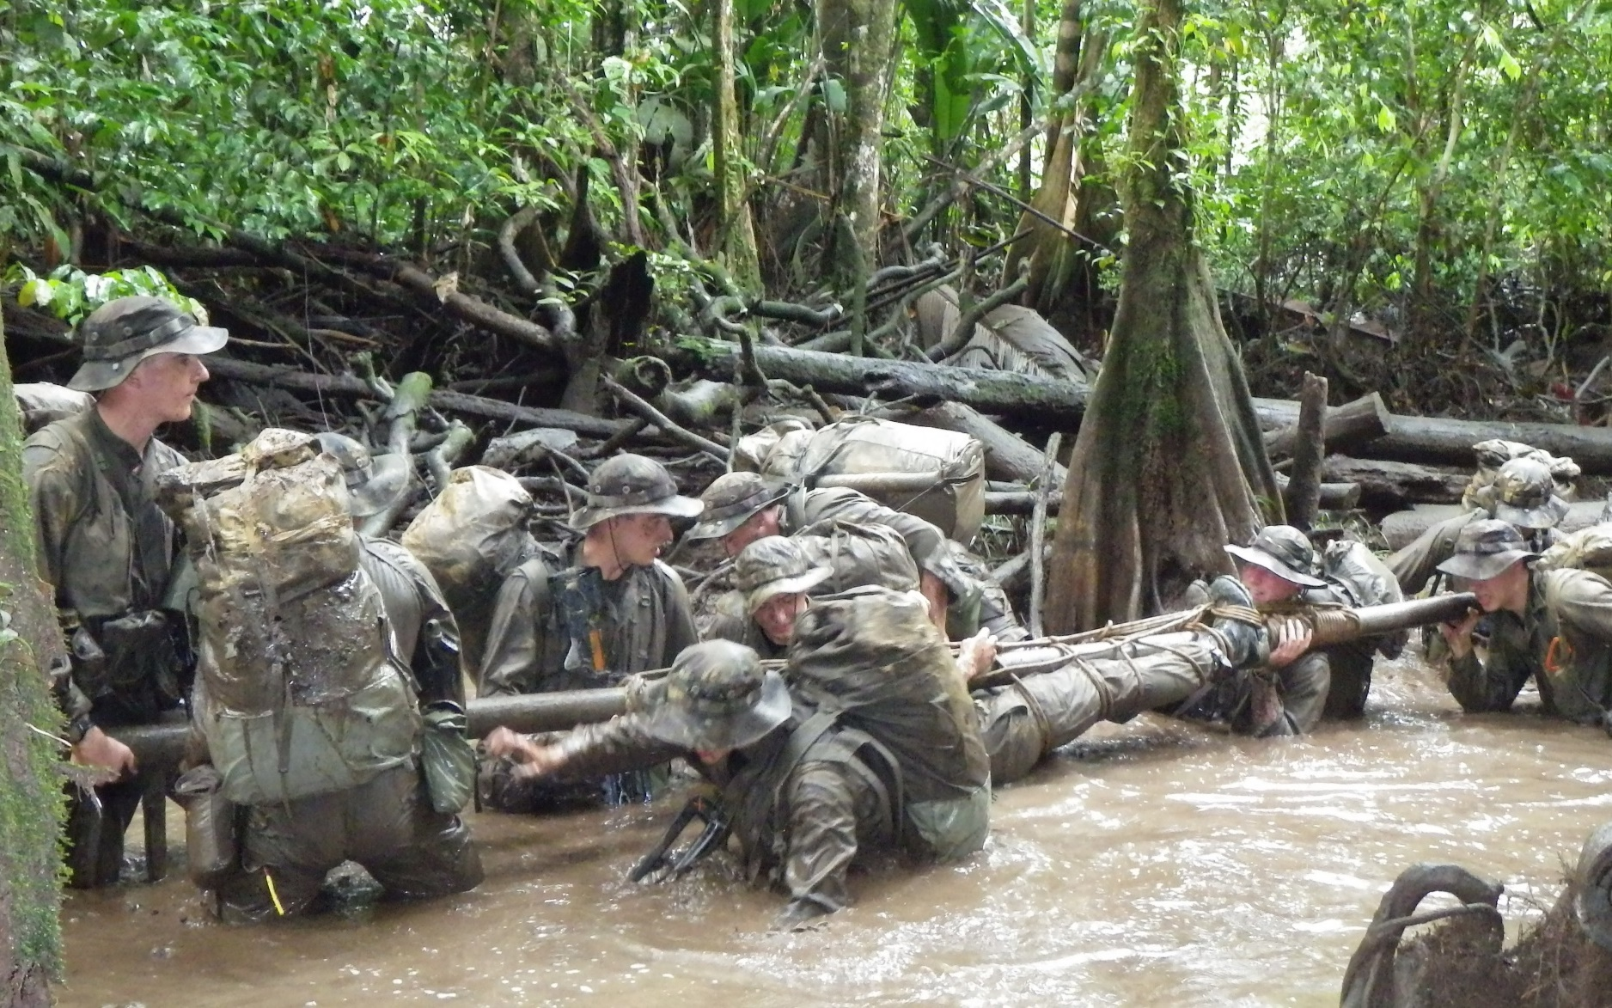
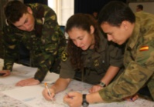
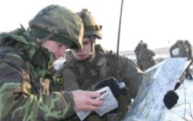
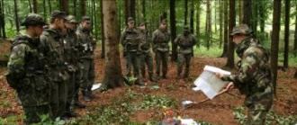
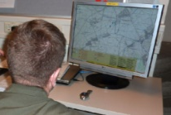
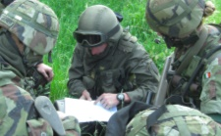
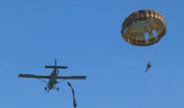
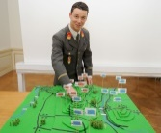
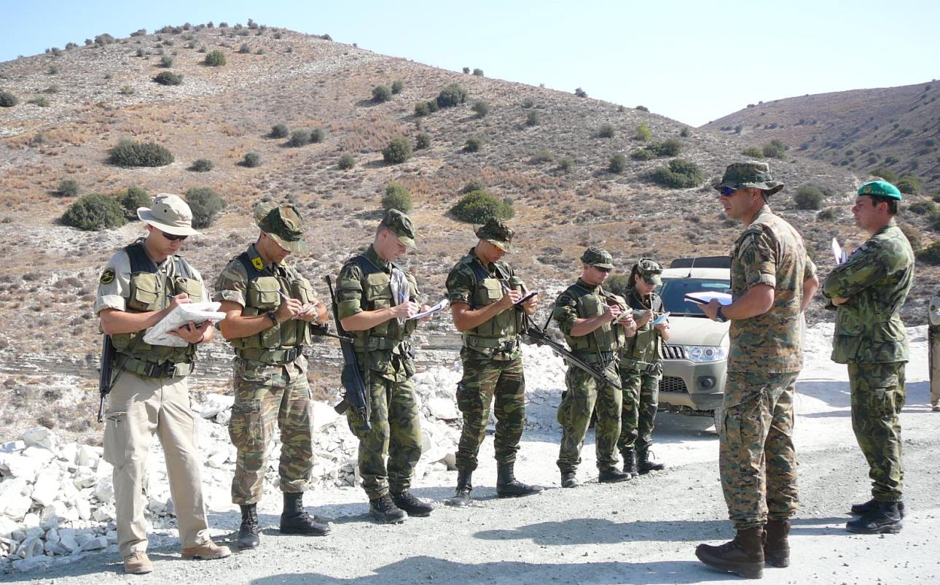
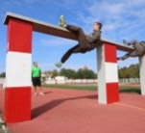
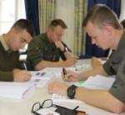
Education System
Segmentation of academic Semesters (in ECTS)
Military Core Subjects (Tactics, TTP, CAX)
+ Internships
76
In-depth Studies
22
Others (Pedagogics, Economy, Polemology, Media)
20
Creation of Theses
16
Foreign Languages
(English
+ 3rd Language)
16
Leadership Education in Sports
15
Academic Semester
(in-depth studies)
in French Guiana
Law
(national
+ international)
15

Slide 12
Education System
Academic Semesters abroad
Jan | Feb | Mar | Apr | May | Jun | Jul | Aug | Sep | Oct | Nov | Dec
Military University of Land Forces
Wroclaw
PL
Ecoles de Saint-Cyr
Coëtquidan
FR
University of Defence
Brno
CZ
Cadre Aspirants Course 1
(CAC 1)
Moravian University College Olomouc
Olomouc
CZ
Hellenic Military Academy
Athens
GR
CAC 1
Cadre Aspirants Course 2 (CAC 2)
(Goal: Squad Leader Infantry)
EE
MDL
1st
Semester
1st
S.
COC
2nd
Semester
Career Officer Course (COC)
3rd
Semester
3rd
S.
COC
4th
Semester
COC
5th
Semester
Political Science, Economics, ICT
Pedagogics, Specific Strategies,
Sports Science,
Security Policy
Some Austrian Cadets:
Germany
United States of America
COC/Branch specific training
(6 weeks National Training
on the Job are included)
L
A
W
Int’l Training on the Job
L
A
W
BE
G
r
a
d
TMA
Wiener Neustadt
AT
TMA
Wiener Neustadt
AT
FH
Wiener Neustadt
AT
United States Military Academy
West Point
US
Offizierschule des Heeres
Dresden
DE
Abbreviations:
EE = Entrance Exam
MDL = Military Driving License
ICT = Information and
Communication Technology
BE = Bachelor Exam
Grad = Graduation
6th Semester

Slide 13
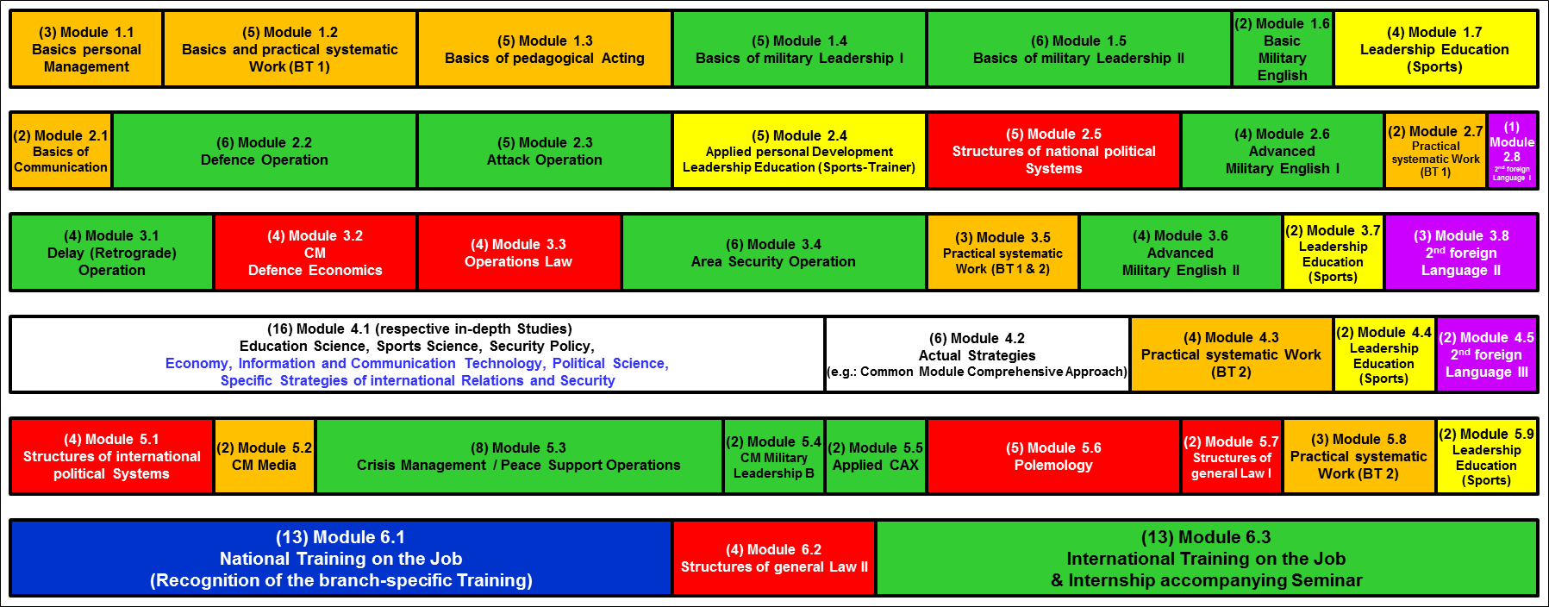
Education System
Modules of the academic Semesters

Slide 14
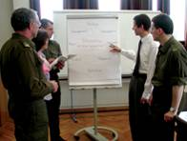
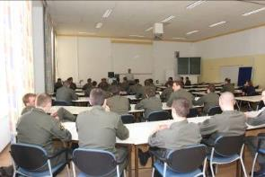
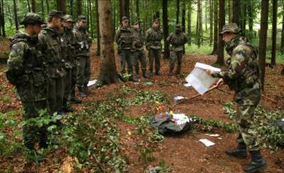
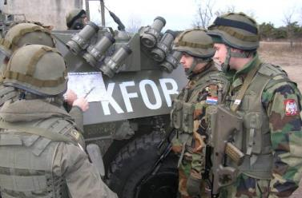
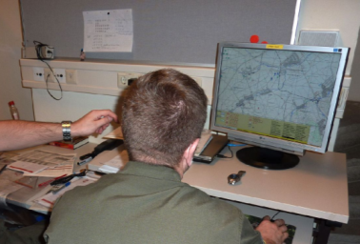
Bachelor & COC
Example for a certain Type of Operation
Map Exercise
(Battalion)
Theory,
Basics
Leadership Training
(Company)
TTP
(Platoon)
CAX
(Batt & Coy)

Slide 15
Career Officer Course (COC)
Model: Motorised Infantry Platoon
Jan | Feb | Mar | Apr | May | Jun | Jul | Aug | Sep | Oct | Nov | Dec
Cadre Aspirants Course 1
(CAC 1)
CAC 1
Cadre Aspirants Course 2 (CAC 2)
(Goal: Squad Leader Infantry)
EE
MDL
1st
Semester
1st
S.
COC
2nd
Semester
Career Officer Course (COC)
3rd
Semester
3rd
S.
COC
Political Science, Economics, ICT
Specific Strategies, Pedagogics,
Sports Science,
Security Policy
4th
Semester
COC
5th
Semester
Some Austrian Cadets:
Germany
United States of America
COC/Branch specific training
(6 weeks National Training
on the Job are included)
L
A
W
Int’l Training on the Job
L
A
W
BE
G
r
a
d
Abbreviations:
EE = Entrance Exam
MDL = Military Driving License
ICT = Information and
Communication Technology
BE = Bachelor Exam
Grad = Graduation
6th Semester

Slide 16
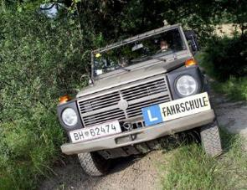
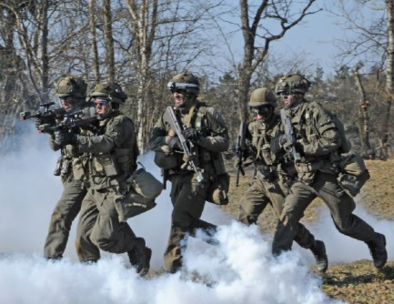
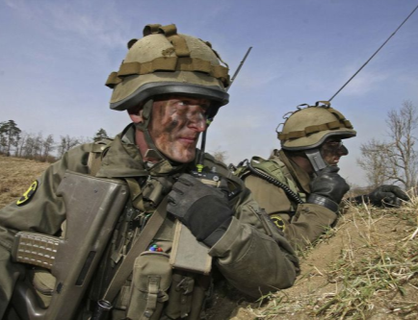
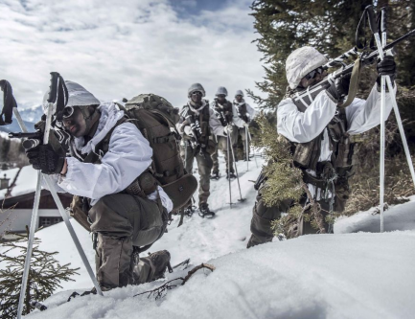
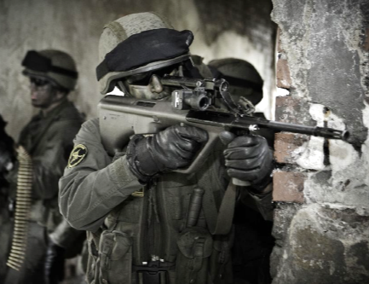
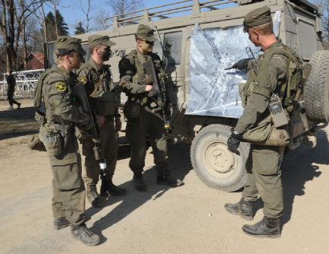
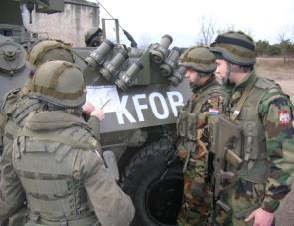
Career Officer Course (COC)
Model: Motorised Infantry Platoon
Military
Driving License
Leadership Education
Attack
Leadership Education
Defence, Delay
Leadership Education
Leader in the Mountains
Leadership Education
Hybrid Threats
Leadership Education
Area Security & CM
(national & int’l)
Leadership Education
Applied Education Management

Slide 17
Career Officer Course (COC)
Branch specific Education
Jan | Feb | Mar | Apr | May | Jun | Jul | Aug | Sep | Oct | Nov | Dec
Cadre Aspirants Course 1
(CAC 1)
CAC 1
Cadre Aspirants Course 2 (CAC 2)
(Goal: Squad Leader Infantry)
EE
MDL
1st
Semester
1st
S.
COC
2nd
Semester
Career Officer Course (COC)
3rd
Semester
3rd
S.
COC
4th
Semester
COC
5th
Semester
Political Science, Economics, ICT
Specific Strategies, Pedagogics,
Sports Science,
Security Policy
Some Austrian Cadets:
Germany
United States of America
COC/Branch specific training
(6 weeks National Training
on the Job are included)
L
A
W
Int’l Training on the Job
L
A
W
BE
G
r
a
d
Abbreviations:
EE = Entrance Exam
MDL = Military Driving License
ICT = Information and
Communication Technology
BE = Bachelor Exam
Grad = Graduation
6th Semester

Slide 18
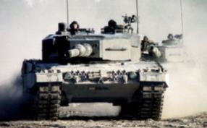
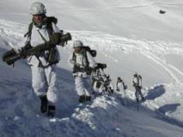
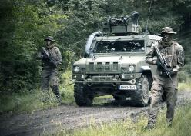
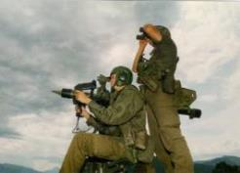
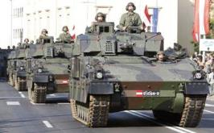
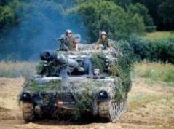
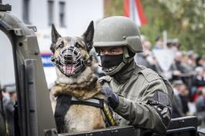
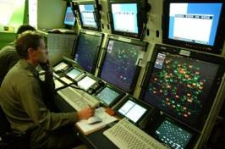
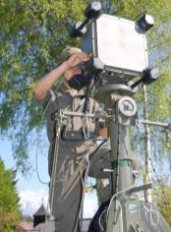
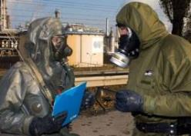
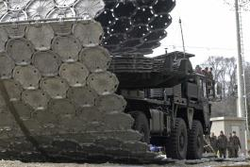
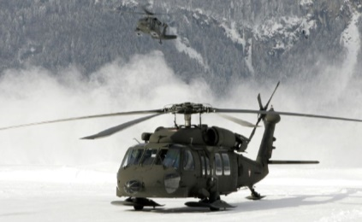
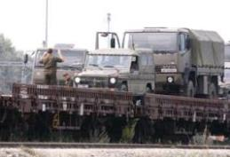
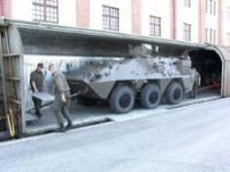
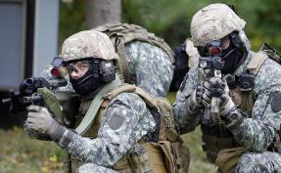
Career Officer Course (COC)
Branch specific Education
Armoured
Corps
Infantry
Reconnaissance
Air Defence
Artillery
Military Police
Air Surveillance
(Pilot)
NBC
Engineer
ICT
Logistics
Technical Officer
(Special Forces)

Slide 19
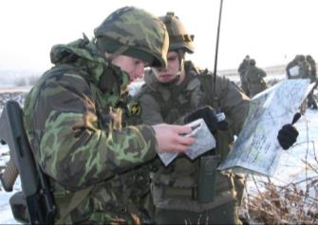
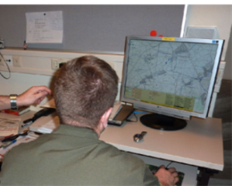






Education Objectives
practice-oriented education
at university level
to ensure
best preparation
for managing
future challenges
PfP

Slide 20



Internationalisation
➔ Programmes

Slide 21
How it began
The ESS (2003) & Report on ESS (2008)
State failure
Organised crime
RURAK, 1st June, 2012, Wroclaw:
“The most dangerous threat is the one, which we have not recognized so far.
Because of that we are not able to confront with,
that’s why it will hit us completely unprepared”
Regional conflicts
Cyber security
Proliferation
Energy Security
Terrorism
Climate change
???

Slide 22

How it continued
The Global Strategy (2016)
HR/VP Federica Mogherini: “None of our countries has the strength nor the resources to address these threats and seize the opportunities of our time alone. But as a Union of almost half a billion citizens, our potential is unparalleled.”
Economic Volatility
Energy Insecurity
Climate Change
Hybrid Threats
Terrorism

Slide 23

How it began (Nov. 2008)
Declaration of EU MoDs
„European initiative for the exchange of young officers inspired by Erasmus“
Goals: Increase Interoperability &
“Harmonise” EU Basic Officer Education
Source: Council of the European Union, Council Conclusions on the ESDP, 2903rd External Relations Council Meeting. Brussels. 10th and 11th November, 2008.

Slide 24

Challenges
Missions & Operations
Fact #1:
All
operations
are
“combined“
Fact #2:
Young
Officers
are
deployed
As of: January 2018

Slide 25

Conclusion for Basic Officer Education
Inter-
operabiliy
Inter-
cultural
compe-
tence
Working language:
English

Slide 26

Intend / Pre-Conditions for Basic Officer Education
Laws &
documents
(e.g. FH)
MOD
intents
(EMILYO)
ensure
best
preparation
for
future
challenges
(inclusive
personal
development)
Inter-
nationalisation
(general)
preparation for
operations

Slide 27

Key-Messages external Evaluation (ESDC/Brussels)
“International participation, therefore, remains key for the success of the module …”
“… keys for success remain those who contributed to its success at its birth: international participation and interactive learning.”
“… international participation remains a key for broadmindedness, solid networking and self-development of the individuals and the group.”

Slide 28

































































Networks
EMILYO – Implementation Group (Chairmanship since 01 04 2015)
Strategic
Partnership
iMAF
CSDP Joint Master Degree

Slide 29

Programmes for Internationalisation
Other programmes
(on case to case basis)
Overall
Basic Officer
Education
International
Training on the
Job (ITJ)
incoming
for students
and
lecturers
outgoing
International
Winter Semester
Semesters
abroad
(with or without
ERASMUS+)
European initiative
for the exchange of
young officers inspired by
ERASMUS

Slide 30

ITJ
International Training on the Job
During
6th Semester
Platoon Leader
(or equivalent
level) in a unit abroad
Goal: taking
over of
responsibility

Slide 31











ITJ
International Training on the Job

Slide 32

ITJ 2018
International Training on the Job
2
16
2
1
= All countries of the ITJ since start of the programme
X
= Number of Cadets in 2018

Slide 33













Semester Exchanges / Partners with or without ERASMUS+
Belgium | Brussels Royal Military Academy
Bulgaria | Veliko Tarnovo National Military University
Cyprus | Nicosia University of Nicosia | Nicosia Open University of Cyprus | Nicosia European University Cyprus | Nicosia University of Cyprus
Czech Republic | Brno University of Defence | Olomouc Moravian University College
Estonia | Tartu Estonian National Defence College
France | Coёtquidan Ecoles de Saint Cyr
Germany | Hamburg Helmut Schmidt University
Greece | Thessaloniki University of Macedonia | Athens Hellenic Military Academy | Athens Hellenic Air Force Academy
Hungary | Budapest National university of Public Service
Latvia | Riga National Defence Academy
Lithuania | Vilnius Military Academy Lithuania
Poland | Wroclaw Military University of Land Forces | Warsaw War Studies University | Warsaw Military Technical University | Cracow Jagiellonian University
Portugal | Lisbon Portuguese Military Academy
Romania | Sibiu Land Forces Academy | Brasov Air Force Academy | Constanta Ovidius University
Slovakia | Liptovsky Mikulas Armed Forces Academy
Sweden | Stockholm Swedish National Defence University

Slide 34

TMA’s International Winter Semester in English
Curriculum
with 24 ECTS (at least)
is developed
each year

Slide 35
Semester Exchanges
Academic Year 2017/2018
2
3
6
7
4
2
3
3
1
13
3
3
XY
= Incoming (number of students)
= Outgoing (number of students)
XY

Slide 36

EMILYO ➔ Common Modules
Common Module | ECTS |  | Common Module | ECTS
Advanced Technologies in Borders Surveillance | 2 |  | English for Aviation Security Personnel | 3
Aviation English for ICAO LPR | 3 |  | How to meet the Media | 2
Aviation English P1 | 3 |  | Individual Personal Development and Meta-Communication | 2
Aviation English P2 | 3 |  | Interoperability | 6
Basic Military English | 2 |  | Irregular Warfare | 3
Battle Physical, Mental and Survival Training | 3 |  | Law of Armed Conflict | 2
Common Operating Environment | 3 |  | Leadership & Agility in Complex Environments | 2
Common Security and Defence Policy | 2 |  | Maritime Leadership | 2
Comprehensive Approach | 4 |  | Maritime Security | 2
CMO/PSO (4 Sub-Modules) | 12 |  | Military Instructor Training | 3
Cross Cultural Communication | 2 |  | Military Ethics (A) | 2
CSDP-Olympiad | 2 |  | Military Ethics (B) | 2
Cultural Awareness | 2 |  | Military Leadership (A) | 2
Cyber Security | 2 |  | Military Leadership (B) | 2
Defence and Security Economics | 4 |  | Military Leadership (C) | 4
Electronic Warfare | 2 |  | Military Strategy and Security in the Baltic Sea Region | 3
English for Aircraft Maintenance SET P1 | 3 |  | Small Unit Tactics | 4
English for Aircraft Maintenance SET P2 | 3 |  | Space Applications for Security and Defence | 2
English for Aircraft Maintenance SET P3 | 3 |  | Total: 37 | 108
+ other modules combined to an international semester

Slide 37

Other Programmes
Decisions on a Case to Case Basis
e.g.: „Integrated Lecture Exercise“ in Munster/DE
e.g.: International Week Breda
Operation “Market Garden” near Arnhem
e.g.: International week RMA/Brussels
Introduction to Services
e.g.: Informal exchanges (UoD Brno)
➔ On own responsibility
➔ On own costs
➔ During leisure-time
No sight-seeing !!!

Slide 38

Lecturer Exchanges
Exchange of Knowledge
Coordination via the EU-Implementation Group www.emilyo.eu

Slide 39
Other Programmes & CMs
Number of Lecturers & Cadets 2017/2018
1
1
3
1
2
5
3
2
9
20
18
2
80
4
17
4
2
11
3
3
7
27
2
1
4
1
6
3
5
5
5
1
10
XY
= Incoming (number of students & lecturers)
= Outgoing (number of students & lecturers)
XY

Slide 40
Statistics BOE
Exchanges during Academic Year 2016/2017

Slide 41

Outgoing Students
Development 2005-2017

Slide 42

Incoming Students
Development 2005-2017

Slide 43
Statistics
Cooperation so far

Slide 44


Further Information www.emilyo.eu

Slide 45
Offers
See
www.emilyo.eu

Slide 46

thank YOU
for YOUR
attention!
Source: Homepage of “slideshare”. Available from: http://de.slideshare.net/InsideAnalysis/forward-looking-bi-the-future-of-decision-making. [15-5-15].

