Slide 1
2023
TMAF is a scientific symposium that deals with the transfer of knowledge and the development of the necessary skills, responsibility and autonomy within the framework of basic officer education with a general orientation as well as cyber specialisation to cope with future challenges of military leadership.
Options for Participation
maximum of three persons per institution may participate (limited participation!)
we are integrating students of future generations (bring and include a student from your institution!)
numerous side events to promote, deepen and broaden (military) cultural exchange
Letter of invitation to all Rectors, (Rector-) Commandants will follow
Location: Wiener Neustadt, Kasematten
Priority | Contribution | Administration
1 | Lecture with publication (Peer Review) | Free board & lodging
2 | Lecture without publication | Free board
3 | Participation | ---
4 | Publication | ---

Slide 2
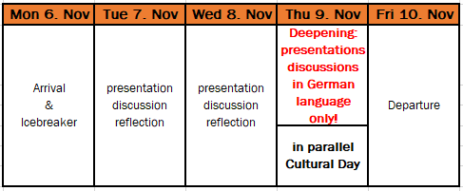
2023
Milestones & further Steps
2023
2024
More details on TMAF 2023:
www.milak.at/en/tmaf2023
First come, first served principle!

