Slide 1
The Organizational Challenges of Increasing Acceleration
Dietmar Roessl
Institute for Small Business Management and Entrepreneurship,
Vienna University of Economics and Business, AT
Barbara Kump
Faculty of Behavioral Management and Social Sciences,
University of Twente, NL
08-11-2022
Notes:
A topic relevant to all organisations regardless of their characteristics

Slide 2
….is there an increasing accelation?
„...at a late family supper a telegram arrives - the poor merchant must wolf down his food to answer." (quote from New York businessman W.E. Dodge, 1873)
We have no measure of the „tempo of time“!
The "perceived" speed is certainly not new!
Nevertheless there are some quite convincing indicators:
  patents in UK:
    1760-70: 200
    1770-80: 300
    1900-1910: 2.500
  London-New York:
    1881: 10-20 days
    1914: 5-10 days
    2016: half a day

Slide 3
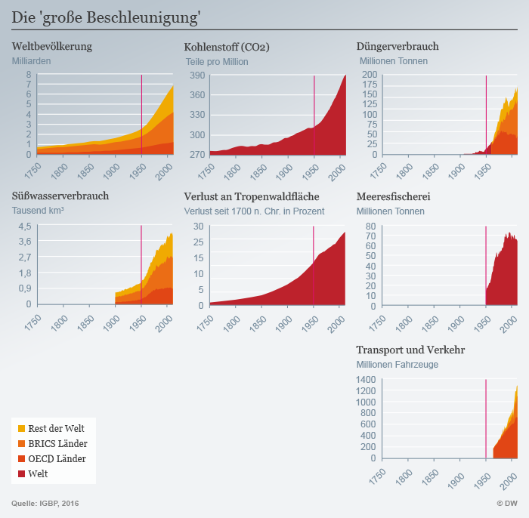
The Great Acceleration (06/2005 Dahlem Conference)
world population
(billions)
Carbon
(parts per million)
fertilizer consumption
(million tons)
freshwater consumption
(1.000 km³)
loss of tropical forests
(in % since 1700)
sea ​​fishing
(million tons)
vehicles
(millions)
[Costanza et al. 2007;
Steffen et al. 2015]
I could show many more charts
looking quite the same!

Slide 4
…so, let‘s assume that there is an increasing acceleration!
Acceleration means:
Organizations and people have to
change faster and faster

Slide 5
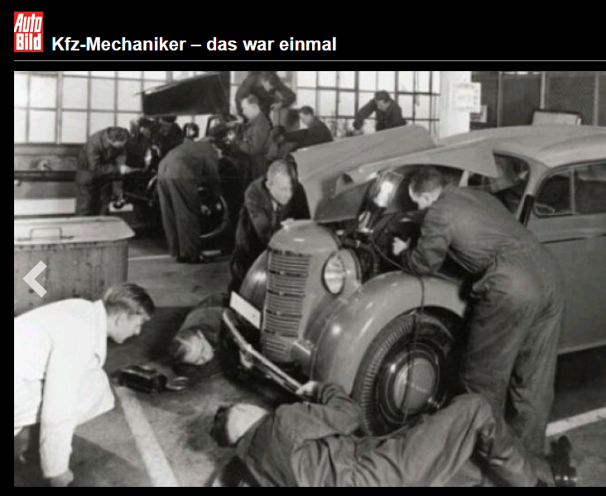
...just an example, showing the changes
workers = experts with special knowledge
and competencies
high esteem
high self-confidence
reputable persons
„Kfz-Mechaniker-Das war einmal“; Autobild.de

Slide 6

...just an example, showing the changes
employee follows commands from a diagnostic
and remote maintenance tool
possible effects:
completely different skills required (mechatronic instead of mechanic)
devaluation of the job
(if this person just implements the instructions from the remote maintenance center)
„Kfz-Mechaniker-Das war einmal“; Autobild.de

Slide 7
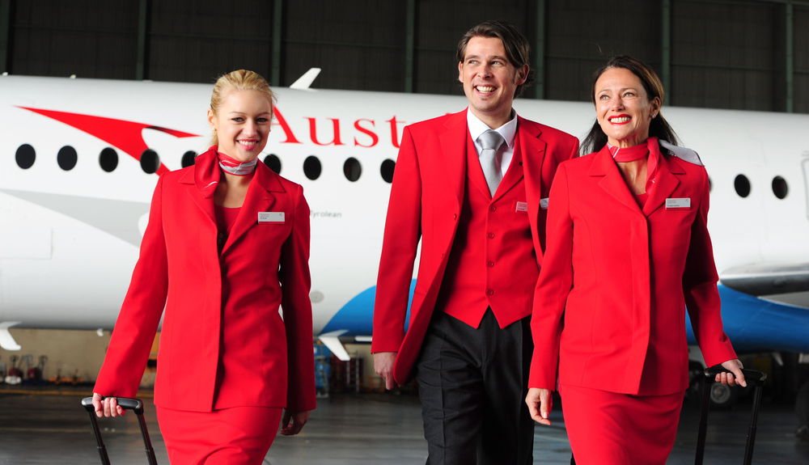
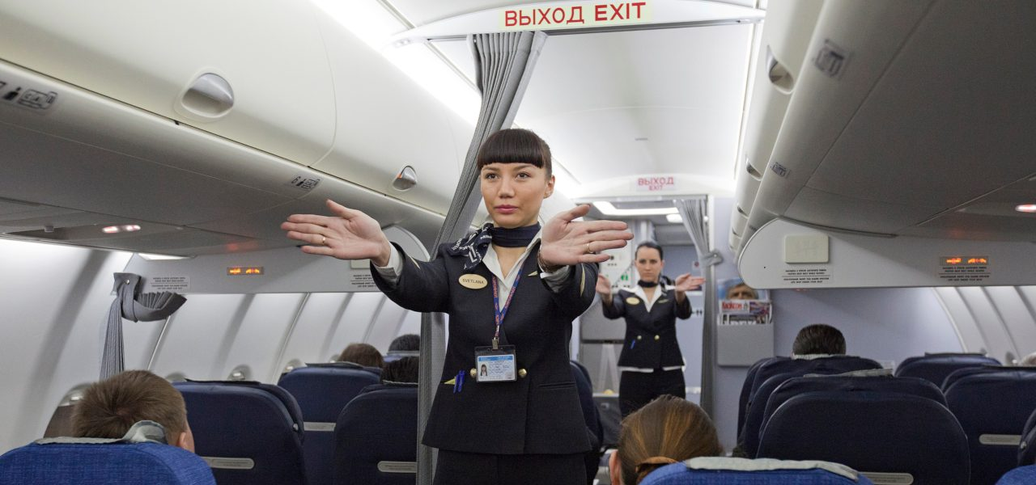
…another example
from the dream job “flight attendant”....
skilled
in security issues
conflict management

Slide 8
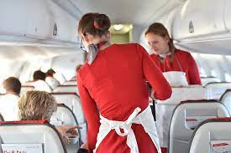
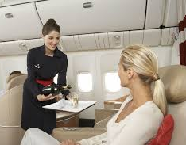
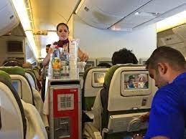
...another example
…to a flying waiter and saleswoman
changed reputation
(„Saftschubse“ a term included in the
„Duden“ in 2004, "Trolley-Dolly", etc.)
“We are reduced to lugging gray trays with plastic bowls through narrow aisles.” (Süddeutsche Zeitung 17.05.2010)

Slide 9
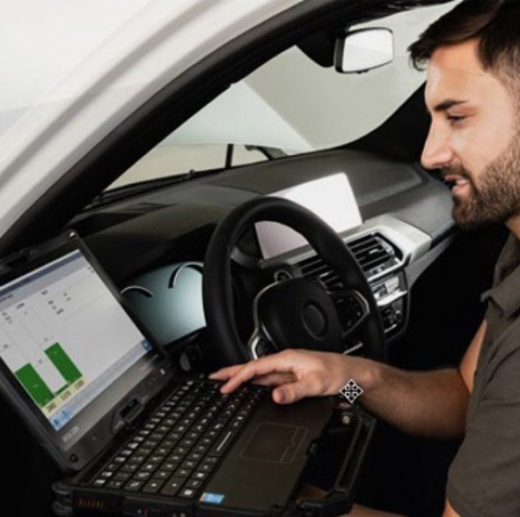
Well, job descriptions change, but what‘s the problem?
BEFORE
BETWEEN
AFTER
Then a new, balanced
situation: a mechatronics
engineer at work
At first balanced situation:
mechanics at work
„crisis“

Slide 10
Why are (rapid) changes
for organizations
so hard to deal with?

Slide 11
The „model of change“ by Kurt Lewin
unfreeze
move
freeze
new equilibrium state of the organization
Changes have to be
“freezed" again, otherwise
the system could fall back
into old routines.
initial equilibrium state of the organization
“Unfreezing” requires that a system
gives up its previous state of equilibrium
that it develops a willingness to change
questions old habits, old beliefs and values
discusses new ideas, etc.

Slide 12
The “old world” wobbles, but the new is still unclear – it does not yet give orientation
orientation
?
crisis
former state
new state
time

Slide 13
What characterizes these
„intermediate crises“?
It’s the imbalance of tasks, knowledge and identity:
identity
Who are we?
Knowledge
What can we do?
TASKS
What are we doing?
Notes:
Pillars
areas

Slide 14
Changes upset the balance
identity
Who are we?
Does, what we do,
fit with our identity
and/or our image?
Does our expertise match what organi-zation we want to be in the future?
TASKS
What are we doing?
Knowledge
What can we do?
Does, what our employees know and can do, match what they are expected to do (in the future)?
Notes:
....so adaptations of tasks, of knowledge and of identity have to take place to develop a balanced situation again

Slide 15
Change upsets the balance →
adaptation of tasks required
  WHAT ARE WE DOING?
  routines and processes have to be “unlearned” [Tsang & Zahra, 2008]
  Initially, efficiency drops, mistakes happen [Tsang & Zahra, 2008, Levitt & March, 1988]
  roles change, usually linked with
  changes in power relations [Nag et al., 2007]
  fear, frustration, anger,...

Slide 16
Change upsets the balance →
adaptation of knowledge required
  WHAT CAN WE DO? WHAT ARE WE EXPECTED TO DO?
  existing knowledge and experiences become outdated and devalued [Tsang & Zahra, 2008]
  individual challenge of being a "newbie" likely to make mistakes
  layoffs of employees who do not want or cannot adapt
  young colleagues have the “right” knowledge → “social rankings” are changed
  expert roles are defined differently, usually linked with changes in power relations
  [Nag et al., 2007]
  Shame, fear, frustration, anger,...
Notes:
develjud

Slide 17
Change upsets the balance → adaptation of identity required
  WHO WE ARE?
  changed external view of the stakeholders on the organization → external status of the individual employee is at risk
  self-image of employees is called into question
  different levels of identification of long-term and of new employees with the "new organization“
  mystifying the good old days / rumination of old values and stories [Knipfer & Kump, 2021; Nolen-Hoeksema et al., 2008]
  faked but unconvinced identification
  commitment endangered → resignation (high sickness levels, declining motivation)
  GRIEF, frustration...

Slide 18
And why exacerbates
acceleration the
problem of change??
Notes:
ex’aserbeits

Slide 19
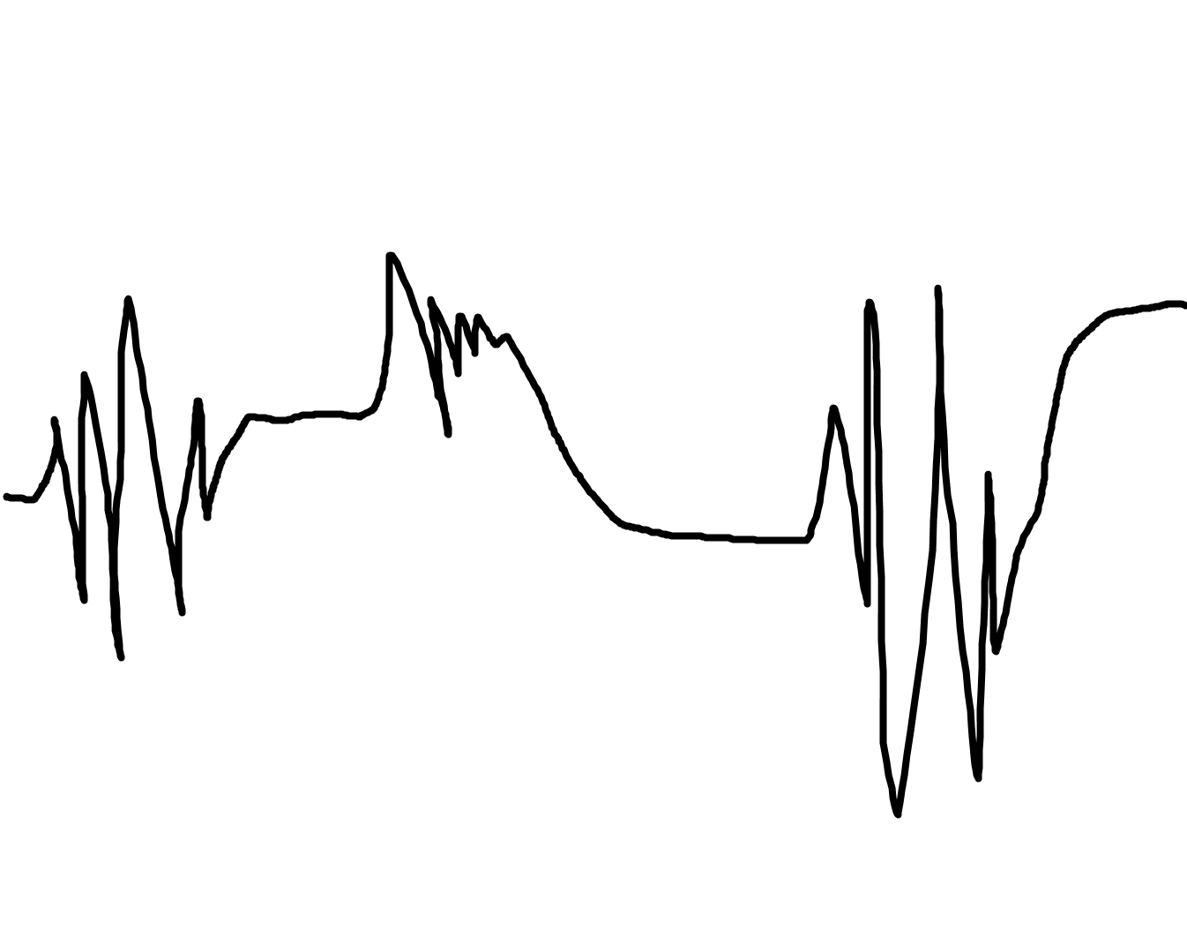
After the crisis is before the crisis!
Changes are becoming necessary more and more quickly.
The organization has little time to stabilize. Thus it finds itself in a permanent "crisis situation”
crisis
crisis
crisis
crisis
crisis
crisis
Notes:
Today în the so-called VUCA world - quite many organizations find themselves in such a situation.

Slide 20
References
Costanza, R., Graumlich, L.J., & Steffen, W. (Eds.) (2007). Sustainability or Collapse? An Integrated History and Future of People on Earth. MIT Press (Dahlem Workshop Reports # 96).
Knipfer, K., & Kump, B. (2021). Collective rumination: When “problem talk” impairs organizational resilience. Applied Psychology, 17(1), doi: 10.1111/apps.12315
Levitt, B., & March, J.G. (1988). Organizational learning. Annual Review of Sociology, 14(-), 319-340.
Lewin, K. (1947). Frontiers in group dynamics. Concept, method and reality in social science. Social equilibria and social change. Human Relations. 1(1), 5–41.
Nag, R., Hambrick, D. C., & Chen, M.-J. (2007). What is strategic management, really? Inductive derivation of a consensus definition of the field. Strategic Management Journal, 28(9), 935–955.
Nolen-Hoeksema, S., Blair, E. E., & Lyubomirsky, S. (2008). Rethinking rumination. Perspectives in Psychological Science, 3(5), doi: 10.1111/j.1745-6924.2008.00088.x
Steffen, W., Broadgate, W. & Ludwig, C. (2015). The trajectory of the Anthropocene: The Great Acceleration. The Anthropocene Review, 2(1), doi: 10.1177/2053019614564785
Tsang, E. W. K., & Zahra, S. A. (2008). Organizational unlearning. Human Relations, 61(10), 1435-1462.

Slide 21
Thank you for your attention!
The Organizational Challenges of Increasing Acceleration
Dietmar Roessl

