Slide 1


Theresan Military Academic Forum 2022
“The Art of Leadership”
Excerpt of Research & Development Projects
08 November 2022
Colonel Assoc. Prof. Hon. Sen. GELL Harald, PhD, MSc, MSD, MBA
(Chairman Military Erasmus [EMILYO] Implementation Group)

Slide 2
Contents
Selection of Leaders
Education of Leaders
International Avenue of Approach (Military Erasmus / EMILYO)

Slide 3


Selection of Leaders
Statement
Wunderer, R. / Switzerland:
“Whatever you test during the selection process; if you do not have enough aspirants, you will fail”

Slide 4
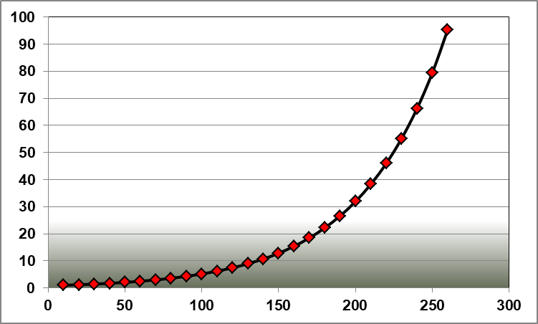
Selection of Leaders
Consequences
basal leadership competence of the individual
number of aspirants
We need more aspirants!
Advertisement?
Work-life balance?
Working environment (infrastructure, exercises, ..)
Acknowledgement / salary / career / ….

Slide 5
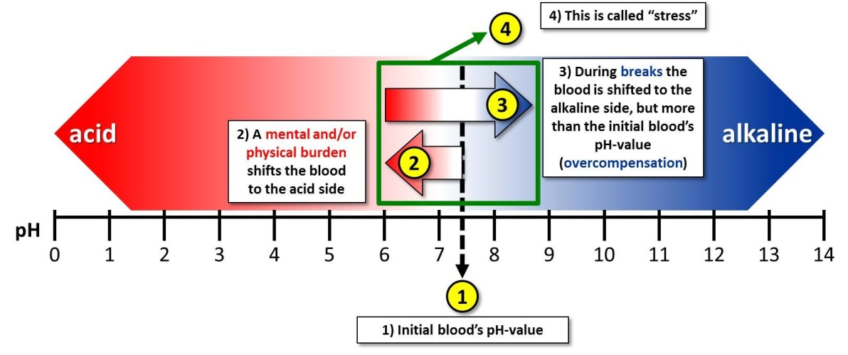
Selection of Leaders
Stress Research Project
What is “stress”?
This shift can be measured;
this shift takes time

Slide 6
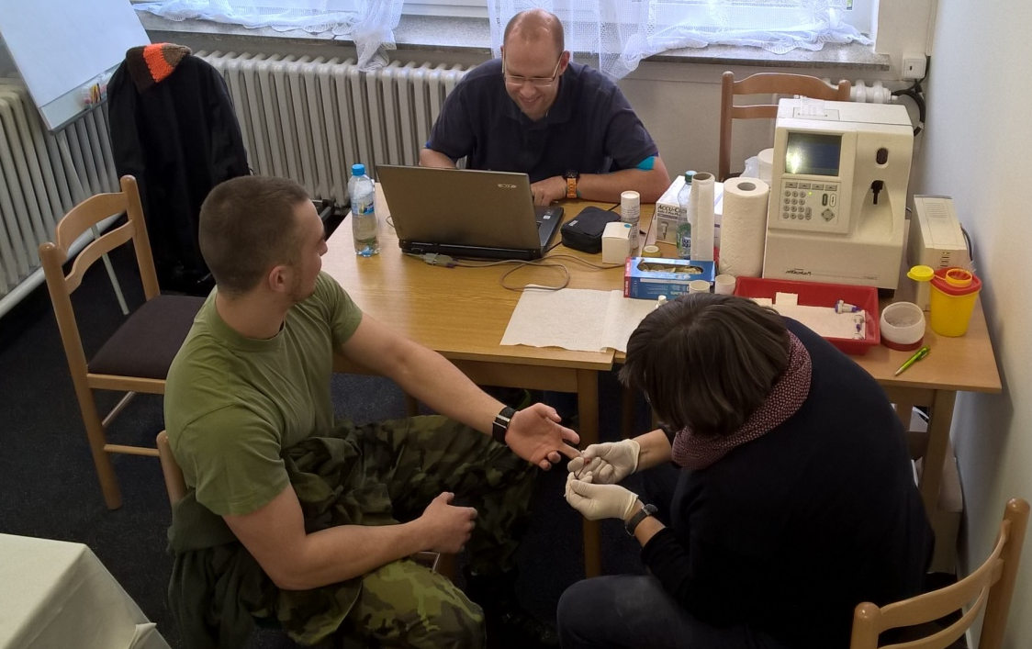
Selection of Leaders
Stress Research Project
Identification of abilities
Analyses of the
blood before, during, and after burdens to identify the “shift of stress”

Slide 7
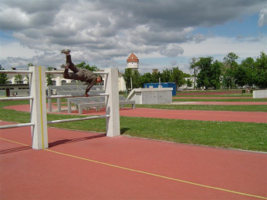
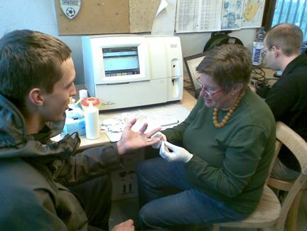

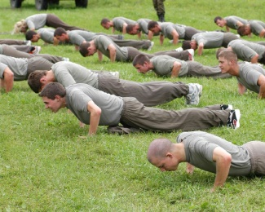
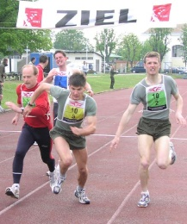
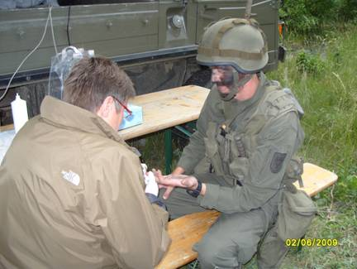
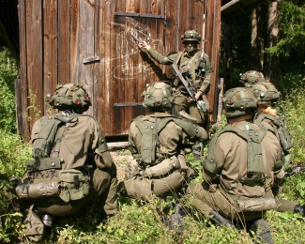
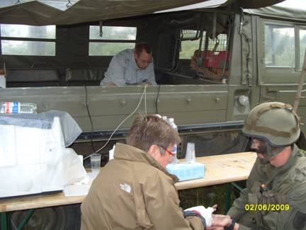
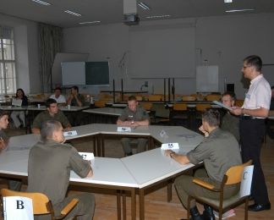
Selection of Leaders
Stress Research Project
Blood measurements during selection process
30 min.
8 min.
30 min.
8 min.
30 min.
8 min.
30 min.
immediately

Slide 8
Selection of Leaders
Stress Research Project
Outcomes (1)
Comparison:
lactate before / points after obstacle run
points after obstacle run
lactate in millimole before obstacle run
➔ We could predict results!

Slide 9
Selection of Leaders
Stress Research Project
Outcomes (2)
Comparison:
pH-value before / points after leadership task
They already knew that they are not accepted
➔ bad attitude
points after leadership task
pH-value before leadership task
➔ We could identify outsiders (attitude)!

Slide 10
Selection of Leaders
Stress Research Project
Outcomes (3)
➔ Types of persons
achieved
points
good basal condition
bad attitude
bad basal condition
good attitude
value of
individual
endeavour

Slide 11
Selection of Leaders
Stress Research Project
achieved
points
Outcomes (4)
➔ How to select leaders?
We all will
select this
person!
and/or:
Basic
Officer
Education
Programme
as such
Selection process /
entrance exam
Selection process 2
value of individual
endeavour

Slide 12
Selection of Leaders
Stress Research Project
Outcomes (5)
Can we use blood testing
for the selection of leaders?
Unfortunately NOT!
  World Medical Association (WMA): blood testing is voluntarily.
  Blood testing must be double-coded (no records linked to individuals).
BUT:
We can identify if the selection process
– as such – is correct.

Slide 13
Selection of Leaders
Stress Research Project
Conclusions
We have to increase the number of aspirants.
We have to keep the value of exams during the Basic Officer Education
➔ compare: “Belgian model for sports”.
We have to conduct more selection processes.

Slide 14
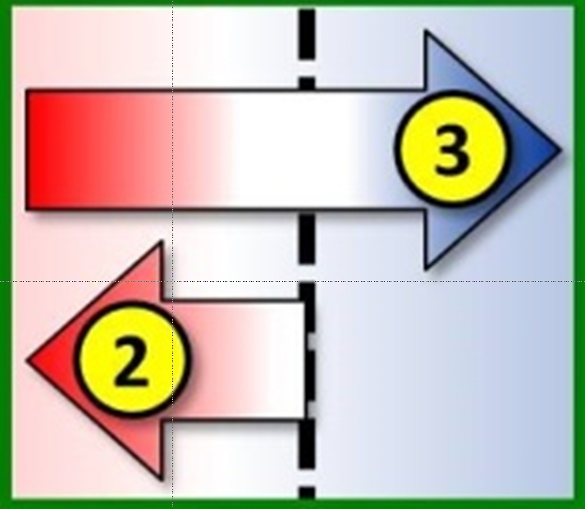
Education of Leaders
Stress Research Project
Repetitions
The more often you repeat a specific education,
the less is the stress shift (in principle)

Slide 15
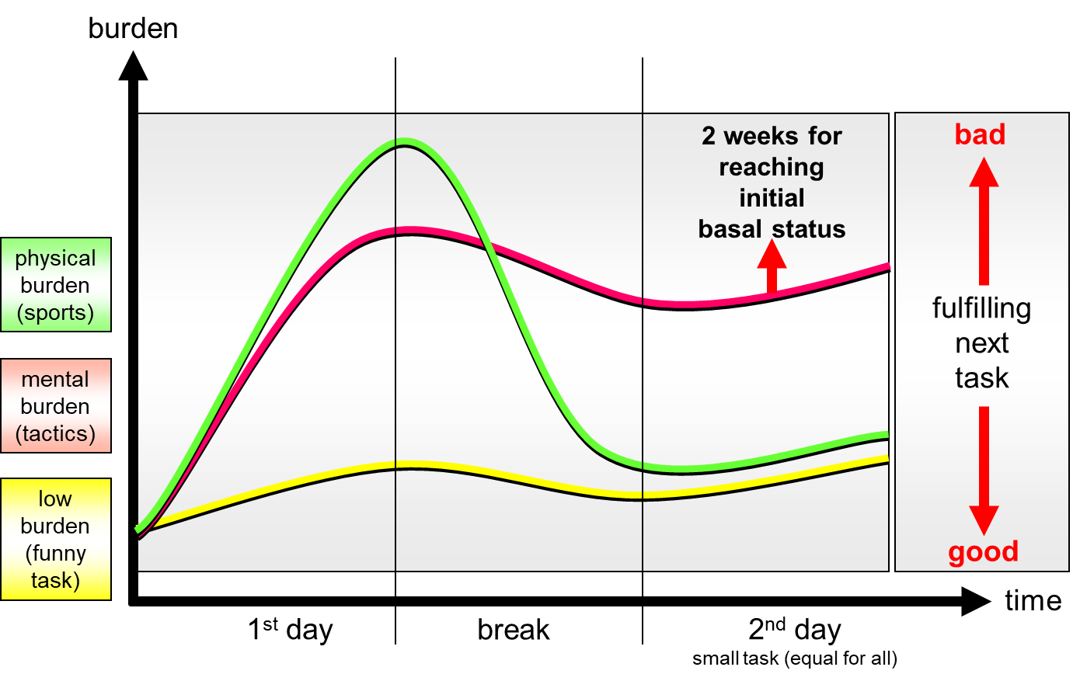
Education of Leaders
Stress Research Project
Different burdens ➔ Results (1)

Slide 16
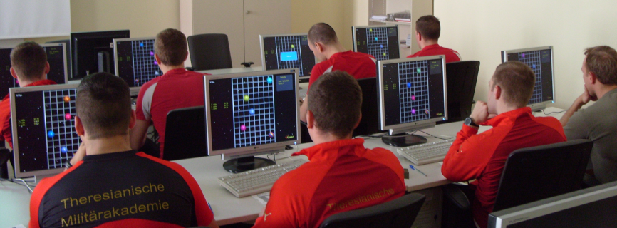
Education of Leaders
Stress Research Project
Sleep deprivation ➔ Results (2)
Blood testing
Test group
burden
reaction test / shooting / sports
sleep
deprivation
burden
reaction test / shooting / sports
Control group
Reserve group
1 night
without sleep
≙ 0.8-1 ‰ alcohol
in the blood!

Slide 17
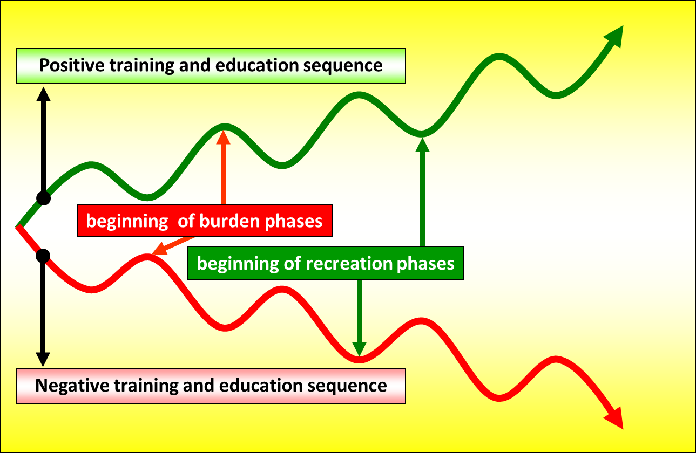
Education of Leaders
Stress Research Project
Repetitions
important is the timing (breaks);
time for “overcompensation”

Slide 18
Education of Leaders
Stress Research Project
Conclusions
Whatever you want to achieve with your education – the more often you repeat it – the less is the burden for individuals.
We need more mental training!
  E.g.: training for “expect the unexpected”.
You have to give time for breaks (overcompensation).
  The ECTS-model is perfect for the studies!
  Do not fill the breaks with something else.

Slide 19
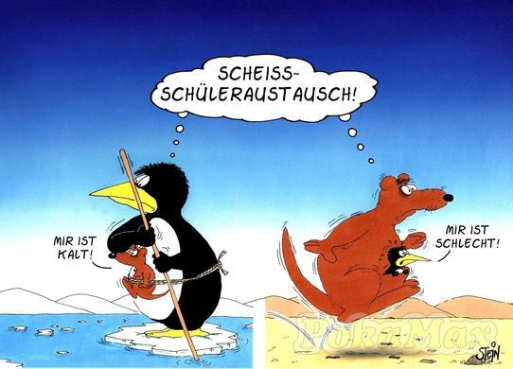
Internationalisation for Leaders
(Stress) Research Project
Why
we conduct this stupid
exchanges ???
Why
we conduct this stupid
exchanges ???
I
feel
cold
I
feel
sick
Source: http://debeste.de/16253/Sch-leraustausch ; re-shaped by Col Gell

Slide 20
Internationalisation for Leaders
(Stress) Research Project
Research project for Habilitation
Conclusions
Evaluation
of
Grades
(409 students
➔ Semester)
N = 22,371
N^{used} = 18,517
Analysis
of external
Evaluation
(361 students
➔ Weeks)
N = 23,104
Clinical
Stress
Assessment
(CSA)-Data
(165 [18] students
➔ Semester)
N = 216
Comparison of international activities

Slide 21
Internationalisation for Leaders
(Stress) Research Project
Comparison of all grades‘ means (1):
  Before and after mobility periods.
  Important is the difference-development between mobility and non-mobility students.
 | Semester 1 | Semester 2 | Semester 3 | Semester 4 | Semester 5 | Semester 6 | Mobility-Semester (7) | Semester 8
Grade 5
Grade 4
Grade 3
Grade 2
Grade 1
?

Slide 22
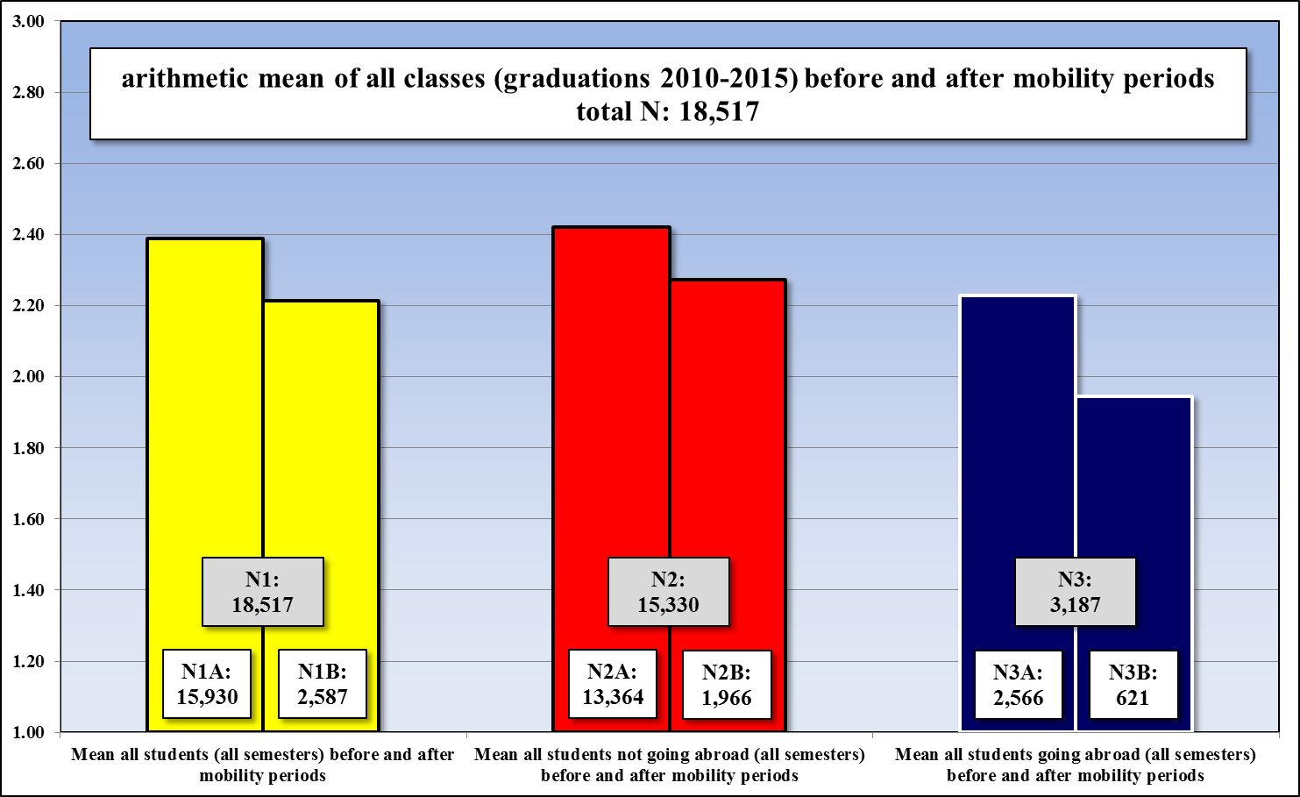
Internationalisation for Leaders
(Stress) Research Project
Comparison of all grades‘ means (2):

Slide 23
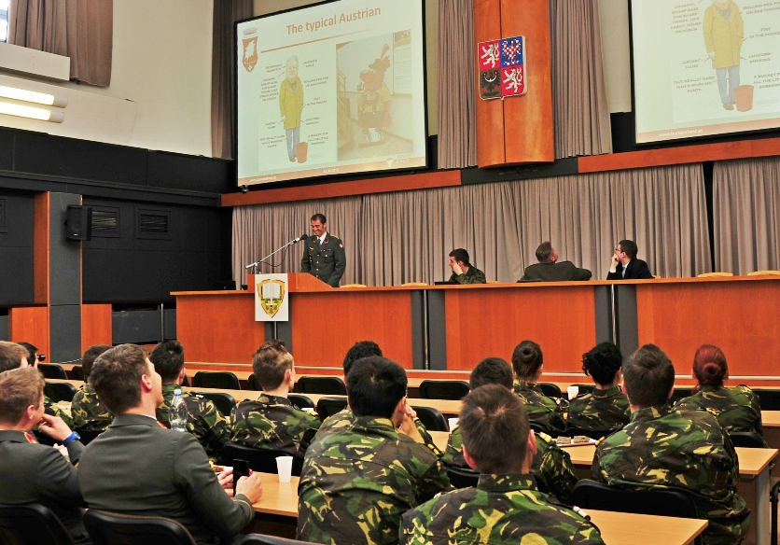
Internationalisation for Leaders
(Stress) Research Project
Based on grades‘ development (n=18,517):
➔ Mobility periods (semesters) cause better grades of mobility students in comparison with grades of non-mobility students.

Slide 24
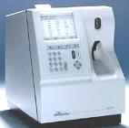
Internationalisation for Leaders
(Stress) Research Project
CSA-data can identify burdens (stress).
Important: Time of blood-measurements.
 | Semester 1 | Semester 2 | Semester 3 | Semester 4 | Semester 5 | Semester 6 | Mobility-Semester (7) | Semester 8
?
?
?
?
!
!
?

Slide 25
Internationalisation for Leaders
(Stress) Research Project
Basal-data (group-averages):
 | pH | pCO₂ | BE | HCO₃ | pO₂ | O₂sat | Na | Ca | Mg | K | BG
Unit | value | mmHg | mmol/l | mmol/l | mmHg | % | mmol/l | mmol/l | mmol/l | mmol/l | mg/dl
Mean | 7.411 | 34.770 | -2.550 | 22.270 | 73.450 | 94.660 | 143.760 | 1.055 | 0.501 | 2.992 | 104.500
SD | 0.017 | 2.577 | 1.059 | 1.140 | 6.332 | 1.388 | 1.165 | 0.031 | 0.025 | 0.267 | 15.565
SEM | 0.006 | 0.911 | 0.374 | 0.403 | 2.239 | 0.491 | 0.412 | 0.011 | 0.009 | 0.094 | 5.503
 | pH | pCO₂ | BE | HCO₃ | pO₂ | O₂sat | Na | Ca | Mg | K | BG
Unit | value | mmHg | mmol/l | mmol/l | mmHg | % | mmol/l | mmol/l | mmol/l | mmol/l | mg/dl
Mean | 7.423 | 35.175 | -1.475 | 23.188 | 71.213 | 94.300 | 144.425 | 1.115 | 0.504 | 4.528 | 103.125
SD | 0.027 | 2.909 | 1.798 | 1.656 | 6.546 | 1.872 | 2.456 | 0.076 | 0.028 | 0.242 | 7.492
SEM | 0.009 | 1.029 | 0.636 | 0.585 | 2.315 | 0.662 | 0.868 | 0.027 | 0.010 | 0.086 | 2.649

Slide 26
Internationalisation for Leaders
(Stress) Research Project
Basal-data (group-averages):
 | pH | pCO₂ | BE | HCO₃ | pO₂ | O₂sat | Na | Ca | Mg | K | BG
Unit | value | mmHg | mmol/l | mmol/l | mmHg | % | mmol/l | mmol/l | mmol/l | mmol/l | mg/dl
Mean | 7.411 | 34.770 | -2.550 | 22.270 | 73.450 | 94.660 | 143.760 | 1.055 | 0.501 | 2.992 | 104.500
SD | 0.017 | 2.577 | 1.059 | 1.140 | 6.332 | 1.388 | 1.165 | 0.031 | 0.025 | 0.267 | 15.565
SEM | 0.006 | 0.911 | 0.374 | 0.403 | 2.239 | 0.491 | 0.412 | 0.011 | 0.009 | 0.094 | 5.503
Non-mobility students: They have significant lower BE, Calcium and Potassium ➔ increased basal-metabolism of NM-Students.
 | pH | pCO₂ | BE | HCO₃ | pO₂ | O₂sat | Na | Ca | Mg | K | BG
Unit | value | mmHg | mmol/l | mmol/l | mmHg | % | mmol/l | mmol/l | mmol/l | mmol/l | mg/dl
Mean | 7.423 | 35.175 | -1.475 | 23.188 | 71.213 | 94.300 | 144.425 | 1.115 | 0.504 | 4.528 | 103.125
SD | 0.027 | 2.909 | 1.798 | 1.656 | 6.546 | 1.872 | 2.456 | 0.076 | 0.028 | 0.242 | 7.492
SEM | 0.009 | 1.029 | 0.636 | 0.585 | 2.315 | 0.662 | 0.868 | 0.027 | 0.010 | 0.086 | 2.649

Slide 27
Internationalisation for Leaders
(Stress) Research Project
Comparison of pH with pCO₂ and pO₂:
 | …. need for the same pH-value a double increased exhalation ➔ mental infuriation.
 | …. have a 65% better saturation of O₂.
 | ➔ profit from a better O₂-supply to the heart, brain and muscles.

Slide 28
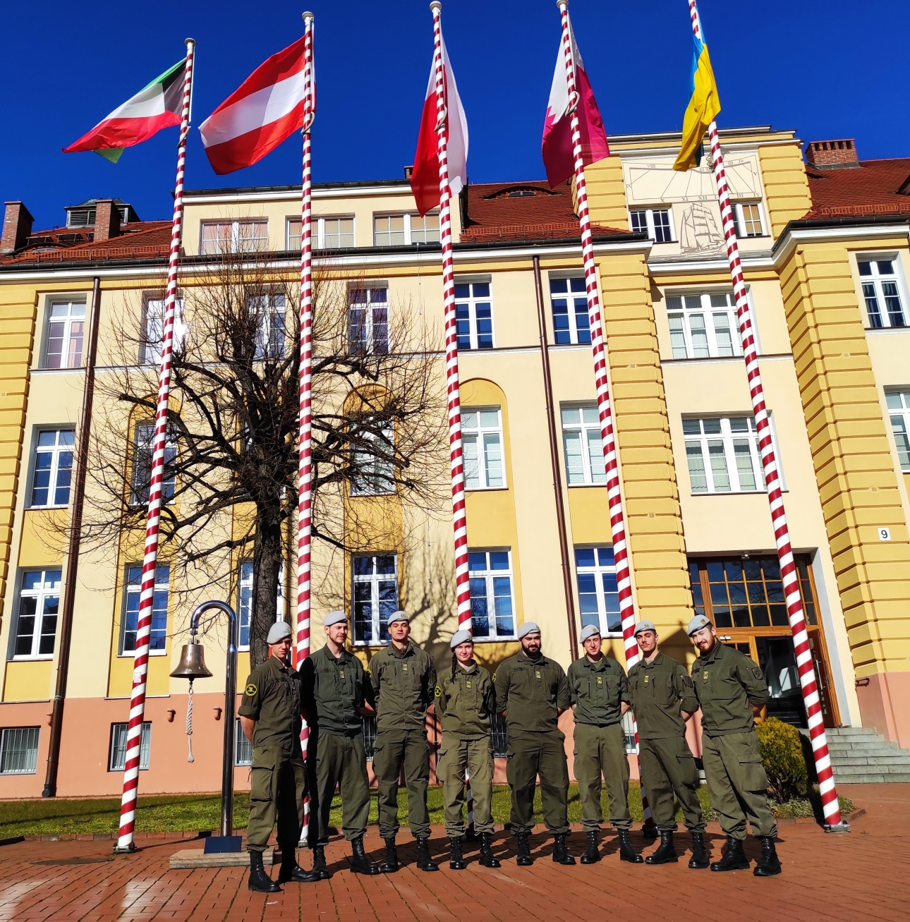
Internationalisation for Leaders
(Stress) Research Project
Based on comparison of
CSA-data group averages:
➔ Mobility periods (semesters) have on
mobility students a positive effect on their basal metabolism.
➔ The selection of topics is less important than the fact that they are abroad.

Slide 29

Internationalisation for Leaders
(Stress) Research Project
Analyses of evaluation data
CSDP
Evaluation
Report
CSDP
Evaluation
Report
CSDP
Evaluation
Report
CSDP
Evaluation
Report
CSDP
Evaluation
Report
1-week modules.
361 Officer Cadets / Students.
29.6% international ones.
23,104 data.
What is in common?

Slide 30
Internationalisation for Leaders
(Stress) Research Project
Analyses of evaluation data ➔ results
Different academic levels (Ba, Ma, PhD) increase learning outcomes (interaction).
Increased international participation increase learning outcomes.
Even 5-day-modules improve English skills.
Increased interaction among the students increase learning outcomes (just “teacher-centred teaching” is counterproductive).
The most important factor is the international presence ➔ the more international presence
➔ the better are the learning outcomes.

Slide 31
Internationalisation for Leaders
EMILYO Common Modules + ~70 Int’l Semesters
Common Module | ECTS |  | Common Module | ECTS
Advanced Technologies in Borders Surveillance | 2 |  | IMINT-GEOINT Analysis Course | 2
Aviation English for ICAO LPR | 3 |  | Individual Personal Development and Meta-Communication | 2
Aviation English P1 | 3 |  | Interoperability | 6
Aviation English P2 | 3 |  | Irregular Warfare | 3
Basic Military English | 2 |  | Law of Armed Conflict | 2
Battle Physical, Mental and Survival Training | 3 |  | Leadership & Agility in Complex Environments | 2
Biosafety and Bioterrorism | 2 |  | Leadership in Communication – IMLA | 2
Budget & Finance in EU Defence | 2 |  | Leadership, Motivation and Influence – IMLA | 2
Close Quarter Battle | 3 |  | Maritime Leadership | 2
Common Operating Environment | 3 |  | Maritime Security | 2
Common Security and Defence Policy | 2 |  | Military Ethics (A) | 2
Comprehensive Approach | 4 |  | Military Ethics (B) | 2
CMO/PSO (4 Sub-Modules [A, B, C, D]) | 12 |  | Military Instructor Training | 3
Crisis Management (Military Leadership) – IMLA | 2 |  | Military Leadership (A) | 2
Crises Management Operations (CMO) | 3 |  | Military Leadership (B) | 2
Cross Cultural Communication | 2 |  | Military Leadership (C) | 4
CSDP-Olympiad | 2 |  | Military Strategy and Security in the Baltic Sea Region | 3
Cultural Awareness | 2 |  | Senior Cadets’ Seminar on Leadership | 1.5
Cyber Security | 2 |  | Small Unit Tactics | 4
Defence and Security Economics | 4 |  | Social Engineering Protection | 2
Digital Leadership | 3 |  | Space Applications for Security and Defence | 2
Electronic Warfare | 2 |  | Stress Management – IMLA | 2
English for Aircraft Maintenance SET P1 | 3 |  | Troop Leading Procedures | 1
English for Aircraft Maintenance SET P2 | 3 |  | Technologies in Cyber Security | 2
English for Aircraft Maintenance SET P3 | 3 |  | Unmanned Aerial Systems | 2
English for Aviation Security Personnel | 3 |  | Winter Warfare Basic Module | 2
Fighting In Built Up Area | 3 |  | (NCN/Intern) Aerospace Technology (PL / MUT) | (8)
Gender Perspectives in Security and Defence | 2 |  | (NCM/Intern) Armament and Missile Technology (PL / MUT) | (8)
How to meet the Media | 2 |  | Total: 55 | 146.5
HR/VP Federica Mogherini 2018:
“Today, our Common Security and Defence Policy already
reaps the benefits of Military Erasmus on the theatres of
operations with young leaders trained to work together.
Tomorrow, it stands to benefit from their European
knowledge and know-how as decision makers.”

Slide 32
Summary (1)
We have to increase the number of aspirants and keep the value of exams.
Whatever we want to achieve, the more often we repeat it – the less is the burden for individuals.
We have to assure time for breaks (overcompensation).

Slide 33
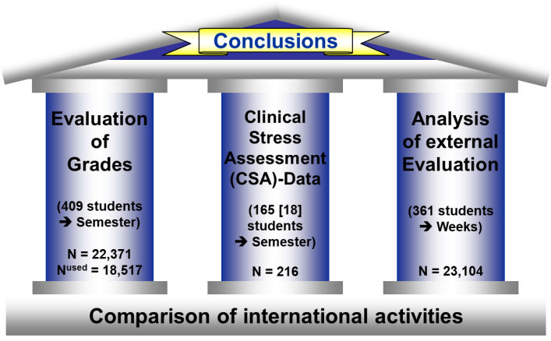
Summary (2)
Internationalisation
increases
the personal development of students!
Based on:

Slide 34


Thank
YOU
for
YOUR
attention!

