Slide 1
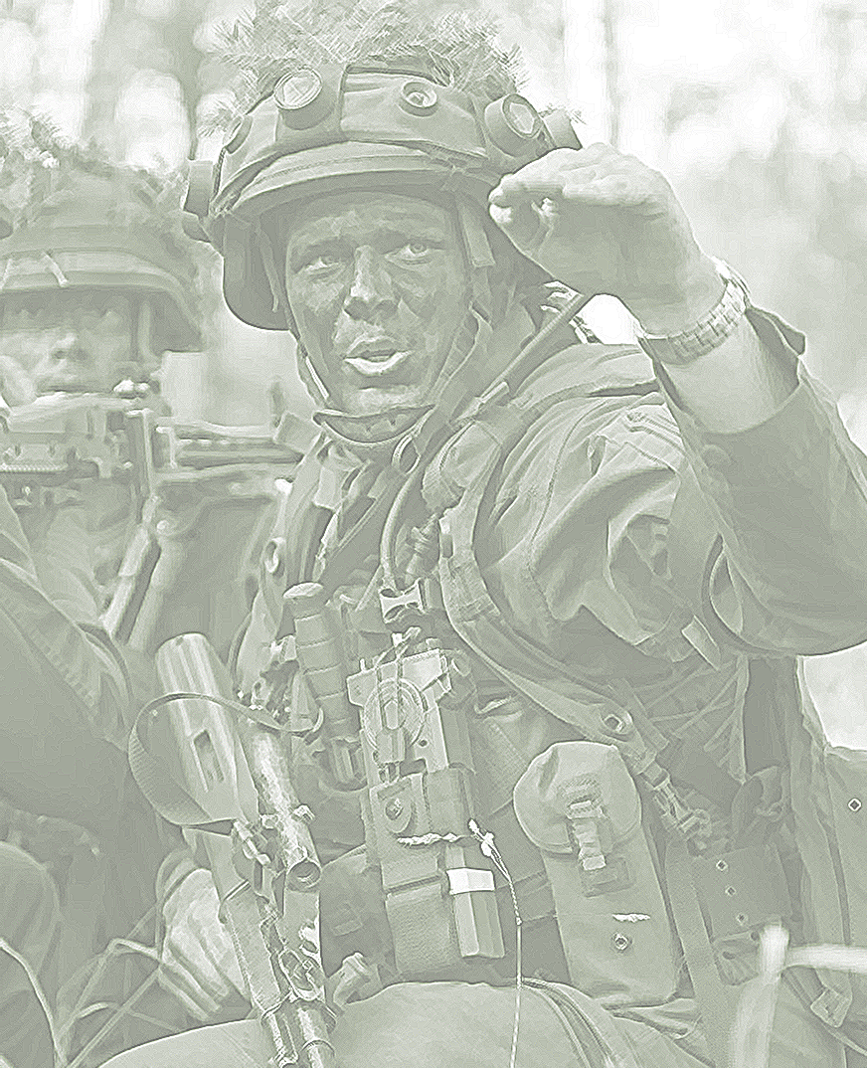
2022

Slide 2
Strategic Communication And Security Force Assistance: Critical Components For Ukrainian Success Against Russia?
Theresan Military Academy Forum - Vienna, November, 2022
Dr. Olga R. Chiriac – Research Fellow, MEI, Washington DC
Assoc. Prof. Jahara “Franky” Matisek, PhD - Naval War College, USA

Slide 3
AGENDA
Key Questions/Methods(cognition, narrative warfare)
Narratives: strategic/operational and tactical levels- StratCom
SFA:formal and informal
Conclusions

Slide 4
Key Questions Posed By Article:
Are strategic communication and SFA critical components for Ukrainian success against Russia?
What is the value of aligning narratives at the strategic, operational, and tactical levels?
The role of non kinetic capabilities to influence audiences and/or shape battlefields around the world- Article 5 vs Below Article 5 threshold
Which elements contributed to resolve and effectiveness?
Are there any lessons that can be drawn from the example of the ongoing Russo-Ukrainian war?

Slide 5
Article explores two major components of the transatlantic security bond:
instrumentality of strategic communication (StratCom)
security force assistance (SFA).
Causality between the two : DECISION MAKING

Slide 6
Decision making
a high-level cognitive process based on cognitive processes such as perception, attention, and memory.
decision making occurs at all level: strategic, operational and tactical
Framework in which SFA and strategic communication occur are heavily emerged in socio-cultural elements

Slide 7
Narratives: the Strategic Level
Strategic aims of the Russian Federation in Ukraine - Draft treaties - Essentially, a renegotiation of European security architecture to pre 1997 security arrangements - Warsaw Pact & USSR
West: divided response pre February 2022, relatively cohesive attitude post invasion
WHY?

Slide 8
Strategic Level - Structural Narratives: WHY?
Narratives and human cognition: DECISION MAKING
“betrayal of the West” - Afghanistan
NATO expansion eastward vs. Historical realities of repression and dominance from Moscow
Romania: membership in NATO: Romanian revolution in 1989, Ribbentrop Molotov Pact, Fantana Alba Massacre
Prague protests in September 2022: “against a Western oriented government” and in favor of “military neutrality” and “maintaining gas imports from Russia” for Central and Eastern European countries

Slide 9
Strategic Communication- Tactical Level
Information Age: social media and internet
Ukrainian forces have been dropping surrender leaflets with a QR code on Russian forces with the message of “ Your ticket to a peaceful life. Show this card to a Ukrainian soldier - it will save your life and help you get back home.”
Geotagging Russian positions
Moskva: Ria Novosti reported 14 April 2022 “The cruiser Moskva sank while being towed during a storm,” while the Ukrainian side reported the UAF destroyed the Moskva.

Slide 10
Security Force Assistance
1991: US, UK to - “foster and assist with defence reform, defense planning and capacity building” (UK government report)
1993, the California National Guard via the US National Guard State Partnership Program, had codified a National Guard relationship with the Ukrainian military
Objectives: included helping foster more interoperable with NATO forces, helping partners become more transparent in military affairs and, perhaps most importantly, helping the nations know how a military works in a democracy

Slide 11
Informal SFA
2016: AF of Lithuania and Poland formed a military unit with the Ukrainian military (the Lithuanian-Polish-Ukrainian Brigade-LITPOLUKRBRIG)
trilateral military unit jointly based in Lublin, Poland
capable of commanding 4,500 troops for joint combined military operations
“outside of the NATO umbrella” which means their unit can engage in some informal military activities with the Ukrainian military that formal NATO military units are unable to do.

Slide 12
Trilateral military unit and trilateral political format(Poland, Romania, Turkey) vs. EU Battlegroups or EU political decision making.
Personal relationships, develop best practices, synergy
Decision making at all levels impacted

Slide 13
CONCLUSIONS
StratCom: game changer in Ukraine
Battle-spaces of the 21st century can be shaped by narratives and technology is a powerful force multiplier
Cognition and narratives
InfoRadar: the Romanian Armed Forces did not embark on a quest to fight every single troll or post. They created a centralized network where the state can respond without implementing censorship or costly influence campaigns but by addressing malign campaigns in a neutral, professional way, with the stated goal to reassure its citizens
Informal SFA: build strong interpersonal relationships and more best practices
Europe still depends on the US for security - not sustainable in the medium to longer term

Slide 14
Q&A

