Slide 1
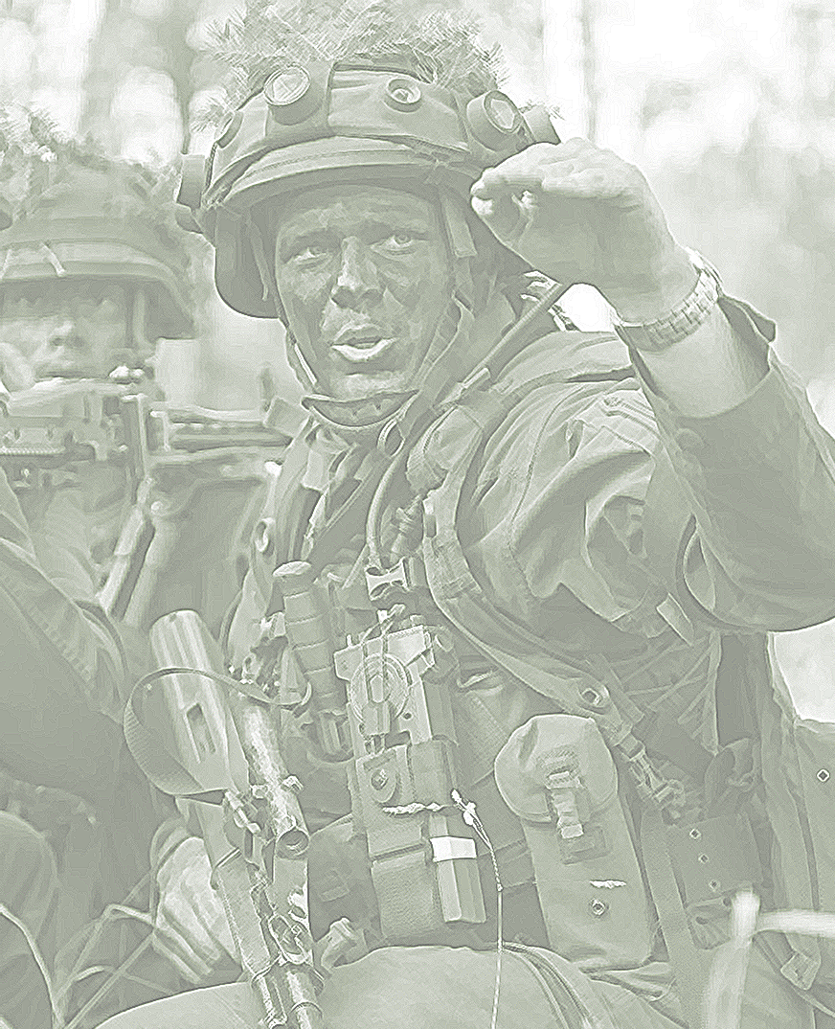

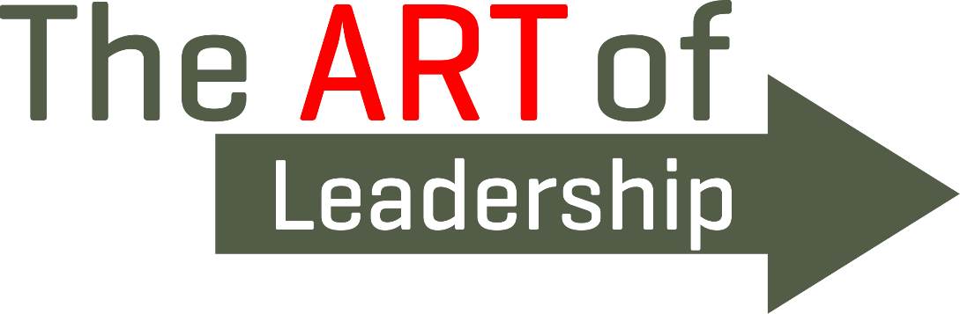

2022

Slide 2
Military Leader’s Identity, Role, and Competencies:
Interrelated Aspects of Leader Development
ESTONIAN MILITARY ACADEMY
9 Nov 2022 Ülle Säälik (PhD)
Theresan Military-Academic Forum Lieut. Jaanus Otsing

Slide 3
Background, problem
How to achieve internalized adoption of the officer’s role?
How to achieve lifelong, self-directed development of officer competencies?
Why change the training system?
- changing societies and generations, rising individualism and primacy of self-interest+ contradiction of traditional and contemporary views on leadership in military
In military academies what can we do to help our learners with such challenges for the best preparation in the ever-changing environment?
Notes:
“leader development is in need of a jumpstart” US Army Major Todd Hertling

Slide 4
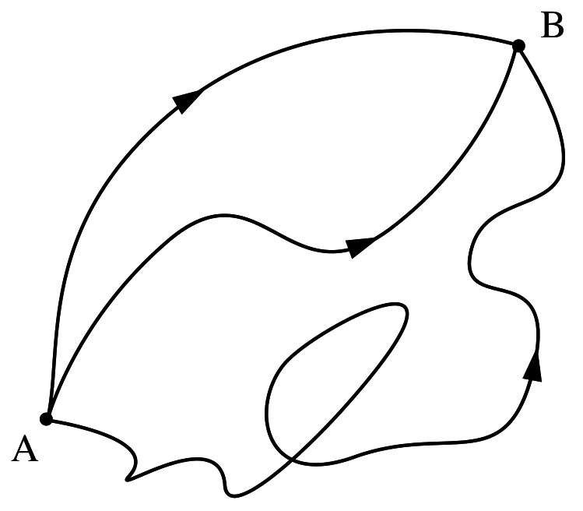

Leader development – what & how?
IDENTITY (personal) ↔ ROLE (professional) (ideal)
PROFESSIONAL IDENTITY
WHO am I?
What am I like?
What can I do?
What am I capable of?
Who is a mil.leader?
What is a leader like?
What must a leader do?
What must they be capable of?
COMPETENCIES
Notes:
Personal identity – How well I know myself? What do I know about myself or what I don’t know yet? How can I find it out?
Professional role – perceived from the environment, from others’ perceptions (a serviceman, an officer, a military leader – films, books, media news, stories from the past etc) + official documents, top leader statements, real life experience with leaders (both posit and neg), presentation of the role in the learning context by the teaching staff!!

Slide 5
Leader development– IDENTITY, ROLE
WHO am I?
What am I like?
Figure 2. Examples of officers’ roles and their relative importance (Möller, 2022), based on role categories of collective identity by Ehala (2018).
Notes:
Personal identity and roles related to family and close relationships – of high importance, and only then the professional role.
NB! Junior officers with about 10-15 years of military experience. Is it different with the cadets?
Why it should be considered and acknowledged – to avoid role conflicts! – also for the organization to accept and adapt when possible (?) as well as design/manage support systems to help to maintain role fulfilment as best as possible…(?)

Slide 6
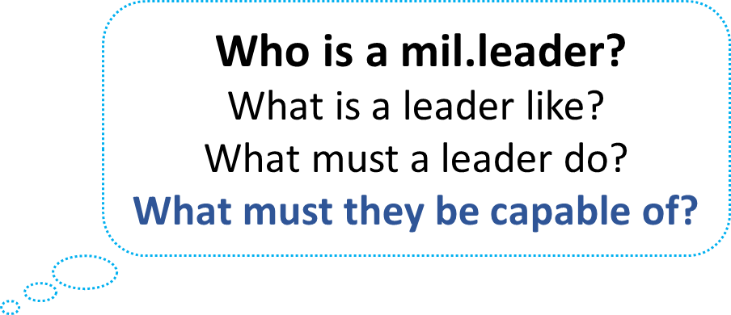
Leader development – professional role and its competencies (MILTIC model)
INTRAPERSONAL
MANAGEMENT
LEADERSHIP
LEADER COMPETENCIES
COMPETENCIES
CONCEPTUAL
TECHNICAL (professional)
Task-dimension
Relation-dimension
Change-dimension
INTERPERSONAL
Dimensions: Meerits, A., Kivipõld, K. (2020). Leadership competencies of first-level military leaders. Leadership & Organization Development Journal
Competency model: Säälik, Ü.; Ermus, A.; Männamaa, I.; Toom, L.; Kasemaa, A. (2020). Kaitseväelise juhi pädevusmudel. Sõjateadlane (Estonian Journal of Military Studies), 14, 11−38
Notes:
The model was created as part of a research Project (leader development in the EDF) – in use as an assessment tool, basis for the self-analyses and feedback – to improve cadets’ intrapersonal competency

Slide 7
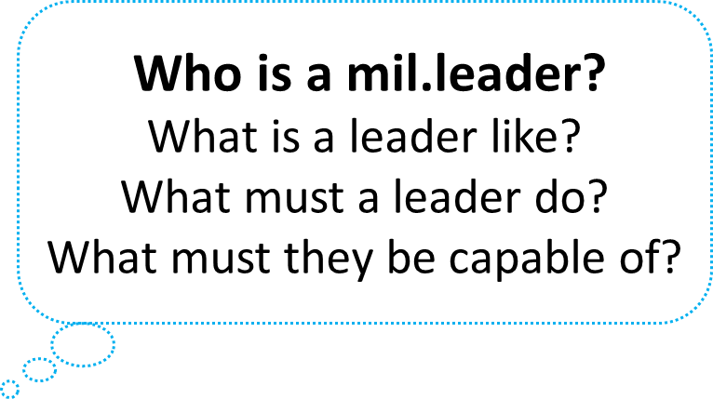
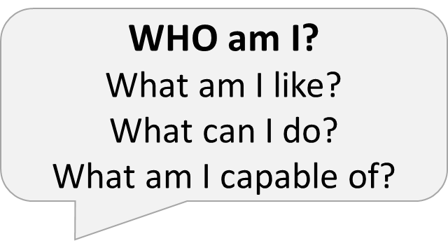
Leader development – what & how?
Challenge
Assessment
incl. self- and peer-assessments, pre-, during and post-process etc.
Support - Learning environment, clear instructions, criteria etc
Van Velsor, E.; McCauley, C. D. 2004. Introduction: our view of leadership development. In: McCauley, C. D.; Van Velsor, E. (eds.). The Center for Creative Leadership. Handbook of Leadership Development. John Wiley and Sons, Ltd., pp. 1–22.

Slide 8
Leader development – what & how?
IDENTITY (personal) ↔ ROLE (professional) (ideal)
PROFESSIONAL IDENTITY
WHO am I?
What am I like?
What can I do?
What am I capable of?
Knowledge
Experience
Feedback
Analysis
Reflection
Conclusions
Who is a mil.leader?
What is a leader like?
What must a leader do?
What must they be capable of?
COMPETENCIES
Notes:
What is it that we do well in our learning process? – knowledge! Some experience and some feedback.
Not so good at – multifaceted feedback (360 degrees), peer-assessments, reflection, analysis, conclusions… - need more depth, instructions how to conduct etc

Slide 9
Conclusions, further research…
Military academies must include goals and tasks in training that focus on self-awareness, provide challenge, multifaceted assessment and support.
Tolerant towards mistakes, guide learners to exploit both success and failure for the sake of development as a habit and a skill.
The organization - clarify the officer’s and leader’s roles and identities by working on its concept and clearly communicating the expectations for the role
Notes:
Editing needed!

Slide 10
Thank you for your attention!
Ulle.Saalik@mil.ee
Jaanus.Otsing@mil.ee

