Slide 1
Unusual Connection of two Worlds
Armed Forces Academy of General Milan Rastislav Štefánik
Liptovský Mikuláš, Slovak Republic
The Art of LEADERSHIP
CDT BSc Alžbeta BUDINSKÁ

Slide 2
Table of main contents

Slide 3
Leadership, leader, command and control
definition
purpose
characteristics

Slide 4
„the process of persuasion or example by which an individual (or team) induces a group to pursue objectives held by the leader or shared by the leaders and their followers“ (Gardner, 1990)
„a process that promotes achieving goals snd focuses on persuading others by an individual or a team of leaders“ (Steigauf, 2011)
„the effort to force people perform tasks willingly on behalf of the leader“ (Dědina, 2005)
How to become a leader?
be „born“ for it
willingness to get better
persistance
learn from mistakes
respect vs. humility
When it comes to fulfilling the mission, everyone desires to win, and people doing the fighting want to believe in the mission's purpose.
leadership
understanding
willingness
better performance

Slide 5
efficient organization
Maintaining balance.
Leadership
drives the interpersonal aspects of the organization, such as morale and team spirit.
Management
deals with the conceptual issues of the organization, such as planning, budgeting, and organizing.
Command
guides the organization with well thought-out visions that make it effective.
Control
provides structure to the organization in order to make it more efficient.

Slide 6
Military Leadership
features
principles
styles

Slide 7
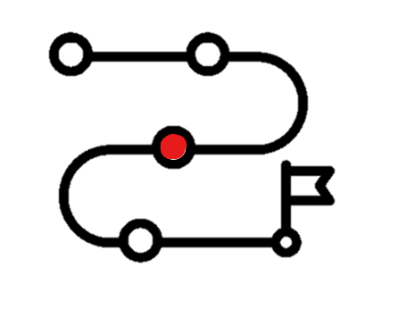
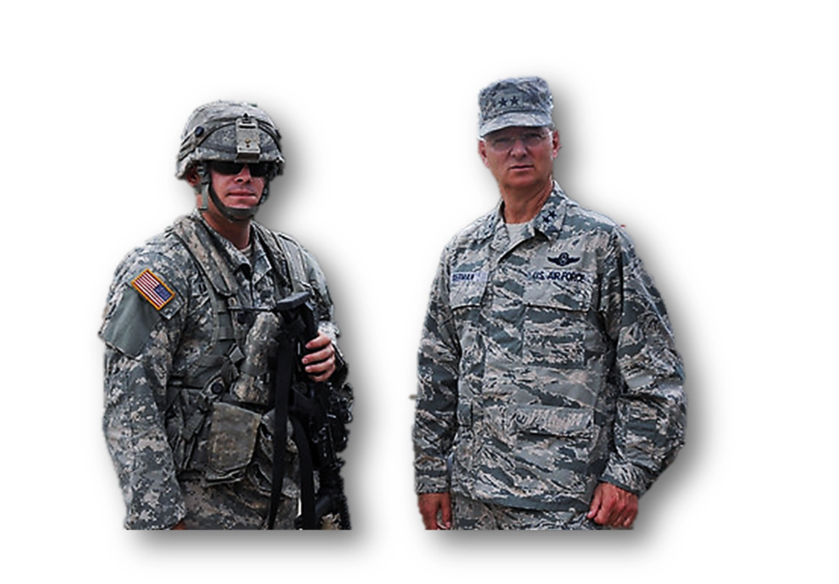
lEADER IN THE MILITARY
UNDERSTANDING – responsibility for the world
EMOTIONS – objectiveness and impartiality
EGO – controlling oneself
LEARNING – never-ending process
STANDARD – monitoring, space for improvement

Slide 8
STRUCTURE VS. STYLE
Recognising the difference.
STRATEGIC
ORGANIZATIONAL
DIRECT
STRATEGIC
TACTICAL
Leadership - Styles
Leadership – Levels of Command

Slide 9
communication in Military Leadership
specifics
importance
efficiency

Slide 10
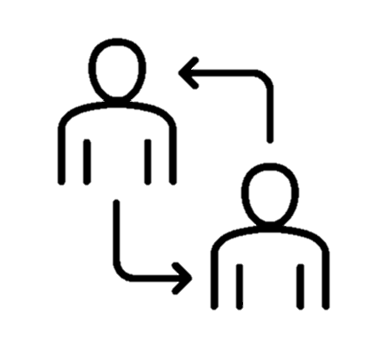
communication is the key
Understanding leads to willingness, willingness leads to better performance.
Specifics:
brevity, volume, objectivity
expressing emotions is not desirable

Slide 11
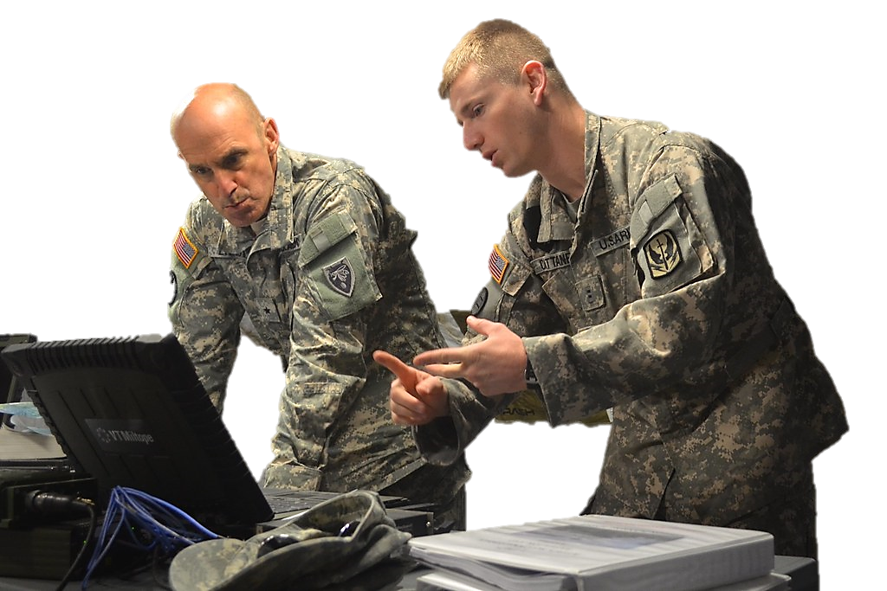
efficiency through communication
„to paint a picture“
UNDERSTANDING – to understand and be able to explain;
SIMPLICITY – understanding lies in the brevity and clarity;
RELATIONSHIPS – top-down and bottom-up, feedback;
PLANNING – awareness, shared creativity, lessons from the past;
PRIORITISATION – releasing the pressure;
COMMAND - decentralized and demarcated;
DECISION-MAKING – to complete an incomplete picture;
TEAMWORK – coverage and movement;
BALANCE - respect versus humility

Slide 12
Conclusion
connection
significance
the art

Slide 13
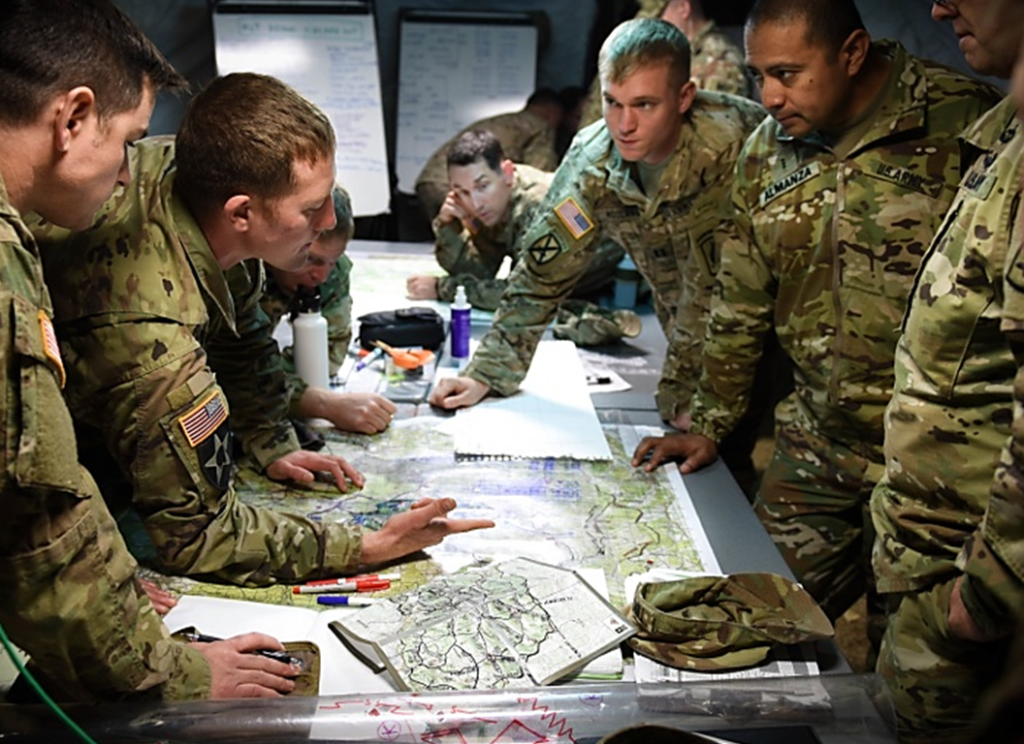
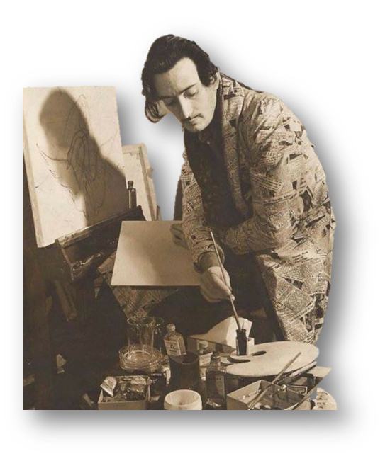
The connection
If leadership is an art, then may leader be the artist.
UNDERSTANDING
EMOTIONS
EGO
STANDARD
LEARNING
SIMPLICITY
RELATIONSHIPS
PLANNING
PRIORITISATION
BALANCE
DECISION-MAKING
TEAMWORK
CREATIVITY

Slide 14
Thank you for your attention
The Art of LEADERSHIP

