Slide 1
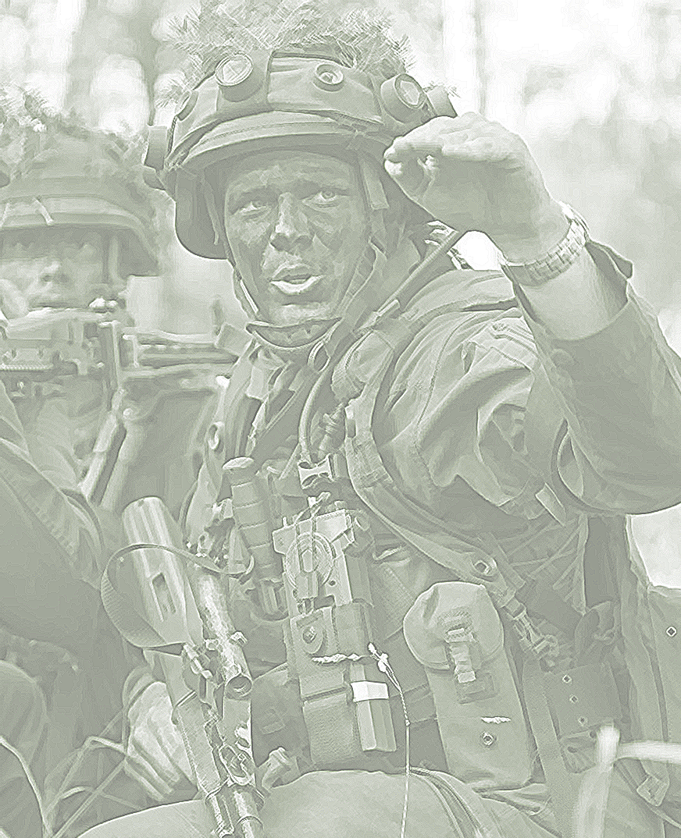
2022

Slide 2
First thoughts
Military demands/needs
Surrounding influences
Human Ressource Development
The people
Output orientation
People orientation
Notes:
The perspective: Leadership in a human ressource development perspective. Competence development and training.
output orientation and people orientation
Goal of HRD:
Leadership has the same goals, but tries to achieve them with a stronger focus on the employees. Successful leadership tries to convey the values and visions of the company to the employees and, in addition to leading teams, also focuses on the leadership personality. Charisma, social competence and the ability to generate enthusiasm in the company and among the employees are basic prerequisites of successful leadership.

Slide 3
Leadership and increasing demands
First considerations:
Leaders decide, guide, motivate, inspire and aim to reach the desired outcome
Military readiness as the desired outcome?
- material readiness & personnel readiness
VUCA: the world we live in
New Generations: the people, we rely on
Potential for conflict?
Notes:
First considerations:
Leadership is about people. People work over paper work.
What is the core mission of every military leader and therefore a unit? guaranteeing military readiness, they have to guarantee personnel readiness of their soldiers and civilians.
esp. In times of VUCA, challenges might appear more „sudden“ and conflicts might emerge „quicker“ thats why readiness is of utmost importance
New generations: leadership always can only work, if you work with the people. And new generations have new „wishes“, demands and needs. but also new skills

Slide 4
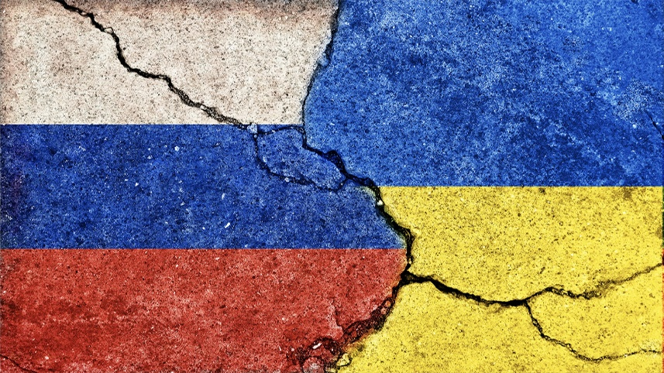
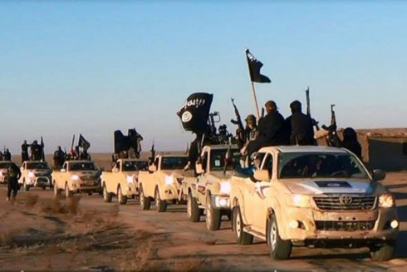
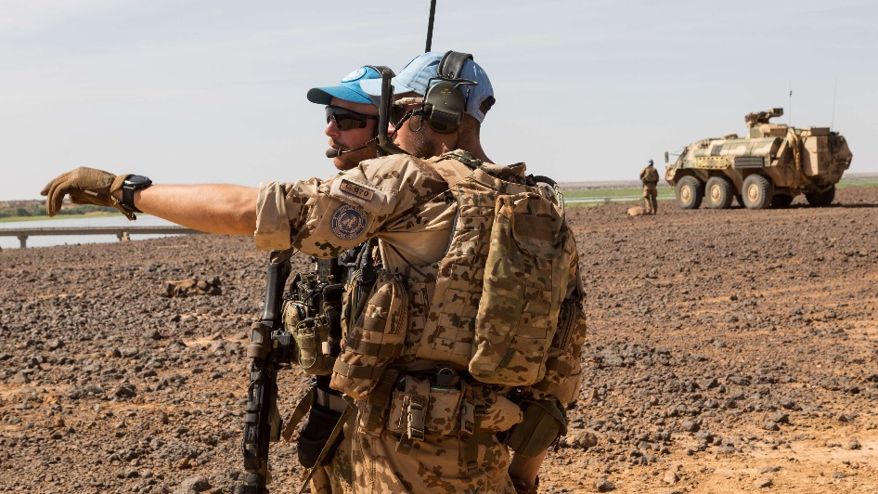
Future Generations and new challenges: Leadership in times of the VUCA-world
?
Notes:
Thesis: Future generations, VUCA and our military requirements all have the potential for conflict and must be confronted with proper leadership.
Or to say in pictures, what I tried to think about:
Russias war against Ukraine
Islamic state in Syria and Iraq
Minusma Mission in Mali
Globalization
Interconnected work
The world is getting smaller, people feel that the world is getting more „dangerous“ even though, most people live in peace.
Guidance, orientation and a clear vision is necessary to give structure

Slide 5
Leading and leadership training in difficult times
Military leadership skills and competences must be optimized in order to meet the challenges of the world we live in, while fulfilling the requirements of operational readiness.
Lifelong learning
Competence development
Leaders set the direction. They offer orientation, they engage people and inspire.
Notes:
Leadership is responsible for change, for shaping change. The leader's motto is to set the direction, to engage people. Inspiration is a suitable keyword for him.
Leadership competence is improved by developing specific competencies. These include professional competence, methodological competence, social competence, self-competence, and numerous other areas, such as a distinctive strategic competence or implementation-oriented competence, which includes a strong personal decision-making ability and the ability to think and act in a results-oriented manner
Lifelong learning is the key foundation for a positive competence development.
30] Ferihan Steiner, Führung der Generation Y durch Servant Leadership, in: Laske/Orthey/Schmid:

Slide 6
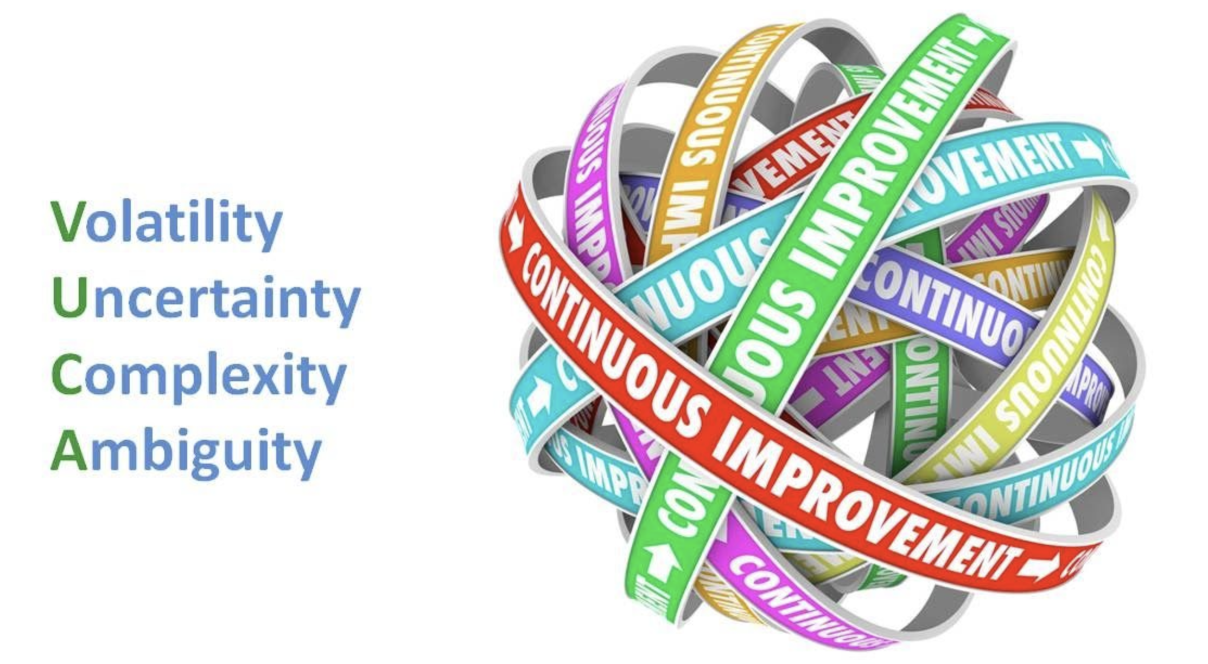
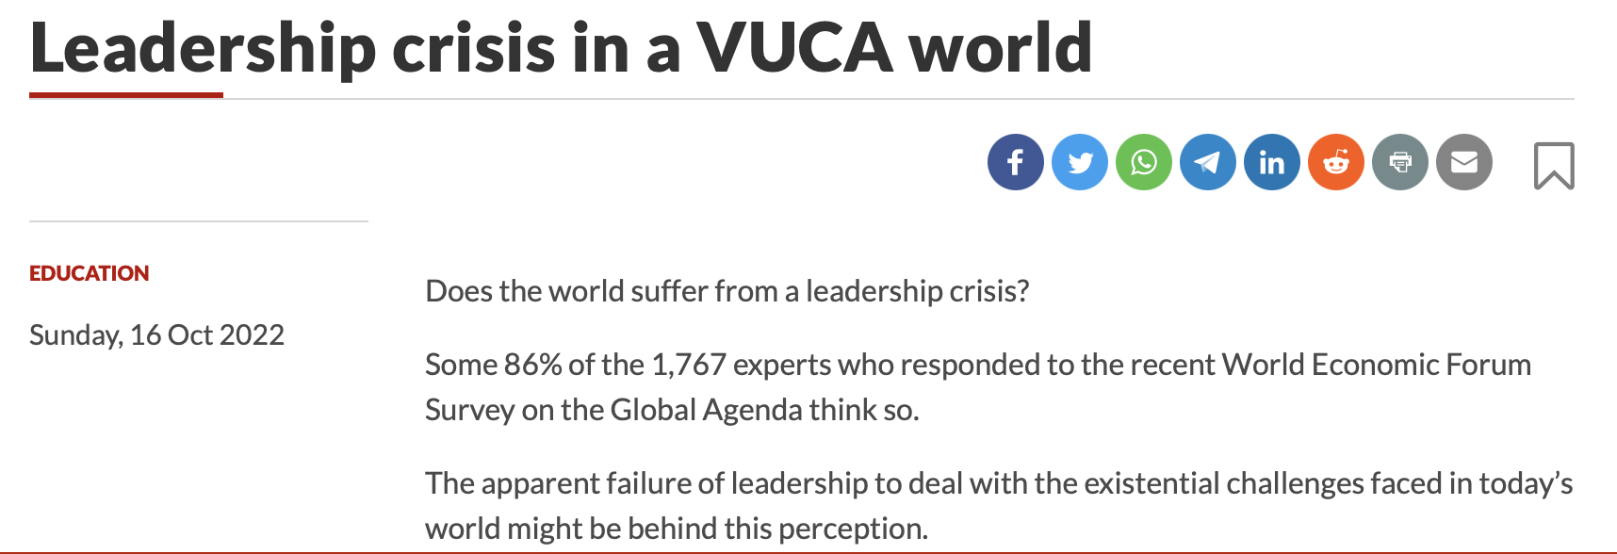
VUCA – the world we live in?
VUCA: introduced by the US Army War College in the 1990s to describe the multilateral world
Volatility: dynamic changes over a certain period
Uncertainty: the unpredictability of events
Complexity: globalization, digitalization, and ever-increasing dependencies
Ambiguity: questions of “why” and “how” are becoming more important
Notes:
Leading people is what happens in the present. But what is our world made out of? What are the circumstances, what is the framework condition?
What is VUCA and how are we influenced by it? Is VUCA more than just a description?
VUCA is an explanatory model for the characteristics of the modern world. For companies, VUCA means one thing above all: they must always be flexible and adaptable in order to be able to react to the unexpected.
V – russias war against Ukraine
U – the world is getting smaller
C– digitalization
A – a lack of orientation.
And when you search for VUCA, you will get lots of information, but mostly about possible, arising conflicts and challenges.
Pictures: VUCA can mean a lot, it means opportunities, but also challenges. VUCA almost always is so challenging, that continous improvement is necessary – lifelong learning.
Also VUCA can make you lose orientation and it is still not clear, how the VUCA world will be. Last but not least: VUCA can clearly cause leadership crises, that means to deal with VUCA is a leadership task.

Slide 7
VUCA and leadership - What now?
Leaders are facing increasing challenges:
Military leaders face more difficulties on and off the job
Demands of operational readiness have increased due to VUCA
Guaranteeing this readiness is a central leadership task
Leaders must be trained and developed accordingly
“When readiness suffers, the risks to forces increase.”
Notes:
Increasing challenges need increased training
VUCA world and generational needs have to be dealt with - on the job challenges increase, off the job they are being influenced by VUCA as every other person is
Since the cold war has ended, the world has become multilateral. Conflicts like UKR RUS war, 9/11 and its consequences, war on terror, have made the world more dynamic and volatile
Leaders are responsible for their personnel and thats why for personnel readiness
Leaders must be trained to develop competencies, that help them challenging the needs of VUCA. They need to develop skills that allow them to face those challenges. All of this is under the overriding theme of lifelong learning.
That is an ever ongoing cycle. Lifelong learning takes a big role

Slide 8
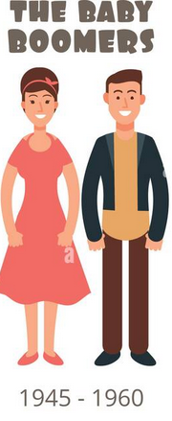
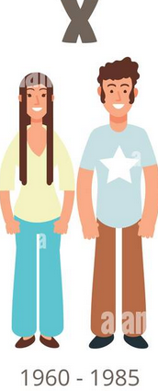
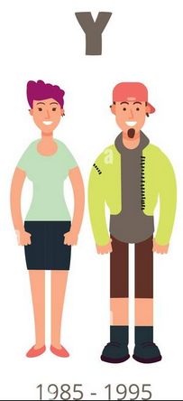
Leadership and new challenges
Military leaders are exposed to higher stress levels:
It is „unusual“ to quit the job at a specific time
serving abroad can be a part of being a military leader
Do future generations tend to reject the necessity of this military need?
Leaders have more obligations towards other hierarchy levels
Resilience needs to be developed as a core competency
Notes:
Leadership roles become less and less attractive
Digitalisation has made leadership an „all-time job“
Serving abroad is part of a smaller world
2. Because changes happen so quickly, leaders need to report how changes will be dealt with: more obligations
3. Resilience can be trained mostly on the job, e.g. by exercises.

Slide 9
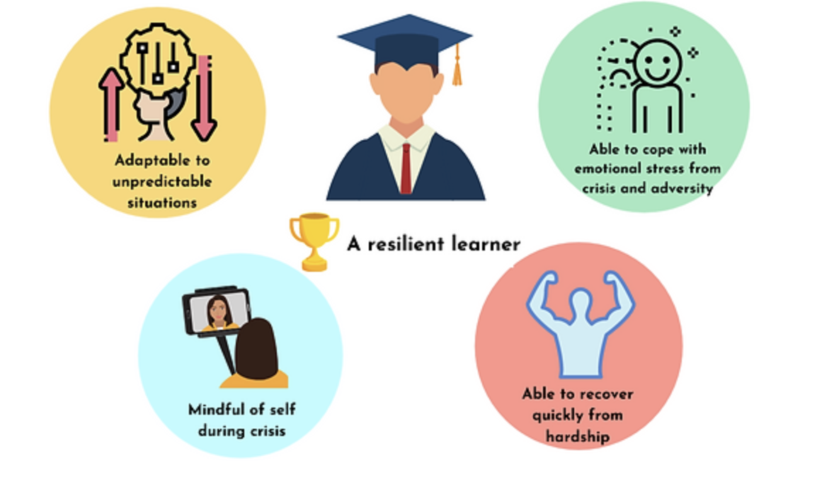
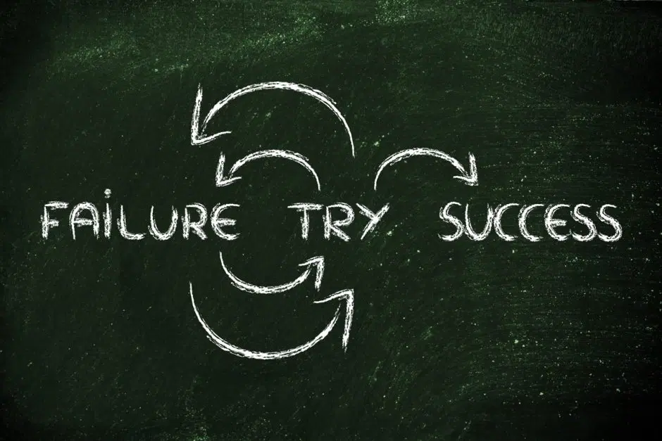
Leading by example
A resilient leader
Notes:
Leading by example gives orientation, which is necessary in VUCA times
A positive error culture can help solving problems and battling uncertainty and ambiguity

Slide 10
New Generations: The people we rely on
A generational shift: values, wishes and needs of the people have changed, while the world has changed
„Baby Boomers“: born before VUCA
„Generation X“: born before VUCA
„Generation Y“: born and raised during VUCA
„Generation Z“: born and raised during VUCA
How does that influence people?
Notes:
But what is VUCA and how are we influenced by it? Is VUCA more than just a description? Or is it “really going on?“
Generations comprise specific age cohorts that share aspects such as birth periods, defining social and historical events, and, therefore, attitudes and identities.
Even though all individuals within a generation have different individual characteristics, strengths, and weaknesses, they can be grouped based on overarching aspects.
BB: 1940s – 1960s
X:
Y:
Z:

Slide 11
Generations… a little bit more theoretical
 | „The Baby Boomers“ | „Generation X“ | „Generation Y“ | „Generation Z“
 | born after WW II High and rising birth rates | born between 1965 and 1979 declining birth rate | born between 1980 and 1995 | born between 1995 and 2012
Framework conditions | Relatively protected environment | Slower economic growth higher unemployment | Global terrorism Economic pressure has increased Financial crises occur Companies are more involved in scandals 9/11, Fukushima,… | Economic pressure has increased Advanced digitalisation and globalisation Framwork conditions similar to Gen Y
Attributes | Strong, competitive behaviour Strong team-oriented and community driven | Tend to be: More insecure and more cautious, more self-focused | Tend to give priority to the realisation of individual needs Frustrated over partly unrealistic expectations placed on them | Search for a community that provides security More concerned about their future Strict distinction between private and professional world
Notes:
I dont want to explain every detail about generations
Generations comprise specific age cohorts that share aspects such as birth periods, defining social and historical events, and, therefore, attitudes and identities. Even though all individuals within a generation have different individual characteristics, strengths, and weaknesses, they can be grouped based on overarching aspects

Slide 12
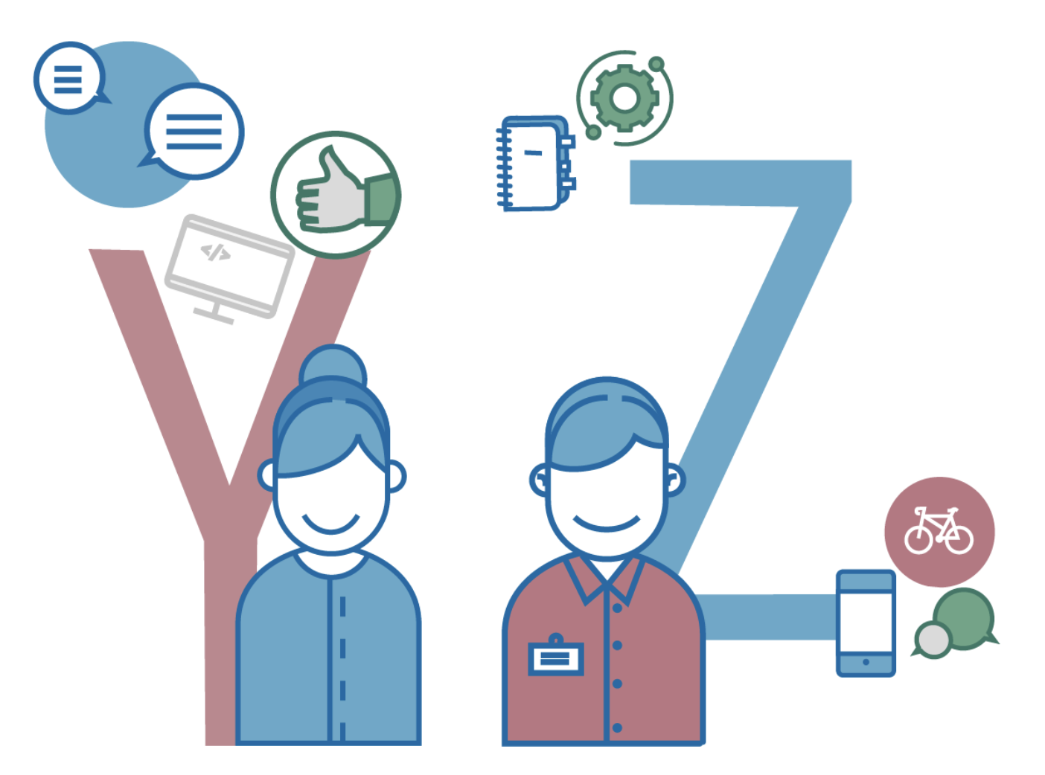
What makes Generation Y and Z special?
Realistic self-perception:
They learn from the mistakes made by previous generations
Creative thought patterns:
They don‘t adapt thought patterns of previous generations
More out-of-the-box-thinking
The aim for self-realisation:
They actively decide on an employer, they value their own time more than a career
The search for orientation:
they set less exaggerated goals for themselves but are looking for sense-making and
orientation in what they do
The search for a diverse, collaborative and authentic community
Notes:
In summary, a typical Gen Zer is a self-driver who deeply cares about others, strives for a diverse community, is highly collaborative and social, values flexibility, relevance, authenticity and non-hierarchical leadership,

Slide 13
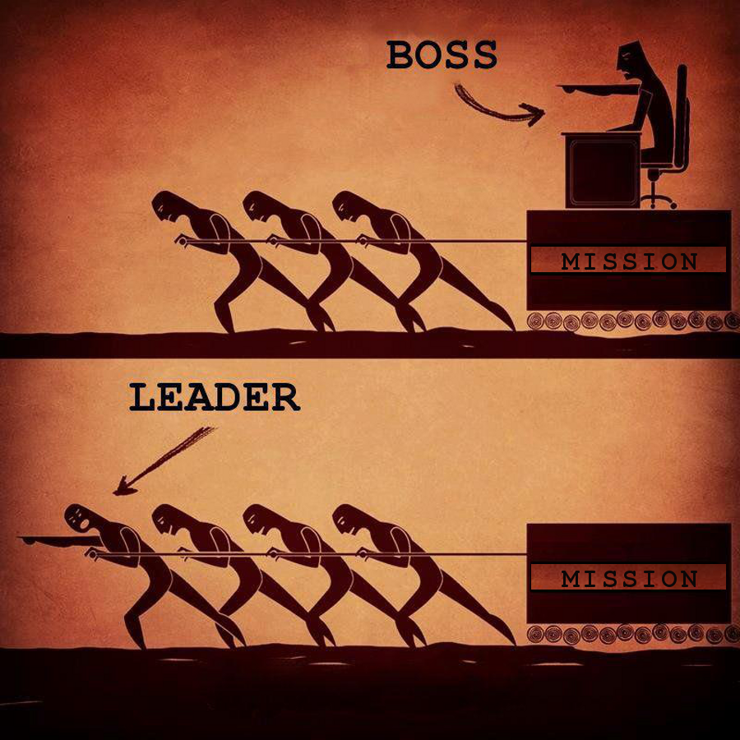
Operational (personnel) readiness is the goal
What should be focused on?:
Fulfilling military needs in times of VUCA
Readiness is necessary
Personal needs to be led accordingly
Meeting the wishes and values of generations Y and Z
As an employer but foremost as a military leader
lead how they want to be led
value empathy, open dialogue and meaningful communication of the assignments
Use what makes Generation Y and Z special
Notes:
Lead from the front
What makes them special: out of the box thinking, creativity, authentic and sense-making work in a community, more freedom in fulfilling tasks

Slide 14
Generations, potential for conflict?
Differences in age:
Generational cohortes and their influence on leaders
Young leaders and old personnel / old leaders and young personnel
Differences in demands and individual wishes:
Younger generations and military requirements?
Personnel readiness / military needs?
Establishing a stronger clarity of purpose
Goals must be clearly defined but personal also needs to have freedom in fulfilling it
Convey meaning through leadership
identification for the mission
stronger communication skills are required

Slide 15
Leading through sense-making
Leadership in uncertain times:
Developing competencies that support an own leadership style
Clear vision, clear goals but also freedom in reaching them
Developing a strong resilience
Offering orientation through resilience
Flexible and adaptable in thinking and acting
Establish meaning through leadership
strong communication skills
Leaders are coaches
They enable, motivate, inspire and develop
Providing structure and security in an uncertain environment
Leaders decide
Notes:
1. professional competence, methodological competence, social competence, self-competence, a distinctive strategic competence, a strong personal decision-making ability and the ability to think and act in a results-oriented manner
1. leadership style: Charismatic leaders are aware of their abilities and trust their leadership style. They develop problem-solving strategies and thus secure the trust of their personnel
2. strong resilience: resilience enables, it engages to act and think flexible and offers orientation trough own actions
3. establishing meaning through leadership: Conveying the meaning and creating a strong identification for the mission are central leadership tasks. Those tasks become increasingly important and require an ever-increasing communication skills by leaders.
This actively is wanted by Gen Y and Z
4. leaders are coaches
Leaders should personally engage with their people and help them developing problem-solving options
Leaders are enablers that give their people tools to develop competencies
Leaders should listen instead of only giving answers
Communication as a guiding principle for leadership success
Active listening, open questions, removing doubts, feedback that is linked
Continuous feedback and reflection
Intellectual stimulation by problem-solving approaches
Working closely with people from Gen Y/Z can lead to out-of-the-box thinking and innovation, creativity and flexibility can emerge
Providing structure and security through sense-making and giving enough freedom in fulfilling tasks

Slide 16
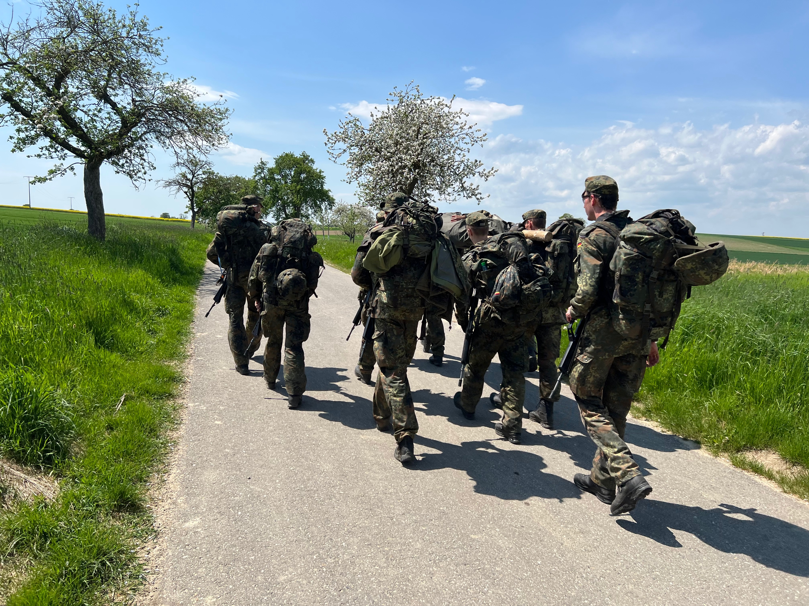
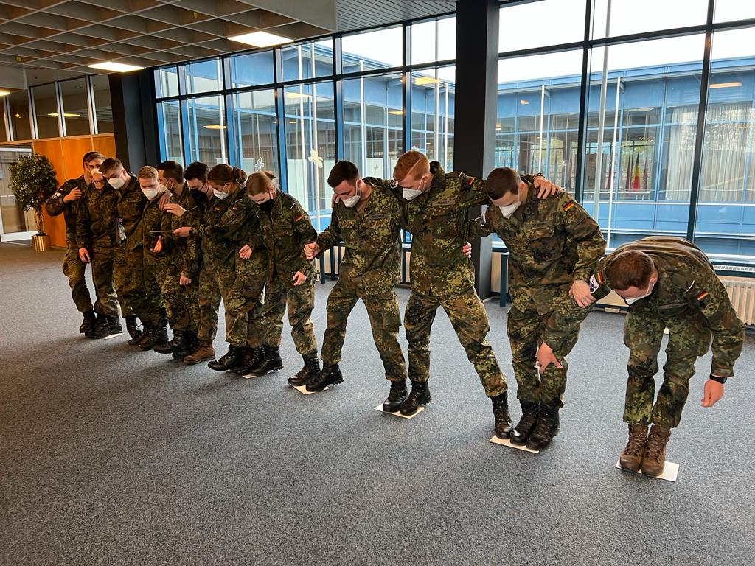
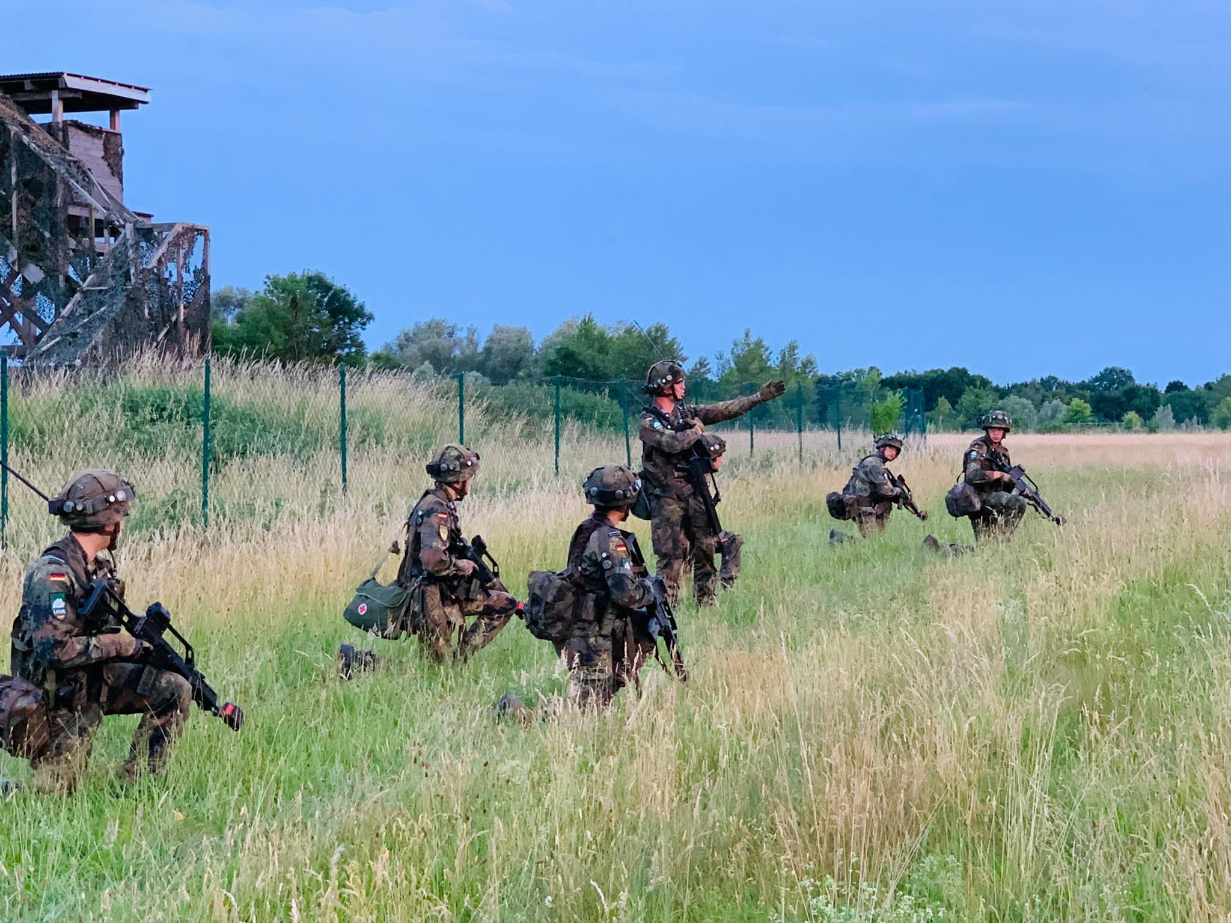
Leadership training
The team matters
Goals can only be met when working together
Using skills and competencies of everybody
Close communication is central
Close communication across hierarchies
Building resilience
Physical and mental strength
Learn how to lead
On-the-job training
Leading in a positive error culture
Leading in a safe environment
Developing competencies that provide structure in an uncertain world
Notes:
On the job:
Working together as a team – higher demands require more skills, more competencies
Leading in a safe environment – training to lead in an environment, where your future skills are being taught
Leaving the comfortzone – leave the comfortzone to enable „out of the box thinking“
Positive error culture – mistakes should be made in order to succeed in real events
Lifelong learning is necessary for the challenges of VUCA
flexibility, freedom, a positive mistake culture, finding your own leadership style in developing supporting competencies, have an open dialog with your superiors, have a clear goal in mind, physical and mental training, Training with digital methods…

Slide 17
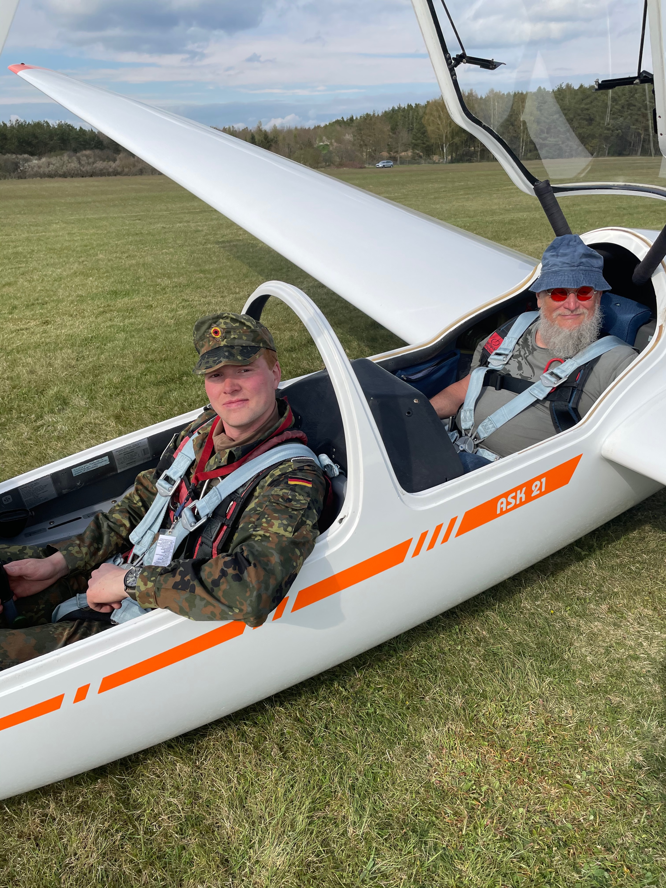
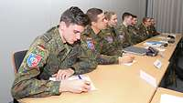
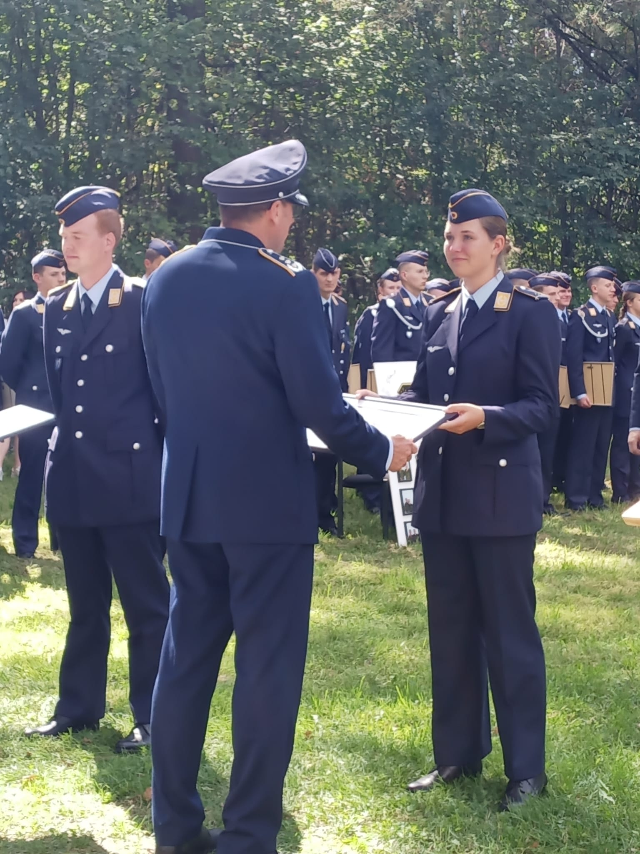
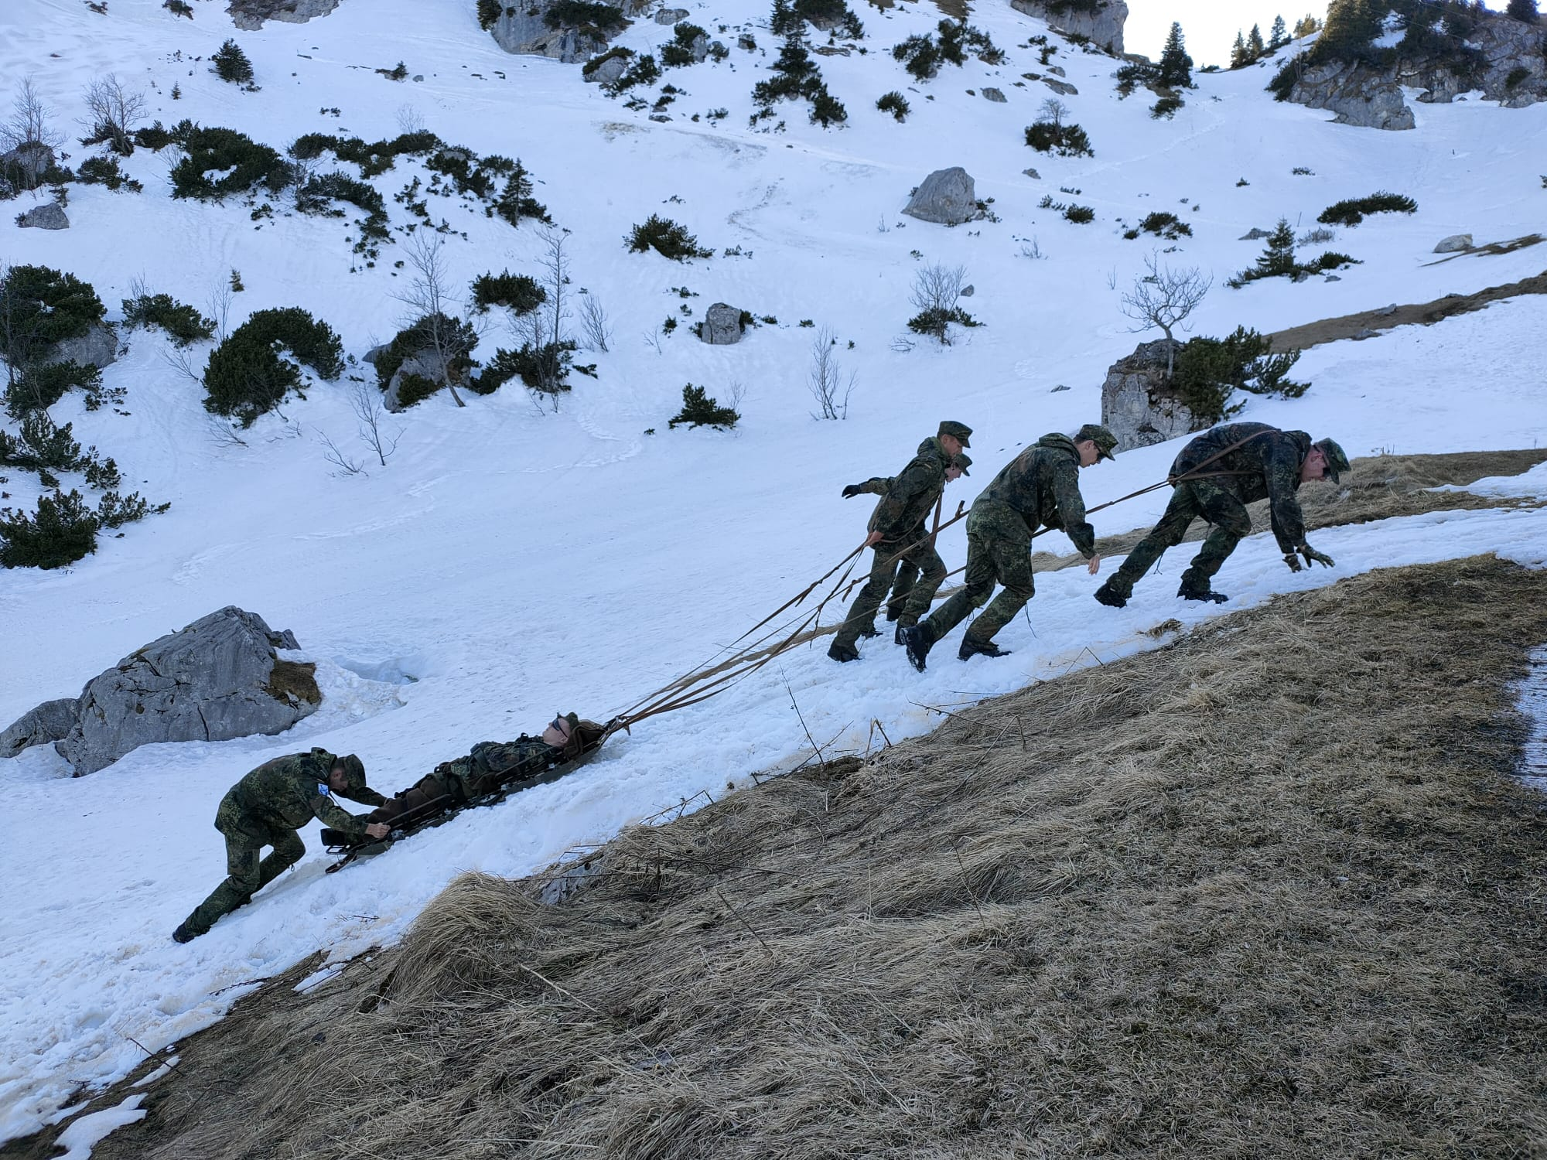
Leadership training
Leaving the comfort zone
Enabling out of the box thinking
A clarity of purpose
Clear formulated goals
Freedoms in reaching them
Individual leadership style
Lifelong learning
Every situation is a learning situation
Notes:
Leaving the comfortzone – leave the comfortzone to enable „out of the box thinking“
Positive error culture – mistakes should be made in order to succeed in real events
Lifelong learning is necessary for the challenges of VUCA

Slide 18
Leading through sense-making
Leadership in uncertain times:
Offer orientation and meaning through leadership /
strong communication skills
Developing a strong resilience
Leaders need to be a coach
Develop competencies that support your own leadership style:
professional competence, methodological competence, social competence, self-competence, a distinctive strategic competence, a strong personal decision-making ability and the ability to think and act in a results-oriented manner
Provide structure and security in an uncertain environment
Notes:
1. Communication as a guiding principle for leadership success
Active listening, open questions, removing doubts, feedback that is linked
Continuous feedback and reflection
Intellectual stimulation by problem-solving approaches
Working closely with people from Gen Y/Z can lead to out-of-the-box thinking and innovation, creativity and flexibility can emerge
Leaders are not only superiors but coaches
the need for developing their personnels competences
Leadership competence can be developed by establishing stronger other competencies
Providing structure and security through sense-making and giving enough freedom in fulfilling tasks

Slide 19
Sources
Notes:
[1] Julia Heller, Resilienz für die VUCA-Welt. Individuelle und organisationale Resilienz entwickeln, (Wiesbaden: Springer, 2019), 51-52.
[2] Christian Freilinger, Vision und Leadership, in: Laske/Orthey/Schmid: PersonalEntwickeln, Beitrag Nr. 6.97, (Köln: Deutscher Wirtschaftsdienst, 2012), 4.5.
[3] DoD Fact Sheet, “Sequestration’s Impact to Regaining Readiness,” last accessed August 31, 2022, https://dod.defense.gov/Portals/1/Documents/pubs/DoD_Readiness_Fact_Sheet_FINAL.pdf
[4] Martin Tschumi, Handbuch zum Personalmanagement (Zürich 2013), 16-18.
[5] Deloitte, “Understanding Generation Z in the workplace,” last accessed August 31, 2022, https://www2.deloitte.com/us/en/pages/consumer-business/articles/understanding-generation-z-in-the-workplace.html.
[6] Susanne Böhlich,Generation YZ, in: Laske/Orthey/Schmid: PersonalEntwickeln, Beitrag Nr. 7.76 (Köln: Deutscher Wirtschaftsdienst, 2012), 13-14.
[7] Samuel Absher, Nathan Chandler, Jennifer Kavanagh, et. al, Building Military Coalitions, Lessons from U.S. Experience (Santa Monica: RAND Corporation, 2021), 171.
[8] Bundeswehr, “Enhanced Air Policing South,” last accessed August 31, 2022, https://www.bundeswehr.de/de/einsaetze-bundeswehr/anerkannte-missionen/nato-air-policing-baltikum.
[9] Bundeswehr, “Slowakei – EVA,” last accessed August 31, 2022, https://www.bundeswehr.de/de/einsaetze-bundeswehr/anerkannte-missionen/slowakei-enhanced-vigilance-activities.
[10] Hedda Nier,“So tickt die Generation Z,” last accessed September 25, 2022, https://de.statista.com/infografik/12176/so-tickt-die-generation-z-in-oesterreich/.
[11] Björn Appellmann, Führen in einer komplexen Welt. Die Zeit der Helden ist vorbei, in: Laske/Orthey/Schmid: PersonalEntwickeln, Beitrag Nr. 6.138 (Köln: Deutscher Wirtschaftsdienst, 2012), 11.
[12] Ibid., 7-8.
[13] Ibid., 11-12.
[14] Zukunftsinstitut, „Megatrend Globalisierung,“ last accessed August 31, 2022, https://www.zukunftsinstitut.de/dossier/megatrend-globalisierung/.
[15] Ahmet Aysan, Bilgin Faruk, Mehmet Huseyin, Hakan Danis and Demir Ender, Eurasian Business Perspectives. Proceedings of the 23rd Eurasia Business and Economics Society Conference (Cham: Springer, 2020), 34.
[16] Björn Appellmann, Führen in einer komplexen Welt. Die Zeit der Helden ist vorbei, in: Laske/Orthey/Schmid: PersonalEntwickeln, Beitrag Nr. 6.138 (Köln: Deutscher Wirtschaftsdienst, 2012), 9-10.
[17] Idem.
[18] Ferihan Steiner, Führung der Generation Y durch Servant Leadership, in: Laske/Orthey/Schmid: PersonalEntwickeln, Beitrag Nr. 7.73 (Köln: Deutscher Wirtschaftsdienst, 2012), 1-2.
[19] Thomas Wiegold, „Personalstärke Juni 2022. Jetzt knapp über 182.000 nach FWDL-Rückgang,“ last accessed August 31, 2022, https://augengeradeaus.net/2022/07/personalstaerke-juni-2022-jetzt-knapp-ueber-182-000-nach-fwdl-rueckgang.
[20] Wissenschaftliche Dienste, Deutscher Bundestag, Personalgewinnungsstrategien im Vergleich. Die Streitkräfte Deutschlands, Kanadas, der Niederlande, Norwegens und der Schweiz unter Berücksichtigung der entsprechenden Strategien im jeweiligen öffentlichen Bereich (Berlin 2019), 6.
[21] Idem.
[22] Thomas Batsching, Generation Y – Was tun? Empfehlungen für Konzepte des Personalmanagements, in: Laske/Orthey/Schmid: PersonalEntwickeln, Beitrag Nr. 7.61 (Köln: Deutscher Wirtschaftsdienst, 2012), 1-2.
[23] Intergeneration, „Babyboomer, Generation X, Y, Z etc.: Die Generationen im Überblick,“ last accessed on August 31, 2022, https://intergeneration.ch/de/grundlagen/generation-x-y-z-ueberblick/.
[24] Susanne Böhlich, Generation YZ, in: Laske/Orthey/Schmid: PersonalEntwickeln, Beitrag Nr. 7.76 (Köln: Deutscher Wirtschaftsdienst, 2012), 3.
[25] Ibid., 4.
[26] Neli Mihaylova, „Generation Y denkt und arbeitet anders,“ last accessed on August 31, 2022, https://www.allgemeine-zeitung.de/panorama/leben-und-wissen/generation-y-denkt-und-arbeitet-anders_18055573.
[27] Susanne Böhlich, Generation YZ, in: Laske/Orthey/Schmid: PersonalEntwickeln, Beitrag Nr. 7.76 (Köln: Deutscher Wirtschaftsdienst, 2012), 5.
[28] Wissenschaftliche Dienste, Deutscher Bundestag, Personalgewinnungsstrategien im Vergleich. Die Streitkräfte Deutschlands, Kanadas, der Niederlande, Norwegens und der Schweiz unter Berücksichtigung der entsprechenden Strategien im jeweiligen öffentlichen Bereich (Berlin 2019), 5.
[29] Christian Scholz, Generation Z. Wie sie tickt, was sie verändert und warum sie uns alle ansteckt (Weinheim: Wiley, 2014), 199-200.
[30] Ferihan Steiner, Führung der Generation Y durch Servant Leadership, in: Laske/Orthey/Schmid: PersonalEntwickeln, Beitrag Nr. 7.73 (Köln: Deutscher Wirtschaftsdienst, 2012), 3-4.
[31] Nina Leonhard, Ines-Jacqueline Werkner, Militärsoziologie – eine Einführung, (Wiesbaden: Springer, 2012), 436.
[32] Hagen Rudolph, Strategisch wichtige Schlüsselkompetenzen von Führungskräften, in: Laske/Orthey/Schmid: PersonalEntwickeln, Beitrag Nr. 7.11, (Köln: Deutscher Wirtschaftsdienst, 2012), 5.
[33] Claudia Schneider, Wenn die gewohnte Ordnung auf dem Kopf steht, in: Laske/Orthey/Schmid: PersonalEntwickeln, Beitrag Nr. 6.139 (Köln: Deutscher Wirtschaftsdienst, 2012,) 10-11.
[34] Björn Appellmann, Führen in einer komplexen Welt. Die Zeit der Helden ist vorbei, in: Laske/Orthey/Schmid: PersonalEntwickeln, Beitrag Nr. 6.138 (Köln: Deutscher Wirtschaftsdienst, 2012), 11-12.
[35] Anna Nguyen, Führungskompetenzen lernen und entwickeln, in: Laske/Orthey/Schmid: PersonalEntwickeln, Beitrag Nr. 6.169, (Köln: Deutscher Wirtschaftsdienst, 2012), 3-4.
[36] Ibid., 8.
[37] Ibid., 9-10.
[38] Jim Thomas, Ted Thomas, “Mentoring, Coaching and Counseling. Toward a Common Understanding,” last accessed on August 31, 2022, https://usacac.army.mil/sites/default/files/documents/cace/DCL/DCL_Mentoring.pdf, 4.
[39] Paul Lawrence, Leading Change. How Successful Leaders Approach Change Management (London: Kogan Page, 2015), 194.
[40] Rainer Niermeyer, Nadia Postall, Führen: Die erfolgsreichsten Instrumente und Techniken (München: Haufe, 2008), 7.
[41] Alexander Groth, Führungsstark im Wandel. Change Leadership für das mittlere Management (Frankfurt am Main: Campus Verlag, 2016), 14-17.
[42] Ibid., 8.
[43] Nicole Strauss, Mit Resilienz gegen Stress und Burnout, in: Laske/Orthey/Schmid: PersonalEntwickeln, Beitrag Nr. 9.23 (Köln: Deutscher Wirtschaftsdienst, 2012), 1.
[44] Julia Heller, Resilienz für die VUCA-Welt. Individuelle und organisationale Resilienz entwickeln (Wiesbaden: Springer, 2019), 4.
[45] Gregor Paul Hoffmann, Organisationale Resilienz. Grundlagen und Handlungsempfehlungen für Entscheidungsträger und Führungkräfte (Wiesbaden: Springer, 2016), 6.
[46] Nicole Strauss, Mit Resilienz gegen Stress und Burnout, in: Laske/Orthey/Schmid: PersonalEntwickeln, Beitrag Nr. 9.23 (Köln: Deutscher Wirtschaftsdienst, 2012), 16.
[47] Leibniz Institute for Resilience Research, “Stichwort Resilienz,” last accessed on August 31, 2022, https://lir-mainz.de/resilienz.
[48] Rafaela Kraus, Tanja Kreitenweis, Führung messen. Inklusive Toolbox mit Messinstrumenten und Fragebögen (Berlin: Springer, 2020), 26-31.
[49] Ibid., 28.
[50] Ferihan Steiner, Führung der Generation Y durch Servant Leadership, in: Laske/Orthey/Schmid: PersonalEntwickeln, Beitrag Nr. 7.73 (Köln: Deutscher Wirtschaftsdienst, 2012), 4-5.
[51] Björn Appellmann, Führen in einer komplexen Welt. Die Zeit der Helden ist vorbei, in: Laske/Orthey/Schmid: PersonalEntwickeln, Beitrag Nr. 6.138 (Köln: Deutscher Wirtschaftsdienst, 2012), 7-8.
[52] James S. Moore, “Personnel readiness in 6 ‘easy’ steps,” last accessed on August 31, 2022, https://www.army.mil/article/203673/personnel_readiness_in_6_easy_steps.

