Slide 1
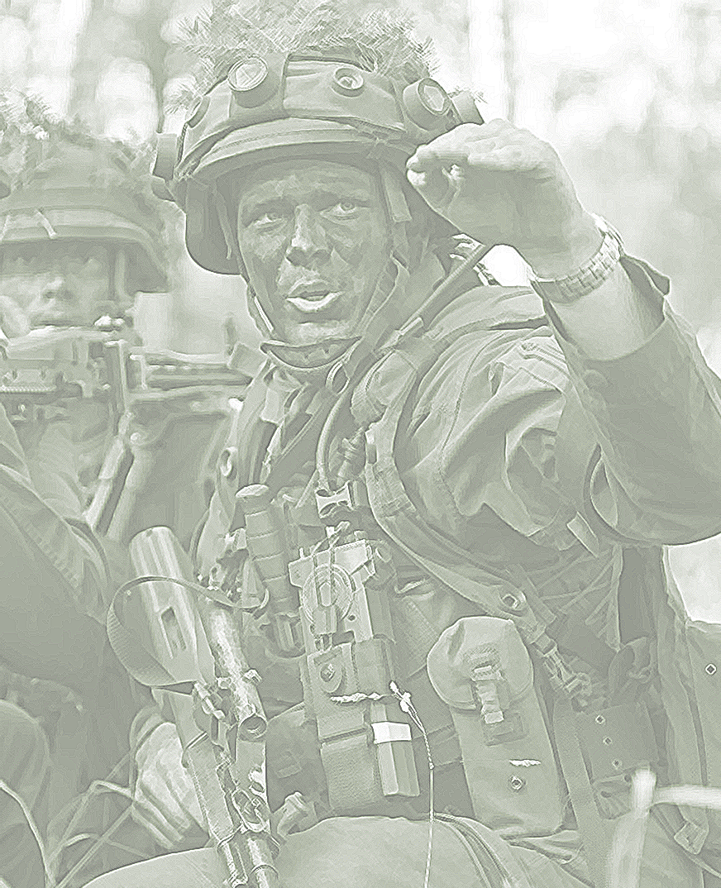
2022

Slide 2
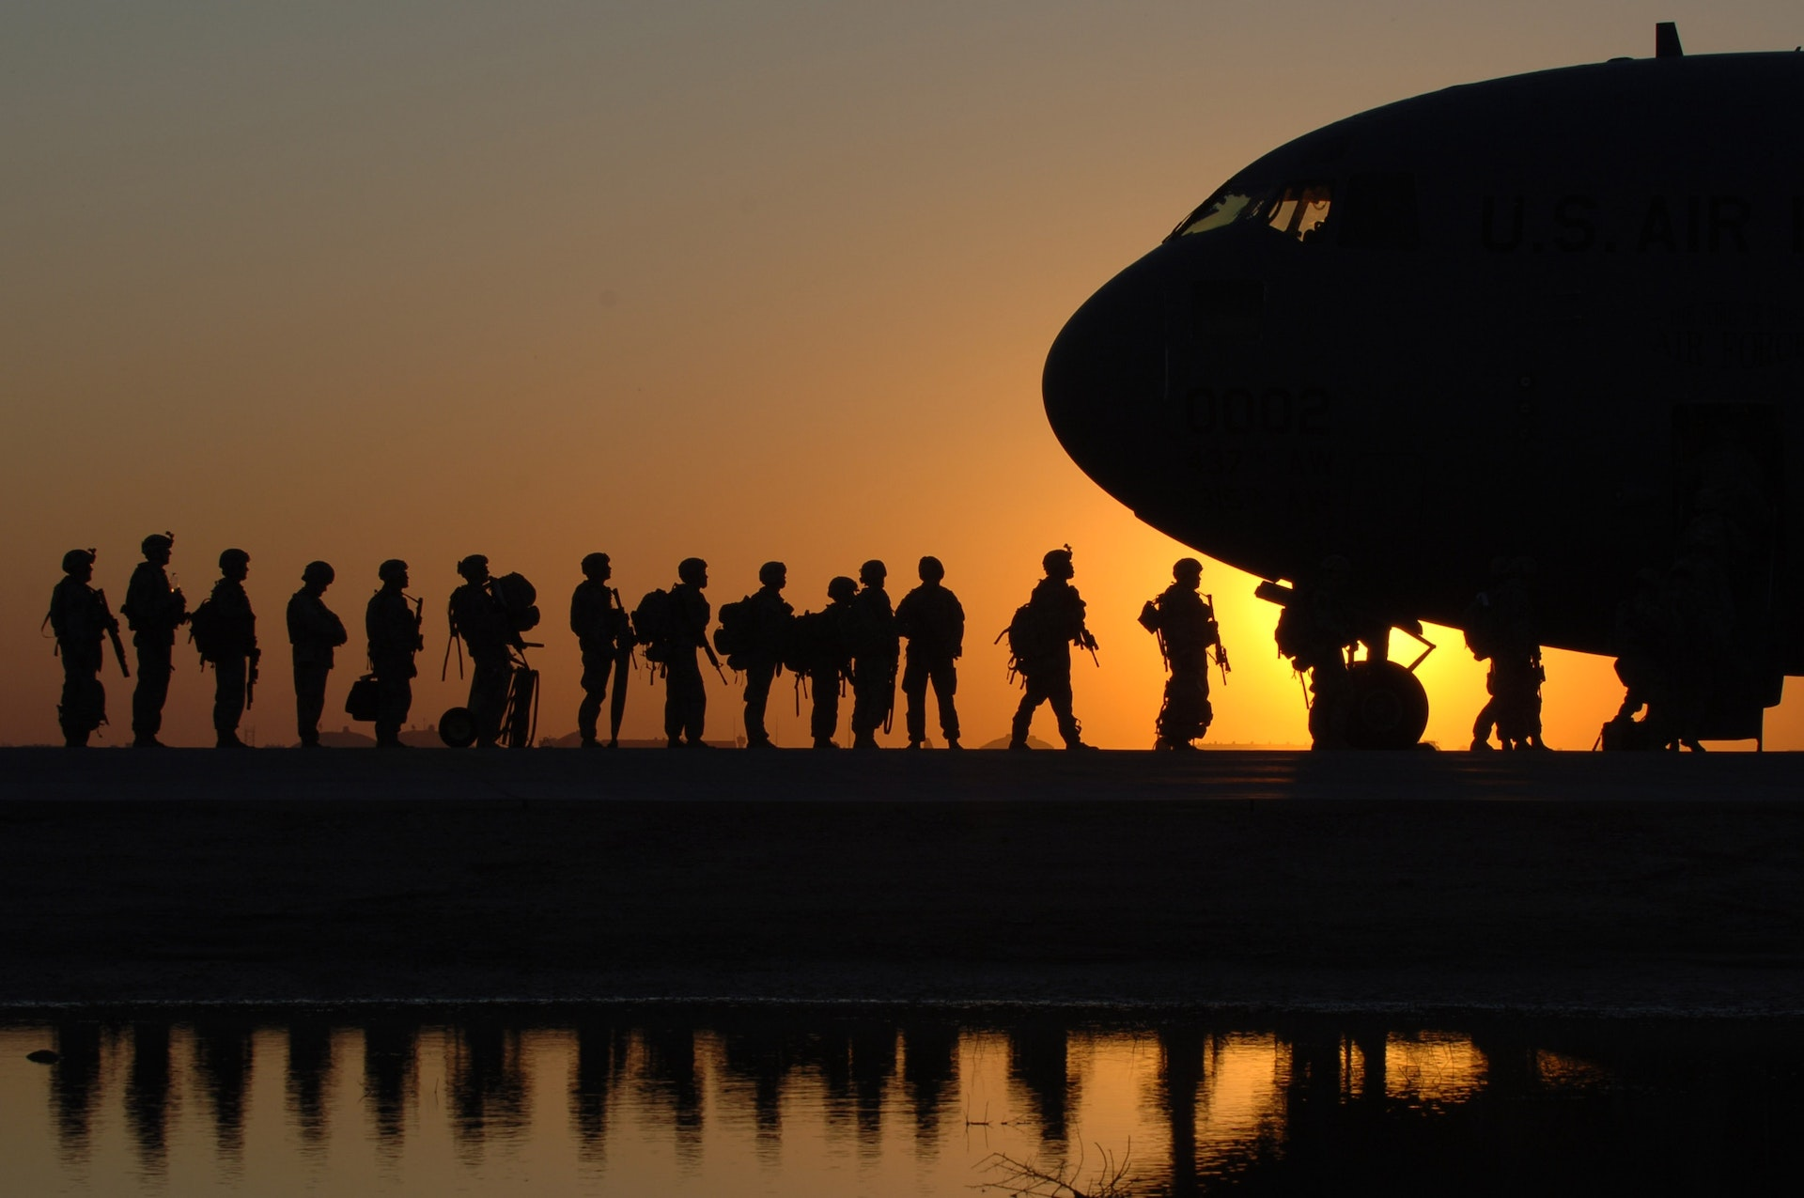
Evaluation of the NATO Innovation Hub´s critical thinking course: What are the course´s effects and influencing factors

Slide 3
Why Critical Thinking?
Cyber warfare
The cyberspace cognitive domain for controlling public opinion (Chen et al. 2022)
Increasing weaponization of social media
Information operations (Goel & Nussbaum, 2021)
Unrest & manipulate public´s opinion to influence elections
Asymmetric warfare
Requires efficient process information decision-making despite ambiguity and dynamic situational changes
Democratic Resilience

Slide 4
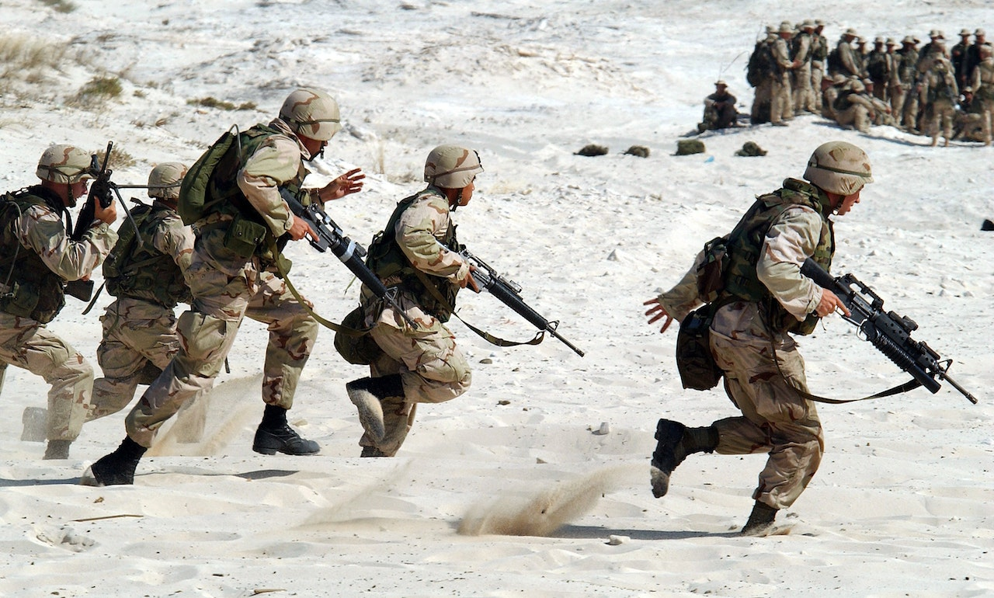
Critical Thinking – Definition
Definition of Critical Thinking (CT):
CT is the intellectually disciplined process of actively and skillfully conceptualizing, applying, analyzing, synthesizing, and/or evaluating information gained or generated through observation, experience, reflection, reasoning, or communication as a guide to belief and action.(Mandernach, 2006)
Improvement in CT addresses not „what to think“ but „how to think“
CT is the intellectually disciplined process of actively and skillfully conceptualizing, applying, analyzing, synthesizing, and/or evaluating information gained or generated through observation, experience, reflection, reasoning, or communication as a guide to belief and action.(Mandernach, 2006)
CT is the intellectually disciplined process of actively and skillfully conceptualizing, applying, analyzing, synthesizing, and/or evaluating information gained or generated through observation, experience, reflection, reasoning, or communication as a guide to belief and action.(Mandernach, 2006)

Slide 5
Critical Thinking – Strategic Role
NATO's Human Factors and Medicine Panel sees CT as necessary to ensure operational agility, adaptability, and multinational interoperability (Masakowski, 2022)
Former Supreme Allied Commander Transformation (SACT), General André Lanata, tasked the NATO Innovation Hub to develop a course to improve CT
We examined the “Critical Thinking Course” and it’s intervention´s effect

Slide 6
Hypotheses
H1: The CT course positively affects Critical Thinking ability.
H2: Participants who received the CT Course will outperform those who did not.
H3: The Influence of Residency, educational level, and military affiliation on CT ability.

Slide 7
The Critical Thinking Course
Course execution: 1 June 2022 and 1 July 2022
Five instructor-led sessions and a summary class
Weekly learning effort: 3 – 5 hours
Topics:
1.) Cognitive Bias and Decision-Making
2.) Cultural biases
3.) Logic and reasoning
4.) Improving Critical Thinking
5.) Data Analysis
Lesson materials:
Lecturer PowerPoint, videos, quizzes, assignments, and further ressources

Slide 8
Participants and Procedures
Sample
Intervention group: N = 40 participants (mean age = 35.57 years; male = 77.5%)
Control group: N = 45 participants (mean age of 34.26 years; male = 73.3%)
Measurement
Pre- and Post measurement
Online assessment consisted of the Selected Response Questions (SRQs) as a subtest of the Collegiate Learning Assessment (CLA+)
25 items in a multiple choice format (one or two documents to refer to when answering questions), with subsections:
Scientific and Quantitative Reasoning (SQR)
Critical Reading and Evaluation (CRE),
and Critiquing an Argument (CA);
Good overall reliability (α = .79)

Slide 9
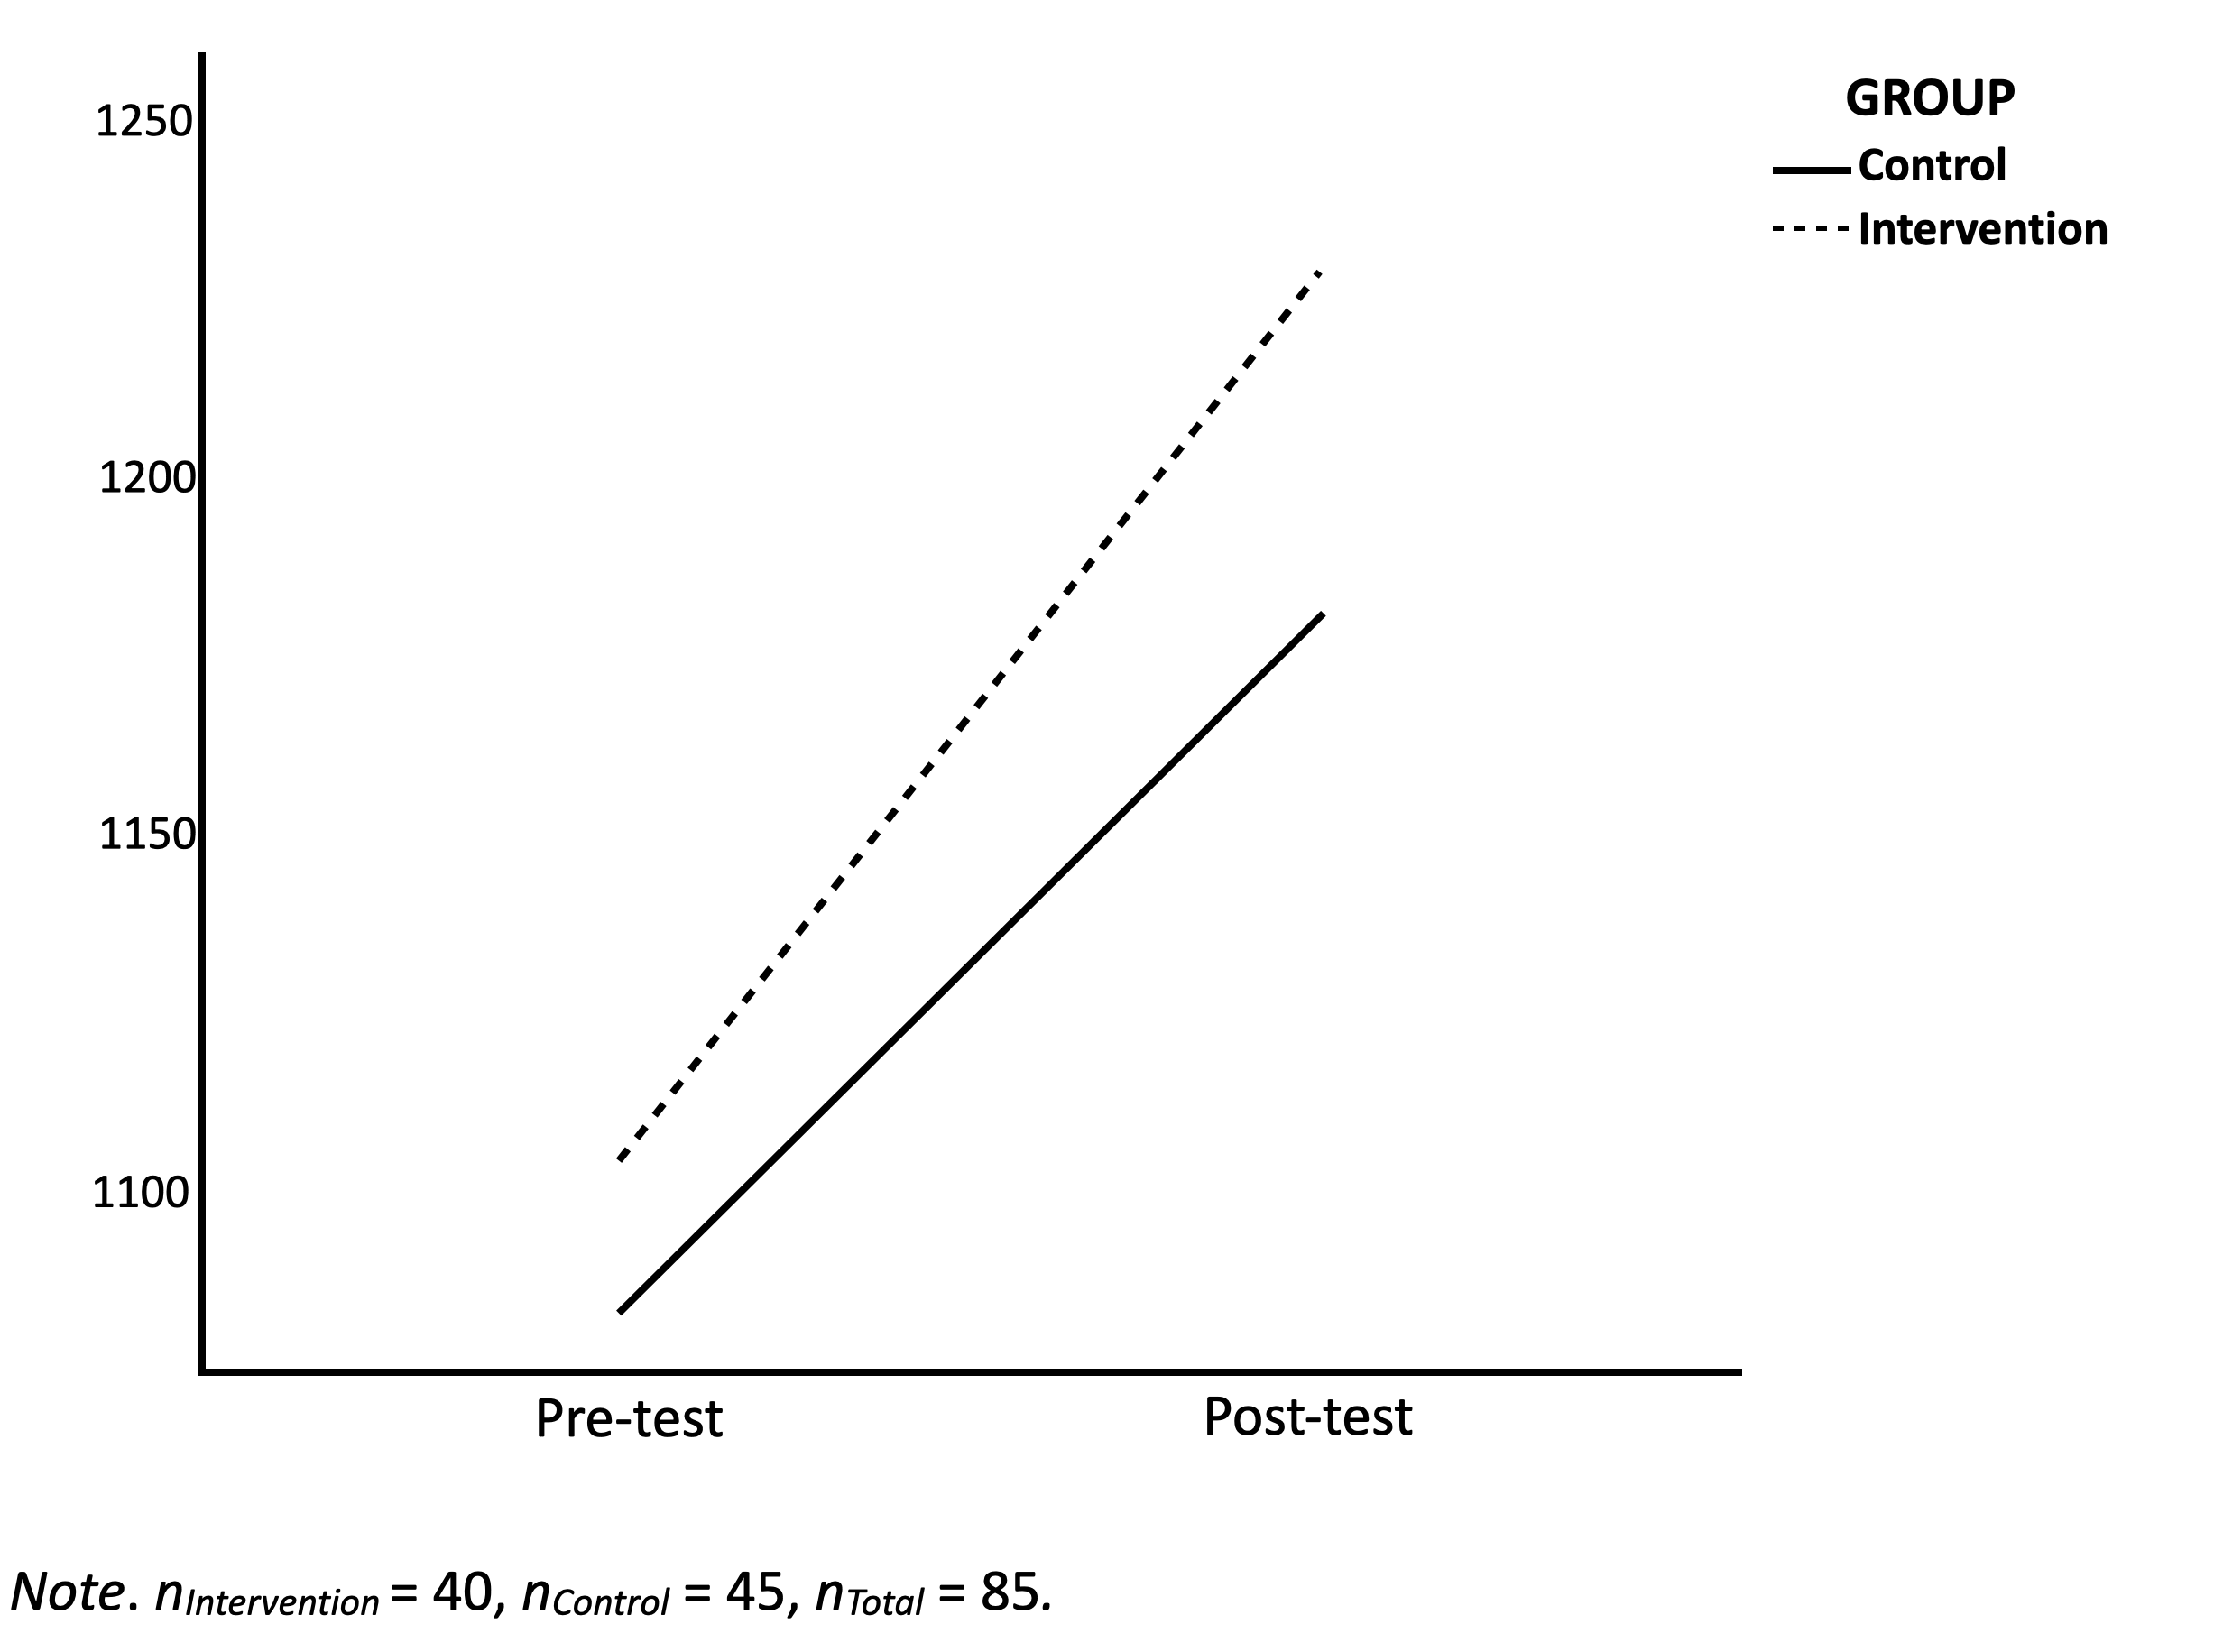
Results
H1: The CT course positively affects Critical Thinking ability.
The paired t-test indicates a significant improvement in CT after the intervention group completed the course, t(39) = –6.02, p < .001.
H2: Participants who received the CT Course will outperform those who did not.
No significant interaction between pre-test/ post-test (time) and group membership, F(1, 83) = 0.54, p = .463.
All participants improved in the pre-and post-test assessment regardless of group membership, (F(1, 83) = 36.47, p < .001).

Slide 10
Results
H3: The influence of residency, educational level, and military affiliation on CT ability.
Subjects from North America (M =1163.96, SD =225.07) scoring on average about 88 points higher in CT than subjects from other continents (M =1075.71, SD =176.68), t(120) = –2.13, p = .036.
No significant influence of:
Educational levels
Active military vs. civil person

Slide 11
Discussion
Limitations
Implications
The learning behavior could not be controlled for
External motivation of the intervention group (certificate)
The pre-test alone may have had an “intervention effect”
Repetitive effect between the pre-test and post-test
The CT ability is increasable
An interaction trend was indicated
Only residency in North America was an significant influencing factor on CT ability
By increasing the awareness of CT, militaries and societies could increase CT abilities to raise individual performance and democratic resilience at a system level

Slide 12
References
Chen, L., Chen, J., & Xia, C. (2022). Social network behavior and public opinion manipulation. Journal of Information Security and Applications, 64, 103060. https://doi.org/10.1016/j.jisa.2021.103060
Goel, S., & Nussbaum, B. (2021). Attribution Across Cyber Attack Types: Network Intrusions and Information Operations. IEEE Open Journal of the Communications Society, 2, 1082–1093. https://doi.org/10.1109/OJCOMS.2021.3074591
Mandernach, B. J. (2006). Thinking Critically about Critical Thinking: Integrating Online Tools to Promote Critical Thinking. InSight: A Journal of Scholarly Teaching, 1, 41–50. https://doi.org/10.46504/01200603ma
Masakowski, Y., R., Cognitive Bias and Decision-Making, NATO Innovation Hub, Norfolk, VA. March 07, 2022.
Van Den Bosch, K., Helsdingen, A., S., and De Beer, M., “Training Critical Thinking for Tactical Command,” TNO HUMAN FACTORS SOESTERBERG (NETHERLANDS), 2004.

Slide 13
Appendix

Slide 14
Critical Thinking – State of Research
Nomological Network:
Positive related to openness, metacognition, truth-seeking, need for cognition, analyticity, curiosity
Effects of CT training:
Positive effect on military leader´s process of tactical command (situational assessment) and on the outcomes (better contingency plans) (Van den Bosch et al., 2003)
Learnability:
Psychological research views CT and sub-skills (verbal reasoning, argument analysis, thinking as a hypothesis, decision making, problem-solving skills) as learnable

