Slide 1
Education of the military cadets during the COVID-19 pandemics - a short case study
1st Lt. Maciej Wielgosik MSc & MA, PHD Student
OCdt. Sgt. Eryk Marchlewski BSc, MSc Student
Military University of Technology, Warsaw, Poland
Notes:
Ladies and Gentlemen, we would like to extend a warm welcome to you and present a study on military education during the SARS-CoV-2 virus epidemic. We represent the Military University of Technology in Warsaw. At the same time, we would like to thank you for the opportunity to speak to such a noble group of scientists and present the results of our research and analyzes. The choice of the topic we represent is not accidental. I am an officer responsible for military discipline and social problems of the service. The appearance of the SARS-CoV-2 virus and the COVID-19 disease changed the way the economies of the world function and forced decision-makers to make decisions in the conditions of a knowledge deficit. Lack of knowledge about the nature of the threat, its spread, effects and the lack of proven methods and forms of treatment were attributes accompanying the initial period of the epidemic in the world. Each of us has specific memories and thoughts about that time. One of the social groups important from the point of view of the army are cadets who study in four military universities in Poland. The research and conclusions contained in this presentation were based on surveys conducted in a representative group of 388 cadets of the Military University of Technology.

Slide 2
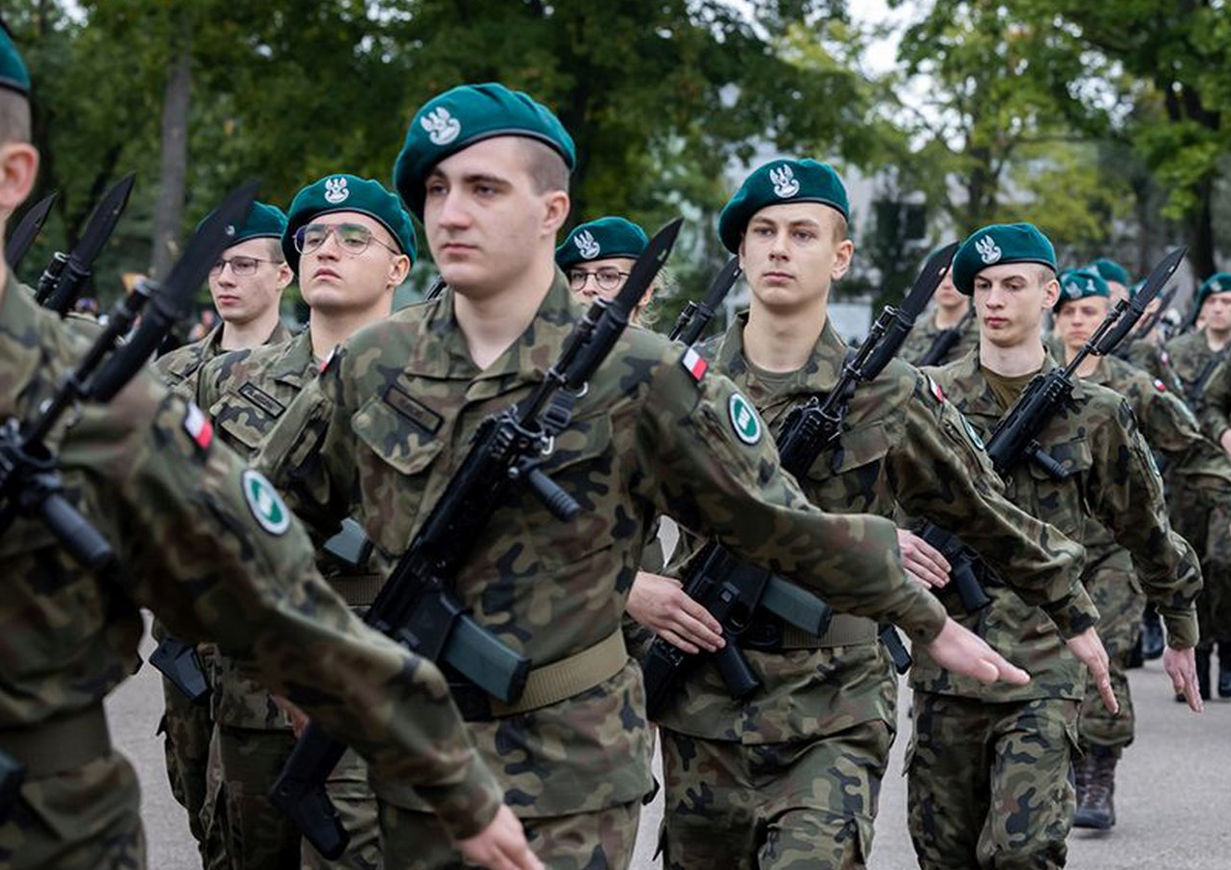
How did Covid-19 affect military education ?
(Positively?)
Notes:
In order to answer the question whether the SARS-CoV-2 virus and COVID-19 disease affected military education, it is necessary to go back to the very end of 2019. Nevertheless, it is worth noting that it is more appropriate to ask how, instead of whether it had such an impact at all. place. If we consider the areas of this impact, from our perspective, several areas should be identified that, in our opinion, have been particularly changed as a result of the pandemic.

Slide 3
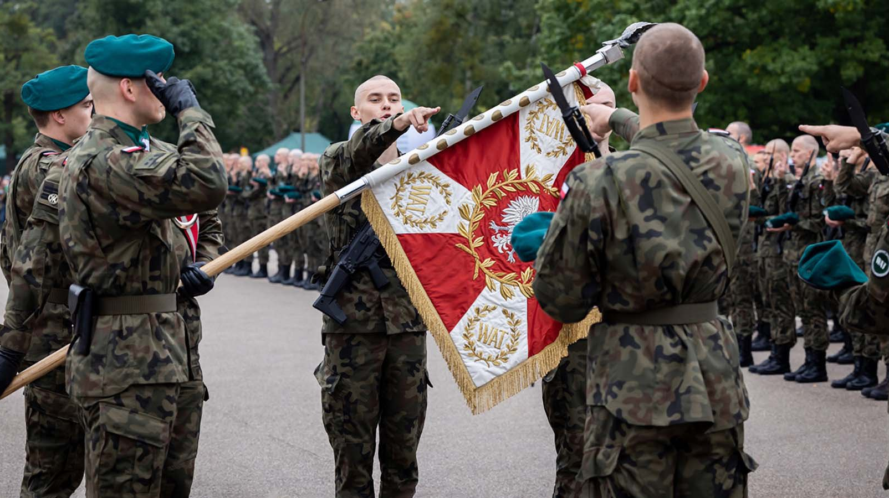
Education of the military in Poland
What does the life of cadets look like ?
Notes:
Before we talk about the impact of the epidemic on the functioning of military education, it is worth considering what the organization of military education looks like in different countries. Higher military education is responsible for the training of officers. It takes place at military universities with different legal statuses. From the first day at the premises of the university, a person who comes to study there obtains the title of officer cadet and acquires skills and knowledge through a wide field of study, as well as general military knowledge. An officer cadet's life within the university's walls is specific in that it resembles the functioning of soldiers on basic military service years ago.
Entering the premises of a military university means the obligation to undergo a particular education process. It lasts five years (except for the medical faculty, where the education lasts six years) and ends with the officer’s examination. This education requires certain sacrifices that were affected by the pandemic; the first concerns the fact that an officer cadet, during their education, cannot leave their designated accommodation without permission. This restriction is due to the increased requirements regarding the necessity to ensure the functioning of the military university as a regular military unit. Still, it also shapes the ability to submit to specific military rules and rigours. Failure to comply with this principle is a source of disciplinary liability. However, repeated rejection of these principles by an officer cadet may result in criminal liability for the officer cadet in question.

Slide 4
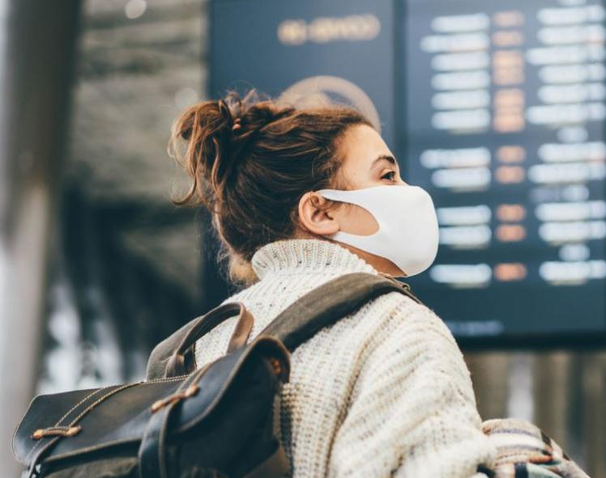
Stage I. How to fight sth unknown ?
„closing gates” – stress test for young people
Notes:
You probably remember that the beginnings of the pandemic were very mysterious and it was difficult to obtain reliable information about this threat. The lack of reliable information highlighted earlier also concerned the possibility of preparing the military education system to function during a pandemic.
It should be recognised that the pandemic was a specific, unplanned personality test for these young people in at least two aspects. First, the ability to function in a hierarchical organisation, and second, morale. The possibility of leaving the Academy was limited only to a few exceptional cases. At the same time, lectures and exercises were suspended, and later, remote forms of education were introduced.
the skills acquired by an officer cadet during the pandemic may prove invaluable because they add a value that cannot be deliberately communicated. This value is about unique social competences, shaping the awareness of responsibility for actions taken and creating the ethos of service in a harsh pandemic reality.

Slide 5
Stage II. Has cadet changed? OR sth has changed in military education system?
Notes:
Skills acquired by an officer cadet during the pandemic may prove invaluable because they add a value that cannot be deliberately communicated. This value is about unique social competences, shaping the awareness of responsibility for actions taken and creating the ethos of service in a harsh pandemic reality. Family, education, socialisation, discipline, morale, and military training are those areas that have been identified as the most significant in the functioning of young people as officer cadets from the perspective of their destiny as future commanders.

Slide 6
Chapter I. Family
Notes:
The family is the basic community. The ties formed with parents, siblings, and life partners determine the decisions made in education and work. A person strives to choose a direction of professional development that will enable them to meet the needs resulting from the hierarchy. The idea of the family and its influence on the service has often been manifested in the research conducted by sociologists. In the society and relationships that govern it, however, there is an equivalent to Newton's Third Law of Motion. Service potentially gives something to the family but also limits the soldier's relationship with their family to some extent.[8] This is evident in young officers' education, as officer cadets' requirements are even more significant than those for other soldiers.
Military socialisation that takes place among newly incorporated soldiers cannot wholly replace the relationship with the family. Hence a kind of struggle for a soldier between the family and the service emerges. The emergence of the SARS-CoV-2 virus was accompanied by the lack of reliable methods for preventing its spread. Due to the real threat of the virus spread among the large community of officer cadets, the lack of aforementioned methods, and the need for epidemiological protection at the academy, it was necessary to keep officer cadets in their place of accommodation
Officer cadets could not be sent home due to the risk of the potential infection of their family members and the possible transmission of the virus from the outside during the officer cadets' return to the Academy. According to the research conducted by the authors, such forced separation from families had negative consequences in the opinion of officer cadets. First of all, there was no reliable information about the duration of the period with no possibility of leaving the Academy. Unfortunately, no one could provide such information because, in the initial phase of the epidemic, the pathways of spreading the virus or the health effects it caused were unknown.

Slide 7
Chapter I. Family
Notes:
The above slide shows the time spent in a row by cadets at the university and in connection with the performance of official duties related to counteracting COVID-19. During this time, they could not leave the academy and did not see their families. The vast majority have not seen their families for a month to six months.
The research shows that the vast majority of officer cadets declared that the restriction of the freedom to leave the Academy significantly impacted their family life. However, taking into consideration the nature of the SARS-CoV-2 virus threat, this action was a necessity. In some extreme cases, certain officer cadets considered leaving the army due to changes in the organisation of the university's functioning during the pandemic.

Slide 8
Chapter II. Education
Notes:
Since March 2020, it has become necessary to adapt the rules, forms, and education methods to correspond to the requirements posed by the state of a pandemic threat and, later, the pandemic. For example, civilian polytechnic students started to implement distance learning. Since military students attend some general polytechnic subjects together with civilian students and organisers of polytechnic education are faculties, military students also receive distance learning. Opinions in this respect, however, are strongly divided, depending on the field of study and the dominant form of teaching (lectures, classes, laboratories).
Most military students found remote courses to be a suitable alternative to classroom lectures. In the research, over 42.27% of officer cadets (N = 388) stated that such education was effective, and 21.40% had no opinion. 36.34% of officer cadets did not consider such education to be effective. There are several reasons for this fact. First, to participate in a course in a remote form, there is no need to go to the lecture hall. The growing number of students with limited housing space may cause a reduction in the quality of reception of the content conveyed in such conditions. Hence allowing the student to choose where s/he participates in classes seems to be an exceptionally satisfactory solution to this problem. Many lecturers organised classes using e-learning platforms, enabling the recording of lectures with the possibility of later reproduction. This provided an opportunity for those students who wanted to re-research the content presented. This solution also gave a chance to those who could not attend lectures for several reasons. Online learning for officer cadets also resulted from the decision of the Academy's authorities, and the positive aspects of distance learning may be used in the post-pandemic future.
It should also be noted that the implementation of remote classes and the idea of recording allows students to familiarise themselves with the presented material later and thus enable absent officer cadets to obtain missing knowledge. It is also worth mentioning that sometimes the conditions of acquiring knowledge by students, and more precisely, the place in which it takes place, determine the success of this process. Many students found it much easier to read the course material in the comfort of their rooms.
61.86% of the surveyed officer cadets (N = 388) stated that they had become so used to the organisation of remote activities that it would be difficult for them to return to those carried out traditionally. 23.97% of the officer cadets stated that they got used to the remote classes, but they would prefer to return to those carried out stationary, and only 14.17% of the officer cadets did not have an opinion in this regard.

Slide 9
Chapter II. Education
Effectiveness of conducting various forms of remote classes on a scale from 1 to 5 (where 1 is the worst and 5 is the best)
Notes:
The respondents assessing the effectiveness of conducting various forms of remote classes on a scale from 1 to 5 (where 1 is the worst and 5 is the best) gave an average mark of 3.81 for lectures, 2.65 for exercises, and 2.05 for laboratories

Slide 10
Chapter II. Education
Notes:
Importantly, 68.30% of officer cadets agreed with the statement that one of the effects of the epidemic is an increase in their efficiency. The use of remote learning in the case of exercises and laboratories did not fully achieve the intended educational goals. Interviews with students conducted as part of the research show that problems related to the workshops appeared in solving complex mathematical problems, requiring discussion of individual stages of the task.
The use of remote learning in the case of exercises and laboratories did not fully achieve the intended educational goals. Interviews with students conducted as part of the research show that problems related to the workshops appeared in solving complex mathematical problems, requiring discussion of individual stages of the task.[13] The inability to obtain quick answers from students led to the verification of whether the result obtained by the student was the same as that resulting from the model solution of the task.
In the case of laboratory classes, the problem was even more complex. Laboratory work requires acquiring theoretical knowledge in the field of problem-solving in a practical manner using materials, tools, and techniques gathered in a specific laboratory. Here, indicating only one adopted solution to the problem is impossible. Some lecturers provided students with a recording of conducting measurements with devices available in the laboratory and the input data necessary to prepare the reports. Thus, they made the test results available that the students would obtain by adequately using their knowledge and skills while operating the device. Others tried to divide training groups into smaller ones, enabling students to make measurements on their own.

Slide 11
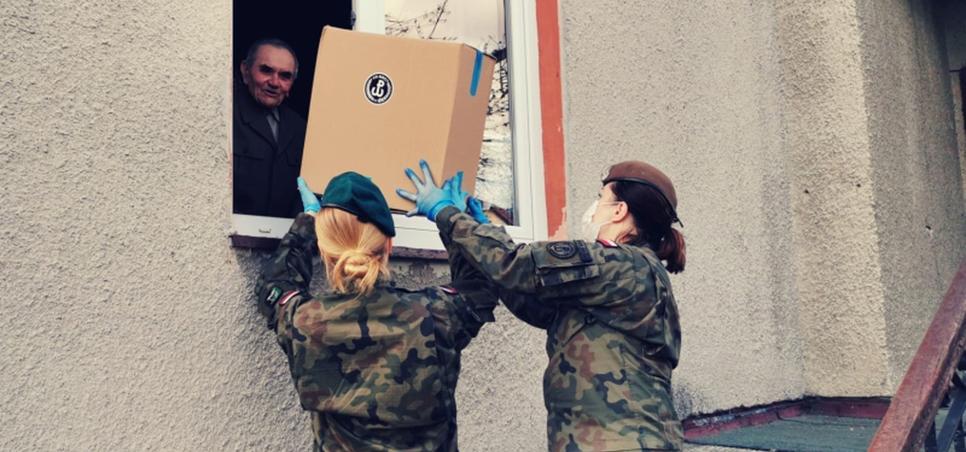
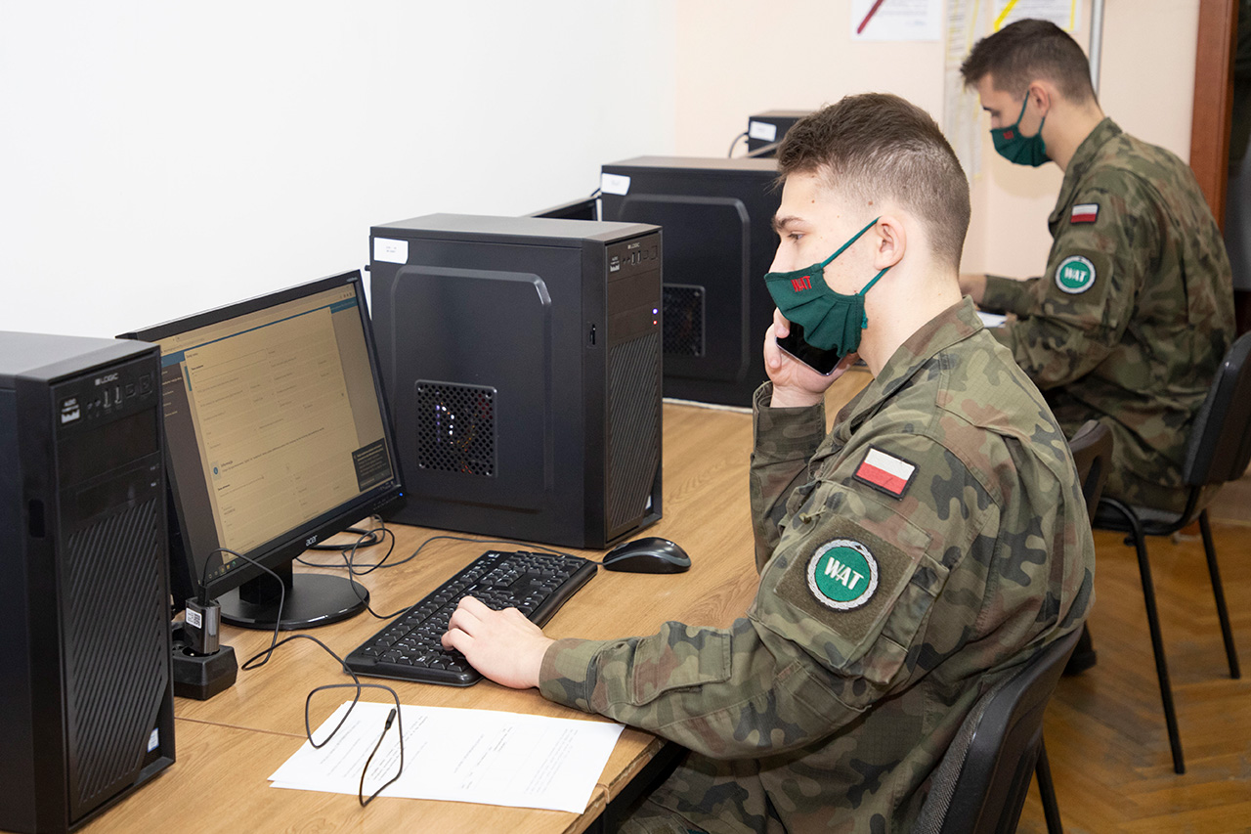
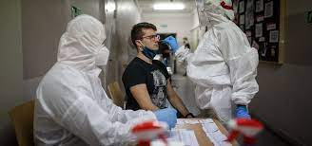
Chapter III. Mil Education - practice
Notes:
Military education involves two stages. The first stage is the adaptation stage, i.e., basic training. During this period, basic military knowledge is transferred, and the character traits desired from a soldier are formed. After completing this stage, military education moves to the second stage - classes done over five years of study. During this time, officer cadets gain technical education and specialist military knowledge, as well as social and command competences, which varies depending on the faculty they study. The literature states that the goal of this stage is to endow individuals with the skills necessary to function in the profession as highly qualified soldiers and thus shape their social values, character traits, and commitment.
During the pandemic, it became necessary to introduce new methods and forms of class organisation that would enable commanders to pass on vital military knowledge. Besides the broader emphasis on using laser simulators in the classes, military training was implemented without significant changes for the soldiers.
The officer cadets from MUT were assigned to support the activities of the Territorial Defense Forces throughout the country during the period of the greatest epidemic threat in Poland. In everyday military training in times of peace, a soldier may overlook the need to help or to devote themselves to service matters beyond the expected level. In short, routine limits empathy in some way. The performance of official tasks for the community allowed the service personnel to find a sense thanks to the fact that their work is recognised, and they noticed its positive effects.
The Military University of Technology officer cadets were responsible in the Territorial Defence Brigades for managing logistic support, completing supplies, and physically delivering food and necessities to residents who could not reach the stores due to quarantine or other reasons. In addition, they supervised the functioning of the aid notification system and, thus, were responsible for gathering information on the needs and taking them into account in the supply plans of Territorial Defence units. As time went by, it also became necessary to perform tasks related to the control of people under isolation or in quarantine at their place of residence. At that time, soldiers helped police officers and controlled the isolation process. Soldiers from the Military University of Technology also developed a mobile application supporting the process of reporting the needs of people staying due to quarantine at their residences and aggregating this information to local crisis management centres. Knowledge in this area was divided into areas of responsibility of respective sub-divisions, and the expected products were delivered to the inhabitants. It is also worth mentioning the soldiers' involvement in conducting epidemiological interviews. At the university headquarters, soldiers obtained information from patients about their health conditions and people in contact with them who could become ill. The implementation of epidemiological interviews greatly supported the sanitary services due to their previous inefficiency.

Slide 12
Chapter III. Mil Education - practice
Notes:
Therefore, attention should be paid to two aspects that have changed in military education during the pandemic; the first concerns a significant deterioration in the possibility of conducting military training due to pandemic restrictions. The number of military classes has decreased, and the possibility of providing specialist training outside the university has been limited. On the other hand, there was an underestimated and unnoticed possibility of developing officer cadets in the area of ​​functioning as part of crisis response, checking their skills in the process of command, and helping citizens. In a subjective opinion, such a value may make soldiers involved in anti-pandemic activities better perform their tasks in the future because, during this time, they saw the meaning of the actions taken.
The research showed that 66.24% of the surveyed officer cadets believed that the practice of their cooperation in hazardous situations allowed them to build better group relationships and esprit de corps. Furthermore, 41.23% of the respondents indicated that one of the most significant positive outcomes of the pandemic was the possibility of acquiring knowledge and competences that were not given due attention previously.
In individual conversations conducted by the authors as part of the research (May 2022) of officer cadets performing functions in the Territorial Defense Brigades in the area of crisis response, there were often statements that even the initial reluctance to perform tasks away from the university in an unfamiliar environment changed when the soldiers tangibly saw the result of their actions, for instance: the food provided, the residents looked after, and the word thank you built an atmosphere of a well-fulfilled duty

Slide 13
Chapter IV. Morale
“In military affairs the strength of an army is the product of its mass and some unknown X”
“That unknown quantity is the spirit of the army, that is to say, the greater or lesser readiness to fight and face danger felt by all the men composing an army, quite independently of whether they are, or are not, fighting under the command of a genius, in two—or three-line formation, with cudgels or with rifles that repeat thirty times a minute.”
Notes:
There is no single definition of morale. Esprit de corps is sometimes called institutional belief, but looking at morale from a unique perspective is better. Leo Tolstoy wrote in War and Peace, “In military affairs the strength of an army is the product of its mass and some unknown x”. Historical experience indicated by Tolstoy shows that the quantity of an army does not necessarily correspond to its strength
Tolstoy also points out that such success of potentially smaller forces is sought in technical superiority, field conditions, or the genius of commanders. Behind such events is an unknown factor X
What is important is that morale may be dependand on both conscious and unconscious actions.

Slide 14
Chapter IV. Morale
Notes:
73.71% of the respondents indicated that they were aware that such a situation might occur in which they would have to risk their lives and health while fighting the epidemic. Therefore, declared awareness of the role played by the military during the pandemic was high
In the authors' opinion, if we recognise a belief in the organisation as morale, this area was also positively influenced because, as declared by 47.68% of respondents, their trust in their colleagues increased. However, ​​morale creates a system of vessels connected with others.
In the authors' opinion, if we recognise a belief in the organisation as morale, this area was also positively influenced because, as declared by 47.68% of respondents, their trust in their colleagues increased. However, ​​morale creates a system of vessels connected with others. Despite the noticeable increase in mental involvement of officer cadets in the military service due to the pandemic, morale was also affected negatively due to imposed restrictions.
However, it is impossible not to notice opinions that express dissatisfaction with this state of affairs. The fact is that the way officer cadets leave the commander of the unit regulates their accommodation. They might feel they have been treated differently from the professional staff who left their place of service every day and went to their families and homes. Suppose we point to people with more rights or freedom functioning in the environment of people whose equal rights or liberties have been restricted. In that case, it could be indicated that this situation is a source of antagonism between them. University authorities noticed such a situation in due time, and staff up to and including company commanders was barracked together with the officer cadets. Thanks to this decision, the officer cadets could see that they were not treated worse or better than the professional staff. From the perspective of participatory observation, the time spent with other officer cadets should be considered the most morally elevating for young soldiers. It was the first time that they had the opportunity to be with their supervisor for such a long time without interruption. The officer cadets' opinions gathered in the interviews conducted by the authors showed that they recognised their superiors as equals. Their only differences were the military rank and the scope of responsibility for the decisions made. There was also mutual respect associated with sharing the hardships of isolation, which contributed to the rise of authority

Slide 15
STAGE II. COVID conclusions. SUMMARY
POPULARISATION OF DISTANCE EDUCATION
BOOST IN SOCIAL COMPETENCIES & EMPATHY AMONG OFFICER CADETS
DESPITE THE PROBLEMS OF AN ORGANIZATIONAL NATURE, IT WAS POSSIBLE TO ACHIEVE THE GOALS OF OFFICER CADETS’ TRAINING
MILITARY STUDIES WILL BE DIFFERENT IN POSTPANDEMIC REALITY THAN THEY WERE BEFORE
Notes:
The COVID-19 pandemic posed a considerable challenge to military education in Poland. However, conclusions must be drawn from this experience. Some of the after-effects of military socialisation, morale, or military education will remain in the education system for long periods. It is worth emphasising the positive aspects of the range of the abovementioned changes. The popularisation of distance education or the increase in social competencies and, thus, also empathy among soldiers are just some of the positive elements brought about by the pandemic.
The case of military education during the pandemic shows that despite the disruptions, a difficult pandemic situation, and changing legal and organisational solutions, it is possible to achieve most of its primary goals, i.e., educate future officers. Educating these personnel has changed its vector over time due to the pandemic, but these positive areas are worth highlighting. Military studies at the time of the pandemic underwent much change. It should be recognised as a kind of compromise that, after the pandemic, military studies will be different from before. At the same time, the educational process will continue to achieve the goal of educating the armed forces personnel.

