Slide 1
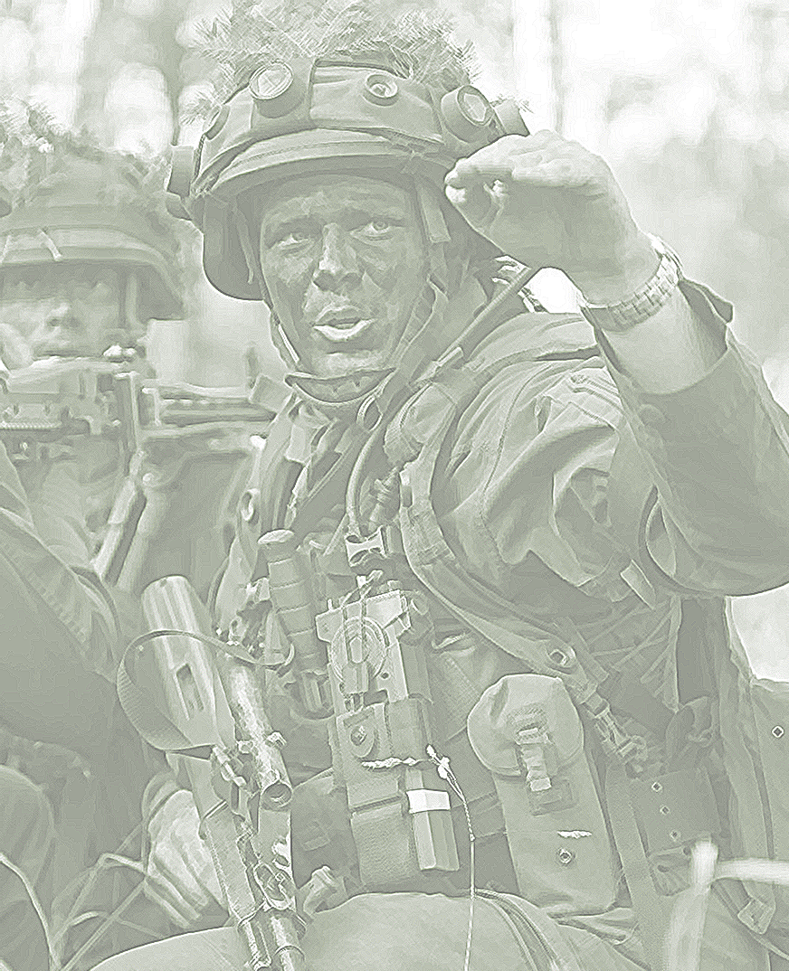
2022

Slide 2
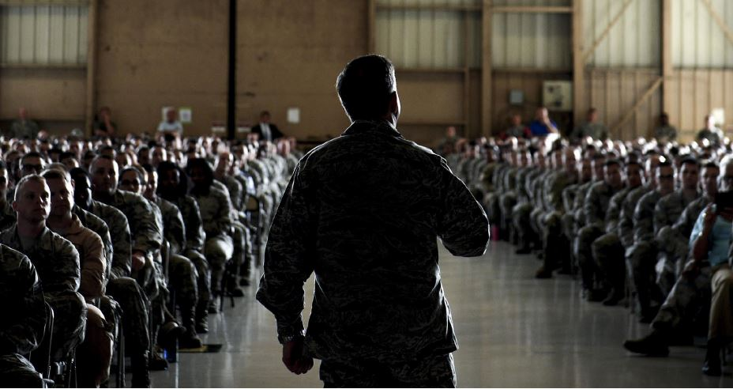
Leadership of the New Military Generations. Premises and Predictions

Slide 3
AGENDA
Main Ideas Addressed in the Article
The VUCA Environment – a Different Framework for Military Personnel and Leaders
The Transition Between Generations
Needs, Requirements and Perspectives
Final Conclusions

Slide 4
Main Ideas Addressed in the Article

Slide 5
How to understand contemporary challenges’ impact on modern military leadership?
TECHNOLOGY
VUCA
Z GENERATION
Military organization
HR department

Slide 6
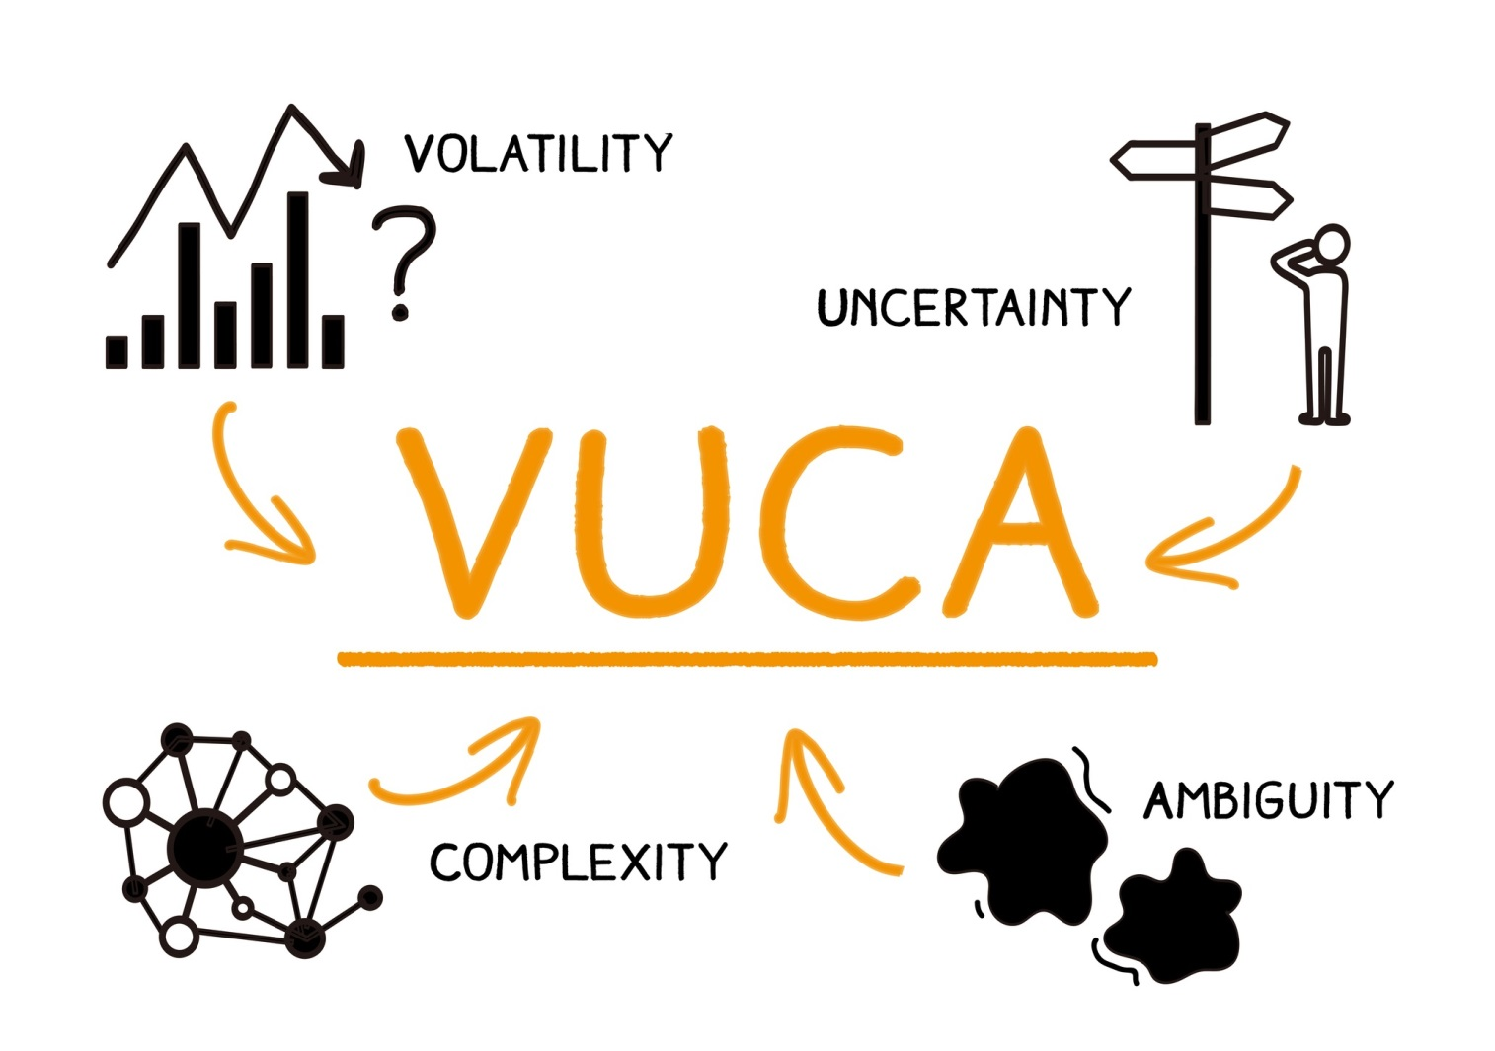
VUCA on the Military Organization Routine and its Components

Slide 7
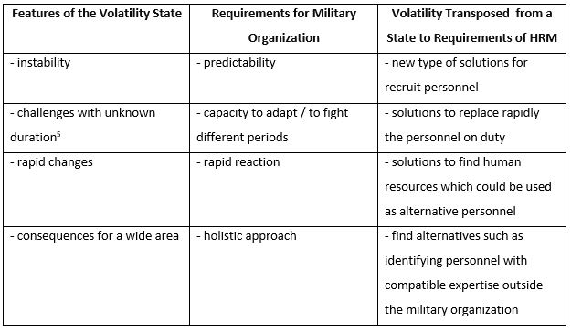
The Features of Volatility represent Demands for the Military Organization

Slide 8
What we found ?
The VUCA environment asks for action

Slide 9
The Transition Between Generations
Generations are clearly identifiable from different values, particularly learning styles, and effective leadership principal to behave and approach professional responsibilities.

Slide 10
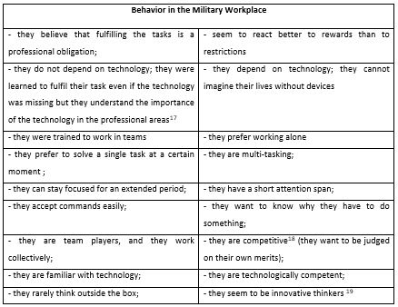
Differences between Generations

Slide 11
Needs, Requirements and Perspectives
The potential of ”digital natives” should be capitalized properly.
It has to be taken into account that we will have a mixture of generations in the military for the next years.

Slide 12
Perhaps the most important resource of the organization, the human capital is a factor we cannot neglect in forming the Z Generation personnel as their own rights, a big undertaking taking into consideration the contemporary financial, industrial, and security situations we live in today.

