Slide 1
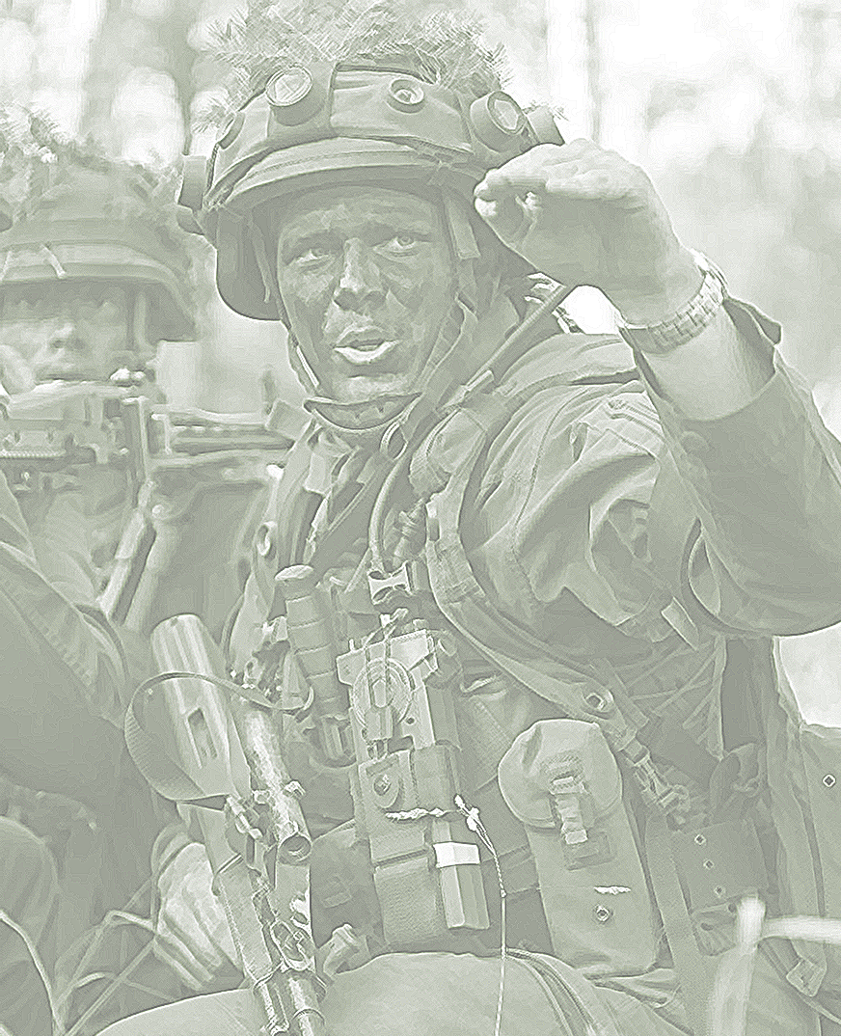


2022
Levelling of the NVNA Cadet’s Curriculum using the SQF MILOF Assoc. Prof. Capt (N) Nedko Dimitrov, PhD – Nikola Vaptsarov Naval Academy, BUL

Slide 2
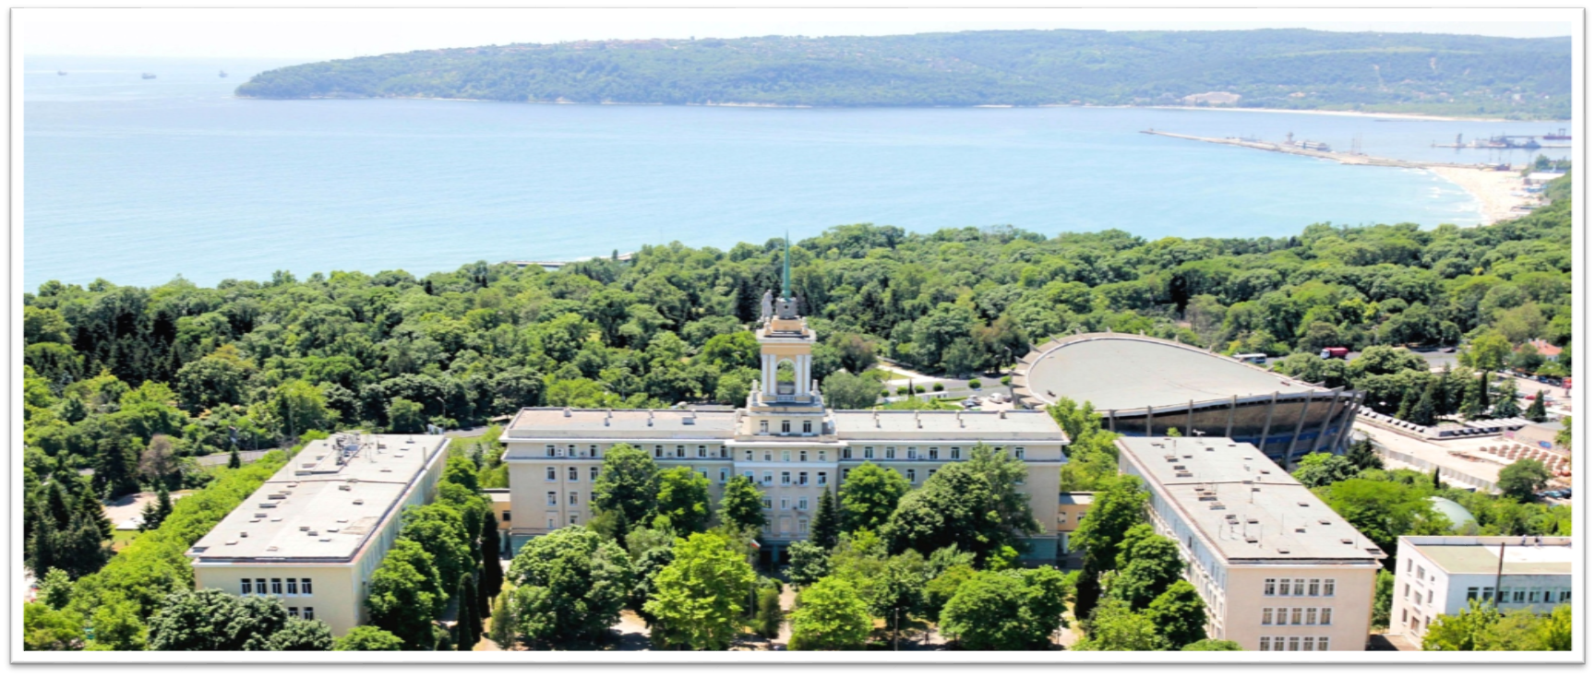
Who is who?
NVNA – Varna, BUL

Slide 3
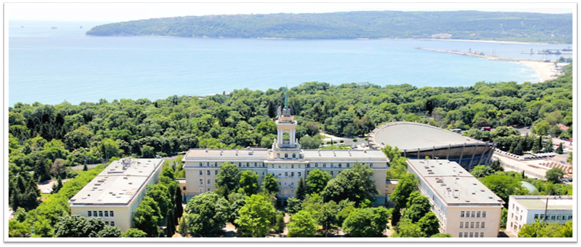
Who is who?
NVNA – Varna, BUL

Slide 4
Who is who?
NVNA – Varna, BUL

Slide 5
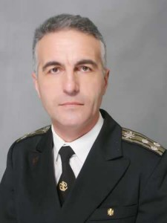
Who is who?
Capt (N) Nedko Dimitrov, PhD
Assoc. Prof. at NVNA;
Dean of the Faculty of Navigation;
Area of interests:
Critical infrastructure protction
National security
Methodology of education and training

Slide 6
Why?
Responsibilities of the position
New developments – new challenges
Competetiveness of the NVNA curriculums

Slide 7
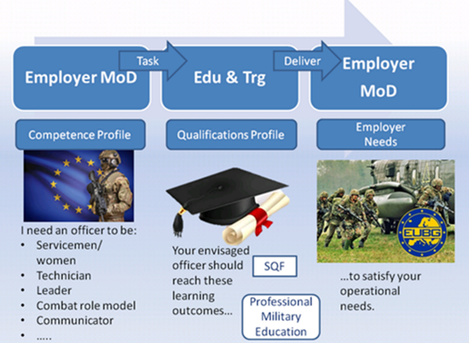
SQF-MILOF-Need and Development
SQF-MILOF – requested by EUMC
SQF-MILOF is:
operationally relevant
learning relevant
EU relevant
nationally relevant

Slide 8
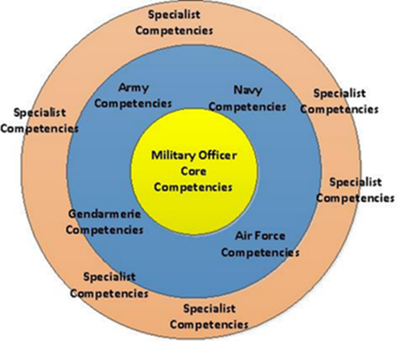
SQF-MILOF-Need and Development
Competence areas:
core competence areas:
Military service member;
Military technician;
Leader and Decision-Maker, and
Combat-Ready Role Model;
transversal competencies:
Communicator;
Learner and Teacher/Coach;
Critical Thinker and Researcher, and
International Security/Diplomacy.

Slide 9
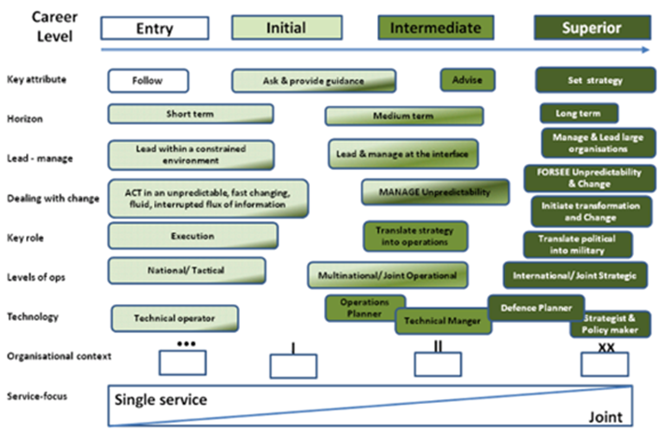
SQF-MILOF-Need and Development
levels of complexity:
Level 1 (equivalent to EQF 5);
……
Level 4 (equivalent to EQF 8).
focus on mil. organizational architecture/operations:
Single arm/branch;
Single service;
Joint/multiple services, and
Political/Civil-Military.

Slide 10
SQF-MILOF-Need and Development
05. MILOF-CORE
04. SQF-MILOF Proper

Slide 11
BUL Qualif. Requirements
NVNA cadet‘s curriculum:
4200 AH; 240 ECTS
NQF6 (equivalent to EQF6)
Thematic areas:
Basic military training;
General military training;
Special military training;
National security, resource management, and fundamentals of law
Academic practice and internship; and
Language, leadership, and physical training

Slide 12
Methodology of Assessment
Aim - to verify the extent to which the learning outcomes described in the SQF-MILOF can be used to assign an SQF-MILOF level and define a military focus for NMQ
Process of Validation:
Identifying the NMQ and its constituent elements;
Identifying NMQs’ KLOs in the core competence areas;
Matching the NMQ’s KLOs with the MILOF-CORE;
Determining the SQF-MILOF level of the NMQ
Determining the military focus of the NMQ

Slide 13
Assessment Results
Identifying NMQs’ KLOs

Slide 14
Assessment Results
Matching the NMQ’s KLOs with the MILOF-CORE

Slide 15
Assessment Results
Determining the SQF-MILOF level of the NMQ
Determining the military focus of the NMQ

Slide 16
Challenges
• To consider each the 91 constituent element of the NVNA qualification requirements;
• In regrouping the constituent elements from national thematic grouping to the eight competence areas defined in SQF-MILOF;
• How to summarize the learning outcomes with equivalent or similar ideas in every one of the competence areas while keeping the essence;
• Matching the NMQ’s KLOs with the content of one huge table (MILOF-CORE) in order to identify the best fits

Slide 17
Conclusion
The informal validation of the SQF-MILOF is successful.
That is, the defined SQF-MILOF Level 2 equals Bulgarian NQF Level 6. Notably, as the NQF is in full compliance with EQF, it can be concluded that– SQF-MILOF Level 2 is equivalent to EQF Level 6 (that was а supposition when developing SQF-MILOF).
Such an validation shall be performed at Master level
The EU community benefit of the implementation of SQF-MILOF

Slide 18
2022
THANKS FOR YOUR ATTENTION Assoc. Prof. Capt (N) Nedko Dimitrov, PhD – n.dimitrov@nvna.eu

