Slide 1
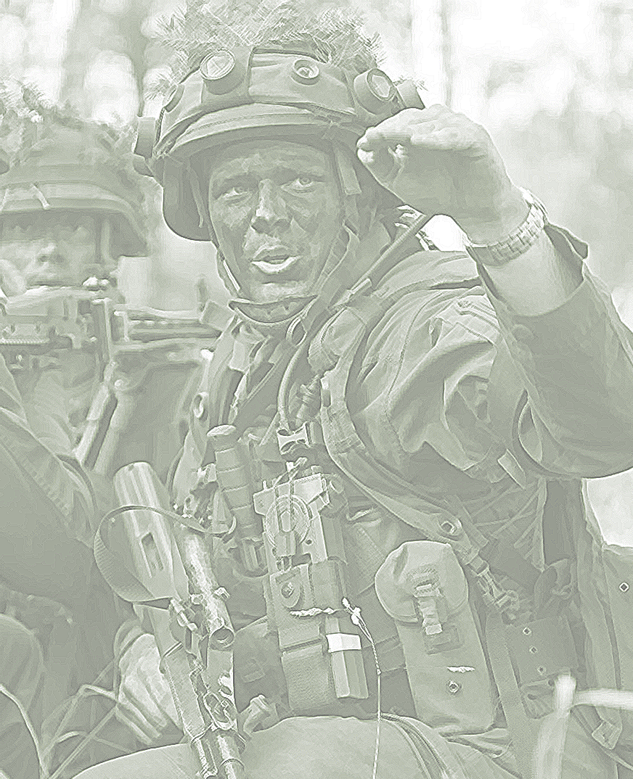



2022
Notes:
Generals, Ladies and Gents!
The Art of Leadership will more and more be driven by information.
But some basics and specially the “Last Mile” will never change.

Slide 2
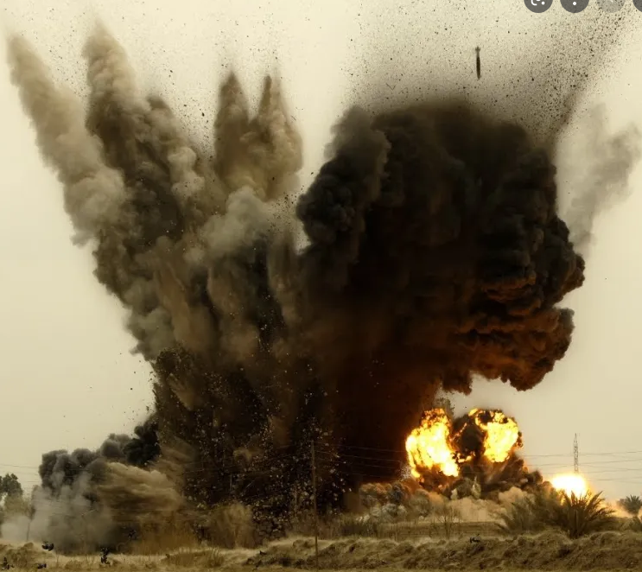
THE LAST MILE-THE FIRST MILE from Coy to Soldier
If you lose the fight at the frontline you lose the war.
If you win the fight at the frontline you may win the war.
„Battle Zone“
Notes:
There are a some titles of my presentation with the same focus.
May be, that nations have a different item for this area but I hope you can accept this thesis.
I also hope this thesis stresses the importance of the ideas of my presentation.

Slide 3
Agenda
Tasks in Asymmetric War
Requirements ICT?
What to do?
Status of COMSys AAF
Notes:
The very short bullets of my presentation are:
..
And if I will have time enough I will brief you about the status of COMSys AAF.

Slide 4
Mission Typs and Tasks
CD Collective Defense
CT Counter Terrorism
PM Peacemaking
SHA Support to Humanitarian Assistance
SCA Military Aid Support to Civil Authorities
PE Peace Enforcement
PB Peacebuilding
NEO Support of Non-Combatant Evacuation Operations
Notes:
Let`s have a look to missions and tasks using the C3 taxonomy.

Slide 5
Mission Typs and Tasks
ESE Enforcement of Sanctions and Embargoes
COIN Counter Insurgency
PK Peacekeeping
CP Conflict Prevention
DR Support to Disaster Relief
EOP Extraction Operations
Adversaries will leverage various technologies to blur the distinction between war and peace, conflict and competition
Notes:
All these tasks must be executed from the soldiers at the last mile.
All these tasks must be done under different conditions and one of this is expressed in the red sentence.
So the fog of war will be also a fog of legalization of military actions.
You can see this in a very special appearance in UKRAINE till 2014.

Slide 6
Notes:
In this slide I want to express the different ICT-threats in all this tasks I mentioned before.
The idea is to get an overview about the environment where the ICT-equipment is deployed.
Hostile EME Electromagnetic environment expresses that the enemy is capable of jamming.
Hostile ES Electromagnetic surveillance expresses that every use of the spectrum will be under surveillance.
BT-Control indicates that if you need a Base-Station for your Communication Net this might be attacked.
CCS-Control indicates that if your communication system has a Central Control Station this Station might be attacked.
ICT-Energy should put the finger on the threat to block or destroy the energy supply of elements of your communication system
ICT-Infra indicates the threat if your communication system of the last mile is dependent on ICT-Infrastructure.
It`s a little bit a “Systems Warfare Concept Analyses” of the ICT-System of the battle zone.
You can also say the tactical ICT-threats analyses of last mile with the aim of disorganization of command and control.
Let me say that this is my personal point of view with an Austrian background.
So every nation and let me say even before training and deployment you should make an evaluation of the threats.
SHA Support to Humanitarian Assistance
You can see that most of the time we operate under red condition`s!

Slide 7
Conclusion No.1
There is no Mission Type and Task were you should be depending on centralized or civilian ICT-Infrastructure and civilian communication equipment.
Electronic Surveillance is a permanent condition during all Mission Types and Tasks.
Notes:
Because of the number of red fields of the table the conclusion No.1 is:
.
.
To use civilian com`s is a little bit suicide !
Civilian Com`s is an excellent RECCE environment !

Slide 8
Development until 2022
Different tasks – multi use of LAST MILE Troops
Table of organization and equipment - Task organization for combat
Commanding officer – expert specialist (competence for tasks)
Management of new assets (drones, sensors, ..)
Notes:
Let`s have a look to the development until 2022.
Because of the different tasks we have to use the last mile troops under different conditions.
The table of organization and equipment must always be adapted to a task orientated organization.
It may also happen that the commanding officer must be an expert for one of this tasks and so it can happen that even the squad organization will be changed.
And most of the time you have to integrate new assets like drones and sensors in your plan of action.

Slide 9
Leading-edge technologies
Artificial intelligence
Autonomy in Systems
Quantum information sciences
Next Generation communications 7G
Biotechnology
Hypersonic and supersonic missiles
Advanced long range precision fires
Directed energy weapons
Cyber and electronic warfare tools
Notes:
In addition and with a strong focus on the leading-edge technologies we can see an ongoing speed up of development in this area.
.
The last years development are the starting point of an evolution.
These technologies will have a great influence to the future battle zone.
The combination of for example electronic warfare and directed energy weapons could be a extreme future threat for the ICT user in the last mile.

Slide 10
Forge the Future-
Trends may break
Climatic Environmental Change
Shifting Energy Markets
Demographic Changes
Challenges to Domestic Governance
Non-state Actors
Infectious Disease (hyper connectivity)
Defense trends to nuclear
Notes:
Future trends like Demographic Changes may break or speed up this development.
For example, to fight under hot conditions would extremely reinforce the burden on soldiers on the frontline.
To fulfil tasks in an environment with a great number of non-state actors is becoming a horrible situation for information and communication.
And in summary it can be the military-technological asymmetric response.

Slide 11
Conclusion No.2
The ongoing development and the new technologies are more and more becoming a slave of or depend on Communication and a free disposal of electromagnetic spectrum.
The Future-Trends will force this development.
Notes:
And again the conclusion.
…

Slide 12
The last mile general ICT-Requirements
VOICE COM under all circumstances between all soldiers.
SMS/SDS COM under all circumstances between all soldiers.
DATA support and DATA transmission under all circumstances between all soldiers and sensors.
VOICE and DATA communications to concerned blue light and civilian organizations.
No Information overflow
Notes:
But now to more details and assessments for the last mile.
What we need in the last mile in general is:
--
But also be aware the dangerous is an information overflow!
The functionality Data Support should express that a leader or commander at this level needs basic information without asking for support.

Slide 13
The Basics of ICT-Equipment
Train as you fight
  No change between private/civilian ICT-equipment
  No change between different task but add on
Drill the use of your ICT-equipment
  including Simulation
Network integration if necessary
  Security aspects
Notes:
All of us have some basics for ICT-equipment always in the brain, but I suppose that sometimes the technical development overlaps this.
So for our remainder:
Train as you fight, this means no change between private and civilian ICT-equipment and no change of the ICT-equipment between different tasks. If necessary you can use some add on`s.
Drill the use of ICT-equipment and use this standard ICT-equipment also during simulation.
And last but not least let us also but the finger on networking and the security aspects. To reduce the threats it can be convenient not to be always in the big network.

Slide 14
The Basics of ICT-Equipment
Independent and flexible use of own ICT-equipment
  Configuration at coy level
  Changing the net participants
  Changing functions
Resilience of own ICT-equipment
  MIL-STD 810
  COMSEC/TRANSEC
Notes:
Don`t forget the basic functions to operate ICT-equipment in the battle zone.
The configuration of ICT-equipment must be possible at coy level.
To change net participants and changing function is a local and not centralized job.
In addition there must be also a strong focus on the resilience of the ICT-equipment.
Namely MILSTD for hardening or COMSEC and TRANSEC basics.

Slide 15

The Basics of ICT-Equipment
Electronic Silence if necessary
  No emission of official ICT-equipment
  No emission of private communication equipment
GNSS integration
Integration of and communication with unmanned systems
Supporting non military Elements
Notes:
To operate the ICT-System you always must be in line with the action plan and so sometimes Electronic Silence is necessary.
In many times you need nearly permanent you position.
And in some cases you need a timing source, which very often uses GPS as basic.
The communication to get sensor information and sensor conditions is important and
You have to be in contact with non military elements.

Slide 16
From COM-Equipment to ICT-Equipment
From Radio to an ICT-System Equipment
Conclusion No.3
Functionality
Receive, Send, Store and Show Data
to handle Voice
Hear
Speak
Ear Protection
Noise Reduction
Navigation
Position/Timing
Notes:
Conclusion No.3!
The development has to bring the COM-Equipment to ICT-Equipment, or from Radio to ICT-Equipment.
From a USER perspective we need the following functionalities.

Slide 17
From COM-Equipment to ICT-Equipment
From Radio to an ICT-System Equipment
Components
Radio-System
Antenna-System (Radio`s and GPS)
Computer
Display for Computer and Radio
Energy for Computer and Radio
Headset-System
GNSS for Computer and Radio
Cabling
Software
Notes:
The components ….
All this components are reliable in a very high sophisticated way.
But does the existing configuration of this components fulfil the requirements?

Slide 18
Typs of ICT-System Configurations
MOUNTED/VEHICULAR
  modular approach
Team, Squad Leader and Coy Commander DISMOUNTED “The Challenge”
Soldiers DISMOUNTED
  Basic functions integrated in personal soldier equipment
Sensors unmanned
  Basic functions integrated in sensors
Notes:
By analyzing the needs we can see that the configuration of ICT-Systems must be different.
The mounted or vehicular configuration can be modular.
The top challenge will be the team and squad leader or coy commander in dismounted situations.
The dismounted soldier configuration must be an integration into the personal soldier equipment.
And a unmanned senor needs, the com-integration.

Slide 19
The challenge
“Fully integrated ICT-system”
with Task specific configuration
Basic HW over 1o years with upgrade of basic SW every 5 years
Expendable items if necessary
Operational SW upgrade in a circle of 2 Years
Notes:
What the last mile commander needs is a fully integrated ICT-System with a task specific configuration with less physical burden.
To handle this in a perfect way this hardware must be available over 10 years may be with a firmware upgrade in between.
There can be expendable items if necessary.
The Software, he has to handle, must be the same as long as possible.
I remember, you have to handle all this things under battle zone conditions.

Slide 20

Notes:
In this picture I show you some well known parts of the existing ICT-equipment.
Two channels Handheld and Manpack radios, key display unit, tablet, cabling Radio tablet,
battery, handset, headset with cabling and antennas.
Al this assets a coy commander or platoon leader has to carry with him, or he is reliant on a second soldier.
That’s really a terrible solution.

Slide 21
What to do?
Multiband/Multichannel Radio with a small form factor
with
Integration of Computer and Display
Wireless and secure Headset
Antenna`s integrated in Soldier Equipment
Notes:
So I will end with a wish list what we need for the last mile dismounted commander.
On the picture you see the idea of some hobby radio specialists.

Slide 22
Conclusion Summary
The idea of my presentation was
to point out the key functions to fulfil military tasks
to show the challenge “ICT-System for dismounted leaders and commanders at the battle Zone”
To force Digitalization and to
reduce the physical burden of dismounted soldiers

Slide 23
Notes:
As a result of my presentation in 2021 in LONDON you can see an R&F project at the start line of EDF to develop such a device I mentioned before.

Slide 24
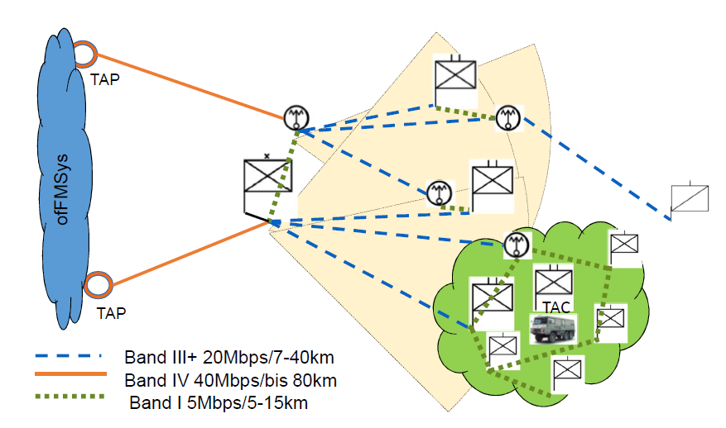
COMSYS-AAF
Tactical Communication Network (TCN)
Notes:
The tactical picture of TCN shows the general architecture of the Network at different levels of command.
With the different use of antennas for example point to point or point to multipoint, and the additional equipment of the signal battalion`s of our force provider you can operate mission tailored at all levels of command.
The green cloud at battalion level indicates the beginning of a mobile cloud by using a round beam antenna at NATO Band I level.
The stroked blue line indicates the point to point or point to multipoint area and the yellow part connects the deployable network to the fixed network.
This is of course a general picture. All the radios you can use to fulfil requirements depending on the scenario.
In 2023 April the education and delivery to our brigades will start and hopefully will be finished in 2024.

Slide 25

Combat-Cloud
Tactical Data Radio (TDR)
TDR
TAC
TCN
The seamless merge of mobile and deployable Comms
Notes:
The project TDR is at the moment under testing.
The result of combining TCN+TDR should be a combat-cloud in the area of operation.
2024 the implementation is planned and hopefully with an successful R&D program I explained before we are on the way.

Slide 26
I believe that timely, accurate and easy to understand information on site can make a decisive different in all situations.

