Slide 1
2022

Slide 2
Sectoral Qualifications Framework for the Military Officer Profession: Models of Application
Dr. Mantas Bileišis, General Jonas Žemaitis Military Academy of Lithuania
COL dr. Alin Bodescu, „Carol I“ National Defence University

Slide 3
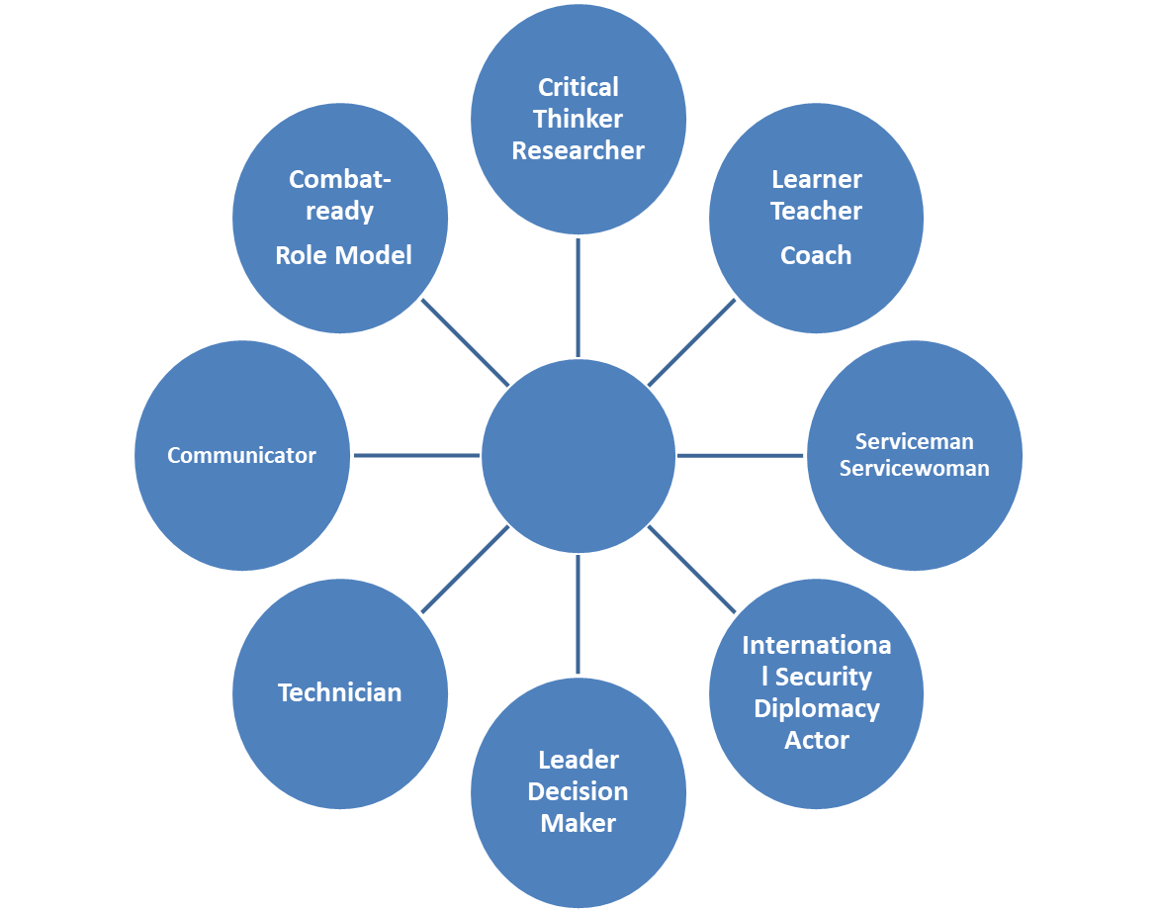
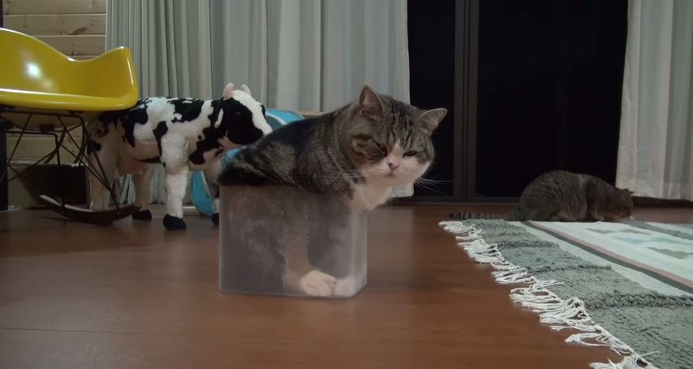
SQF-MILOF: what‘s the frame?

Slide 5
3 areas of research on MILOF-SQF
CIVIL-MILITARY relations
Military sociology
Education/education policy

Slide 6
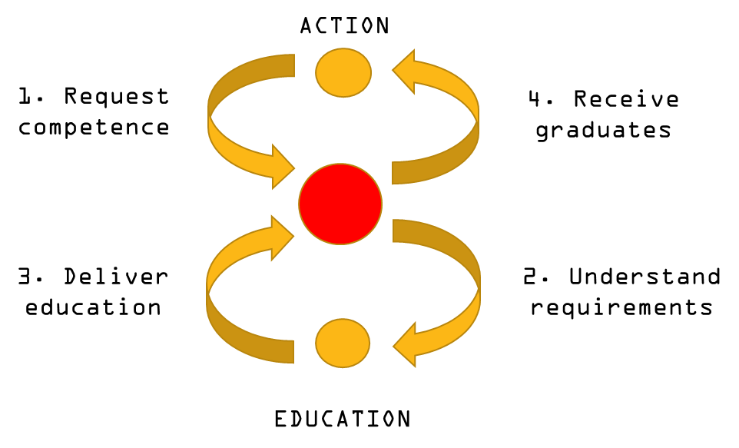
SQF: from market to multi-level governance

Slide 7
 | Opportunistic | Voluntary certification (accreditation) | Strategic Human Resource Management
Scope and political commitment | Coordination between service providers sufficient | Need to facilitate standardization at a supranational level | Integration of SQF-MILOF into HRM processes in the militaries
Output | Multi-institutional/multi-national training and education curricula | Best-practice sharing and adaptation to new requirements | An integrated officer career support mechanism
SQF-MILOF application | Vocabulary for common curriculum development and training recognition | Voluntary compliance standard | The ontology for effective HRM
Mechanism of implementation | Horizontal: peer-to-peer | Bottom-up: „coalition of the willing“ | Top-down: strategic goals driven

Slide 8
Conclusion: entertain the idea of SHRM approach
Recruiting
Making citizen-soldiers effective
Monitoring, identifying gaps
Intensive use of competences in high demand
International deployments

