Slide 1
COMMANDER OF TOMMORROW
Lt. Col. Andrzej TRUSKOWSKI, PhD, Eng.

Slide 2
AGENDA
1. NEW ENVIRONMENT FOR COMMANDER
2. STRUCTURAL CHARACTERISTICS OF LEADERS’ PERSONALITIES
3. WHERE TO FIND NEW LEADERS?
4. BECOMING A LEADER
5. CHALLENGES FOR THE FUTURE LEADERS
6. SYMMETRY IN MILIATRY RELATIONS
7. PRESENT CONDITIONS OF SERVICE
8. AIR FORCE ORGANIZATIONAL CULTURE
9. MODERN LEADER
10. COMPETENCIES
2

Slide 3
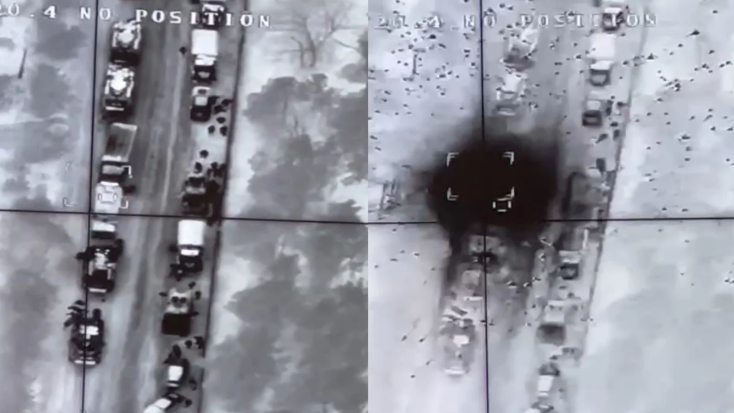
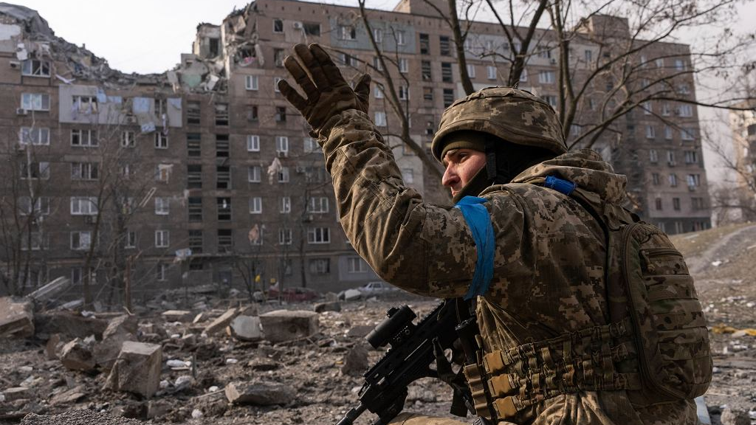
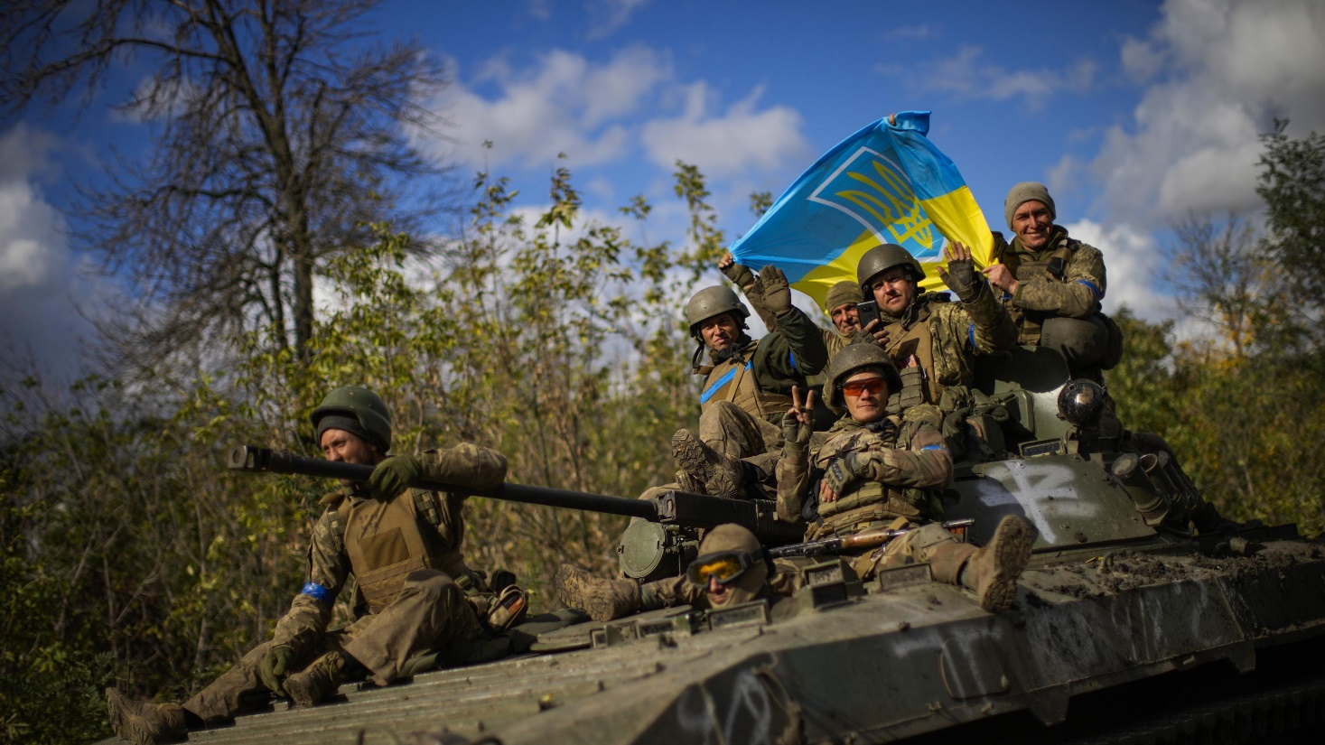
3

Slide 4
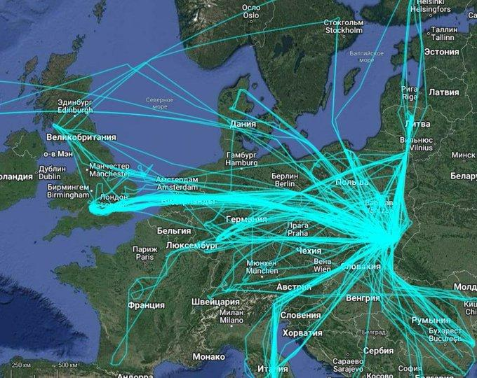
THE MAIN HUB FOR THE SUPPLY OF WEAPONS TO UKRAINE IS THE POLISH RZESZÓW-JASIONKA (J-TOWN) AIRPORT.
100KM (60MILES) TO THE POLISH - UKRAINIAN BORDER
170KM (100MILES) TO LVIV
4

Slide 5
NEW ENVIRONMENT FOR COMMANDER
ASYMMETRIC WARS
WAGED BETWEEN STATE AND NON-STATE ENTITIES
INTER-STATE WARS
STATES PARTICIPATE
INTER-CIVILISATION WAR
BORDER OF CIVILISATION (CIVILISATION WARS)
5

Slide 6
STRUCTURAL CHARACTERISTICS OF LEADERS’ PERSONALITIES
THE TRAIT THEORY
THE GREAT EVENTS THEORY
THE TRANSFORMATIONAL OR PROCESS LEADERSHIP THEORY
CHOSEN PERSONALITY TRAITS MAY LEAD PEOPLE NATURALLY INTO LEADERSHIP ROLES
FOLLOWING A CRISIS OR ANOTHER LIFE-CHANGING EVENT, AN ORDINARY PERSON CAN REVEAL HIS LEADERSHIP QUALITIES WHILE ADAPTING HIMSELF TO THE NEW SITUATION
PEOPLE CAN DECIDE IF THEY ARE WILLING TO BECOME LEADERS AND DEVELOP LEADERSHIP SKILLS
6

Slide 7
WHERE TO FIND NEW LEADERS?
NATURAL BORN LEADERS ARE RARE COMMODITIES.
LEADERSHIP CAN BE LEARNED WITHIN A WELL-DEVELOPED TEACHING AND TRAINING PROCESS
PREPARING FUTURE COMMANDERS-LEADERS OF TOMORROW THAT WOULD BE CONDUCTED IN AUTHORISED MILITARY ORGANISATIONS
7

Slide 8
SYMETRY IN MILITARY RELATIONS
MILITARY SERVICE IS INEXTRICABLY CONNECTED WITH VARIOUS VERY HIGH REQUIREMENTS (GENERAL AND SPECIALIZED), WHICH OFTEN DEMAND THAT SOLDIERS AND THEIR COMMANDERS PERFORM EFFECTIVELY IN DIFFICULT AND DANGEROUS SITUATIONS.
IN SUCH CASES, A DIALOGUE AND FREE FLOW OF INFORMATION ARE OFTEN HAMPERED.
PRESENTLY THERE IS AN INCREASING NEED IN THE MILITARY ENVIRONMENT TO DEVELOP RELATIONSHIP DIALOGUES (SYMMETRICAL AND PARTNERSHIP RELATIONSHIPS) INSTEAD OF ASYMMETRIC RELATIONS (I.E. ONLY OFFICIAL AND FORMAL ONES) BETWEEN A SUPERIOR AND SUBORDINATE (E.G. WITHIN A GROUP, TEAM, PLATOON).
10

Slide 9
BECOMING A LEADER
PEOPLE BECOME GOOD LEADERS. A LEADER IS NOT BORN A LEADER.
“ONLY IF YOU HAVE A DESIRE AND WILLPOWER, CAN YOU BECOME AN EFFECTIVE LEADER”.
GOOD LEADERS CONSTANTLY WORK AND LEARN TO IMPROVE THEIR LEADERSHIP SKILLS; THEY DO NOT REST ON THEIR LAURELS
BEING A LEADER IS A MATTER OF “BECOMING ONE”, NOT A MATTER OF FATE, NEGLIGENCE OR PURE CHANCE.
GOOD LEADERS DEVELOP THEMSELVES IN A LIFE-LONG PROCESS OF SELF-STUDY, LEARNING, TRAINING AND EXPERIENCE
LEADERSHIP IS EVERYTHING THAT AN INDIVIDUAL DOES TO LEAD EFFECTIVELY.
8

Slide 10
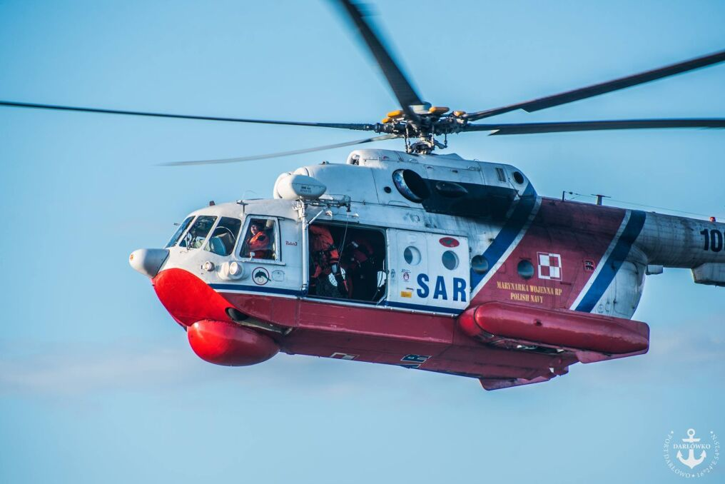
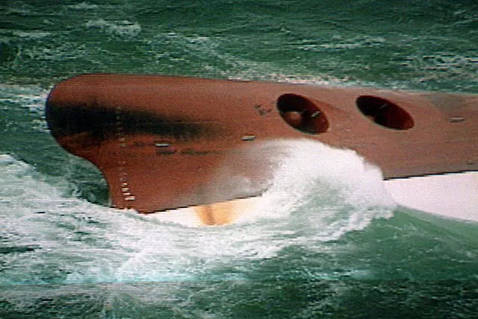
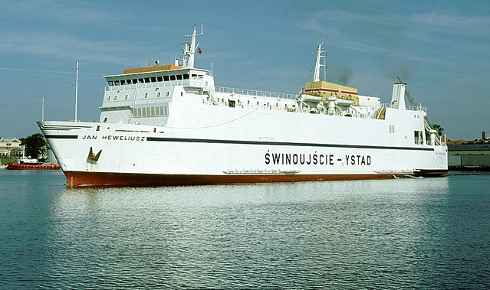
CHALLENGES FOR THE FUTURE LEADERS
FERRY „JAN HEWELIUSZ” – JANUARY 1993
FERRY „JAN HEWELIUSZ” – JUNE 1992
MI-14 SAR HELICOPTER WITH YOUNG LT. TRUSKOWSKI ON BOARD – RESCUE MISSION JANUARY 1993
9

Slide 11
PRESENT CONDITIONS OF SERVICE
THE ARMED FORCES HAS TO FACE THOSE SUPPOSED CHALLENGES POSED BY THE BATTLEFIELD
SOLDIERS AND THEIR COMMANDERS ARE PREPARED TO PERFORM IN CONDITIONS DOMINATED BY SITUATIONS WHICH ARE DIFFICULT, DANGEROUS, DYNAMICALLY CHANGING, OFTEN NEW, SURPRISING AND GENERATING STRESS.
PREPARING A SOLDIER-COMMANDER FOR PERFORMING IN SUCH SITUATIONS REQUIRES AN ENVIRONMENT CHARACTERISED BY A SUITABLE TYPE OF ORGANISATIONAL CULTURE.
11

Slide 12
AIR FORCE ORGANIZATIONAL CULTURE
MOST APPROPRIATE TYPE WOULD THE STRONG ORGANIZATIONAL CULTURE (ITS VARIOUS EXAMPLES CAN BE FOUND IN NATO AIR FORCE, ITS PATTERS ARE INTRODUCED INTO THE POLISH AIR FORCE BY PILOTS AND MAINTENANCE PERSONNEL RESPONSIBLE FOR F-16 FIGHTER JETS AND TRAINED IN THE USA
CHARACTERISTICS OF A STRONG CULTURE CLEARLY CORRESPOND TO RULES INCLUDED IN CRM TRAINING PROGRAMMES (CREW RESOURCE MANAGEMENT) CONDUCTED FOR THE AIR FORCE PERSONNEL
12

Slide 13
MODERN LEADER
FOSTER ACQUIRING KNOWLEDGE WITHIN AN ORGANISATION
PREPARING ORGANIZATION FOR FUNCTIONING IN MODIFIED CONDITIONS
FORGING RELATIONS BETWEEN ORGANISATION MEMBERS INSTEAD OF ONLY COMPETING FOR POWER
13

Slide 14
COMPETENCIES
TECHNICAL COMPETENCIES (HARD SKILLS)
CONNECTED WITH MILITARY EXPERTISE (E.G. TACTICAL KNOWLEDGE)
PERSONAL AND SOCIAL COMPETENCIES (SOFT SKILLS)
LEADERSHIP SKILLS, WHICH ARE A PRECONDITION FOR BECOMING A COMMANDER
SOFT SKILLS ENABLE LEADERS TO ACHIEVE “HARD” RESULTS.
14

Slide 15
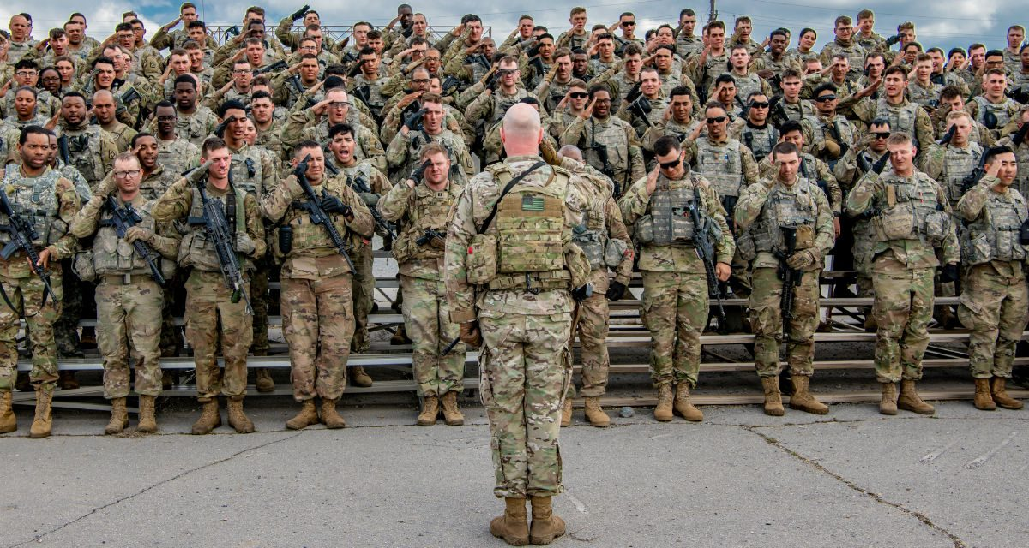
CONCLUSIONS
Contemporary soldier, commander and leader has to be prepared to cope with a complex, diverse and dynamic environment of the future battlefield.
15
Source: Sgt. Dustin Biven, US Army

Slide 16
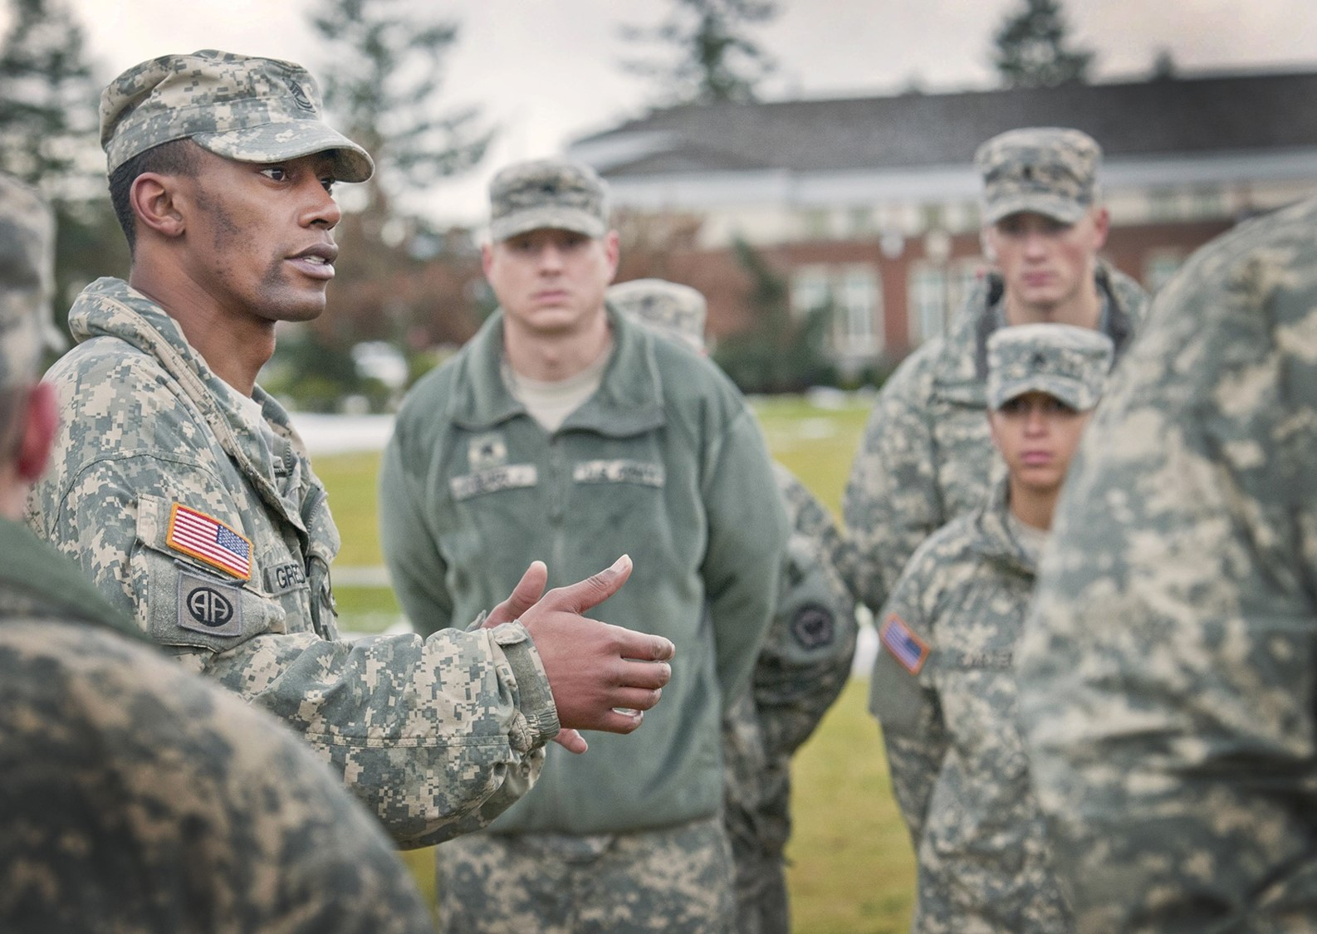
CONCLUSIONS
Soft skills (non-technical, personal and social) can play a significant role in the successful performance of commanders-leaders of tomorrow.
16
Source: US Army

Slide 17
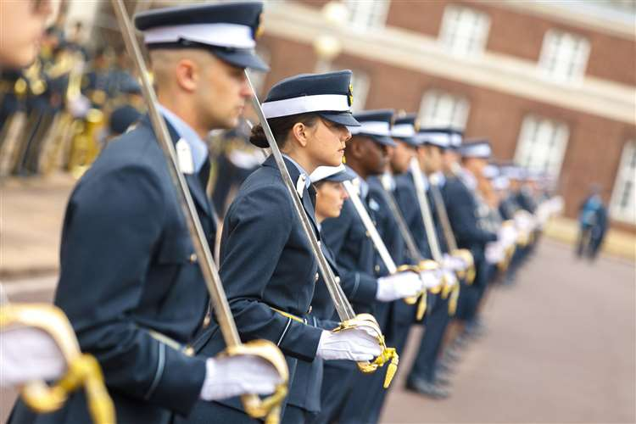
CONCLUSIONS
The specific education, training and professional development designed for candidates to fulfil such roles should include conditions which will make a military organisation acquire the biggest number of features defining the strong culture.
17
Source: RAF College Cranwell

Slide 18
THANK YOU FOR YOUR ATTENTION

