Slide 1
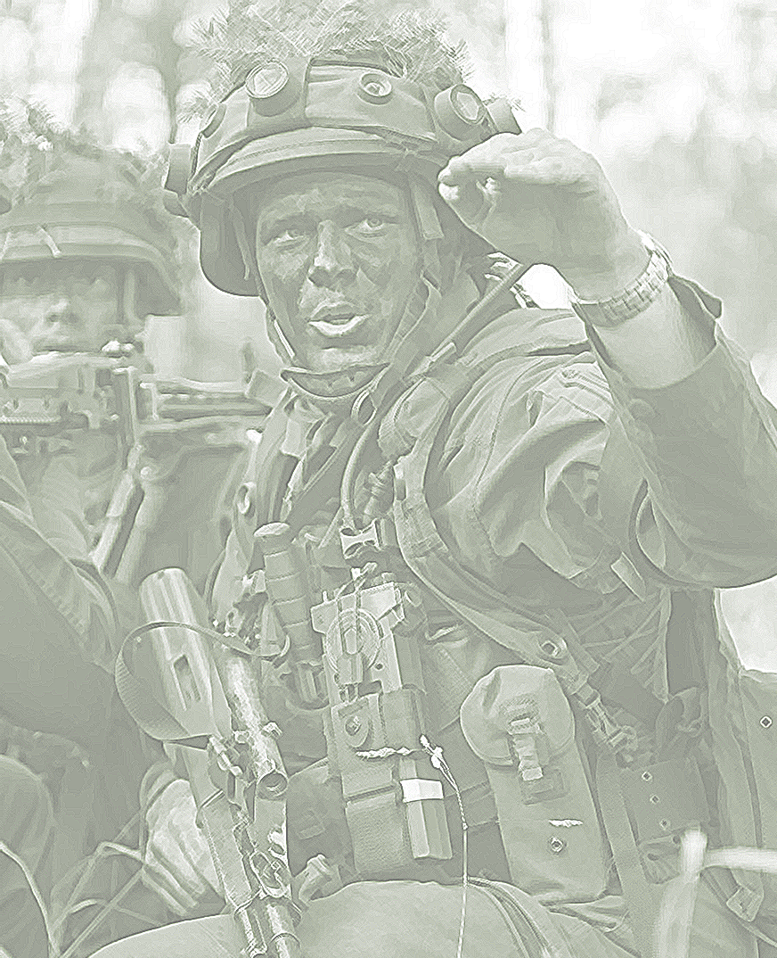

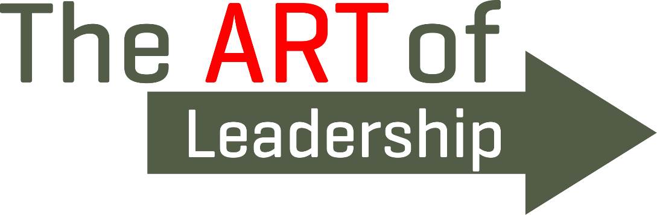

2022

Slide 2
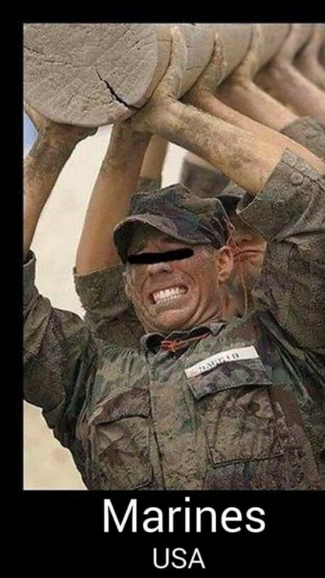
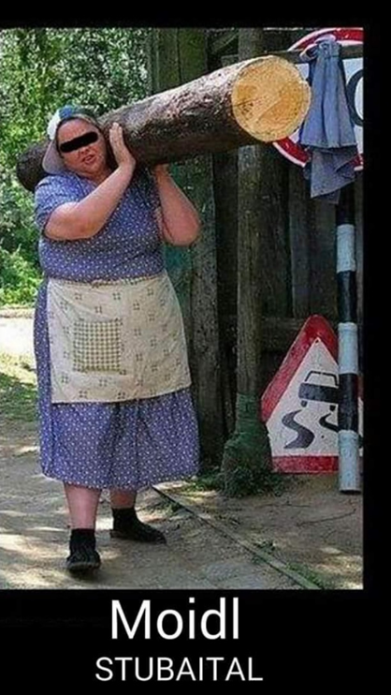
Development of Society and the Impact on the Military

Slide 3
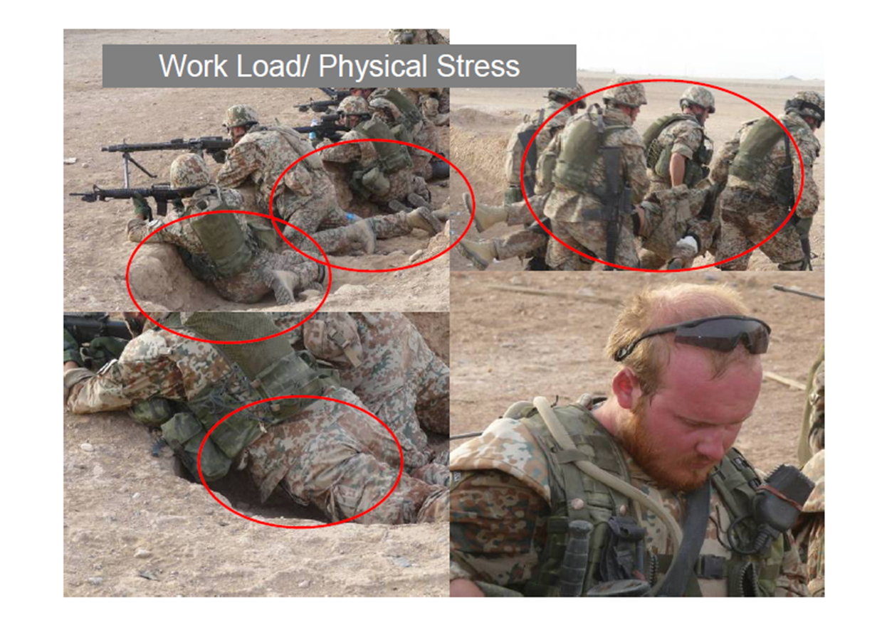
What is scientifically secured
walk while carrying loads of 50- 60 kg ;
walk in crouched posture, climb stairs,
crawl in a confined space while wearing fighting load of 25 - 40 kg
Load of 25 % of bodyweight increases risk of overuse injuries over 50 %
The Norwegian Defence University College Norwegian School of Sport Sciences/Defence intitute Sognsvn. 220 • Pb. 4014 Ullevål stadion • 0806 Oslo

Slide 4
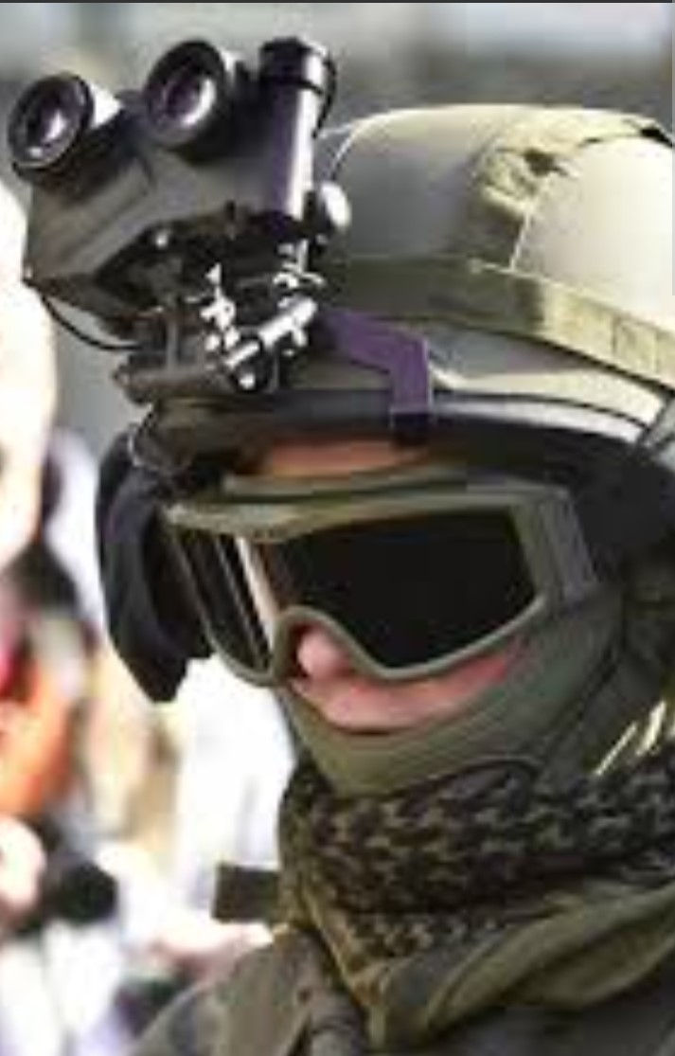
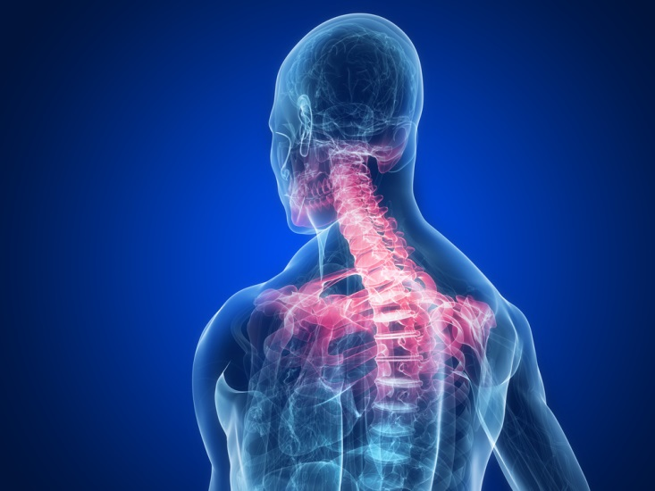
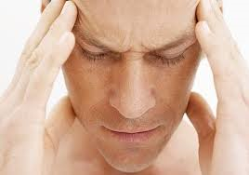
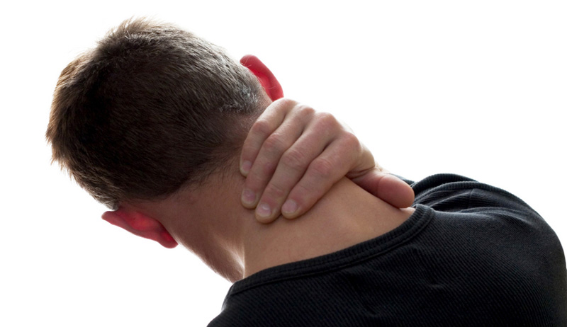
„Stress on the neck“
What happens to the musculo-skeletal system in phases of "persistent" stress, especially psychological, combined with physiological stress?
Barrett, J. M., Healey, L. A., Fischer, S. L., & Callaghan, J. P. (2022). Cervical spine motion requirements from night vision goggles may play a greater role in chronic neck pain than helmet mass properties. Human factors, 00187208221090689.
Abb. Fotolia

Slide 5
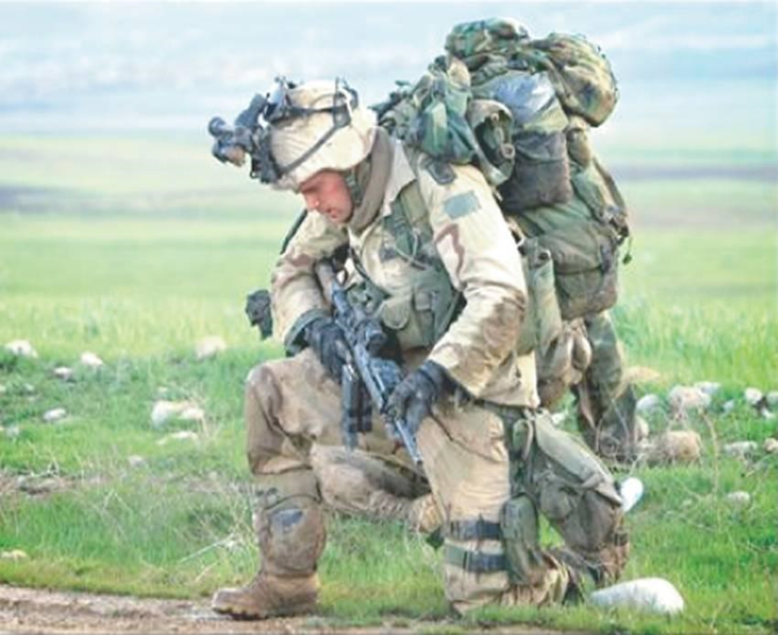
How can we manage that ?
Army asks industry about the latest in exoskeletons to improve soldier performance and physical endurance
March 28, 2022, NATICK, Mass. – U.S. Army
Exoskeletons may improve the strength, endurance, safety, and ergonomics of soldiers as they walk, run, jump, climb, and maneuver on the battlefield
https://www.militaryaerospace.com/unmanned/article/14270047/exoskeletons-soldier-performance-physical-endurance

Slide 6
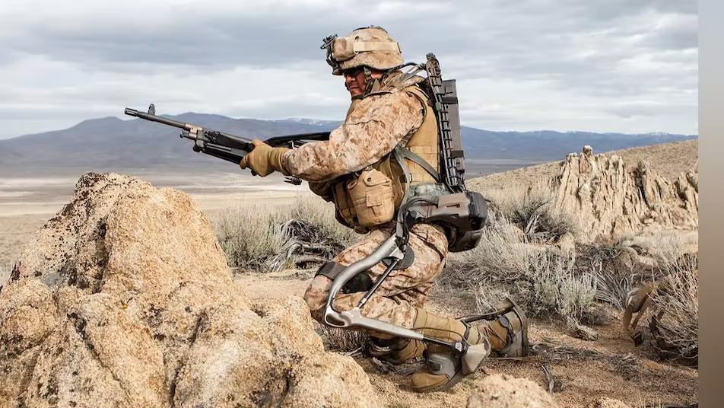
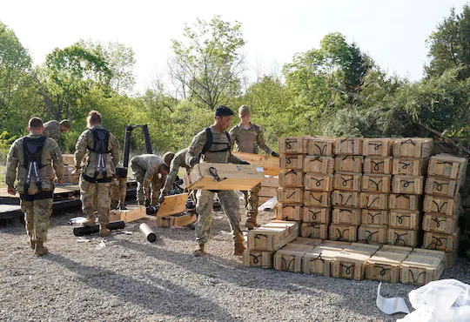
Wearing exoskeletons may reduce physical fatigue and muscle activity in workplace.
A map was developed to suggest potential exoskeleton types for different trades.
Risk and safety concerns exist on wearing exoskeletons in workplace.
More assessments are required to evaluate exoskeleton's efficacy in field practice.
Zhu, Z., Dutta, A., & Dai, F. (2021). Exoskeletons for manual material handling–A review and implication for construction applications. Automation in Construction, 122, 103493.
https://www.science.org/content/article/feature-can-we-build-iron-man-suit-gives-soldiers-robotic-boost

Slide 7
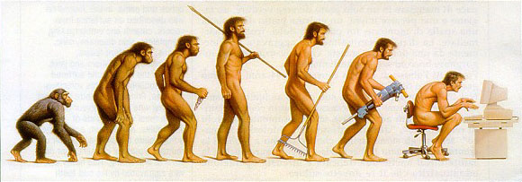
Lifestyle and Selection
„Biology of human being does not follow military
orders and comands “
(Dr. Wittels, HSP Leistungsmedizin, Fachkräfte - Fortbildung 1998),
for increasing physical performance rules of physiology and knowledge of principles of training are required

Slide 8
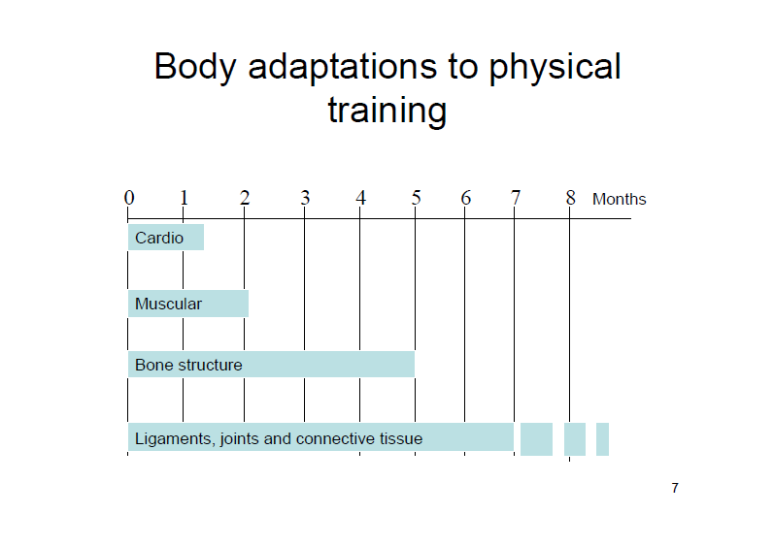
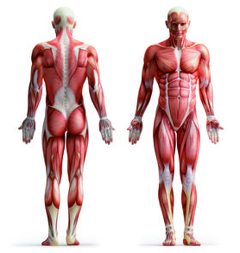

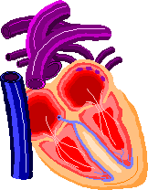
Exercise-induced Adaptions

Slide 9
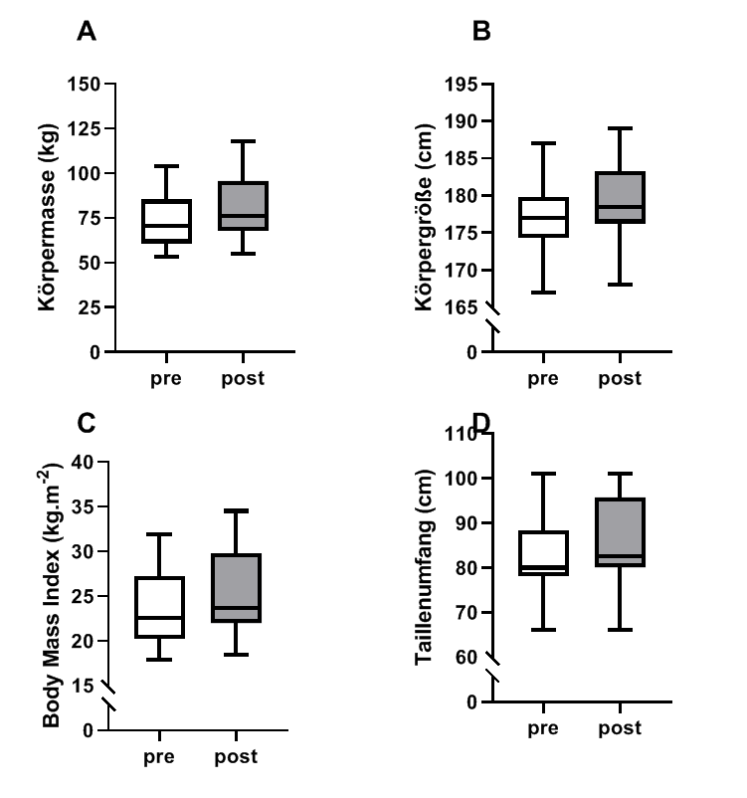
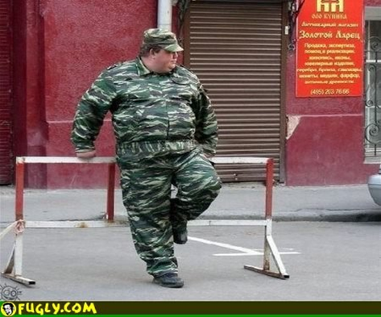
Impact of Lifestyle on Fitness
Stocker, H., & Leo, P. (2020). Predicting military specific performance from common fitness tests. Journal of Physical Education and Sport, 20(5), 2454-2459.

Slide 10
Everyone suitable for everything?? !
Persons smaller than 165 cm are not suitable as aidmen, assuming that a medical orderly must be able to load an ambulance; this requires a reaching height of 210 cm.
46 % of females in medical service did not meet this requirement..
(Universität Köln,Institut fürArbeitsmedizin,2002)

Slide 11
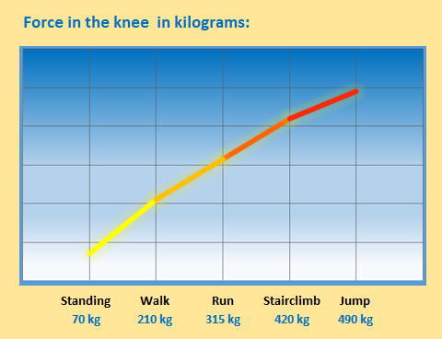
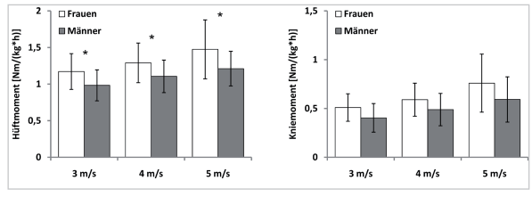
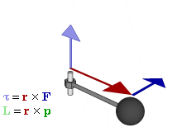
The Gender Gap
Kleindienst, F. I., Michel, K. J., Schwarz, J., & Krabbe, B. (2006). Vergleich von kinematischen und kinetischen Parametern zwischen den Bewegungsformen Nordic Walking, Walking und Laufen. Sportverletzung· Sportschaden, 20(01), 25-3
relationship between force (F), torque (τ), linear momentum (p), angular momentum (L), and position (r) of rotating particle.

Slide 12
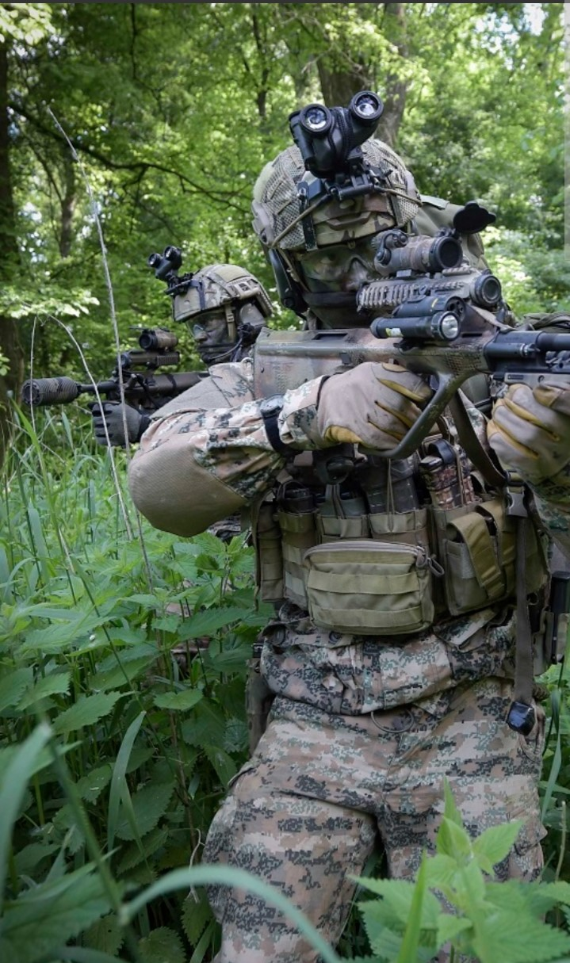
Conclusion
orandum est ut sit
mens sana in corpore sano ?
Satire 10, 356: Juvenal (01/02)
God helps those who help themselves!
Till technical support properly works
self-initiative of Armed Forces is required
Foto: ÖBH

