Slide 1
2022

Slide 2
Inclusive Strategy Development at Leadership as a Prerequisite Clemens Zierler November 2022

Slide 3
Disclaimer
This is a field report.
The hypotheses set up
are based on the field report and on the authors personal experience,
still lack strong evidence.
The field report represents the authors personal view and not the view of Rosenbauer as a company.

Slide 4
Who is Rosenbauer?
World’s leading manufacturer of systems for firefighting and disaster protection, offering a full range of products.
Revenues of € 975.1 million and around 4,100 employees (as of December 31, 2021).
All of the main sets of standards are covered by products manufactured in Europe, the US and Asia.
Active service and sales network in over 120 countries.
Stock listed family company in its sixth generation
More than 150 years of history.
Strong customer focus, innovative strength and reliability are key assets.
Source: “Group profile“, Rosenbauer International AG, 2022, accessed June 5th, 2022, https://www.rosenbauer.com/en/at/rosenbauer-group/company/group-profile.

Slide 5
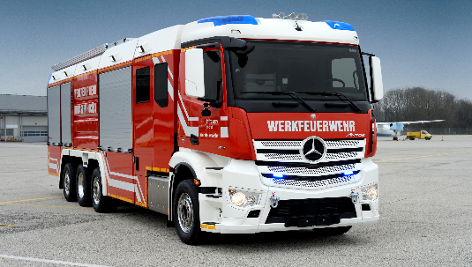
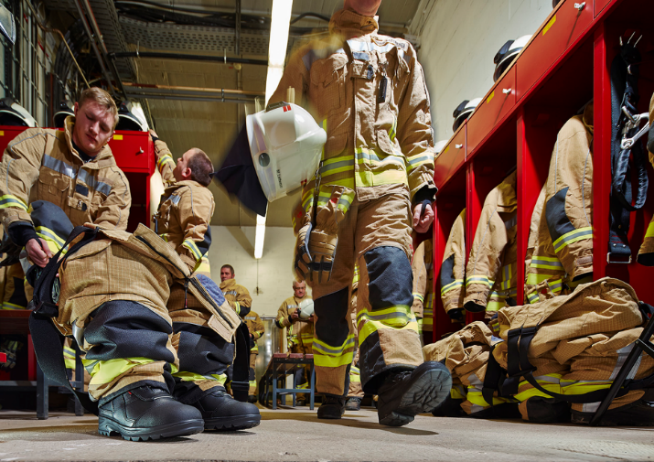
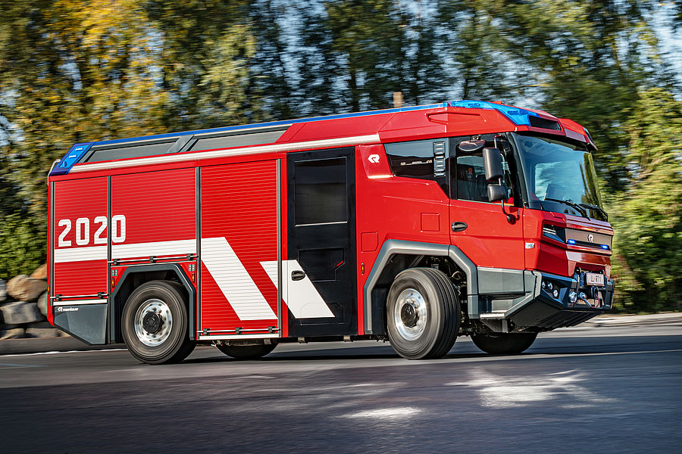
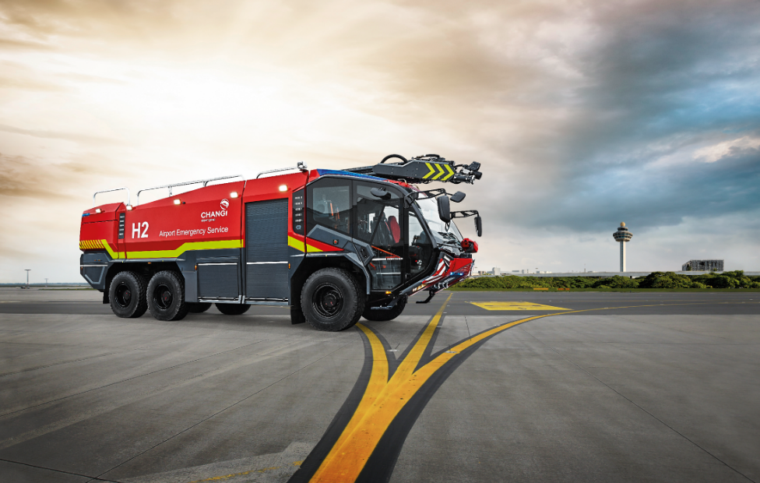
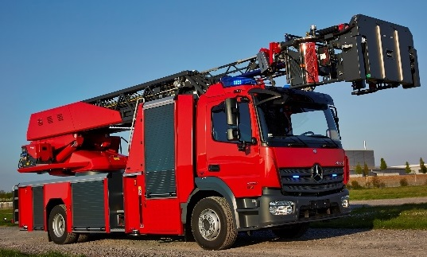
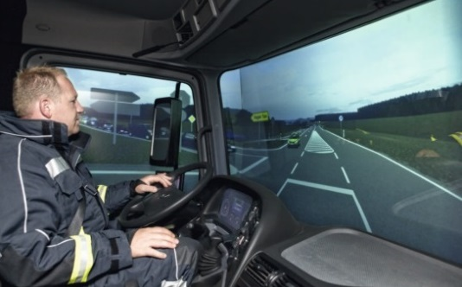
Product Range

Slide 6
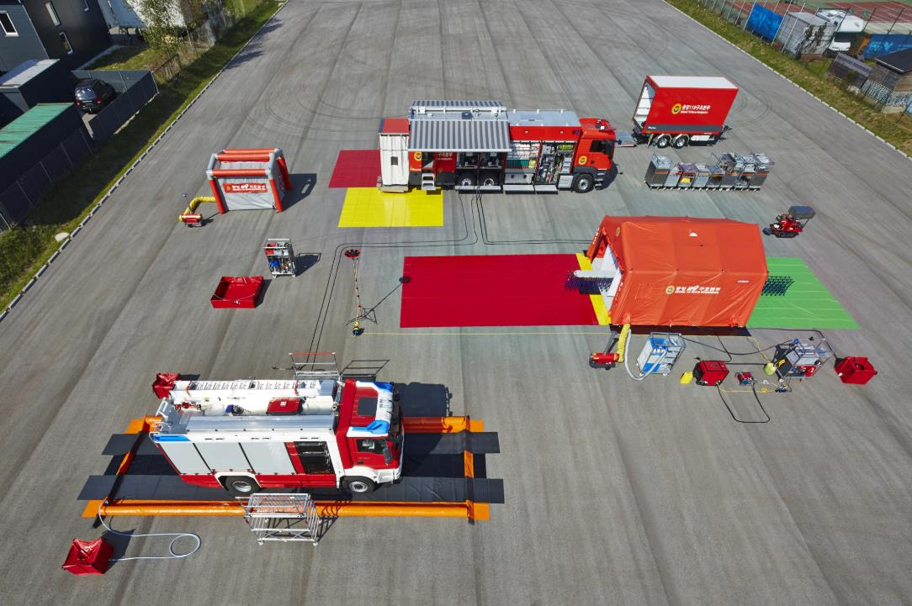
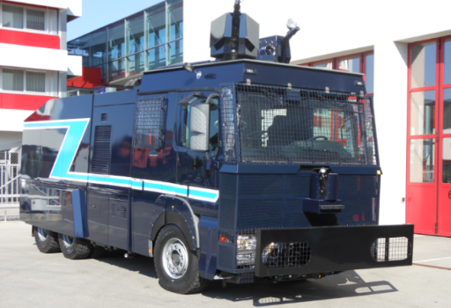
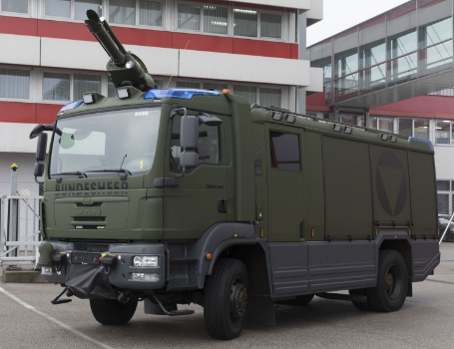
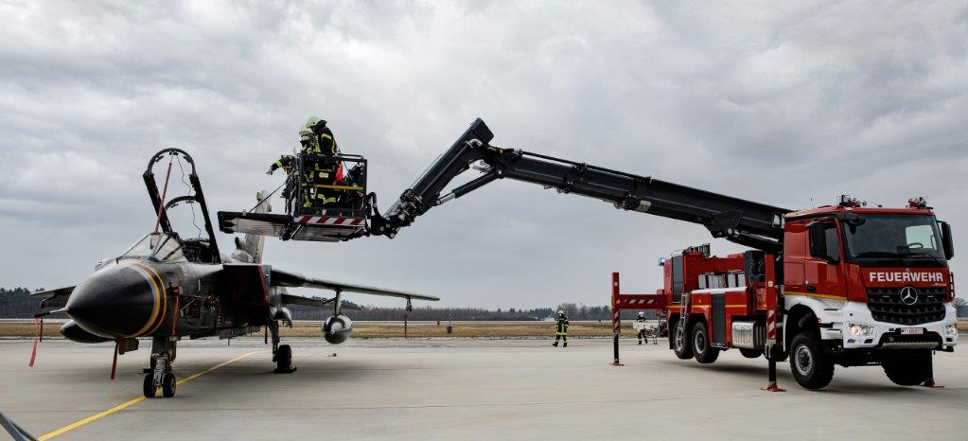
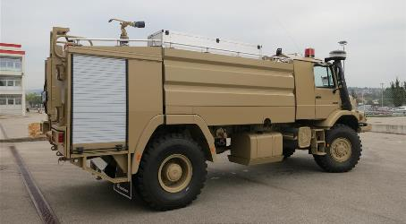
Product Range

Slide 7
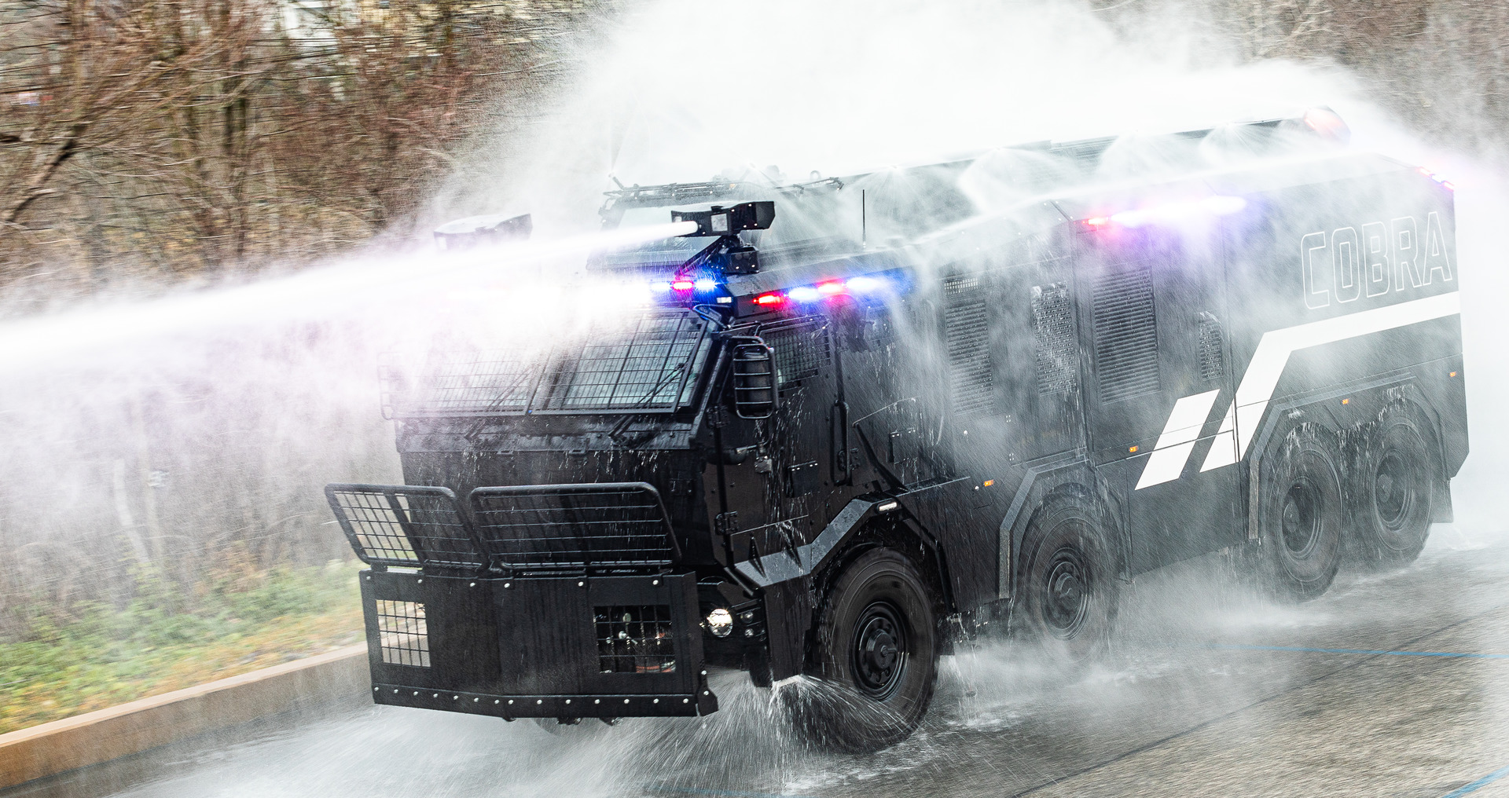
Product Range

Slide 8
Problem Statement
How to cope with complexity and increasing dynamic frameworks in strategic management?
How to maintain initiative in a competitive environment?

Slide 9
Comparison between Military and Business Strategy¹
 | Military Strategy | Business Strategy
Scope | Part of state strategy | General strategy
Effective range | Military units | Economic corporate structures
Goals | Survival as well as maintenance and expansion of the independence of a population community. | Long-term securing of the existence of a productive social system and achieving a profit.
Orientation | Defensive or offensive | Offensive/Proactive
Gain of knowledge | Analysis of successful and unsuccessful campaigns and battles | Analysis of successful and unsuccessful companies
Level | Supreme leadership | Every level
Game theoretical framework | Zero-sum game | Non-zero-sum game
Purpose | Final solution | Maintaining the game
Framework for action | Finite | Infinite

Slide 10
Strategizing Today
Is there still any reliable way to predict the future?
Is there still any reliable way to operationalize strategy?
Is strategic planning still a viable way to coordinate action?
If yes, on what level and to what extent?
Hypothesis: No, reality has finally crushed all of them.

Slide 11
We are dealing with a BANI² world
B rittle Brittleness is illusory strength.
A nxious In an Anxious world, every choice appears to be potentially disastrous.
N onlinear In a Nonlinear world, cause and effect are seemingly disconnected or disproportionate.
I ncomprehensible We try to find answers, but the answers don’t make sense.

Slide 12
Four Pillars for Strategizing and Organizing in a BANI world
Brittleness
Anxiety
Nonlinearity
Incomprehensibility
Resilience
&
Antifragility
Empathy
&
Mindfullness
Context
&
Adaptivity
Transparency &
Intuition
Source: Based on Grabmeier³ and Taleb⁴

Slide 13
Classic versus Modern Approaches towards Strategizing
There are three major limitations to all classic strategy building processes:
Inductive reasoning can lead to surprises.⁵
Every formulation of strategy has a restricted scope.
Complexity of the environment can hardly be perceived by central instances alone.
Newer approaches try to overcome these limitations: Scenario techniques, strategic futuring, trend meta boards, roadmaps, and wildcards.⁶

Slide 14
Systemic Strategy Building Process at Rosenbauer
Main assumptions that guided the process:
Strategic Goals are less important than a strong purpose.
Vision and Mission are less important than cohesion amongst people.
Capabilities of lower ranks are getting more and more important.
Leadership and trust are key to success in complex and dynamic environments.
Broad inclusion in the strategy building process helps in two ways:
Broad knowledge is present in the process.
Everyone in the organization understands the strategy from the beginning. This ensures that strategy equals execution.

Slide 15
Systemic strategy building process at Rosenbauer
In 2020 and 2021 Rosenbauer developed its group strategy “Rosenbauer City 2030”.
50 employees from all over the world and different hierarchical levels were involved.
Starting with one idea:
“What if Rosenbauer was a City?
How would it look like in 2030?”

Slide 16
Systemic strategy building process at Rosenbauer
Walt Disney Method⁷
Dreamer Party
Spoiler Party
Realist Party

Slide 17
Strategic Themes and Refinement
Theme Title
Scope
1
2
Backlog | In Progress | Testing | Done
Planned
Customers/
Consumers/ Users
Planned Outcomes
Activities
5
3
8
Critical Success Factors
6
Required Key Resources
Key Partners
9
10
Current State
7
Environmental Analysis
4
Bring Strategic Activities in
a KANBAN System and execute – agile.
A number of Strategic Themes with one Strategic Theme Canvas and one Theme Owner each.

Slide 18
Operationalisation of the strategy…
Crisis hit Rosenbauer just in between strategy development and operationalization. Strategy is finally formulated and remains in force. It will be open, to what extend the strategy will evolve its effect on success.
Strategy = Execution

Slide 19
Conclusion
The strategy development process was conducted in an agile way.
Leadership and ownership of managers and employees was needed for this processes and the process itself fostered leadership and ownership vice versa.
The BANI world will demand even more leadership and ownership from both managers and employees.

Slide 20
Main Takeaways for Future Leaders
You are the future - Build it!
Look for ways to innovate the system, each and every single day!
Include your subordinates, whenever possible!
Build strong social bounds in your organizations (trust, commitment, performance norms, good role models), they are the only fixed stars in a brittle world!
The military should not be afraid to experiment and reinvent itself!

Slide 21
Literature
“Kritik an der Anwendung von Militärstrategie“, Stefan Moch, without date, accessed June 5th, 2022, http://www.strategienet.de/kritik.html.
Source: “Facing the Age of Chaos”, Jamais Cascio, 2022, accessed November 4th, 2022, https://medium.com/@cascio/facing-the-age-of-chaos-b00687b1f51d.
Stephan Grabmeier, BANI versus VUCA: a new acronym to describe the world, 2020, accessed November 7th, 2022, https://stephangrabmeier.de/bani-versus-vuca/.
Nassim N. Taleb, Antifragilität: Anleitung für eine Welt, die wir nicht verstehen (München: btb Verlag, 2014).
Karl R. Popper/Karl Lorenz, Die Zukunft ist offen. Das Altenberger Gespräch. Mit den Texten des Wiener Popper-Symposiums (München/Zürich: Piper, 1985).
Michael König, Strategische Regentänze? Wildes Denken im Strategischen Management, In: Peter Heimerl/Ralph Sichler (Hg.), Strategie Organisation Personal Führung (Wien: Facultas Verlags- und Buchhandels AG, 2012), 117-188.
Christian Schawel/Fabian Billing, Top 100 Management Tools, Das wichtigste Buch eines Managers (Wiesbaden: Gabler, 2011), S.200f.

Slide 22
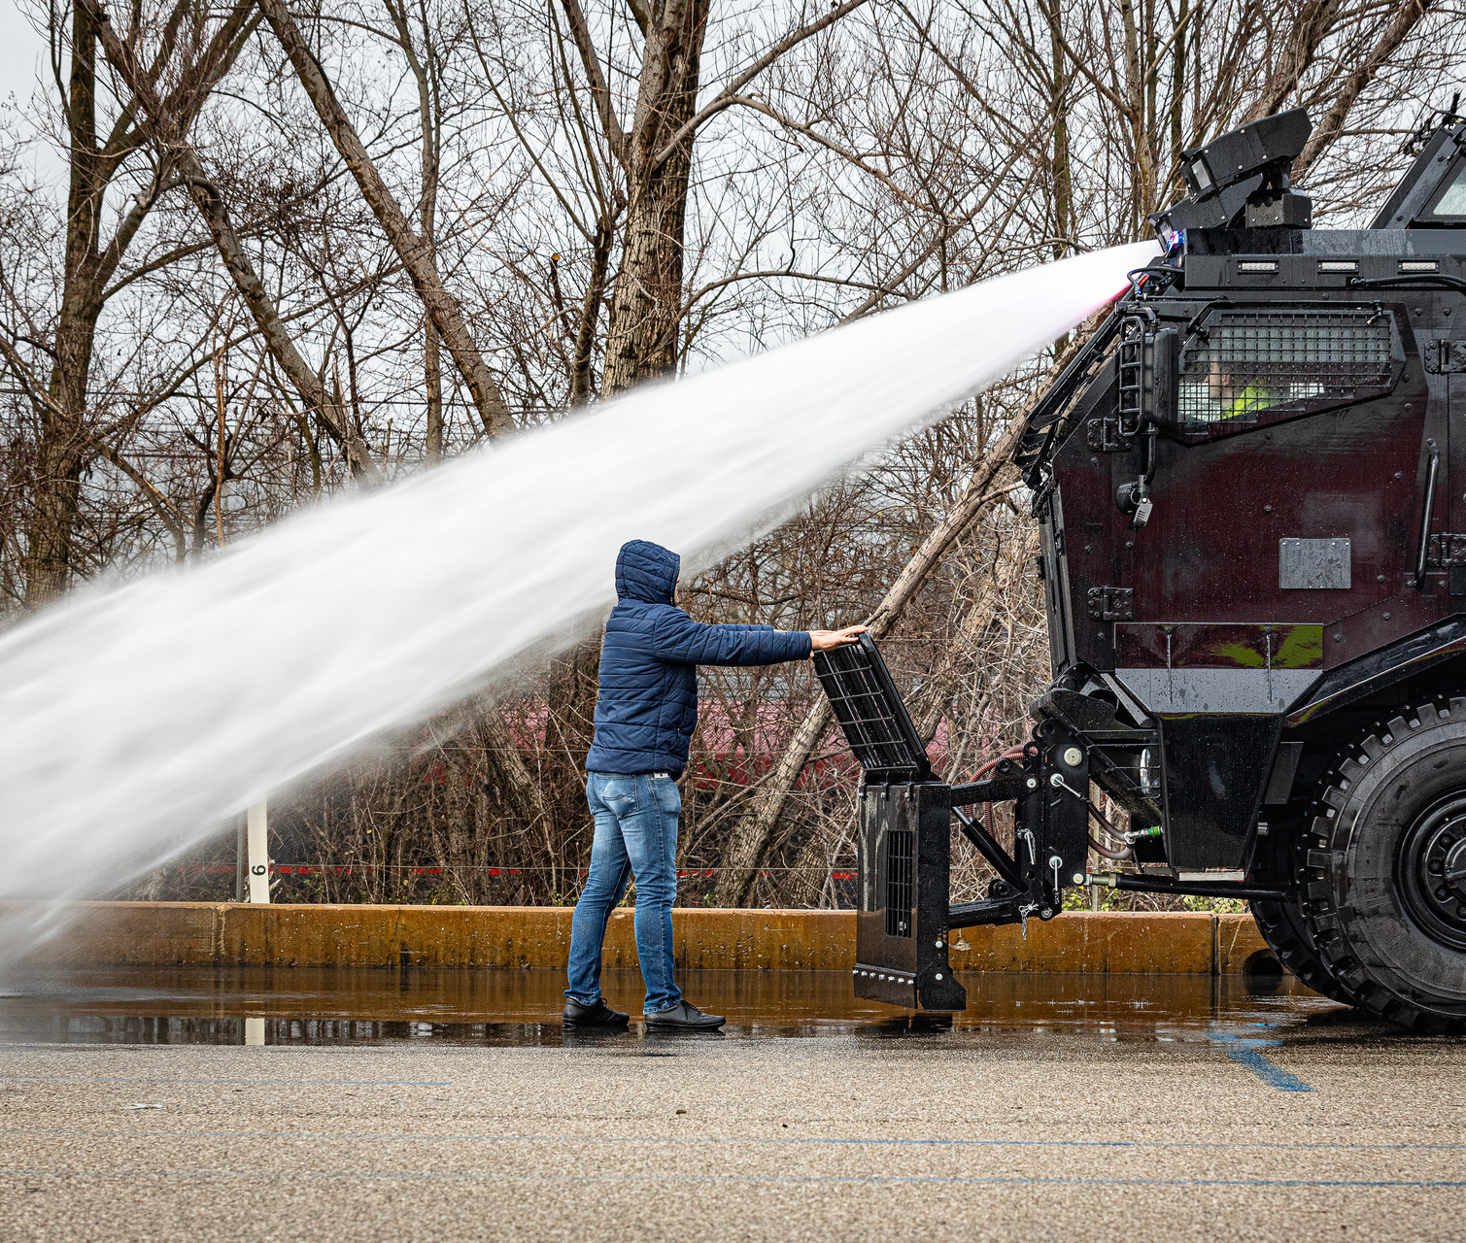
Have a refreshing break!

