Slide 1
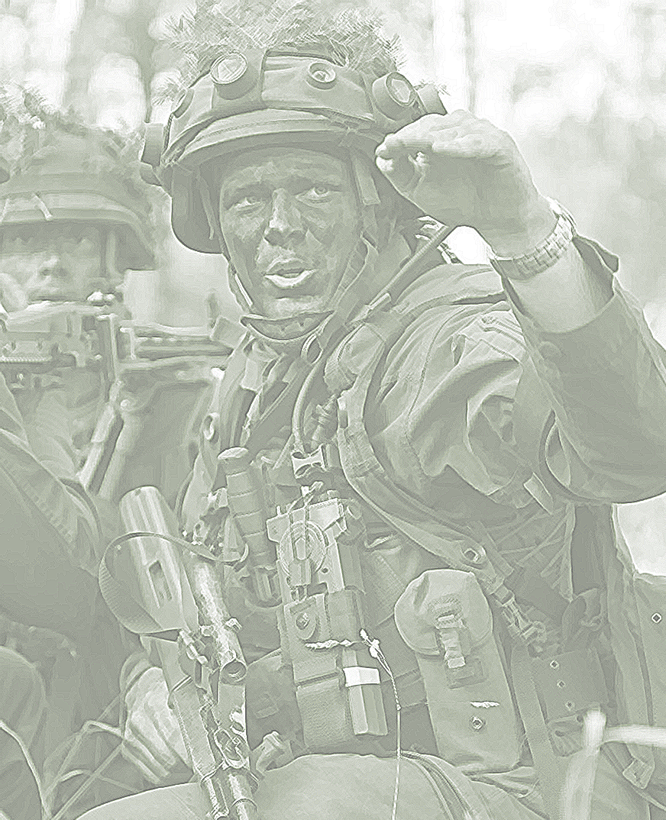
2022

Slide 2
Improving Efficiency Through Data-driven Decision Making in a military Environment
Agenda
What is 3DM?
Requirements for using 3DM
Challenges of the military environment
Areas of implementation
Opportunities
Risks
Impact at the battlefield
Way ahead of 3DM in the AAF

Slide 3
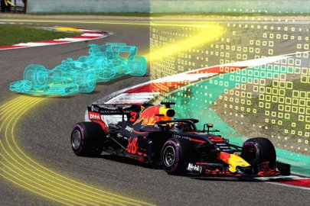
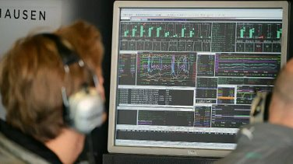
What is 3DM?
Formula 1
400+ sensors installed in the vehicle
15 race engineers for live evaluation
"Digital twin" for simulation
Effects on:
Race tactics
Driver behaviour
Tuning of the vehicle
Training of the pilot
Further development in all areas
https://i0.wp.com/ciudadesdelfuturo.es/wp-content/uploads/2018/07/1531127422773.png?ssl=1
https://images.motorsport-magazin.com/images/960/540/q_80/0611777.webp

Slide 4
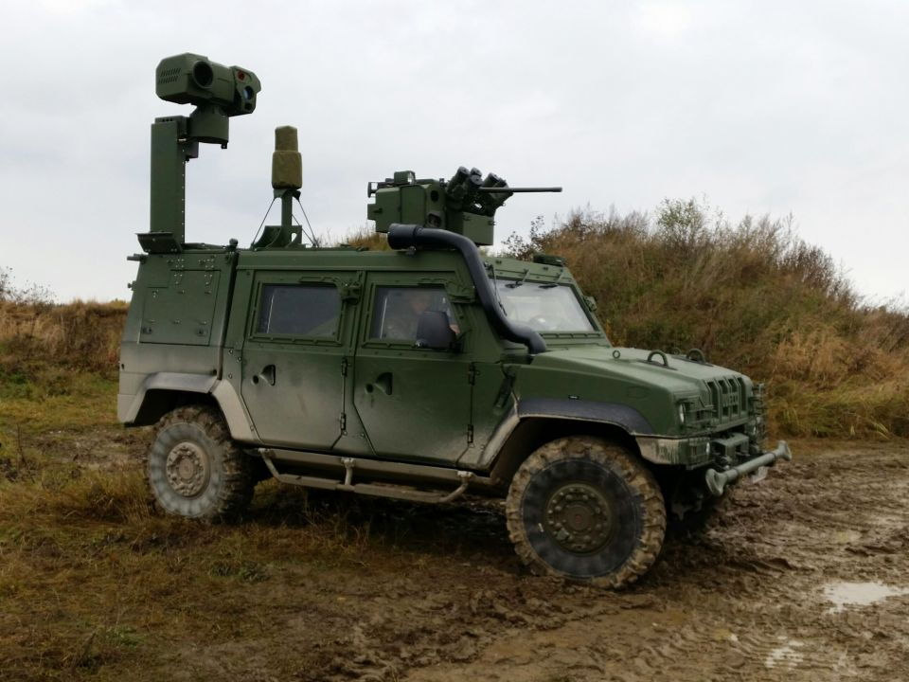
Requirements for using 3DM
open-minded corporate culture
analysis-based leadership culture
Battlefield
C2F
Data Analysis Center
sensor-related analysis
Processes
Information- and Knowledgemanagement
…
Data Analysis Center
Big Data Experts
Analysis Toolbox (AI, ML)
SSOT
Services
C2IS, BMS, …
Visualisation
Digital Map, VR, AR, …
highly efficient
mission tailored C2F
high quality
network structure
high number of
data-collecting systems

Slide 5
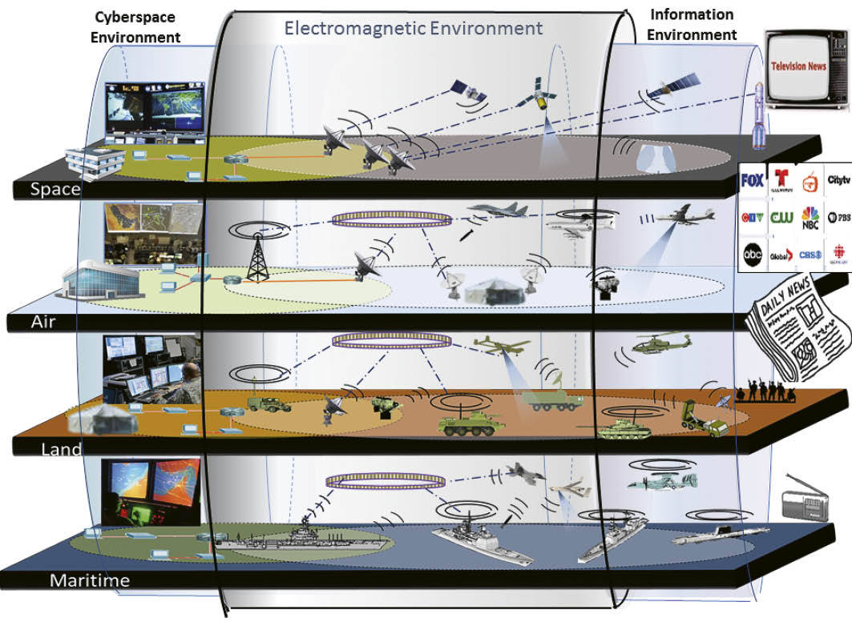
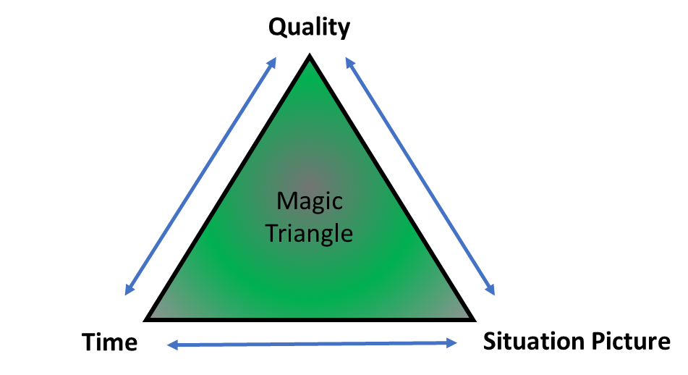
Challenges of the military environment
Integration of sensors and usage of existing sensors in military Equipment
Ongoing and dynamic change in network structures
Intensive use of the electromagnetic spectrum
Classification and protective measures
Emerging technology (AI, ML)
https://www.japcc.org/wp-content/webp-express/webp-images/uploads/J27_Art-07_03.jpg.webp
Foto: Bundesheer/Axel Alber
Leadership Dilemma

Slide 6
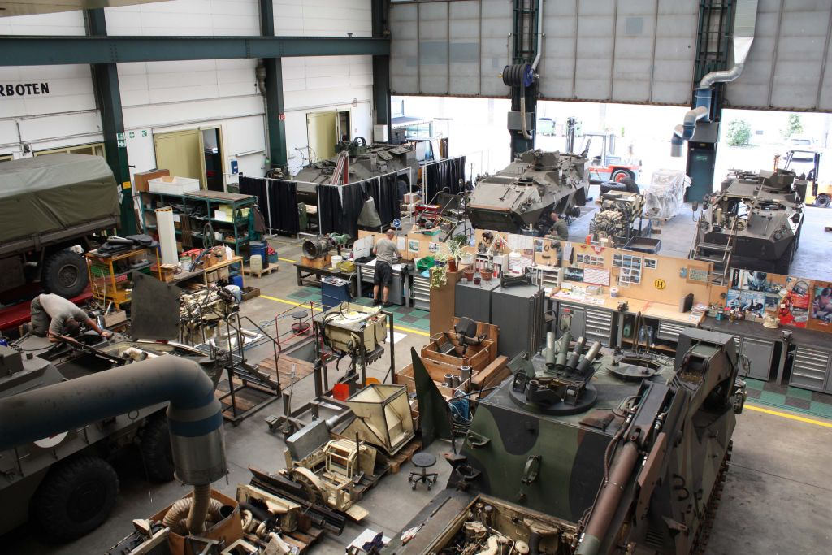
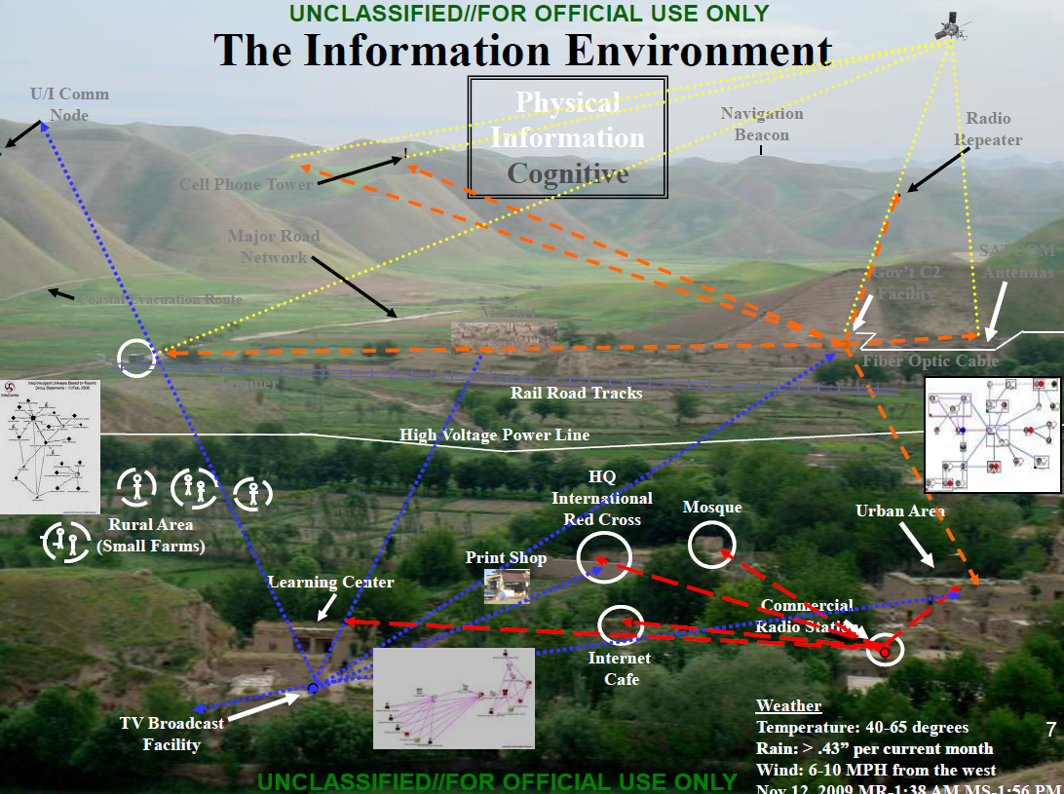
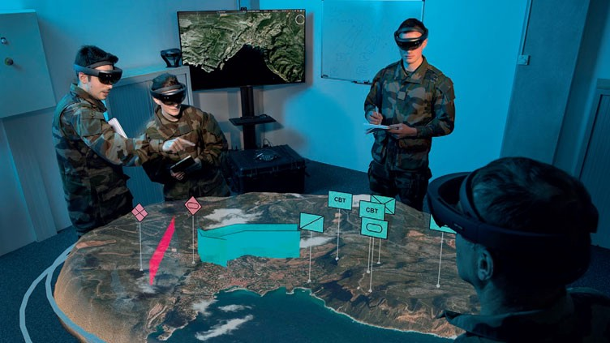
Areas of Implementation
Predictive maintenance
Supply chain optimization
Automated evaluation of image material
Accurate situational picture
Atomized Course-of-Action development
Digital twin of the battlefield
…
Foto: Bundesheer/Weissenberger
https://q.publicintelligence.net/wp-content/uploads/2010/05/infoops1-1024x764.png
https://miro.medium.com/max/720/0*rtHV0Z6RvvqHFIIZ

Slide 7
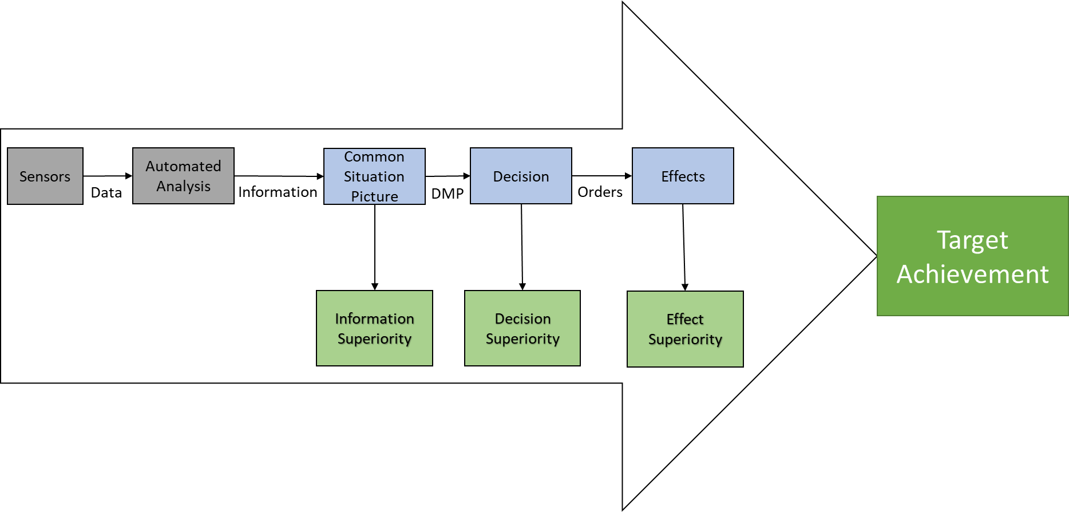
Opportunities
Faster and more accurate collection of sensor data
Shared and combined situation picture
Automated creation and presentation of key insights
Partial automations of the DMP
Verification of feasibility
Automated preperation of orders

Slide 8
Risks
Limited objectivity of human beings
Formation of a preconceived opinion/assessment
Limited ability of humans to comprehend complicated or complex facts
Dependence on data to make decisions
Security risks due to the loss or manipulation/falsification of data
Time and costs for implementation

Slide 9
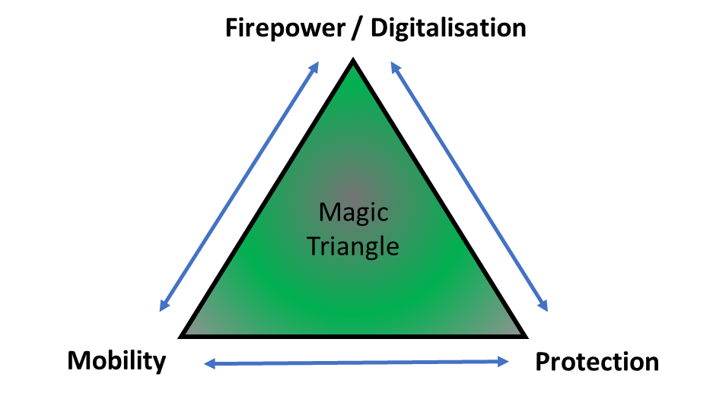
Impact at the battlefield
Functional clothing (cooling, heating)
Body armor
Health monitoring (HR, temp, …)
Wound care (heaters, E-Stim, …)
Performance monitoring (muscle activity, …)
Weapon(s) with optics incl. IR and camera
AR integrated in helmet incl. camera
Headgear with sensors to track brain activity
Wearable robots
Data input and output device for the BMS
Soldier radio / Platoon radio
Power Unit(s)
…
https://www.behance.net/gallery/20263147/Battlefield-3-Key-Art-Logo-Design

Slide 10
Way ahead of 3DM in the AAF
Information gathering and networking
Allies, industry, universities, …
Define and describe concrete use-cases
Prototyping – proof of concepte
Processes, sensors, network, SSOC, software, ML/AI, visualisation
Description of requirements – best practice
Procurement process

Slide 11
https://www.behance.net/gallery/20263147/Battlefield-3-Key-Art-Logo-Design
https://i0.wp.com/ciudadesdelfuturo.es/wp-content/uploads/2018/07/1531127422773.png?ssl=1
https://miro.medium.com/max/720/0*rtHV0Z6RvvqHFIIZ

