Slide 1
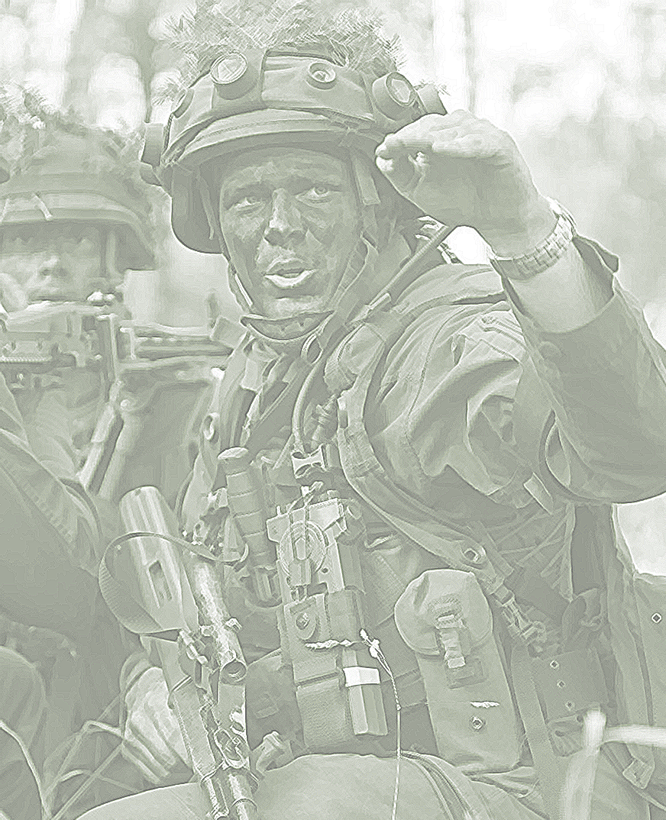
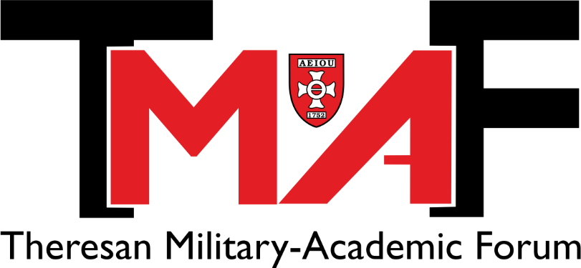
2022

Slide 2
Combined Arms Warfare in the 20th Century. History or not?
Tom Simoens
Maj PhD
Associate Professor in History
Royal Military Academy
(Brussels, Belgium)

Slide 3
Combined Arms Warfare in the 20th Century. History or not?
Q1. Is CAW still a key concept in warfare (why/why not)?
Q2. What does this mean for the basic military officers’ training?

Slide 4
Combined Arms Warfare in the 20th Century. History or not?
Q1. Is CAW still a key concept in warfare (why/why not)? Yes - DNA
Q2. What does this mean for the basic military officers’ training?
Teaching the (historical) importance of CAW
Teaching and applying ASAP mission command
Teaching and applying critical thinking

Slide 5
Combined Arms Warfare in the 20th Century. History or not?

Slide 6
Combined Arms Warfare in the 20th Century. History or not?
CAW = “the synchronised and simultaneous application of arms
to achieve an effect greater than if each element was used separately or sequentially”
Remark 1: all types of military operations and warfare
Remark 2: more often than not joint

Slide 7
Combined Arms Warfare in the 20th Century. History or not?
Historical perspective
First World War

Slide 8
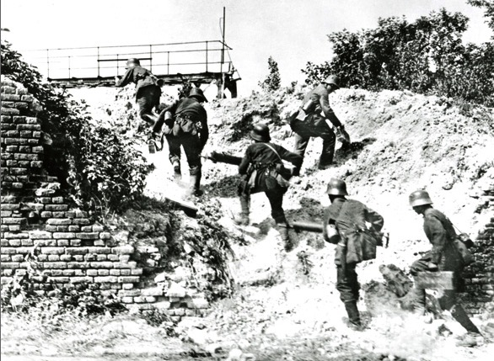
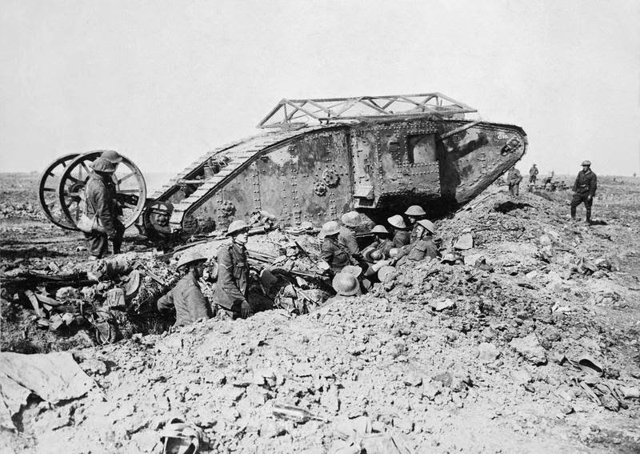
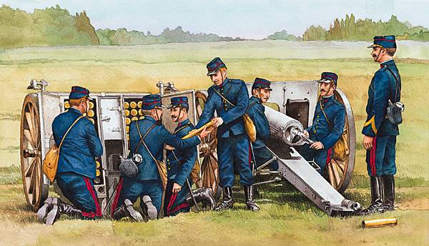
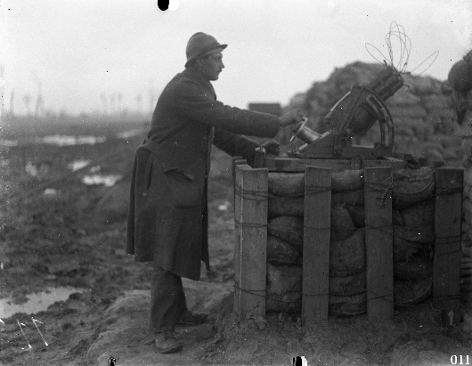
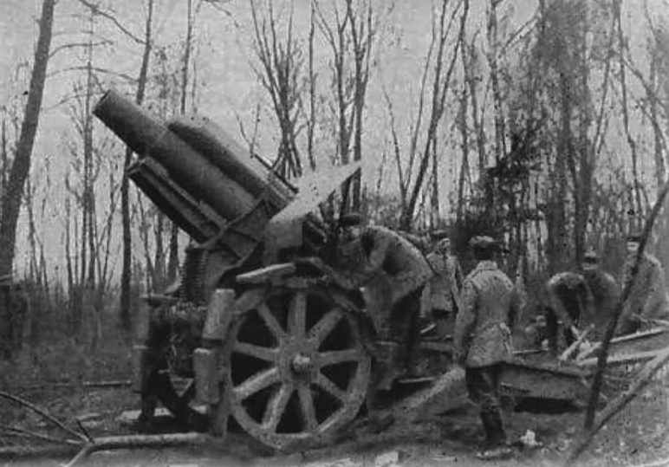
First World War

Slide 9
Combined Arms Warfare in the 20th Century. History or not?
Historical perspective
First World War
Second World War

Slide 10
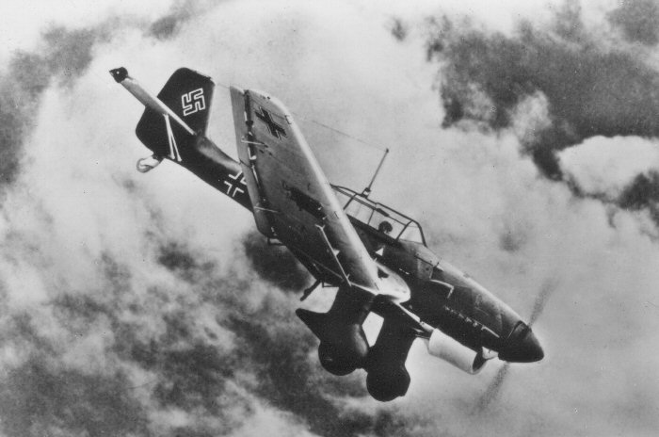
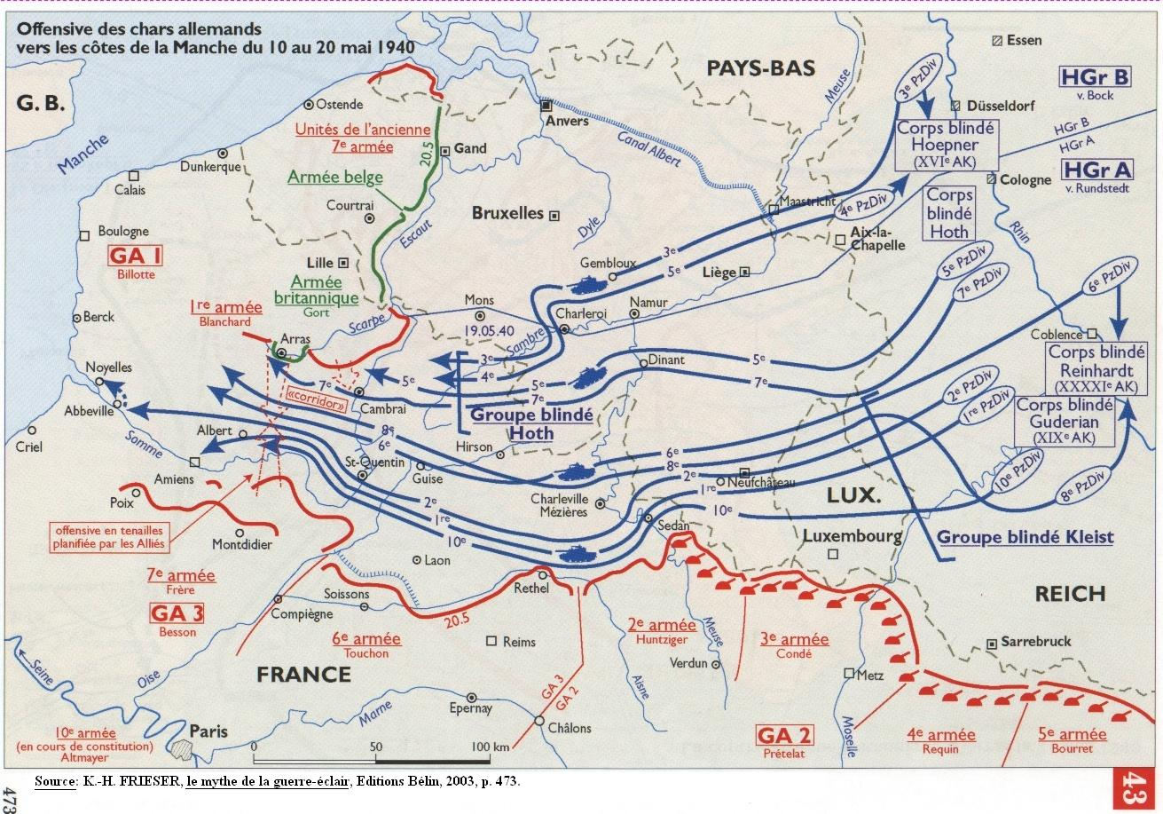
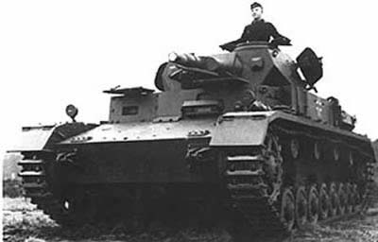
Second World War

Slide 11
Combined Arms Warfare in the 20th Century. History or not?
CAW is crucial for success on the battlefield, but it requires
Weapon systems
Doctrines and field manuals
Force structure
DOTMLPF
CAW in Basic Military Officers’ training
Courses on military history or land operations
Mission Command
Critical Thinking
Historical perspective
First World War
Second World War
Cold War
Post Cold War
+
Applying CAW is easier said than done
CAW is becoming increasingly complex
Armies are bulwarks of conservatism
CAW is expensive

Slide 12
“Strong and adaptive leaders can overcome problems with doctrine and technology, but weak and inflexible leaders can undermine even the best examples of each. For this reason, developing adaptive leaders in peacetime, who are ready to adjust to the always unpredictable demands of war, may be one of the most important objectives of any military.” David Barno and Nora Bensahel, Adaptation under Fire. How Militaries Change in Wartime (New York: Oxford University Press, 2020) Thank you for your attention

