Slide 1
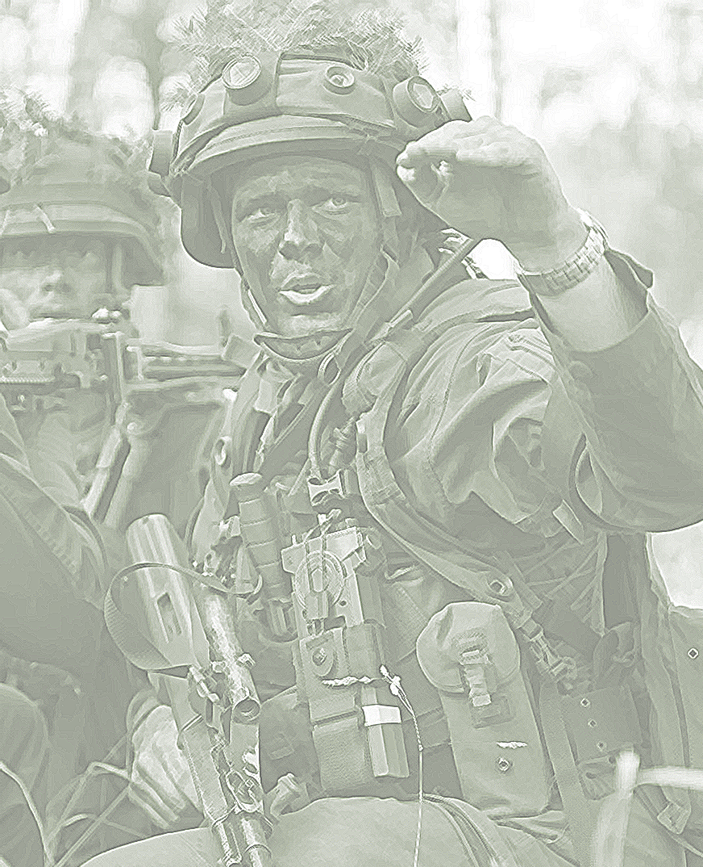



2022

Slide 2

the force

Slide 3
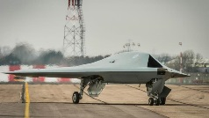
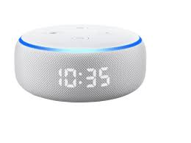

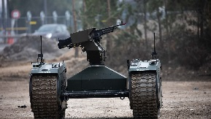
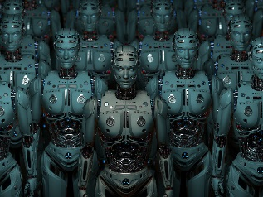
Future AI Forces?
Strategic C2 - why (AI supported)
Artificial intelligence - Come on
Tactical leadership - Lets go (AI supported)

Slide 4
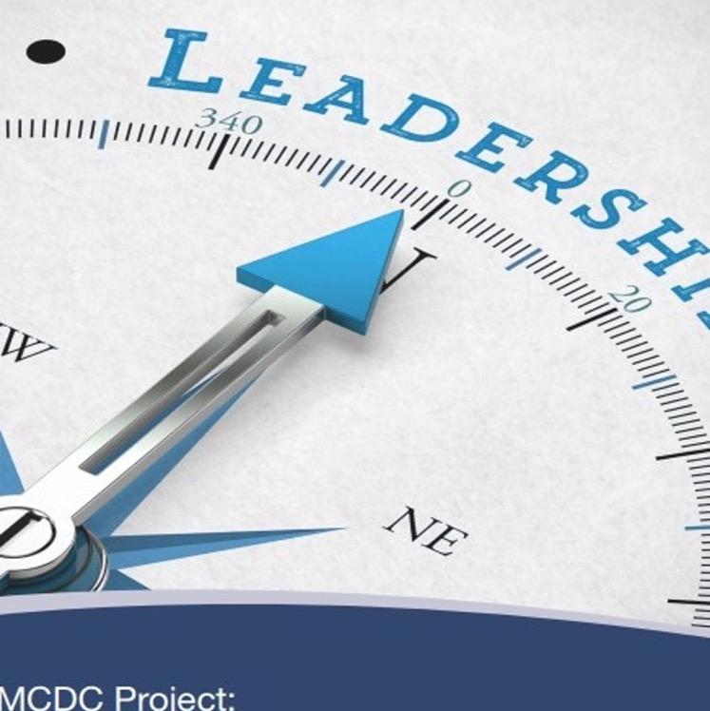
Leadership Challenges for the 21st century
Downloadable
VUCA – volatility , uncertainty, complexity, ambiguity
Hybridity / Grey Zone
The fog of big data / Artificial intelligence

Slide 5
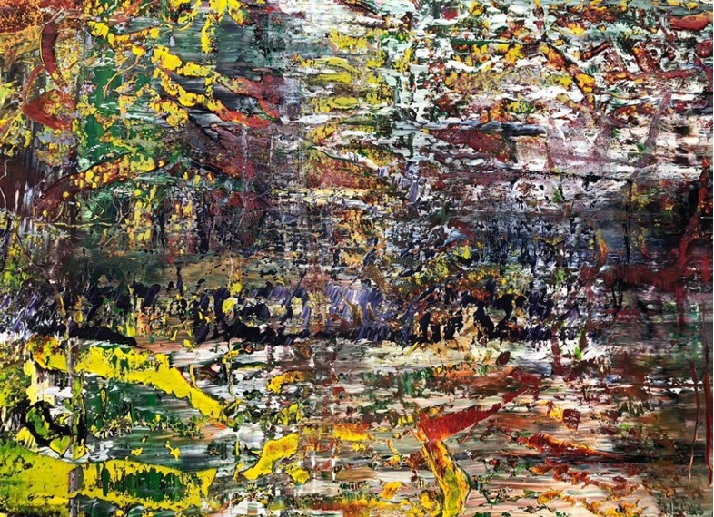

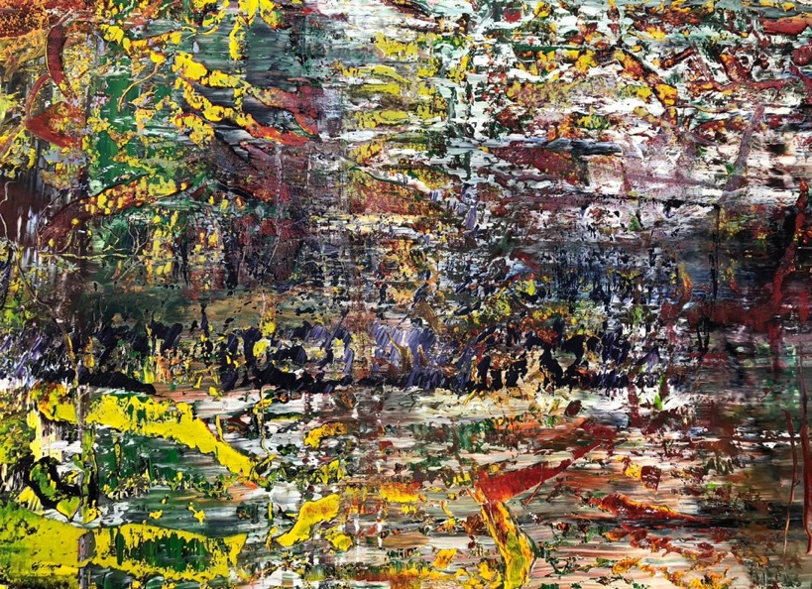
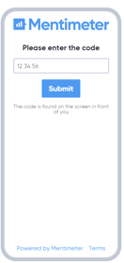
Which picture do you prefer?

Slide 6
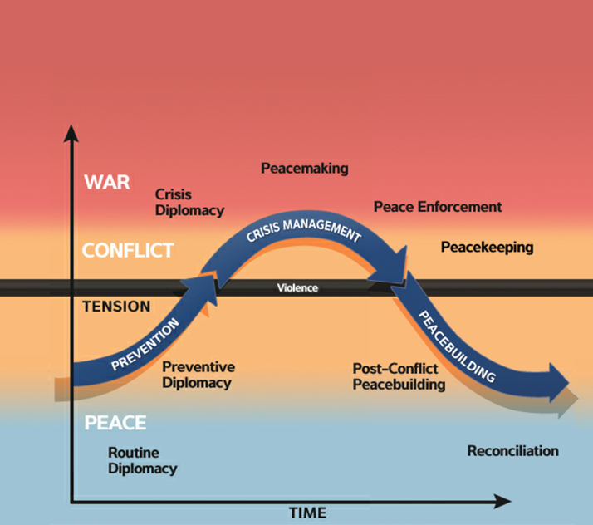
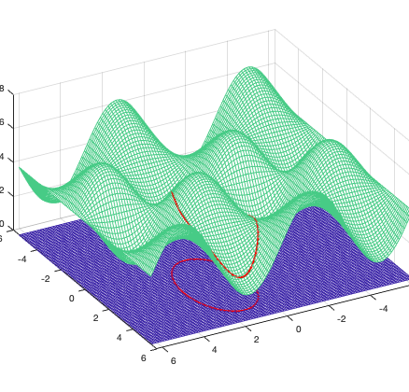
Paradigm shift from Linear Peace & War thinking
to a polydomain (In)stability area security approach

Slide 7
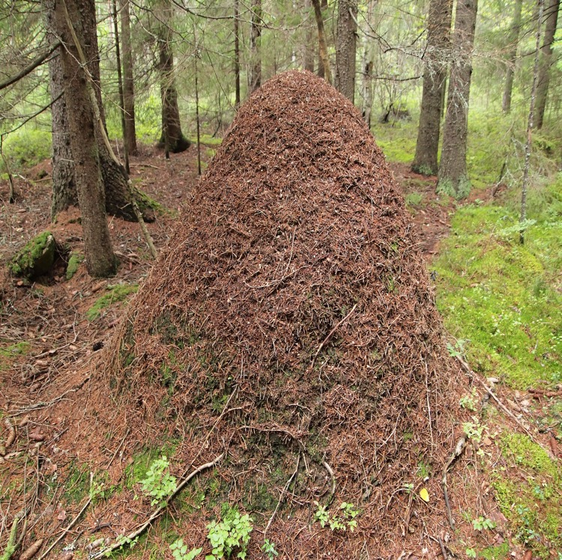

Complex or complicated?

Slide 8









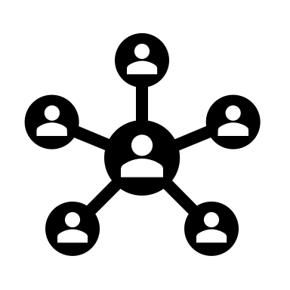
Context : The 21 century security environment
Virtual world
Increasing tendency to undermine democracy
Dark side of
Globalisation
Actors that seek to increase their position and status
21st century security environment
New Information
platforms
Renegotiations of reality
Digital and Technological Revolution
Changing character of peace
Speed
Networks

Slide 9
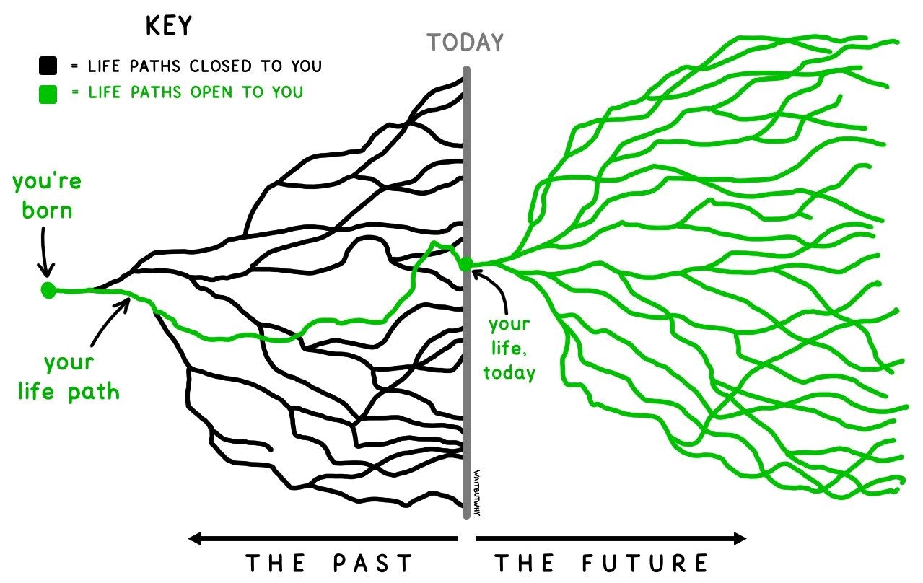

Slide 10
Solution I - ‘FUTURE’ SKILLS
SYSTEMIC THINKING
SOCIAL SKILLS
(EMOTIONAL INT.)
DIGITAL MINDSET
CHANGE MANAGEMENT
COMPLEXITY MANAGING
TOLERANCE TO AMBIGUITY
BUILDING (USING)
CONNECTIONS
SELF AWARENESS
UNLEARNING AND RELEARNING

Slide 11
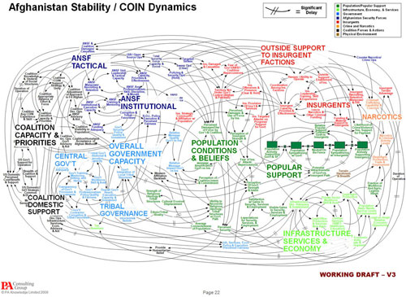
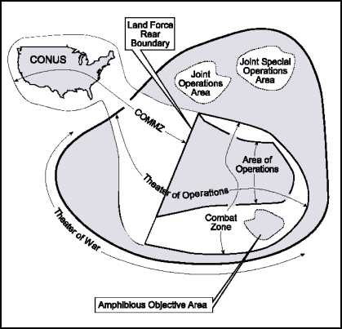
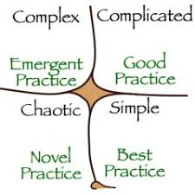
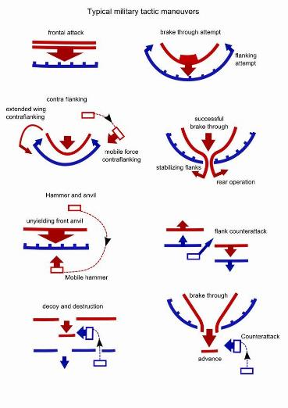
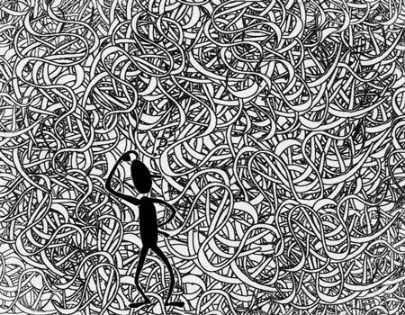
Solution I a - We have to teach new thinking tools!
JointOps
MDO
Hybrid Warfare
LandOps

Slide 12
Leadership Challenges for the 21st century
Downloadable
VUCA – volatility , uncertainty, complexity, ambiguity
Hybridity / Grey Zone
The fog of big data / Artificial intelligence

Slide 13
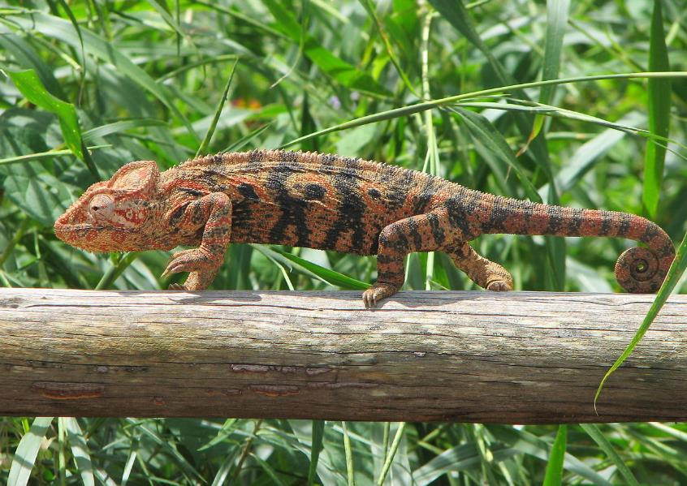
War is a chameleon
Von Bernard Gagnon - Eigenes Werk, CC BY-SA 3.0, https://commons.wikimedia.org/w/index.php?curid=3702683
War is thus more than a true chameleon, because it changes its nature to some extent in each concrete case. (Carl von Clausewitz: “On war")

Slide 14
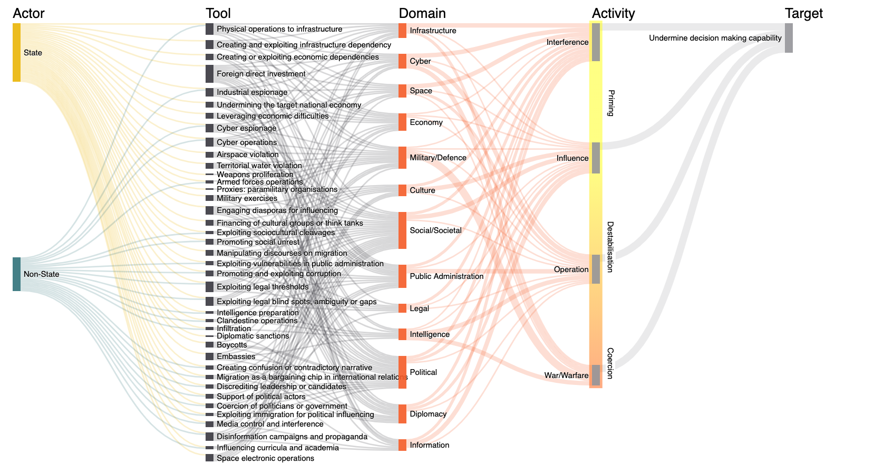
Attack Vectors
*
* You are here

Slide 15
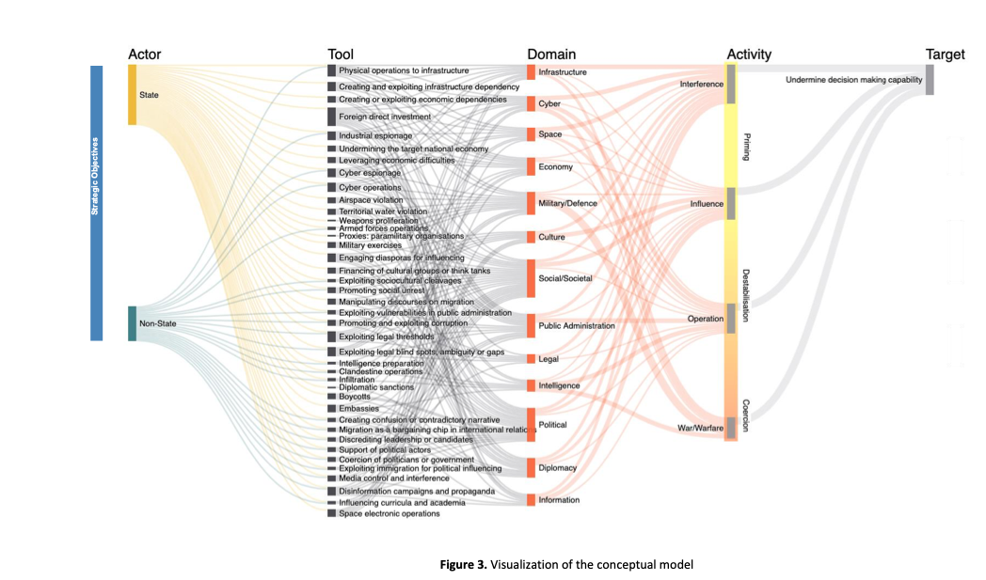
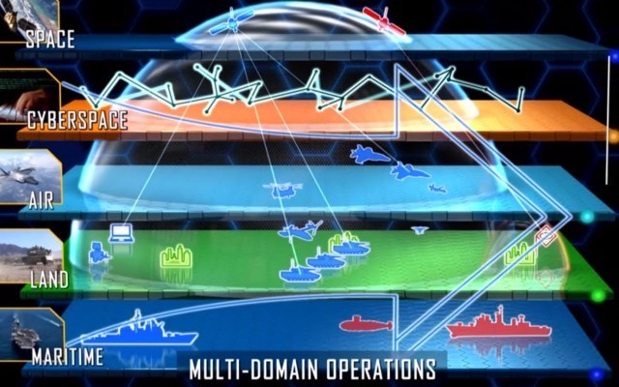
Hybrid Warfare is somehow also MDO, but…. They won’t let you fight in it.
Hybrid warfare
Peace Crisis War

Slide 16
Hybrid War as the antithesis of war
Rules of Laws vs Laws of ruling
„Hybridität“
Article 2 UN Charta
The Organization and its Members, in pursuit of the Purposes stated in Article 1, shall act in accordance with the following Principles.
The Organization is based on the principle of the sovereign equality of all its Members.
All Members shall refrain in their international relations from the threat or use of force against the territorial integrity or political independence of any state, or in any other manner inconsistent with the Purposes of the United Nations.

Slide 17
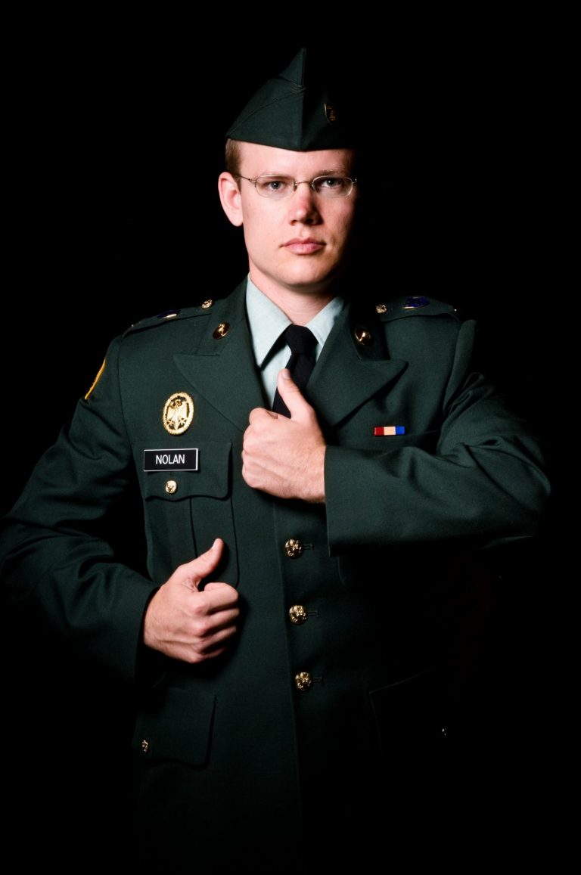
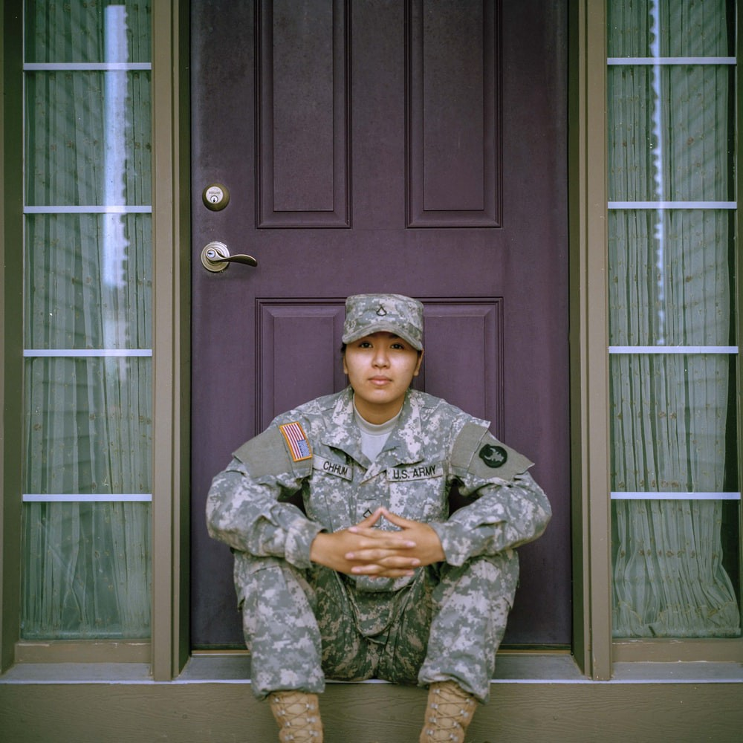
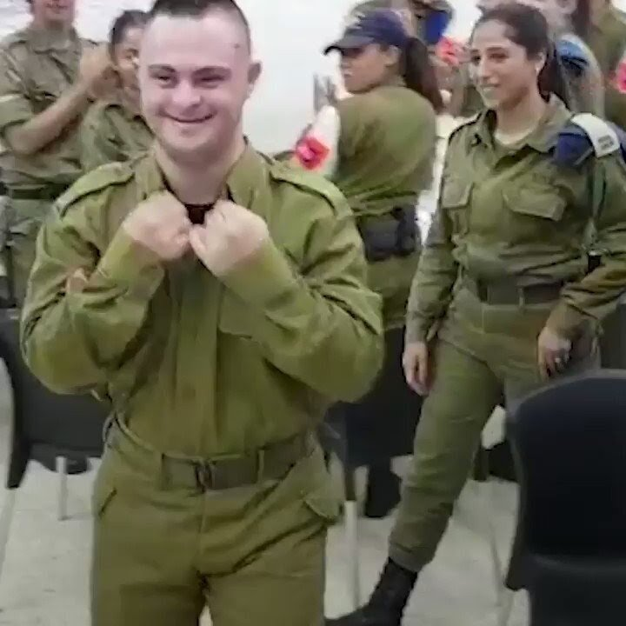
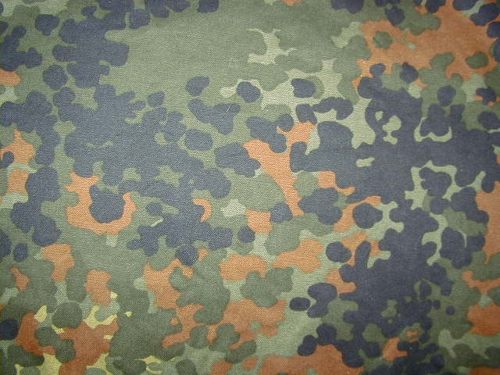
Solution II - Diversity -
Resilient all society defense of the future
War is a man*s world
women?????
male & female & divers
Athenians vs Spartans
Not for nerds
strong & smart
Social media affinity
Traditions, traditions, traditions
Empathetic / intellectual
Artificial Intelligence
&
Human Intelligence
Autists & Down Syndrom & Deaf

Slide 18
Leadership Challenges for the 21st century
Downloadable
VUCA – volatility , uncertainty, complexity, ambiguity
Hybridity / Grey Zone
The fog of big data / Artificial intelligence

Slide 19
I, Robot — Isaac Asimov
First Law
A robot may not injure a human being or, through inaction, allow a human being to come to harm.
Second Law
A robot must obey the orders given it by human beings except where such orders would conflict with the First Law.
Third Law
A robot must protect its own existence as long as such protection does not conflict with the First or Second Law.

Slide 20
I, Warbot — Kenneth Payne.
A warbot should only kill those I want it to, and it should do so as humanely as possible.
A warbot should understand my intentions, and work creatively to achieve them.
A warbot should protect the humans on my side, sacrificing itself to do so — but not at the expense of the mission.

Slide 21
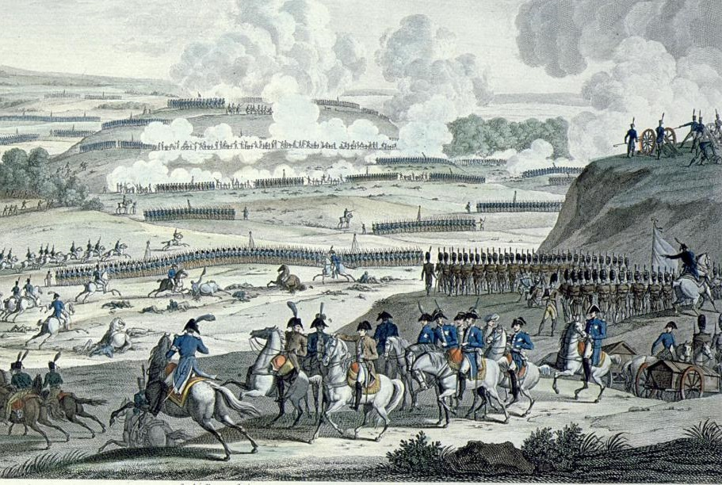
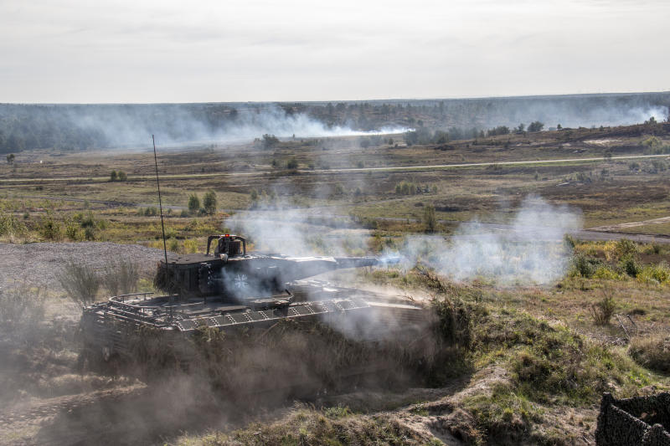
Von Jena & Auerstedt to the 21. Century
„Mission command is not Auftragstaktik“
As a rule: the order shall only include (and never ever more) what a subordinate cannot order by himself in order to reach a given aim
Moltke, the Elder

Slide 22



„Auftragstaktik“
superior
Auftragstaktik
O
R
D
E
R
Self - action space
Mission command
Führen m. Auftrag
subordinate

Slide 23

Auftragstaktik (operationalized)
Conduct of mission through units instead of lines
    [organisational change!]
Freedom of execution
  [cognitive creative competence]
Self acting
[cognitive competence]
4. Special Order format
  [functional competence]
5. Leadership training
  [cognitive competence]
6. Active discipline and bilateral trust
    [social competence]

Slide 24
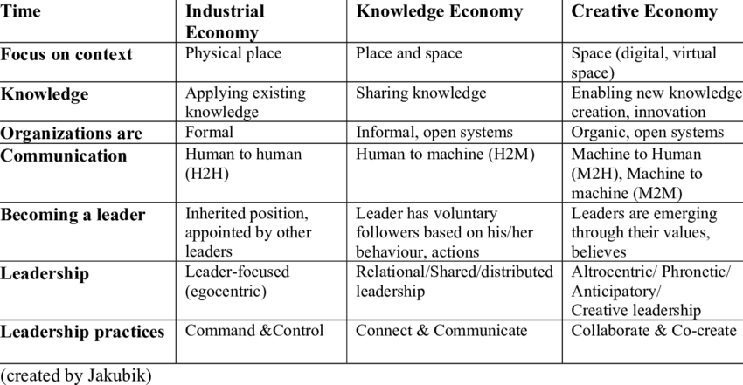
Striving for a
21 century instantiation of Auftragstaktik
Auftragstaktik 2.0
„Effective Command“?
Mission command
Countering
Hybrid Warfare
Artificial Intelligence
InFü
Auftrags-taktik

Slide 25
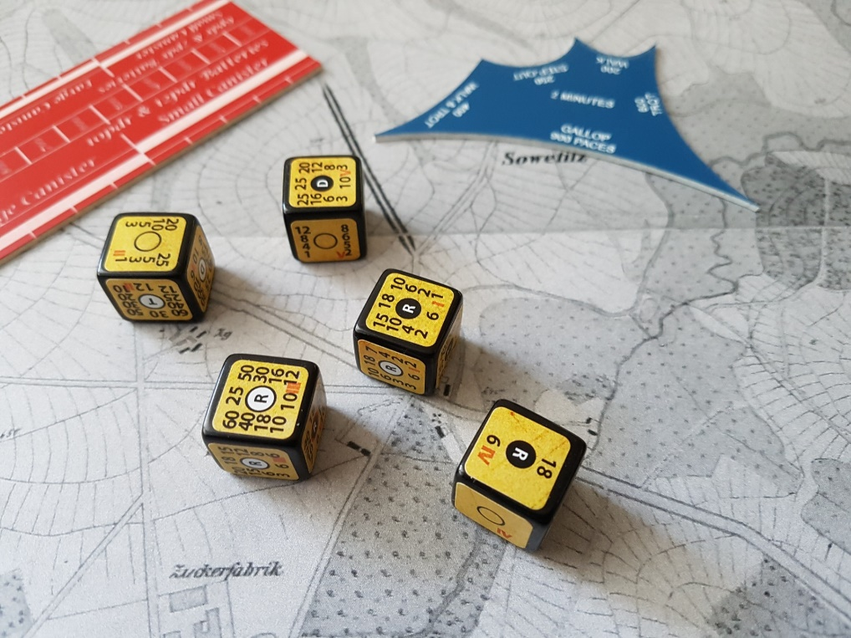
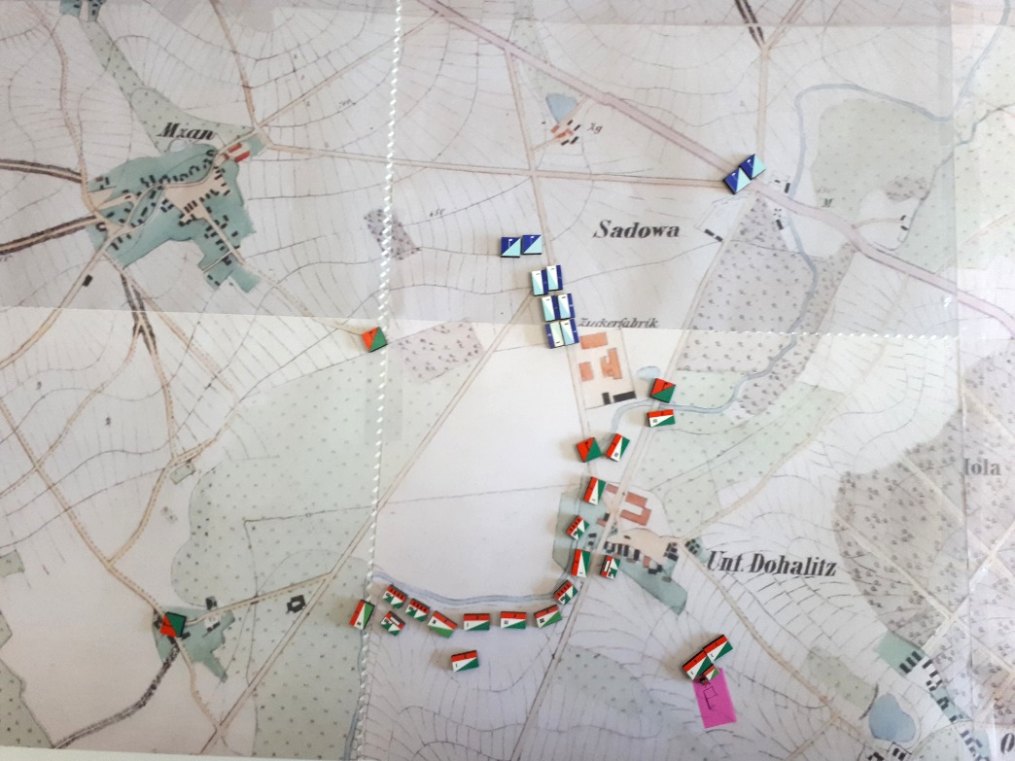
Solution IV – Teach Auftragstaktik
Self acting [cognitive competence]
Wargaming
Do it yourself

